Slide 1
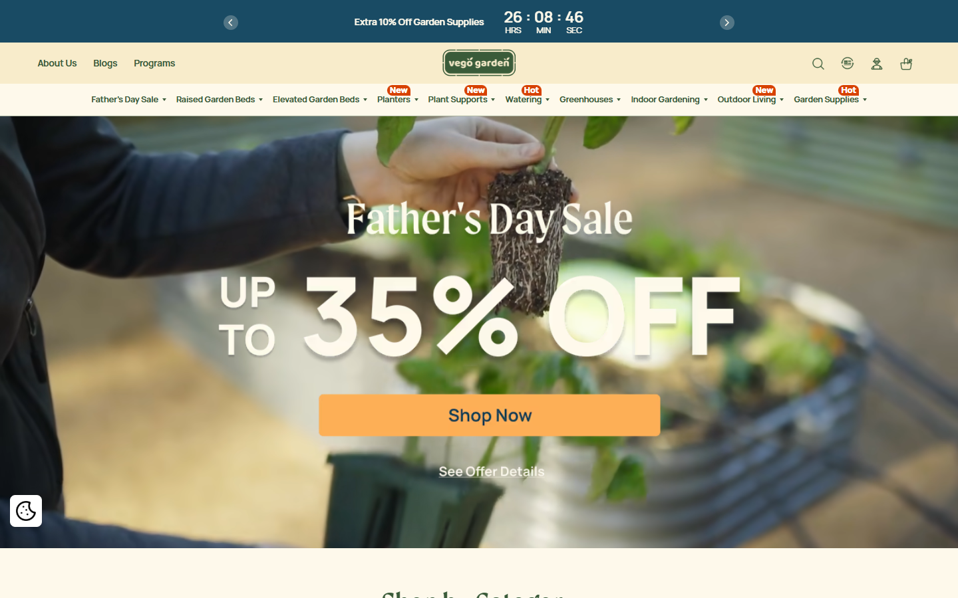
VEGO Garden
官网 Design System
现状与优化计划
Current State & Plan
从“好看的园艺电商”升级为“可复用、可扩展、可导购”的品牌零售系统。
From a polished garden commerce site to a reusable, scalable guided retail system.
范围 / Scope：首页、导航、分类页、商品详情页、Help Me Choose、移动端首屏。
Current System
Optimization Plan
Guided Commerce
VEGO 官网 Design System 现状与优化计划 | 2026-06-12
01

Slide 2
SYSTEM SNAPSHOT
为什么要固化品牌层、交易层、导购层
Why define Brand, Commerce, and Guidance layers
VEGO 同时承担品牌信任、商品成交和复杂选择三件事；三层关系能让设计与开发判断每个模块的职责。
VEGO must build trust, convert purchases, and simplify complex choices; the layers clarify module ownership.
核心判断 / Key take
不要先重做风格，先把“品牌、交易、导购”的职责边界固定下来。
Do not redesign the style first; define the responsibilities of Brand, Commerce, and Guidance first.
Brand Layer
Commerce Layer
Guidance Layer
品牌层
Brand
交易层
Commerce
导购层
Guidance
让用户愿意看：建立 VEGO 是谁，自然、可信、家庭园艺、户外生活。
Make users care: define who VEGO is through nature, trust, gardening, and outdoor life.
让用户可以买：价格、折扣、评价、库存、色卡和 Add to Cart。
Enable purchase: clarify price, sale, reviews, stock, swatches, and ATC.
让用户知道买哪个：把尺寸、高度、颜色、kit 类型翻译成场景建议。
Guide the choice: translate size, height, color, and kit type into scenarios and advice.
一句话 / In short: 品牌层建立信任，交易层完成购买，导购层降低选择成本。
Brand builds trust, Commerce converts, Guidance reduces choice cost.
VEGO 官网 Design System 现状与优化计划 | 2026-06-12
02

Slide 3
VISUAL TOKENS
颜色系统：问题不是不统一，而是职责不够清楚
Color system: recognizable, but roles are not specific enough
当前促销、CTA、提示和导购都在使用相近的黄/橙/绿，用户很难判断哪个是主行动。
Promo, CTA, alert, and guidance colors overlap; users cannot always tell the primary action.
Brand
Surface
Commerce CTA
Promo Sale
Guidance
Logo / heading / nav
品牌识别、标题、导航
Page background
页面底色
Add to Cart / Shop Now
主购买按钮
Discount / sale badge
折扣、活动标签
Help Me Choose / scenario
导购、场景筛选
只用于品牌信号，不承载折扣。
Brand signal only, not discount.
保持温暖，但卡片和模块用白色拉开层级。
Warm base; use white for cards.
只给购买动作，避免和促销 badge 混用。
Reserve for purchase actions.
用于折扣和紧急促销，不用于主 CTA。
Use for sale urgency, not CTA.
让导购模块有独立识别，不被促销淹没。
Separate guidance from promo.
具体落地 / Implementation
1. Figma Variables 建 5 个 color role；2. Shopify CSS variables 同名映射；3. 检查 Button、Badge、PromoBanner、GuidanceTag 是否引用正确 token。
Create five Figma color roles, map them to Shopify CSS variables, then audit Button, Badge, PromoBanner, and GuidanceTag usage.
VEGO 官网 Design System 现状与优化计划 | 2026-06-12
03

Slide 4
TYPE + HIERARCHY
字体优化：不是换字体，而是给每种信息固定角色
Typography: keep the voice, assign roles to information
当前 serif 标题有品牌温度，但促销、商品名、价格、导购解释的层级没有被系统化。
The serif voice works; the missing piece is a repeatable hierarchy for promo, product, price, and guidance.
Display / Campaign
Commerce Heading
Price + Utility
Guidance Copy
活动标题、品牌故事
Campaign and brand story
商品名、分类名
Product and category names
价格、库存、筛选、导航
Price, stock, filters, nav
选择解释、场景建议
Choice help and scenarios
Serif 34-44 / bold
只用于首屏和大型活动
Serif 20-28 / semibold
商品卡最多 2 行，PDP 可 2-3 行
Sans 13-18 / medium
价格优先级高于折扣说明
Sans 13-15 / regular
贴近选项出现，不放长段落
具体落地 / Implementation
Figma 建 text styles：display / commerce-title / utility / guidance；Shopify 里把 product-card、main-product、facets、promo banner 分别绑定对应 class。
Create Figma text styles and bind Shopify product-card, main-product, facets, and promo banner to matching typography classes.
VEGO 官网 Design System 现状与优化计划 | 2026-06-12
04

Slide 5
COMPONENT SYSTEM
组件页要回答：哪些组件要抽、抽到哪里、先改什么
Component system: what to extract, where it lives, what to fix first
VEGO 不是缺 UI 元素，而是缺可复用的组件边界。建议按 Shopify Theme 的 sections / snippets / JS behavior 来拆。
VEGO has UI elements, but not enough reusable component boundaries. Map them to Shopify sections, snippets, and JS behavior.
Navigation
Product Card
PDP Purchase
Guidance
当前问题：促销、类目、信任信息都在导航区域抢注意力。
Issue: promo, category, and trust messages compete in nav.
当前问题：折扣、星级、色卡、加购按钮优先级偏平均。
Issue: sale, rating, swatches, and ATC feel visually equal.
当前问题：变体选择有按钮，但缺少选择解释。
Issue: variants are selectable but not explained.
当前问题：Help Me Choose 是好入口，但没有成为系统组件族。
Issue: Help Me Choose exists, but is not a component family.
抽成：AnnouncementBar / HeaderMegaMenu / TrustStrip
Extract: sections/header, announcement-bar + trust strip
抽成：ProductCard / Price / Badge / SwatchGroup
Extract: snippets/card-product, price, badge, swatches
抽成：VariantSelector / PurchasePanel / ChoiceHelp
Extract: main-product, variant picker, product-form JS
抽成：GuidanceCard / ScenarioFilter / BestForTag
Extract: new guided-choice section, metafields/metaobjects
优先级 / Priority: 先统一 ProductCard + PDP VariantSelector，再把 Guidance 做成正式组件族
VEGO 官网 Design System 现状与优化计划 | 2026-06-12
05

Slide 6
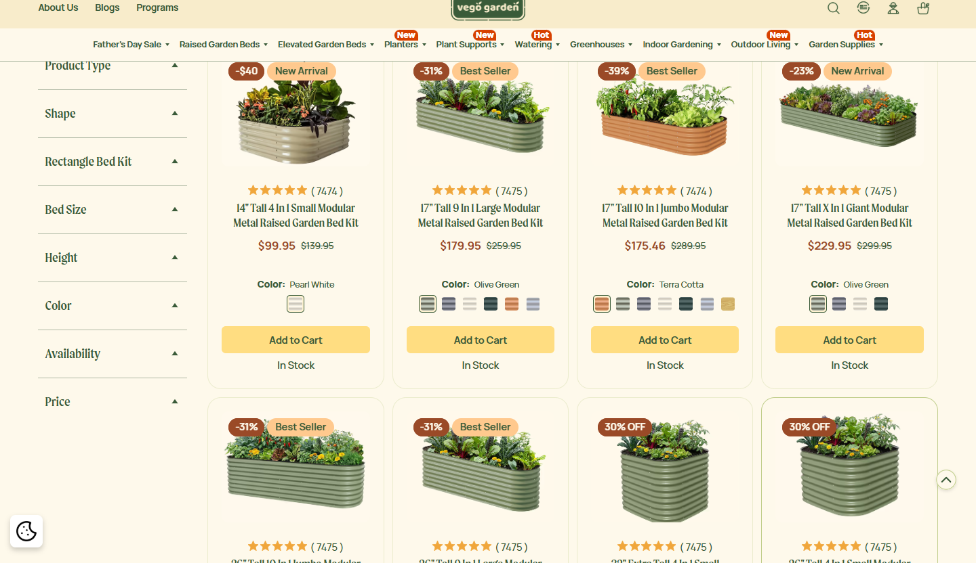
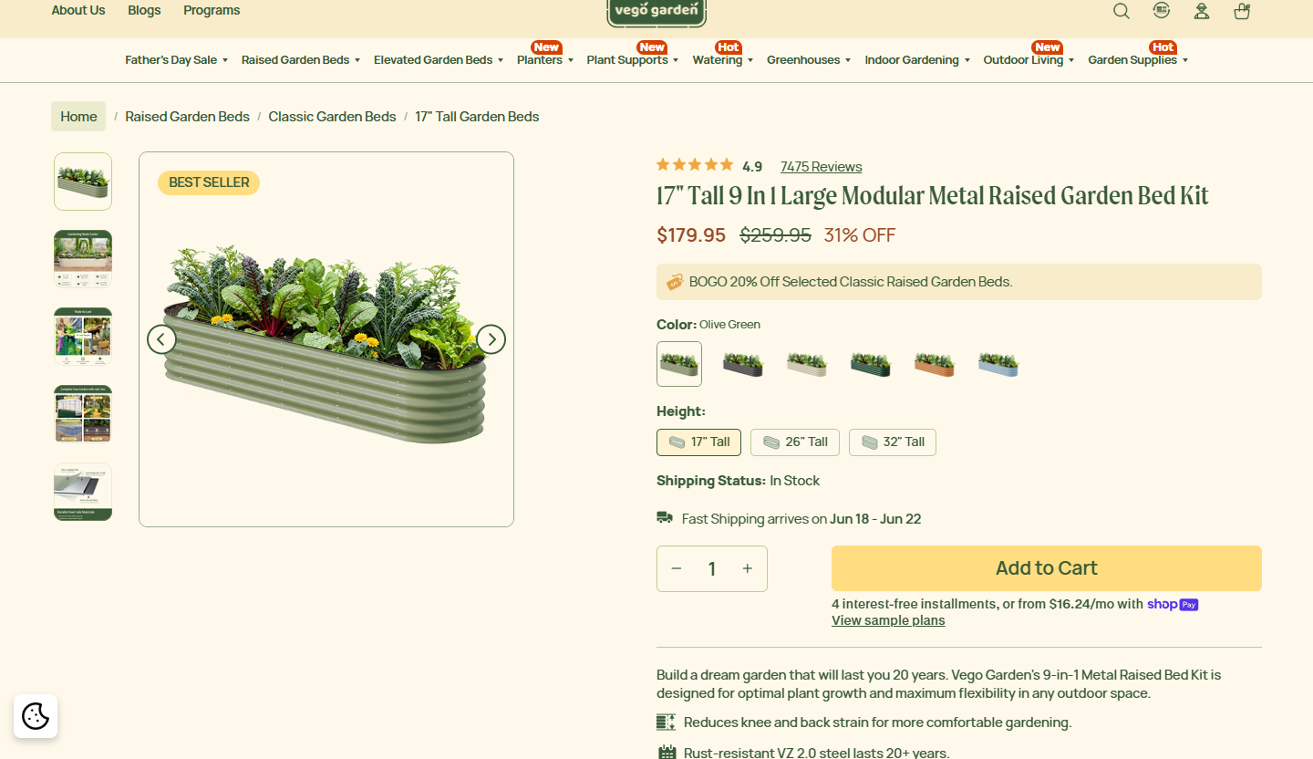
PAGE PATTERNS
页面模式：同一系统在不同页面上的表现
Page patterns: one system across multiple shopping moments
首页负责吸引，分类页负责比较，PDP 负责成交，Help Me Choose 负责降低选择成本。
Homepage attracts, collection compares, PDP converts, Help Me Choose reduces decision cost.
Homepage
Collection
PDP
强活动视觉，但下一步路径主要被 Shop Now 承接。
Strong campaign visual; next step is mostly Shop Now.
筛选完整，但按产品参数组织，学习成本偏高。
Complete filters, but organized around product specs.
购买模块完整，但高度/颜色/kit 的选择解释不足。
Purchase flow is strong; variant guidance is weak.
页面级优化方向 / Page-level priority: 在每个关键页面补齐“我该怎么选”的系统性解释。
Add systematic “how do I choose?” guidance to each key page.
VEGO 官网 Design System 现状与优化计划 | 2026-06-12
06

Slide 7
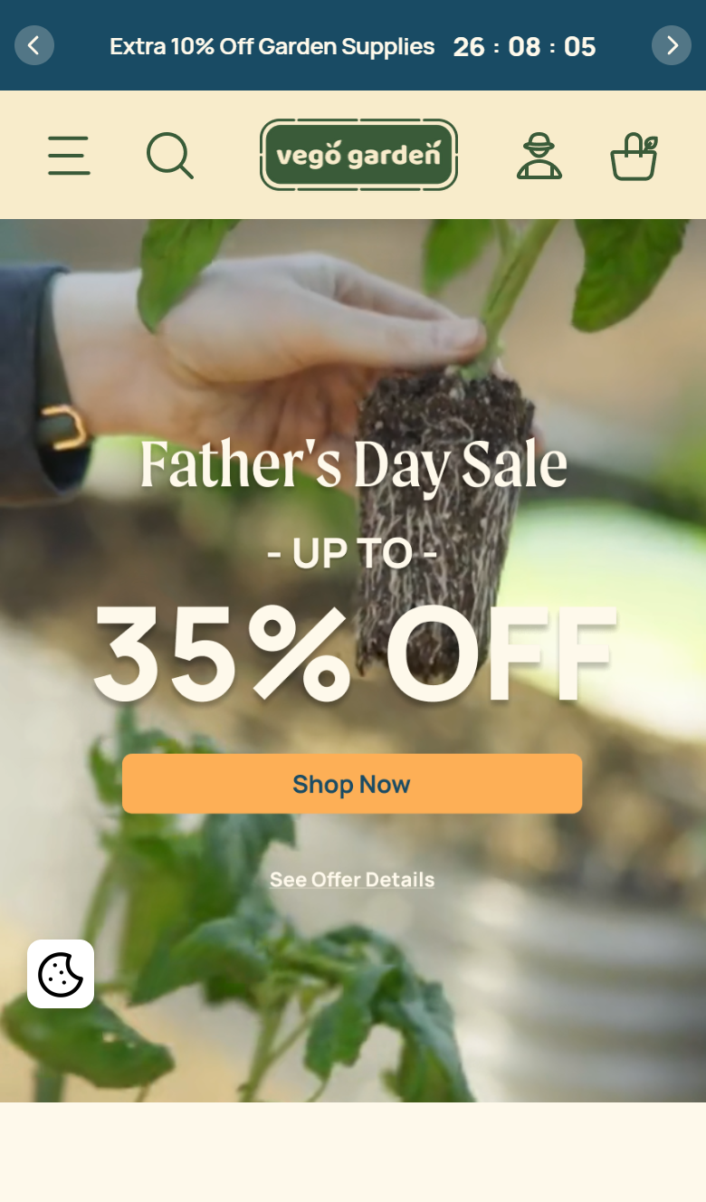
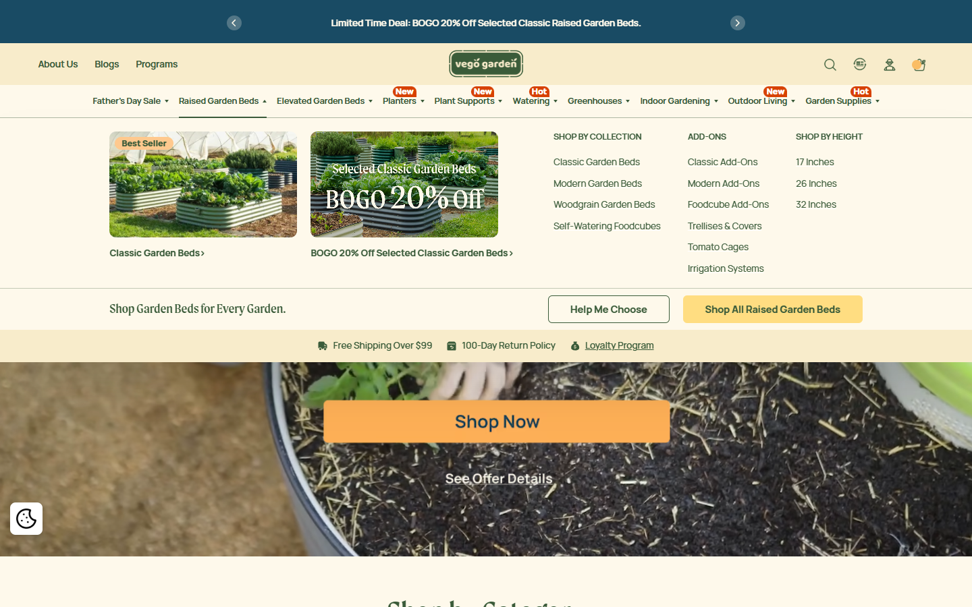
SYSTEM GAPS
主要缺口：不是视觉不统一，而是决策路径不统一
Key gap: not visual consistency, but decision-path consistency
当前最值得修的是信任一致性、选择解释和移动端首屏路径。
The priority is promo consistency, choice explanation, and mobile next-step clarity.
优先修复 / Priority fixes
P1
促销口径统一
Promo hierarchy
明确 Father’s Day、BOGO、Extra 10% 的主次。
Decide which offer leads and where it appears.
P1
导购入口前置
Promote guidance
Help Me Choose 进入首页、分类页、导航主路径。
Make Help Me Choose a primary route.
P2
选择解释补齐
Explain choices
PDP 高度/颜色/kit 旁说明适合谁、适合什么场景。
Explain variant fit beside the option.
P2
移动第二行动
Mobile second action
保留促销冲击力，同时给 Help Me Choose 留入口。
Keep campaign impact but expose guidance.
先解决路径，再做视觉细节。
Fix path clarity before visual polish.
VEGO 官网 Design System 现状与优化计划 | 2026-06-12
07

Slide 8
OPTIMIZATION PLAN
后续优化计划：先固化规则，再扩展导购系统
Optimization plan: define rules first, then scale guidance
建议用 7 天快速修复 + 30 天系统化 + 60-90 天实验迭代来推进。
Use a 7-day fix, 30-day system build, and 60-90 day experiment cycle.
0-7 天
降低风险
Reduce risk
30 天
沉淀系统
Build system
60-90 天
验证增长
Validate growth
统一促销文案；首页增加 Help Me Choose 高优先级 CTA；PDP 变体旁加选择说明。
Unify promos, promote Help Me Choose, add PDP choice help.
建立 token 命名；定义商品卡片/PDP/导航/导购组件规范；补齐场景筛选。
Define tokens, component specs, and scenario filters.
A/B 测试首屏 CTA、场景筛选顺序、PDP 解释模块；追踪 CTR、PDP CVR、筛选使用率。
Test CTAs, filters, PDP explainers; track CTR, CVR, and filter usage.
最终交付物 / Deliverables: Design tokens + Component specs + Guided commerce patterns + Experiment backlog
VEGO 官网 Design System 现状与优化计划 | 2026-06-12
08

Slide 9
TWO TRACK SYSTEM
Design System 要同时服务两个角色
The system must serve two roles
设计师需要在 Figma 中快速复用，开发需要在 Shopify 主题中稳定落地；两条路线共享 token 和组件命名。
Designers reuse in Figma; developers implement in Shopify Theme. Both tracks share tokens and component names.
Figma System
给设计师用
Engineering System
给开发落地
用 Variables 固化颜色、字体、间距、圆角。
Use Variables for color, type, spacing, radius.
把 design tokens 转成 CSS variables / theme settings。
Convert tokens into theme variables.
组件化 Header、Mega Menu、Product Card、PDP 选择器、Filter、CTA。
Componentize core retail UI.
抽 Liquid sections/snippets 和 JS 交互组件。
Extract Liquid and JS components.
沉淀 Homepage、Collection、PDP、Help Me Choose 页面模板。
Create reusable page templates.
定义商品卡、促销、筛选、PDP 购买面板的数据接口。
Define data contracts for commerce UI.
每个组件写清 usage rule、状态和禁用场景。
Document usage rules, states, and limits.
建立响应式、可访问性、视觉回归和转化路径 QA。
Add responsive, a11y, visual, and funnel QA.
关键原则 / Key rule: Figma 和代码不要各做一套，必须共享 token、组件名称和状态定义。
Figma and code must share tokens, component names, and state definitions.
VEGO 官网 Design System 现状与优化计划 | 2026-06-12
09

Slide 10
SHOPIFY IMPLEMENTATION
工程化落地：优先按 Shopify Theme 路线推进
Implementation: prioritize the Shopify Theme layer
公开页面可见 /cdn/shop 路径、Shopify variant 数据和 inventory_management: shopify。
Public page signals point to Shopify Theme as the first implementation target.
实现路径
Path
主要困难
Challenges
所需资源
Resources
Tokens
CSS variables + theme settings
历史主题样式分散
Legacy styles scattered
Shopify theme 源码
Theme source access
Liquid
sections / snippets / blocks
依赖商品/促销/库存数据
Depends on product and promo data
商品/促销/库存规则
Product, promo, stock rules
Commerce
ProductCard / PromoBanner / VariantSelector
状态膨胀：折扣、缺图、长商品名
State explosion from real data
共同 token owner
Shared token ownership
Behavior
mega menu / filters / sticky ATC
Figma 需补真实边界
Figma needs edge cases
截图回归 QA
Visual regression QA
交付模型 / Delivery model: Design tokens -> Liquid components -> Page patterns -> QA and experiments
VEGO 官网 Design System 现状与优化计划 | 2026-06-12
10

Slide 11
ACTION PLAN
Design System 怎么落地：先锁规则，再抽组件，再接 Shopify
How to land it: rules first, components next, then Shopify implementation
落地不要从全站改版开始，而是从 token、核心组件、导购数据和 QA 流程逐层推进。
Do not start with a full redesign. Build tokens, core components, guidance data, and QA step by step.
Week 1
Foundation
基础规则
Week 2
Core Components
核心组件
Week 3
Guided Commerce
导购能力
Week 4
QA + Experiment
验证上线
Figma Variables
颜色、字体、间距、圆角
Button / Badge / Price
先改低风险组件
PDP Variant Explainer
高度/颜色/kit 解释
Mobile + edge states
缺图、长标题、缺货、促销
Shopify CSS variables
同步 token 命名
ProductCard / Swatches
统一商品卡层级
GuidanceTag / BestForTag
适合谁、适合什么
Visual regression
截图回归检查
Usage rules
明确颜色/字体职责
PromoBanner
统一促销口径
Help Me Choose CTA
进入首页/分类/PDP
A/B plan
CTA、筛选、PDP解释模块
关键交付 / Key deliverables: tokens + Figma library + Shopify snippets/sections + metafields + QA checklist
VEGO 官网 Design System 现状与优化计划 | 2026-06-12
11

Slide 12
WEEK 1 EXECUTION
Week 1 不是讨论周：目标是交付 Foundation v1 并进入组件建设
Week 1 is an execution sprint: ship Foundation v1, then move into components
把“设计师可用的 Figma 系统”和“开发可落地的 Shopify 系统”放在同一张节奏表里推进。
Run Figma and Shopify implementation in one operating rhythm.
Sprint Goal / 本周目标
完成 color / typography / spacing / radius 基础 Token、Figma Variables 草案、Shopify CSS variables 草案、三层使用规则、Week 2 组件优先级。
Deliver base tokens, Figma variables, Shopify CSS variables, layer usage rules, and Week 2 component backlog.
Day
Focus
Key activities / 关键活动
Outputs / 当日产出
Decision gate / 决策点
Day 1
06/15
Audit
现状盘点
收集桌面/移动截图；盘点颜色、字体、按钮、badge、商品卡、导航、导购入口。
Capture key pages and audit color, type, button, badge, product card, nav, guidance entry.
UI inventory, color map, type map, component inventory, Top 10 inconsistency list
确认范围只做 Foundation，不进入整站改版。
Keep scope at foundation, not full redesign.
Day 2
06/16
Naming
规则命名
固化品牌层/交易层/导购层；定义 color/type/spacing/radius 命名和禁止混用规则。
Lock layer model and semantic token naming.
Token naming table, color roles, type roles, usage rules draft
确认唯一主 CTA 色、促销优先级、导购层边界。
Confirm CTA, promo priority, guidance scope.
Day 3
06/17
Figma
设计系统
建立 Figma Variables、Text Styles、基础样板页；检查中英文长文和移动端可读性。
Create variables, text styles, sample board, bilingual stress checks.
Figma Variables v1, Text Styles v1, Foundation sample board, designer usage rules
设计师能否直接用变量搭页面。
Can designers use the variables directly?
Day 4
06/18
Shopify
工程验证
定位 theme CSS/settings/sections/snippets；建立 CSS variables；在 Button/Badge/Price 做低风险 spike。
Map theme files, draft CSS variables, spike low-risk components.
Theme style map, CSS token draft, spike PR/code draft, Shopify config plan
确认哪些变量进入 theme settings，哪些保持代码控制。
Decide admin-configurable vs code-owned tokens.
Day 5
06/19
QA + Backlog
评审交付
设计/开发评审；检查对比度、按钮状态、长文本、移动端；排序 Week 2 组件。
Review, QA, and prioritize component backlog.
Foundation v1 spec, QA checklist, Week 2 component backlog, open questions list
Go / No-Go：Foundation v1 是否足够进入组件建设。
Is Foundation v1 ready for component build?
VEGO 官网 Design System 现状与优化计划 | 2026-06-12
12

Slide 13
INPUTS NEEDED
Week 1 能不能跑起来，取决于这些输入能否在前两天到位
Week 1 depends on getting these inputs by Day 1-2
缺 Shopify 源码会卡工程验证；缺促销优先级会卡交易层规则；缺 Figma 权限会卡设计师侧落地。
Missing Shopify source blocks engineering; missing promo priority blocks commerce rules; missing Figma access blocks designer adoption.
Business / Brand
业务与品牌
Design
设计侧
Engineering
工程侧
Ops / Data
运营与数据
Owner: PM / Brand / Ops
Owner: Design Lead
Owner: Shopify / Frontend Dev
Owner: Content / Ops
当前官网截图：Homepage、Collection、PDP、Help Me Choose、Campaign，桌面 + 移动端。
当前 Figma 文件、组件库、页面模板；需要可编辑权限。
Shopify theme source access：Dawn / custom / third-party 主题类型。
商品分类和商品状态：Sale、New arrival、Best seller、Out of stock。
品牌资料：logo、官方色值、字体规范、语气表达；没有则先从现站反推 v1。
设计师最常改的页面：Homepage、Collection、PDP、Campaign Landing。
CSS 入口：base.css、theme.css、component-*.css、section CSS。
metafields / metaobjects 是否已使用；哪些字段运营可维护。
促销优先级：Father's Day、BOGO、Extra 10%、Free gift 哪些是长期规则。
现有颜色、字体、按钮、商品卡、badge、导购模块的重复样式。
settings_schema.json、settings_data.json：确认哪些 token 可以给运营配置。
导购数据：适合谁、适合什么场景、尺寸/颜色/kit 解释。
目标市场和语言：确认中英文都要被设计系统覆盖。
设计师希望在 Figma 中直接拖用的组件优先级和命名习惯。
sections / snippets / JS 行为清单：Button、Badge、Price、ProductCard、VariantPicker。
上新/促销/缺货流程：哪些信息会频繁变化，不能写死在组件里。
Critical path / 关键路径：Shopify source access + Figma edit access + promo priority must be available before Day 3
VEGO 官网 Design System 现状与优化计划 | 2026-06-12
13

Slide 14
DAY-BY-DAY PLAN
把 Week 1 拆成 5 个可交付工作日，每天都有产出和关口
Five delivery days, each with concrete outputs and a gate
这页可以直接用作项目每日 standup 的 agenda。
Use this as the daily standup agenda.
Day 1
Audit
现状盘点
Day 2
Token Naming
命名规则
Day 3
Figma
设计基础
Day 4
Shopify
工程验证
Day 5
QA + Backlog
评审交付
Activities / 活动
Activities / 活动
Activities / 活动
Activities / 活动
Activities / 活动
Kickoff: scope + roles
Define 3-layer model
Create Figma Variables
Find theme CSS/settings
Design-dev review
Capture desktop/mobile pages
Name color roles
Create Text Styles
Draft CSS variables
Check contrast + mobile text
Map color + type usage
Name type roles
Build foundation sample board
Spike Button/Badge/Price
Close/open decisions
Inventory Shopify-like components
Align Figma/CSS naming
Write designer do/don't rules
Define admin config path
Prioritize Week 2 components
Deliverables / 交付件
Deliverables / 交付件
Deliverables / 交付件
Deliverables / 交付件
Deliverables / 交付件
UI inventory; Color usage map; Typography usage map; Component inventory; Top 10 inconsistency list.
Token naming table; color role table; type role table; usage rule draft.
Figma Variables v1; Text Styles v1; foundation board; usage examples.
Theme style map; CSS token draft; spike PR/code draft; Shopify configuration plan.
Foundation v1 spec; QA checklist; Week 2 component backlog; open questions list.
Gate: scope locked
Gate: CTA / promo / guidance boundaries confirmed
Gate: designers can apply variables without guessing
Gate: tokens work in 2-3 low-risk components
Gate: Go / No-Go for Week 2
VEGO 官网 Design System 现状与优化计划 | 2026-06-12
14

Slide 15
DESIGNER PATH
给设计师的目标：用 Figma 变量和组件把页面搭出来，而不是每次重画
Designer-facing goal: build with Figma variables and components, not one-off drawings
设计侧系统先解决选择成本：什么颜色、什么字体、什么间距、什么组件在什么场景使用。
The design system reduces choice cost: which color, type, spacing, and component belongs in each scenario.
1. Foundations / 基础变量
2. Components / 组件路径
3. Governance / 使用规则
4. Difficulties / 难点与资源
Color variables
Week 1 sample board
3-layer discipline
Hard parts
color/brand/default, color/commerce/cta, color/promo/sale, color/guidance/default, color/surface/page
先做样板，不急着做完整组件库；证明 token 可以被正确使用。
Brand builds recognition; Commerce drives purchase; Guidance reduces choice anxiety.
历史页面样式分散；促销活动频繁；中英文长度差异；移动端按钮空间小。
Type styles
Week 2 core components
Do / Don't examples
Resources
type/display/campaign, type/commerce/title, type/commerce/price, type/utility/default, type/guidance/body
Button, Badge, Price, ProductCard, SwatchGroup, PromoBanner.
Promo sale 不替代主 CTA；Guidance 色不做价格；Brand 色不做所有强调。
Figma 编辑权限；现有页面模板；品牌色/字体确认；设计负责人 0.5-1 天集中梳理。
Spacing + radius
Week 3 guidance family
Naming sync
Quality bar
4/8px spacing scale; radius/card; radius/control; border/default; focus/hover states
GuidanceCard, ScenarioFilter, BestForTag, ChoiceHelp, Help Me Choose CTA.
Figma variable 与 CSS variable 一一映射，避免设计/开发两套语言。
设计师不查文档也能选对颜色；组件拖入后默认就是正确层级。
Bilingual stress
Variants
Review habit
Week 1 output
中文、英文、长词、价格、促销标签、移动端按钮都要测试。
状态至少包含 default, hover, active, disabled, sale, out-of-stock, mobile.
每个新模块必须说明使用的 token、组件、例外原因。
Figma Variables v1 + Text Styles v1 + Foundation sample board + usage rules.
Designer acceptance / 设计侧验收：能用 Figma 变量搭出 Homepage / Collection / PDP 关键模块，并且中英文不重叠。
VEGO 官网 Design System 现状与优化计划 | 2026-06-12
15

Slide 16
SHOPIFY ENGINEERING PATH
工程化系统不是重写主题，而是把 Token 接进 Shopify 的组件边界
Engineering path: connect tokens into Shopify theme boundaries, not rewrite the theme
VEGO 如果使用 Shopify 主题，落地方式应围绕 sections / snippets / theme settings / CSS variables 配合修改。
If VEGO is on Shopify, implementation should align with sections, snippets, theme settings, and CSS variables.
1
Theme discovery
主题结构定位
2
Token layer
CSS 变量层
3
Low-risk spike
低风险组件验证
4
Settings boundary
后台配置边界
确认主题类型 Dawn / custom / third-party；定位 base.css、theme.css、component-*.css、section CSS、main-product、card-product、price、badge、swatches、product-form JS。
先建立 :root / theme scope 变量：--vego-color-brand, --vego-color-commerce-cta, --vego-color-promo-sale, --vego-color-guidance, --vego-radius-card, --vego-radius-control。
先接 Button / Badge / Price，不改布局、不动业务逻辑；只验证 token 引用、状态、移动端、促销场景是否稳定。
少量品牌/促销变量可进入 theme settings；核心层级、按钮角色、导购组件规则应由代码和组件约束，避免后台配置破坏系统。
How Shopify components cooperate / Shopify 组件怎么配合修改
Engineering difficulties / 工程难点
1. sections 负责页面区域：header、announcement、featured collection、main product、guided choice。
2. snippets 负责可复用 UI：button、price、badge、product-card、swatch、guidance-tag。
3. CSS variables 负责视觉 token：颜色、字体、间距、圆角、状态。
4. metafields/metaobjects 负责导购数据：适合谁、适合什么场景、推荐理由、变体解释。
• 主题可能有第三方 app 样式覆盖，Token 不一定能完全控制。
• 老页面样式可能写在 section 或 inline setting 中，需要逐步迁移。
• Shopify 后台配置太多会让设计系统失控，太少会影响运营效率。
• ProductCard / PDP VariantSelector 牵涉转化链路，Week 1 只 spike，不大范围替换。
Engineering acceptance / 工程侧验收：2-3 个低风险组件能通过 CSS variables 控制视觉，并保留 Shopify 运营配置边界。
VEGO 官网 Design System 现状与优化计划 | 2026-06-12
16

Slide 17
TOKEN MAP + ACCEPTANCE
三层关系要被固化，是因为它直接决定购买、促销和导购的视觉优先级
The three layers must be fixed because they control purchase, promo, and guidance priority
Brand 建立识别，Commerce 推动交易，Guidance 降低选择成本；三者混用会让 CTA、促销、解释信息互相抢注意力。
Brand builds recognition, Commerce drives purchase, Guidance reduces choice anxiety; mixing them blurs priority.
Why fixed layers / 为什么要固化三层
如果促销色、购买按钮色、导购色都能随意互换，用户会不知道哪里是购买动作、哪里是优惠信息、哪里是选择帮助。固化三层后，设计师选变量、开发接组件、运营配置活动都沿着同一套优先级。
When promo, purchase, and guidance colors are interchangeable, users lose the action hierarchy. Fixed layers let design, engineering, and ops work from one priority model.
Layer / 层
Figma variable
CSS variable
Recommended use
Forbidden use / 禁止混用
Brand
品牌层
color/brand/default
color/surface/page
--vego-color-brand
--vego-color-surface-page
Logo, nav, brand proof, campaign atmosphere
品牌识别、导航、品牌证明、页面氛围
不要替代 Add to Cart；不要变成所有强调色。
Do not replace purchase CTA or become every emphasis color.
Commerce
交易层
color/commerce/cta
color/commerce/price
--vego-color-commerce-cta
--vego-color-commerce-price
Add to Cart, Shop Now, price, purchase panel
购买按钮、价格、转化动作
不要被 promo/sale 或 guidance/default 抢走主行动位置。
Do not let promo or guidance override primary action.
Promo
促销层
color/promo/sale
--vego-color-promo-sale
Discount badge, limited offer, campaign sale cue
折扣、限时活动、优惠提醒
不要做主购买按钮默认色；不要和价格正文混为一体。
Do not become primary CTA or generic price text.
Guidance
导购层
color/guidance/default
type/guidance/body
--vego-color-guidance
--vego-type-guidance-body
Help Me Choose, best-for tags, variant explainer
选择帮助、适合谁、变体解释
不要做交易主 CTA；不要伪装成促销信息。
Do not act as purchase CTA or fake promo urgency.
Acceptance criteria / Week 1 验收标准
主购买按钮有唯一 commerce/cta；Promo badge 和 Add to Cart 不用同一 token；Help Me Choose 有独立 guidance 色；商品标题和 Campaign 标题使用不同 type style；Figma 与 Shopify token 一一映射；Week 2 组件 backlog 有优先级和理由。
VEGO 官网 Design System 现状与优化计划 | 2026-06-12
17

Slide 18
START NOW
从今天开始按 tracker 推进：每日更新状态，周五做 Go / No-Go
Start now: update the tracker daily and run Go / No-Go on Friday
这不是一份静态建议，而是一套可以被 PM、设计、开发、运营共同跟踪的 Week 1 工作包。
This is not a static recommendation; it is a shared Week 1 execution pack.
RACI / 角色分工
Resources / 需要资源
Risks / 风险与应对
PM / Owner
锁范围、促销优先级、评审节奏、Go/No-Go。
Access
Figma 编辑权限；Shopify theme source 或 staging access。
No source
拿不到 Shopify 源码会卡工程验证；先要权限或 staging。
Design Lead
负责三层规则、Token spec、Figma foundation、设计验收。
Time
Design Lead 0.5-1 天集中梳理；Shopify Dev 0.5-1 天 spike。
Promo unclear
促销优先级不清会导致交易层混乱；Day 2 必须决策。
UX/UI Designer
截图盘点、样板页、中英文与移动端压力测试。
Artifacts
官网截图、品牌资料、促销规则、组件清单、主题文件路径。
Naming split
Figma/CSS 命名分叉会提高维护成本；用 mapping table 管。
Shopify Dev
主题结构、CSS token、组件 spike、theme settings 边界。
Decision
主 CTA 色、促销优先级、导购层范围、后台配置边界。
Scope creep
Week 1 不做整站改版，只记录问题并进入 backlog。
Ops / Content
商品状态、促销规则、导购字段、运营可维护边界。
QA
移动端、长文本、中英文、对比度、按钮状态检查时间。
Admin drift
后台配置过多会破坏系统；只暴露少量可控变量。
Tracking mechanism / 跟踪机制
已生成 Excel tracker：Dashboard 自动汇总任务状态；Week 1 Tracker 记录 23 个任务；Inputs Needed 追踪前置资料；Deliverables 追踪交付件；Token Mapping 作为 Figma/Shopify 唯一对照表；Risks & Decisions 记录阻塞与决策。
Excel tracker is the working control room: task status, inputs, deliverables, token mapping, risks, and decisions are updated daily.
Immediate next action / 立刻开始：PM 发起 30 分钟 kickoff，确认权限、页面范围、促销优先级、Day 1 截图负责人。
VEGO 官网 Design System 现状与优化计划 | 2026-06-12
18

