Slide 1
Einführung in Data Science und maschinelles Lernen
Von Helena Busch, Bastian Schröter, Anja Jendryschik und Daniel Meisinger
2024-01-23

Slide 2
Variables
NEW_YEARS_EVE New Year’s Eve
HK_GAMES Holstein Kiel
TK_GAMES THW Kiel
CRUISE_SHIPS Cruise Ships
INDEX Inflation
RETAIL Retail Prices
Introduction

Slide 3
New Year’s
Dataset

Slide 4
New Year’s
Dataset

Slide 5
Weather
Dataset

Slide 6
Weather
Dataset

Slide 7
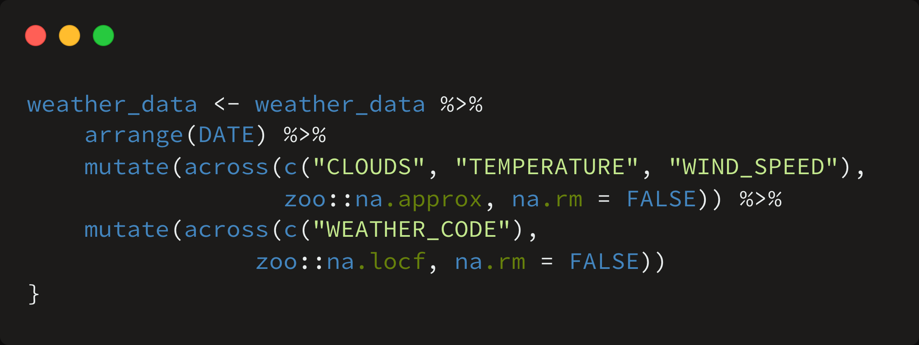
Imputation Method
Dataset

Slide 8
Dataset

Slide 9

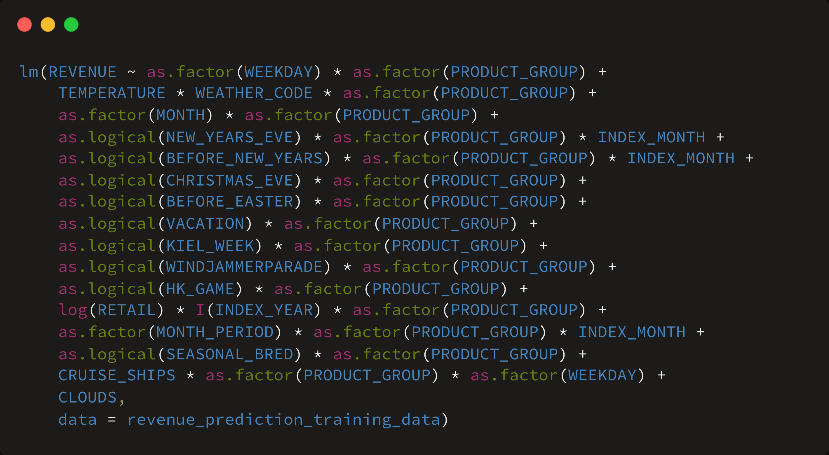
Baseline Model
Baseline Model

Slide 10
Baseline Model

Slide 11
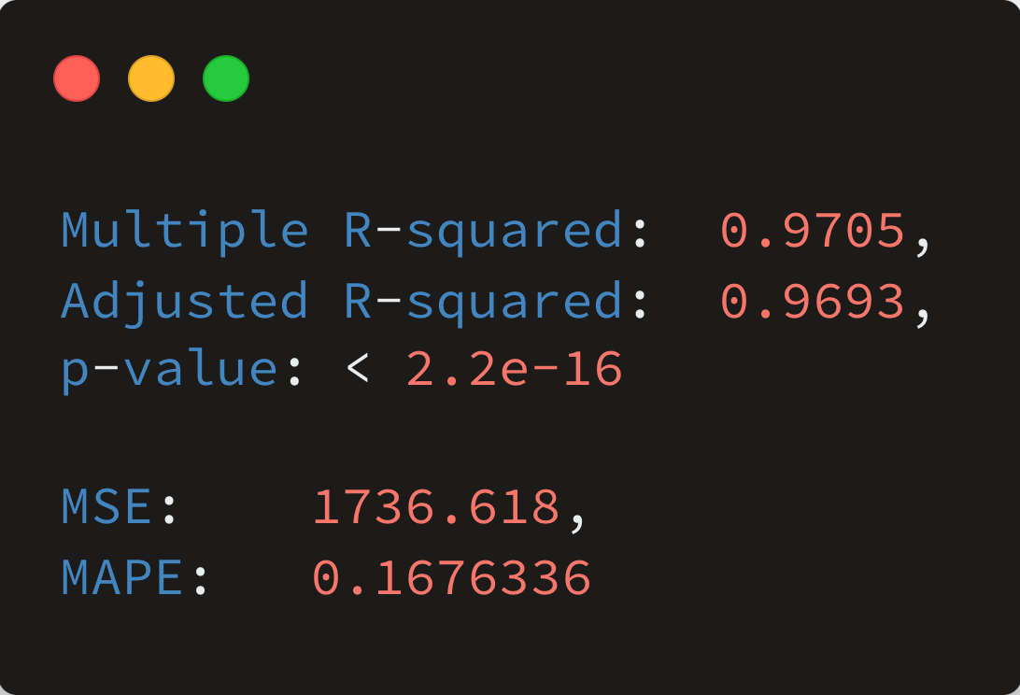
Baseline Model

Slide 12
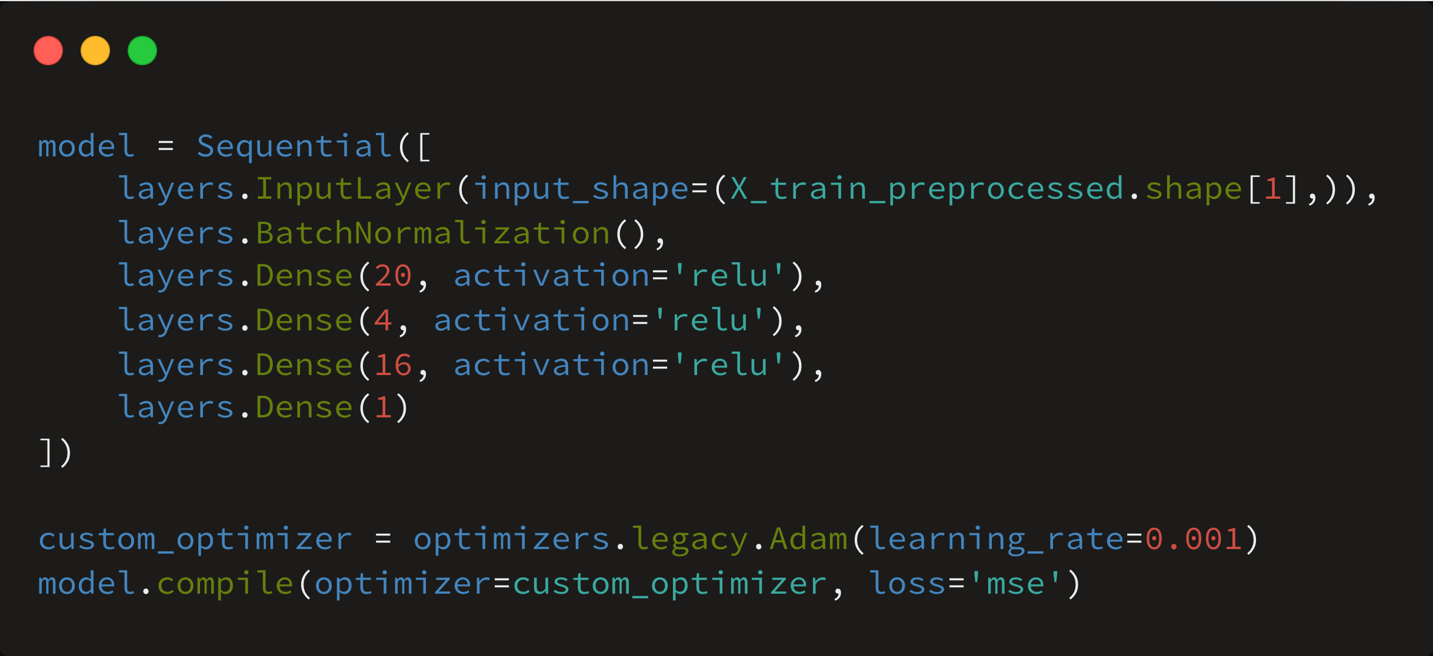
Neural Network
Neural Network

Slide 13
Neural Network

Slide 14
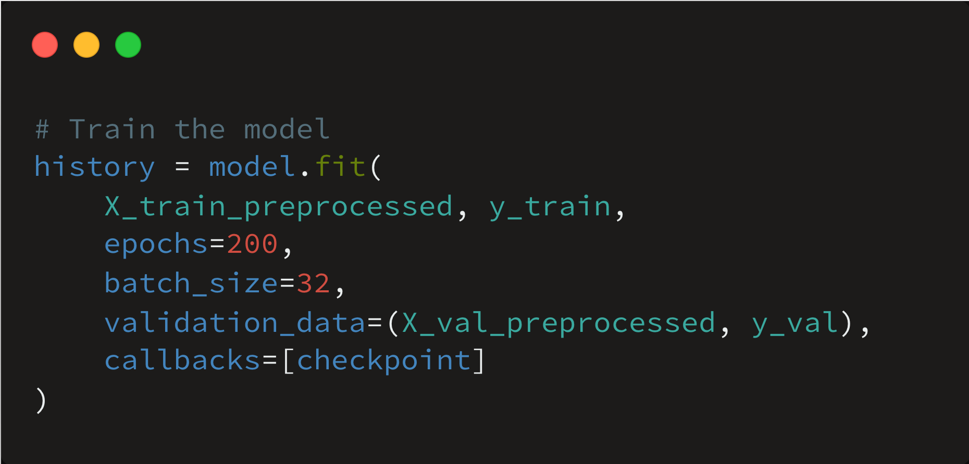
Neural Network

Slide 15
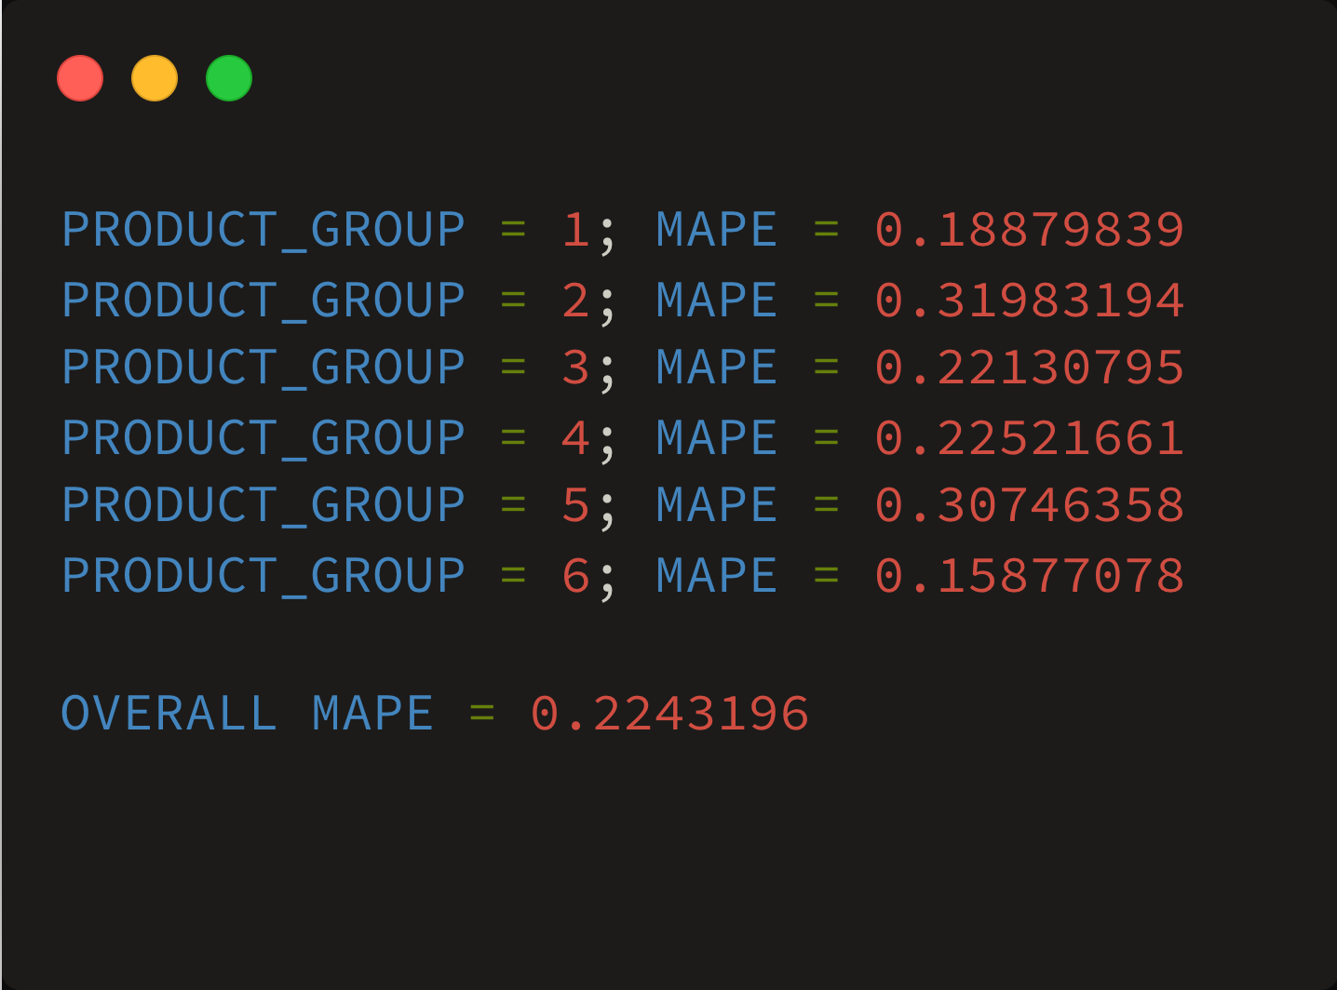
Neural Network

Slide 16
Loss function
Neural Network

Slide 17
Worst Fail
zu hohe Dropout Rate gewählt

