Slide 1
GLEON MEETING · BANYOLES · 31 AUGUST 2026
Is it safe to swim in Lake Banyoles
during the GLEON meeting?
Hybrid Lake Modelling with Process-Based Models and Machine Learning
Daniel Mercado-Bettín | CEAB-CSIC
Duration: 2.5–3 hours · Language: R · Level: Intermediate
github.com/danielmerbet/gleon2026_modelling_workshop
Notes:
Welcome. Acknowledge we are literally at Banyoles -- use this! Set the hook: can we predict if it's safe to swim, using weather data alone?

Slide 2
WORKSHOP STRUCTURE
Agenda — 2.5 to 3 hours
Part | Script | Topic | Time
0 | — | Introduction & the swimmer-safety story | 10 min
1 | 02_explore.R | Data exploration & risk thresholds | 30 min
2 | 03_process_model.R | 1D process-based model & residuals | 40 min
 |  | ☕ Break | 10 min
3 | 04_ml_residuals.R | Random forest on residuals (LOCO CV) | 40 min
4 | 05_hybrid_compare.R | Risk map, limitations & discussion | 20 min
Bonus | 06 + 07 | Live forecast & independent validation | as time allows
GLEON Banyoles 2026 | Hybrid Lake Modelling
Notes:
Walk through timing quickly. Flag the break. Emphasise this is hands-on R throughout -- everyone should have RStudio open with the repo cloned.

Slide 3
BEFORE WE START
Setup check
• Clone: github.com/danielmerbet/gleon2026_modelling_workshop
• Open gleon-banyoles-workshop.Rproj in RStudio (sets working directory)
• Run 00_packages.R — installs & loads everything (tidyverse, caret, randomForest, readxl, shiny, ...)
• Data is bundled — data/data.csv, data/era5_banyoles.csv, data/vilar_temperature.csv — no internet needed once cloned
• We live-code throughout — follow along in the numbered scripts, 01 → 07, in order
GLEON Banyoles 2026 | Hybrid Lake Modelling
Notes:
Give people 3-5 minutes to get 00_packages.R running. Troubleshoot installs now, not later. Check everyone has R open before moving on.

Slide 4
THE STORY
Why hybrid modelling?
Lake Banyoles looks perfectly safe from the shore. But every summer, as the surface warms to 28°C, the water column stratifies and biological decomposition strips the oxygen from the deep layer.
Below ~15–20 m: near-zero dissolved oxygen and potential hydrogen sulphide. A freediver descending without knowing the profile is in serious danger.
Can we predict the safe swimming depth from weather data alone,
without sending a boat out?
GLEON Banyoles 2026 | Hybrid Lake Modelling
Notes:
This is the question the whole workshop answers. Process-based physics for the lake's thermal structure + random forest to correct what the physics gets wrong = depth-by-depth risk map for every campaign, and eventually a live next-day forecast.

Slide 5
THE MODELLING SPECTRUM
Where does your model sit?
• Pure process model (GLM, GOTM, DYRESM)
– Strengths: conservation laws, extrapolation, interpretability
– Weaknesses: calibration cost, complex biogeochemistry, data-hungry parameters
• Pure ML (random forest, LSTM, XGBoost)
– Strengths: flexible, data-driven, no equations needed
– Weaknesses: no physics, needs lots of data, black box
• Most real lake problems sit somewhere in between — that's the hybrid space
GLEON Banyoles 2026 | Hybrid Lake Modelling
Notes:
Ask the room: where do your own models sit on this spectrum? Today we deliberately sit in the middle.

Slide 6
THREE HYBRID STRATEGIES
How to combine physics and ML
• 1. Residual correction — what we do today
– Process model → residuals → ML corrects → hybrid output
• 2. Physics-informed features
– ML uses process model outputs as input features (T_pred, Schmidt stability)
• 3. Physics-informed loss / constraints
– ML is penalised when it violates conservation laws (advanced)
• All three are in active use in the lake modelling literature — we only cover strategy 1 today
GLEON Banyoles 2026 | Hybrid Lake Modelling
Notes:
Emphasise we only cover strategy 1. Mention 2 and 3 exist for people who want to go further after the workshop.

Slide 7
WHY LAKE BANYOLES?
A karstic system that breaks simple models
• Largest lake in Catalonia — karstic, complex basin structure
• Groundwater inflow creates an intermittent secondary warm layer at ~25–28 m
• Summer anoxia below ~15–20 m in the deep basin
• ACA monitoring: station 0450401, 2007–2026, temperature, DO, chlorophyll a, conductivity, pH, turbidity
• A simple process model will get the seasonal surface cycle right — and fail on the karstic groundwater signal and the anoxia
GLEON Banyoles 2026 | Hybrid Lake Modelling
Notes:
Point out the window if the lake is visible! This slide sets up exactly the two failure modes the process model will show in Part 2.

Slide 8
PART 1
Explore the data
Understand Lake Banyoles through the lens of swimmer safety
File: 02_explore.R
~ 30 min

Slide 9
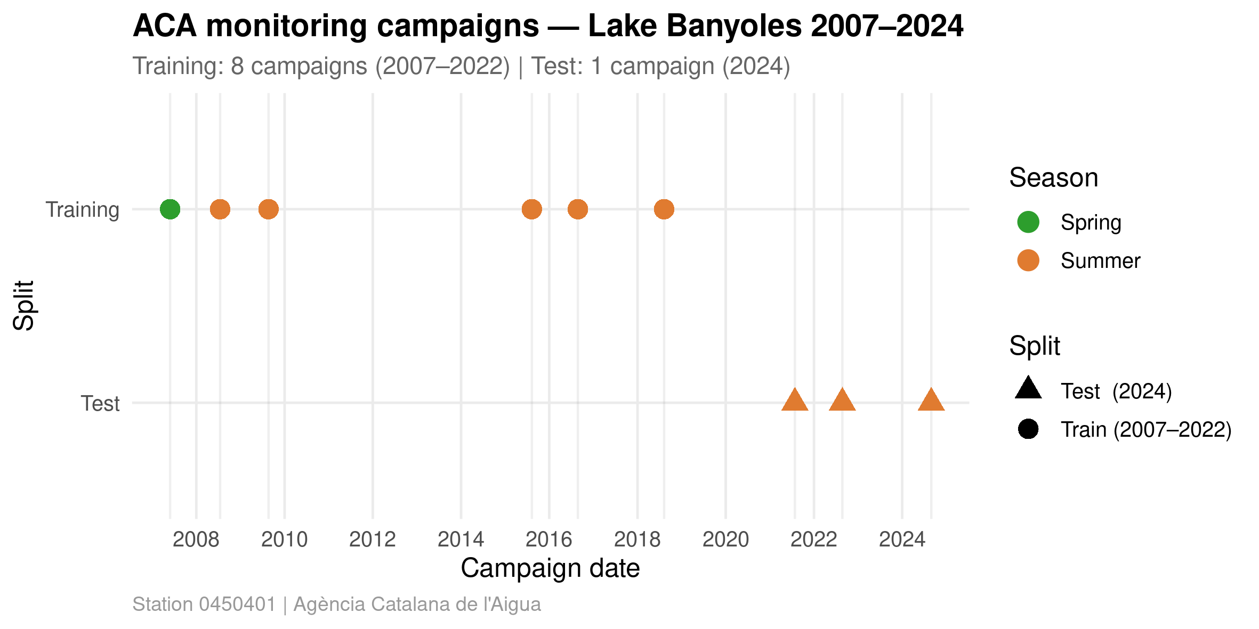
PART 1 · 02_EXPLORE.R
Campaign overview
Train (2007–2018) vs. test (2021–2024) campaigns.
GLEON Banyoles 2026 | Hybrid Lake Modelling
Notes:
All campaigns are summer -- high air temp, strong stratification expected. Point out the train/test split before diving into values.

Slide 10
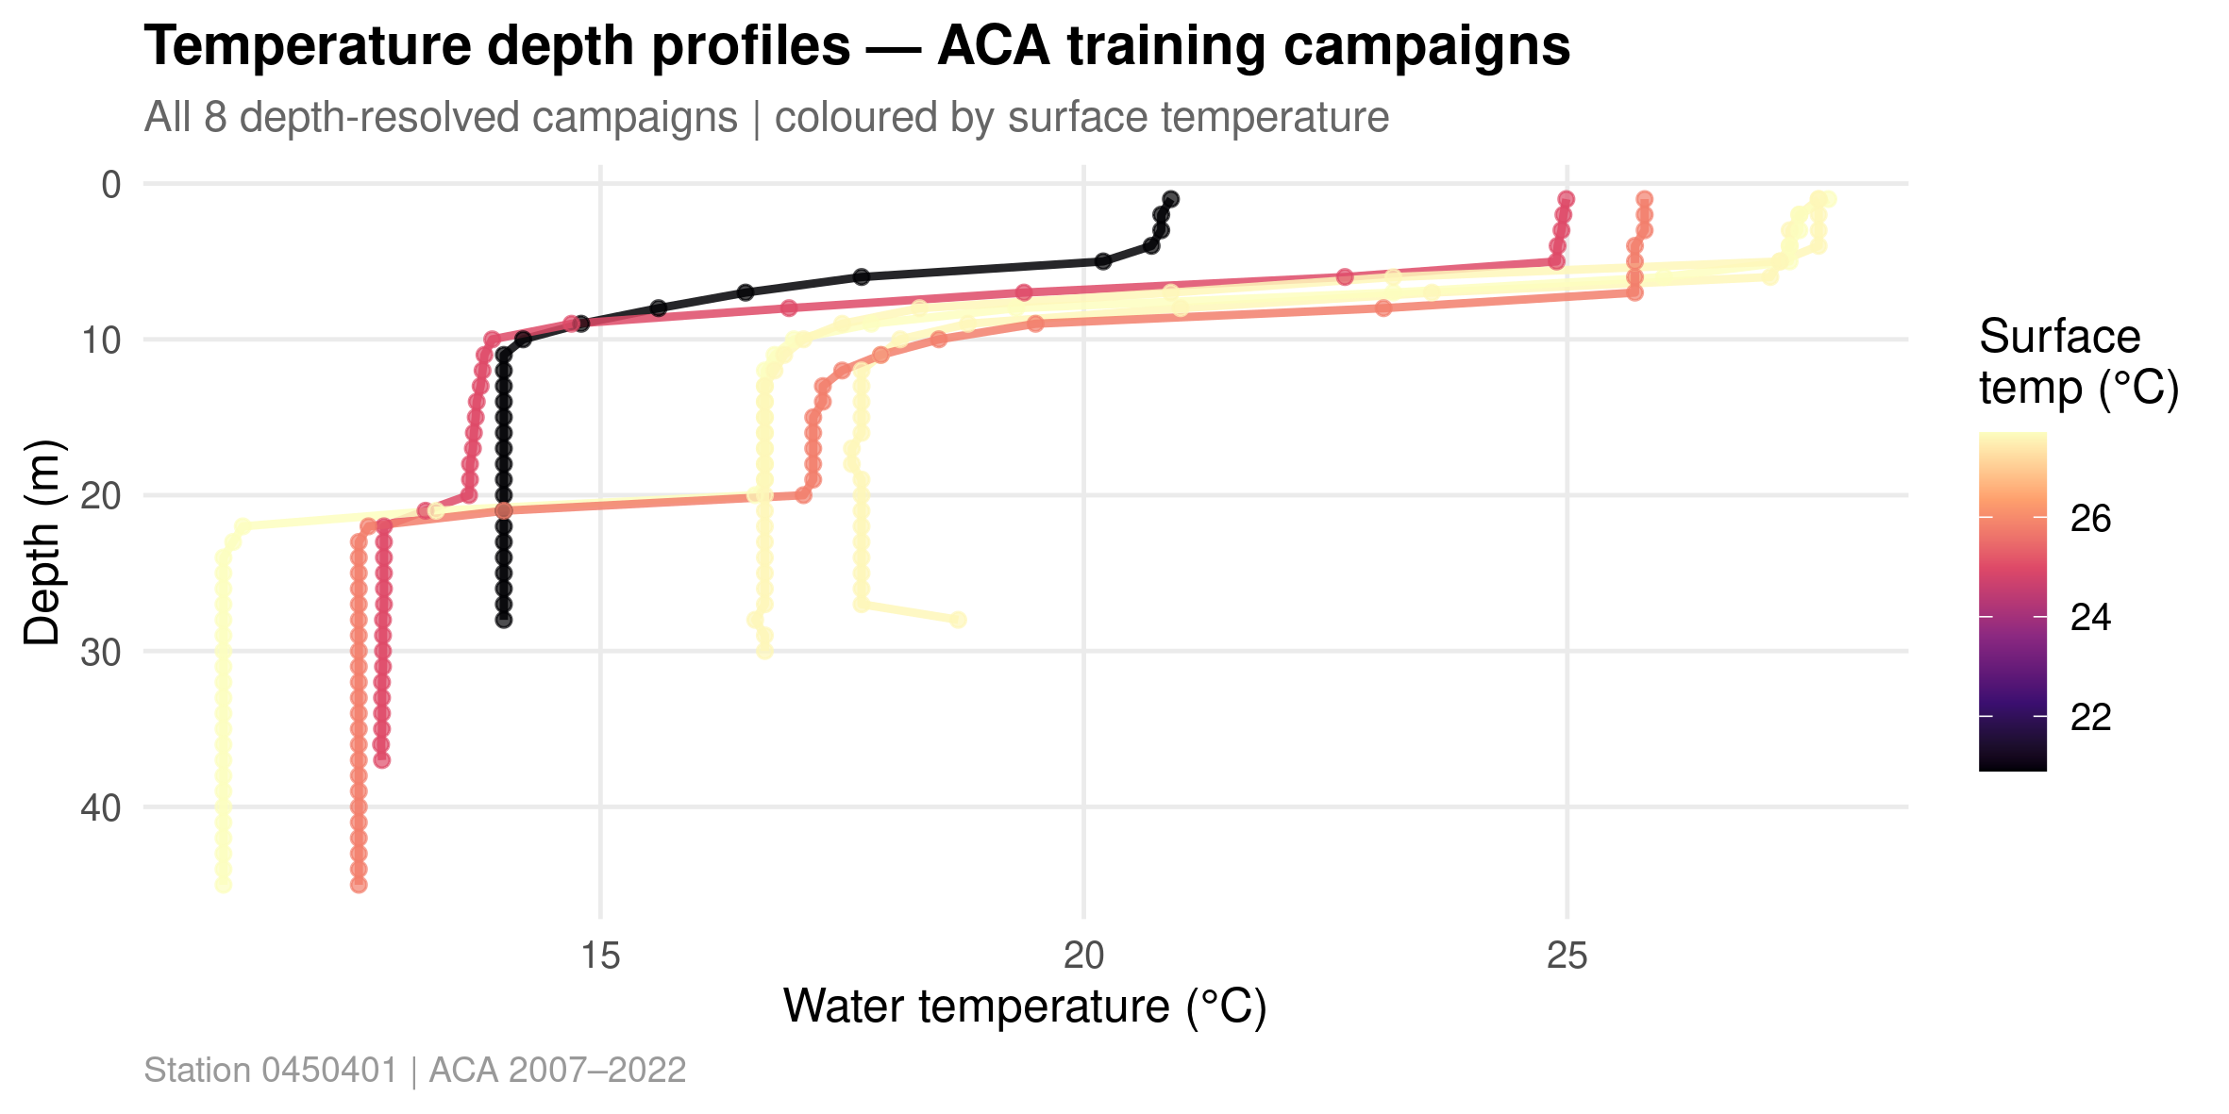
PART 1 · 02_EXPLORE.R
Temperature profiles, 2007–2024
One line per campaign — the observed thermal record.
GLEON Banyoles 2026 | Hybrid Lake Modelling
Notes:
Ask: what's that warm patch at 25-28 m in some campaigns? Is the thermometer broken? -> intermittent karstic groundwater intrusion, ~18C. A process model will miss this unless we tell it to look.

Slide 11
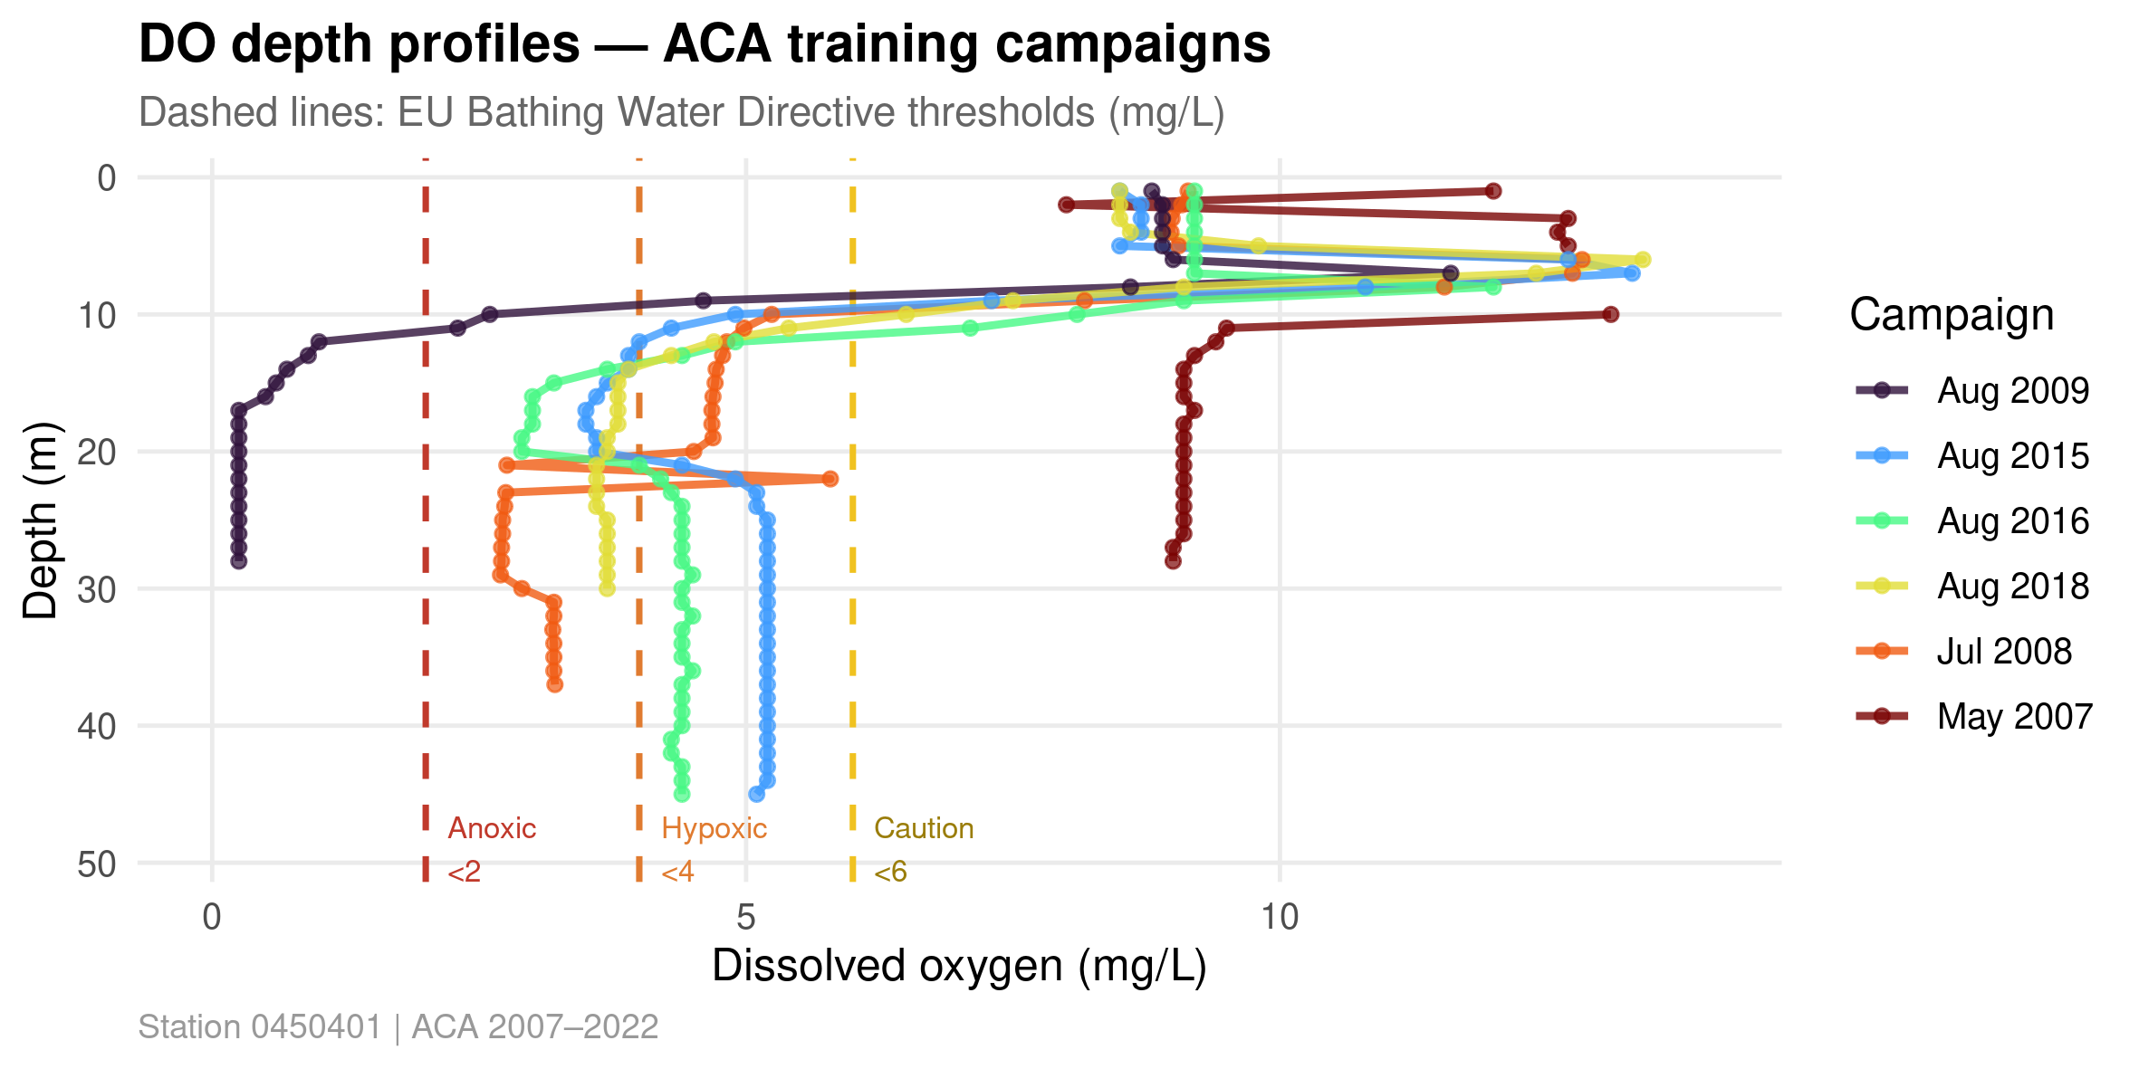
PART 1 · 02_EXPLORE.R
Dissolved oxygen profiles
With swimmer-risk thresholds overlaid (2 / 4 / 6 mg/L).
GLEON Banyoles 2026 | Hybrid Lake Modelling
Notes:
Note the May 2007 exception -- why? Spring mixing not yet complete. Below the thermocline O2 collapses fast in summer.

Slide 12
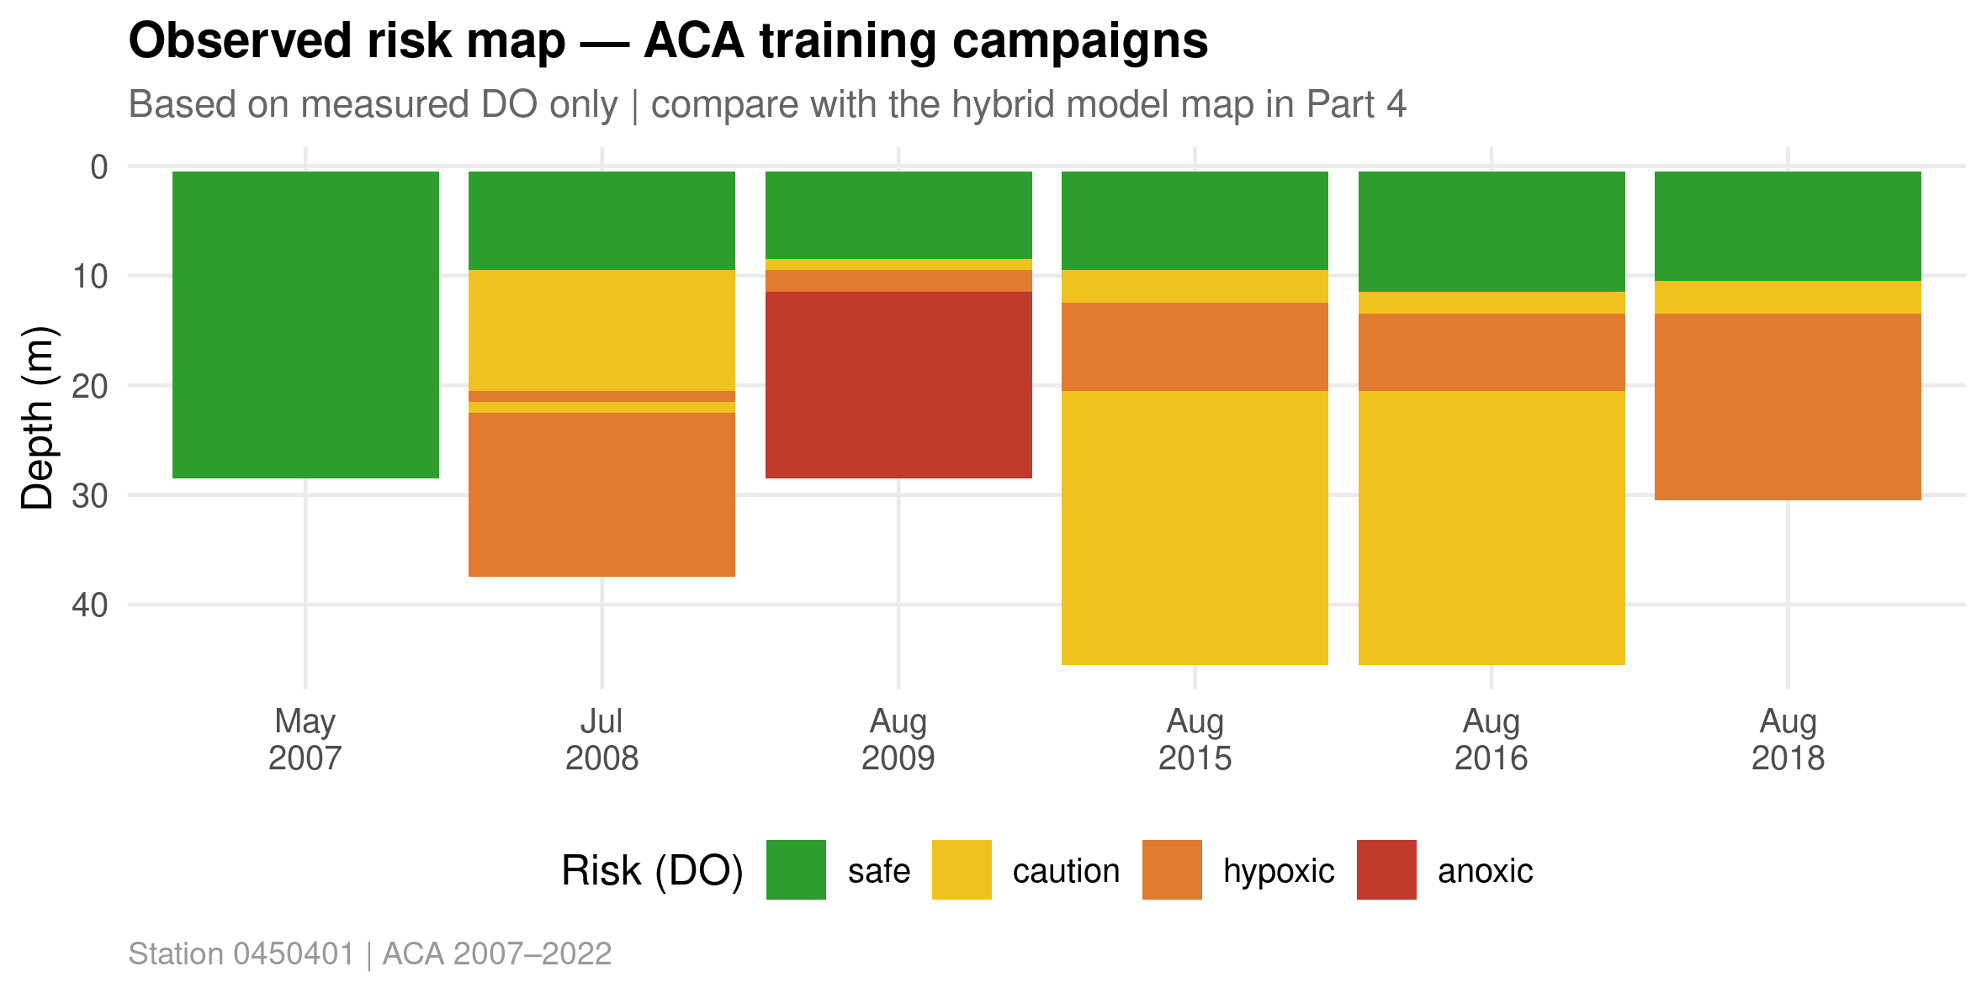
PART 1 · 02_EXPLORE.R
Observed swimmer-risk map
Depth × campaign heatmap of swimmer risk category.
GLEON Banyoles 2026 | Hybrid Lake Modelling
Notes:
This is the centrepiece visual we will try to reproduce with the hybrid model in Part 4. Ask: where would YOU stop diving?

Slide 13
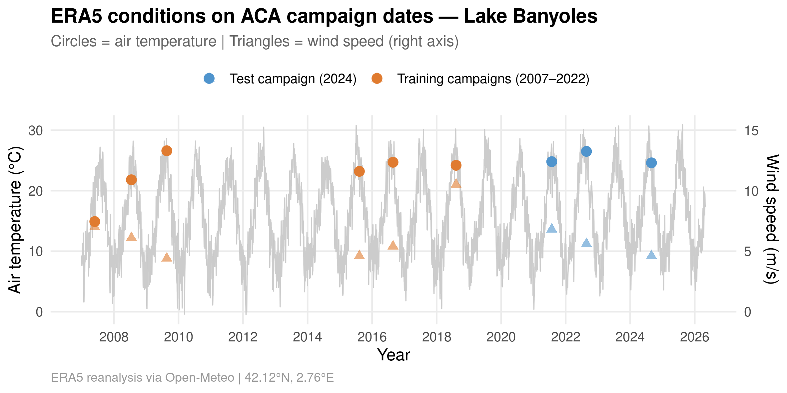
PART 1 · 02_EXPLORE.R
ERA5 meteorological context
What drives stratification? Air temperature, wind, radiation.
GLEON Banyoles 2026 | Hybrid Lake Modelling
Notes:
All campaigns are summer -- high air temp, strong stratification. This is the forcing data the process model and later the RF will use.

Slide 14
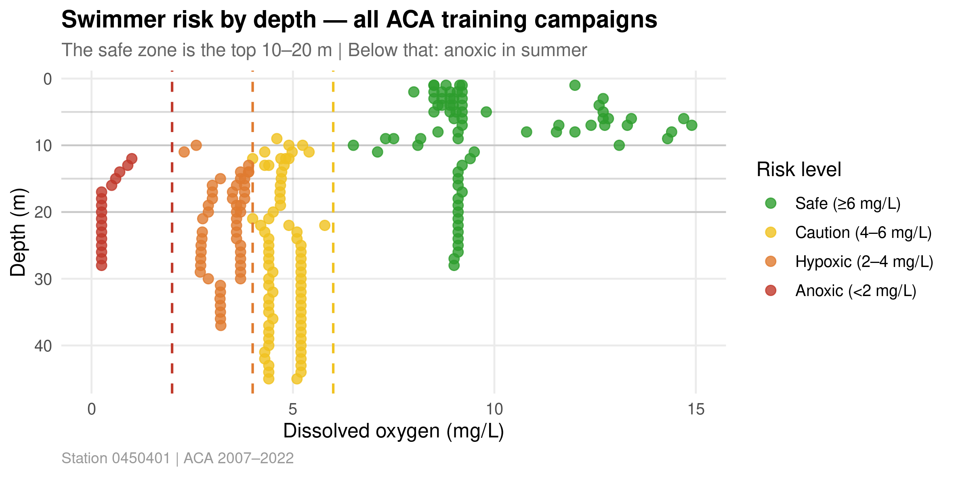
PART 1 · 02_EXPLORE.R
Risk thresholds vs. temperature/DO
The 2 / 4 / 6 mg/L thresholds that frame everything that follows.
GLEON Banyoles 2026 | Hybrid Lake Modelling
Notes:
These risk thresholds (2/4/6 mg/L DO) are the lens for every plot in the rest of the workshop. Make sure everyone understands them before moving to Part 2.

Slide 15
PART 2
The process model
Build a simple 1D physics model and compute its residuals
File: 03_process_model.R
~ 40 min

Slide 16
PART 2 · MODEL.R
The physics — deliberately simple
• Mixed layer depth: seasonal, 5 m (summer) to 8 m (winter)
• Surface temperature: air-coupling + seasonal solar warming
• Below the mixed layer: exponential thermocline decay toward a deepwater background temperature
• Weak exponential groundwater bump below ~25 m (intentionally weak — ML learns the rest)
• Dissolved oxygen: saturation at predicted temperature × a sigmoid O2 fraction that collapses with depth in the stratified season
• This model is intentionally simple. Its job is not to win an RMSE competition — it's to provide a physically-structured prior that ML can improve.
GLEON Banyoles 2026 | Hybrid Lake Modelling
Notes:
Before running the model, ask: what would you expect this to get right? Wrong? Right: surface seasonality. Wrong: groundwater anomaly, anoxia. Show the DO saturation formula -- this is real physics (Benson & Krause 1984), not an ML trick.

Slide 17
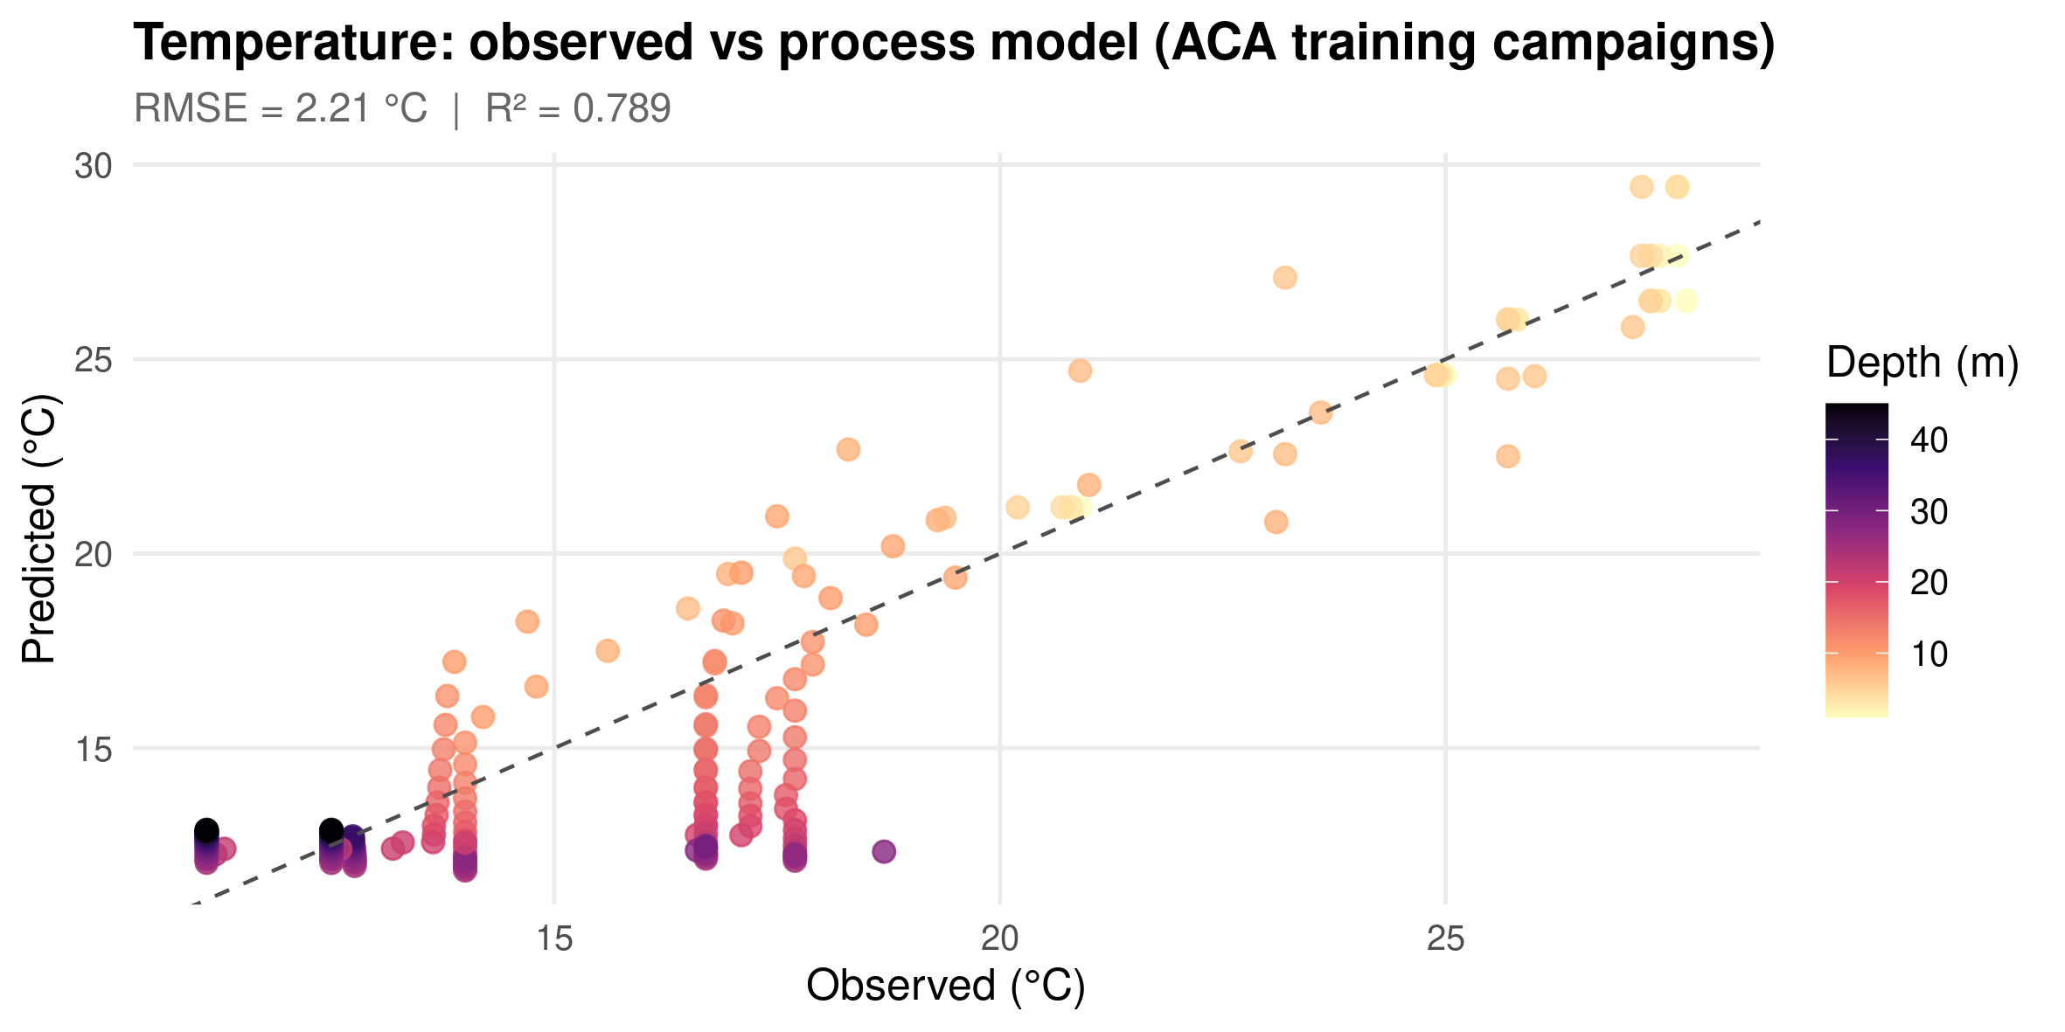
PART 2 · 03_PROCESS_MODEL.R
Observed vs. process-model temperature
Training campaigns, process model only.
GLEON Banyoles 2026 | Hybrid Lake Modelling
Notes:
Good overall fit on the bulk structure -- this is what physics alone buys you.

Slide 18
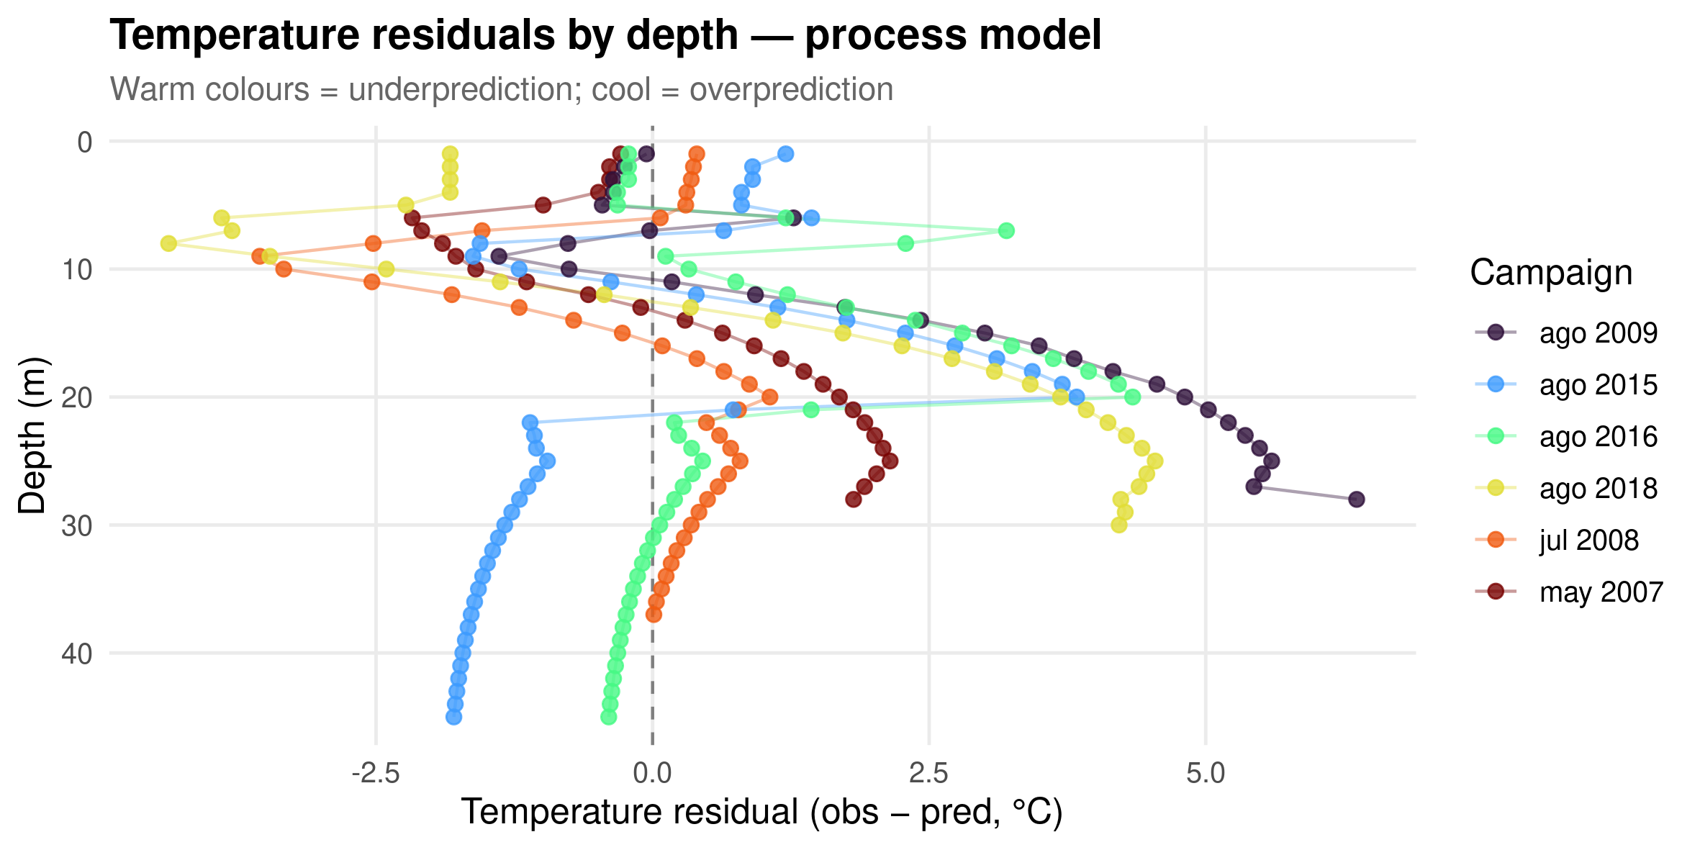
PART 2 · 03_PROCESS_MODEL.R
Temperature residuals by depth & campaign
Where the process model is systematically wrong.
GLEON Banyoles 2026 | Hybrid Lake Modelling
Notes:
The model is cold at 20-28 m in some campaigns. Why, and why does that pattern matter for ML? Structured residuals = learnable by ML. Random residuals = not. This is exactly the karstic intrusion signal from Part 1.

Slide 19
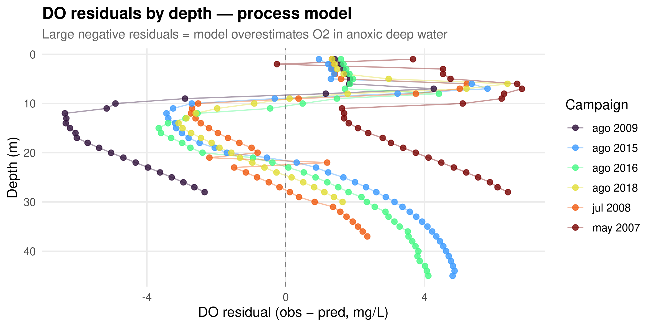
PART 2 · 03_PROCESS_MODEL.R
Dissolved oxygen residuals
The process model never predicts anoxia — by design.
GLEON Banyoles 2026 | Hybrid Lake Modelling
Notes:
The model never predicts anoxia. That is not a bug -- it is a design choice. We deliberately left this out, to give ML something useful to do.

Slide 20
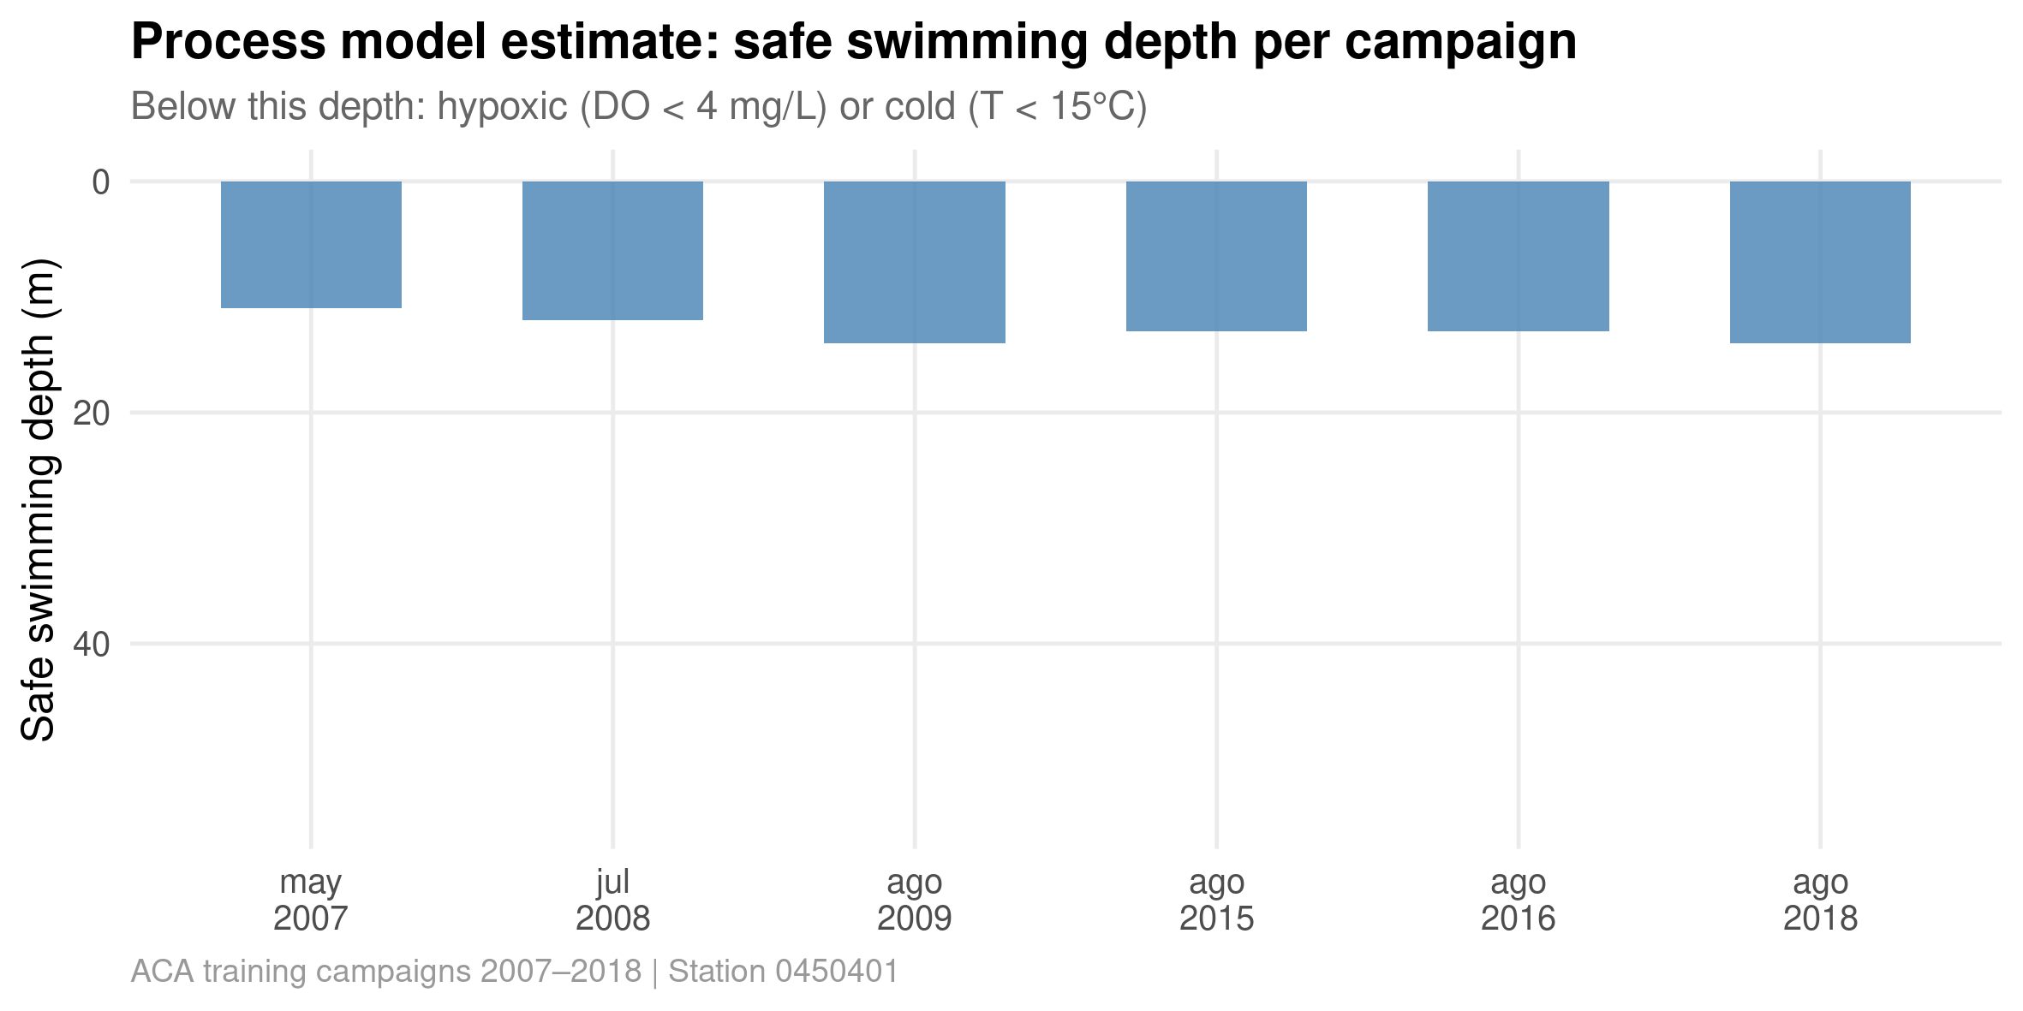
PART 2 · 03_PROCESS_MODEL.R
Safe swimming depth — process-model estimate
A first pass at the risk map, physics only.
GLEON Banyoles 2026 | Hybrid Lake Modelling
Notes:
Compare mentally with slide 'Observed swimmer-risk map' from Part 1 -- how close are we already, with physics alone?

Slide 21
☕ Break
10 minutes — troubleshoot package installs, check data/aca_modelled_train.rds and data/model_params.rds exist
Notes:
Use this break to make sure everyone's environment produced data/aca_modelled_train.rds and data/model_params.rds -- Part 3 needs both.

Slide 22
PART 3
ML on residuals
Train a random forest to correct what the physics gets wrong
File: 04_ml_residuals.R
~ 40 min

Slide 23
PART 3 · 04_ML_RESIDUALS.R
Feature matrix & validation strategy
• Features: sin(doy)/cos(doy) — cyclical day-of-year encoding, so December and January are 'close', not 11 apart
• rel_depth, depth_x_summer — depth interacted with season
• T_pred, air_temp_14d, wind_ms, radiation_MJ_m2 — physics output + ERA5 forcing
• Target: temp_residual / DO_residual (observed − process-model prediction)
• Validation: leave-one-campaign-out (LOCO) CV — random splits would leak temporal information across campaigns from the same period
• Two random forests trained: one for temperature residuals, one for DO
GLEON Banyoles 2026 | Hybrid Lake Modelling
Notes:
Why leave-one-campaign-out and not random splits? Random splits leak future information into training because rows from the same campaign are highly correlated. This is the single most important methodology point in the whole workshop.

Slide 24
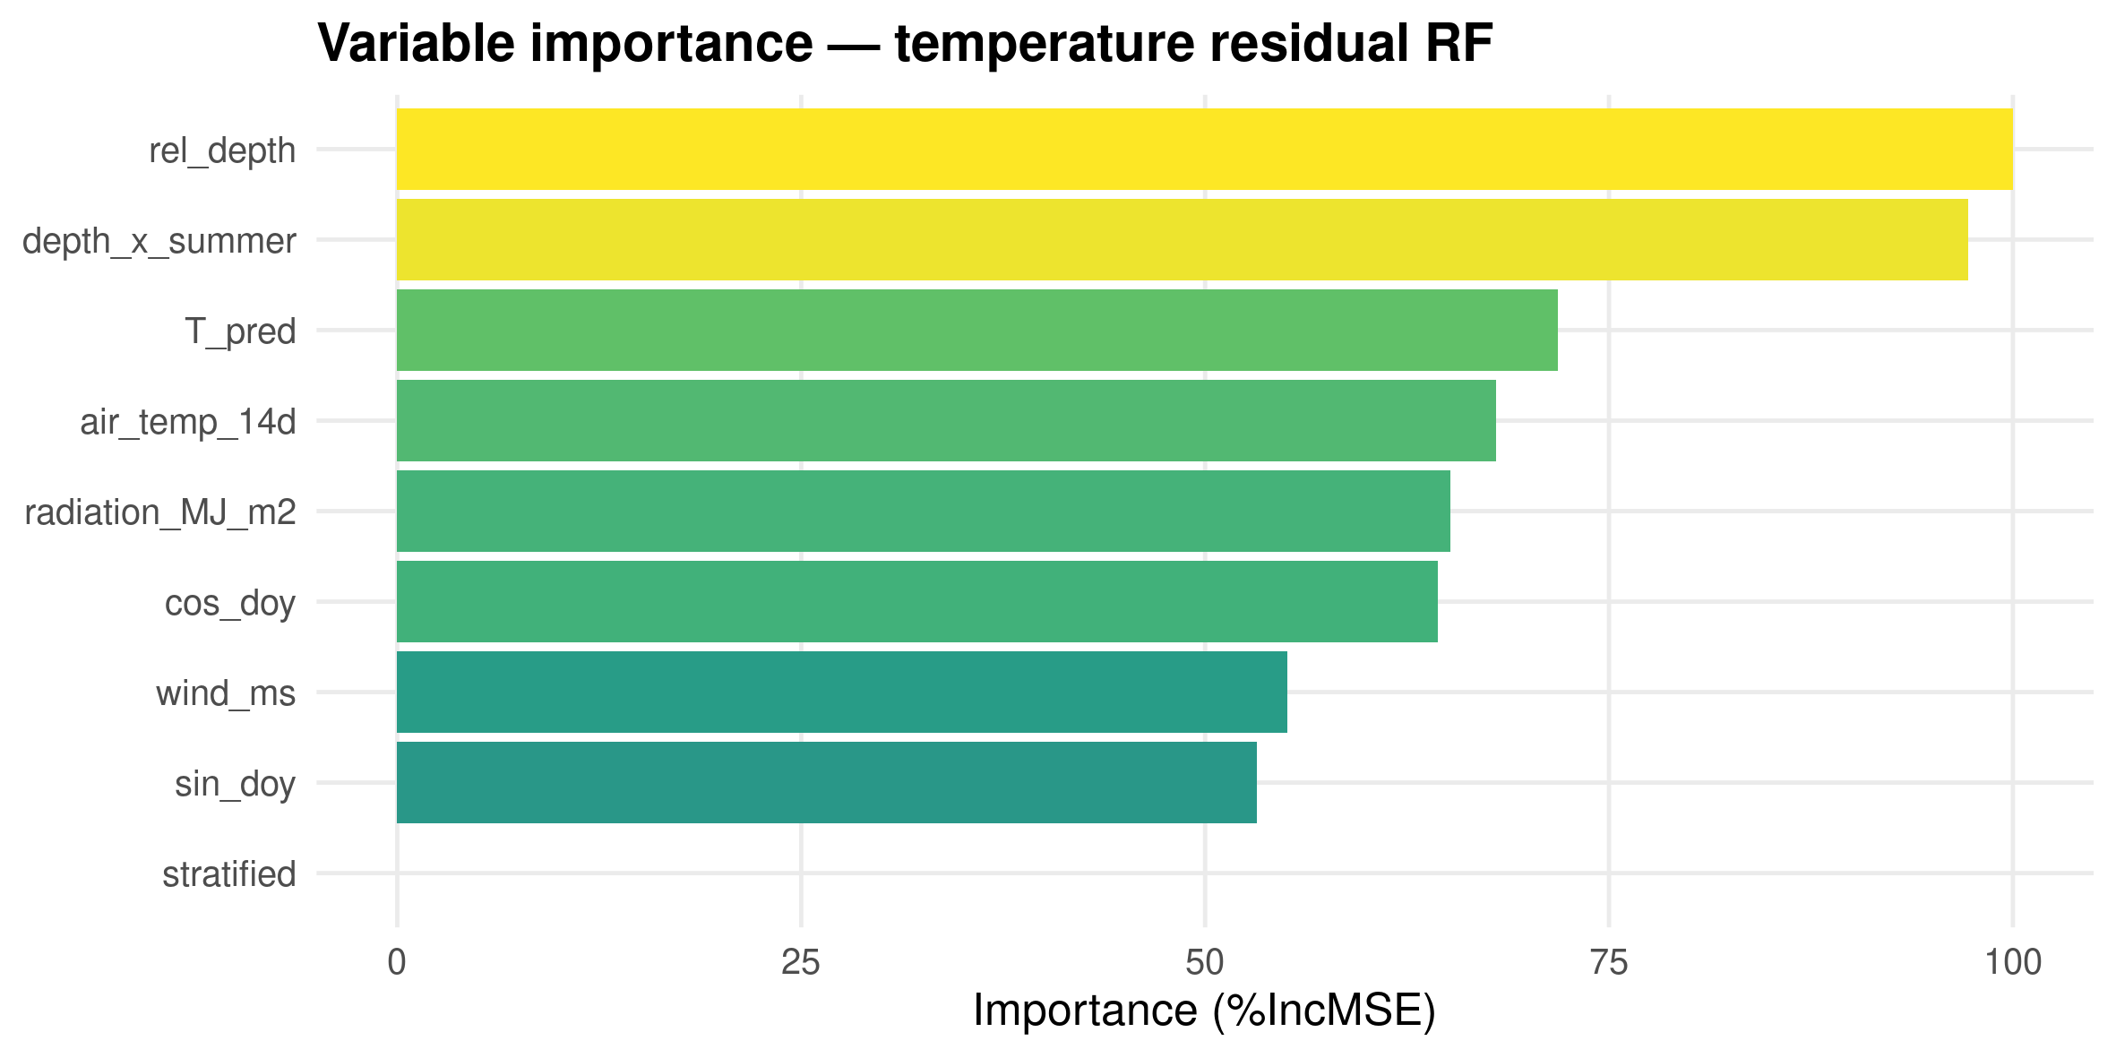
PART 3 · 04_ML_RESIDUALS.R
Variable importance — temperature RF
GLEON Banyoles 2026 | Hybrid Lake Modelling
Notes:
Does this make physical sense? rel_depth and depth_x_summer dominating = the RF learnt the thermocline/anoxia-adjacent gradient on its own.

Slide 25
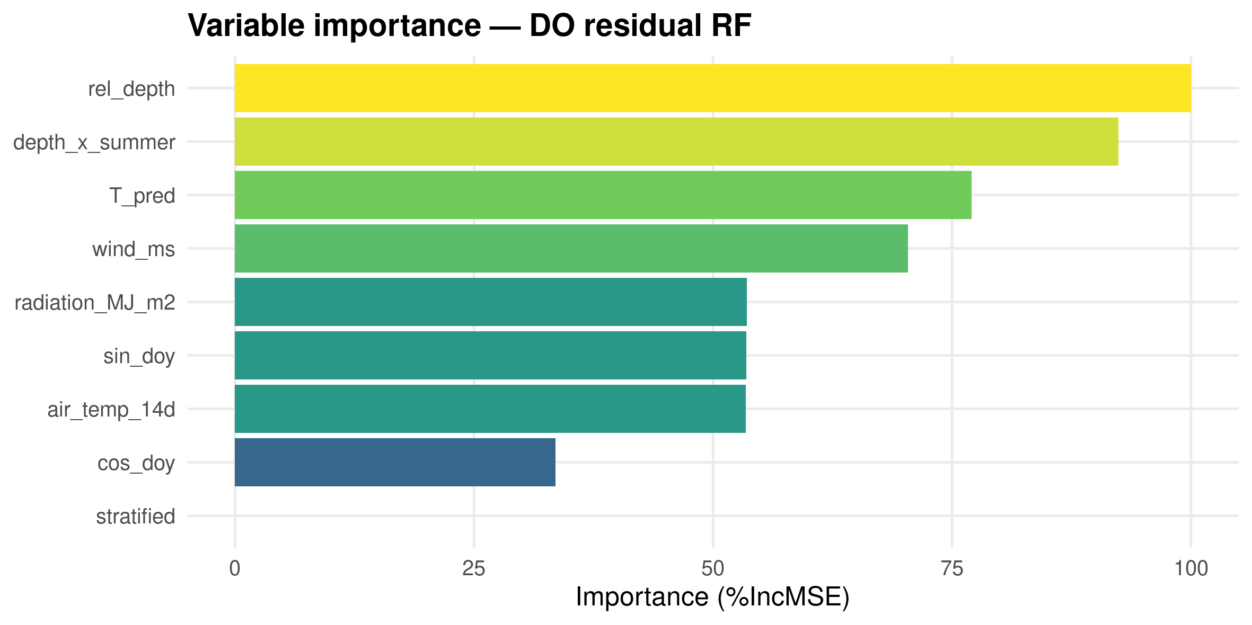
PART 3 · 04_ML_RESIDUALS.R
Variable importance — DO RF
GLEON Banyoles 2026 | Hybrid Lake Modelling
Notes:
Compare with the temperature importance plot -- similar features dominate, which is reassuring: the RF is learning depth/season structure, not noise.

Slide 26
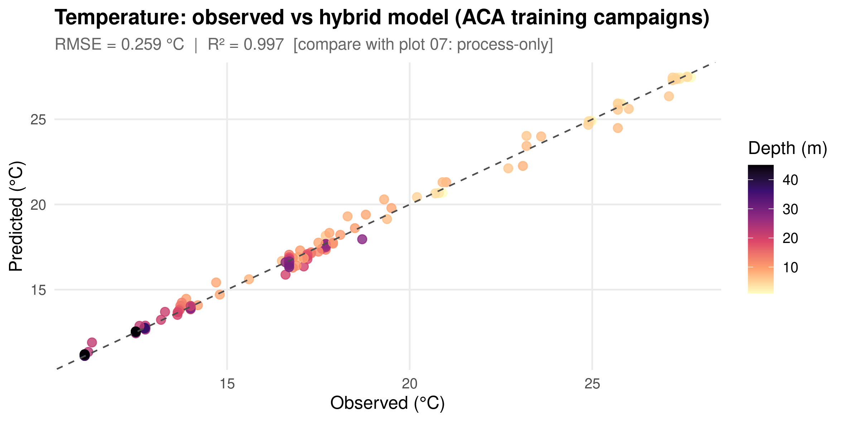
PART 3 · 04_ML_RESIDUALS.R
Hybrid vs. observed temperature
Compare the scatter tightness with the process-only fit in Part 2.
GLEON Banyoles 2026 | Hybrid Lake Modelling
Notes:
The ML correction tightens the fit, especially at intermediate depths where the thermocline shape was poorly captured by the simple physics. We added process prediction + ML correction -- what guarantees DO >= 0? pmax(0, ...), a simple physics constraint.

Slide 27
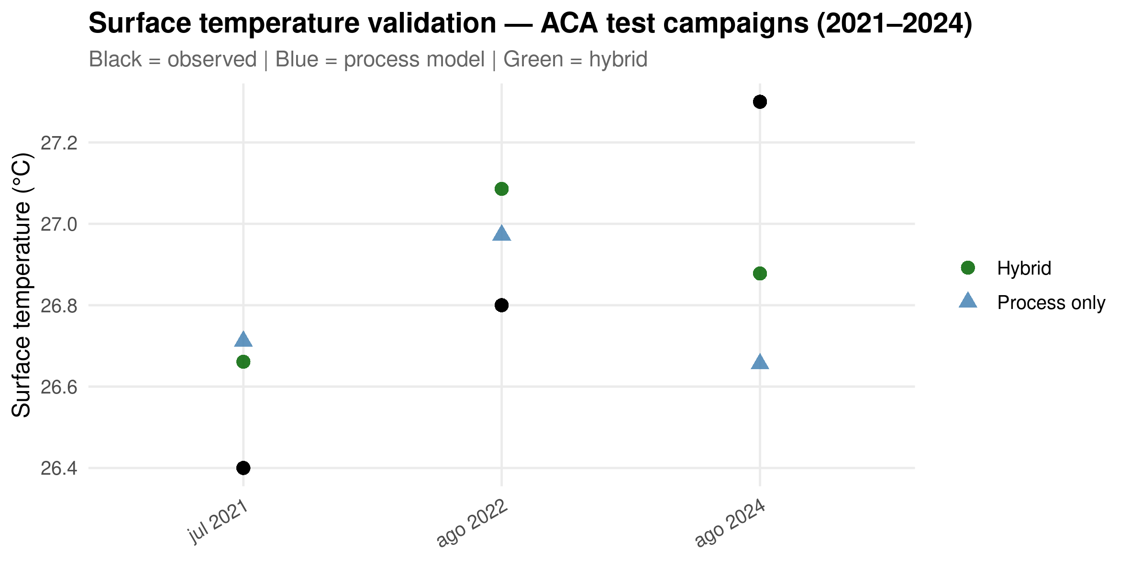
PART 3 · 04_ML_RESIDUALS.R
Surface temperature validation
ACA test campaigns (2021–2024) — held out from training.
GLEON Banyoles 2026 | Hybrid Lake Modelling
Notes:
Black = observed, blue = process only, green = hybrid. This is the first genuinely held-out check.

Slide 28
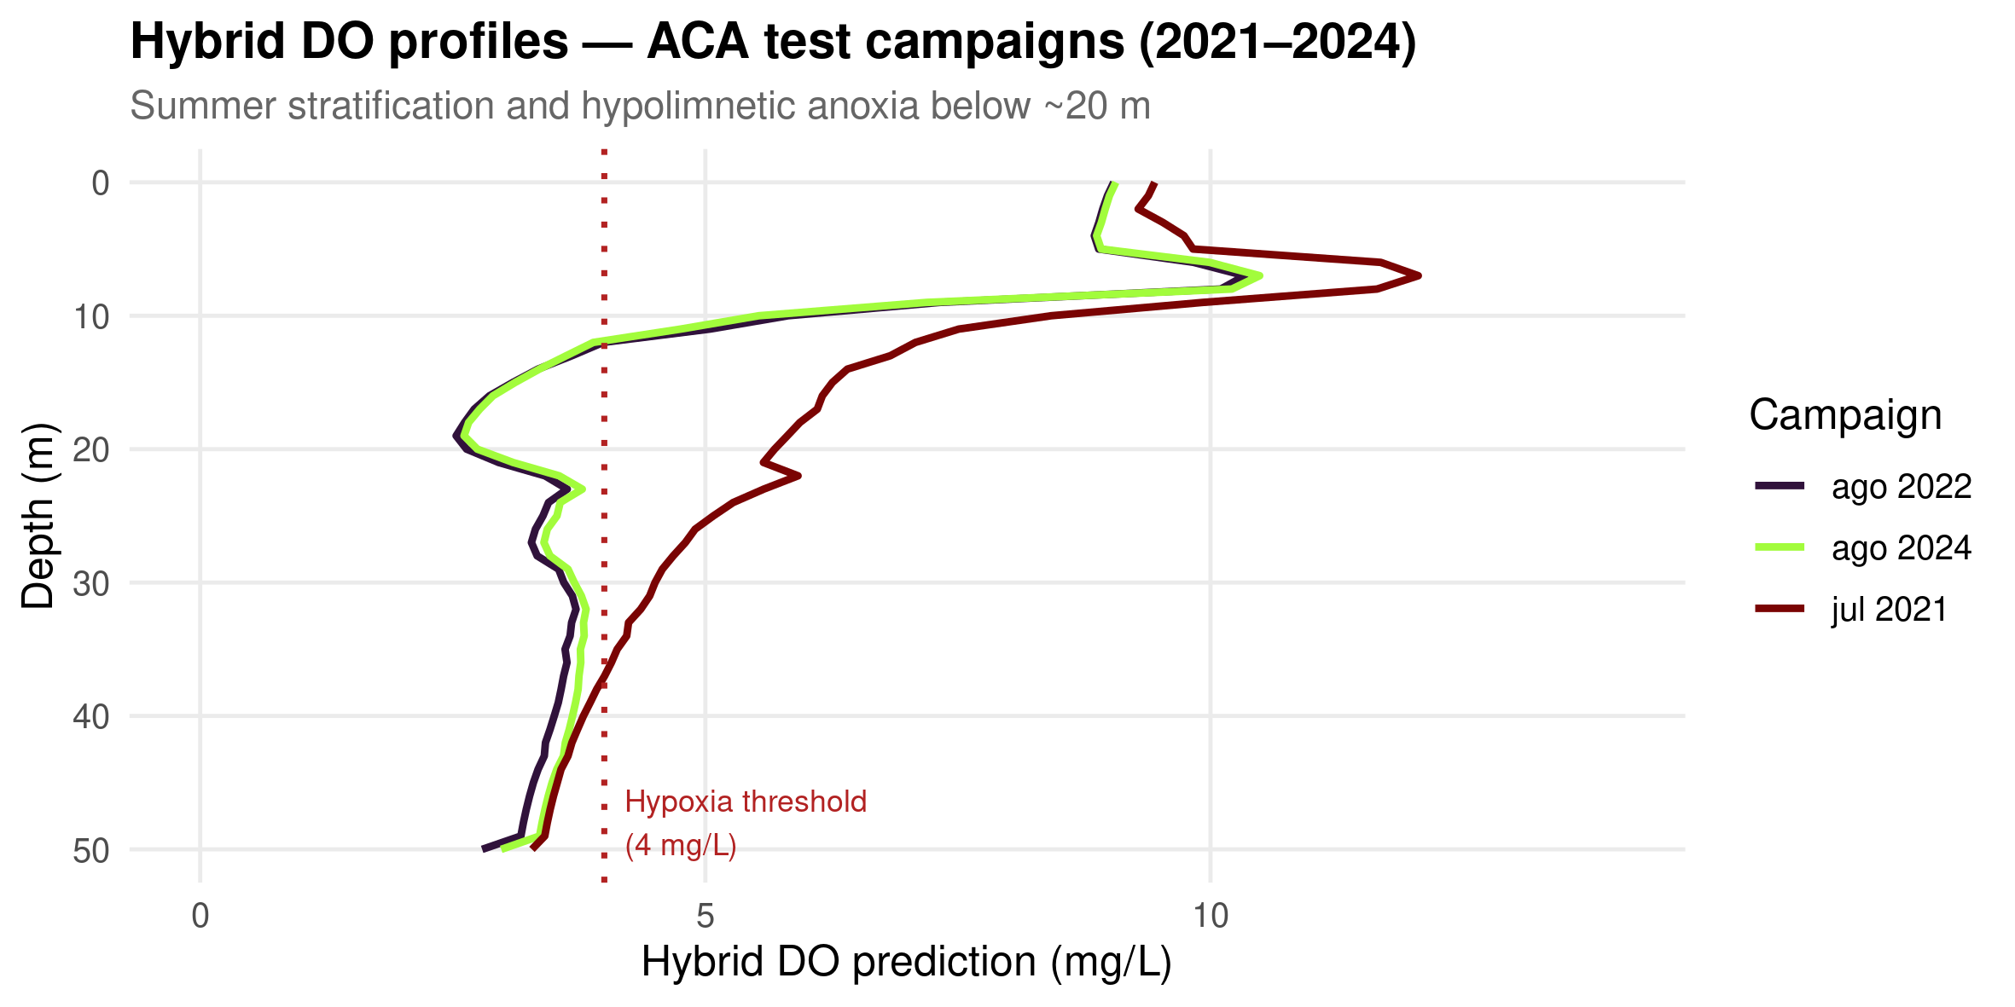
PART 3 · 04_ML_RESIDUALS.R
Hybrid DO depth profiles
Test campaigns — did we recover the anoxia the process model missed?
GLEON Banyoles 2026 | Hybrid Lake Modelling
Notes:
Show this next to the process-only DO residual plot from Part 2. The hybrid model now reproduces the sharp hypolimnetic O2 collapse.

Slide 29
PART 4
Compare & limitations
Assemble the risk map and talk honestly about what's still wrong
File: 05_hybrid_compare.R
~ 20 min

Slide 30
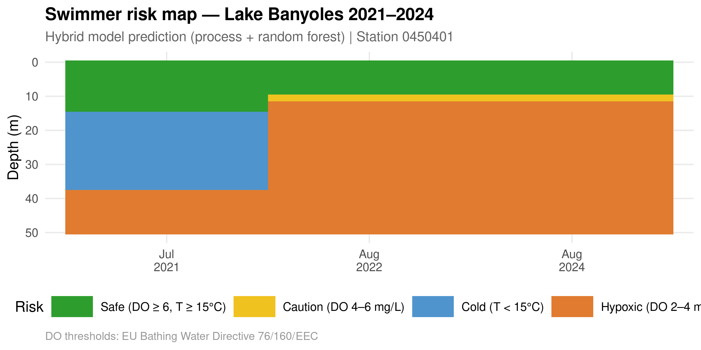
PART 4 · 05_HYBRID_COMPARE.R
Hybrid swimmer-risk map
The centrepiece visual — depth × campaign, hybrid predictions.
GLEON Banyoles 2026 | Hybrid Lake Modelling
Notes:
Let participants read the numbers first before you talk. Ask who is surprised, and by what.

Slide 31
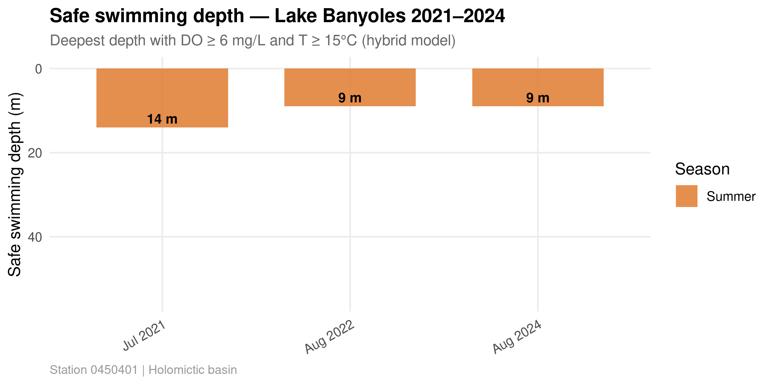
PART 4 · 05_HYBRID_COMPARE.R
Safe swimming depth per campaign
GLEON Banyoles 2026 | Hybrid Lake Modelling
Notes:
This is the number a swimmer actually wants: how deep is safe, today?

Slide 32
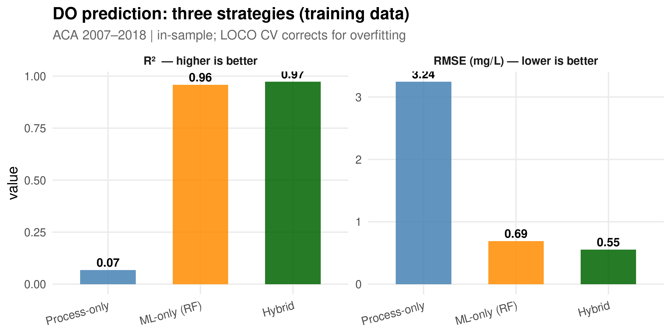
PART 4 · 05_HYBRID_COMPARE.R
Three-way model comparison
Process-only vs. ML-only vs. hybrid — training data, in-sample and LOCO CV.
GLEON Banyoles 2026 | Hybrid Lake Modelling
Notes:
Which wins? Why? Let the room debate before revealing that the hybrid model roughly halves RMSE vs. process-only on depth profiles, but watch the in-sample vs LOCO CV gap for the ML-only model -- that gap is overfitting.

Slide 33
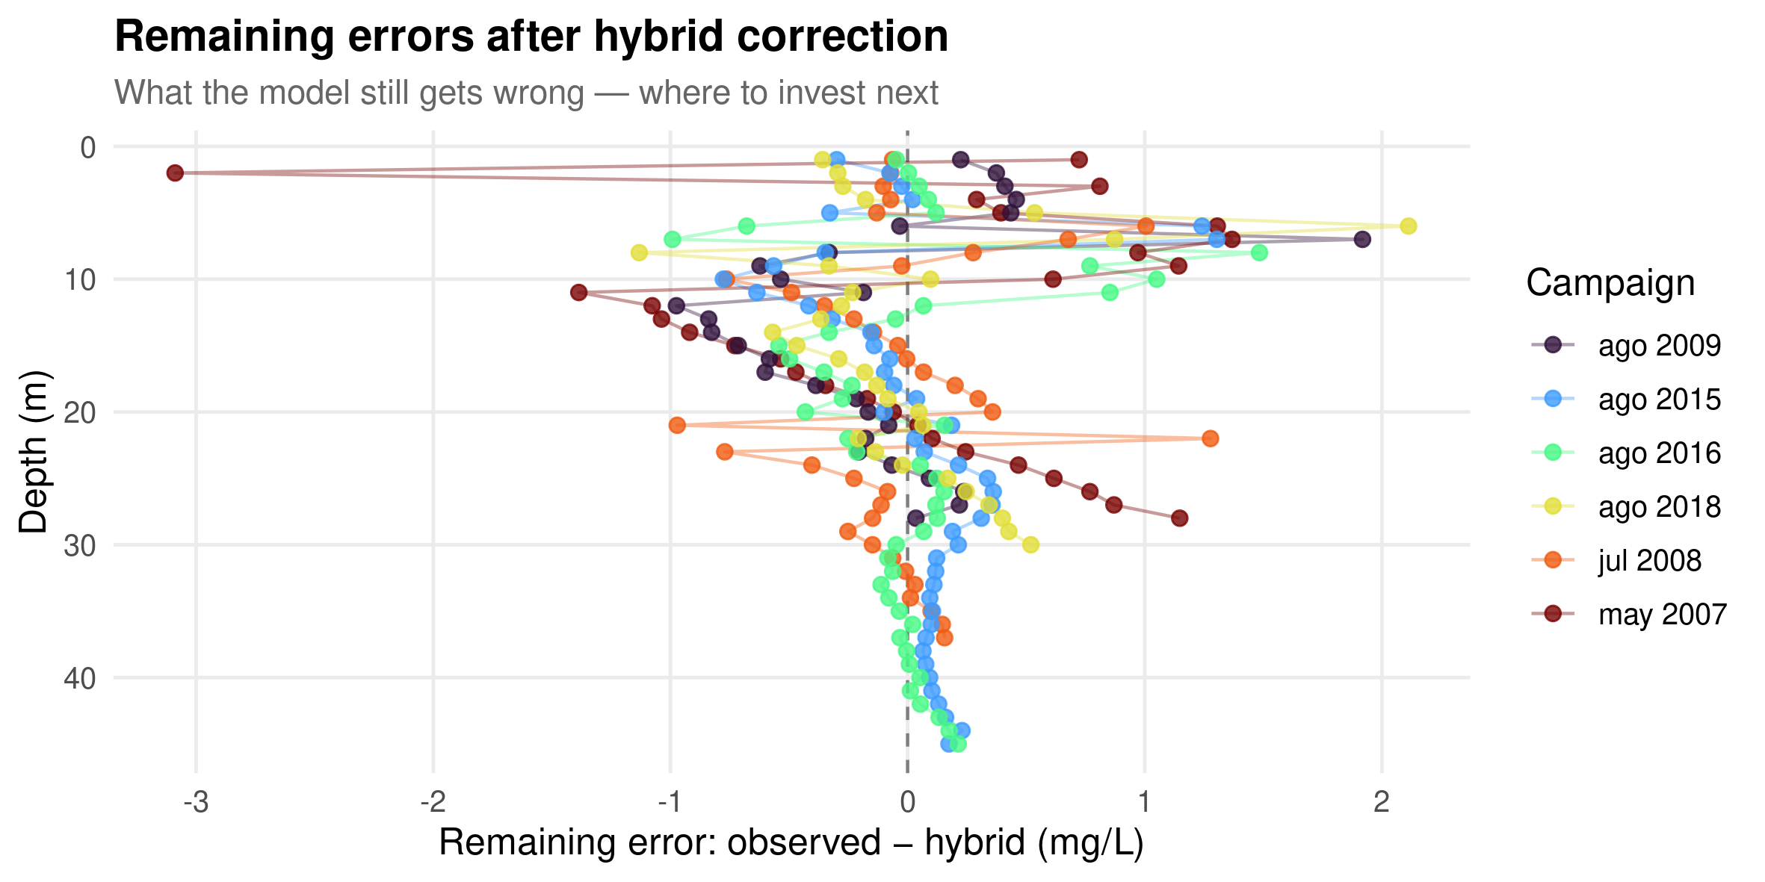
PART 4 · 05_HYBRID_COMPARE.R
Remaining errors after the hybrid correction
Where to invest next.
GLEON Banyoles 2026 | Hybrid Lake Modelling
Notes:
We improved a lot, but the model still fails here. What would it take to fix this? More data, a biogeochemical module, GOTM with sediment oxygen demand.

Slide 34
PART 4 · HONEST LIMITATIONS
Three honest limitations
Limitation | What it means
1. Overfitting | In-sample RMSE << LOCO CV RMSE — the RF memorises campaign-specific patterns it won't see again
2. Surface DO biology | Trained on stratification-driven depth gradients — cannot predict spring blooms (supersaturation) or autumn turnover
3. Depth extrapolation | Training: mostly 0–50 m, 9 summer campaigns. Deep winter/spring hybrid predictions are unvalidated extrapolation
GLEON Banyoles 2026 | Hybrid Lake Modelling
Notes:
The hybrid is only as good as its weakest component. Use as many of the discussion prompts as time allows: (1) what would fix the spring/autumn surface DO gap? (2) how would you design a monitoring campaign to validate deep-water predictions? (3) is a surface-only Bathing Water Directive sample enough for a 20 m deep risk? (4) would you issue a public advisory off this model? (5) what process model fits YOUR lake better?

Slide 35
PART 4 · WHEN TO HYBRIDISE
When is a hybrid worth it?
• Use it when:
– You have a process model that captures the dominant dynamics (≥ 60% variance)
– You have a hard-to-model variable (DOM, cyanobacteria, deep O2)
– Data are limited but process knowledge is strong
– Extrapolation to new conditions is needed
• Don't bother when:
– Your process model is worse than climatology
– You have abundant data and don't need physics
– The variable is purely data-driven (e.g. discharge from rainfall)
GLEON Banyoles 2026 | Hybrid Lake Modelling
Notes:
Good wrap-up slide for Part 4 before moving to the bonus material.

Slide 36
BONUS
Live forecast
Put the hybrid model to work: a real next-day ENSEMBLE swimmer safety forecast
File: 06_forecast_tomorrow.R
~ as time allows

Slide 37
BONUS · 06_FORECAST_TOMORROW.R
Why an ensemble, not a single forecast?
• A single deterministic forecast hides how much tomorrow's weather could plausibly differ — and therefore how much the risk map could shift
• We use Google DeepMind's WeatherNext 2 (via Open-Meteo's Ensemble API) — a machine-learning weather model that outputs 64 physically plausible realisations of tomorrow's weather instead of one
• Each of the 64 members is pushed through the exact same process + RF hybrid pipeline used everywhere else today — 64 full depth profiles, not 1
• One gap: WeatherNext doesn't forecast solar radiation, so that one input is backfilled from a deterministic forecast, shared across members — a good example of a real-world ML-model limitation
• The payoff: instead of 'safe depth = 9 m', we get a median, a 10–90% range, and a probability of safe conditions at every depth
GLEON Banyoles 2026 | Hybrid Lake Modelling
Notes:
This slide sets up why we bothered with 64 model runs instead of one. Ask the room: when would you NOT need an ensemble? (When the process is well-observed and weather forecast skill is high, e.g. same-day nowcasting.) Also a nice moment to flag that even cutting-edge ML weather models don't forecast every variable -- radiation is missing from WeatherNext's output, so we fall back to a deterministic forecast for that one input.

Slide 38
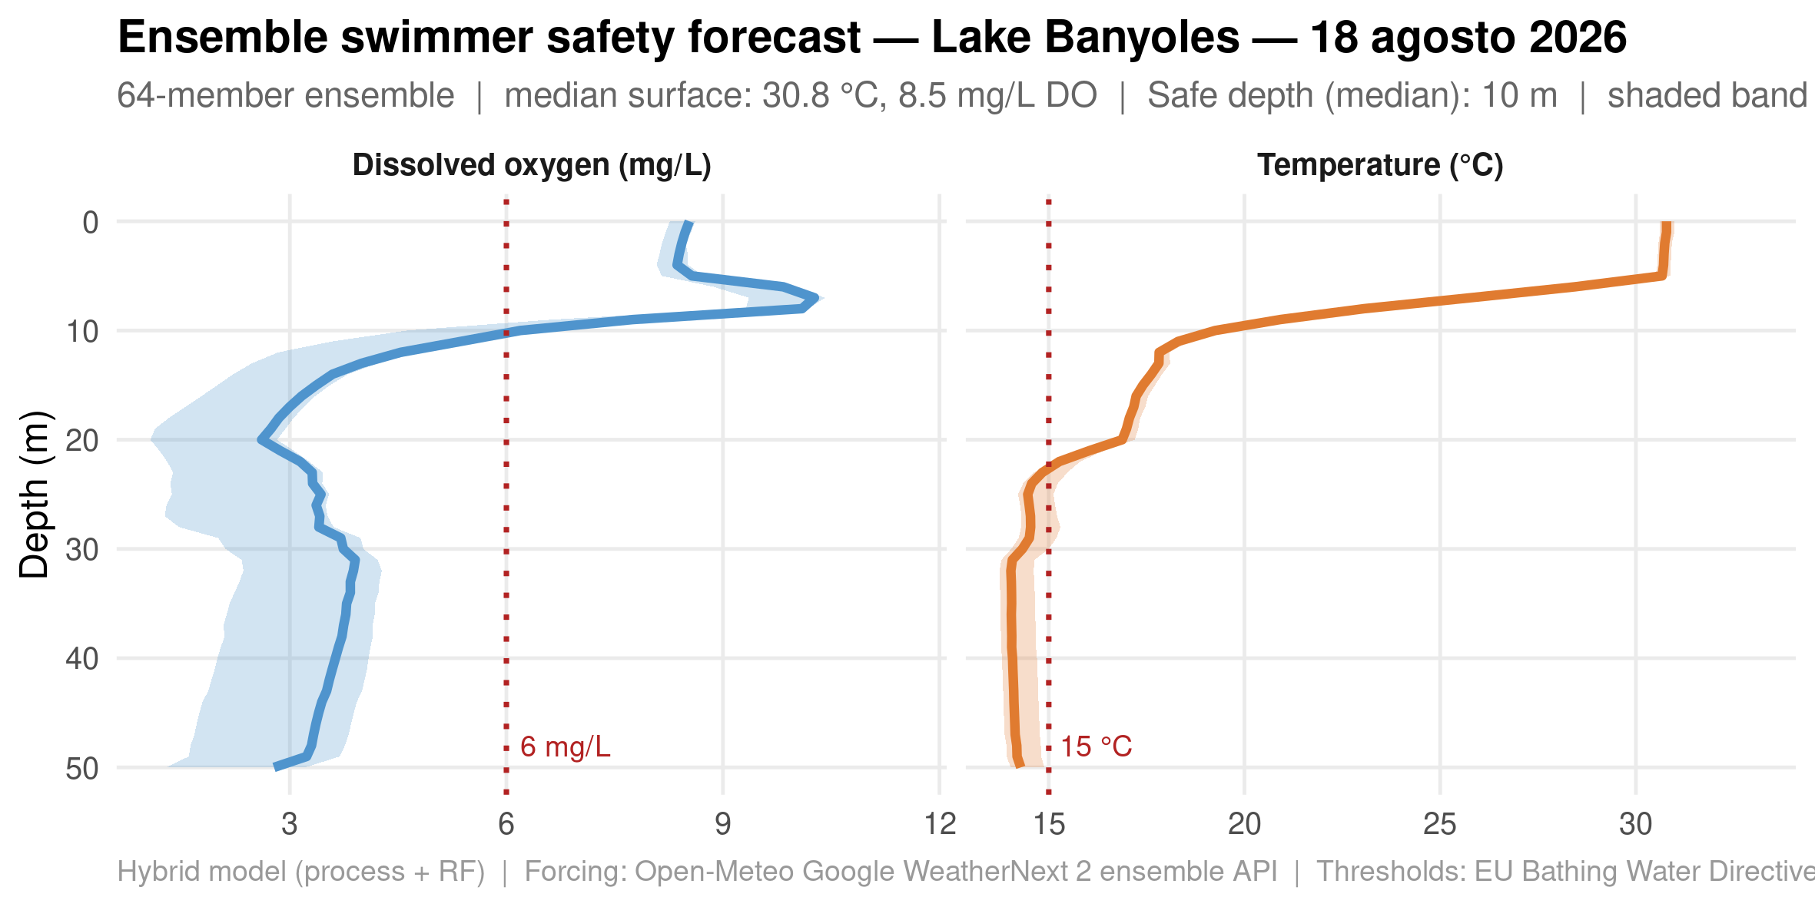
BONUS · 06_FORECAST_TOMORROW.R
Ensemble forecast — median & 10-90% range
Driven live by Google WeatherNext 2's 64-member ensemble — no boat required.
GLEON Banyoles 2026 | Hybrid Lake Modelling
Notes:
Run this live if time allows -- it hits the Open-Meteo ensemble API for tomorrow's forecast, runs all 64 WeatherNext members through the process + hybrid pipeline, and shows the median with a shaded 10-90% spread. Great closing demo: this is the payoff promised on slide 1, now honest about uncertainty.

Slide 39
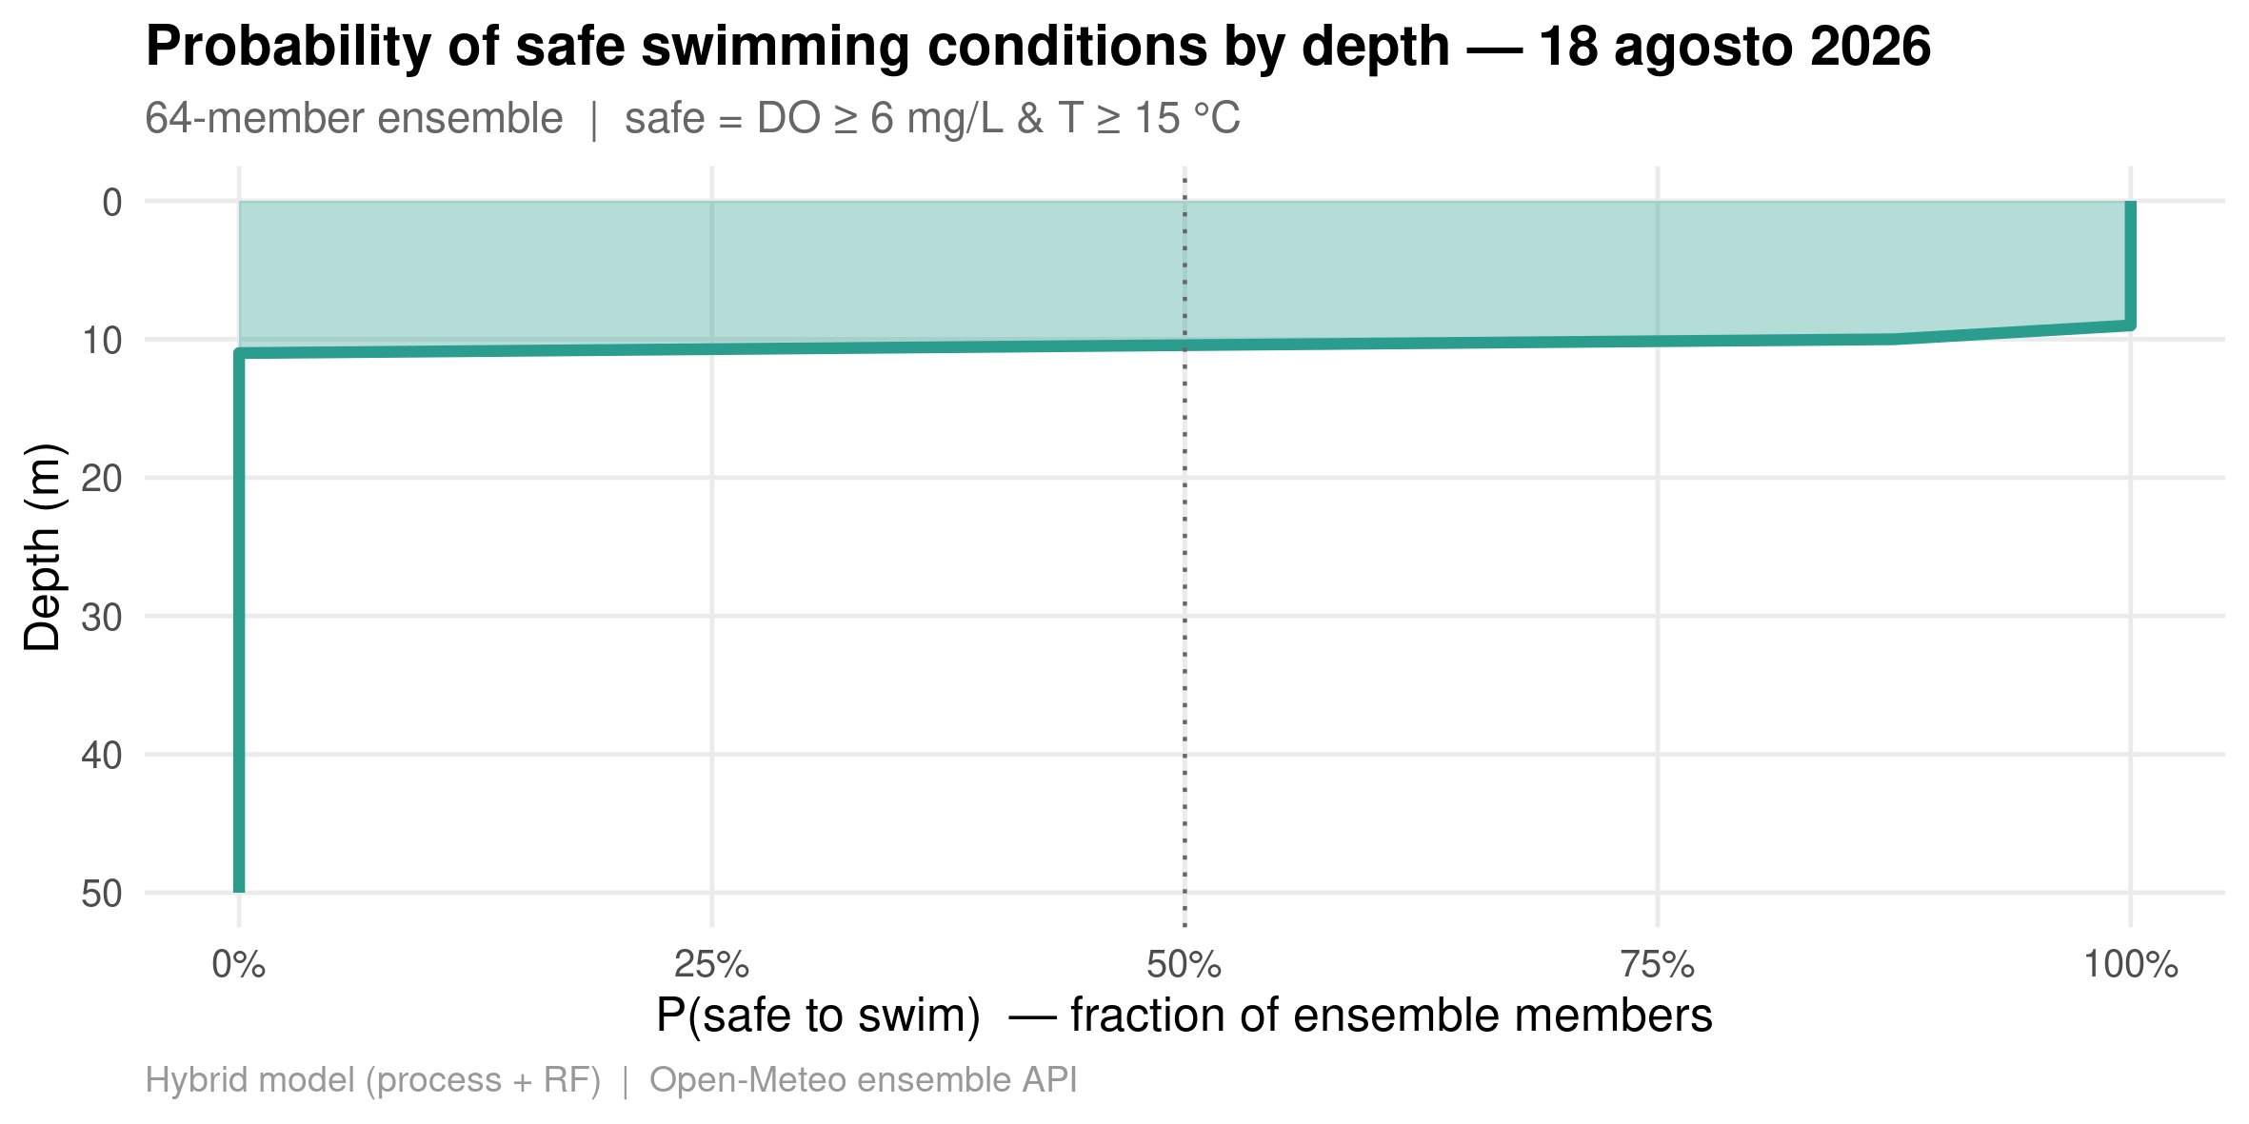
BONUS · 06_FORECAST_TOMORROW.R
Probability of safe swimming, by depth
The fraction of ensemble members classifying each depth as safe.
GLEON Banyoles 2026 | Hybrid Lake Modelling
Notes:
This is the genuinely new payoff of the ensemble: not just 'is it safe' but 'how confident are we'. Ask: how would you communicate a 60% probability of safe conditions to the public, versus a single yes/no forecast?

Slide 40
BONUS
Independent validation
A genuine out-of-sample test: citizen-science data from a nearby site
File: 07_validate_vilar.R
~ as time allows

Slide 41
BONUS · 07_VALIDATE_VILAR.R
New data: the Vilar temperature soundings
• Citizen-science monitoring shared by Josep Pascual (meteolestartit.cat) — thank you, Josep!
• 62 campaigns, 2023–2026, temperature at 4 sampling points (A, B, C, D)
• Site A's deep-water plateau (~12.3°C, 20–50 m) matches the ACA station almost exactly on the one directly-overlapping campaign
• → Site A becomes an independent validation set: 57 campaigns the hybrid model never saw during training (ACA training data is summer-only, 2007–2018)
• Sites B/C/D are a different, shallower, warmer sub-basin — not comparable to the ACA/process-model domain
GLEON Banyoles 2026 | Hybrid Lake Modelling
Notes:
This is a live example of finding and vetting an external dataset: we matched site A to the ACA station by comparing the deep-water plateau temperature on the one day both were sampled a day apart.

Slide 42
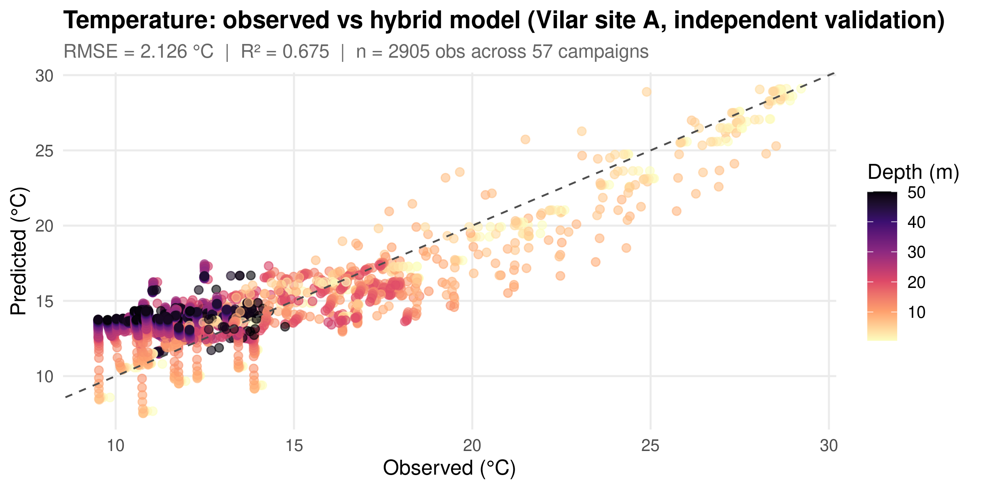
BONUS · 07_VALIDATE_VILAR.R
Observed vs. predicted — Vilar site A
2,905 depth observations across 57 independent campaigns.
GLEON Banyoles 2026 | Hybrid Lake Modelling
Notes:
Look at the deep, dark points (20-50 m): the hybrid model is systematically too warm at depth on this new site.

Slide 43
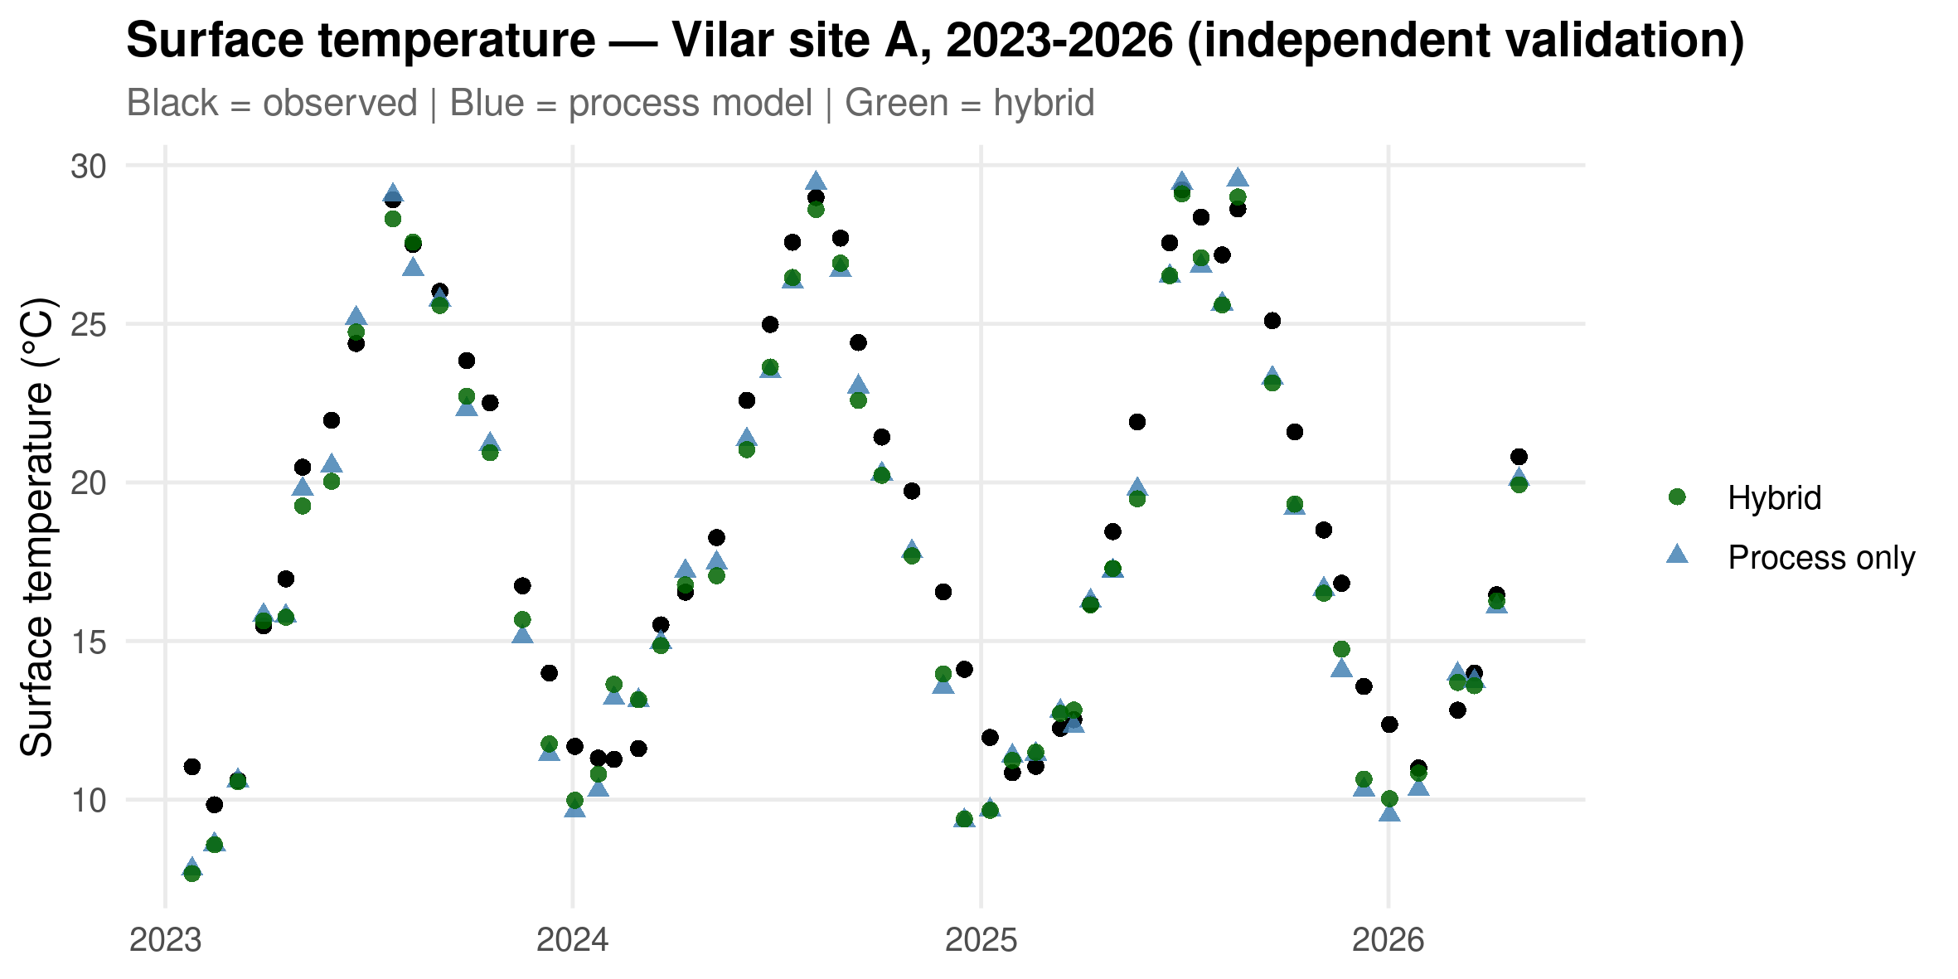
BONUS · 07_VALIDATE_VILAR.R
Surface temperature — Vilar site A, 2023–2026
Black = observed | Blue = process model | Green = hybrid.
GLEON Banyoles 2026 | Hybrid Lake Modelling
Notes:
Surface tracks well across all four years -- the divergence is concentrated at depth, which is what the next slide quantifies.

Slide 44
BONUS · KEY FINDING
The hybrid model does NOT win here
 | Process-only | Hybrid
RMSE (°C) | 1.70 | 2.13
R² | 0.79 | 0.68
Bias (°C) | +0.09 | +1.01
GLEON Banyoles 2026 | Hybrid Lake Modelling
Notes:
On this independent site, the process-only model beats the hybrid model. The +1C warm bias shows up in BOTH summer and winter subsets, so it isn't just seasonal extrapolation -- the random forest learned residual patterns specific to the single ACA sensor/site (calibration quirks, exact timing of that station's karstic intrusion) that don't transfer even to a physically similar site a few hundred metres away. This is a genuine, unplanned result -- not scripted for the workshop.

Slide 45
THE HONEST TALK
We did many things wrong, but we learned some things.
In a typical workshop, everything works perfectly.
Not in this one.
Notes:
This slide sets up the closing lessons-learned slide. Own the imperfection -- it's more useful pedagogically than a clean demo.

Slide 46
LESSONS LEARNED
What we got wrong — and why it matters
• We are probably swimming in point C, not A — but we don't have enough ACA data at C to confirm it properly
• The DO validation is weak: too little recent data to tell if the ML model is overfitting, or genuinely being tested on a different regime
• Taking independent data from the same lake and running it through 07_validate_vilar.R showed the ML correction is deficient — it likely overfits to the single training site and does not generalise
• → For this system, right now, trust the process-based model over the ML correction when extrapolating to a new site or season
• This is the real value of hybrid modelling: it doesn't just make better predictions, it tells you WHERE to be careful
GLEON Banyoles 2026 | Hybrid Lake Modelling
Notes:
This is the most important slide in the deck. The finding that the process-only model generalises better than the hybrid model is not a failure of the workshop -- it's the workshop's best lesson. A hybrid model is only trustworthy as far as its validation data reaches.

Slide 47
ACKNOWLEDGMENTS
Data & thanks
• Agència Catalana de l'Aigua (ACA) — station 0450401, Lake Banyoles holomictic basin, 2007–2026
• Open-Meteo — ERA5 daily meteorological reanalysis, 2007–2026
• Josep Pascual, meteolestartit.cat — Banyoles / Estanyol del Vilar temperature soundings, 2023–2026. Many thanks for generously sharing this citizen-science dataset with the workshop.
GLEON Banyoles 2026 | Hybrid Lake Modelling
Notes:
Give this its own moment -- Josep's data materially improved the workshop by giving us a genuine independent validation set.

Slide 48
TAKE-HOME MESSAGE
“A bad process model produces bad residuals for ML to learn.
A good process model leaves small, structured residuals
that ML can fix.”
The residual is your research question in disguise.
Notes:
Close on this. Then open the floor: what process model would better represent YOUR lake?

Slide 49
Thank you
Daniel Mercado-Bettín · CEAB-CSIC
github.com/danielmerbet/gleon2026_modelling_workshop
Key references: Willard et al. (2022, SIAM Review) · Read et al. (2019, WRR) · Casamitjana & Roget (1993, L&O)
Notes:
Leave contact info up during Q&A.

