Slide 1
C++ Training (The Mediums)
Daniel Medina

Slide 2
Whats next?
General theory aimed to real use when coding
C++ general exercise aimed to clarity and techniques that can be use in VP and PPC development

Slide 3
Topic Index
Don’t pessimize prematurely and optimize prematurely
Objects and operators
Containers
Memory management
Strings vs char arrays
Interfaces
Std
Error handler

Slide 4
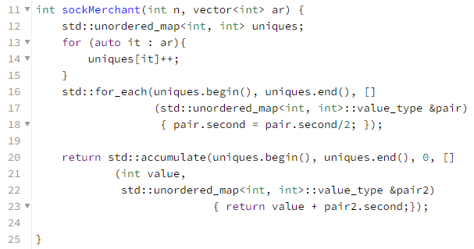
1rst round
Pairs:
Count the number of pairs from each unique number
Int PairsCounter(std::vector<int>&)

Slide 5
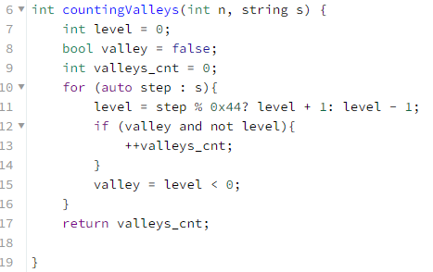
1rst round
Valleys:
From level 0, detect level going down and up to level 0 again.
Int ValleysCounter(std::string&) //’D’ = 1 level down; ‘U’ = 1 level up

Slide 6
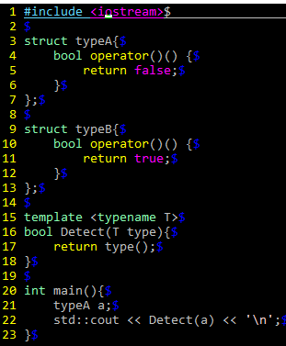
1rst round
Types
Port the following code to types
enum Type { typeA, typeB }; bool detect( Type type){ switch(type){ case typeA: return false; case typeB: return true; default: //error handler }; }
Notes:
Main becomes the customer code
Rest, is the backed code

Slide 7
FrontEnd and BackEnd in your own code
unordered_map<int, int> uniques;
Class Obj {
vector<int> _ar;
public:
Obj(vector<int>& ar) : _ar(ar) {}
void run() { do_uniques(_ar); }
void do_uniques(vector<int>& ar) {
for (auto it : ar){
uniques[it]++;
}
int result(unordered_map<int, int>& myUniques){
return accumulate(MyUniques.begin(), MyUniques.end(), 0, []
(int value,
unordered_map<int, int>::value_type &pair2)
{ return value + pair2.second;});
};
Int main () {
Obj obj{1,2,3,4,4,5,6,7,6};
obj.run(); for_each(uniques.begin(), uniques.end(), []
(std::unordered_map<int, int>::value_type &pair)
{ pair.second = pair.second/2; });
cout << obj.result(uniques) << ‘\n’;
}
Namespace xtor {
unordered_map<int, int> GenerateUniquesCounter(vector<int> ar) {
std::unordered_map<int, int> uniques;
for (auto it : ar){
uniques[it]++;
}
return uniques;
}
void TransformIntoPairsCounter(unordered_map<int, int>& uniques) {
for_each(uniques.begin(), uniques.end(), []
(unordered_map<int, int>::value_type &pair)
{ pair.second = pair.second/2; });
}}
TransformIntoPairsCounter(unordered_map<int, int>& uniques) {
return std::accumulate(uniques.begin(), uniques.end(), 0, []
(int value,
std::unordered_map<int, int>::value_type &pair2)
{ return value + pair2.second;});
}
};
Int main () {
auto uniquesCnt = xtor::GenerateUniquesCounter((1,2,3,4,4,5,6,7,6});
xtor::TransformIntoPairsCounter(uniquesCnt);
cout << xtor::CountPairs(uniquesCnt) << ‘\n’;
}

Slide 8
Don’t pessimize prematurely and don’t optimize prematurely
Optimize prematurely
Golden 2 Rules for optimizations:
1.- Don’t
2.- (For experts) Not yet
Void doAll() { int a = 0; for (…);
// crazy algorithm for(….) for(….) int b = getfoo(); int c = a *b * c; // crazy logic int x = a >> 2 + 2 * 5 / 0 >>7; if (x) { return; } …
Inline foo(); class A { inline void foo1(); };
Int global_int = 0; int* global_ptr = something;
MyType global_type
Void Foo(){ if (global_int) run(); if (global_ptr) global_int = global_ptr();
global_type.run();
foo1();
}
Void foo1(){
global_type.run2(); }
Notes:
-Profilers are good to recommend which functions are more often called to inline them. But cannot tell which ones should not be inlined. And really inline does not really matters to your compiler
Avoid execution branches in the name of optimization
When time for optimization comes. Look for algorithm optimization rather than micro optimizations

Slide 9
Don’t pessimize prematurely and don’t optimize prematurely
Pessimize prematurely
Int a = 0;
Int b = a++;
Int c = ++a;
Int a; for (a = 0; a != 10; ++a); for (int a = 0; a != 10; ++a);
Void foo(int);
Void foo(int&); void foo(const int& );
Void foo(myType);
Void foo(myType&); void foo(const myType& );
Int sum = 0;
For (int a = 0; a != container.size(); ++a){ sum = sum + container[a];
}
Const Int sum = std::accumulate(container.begin(), container.end(), 0);

Slide 10
Don’t pessimize prematurely and don’t optimize prematurely
RESUMEN:
It is far, far easier to make a correct program fast.
Than is to make a fast program correct

Slide 11
2nd round
// A tricky and fun one
// White down a code that prints Hello World without any “;”
Int main() {
if (cout << “Hello World”) { }
}

Slide 12
2nd round
CleanUp code exercise

Slide 13
2nd round
Write a hierarchy object with a API with the following characteristics:
API1:
Has a default pre and pos print statement (“begin” “end”) for all possible deriver classes.
Deriver class might or might not add a print within this API1 “API1 <deriver class name>”
Can you imagine for what this idiom for?
Notes:
NVI

Slide 14
Objects and operators
Treat clas designs as type designs
How should objects of your new type be created and destroyed?
What operators and functions make sense for the new type?
Who should have access to the members of your new type?
What does it mean for objects of your new type to be passed by value?
How general is your new type?
Is a new type really what you need?

Slide 15
Test
Define an object that cannot be instantiated more than once
Every time code instantiate the object, the object will return the first same instantiation
Notes:
Treat clas designs as type designs

Slide 16
Objects and operators
Constructor
Destructor
Copy Constructor
Copy assignator
Move constructor (c++11)
Notes:
Examples when rule of 5 matters
An opcode class
A xtor class
When passing to functions
When pushing to standard containers

Slide 17
Access directives
Public
Private
Protected
Notes:
What for?

Slide 18
Containers
Sequence containers
Vector
Deque
List
Associative containers
Map
Set
Notes:
For what so many containers types?

Slide 19
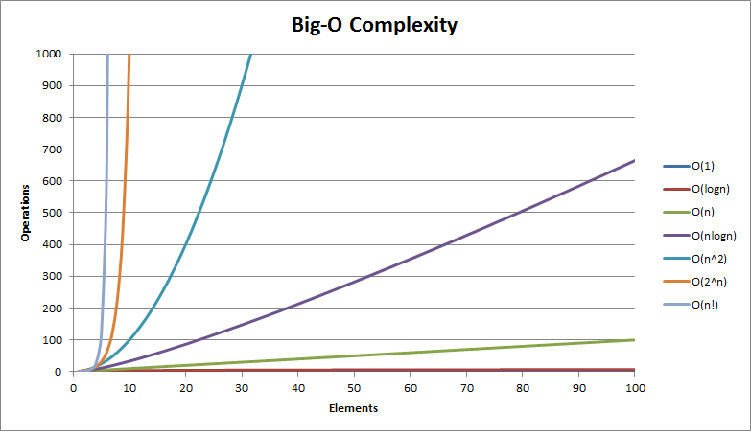
Containers (Big O)

Slide 20
Vector
The storage of the vector is handled automatically, being expanded and contracted as needed.
Vectors usually occupy more space than static arrays, because more memory is allocated to handle future growth.
Random access - constant O(1)
Insertion or removal of elements at the end - amortized constant O(1)
Insertion or removal of elements - linear in the distance to the end of the vector O(n)

Slide 21
Deque
indexed sequence container that allows fast insertion and deletion at both its beginning and its end.
Insertion and deletion at either end of a deque never invalidates pointers or references to the rest of the elements.
implementations use a sequence of individually allocated fixed-size arrays, with additional bookkeeping, which means indexed access to deque must perform two pointer dereferences
The storage of a deque is automatically expanded and contracted as needed
Random access - constant O(1)
Insertion or removal of elements at the end or beginning - constant O(1)
Insertion or removal of elements - linear O(n)
Notes:
As opposed to std::vector, the elements of a deque are not stored contiguously
Expansion of a deque is cheaper than the expansion of a std::vector because it does not involve copying of the existing elements to a new memory location. On the other hand, deques typically have large minimal memory cost

Slide 22
List
Container that supports constant time insertion and removal of elements from anywhere in the container.
Fast random access is not supported. It is usually implemented as a doubly-linked list.
Adding, removing and moving the elements within the list or across several lists does not invalidate the iterators or references. An iterator is invalidated only when the corresponding element is deleted.

Slide 23
Map-MultiMap

Slide 24
Set-MultiSet

Slide 25
Quiz
Input: Array of digits from 0-9 with length N
TODO: Print out the number of times each number get repeated in the input array
void printRepeatedNumbers(std::vector<int>& input)
Version 1: with standard containers
Version 2: without standard containers

Slide 26
Quiz 2
Given an array of unordered numbers with N array length as a input. Define the logic to arrange the data to provide a quick response to the following request from the standard input.
Request: 2 integers X and Y. The Logic should print the sequence of Y numbers from the array input, starting from X, only and only if X exist in the input array. From there, make sure X cannot be found and printed any more in following request.
If X is not found, do nothing.

Slide 27
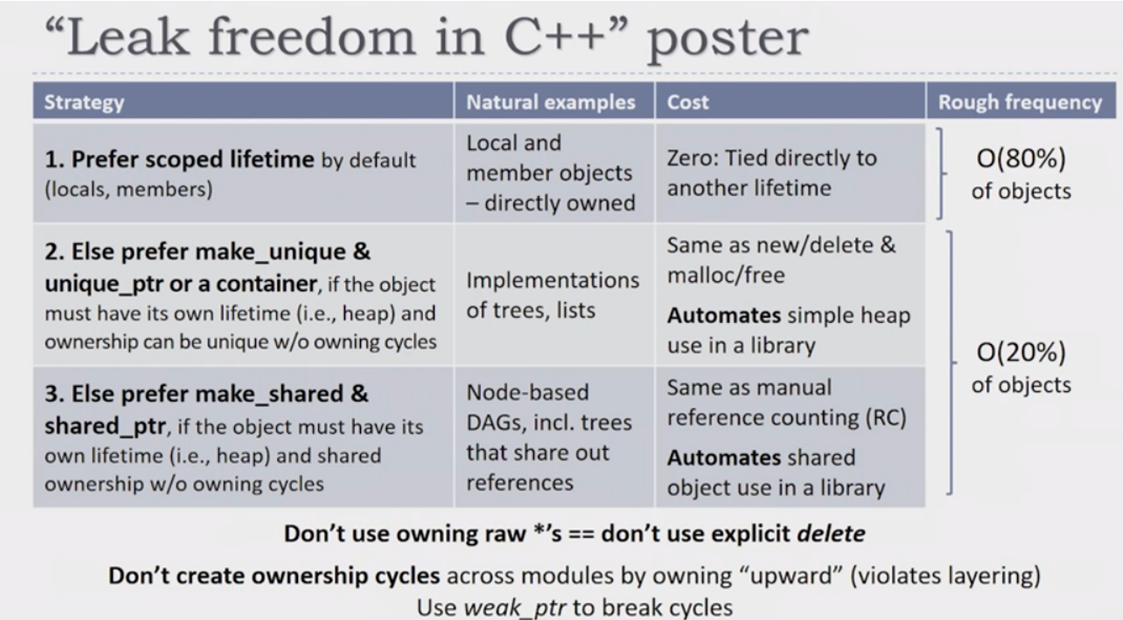
Memory management

Slide 28
Containers
Vector
Set
List
Map
Dequeue
array

Slide 29
Smart pointers
Unique_ptr
owns and manages another object through a pointer and disposes of that object when the unique_ptr goes out of scope.
Shared_ptr
retains shared ownership of an object through a pointer. Several shared_ptrobjects may own the same object. The object is destroyed and its memory deallocated when either of the following happens:
the last remaining shared_ptr owning the object is destroyed;
the last remaining shared_ptr owning the object is assigned another pointer via operator= or reset().
Weak_ptr
holds a non-owning ("weak") reference to an object that is managed by std::shared_ptr. It must be converted to std::shared_ptr in order to access the referenced object.
Auto_ptr

Slide 30
Test
Consider a transactor with the following packet fields:
ID, Addr, Data, Opcode
In order to keep track of the transactions in SW. Write a solution to create a packet object or return the existing one. And also with the ability to be asked for the existence of a particular packet
Shared_ptr<widget> make_widget (int id) { static map<int, weak_ptr<widget>> cache; static mutex mut_cache; lock_guard<mutex> hold(mut_cache); auto sp = cache[id].lock(); if (!sp) cache[id] = sp = load_widget(id); return sp; }

Slide 31
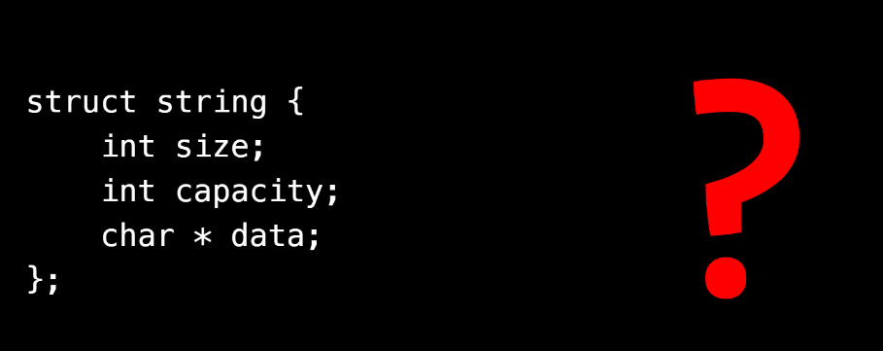
Std::string

Slide 32
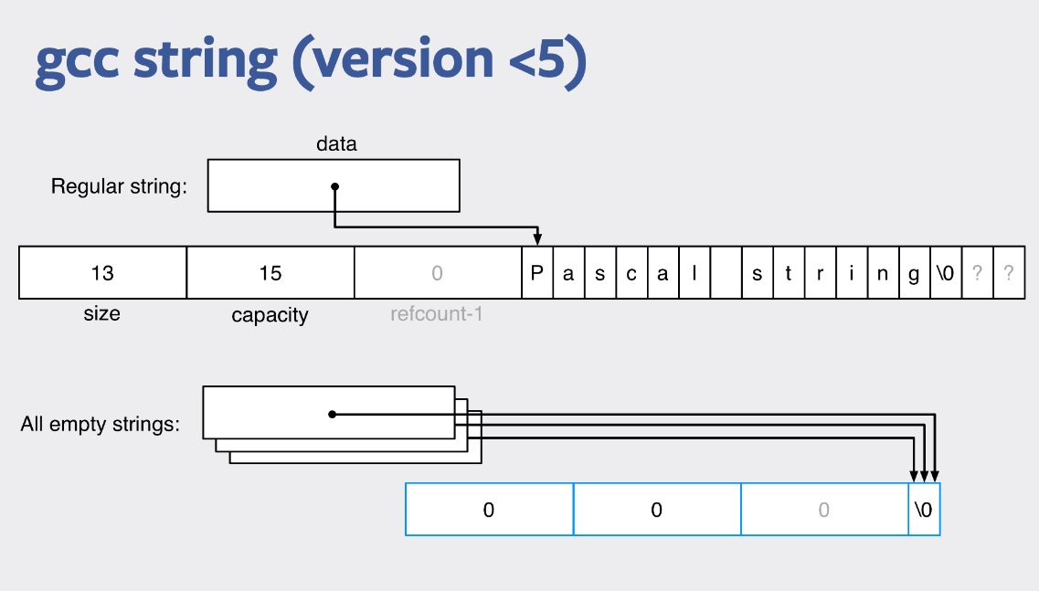

Slide 33
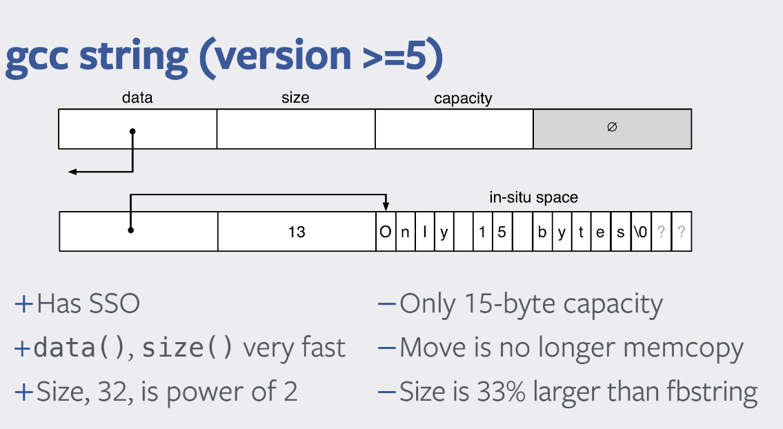

Slide 34
Std::strings
Std::string vs char arrays
Std::stringstream
Do not use std::endl
template< class CharT, class Traits > std::basic_ostream<CharT, Traits>& endl( std::basic_ostream<CharT, Traits>& os );
Don’t forget about std::puts

Slide 35
Test
Is string a palindrome?
Reverse a string with recursion
String intersection (what if they are lexicographical order)
Lexicographical compare of strings

Slide 36
Extra Test
From an 2D array ints. Identify the biggest group of adjacent numbers with the same value

Slide 37
STL algorithms

Slide 38
PERMUTATIONS

Slide 39
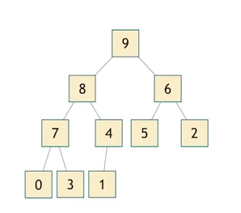
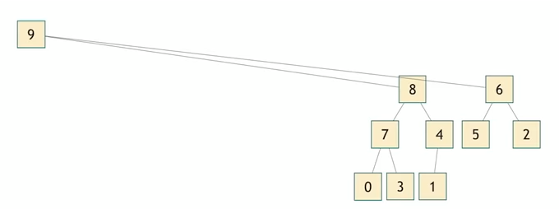
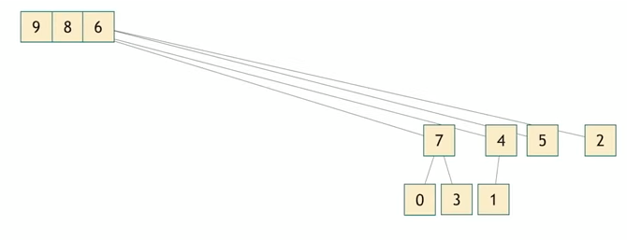

Heap

Slide 40

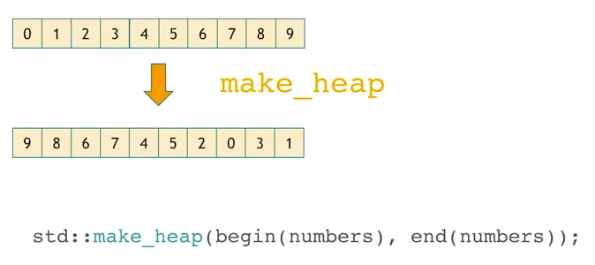
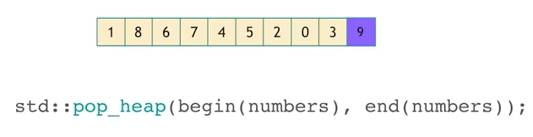
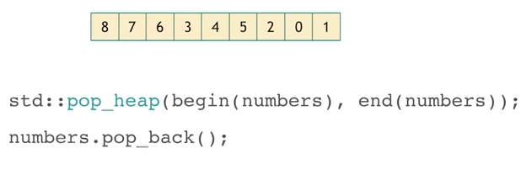

Heap
N std::pop_heap

Slide 41

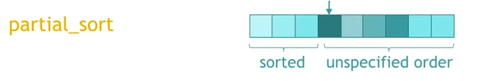
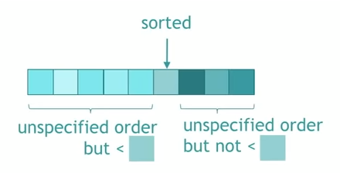

Sort

Slide 42


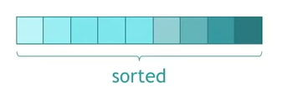
sort

Slide 43

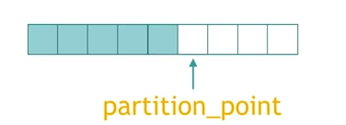
Partition

Slide 44



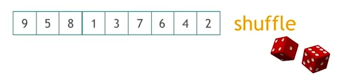
Other Permutations

Slide 45
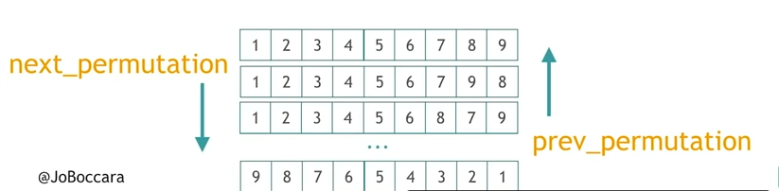


Other Permutation

Slide 46
COMBINE

Slide 47

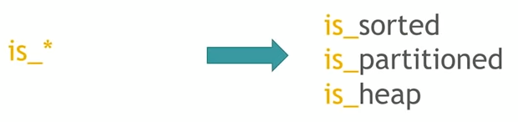
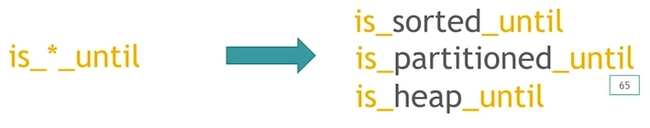
Partitioning-sort-heap

Slide 48

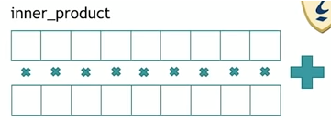
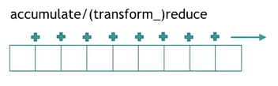
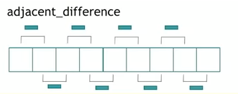
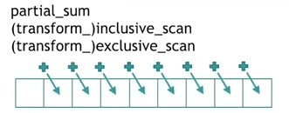
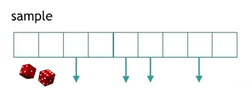
Numeric Algorithms

Slide 49



Querying A Property

Slide 50
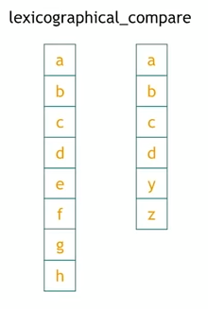
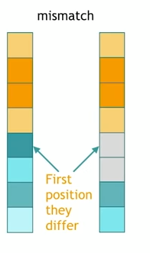
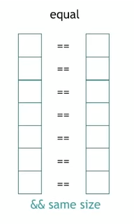

Querying A Property On 2 Ranges

Slide 51
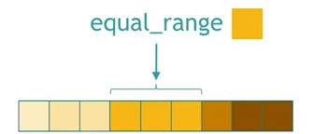
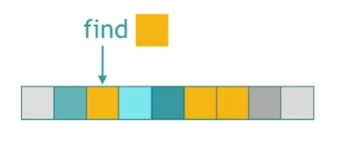
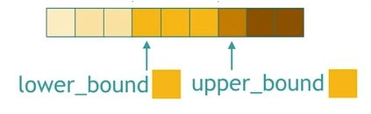
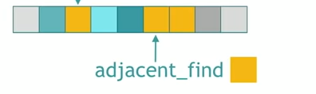

Searching A Value
Not Sorted
Sorted

Slide 52
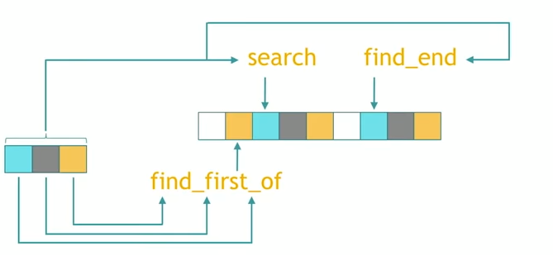
Searching A Range

Slide 53
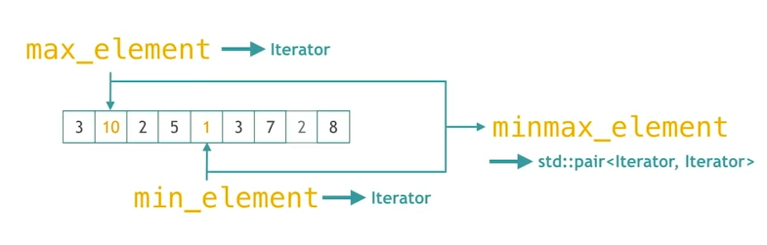
Searching A Relative Value

Slide 54

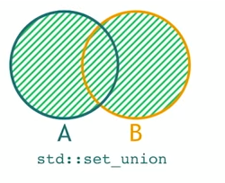

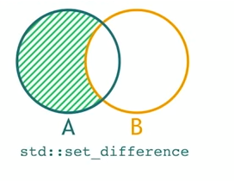
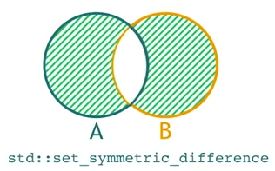
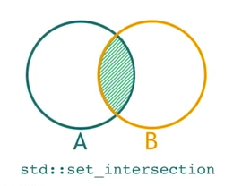

SET

Slide 55
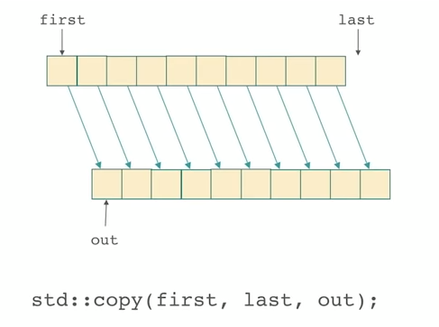
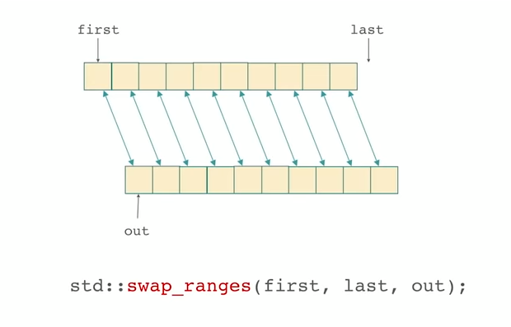
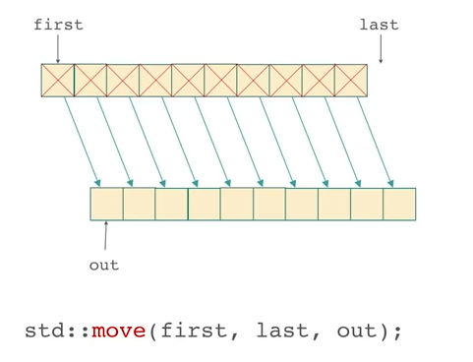
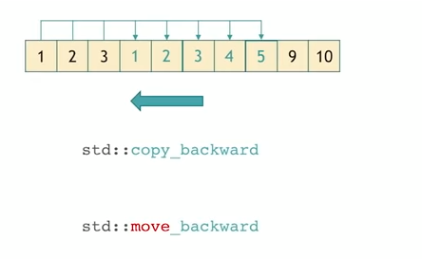
MOVES

Slide 56
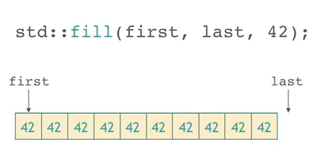
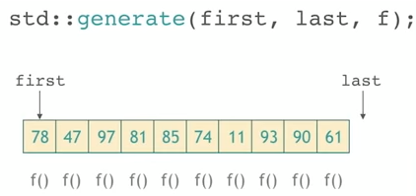
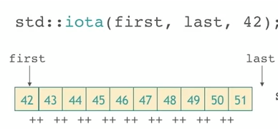

VALUE MODIFIERS

Slide 57
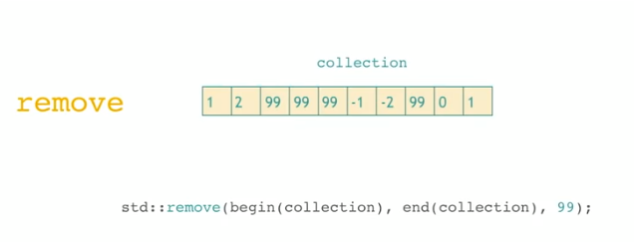
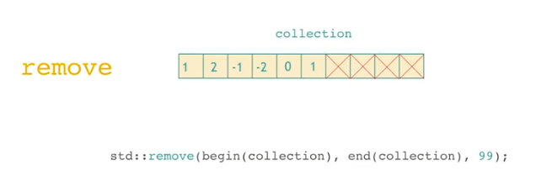
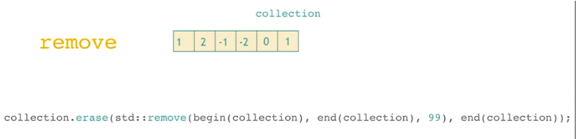
STRUCTURE CHANGES

Slide 58




Slide 59



Slide 60


FOR EACH & TRANSFORM

Slide 61


Slide 62


RAW MEMORY

Slide 63
HOMEWORK
Find out a loop algorithm in code, and think of a STL algorithm that can replace them
Go through STL algorithm and find out how they are implemented

