Slide 1


Daniel Hill
2025-06-21

Slide 2

Outline
Executive Summary
Introduction
Methodology
Results
Conclusion
Appendix

Slide 3
Executive Summary
Business Problem:
SpaceX advertises Falcon 9 rocket launches at $62 million while competitors cost upward of $165 million. Much of the savings comes from SpaceX's ability to reuse the first stage. If we can predict first stage landing success, we can determine launch costs and enable competitive bidding against SpaceX.
Key Methodologies Applied:
Data Collection: SpaceX REST API calls and web scraping
Data Wrangling: landing outcome classification and feature engineering
Exploritory Data Analysis: Visualization and SQL analysis
Interactive Analytics: Folium maps and Plotly dashboard
Predictive Modelling: Classification algorithms training and tuning
Summary of Results:
Identified key factors influencing landing success rates across launch sites
Built predictive models achieving 83% accuracy
Launch site location and payload mass used as predictive features
GitHub Repository: https://github.com/danielmh111/imb-ds-cert-capstone

Slide 4
Introduction
Project Background and Context:
SpaceX has revolutionized space launches through first stage reusablity, dramatically reducing costs compared to traditional disposable rocket stages. This is their key competative advantage
Poblems We Want to Find Answers To:
What factors determine first stage landing success?
Can we predict landing outcomes with high accuracy?
Which launch sites have the highest success rates?
How do payload characteristics affect landing probability?
What is the best model for cost prediction?
Business Impact:
Accurate landing predictions enable competitor cost modelling and strategic bidding decision in the commercial launch market.

Slide 5

Section 1

Slide 6
Methodology
Executive Summary
Data collection methodology:
  Combined SpaceX API integration with web scraping to create a dataset covering rocket specifications, launch sites, payloads, and outcomes
Perform data wrangling
  Transformed landing outcomes into binary class labels (1=success, 0=failure) and engineered features from categorical variables including launch site, booster version, and payload characteristics
Perform exploratory data analysis (EDA) using visualization and SQL
Perform interactive visual analytics using Folium and Plotly Dash
Perform predictive analysis using classification models
  Implemented and compared multiple classification algorithms (Logistic Regression, SVM, Decision Tree, KNN) with hyperparameter tuning and cross-validation to achieve optimal prediction accuracy

Slide 7
Data Collection
SpaceX REST API Integration:
Collected launch data using GET requests to SpaceX API endpoints
Retrieved rocket specifications, launch sites, payloads, and outcomes
Processed JSON responses into structured pandas DataFrames
Web Scraping Supplement:
Used BeautifulSoup for additional launch information
Extracted tabular data from SpaceX mission pages
Integrated scraped data with API results for comprehensive dataset

Slide 8
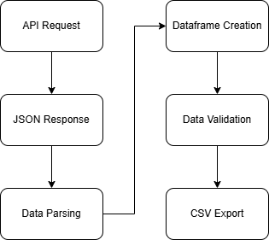
Data Collection – SpaceX API
Process Overview:
Used SpaceX Rest API to collect launch data
Extracted rocked specs, launch sites, payloads, and outcomes
Implemented data validation for quality checks
Key Data Points Collected:
Flight numbers and dates
Booster versions
Launch sites and coordinates
Payload mass and orbits
Landing outcomes
GitHub URL: https://github.com/danielmh111/imb-ds-cert-capstone/blob/main/spacex-data-collection-api.ipynb

Slide 9
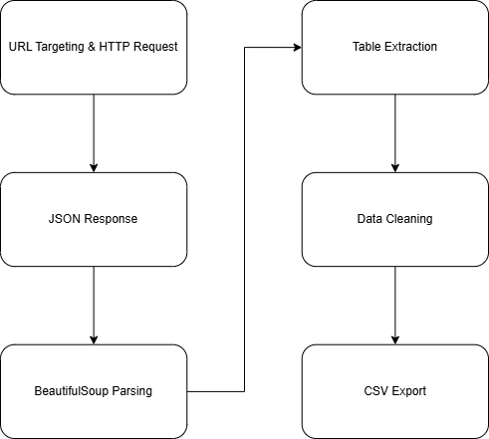
Data Collection - Scraping
Process Overview:
Augmented API data with additional launch information
Used beautifulsoup for html parsing
Implemented error handling and data cleaning
Key Data Points Collected:
Launch Dates
Booster Versions
Customers
Payloads
Landing Success
GitHub URL:
https://github.com/danielmh111/imb-ds-cert-capstone/blob/main/spacex-data-webscraping.ipynb

Slide 10
Data Wrangling
Approach:
Created binary classification target variable
Handled missing values in landing pad data (28.9% missing)
Engineered features from categorical variables
Standardized booster version classifications
Computed overall success rate: 66%
GitHub Reference: https://github.com/danielmh111/imb-ds-cert-capstone/blob/main/spacex-data-wrangling.ipynb

Slide 11
EDA with Data Visualization
Visualisations:
Scatter plots to the relationship between Flight Number and Launch Site and between Payload Mass and Launch Site
Bar chart for showing the success of each of each orbit
Line graph for showing launch success yearly trend
GitHub Reference: https://github.com/danielmh111/imb-ds-cert-capstone/blob/main/eda-viz.ipynb

Slide 12
EDA with SQL
Query Summary:
Unique Launch Sites:
  4 primary launch sites identified (CCAFS LC-40, VAFB SLC-4E, KSC LC-39A, CCAFS SLC-40)
CCAFS Launch Records:
  CCAFS sites handle majority of commercial and ISS missions
NASA CRS Payload Analysis:
  Total NASA CRS payload mass = 45,596 kg across multiple missions
Booster Version Performance:
  F9 v1.1 average payload capacity demonstrated incremental improvements

Slide 13
Build an Interactive Map with Folium
Map Objects Created:
Markers: Colour-coded markers for each launch site with custom labels showing site names
Circles: Highlighted areas around launch sites for geographic reference
Lines: Distance measurement lines connecting launch sites to nearby features
Marker Clusters: Grouped markers for better visualization when zoomed out
MousePosition Plugin: Interactive coordinate tracking for precise location identification
Why These Objects Were Added:
Success/Failure Markers: Enable quick visual identification of which launch sites have higher success rates
Proximity Lines: Reveal geographic advantages - all sites positioned near coastlines for safety, with varying distances to infrastructure
Distance Measurements: Support analysis of whether launch site location correlates with success rates based on proximity to transportation and population centers
GitHub Reference: https://github.com/danielmh111/imb-ds-cert-capstone/launch_site_locations.ipynb

Slide 14
Build a Dashboard with Plotly Dash
Plots and Interactions Added:
Dropdown Menu: Site selection filter (All Sites, CCAFS LC-40, etc.)
Pie Charts: Success distribution visualization that updates based on site selection
Range Slider: Payload mass filter (0-10,000 kg) with 1000 kg increments
Interactive Scatter Plot: Payload mass vs. launch success with booster version color coding
Why These Features Were Added:
Site-Specific Analysis: Dropdown enables comparison of individual launch site performance vs. aggregate performance
Payload Correlation: Scatter plot reveals payload ranges for mission success
Real-time Filtering: Combined interactions allow users to explore specific payload ranges at specific sites to identify performance patterns
Booster Evolution Tracking: Colour coding shows how different booster versions perform across payload ranges
GitHub Reference: https://github.com/danielmh111/imb-ds-cert-capstone/spacex-dash-app.py

Slide 15
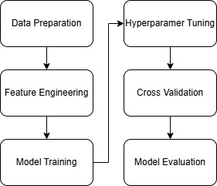
Predictive Analysis (Classification)
Process Summary:
Built: Four classification algorithms
Evaluated: 10-fold cross-validation for robust assessment
Improved: hyperparameter optimisation for each algorithm to maximize accuracy
Selected: Decision Tree as best performer (87.52% CV accuracy) despite identical test set performance
Key Process Steps:
Feature Engineering: Binary encoding of categorical variables
Data Splitting: 80/20 train-test split with stratification
Hyperparameter Tuning: Grid search across multiple parameter combinations
Performance Validation: Cross-validation to ensure model generalisability
Final Testing: Hold-out test set evaluation for unbiased performance assessment
GitHub Reference:
https://github.com/danielmh111/imb-ds-cert-capstone/SpaceX_Machine_Learning_Prediction_Part_5.ipynb

Slide 16
Results
Exploratory Data Analysis Results:
Launch Site Performance: KSC LC-39A achieved highest success rate (41.7%)
Payload Impact: Best performance in 3k-5k kg range; high failure rates above 6,000kg
Booster Evolution: Clear progression from experimental v1.0/v1.1 (high failure rates) to operational FT/B4/B5 (consistent success)
Interactive Analytics Demo Results:
Geographic Insights: All launch sites positioned near coastlines, Florida sites leverage Earth's rotation for orbital efficiency
Dashboard Discoveries: Payload mass and launch location shown as key factors for mission success
Performance Patterns: Site-specific analysis revealed VAFB optimized for polar orbits while Florida sites handle commercial/ISS missions
Predictive Analysis Results:
Model Accuracy: 83.33% prediction accuracy achieved across all four classification models
Business Impact: Perfect recall (100%) for successful landings ensures no missed cost-saving opportunities
Key Limitation: Small test dataset (18 samples) prevented meaningful model differentiation despite cross-validation differences

Slide 17

Section 2

Slide 18
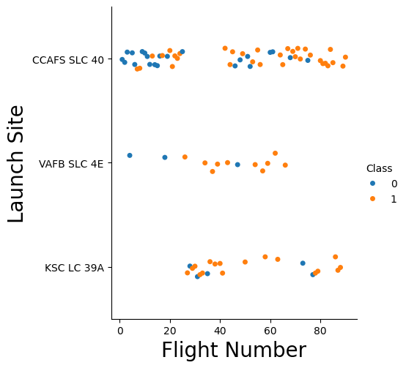
Flight Number vs. Launch Site
Show a scatter plot of Flight Number vs. Launch Site
Show the screenshot of the scatter plot with explanations

Slide 19
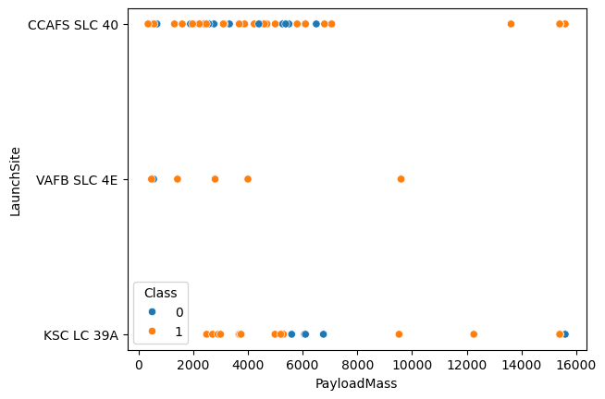
Payload vs. Launch Site
Show a scatter plot of Payload vs. Launch Site
Show the screenshot of the scatter plot with explanations

Slide 20
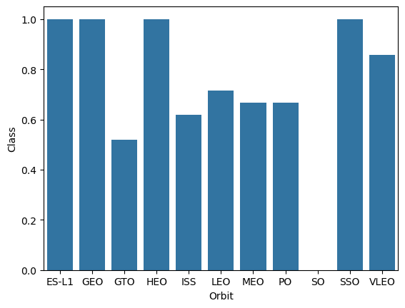
Success Rate vs. Orbit Type
Show a bar chart for the success rate of each orbit type
Show the screenshot of the scatter plot with explanations

Slide 21
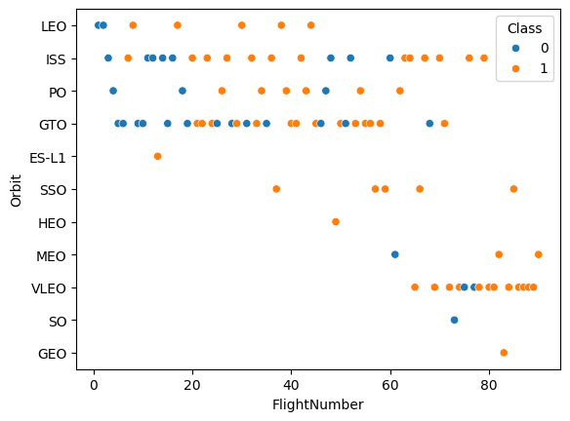
Flight Number vs. Orbit Type
Show a scatter point of Flight number vs. Orbit type
Show the screenshot of the scatter plot with explanations

Slide 22
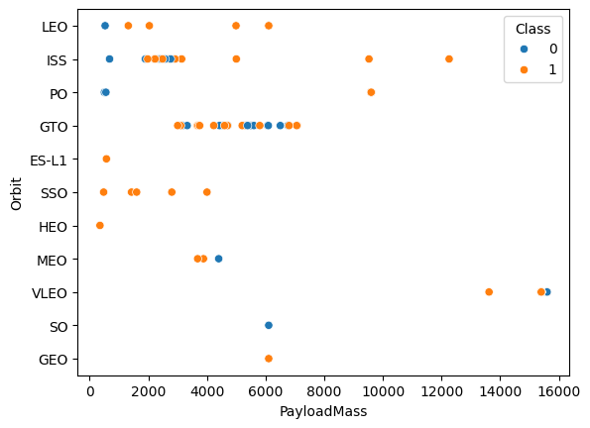
Payload vs. Orbit Type
Show a scatter point of payload vs. orbit type
Show the screenshot of the scatter plot with explanations

Slide 23
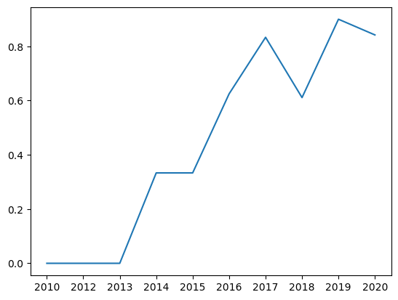
Launch Success Yearly Trend
Show a line chart of yearly average success rate
Show the screenshot of the scatter plot with explanations

Slide 24
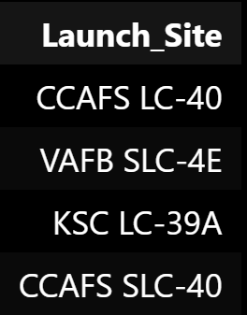
All Launch Site Names
Four primary launch sites identified: CCAFS LC-40, VAFB SLC-4E, KSC LC-39A, and CCAFS SLC-40.
Geographic distribution reveals strategic positioning - Florida sites (CCAFS/KSC) leverage Earth's eastward rotation for efficient orbit insertion, while California site (VAFB) enables polar and sun-synchronous orbits. This site diversity provides SpaceX operational flexibility across mission types.

Slide 25
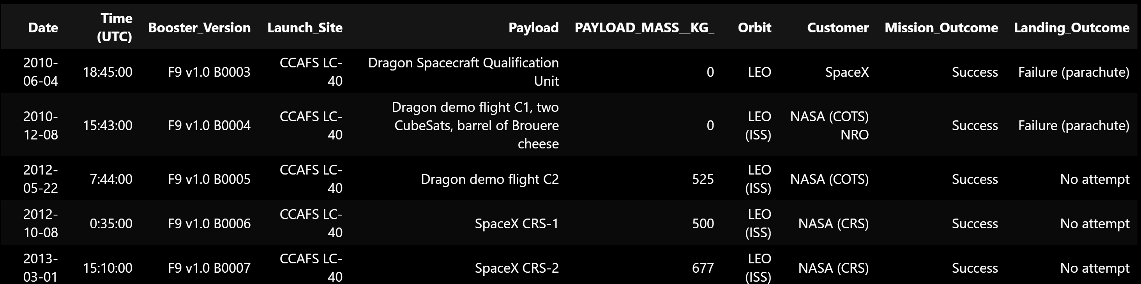
Launch Site Names Begin with 'CCA'
Cape Canaveral Air Force Station (CCAFS) operates two launch complexes: LC-40 and SLC-40, handling multiple mission types from commercial satellites to ISS resupply.

Slide 26
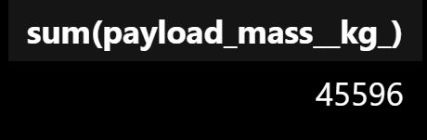
Total Payload Mass
NASA CRS (Commercial Resupply Services) missions delivered 45,596 kg total payload mass across multiple flights. This represents significant NASA partnership value.

Slide 27
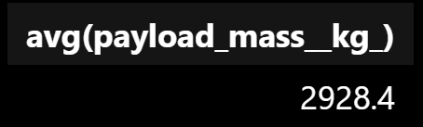
Average Payload Mass by F9 v1.1
Falcon 9 version 1.1 carried an average payload mass of 2928 kg, representing improved capability over earlier versions.

Slide 28

First Successful Ground Landing Date
22nd of December 2015 marked SpaceX's first successful Return-to-Launch-Site (RTLS) landing, a historic aerospace achievement.

Slide 29
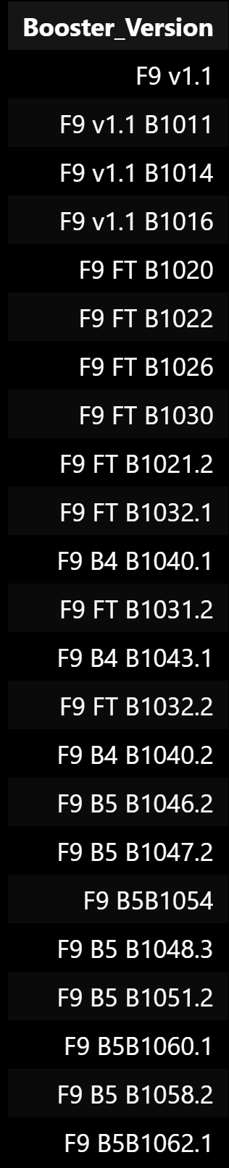
Successful Landing with Payload between 4k and 6k
Multiple boosters successfully completed drone ship landings within the 4000-6000kg payload range, including various Falcon 9 versions (v1.1, FT, B4, B5).
This range of payload masses is significant because it is a sweet spot for providing mission value and managing fuel for the landing.

Slide 30
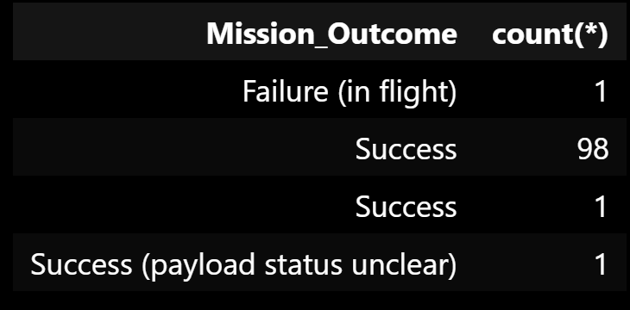
Total Number of Successful and Failure Mission Outcomes
Mission success rate of approximately 99%, demonstrating exceptional mission reliability.

Slide 31
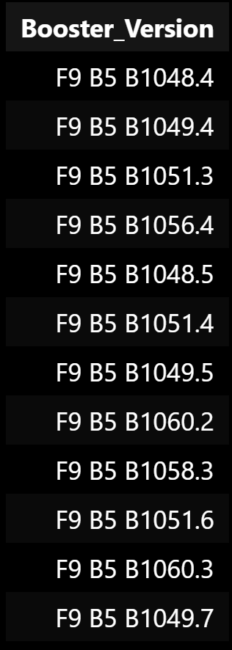
Boosters Carried Maximum Payload
Multiple Falcon 9 booster versions have carried the maximum payload value.

Slide 32
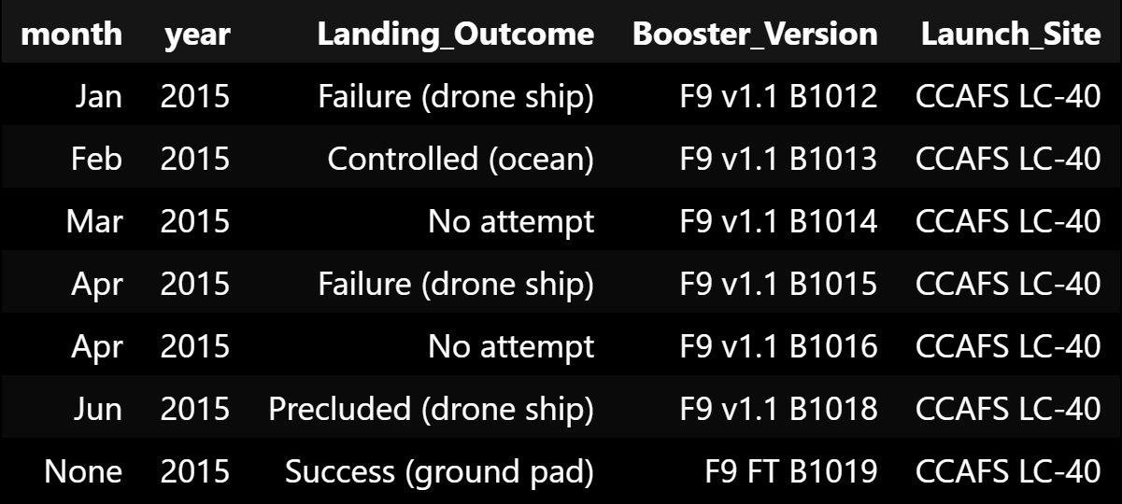
2015 Launch Records
2015 marked an important year with both breakthrough successes and significant failures, including first successful landings and the CRS-7 mission failure.

Slide 33
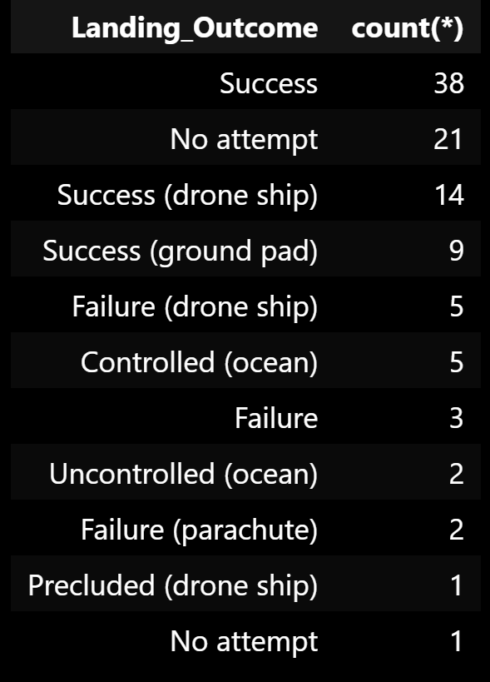
Rank Landing Outcomes Between 2010-06-04 and 2017-03-20
During this 7-year period: 38 general successes, 21 no attempts, 14 drone ship successes, 9 ground pad successes, with various failure modes totaling significantly fewer occurrences.
The data shows clear progression from "no attempt" landings in early years to successful recovery methods by 2017. This timeline reveals the development maturity curve, indicating when landing technology became reliable enough.

Slide 34

Section 3

Slide 35
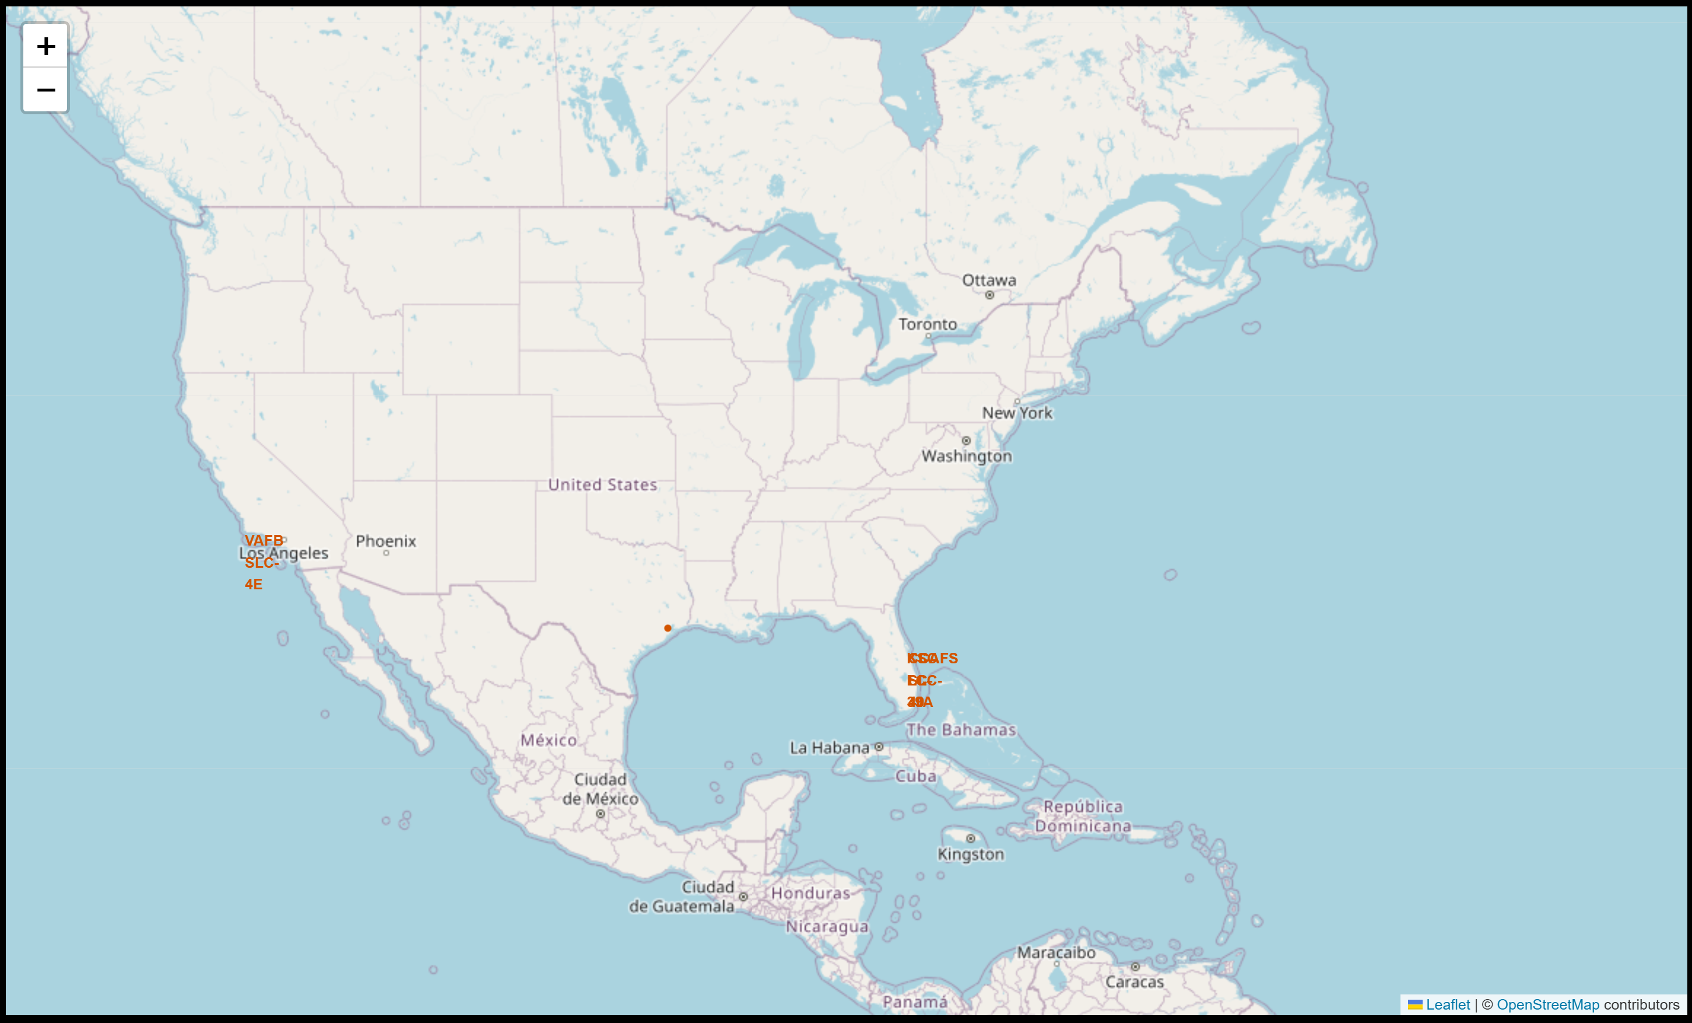
SpaceX Launch Sites - Strategic Geographic Distribution
This global map displays all four SpaceX launch sites with clear geographic positioning:
VAFB SLC-4E (California, West coast)
CCAFS LC-40 and KSC LC-39A (Florida, East Coast)
CCAFS SLC-40 (Florida, East Coast)
Key Geographic Advantages:
All sites positioned near coastlines for safety
Florida sites leverage Earth's rotation for efficient orbits
VAFB enables polar/sun-synchronous missions - Multiple Florida sites provide operational flexibility

Slide 36
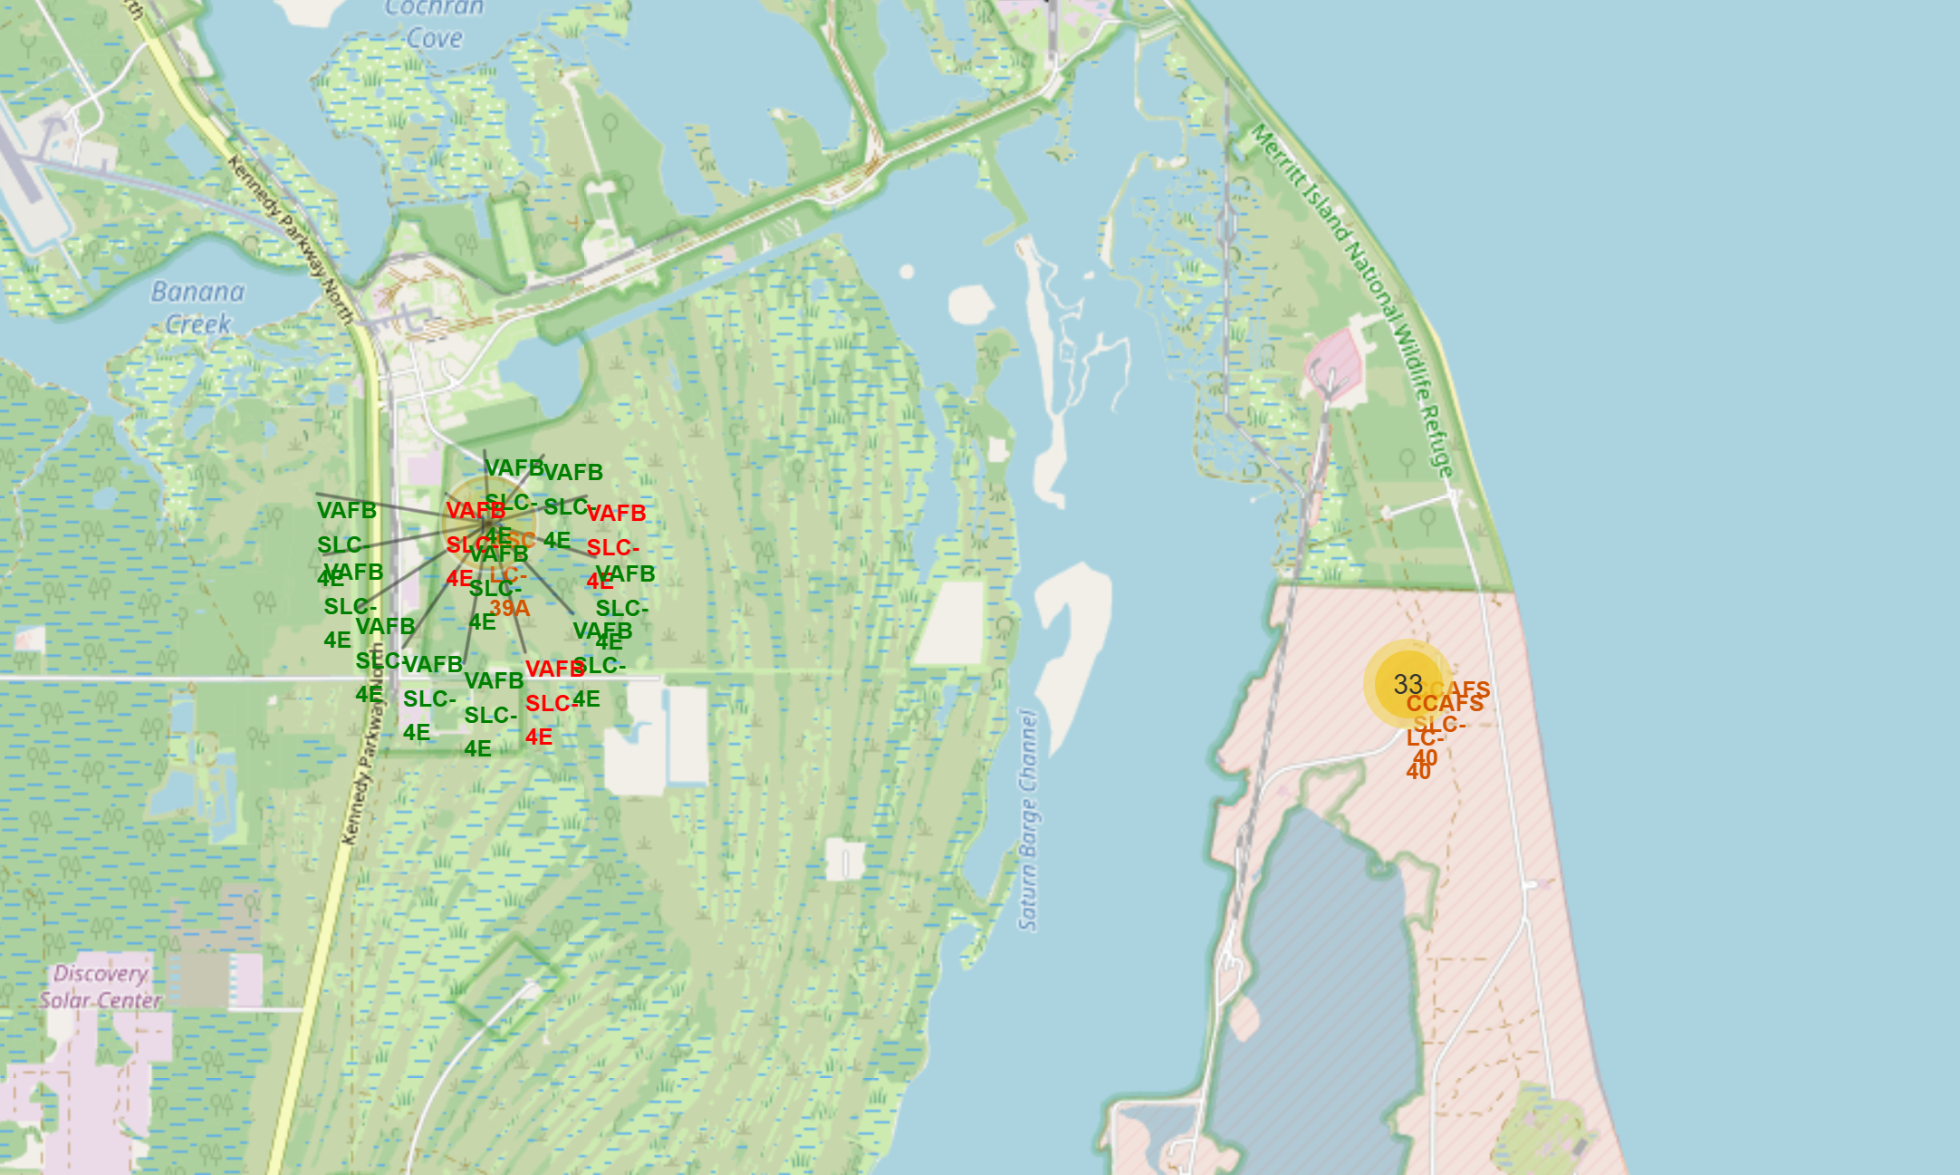
SpaceX Launch Outcomes - Colour-coded Success Analysis
Colour Coding System: Green markers indicate successful launches, while red markers indicate failed launches
Marker Clustering: The map uses marker clusters to manage overlapping launch markers at the same coordinates
Success Rate Patterns:
  KSC LC-39A shows predominantly green markers, indicating high success rates
  CCAFS sites show a mix of red and green markers, suggesting more varied outcome
Geographic Insights: The clustering reveals that most launches occur from the Florida sites, leveraging the eastward rotation advantage for equatorial and geostationary orbits

Slide 37
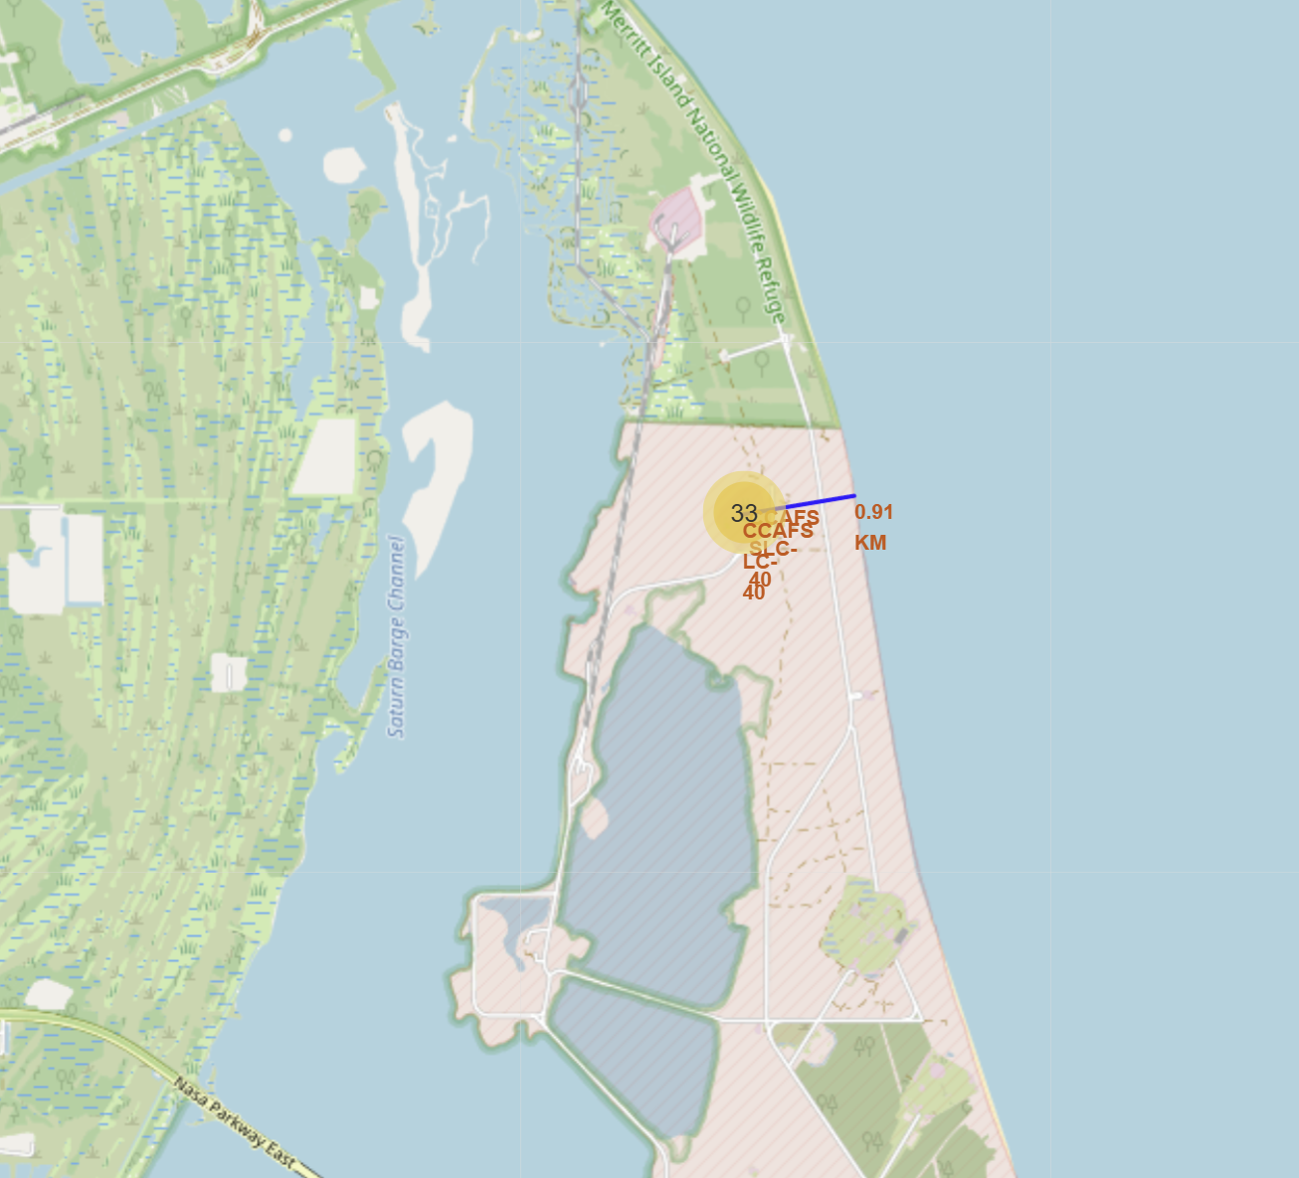
Launch Site Proximity Analysis
Coastline Proximity: All launch sites are positioned close to coastlines (typically < 1 km), ensuring failed launches fall into the ocean rather than populated areas
Distance Measurements: Using the haversine formula to calculate precise distances:
  Coastline: ~0.98 km (for CCAFS LC-40)
Safety Considerations:
  Launch sites maintain safe distances from populated areas
  Coastal positioning allows for safe failure scenarios
  Infrastructure proximity enables transport while maintaining safety buffers
Strategic Location Benefits: The proximity analysis reveals how SpaceX balances accessibility (near highways/railways for logistics) with safety requirements (coastal location, distance from cities)

Slide 38

Section 4

Slide 39
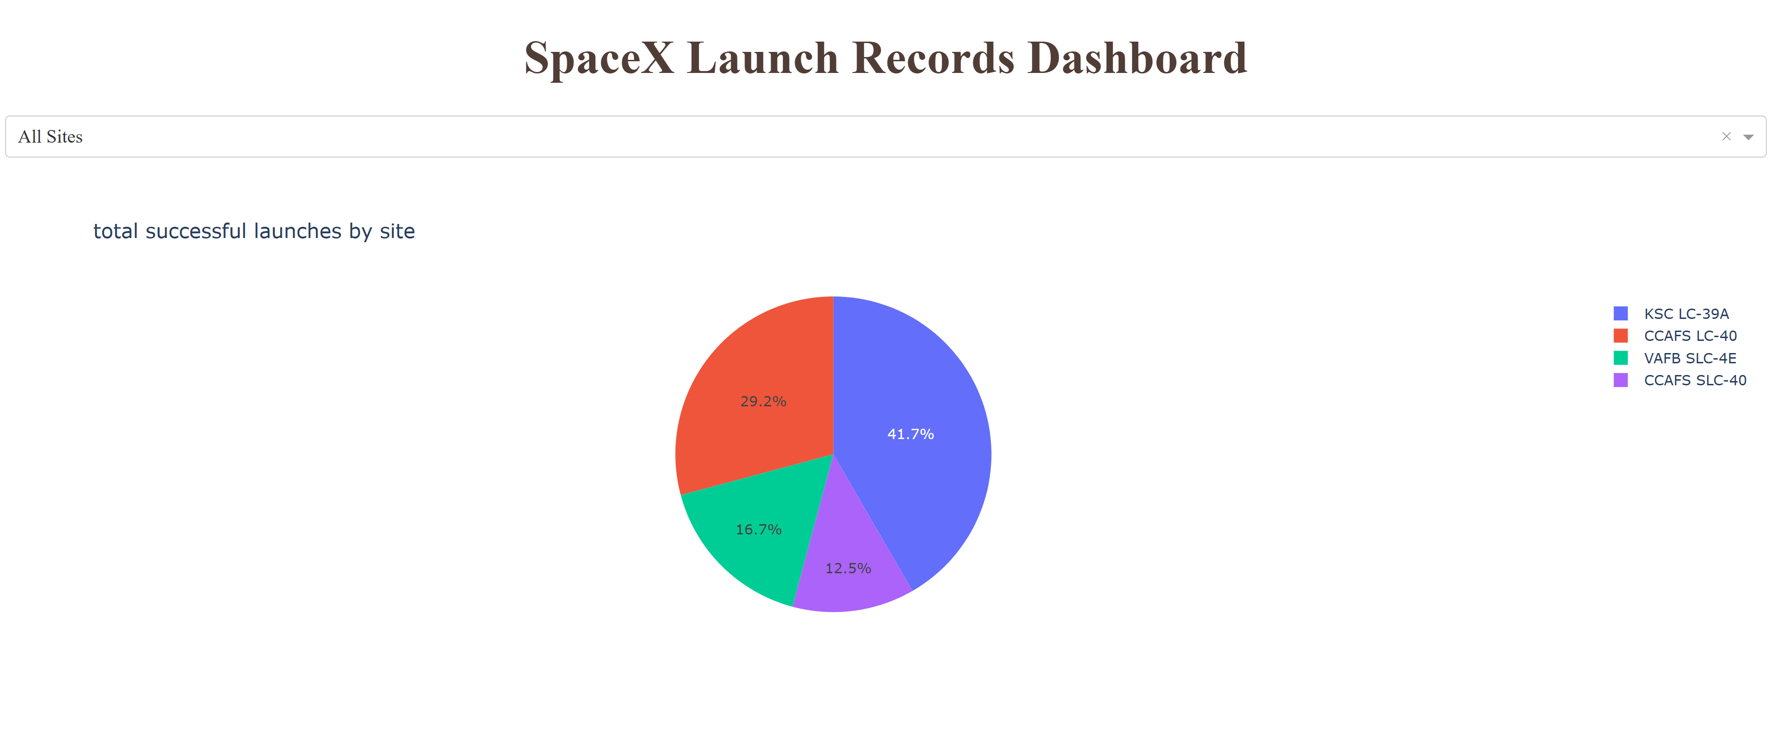
Launch Success Distribution Across SpaceX Launch Sites
Interactive pie chart displaying the distribution of total successful launches across all four SpaceX launch sites. KSC LC-39A demonstrates the highest success concentration at 41.7%, followed by CCAFS LC-40 at 29.2%. The visualization enables stakeholders to quickly identify which launch sites contribute most significantly to SpaceX's overall mission success rate, supporting site-specific performance analysis for predictive modeling.

Slide 40
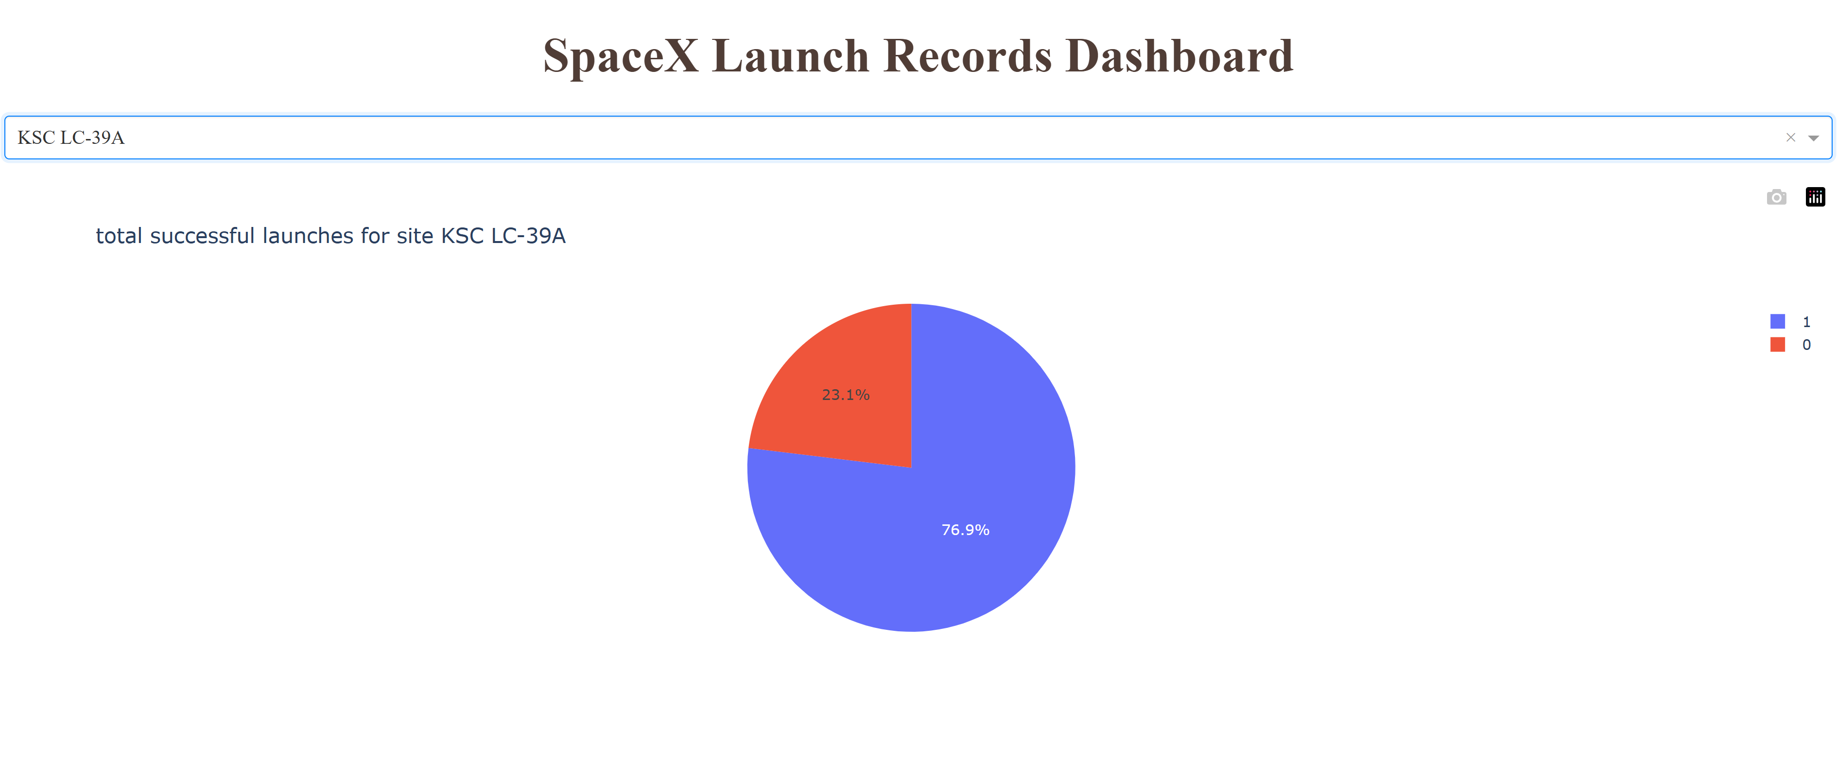
KSC LC-39A Launch Success Rate Analysis
Performance analysis for Kennedy Space Center Launch Complex 39A shows a 76.9% mission success rate, significantly exceeding the SpaceX fleet average of 66%. With only 23.1% mission failures, KSC LC-39A emerges as SpaceX's most reliable launch facility.

Slide 41
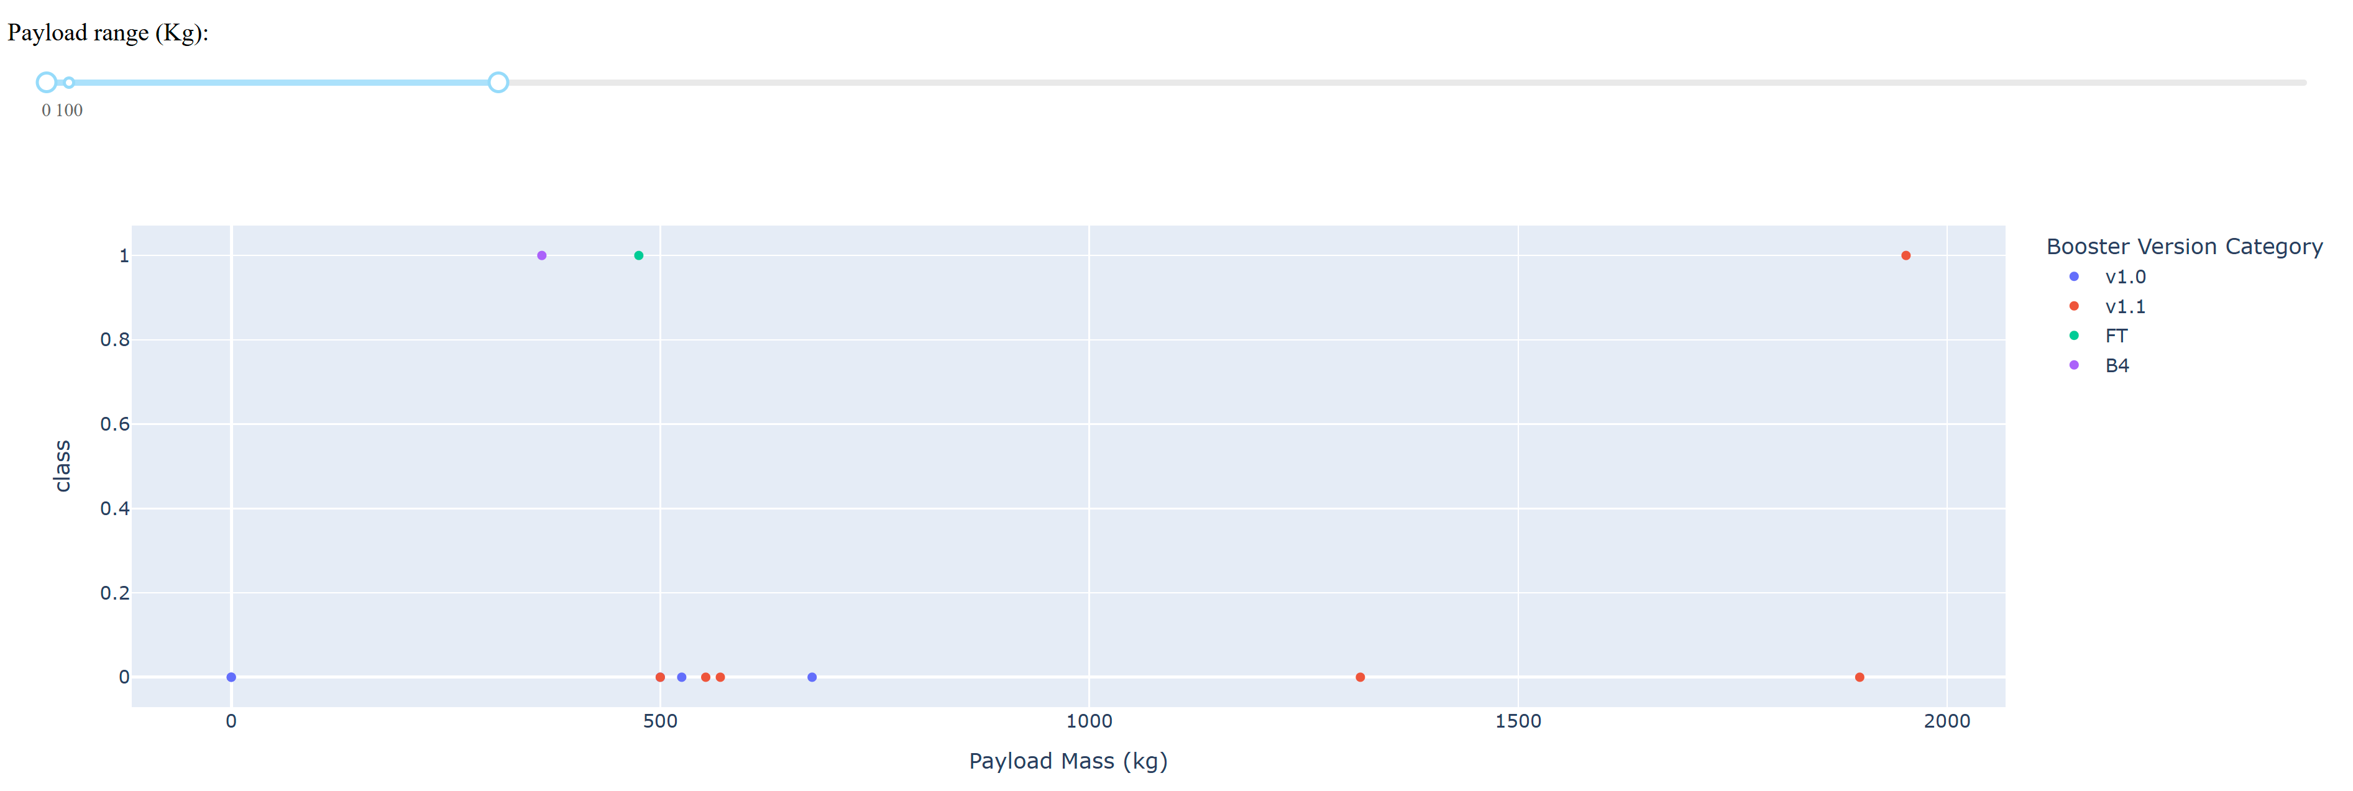
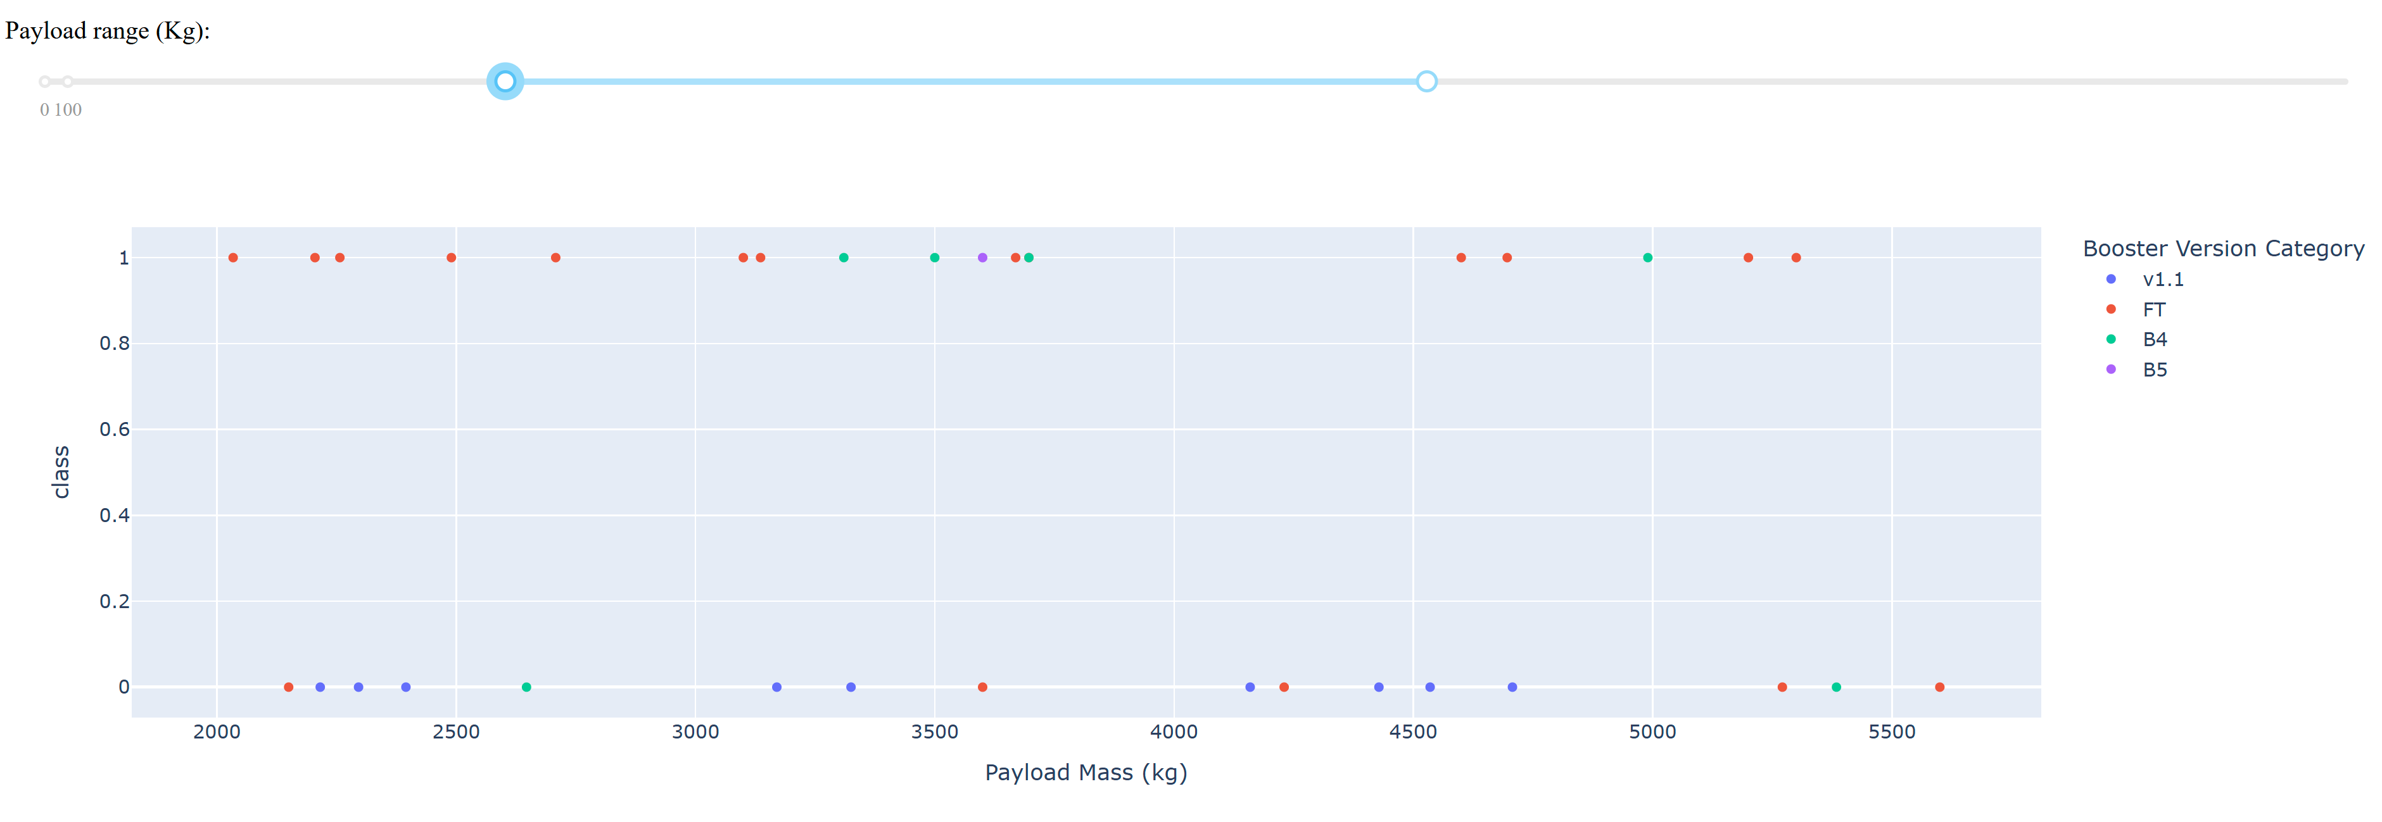
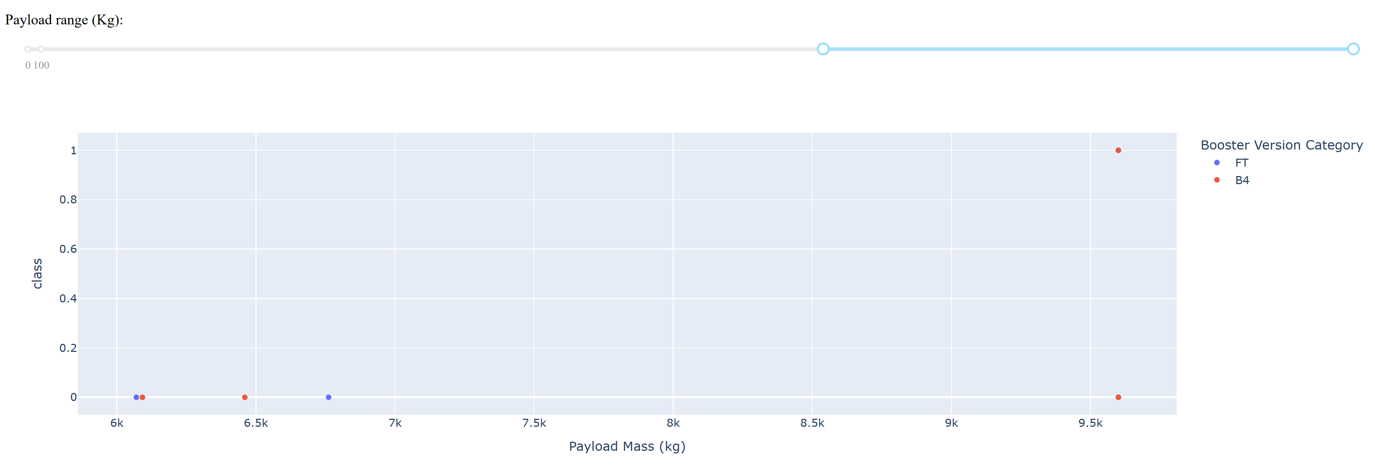
Payload Mass Impact on Launch Success Across Mission Profiles
0 - 2,000kg Range: Low payload missions demonstrate SpaceX's learning curve with early v1.0 and v1.1 boosters showing high failure rates (class=0). Success emerges with FT booster introduction, marking the transition from experimental to operational capabilities.
2,000 - 7,000kg Range: Mid-to-high payload missions showcase SpaceX's operational maturity with consistently high success rates (class=1) across FT, B4, and B5 boosters. The 3,000-5,000kg corridor represents peak performance reliability for commercial operations.
6,000 - 9,500kg Range: High-mass missions reveal performance limits with more failures than successes. Limited sample size means these represent SpaceX's maximum capacity missions, where payload constraints significantly impact landing success probability. This sparse data suggests heavy payloads remain a challenging frontier.

Slide 42

Section 5

Slide 43
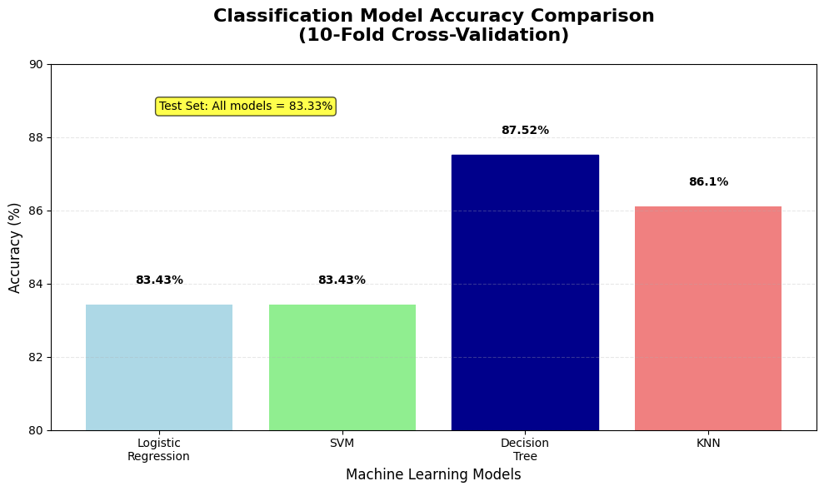
Classification Accuracy
Model Performance Comparison:
Cross-Validation Results:
  Decision Tree: 87.52% (highest)
  KNN: 86.10%
  Logistic Regression: 83.43%
  SVM: 83.43%
Test Set Results: All models achieved identical 83.33% accuracy
Limitation: Small test set (18 samples) prevented meaningful model differentiation
Best Model: Decision Tree based on cross-validation performance

Slide 44
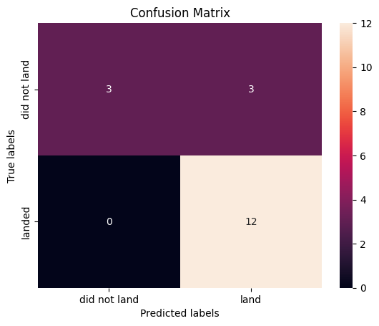
Confusion Matrix
Results:
True Positives: 12 (successful landings correctly predicted)
True Negatives: 3 (failed landings correctly predicted)
False Positives: 3 (failed landings incorrectly predicted as successful)
False Negatives: 0 (no successful landings missed)
Key Insights:
Perfect Recall: 100% of actual successful landings were correctly identified
Precision Challenge: 50% precision for failed landings (3 FP out of 6 actual failures)
Overall Accuracy: 83.33% (15 correct out of 18 predictions)
Business Impact: The model never misses a successful landing (critical for cost estimation) but occasionally overestimates landing success, leading to conservative cost predictions.

Slide 45
Conclusions
Point 1: Decision Tree classifier achieved the highest cross-validation accuracy (87.52%), but all models converged to identical 83.33% performance on the small test dataset.
Point 2: Machine learning models can reliably predict Falcon 9 landing success with >83% accuracy, enabling competitor cost estimation and strategic bidding against SpaceX.
Point 3: Perfect recall for successful landings (100%) ensures no missed cost-saving opportunities, while conservative false positive predictions provide risk mitigation.
Point 4: Dataset limitations (18 test samples, 90 total observations) restrict model differentiation and generalizability, highlighting the need for larger datasets in future work.
Point 5: Launch site location, payload mass, and booster specifications provide sufficient predictive power for commercial space launch cost modeling.

Slide 46
Appendix
GitHub Repository Link: https://github.com/danielmh111/imb-ds-cert-capstone

Slide 47


