Slide 1
Lab Preparations
CPS510
Database Systems I
Department of Computer Science
By Abdolreza Abhari
Ryerson University
Page <number>

Slide 2
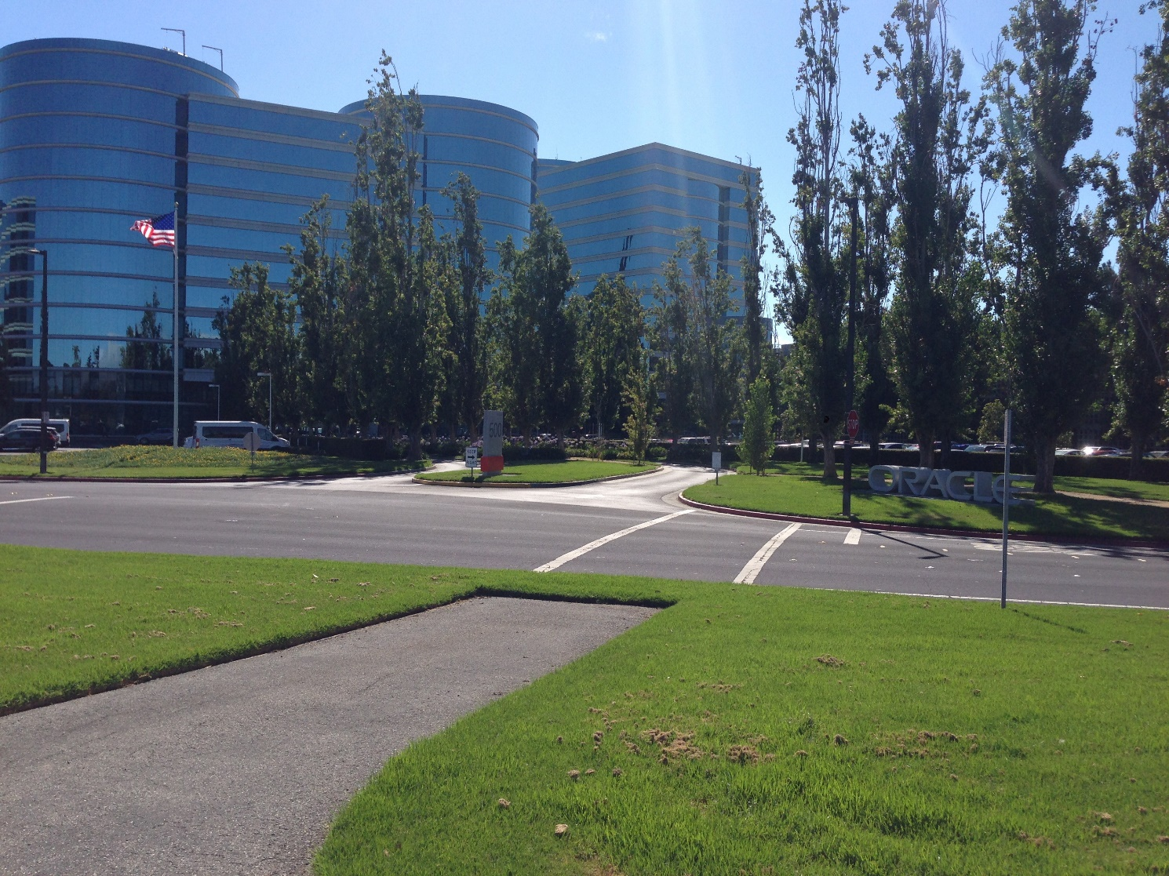
Oracle Database
Page <number>

Slide 3
Different ways to connect to Oracle
Different Setups (School, XE, Virtualbox)
Prerequisite to Labs
Make groups
Try Setups with school databases and your laptop
Page <number>

Slide 4

The Different Setups
School DB
Oracle XE DB
VirtualBox DB
Page <number>

Slide 5
VPN for Connecting to school database from home (including Mac OS users)
The general way is using Mobaxterminal and Sqldeveloper on moon. Another way to connect to the school's Oracle database from home when using sqldeveloper on your own Mac OS/X or Windows based laptop is using VPN. As mentioned before the school's databases cannot be connected unless you are in the SCS network. The Pdf document in the assignment section called "cps510_workingwithoracle PDF document" explains different ways of connection to or installing Oracle for Windows Users and Mac users by virtual box. Another solution for all users to be able to locate the school's database outside the school is using VPN on their Mac OS/X or Windows. Please download the vpn file from the updated web site:
scs.ryerson.ca/site_public_dir/SCS-Student.7z (should be updated)
Unzip the file and follow the pdf inside the folder.
Page <number>

Slide 6
VPN for Connecting to school database from home (including Mac OS users)
Once you are connected to the VPN, you will be able to connect to the school's database from anywhere as long as you have an internet connection. Please note that VPN is good when you want to use sqldeveloper client and school database as a server. The sqldeveloper should be downloaded on your own machine and make sure to run OpenVPN as administrator.
When OpenVPN is installed, the icon in the pdf instructions may not look the same as what is currently installed since what is being installed is a newer version. Please look in your taskbar (it may be under the hidden icons) for the OpenVPN. To login to the SCS-Student VPN network, you must login with your SCS username and password. Once connected, open sqldeveloper and connect with your database username and password which is different from your SCS username and password.
Page <number>

Slide 7
VPN for Connecting to school database from home (including Mac OS users)
If still it is difficult for you to use VPN on your laptop, use the instructions in the course web page "cps510_workingwithoracle " and you can at least get connected perfectly well with using command prompt SQL school database from home via SSH or you can simply work in the school lab.
With MobaXterm you should be able to connect to moon and run school sqldeveloper on with any Os on your laptop. For lab 9 there maybe an error about jdk path when using sqldeveloper from the moon that can be solved by entering the path:
/usr/lib/jvm/java-8-openjdk-amd64
Once the path is entered, you should be able to use sqldeveloper through the moon so there is no need to do any extra installations.
Page <number>

Slide 8
Setup 1: School Database
sqlplus64 "your_username@(DESCRIPTION=(ADDRESS=(PROTOCOL=TCP)(Host=oracle.scs.ryerson.ca)(Port=1521))(CONNECT_DATA=(SID=orcl)))"
Provided by SCS
Must be connected to Ryerson Wifi or be present in the labs
Page <number>

Slide 9
Setup 2: Oracle Database Express Edition
It is a light version of Oracle at following link (before download make sure if works with your OS)
http://www.oracle.com/technetwork/database/database-technologies/express-edition/downloads/index.html
Page <number>

Slide 10
Setup 2: Oracle Database Express Edition
Previous version of XE (Oracle 11g) for Windows and Linux can be downloaded from the link below which works with Windows 10 home edition
https://www.oracle.com/technetwork/database/database-technologies/express-edition/downloads/xe-prior-releases-5172097.html
Follow the installation instructions and REMEMBER the account and password made for system user during installation
Page <number>

Slide 11
Setup 2: Oracle Database Express Edition (2)
Run "Get Started" from Oracle Database 11g Express Edition to check if it is running.
An error regarding %HTTPPORT% may appear but the following will give access to the correct home page http://127.0.0.1:8080/apex/f?p=4950
If you want to use sqldeveloper on your machine and get connected to Oracle XE as localhost, you should be able to after the installation.
Default port is 1521 and SID is xe.
Page <number>

Slide 12
Setup 3: VirtualBox
Virtual Machine with VirtualBox
https://www.virtualbox.org/wiki/Downloads
Image of VM (Has Oracle 18.3 as of 10/18/2018)
http://www.oracle.com/technetwork/database/enterprise-edition/databaseappdev-vm-161299.html
Page <number>

Slide 13
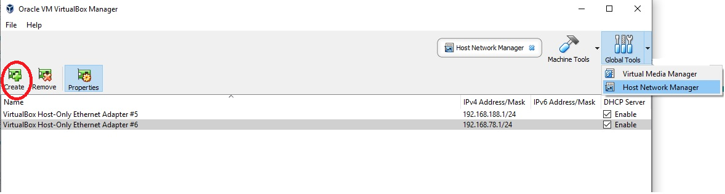
Setup 3: VirtualBox (2)
After installing VirtualBox
Go to Host Network Manager under Global Tools
Create a Host-only Network
Page <number>

Slide 14
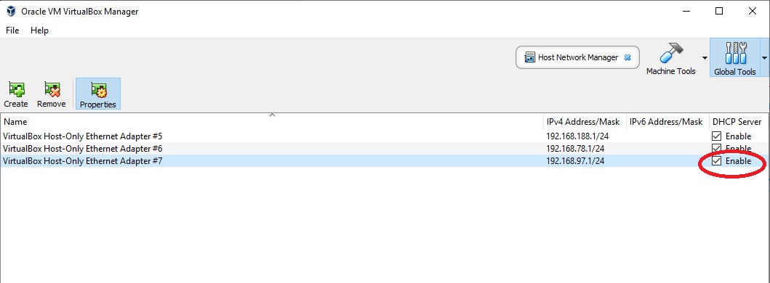
Setup 3: VirtualBox (3)
Enable DHCP server on the newly created Host-only Ethernet Adapter
Page <number>

Slide 15
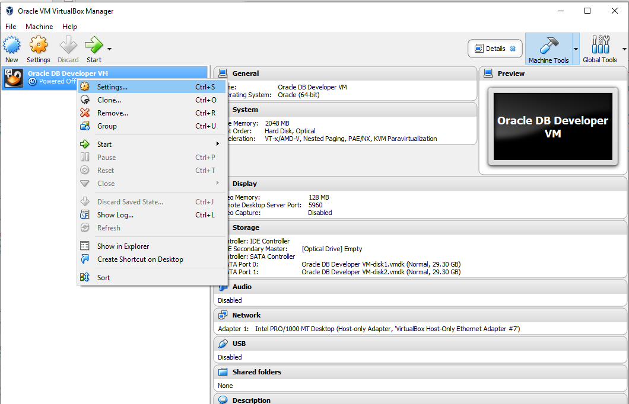
Setup 3: VirtualBox (4)
Import the Image of VM downloaded previously, File -> Import Appliance -> Image
Enter the settings of the imported VM
Page <number>

Slide 16
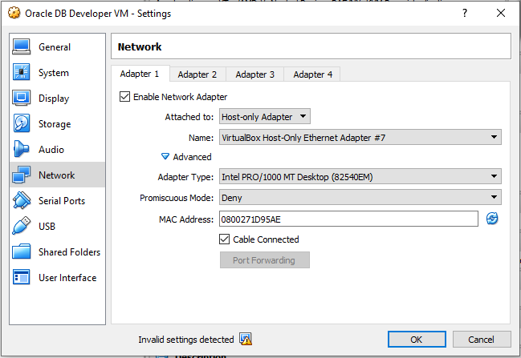
Setup 3: VirtualBox (5)
Change the network settings of VM to Host-only Adapter and select the previously created Host-only Adapter for the Name
Your settings should look similar to the screenshot
Page <number>

Slide 17
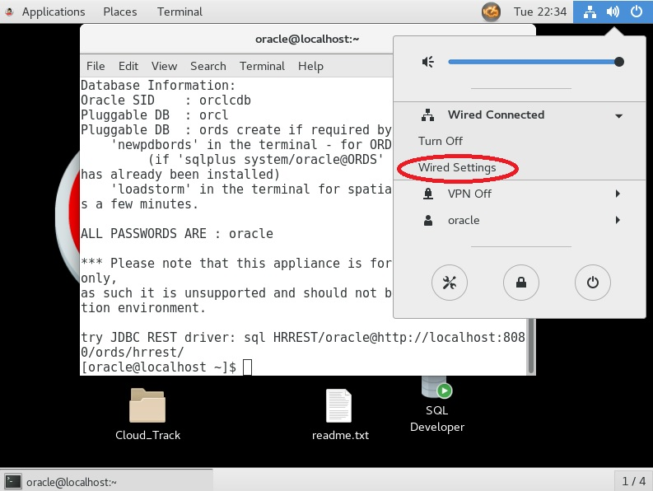
Setup 3: VirtualBox (6)
Power on VM and go to wired settings
Page <number>

Slide 18
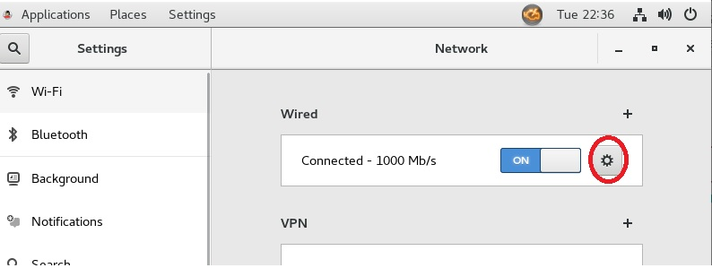
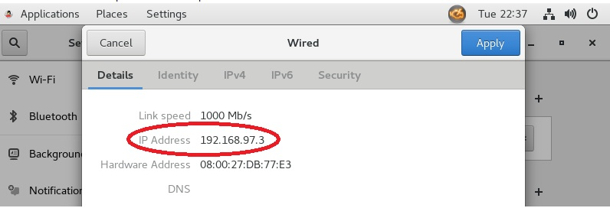
Setup 3: VirtualBox (7)
Find the IP provided to your VM
Page <number>

Slide 19
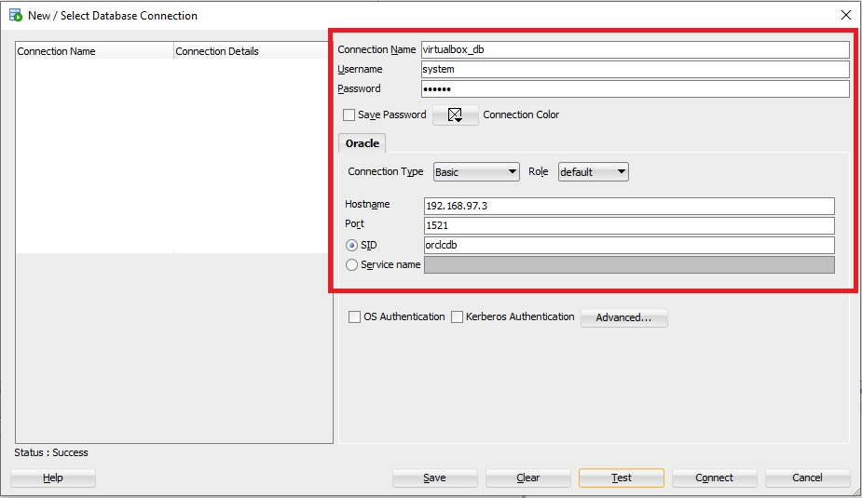
Setup 3: VirtualBox (8)
In SQL Developer
Connection Name can be anything you wish
Hostname is the IP address found from the previous slide
Port: 1521 SID: orclcdb (For 18.3 10/18/2018 VM)
Page <number>

Slide 20
Setup 3: VirtualBox (9)
Login is system/oracle in the VM, info can be found in the terminal
Can make another account if you wish once logged in through sqldeveloper and using the following commands:
ALTER SESSION SET "_ORACLE_SCRIPT"=TRUE;
CREATE USER username IDENTIFIED BY password;
GRANT CONNECT,RESOURCE,DBA TO username;
GRANT CREATE SESSION TO username WITH ADMIN OPTION;
GRANT UNLIMITED TABLESPACE TO username;
Page <number>

Slide 21
JDBC
API (Application Programming Interface)
For communication with your database
Written for Java, the minimum version of the drivers for each database version is provided below
For 11g ojdbc6: http://www.oracle.com/technetwork/apps-tech/jdbc-112010-090769.html
For 12c ojdbc7: http://www.oracle.com/technetwork/database/features/jdbc/jdbc-drivers-12c-download-1958347.html
For 18.3 ojdbc8: https://www.oracle.com/technetwork/database/application-development/jdbc/downloads/jdbc-ucp-183-5013470.html
Page <number>

Slide 22
JDBC (2)
Compile then run with the following lines
Example command lines for Windows-based:
javac -cp ojdbc6.jar; JdbcMTSample.java
java -cp ojdbc6.jar; JdbcMTSample
Example command lines for Unix-based:
javac -cp ojdbc6.jar: JdbcMTSample.java
java -cp ojdbc6.jar: JdbcMTSample
Notice the difference between ; and : based on the OS
Page <number>

Slide 23

Labs 1-10
Read over the instructions in Labs
Page <number>

Slide 24

Group Formation
Page <number>

Slide 25
Technical Help
For any questions about project/ assignments contact TAs
For problems about Oracle Accounts contact technical Support of Computer Science
request@scs.Ryerson.ca
Also for problems about labs or your Ryerson account contact CS technical staffs (above email) in the computer science department
For all other questions please contact your TA
Page <number>

