Slide 1

MERKLE TREE
Daniel Moreira Ribeiro 21270945
Jorge Alberto Martins Coelho 21270588

Slide 2



ZFS

Slide 3
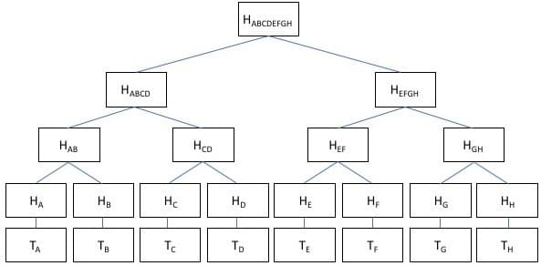

Slide 4
36
10
26
3
7
11
15
1
2
3
4
5
6
7
8

Slide 5
36
-10
10
26
-11
3
7
11
15
-7
1
2
3
4
5
6
7
8

Slide 6
36
37
-10
10
11
26
-11
3
7
8
11
15
-7
1
2
3
4
5
5
6
7
8

