Slide 1
Music Social Database MusicBoard
Daniel Rios – CPSC 2300 Project

Slide 2
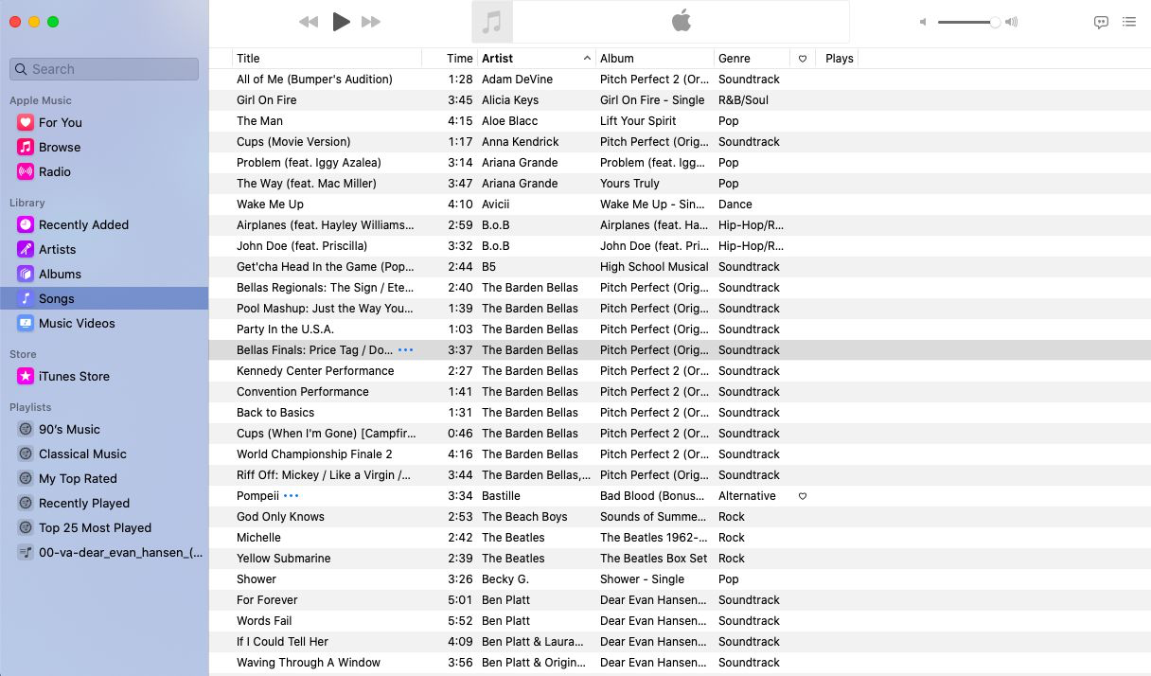
Project Description
Similar to popular movie website Letterboxd, but for music, and with more search/query options
The database encompasses entities such as…
Songs
Albums
Artists
Date
Reviews
Functionalities:
(1) User Account: Integrate the Music Database seamlessly into MusicBoard, requiring users to register for an account to access all functionalities. Provide account functions, including registration, email, sign-in, and profile updates.
(2) User Interaction: Allow signed-in users to write and see album/song reviews, list favorite artists, and see other profiles.
(3) Search: Implement a search interface, enabling users to explore music based on keywords, characteristics, and ratings.

Slide 3
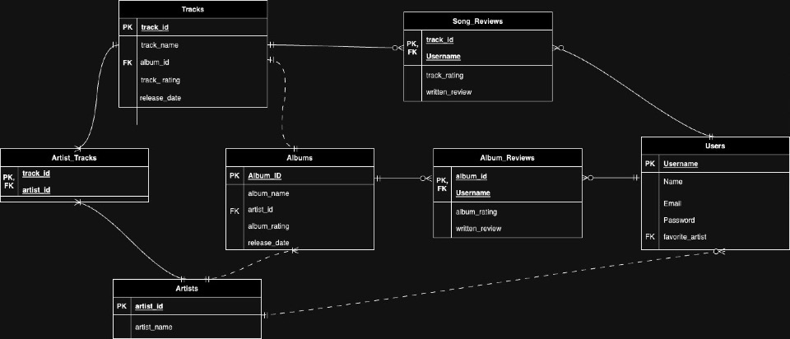
ER Diagram & Normalization
Notes:
Tables & areas
Attributes
Linking between tables
Normalization process
Of course involved taking what might be larger tables such as a full reviews table and splitting into albums and songs
Each has a primary key, and all parts are dependent on that key and no other
In some instances there were composite keys necessary to have this be the case
Needed to take out some attributes that didn’t fit this like artist_id in tracks or reviews
This also involved having a linking entity from tracks to artists to prevent the many to many relationship

Slide 4
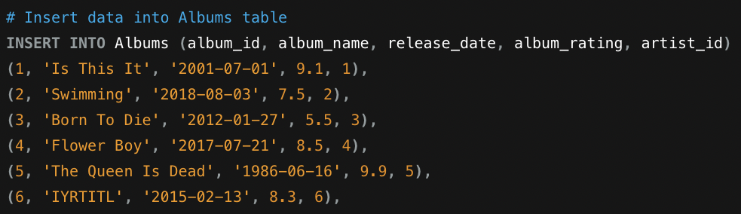
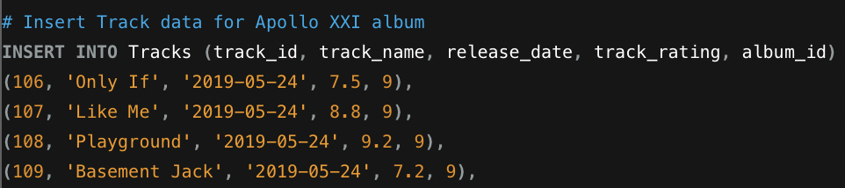
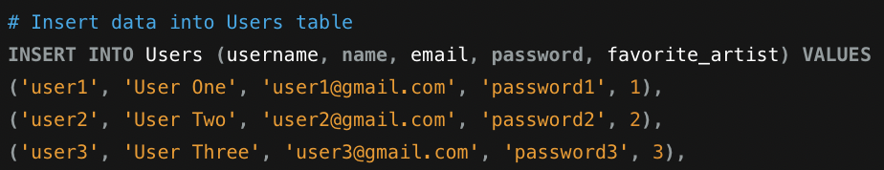
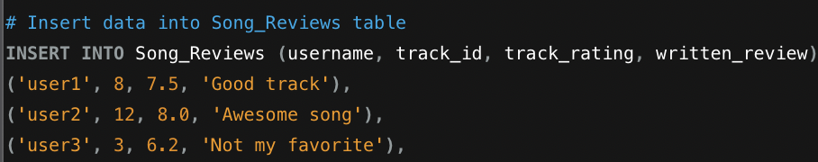
Data Entry

Slide 5
SQL Queries

Slide 6
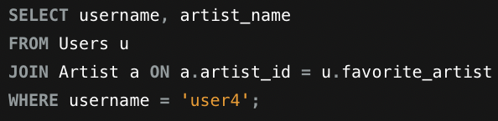
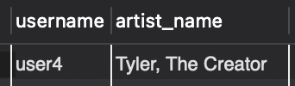
Inner Join on 2 Tables
Find the name of user 4’s favorite artist

Slide 7
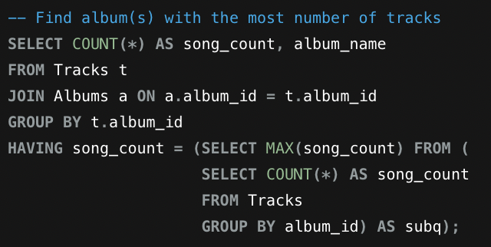
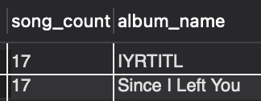
Subquery
Find Albums with the highest number of tracks

Slide 8
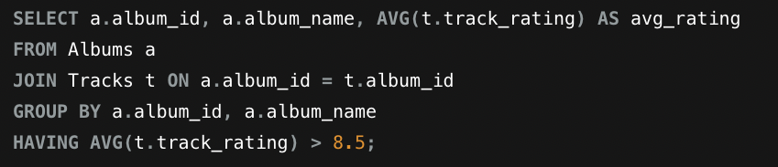
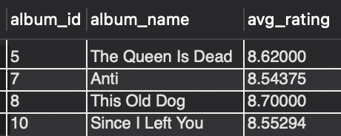
Group By, Having
Find the average track rating for each album, only show those with a greater than 8.5 average

Slide 9
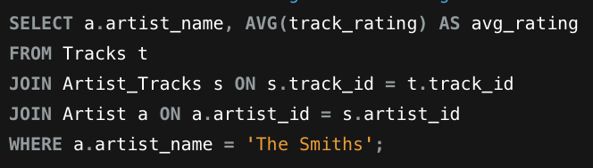
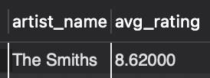
Aggregate Function
Find ‘The Smiths’ average track rating

Slide 10
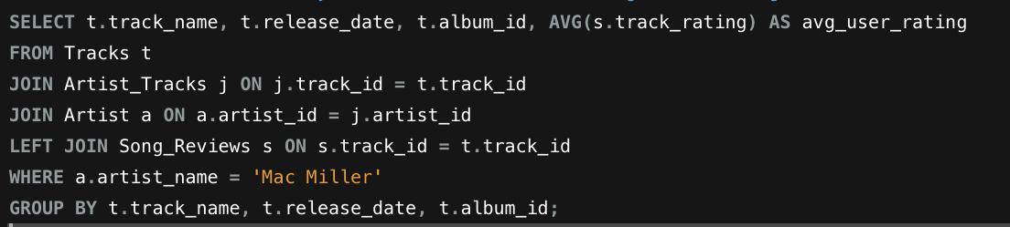
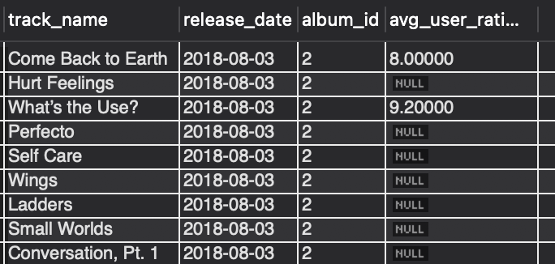
Left Join
Find info on all tracks by ‘Mac Miller’ and the average user rating, even if a rating has not been made

