Slide 1
Education Inequality Project
DATA 3320 - Daniel Rios

Slide 2
Background (Problem + Data)
This project addresses the inequality of educational opportunity in U.S. high schools.
Here we will focus on average student performance on the ACT or SAT exams that students take as part of the college application process. Is school performance predicted by socioeconomic factors?
The Data
The primary data set is the EdGap data set from EdGap.org. This data set from 2016 includes information about average ACT or SAT scores for schools and several socioeconomic characteristics of the school district.

Slide 3
Additional Step
Is being foreign-born or speaking a language other than English correlated with ACT performance?
Motivation for the question is foreign-born as a unique socioeconomic factor not currently considered in the analysis, this could help further address the question of whether SAT score is correlated with socioeconomic factors.
The data was retrieved from United States Census Bureau, grouped by ZIP code

Slide 4
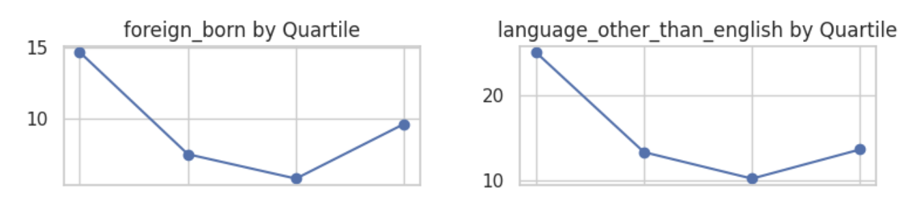
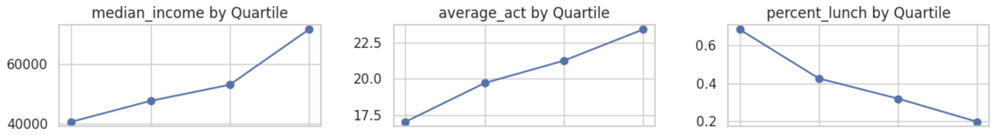
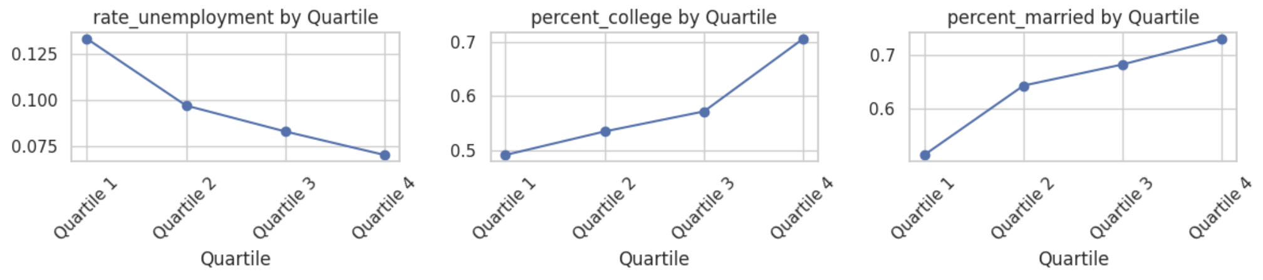
High-Level Exploration
I started by splitting the schools into quartiles by ACT score to see what the average socioeconomic status (for numeric variables) looks like in each bucket. This was interesting to see correlation and how they change across groups
From this I was able to identify which variables are positively and negatively correlated with ACT score
Positively correlated:
percent of adults with a college degree
percent of children in marries couple family
median household income
Negatively correlated:
unemployment rate
percent of students on subsidized or free lunch
percentage of foreign-born residents
Language other than English spoken at home
We can also note the unusual distribution of foreign born and language other than English

Slide 5
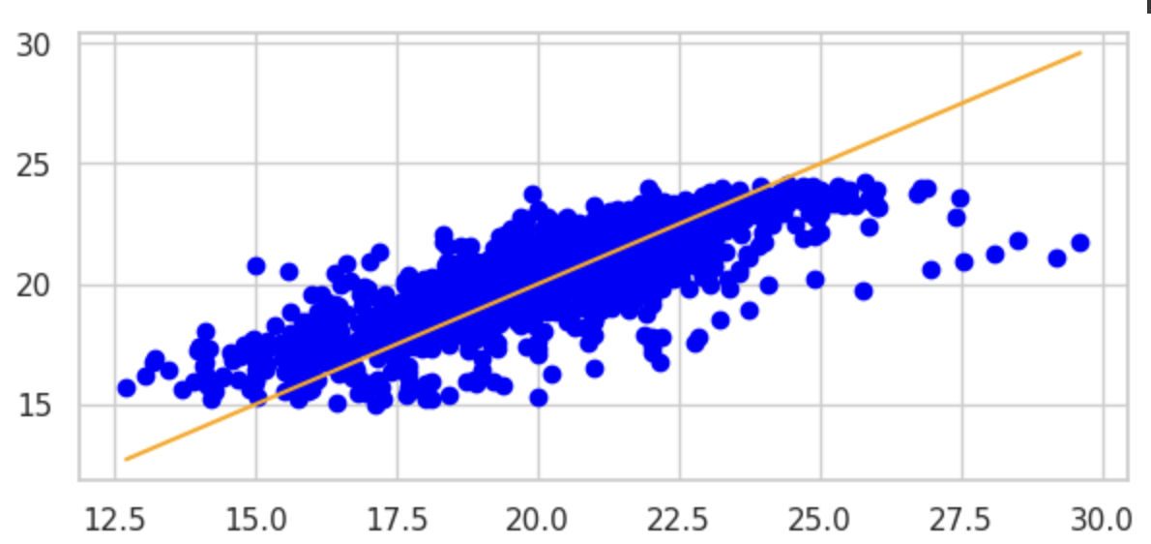
Regression Models
I used what we've learned about the features in our dataset to create two models predicting school ACT scores
Classic Regression
Found the best combination of our features by trying each feature
Applied to linear regression model
Trained on portion of data then applied to new unseen data
Features explained 61.5% of the variance
2. Regression Tree
Found the optimal number of nodes
Applied to regression tree model
Included additional variables for model despite unusual distribution
Explained 67.2% of the variance
predicted
So, to answer the question with our results, yes, ACT scores can be predicted from socioeconomic factors.
ACT Score

