Slide 1
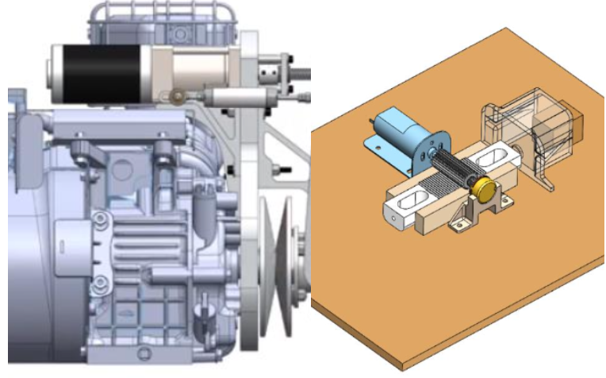
Electronic - CVT Software
Electronic Continuous Variable Transmission Control System for UBC Baja
May 2020-Present
UBC Baja is implementing an E-CVT system for our 2022 race vehicle
• Implementing a Multiple-Input Single-Output control system for Electronic-CVT on off-road race vehicle using C++
• Used QEMU to simulate a STM-32 running the control system in a multi-threaded environment using FreeRTOS
• Tuning PID controller that relates engine RPM and throttle position to torque conducted unit tests with Google Test
• Coded a GUI interface with Python Tkinter library to adjust parameters for testing
Technologies Used: C++, STM-32, QEMU, Eclipse, multi-threading, FreeRTOS, Google Test , Python(Tkinter)

Slide 2
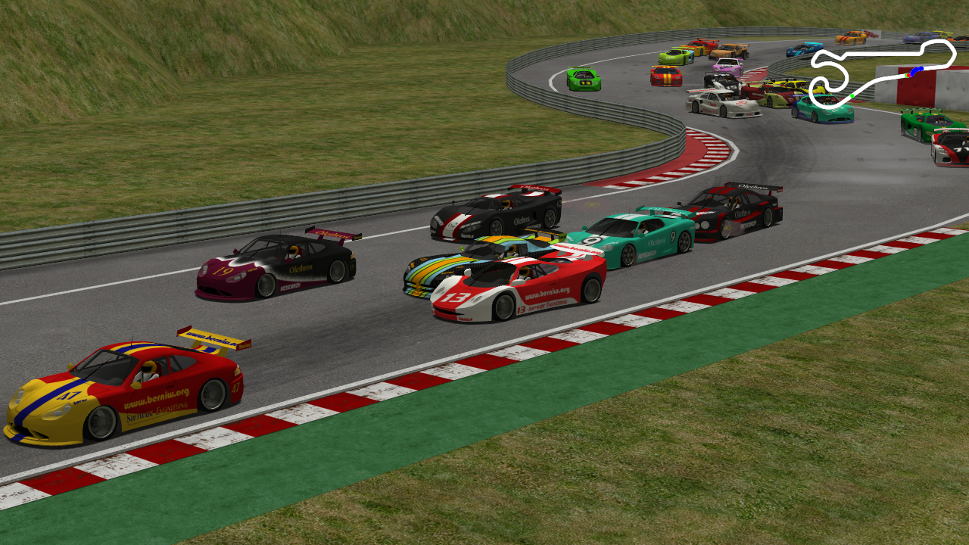
Autonomous Driving Software with Hardware Acceleration
May 2020-Present
Developed a mathematical lane detection algorithm with C++ and OpenCV, tuned a PID controller for steering
Wrote Verilog for image manipulations to allow for hardware acceleration on FPGA, resulted in 92% image size reduction
Designing interface which allows the FPGA to communicate with an ARM processor running the autonomous driving software
Implemented YOLOv3 model with TensorFlow for car detection
Technologies Used: C++, STM-32, QEMU, multi-threading, FreeRTOS, Google Test , Python(Tkinter)

