Slide 1
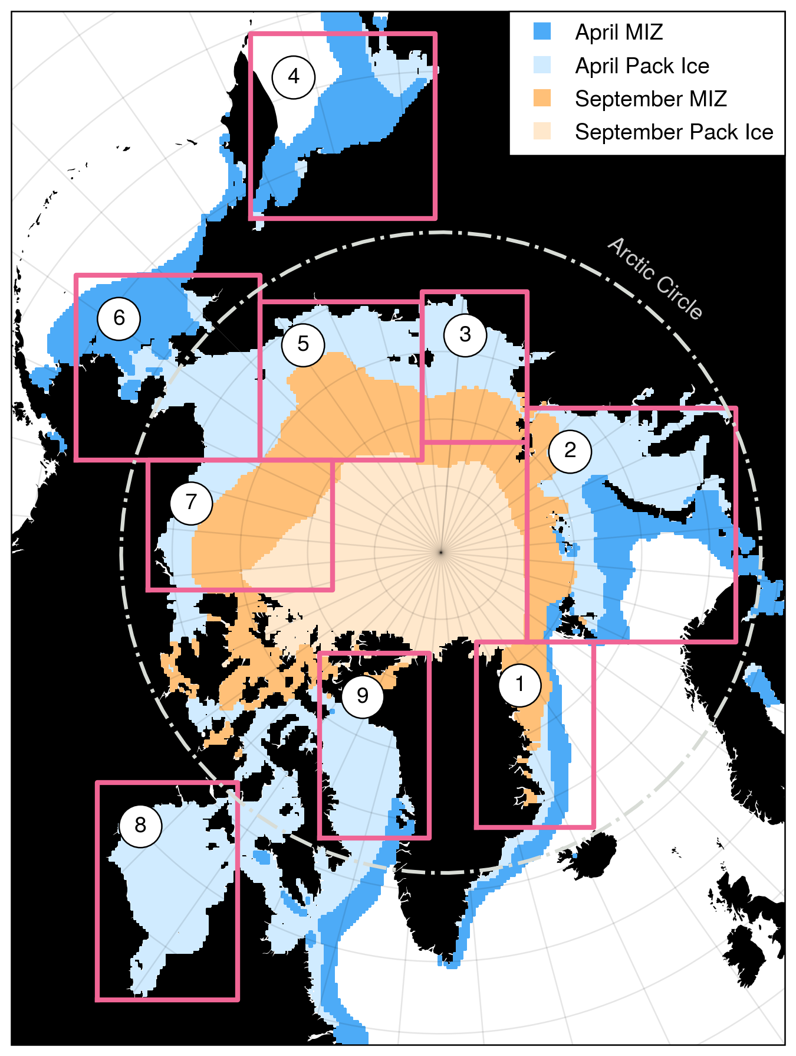
Fig. 1

Slide 2
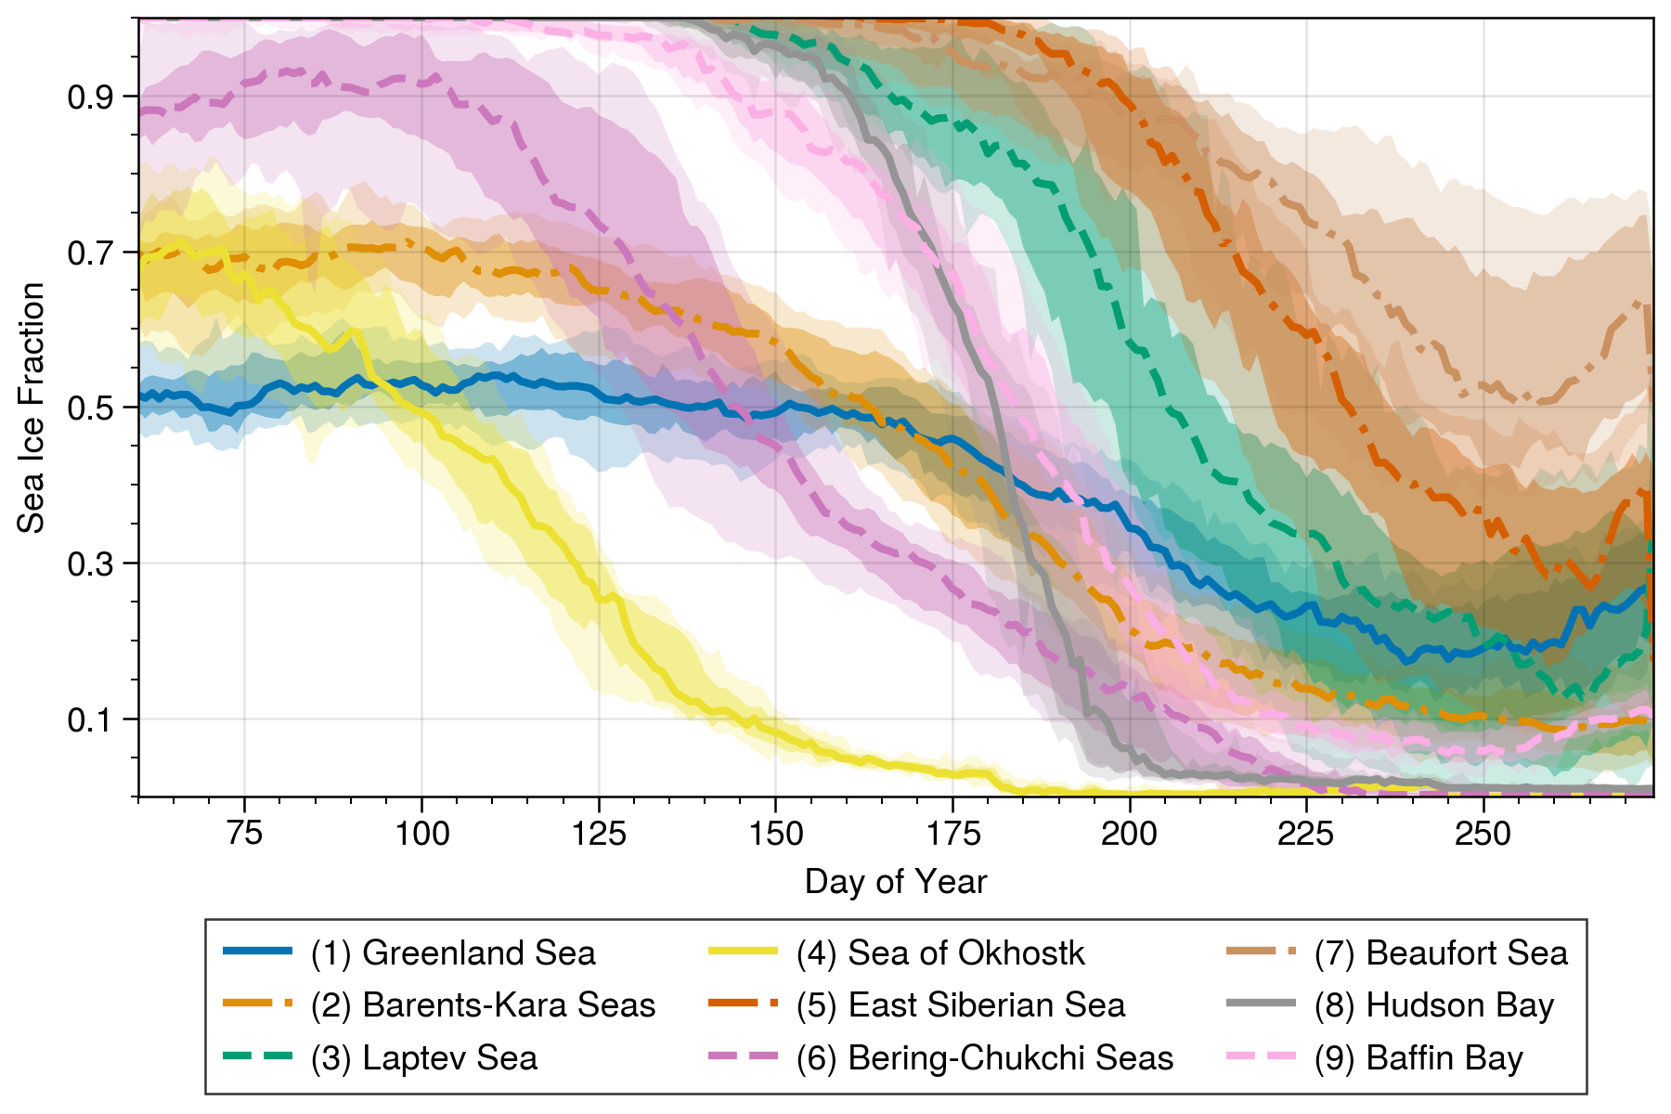
Fig. 2

Slide 3
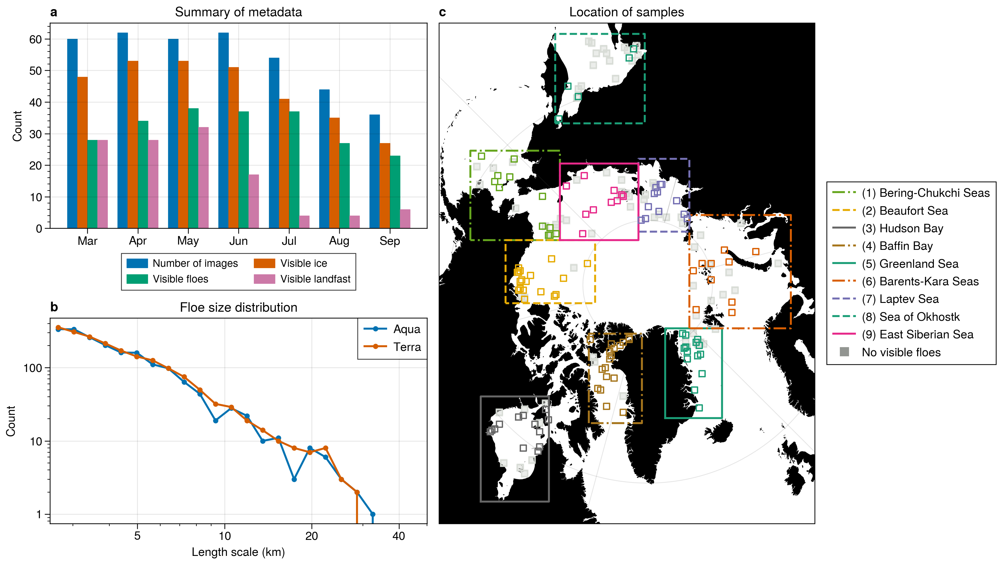
Fig. 3

Slide 4
Fig. 4
True Color Image
Grayscale Image
Floe Detection
K-Means Workflow
Merge Floes
Detected Floes
Adaptive Threshold Workflow
False Color
Image
Classification Masks
Land Mask

Slide 5
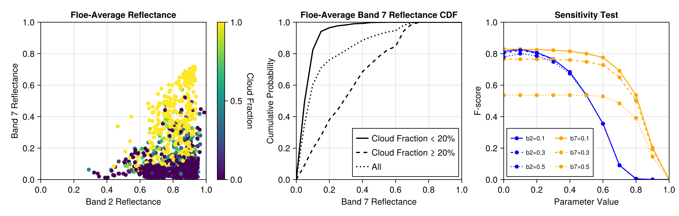
Fig. 5
a
b
c
d
e
Notes:
Motivation and calibration for the cloud mask function. Potential addition: histograms, curves for the ice/water functions.

Slide 6
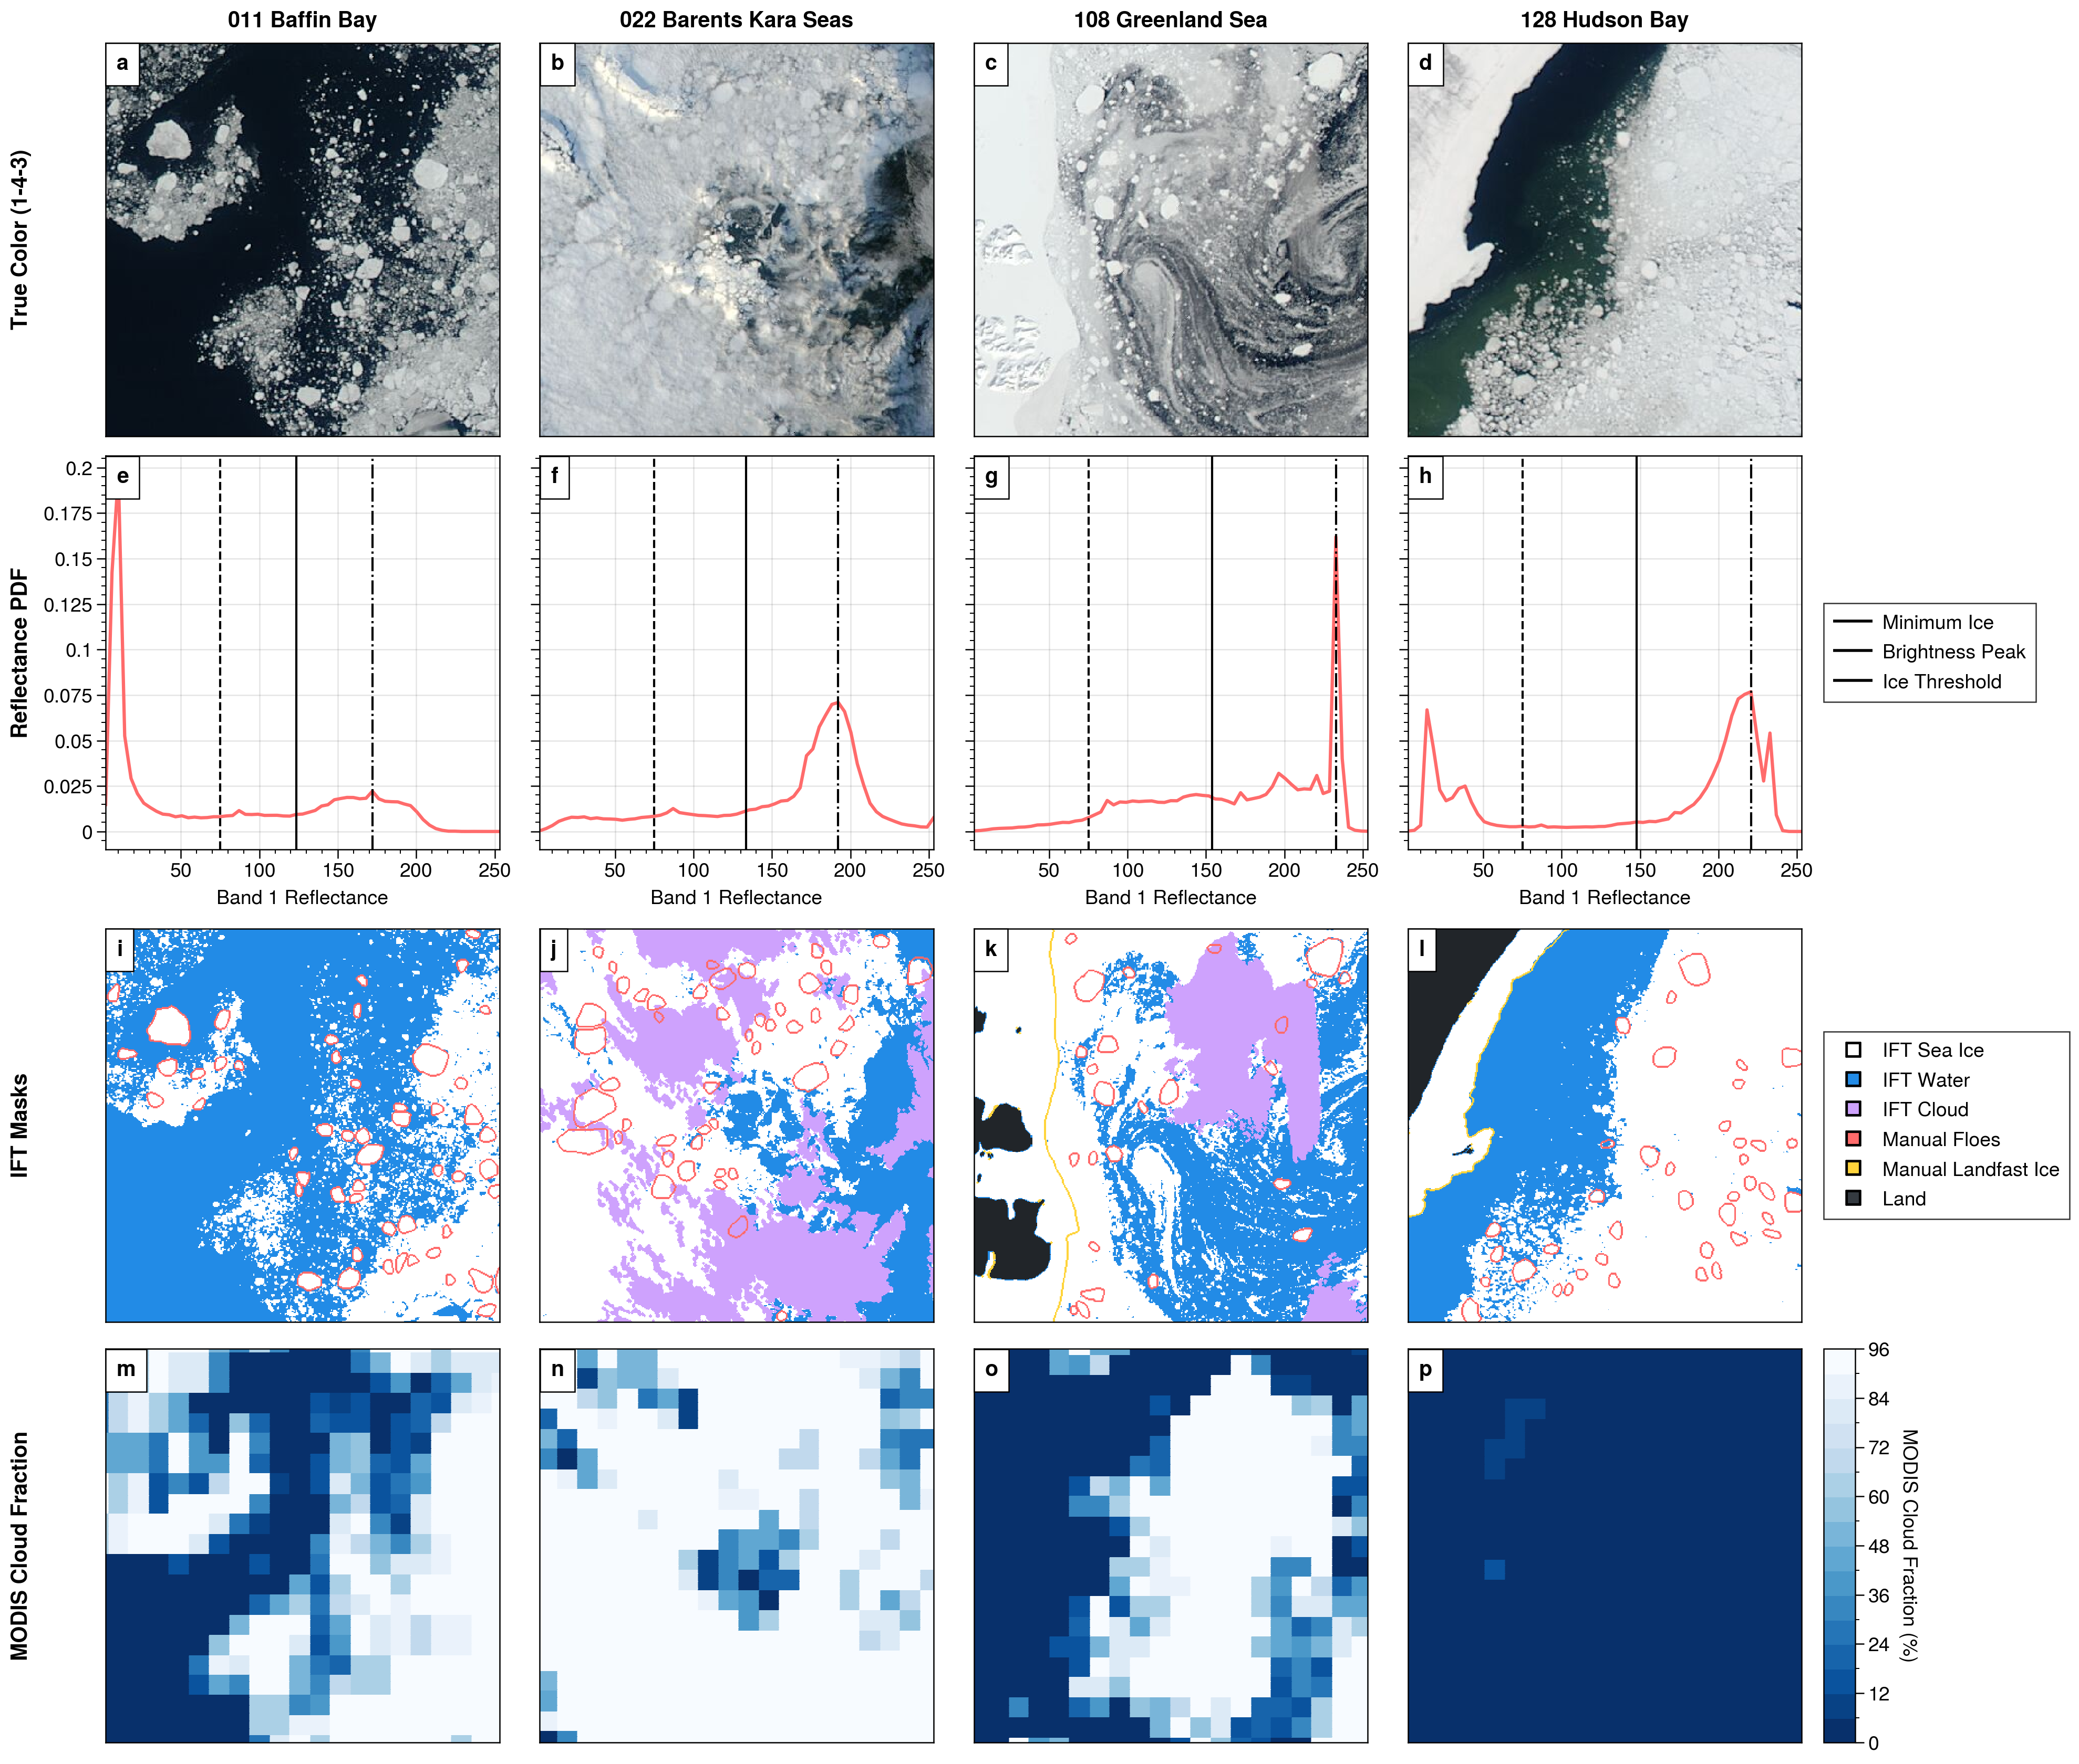
Fig. 6
Notes:
Explanation of the discriminate ice-water function, uses the training cases.

Slide 7
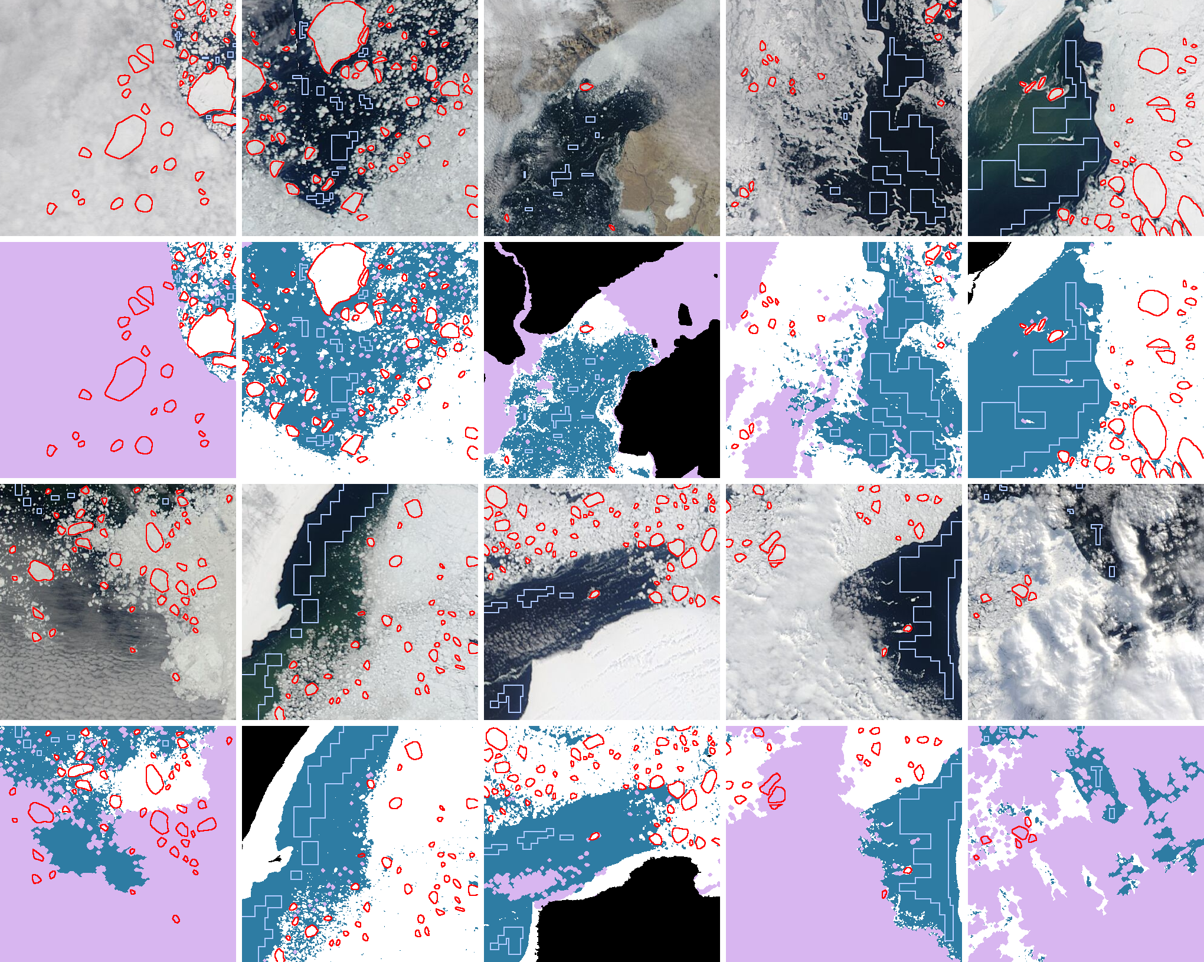
Fig. 7
a
b
c
d
e
f
g
h
i
j
k
l
m
n
o
p
q
r
s
t
Notes:
Overlay of reference shapes, testing data.

Slide 8
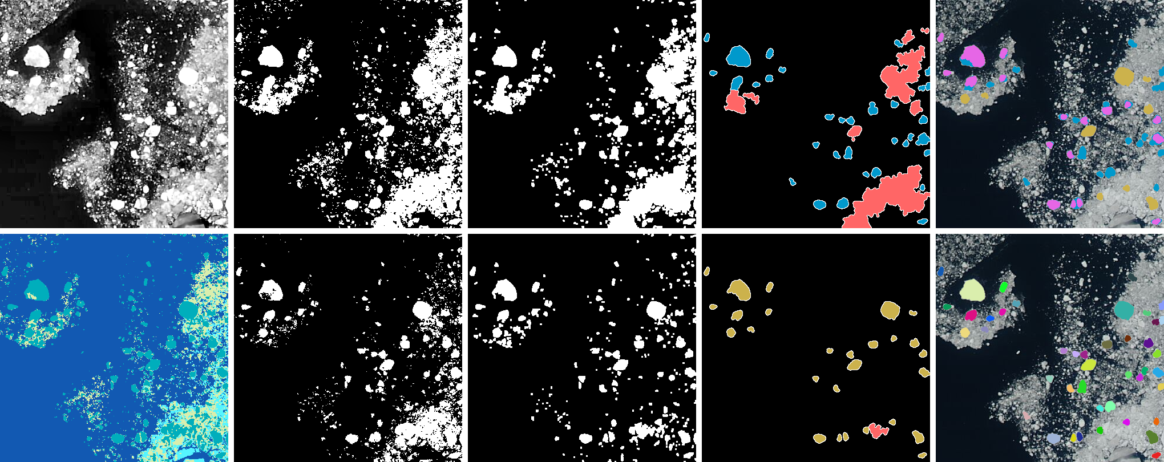
Fig. 8
a
b
c
d
e
f
g
h
i
j
Notes:
Distance-morph-split function

Slide 9
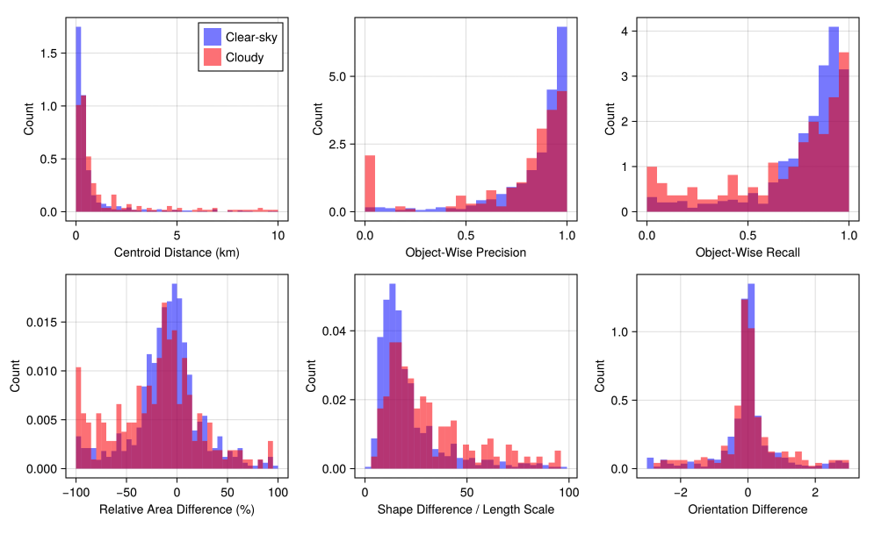
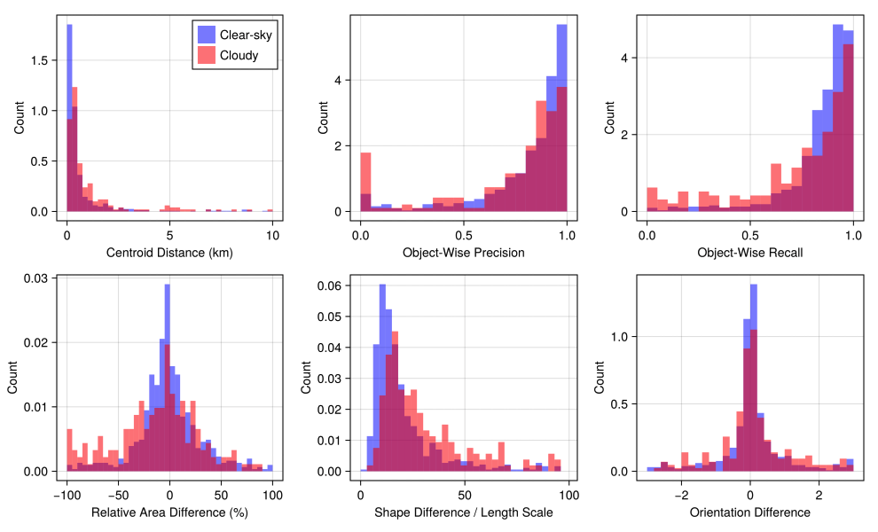
Fig. 9
Clip = 5
Clip = 2

