Slide 1
Final exam review
ITI1121/ITI1521

Slide 2
Immediately after this statement executes, what best describes the result:
Actor[ ] x = new Actor[1000];
x is an array of 1000 Actor objects.
x is an index into an array of Actor objects.
x is allocated on the heap and the resulting array is allocated on the stack.
x refers to an array of references to objects which could be of any subclass type (such as Hobbit or Wizard, etc.)
generates a syntax error because Actor is an abstract class.
Answer: d

Slide 3
Immediately after the last statement executes, what best describes the result:
Actor x = new Wizard();
// . . . some additional code
x = new Hobbit();
The Wizard object will be eligible for garbage collection.
Wizard is a subclass of x.
x becomes a Hobbit object.
The statement generates a warning about overwriting.
None of the above
Answer: a

Slide 4
The term signature can be used when describing a method. In this context, a signature is:
Defined by the import statement for that class.
The number of arguments and the data type of each argument.
The return type of method (for example, double or String).
The variable names in the argument list.
All of the above.
Answer: b

Slide 5
Which of the following is an application of the principle of inheritance:
An object of class A has a reference to a class B object.
Several methods have the same name, but have different signatures.
Objects created with new are allocated on the heap.
Fields are usually declared private.
All classes are ultimately derived from the super class called Object.
Answer: e

Slide 6
Consider the following statement which is defined in a class (let's call it class Test). The keyword static:
private static int serial = 0;
means that serial is a constant.
ensures that only one instance of serial exists and it will be shared by all objects of type Test.
means that serial should be capitalized (e.g. SERIAL) to comply with Java naming conventions.
results in a syntax error because it is missing the keyword final.
None of the above.
Answer: b

Slide 7
A virtual method requires which of the following to be in effect:
The method signatures must be identical in the super class and subclass.
The subclass overrides all methods in the ultimate super class (called Object).
The keyword virtual is applied to the method name.
The super class must be declared to be abstract.
All of the above.
Answer: a

Slide 8
Which of the following is true about a primitive variable:
It holds the raw machine-code address of a variable.
During program execution, accessing a primitive is slower than accessing a reference-based object.
Primitives are close to the machine-code level, thus have different byte sizes on different hardware platforms.
The value stored in the variable is an actual value (as opposed to a reference to something).
None of the above.
Answer: d

Slide 9
Which of the following is true about a reference variable:
It holds the raw machine-code address of a variable.
When created, it will always contain location information for some object.
It can hold location information for objects of the named class, or objects of any subclass.
Once the location information in the reference variable is established, it cannot be changed.
None of the above.
Answer: c

Slide 10
Which of the following statements about constructors is correct:
A constructor has the same name as the class name.
A constructor is responsible for the initialization of an object's instance fields.
Constructor methods have no return type.
A class can have several constructors.
All of the above.
Answer: e

Slide 11
You know that memory is allocated when a stack-oriented variable is created in a method. That memory is released when:
Program execution enters a catch block.
The garbage collector discovers that there are no outstanding references to the variable.
The program execution leaves the block of code where the variable was defined.
The class loader detects an exception.
None of the above.
Answer: c

Slide 12
In the example code fragment shown below, the keyword abstract:
public abstract class Test { // . . . more class code
Implies that no object of type Test can ever be created.
Makes class Test independent of all other classes, in particular, it is not a subclass of the class Object.
Requires the implementation of the toString() method.
Ensures that only one object of type Test is ever created.
All of the above.
Answer: a

Slide 13
The following statements compare and contrast array and ArrayList. Which one is true (or are all true)?
Both ArrayList and array objects automatically keep track of their capacity and the number of elements actually in use.
The array type extends from Object. The ArrayList type extends from array.
The elements in an ArrayList can be primitives (int, float, double etc.) or reference-to values. An array can store only reference-to values.
ArrayList can expand its storage space as needed; an array cannot change the initial size of the array.
All of the above.
Answer: d

Slide 14
The following declaration will be used in the next three questions:
class SuperClass {
private int x; private int y;
public SuperClass ( ) { x = 2; y = 3; }
public SuperClass (int x, int y) { this.x = x; this.y = y; }
public String toString ( ) { return "Numbers are: " + x + " and " + y; }
public int returnSum( ) { return (x+y); }
}
class SubClass extends SuperClass { private int z;
public SubClass( ) { super( ); }
public SubClass(int x, int y) { super(x, y); z = 4; }
public int returnSum( ) { return (super.returnSum() + z); }
}
and the declarations:
SuperClass obj1 = new SuperClass();
SuperClass obj2 = new SubClass(1, 2);

Slide 15
What will the following statement display to the screen?
System.out.println (obj1);
Something like: SuperClass@4e3380fa (the Object implementation of toString())
Numbers are: 1 and 2
Numbers are: 2 and 3
Numbers are: 2 and 3 and 9
None of the above.
Answer: c

Slide 16
What will the following statement display to the screen?
System.out.println(obj2);
Something like: SubClass@4e7770bb (the Object implementation of toString())
Numbers are: 1 and 2
Numbers are: 2 and 3
Numbers are: 1 and 2 and 3
None of the above
Answer: b

Slide 17
Given the following statement, what will display to the screen?
System.out.print("Sum is:" + obj2.returnSum());
Sum is: 20
Sum is: 200
Sum is: 4
Invalid statement – won’t compile
None of the above. Sum is: 7
Answer: e

Slide 18
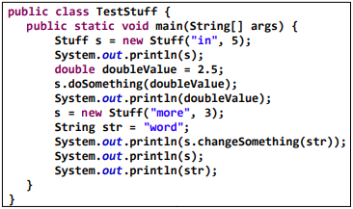
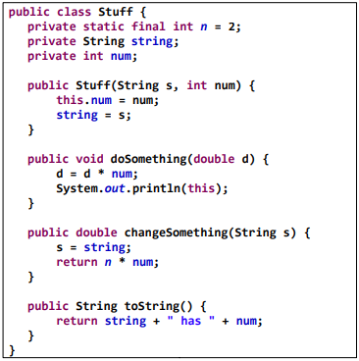
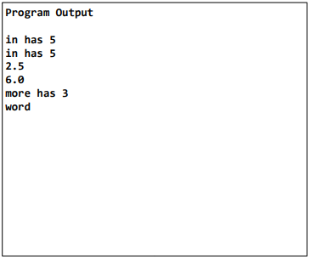
Show the output that will result from the following code:

Slide 19
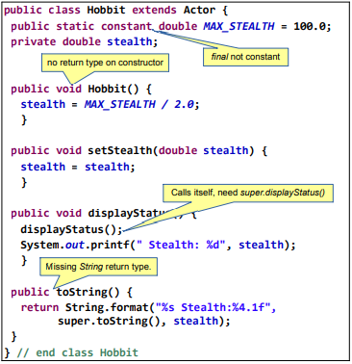
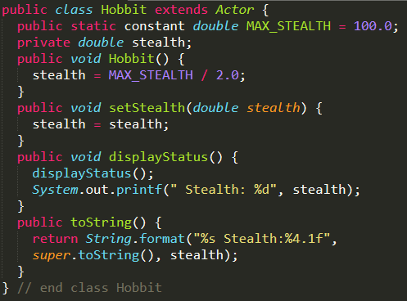
Find 3 syntax and / or logic errors. Circle each error and suggest a correction.

Slide 20
Which of the following interfaces does a LinkedList implement?
Iterable
Comparable
Comparator
Iterator
Answer: a

Slide 21
Which is faster at accessing the midpoint?
ArrayList
LinkedList
Answer: a

Slide 22
True or False: The order in which elements are inserted into a LinkedList is preserved?
True
False
Answer: True (depends)

Slide 23
For a LinkedList, which is faster to find?
First element
Midpoint
Answer: a

Slide 24
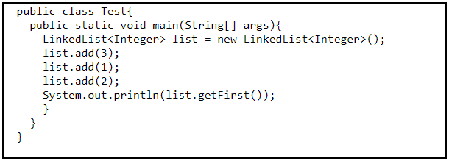
What is printed by the code?
1
2
3
Answer: c

Slide 25
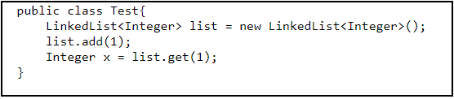
What is the value of x?
null
3
Exception thrown
Answer: c (depends on implementation)

Slide 26
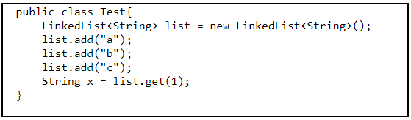
What is the value of x?
a
b
c
Answer: b

Slide 27
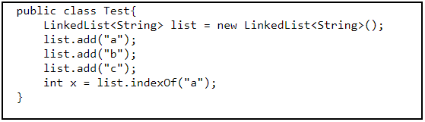
What is the value of x?
0
1
2
Answer: 0

Slide 28
True or False: Java ArrayList uses a LinkedList in its implementation
True
False
Answer: b

Slide 29
Which uses more memory to store the same amount of data
Singly LinkedList
Doubly LinkedList
Answer: b

Slide 30
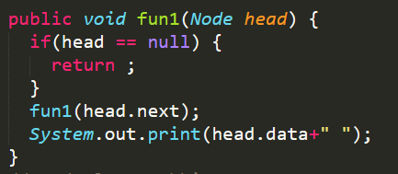
What does the following method do for a given Linked List with first node as head?
Prints all nodes of linked lists
Prints all nodes of linked list in reverse order
Prints alternate nodes of linkedlist
Prints alternate nodes in reverse order
Answer: b

Slide 31
Which of the following points is/are true about Linked List data structure when it is compared with array
It is easy to insert and delete elements in Linked List
Random access is not allowed in a typical implementation of Linked Lists
The size of array has to be pre-decided, linked lists can change their size any time.
All of the above
Answer: d

Slide 32
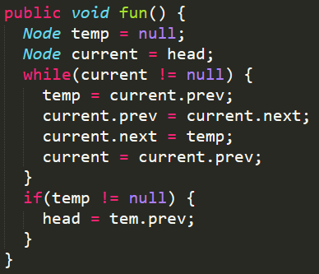
What should be the modified linked list after the method call?
Doubly linked list: 1 <--> 2 <--> 3 <--> 4 <--> 5 <-->6.
2 <--> 1 <--> 4 <--> 3 <--> 6 <-->5
5 <--> 4 <--> 3 <--> 2 <--> 1 <-->6
6 <--> 5 <--> 4 <--> 3 <--> 2 <--> 1
6 <--> 5 <--> 4 <--> 3 <--> 1 <--> 2
Answer: c

Slide 33
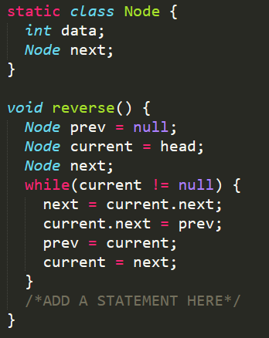
The following method reverse() is supposed to reverse a singly linked list. There is one line missing at the end of the method.
What should be added in place of "/*ADD A STATEMENT HERE*/", so that the method correctly reverses a linked list.
head = prev;
head = current;
head = next;
head = null;
Answer: a

Slide 34
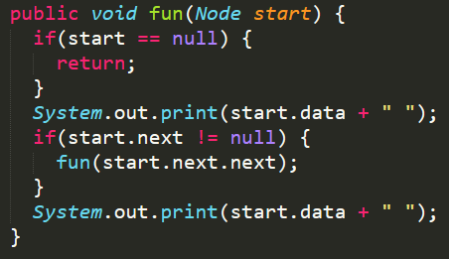
What is the output of following method for start pointing to first node of following linked list?
List: 1->2->3->4->5->6
146641
135135
1235
135531
Answer: d

Slide 35
In the worst case, the number of comparisons needed to search a singly linked list (1->2->3->4) of length n for a given element is:
Log2(n)
n/2
Log2(n-1)
N
Answer: d

Slide 36
When would it be most appropriate to create a linked list in Java?
Fetching elements happens from the beginning of the list
Storing a non fixed number of elements
Deleting only from the end of the list
Reading middle values stored is not a priority
All of the above
Answer: e

Slide 37
Is inserting an element into a stack always more efficient than inserting it into a queue?
True
False
Answer: b (depends on the implementation).

Slide 38
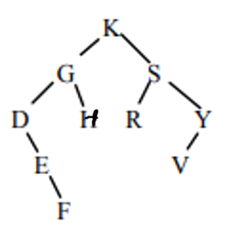
Write the node labels in the order they would be printed in an in-order traversal of the tree
D E F G H K R S V Y
K G D E F I S R Y V
D E F I G R V Y S K
F E D I G Y V R S K
Answer: a

Slide 39
With n being the size of the tree, the height of a BST can be:
height = N
0 <= height <= N
Height = log2(N)
Height > log2(N)
All of the above
Answer: e

Slide 40
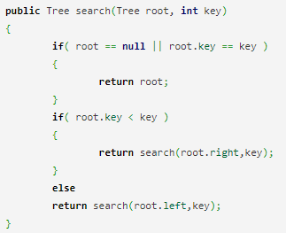
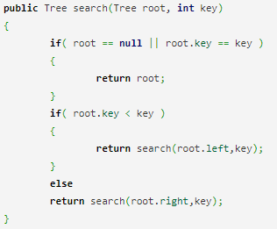
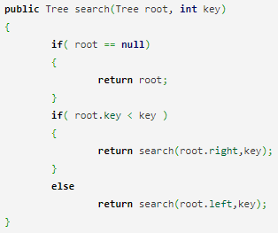
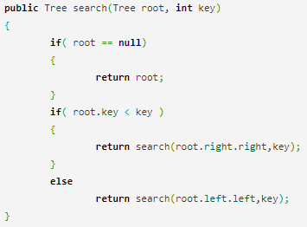
How to search for a key in a binary search tree?
a) b) c) d)
Answer: a

Slide 41
What is the speciality about the inorder traversal of a binary search tree?
It traverses in a non increasing order
It traverses in an increasing order
It traverses in a random fashion
It traverses based on priority of the node
Answer: b

Slide 42
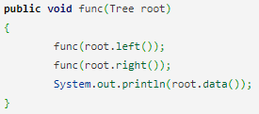
What does the following piece of code do?
Preorder traversal
Inorder traversal
Postorder traversal
Answer: c

Slide 43
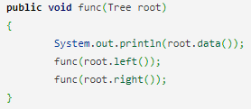
What does the following piece of code do?
Preorder traversal
Inorder traversal
Postorder traversal
Answer: a

Slide 44
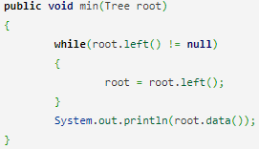
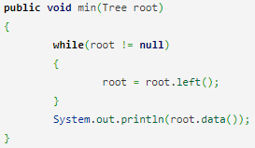
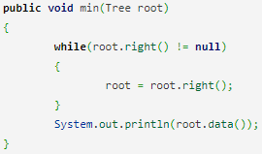
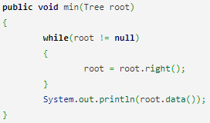
How will you find the minimum element in a binary search tree?
a) b) c) d)
Answer: a

Slide 45
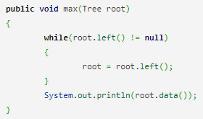

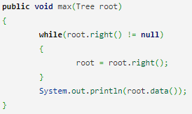
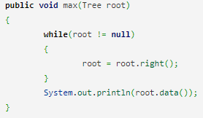
How will you find the maximum element in a binary search tree?
a) b) c) d)
Answer: c

Slide 46
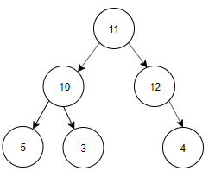
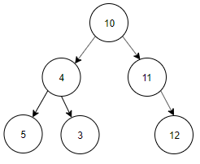
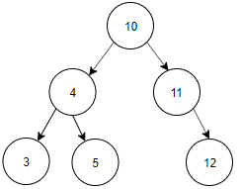
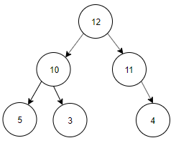
Construct a binary search tree with the below information.
The preorder traversal of a binary search tree 10, 4, 3, 5, 11, 12.
a) b) c) d)
Answer: c (trick: find the inorder traversal and use it to construct the tree)

Slide 47
Resources:
http://elearning.algonquincollege.com/coursemat/woollar/Courses/CST8132/Tests/2014Winter/OOP-Java-Midterm-Part-1-2014-Winter-Solution.pdf
https://www.cs.umd.edu/class/summer2018/cmsc132/javatest/linkedlist/linkedlist.html
https://www.geeksforgeeks.org/data-structure-gq/linked-list-gq/
http://www.cs.toronto.edu/~hojjat/148s07/tests/PastExams/20051ans.pdf
https://www.sanfoundry.com/data-structure-questions-answers-binary-search-tree/

