Slide 1

Backlight
HackFMI6

Slide 2


Problem
Philips Ambilight
1 000 $
>

Slide 3
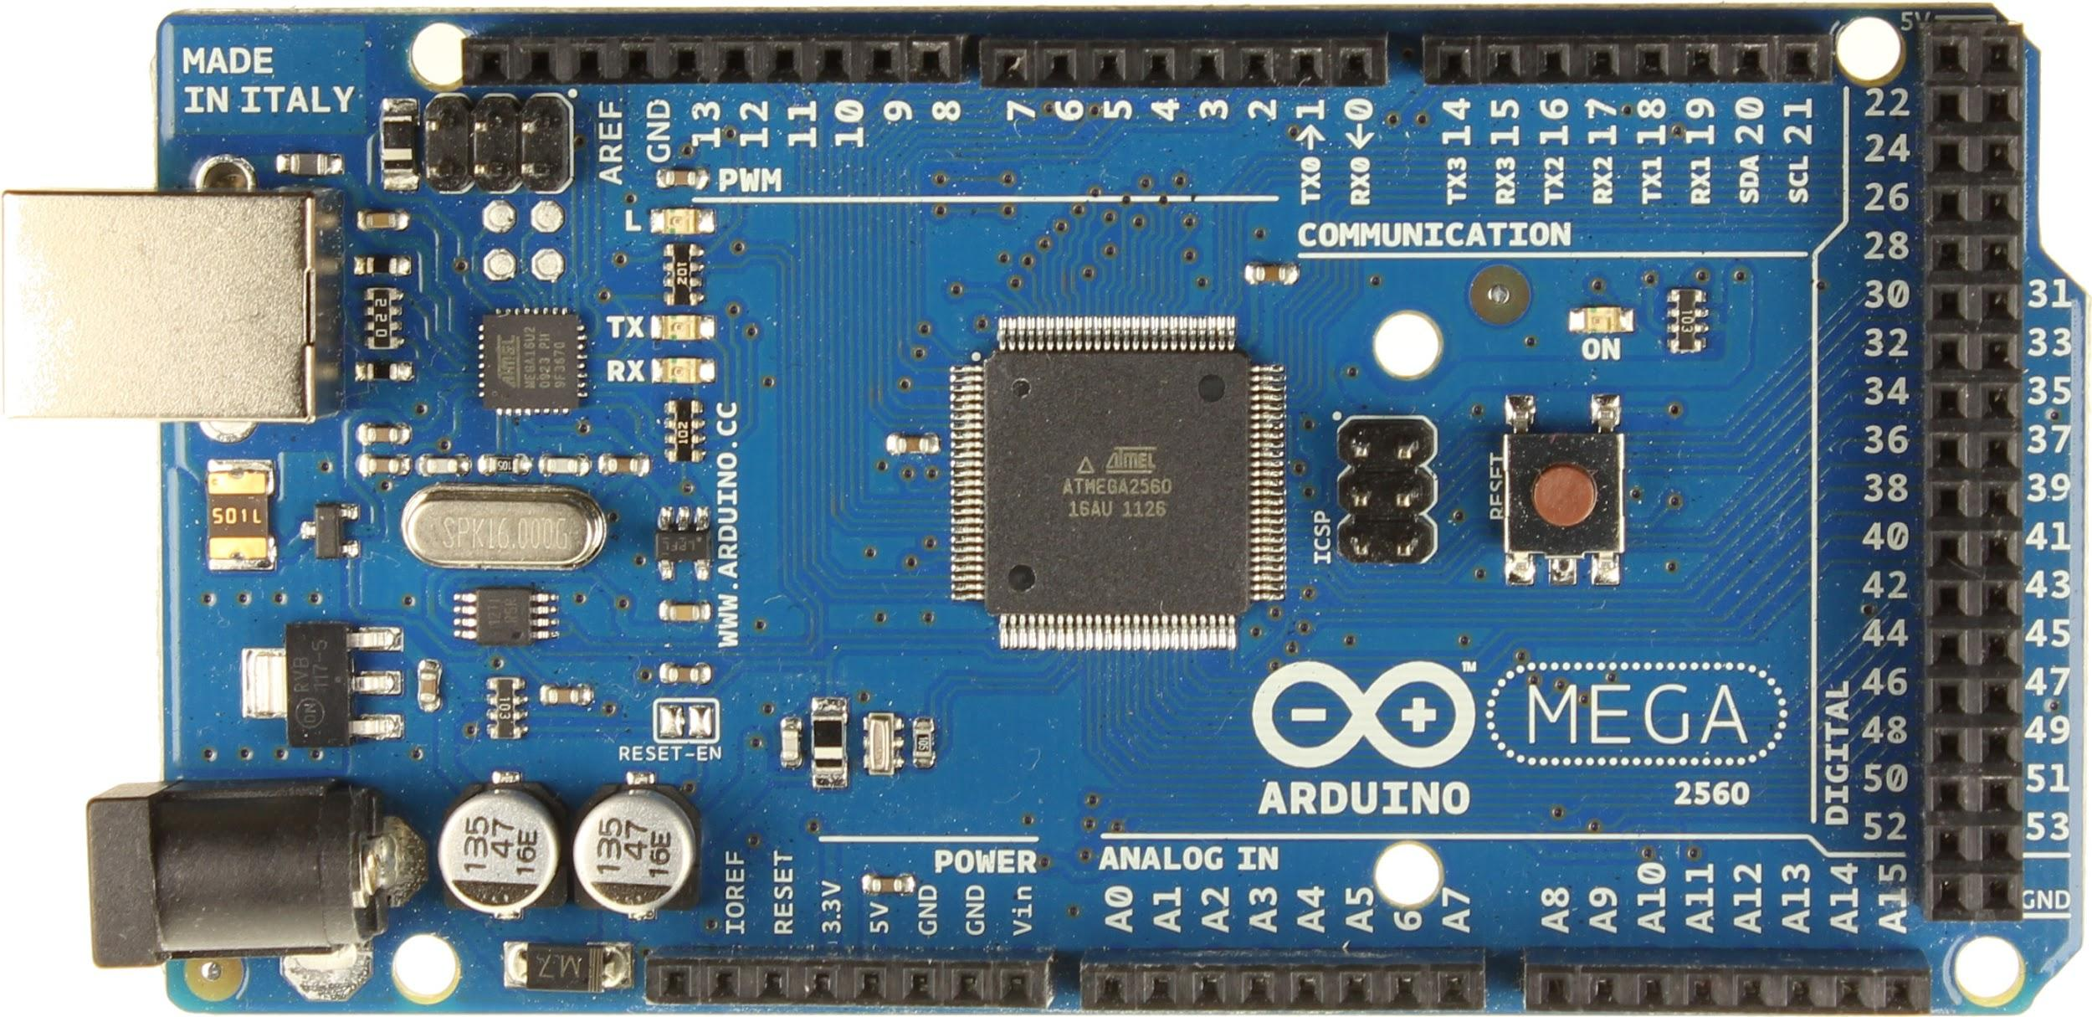
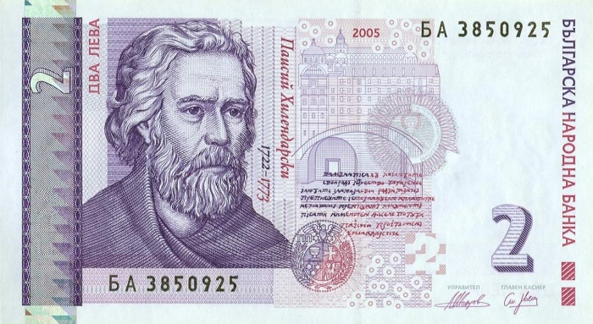
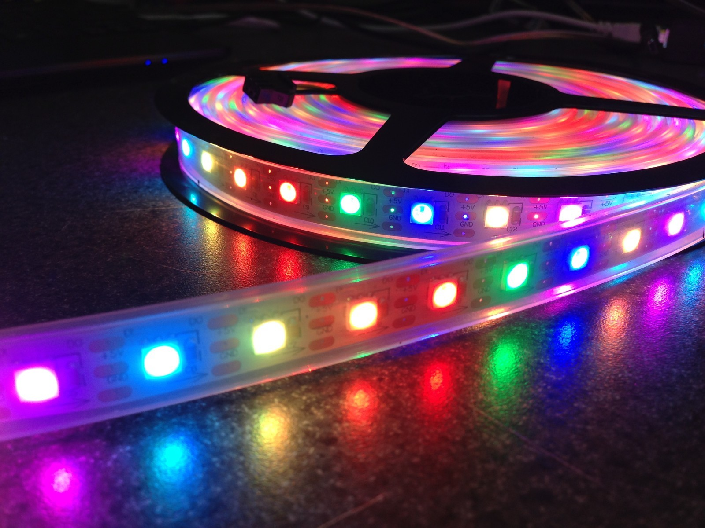
Solution
100 $
<

Slide 4


=
Backlight
+

Slide 5

Why

Slide 6
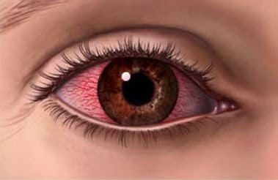
Relief eye strain

Slide 7
How

Slide 8


Slide 9


Slide 10

It’s cool

Slide 11
Team
Даниел Георги Инж. Христо

Slide 12
Demo
Pray for it

Slide 13
Thanks
:)

