Slide 1
Day
January has 31 days.
He runs five miles every day.
They haven't been seen for days
Notes:
a period of 24 hours

Slide 2
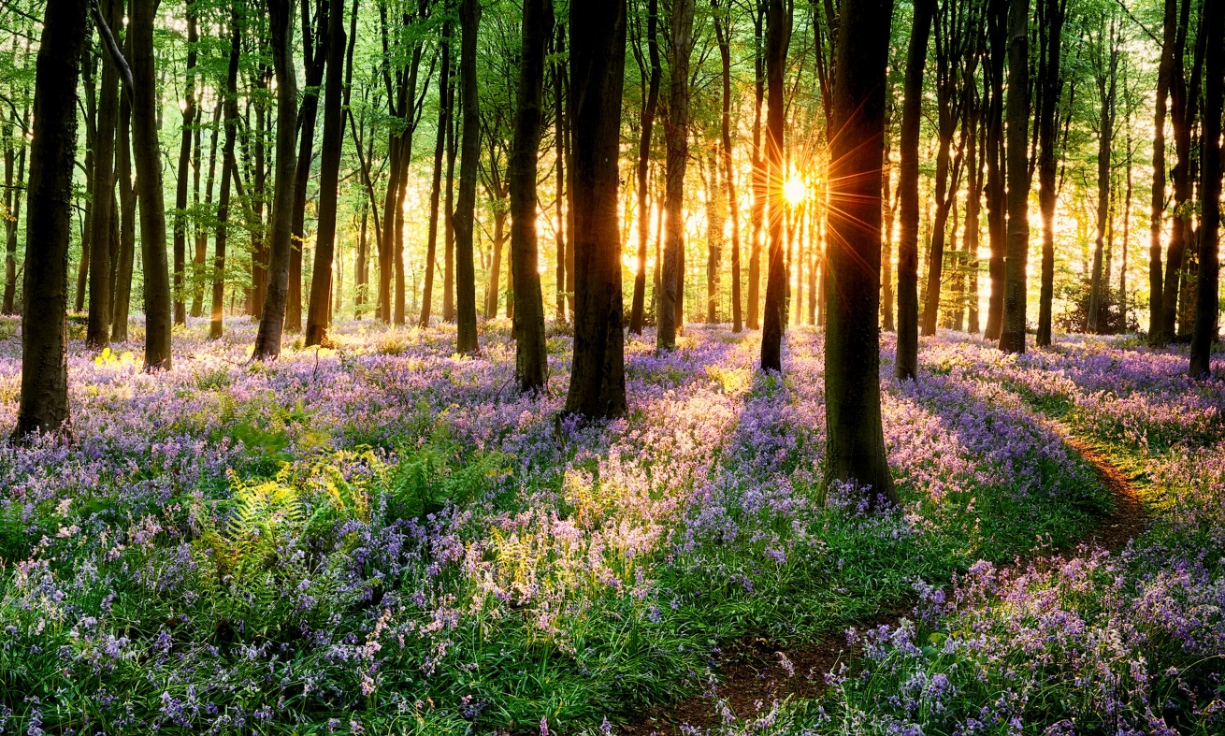
spring
We decided to have a spring break in Paris.
Summer
Autumn
Winter
Notes:
the season of the year between winter and summer

Slide 3

Hour
There are 24 hours in a day.
Our opening hours are from 8.00 to 6.00.
Minute
Second
Notes:
How many hours' sleep do you need?
There are 24 hours in a day.

Slide 4
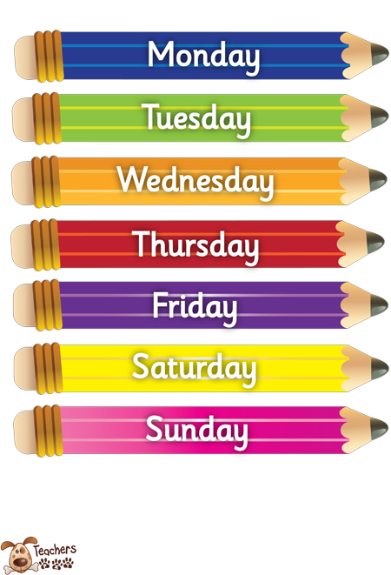
Week
We go to the cinema about once a week.
Weekend
Notes:
a period of seven days, especially either from Monday to Sunday

Slide 5

Year
We went to Egypt on holiday last year.
Decade
Century
Notes:
a period of twelve months, especially from 1 January to 31 December

Slide 6
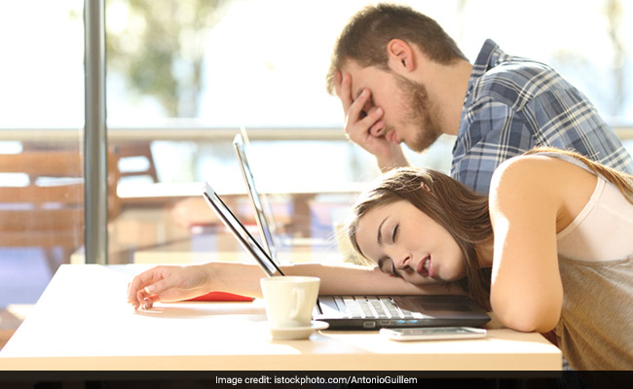
Afternoon
Let's go to the park this afternoon.
It was a sunny afternoon.
Morning
Noon
Evening
Midnight
Notes:
the time from noon until evening

