Slide 1
CHOOSE A OR B

Slide 2
... to take money out of a bank account
A. invest money
B. withdraw money

Slide 3
... to get money by working
earn money
B. waste money

Slide 4
... to receive money from somebody who has died
inherit money
lend money

Slide 5
... to get money from somebody that you will give back
A. borrow money
B. invest money

Slide 6
... to use money on something you don’t need
A. lose money
B. waste money

Slide 7
... to give somebody money that they must give back to you
A. lend money
B. borrow money

Slide 8
... to buy shares in for example a business and hope that you will make a profit
A. invest money
B. waste money

Slide 9
GUESS THE VOCABULARY

Slide 10
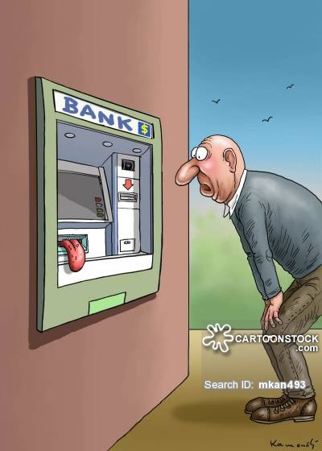
ATM/CASH MACHINE

Slide 11

BANK

Slide 12

CASH

