Slide 1
Tilemaps

Slide 2
Tile-maps
Why we use:
the world in which the character is moving can be very big - drawing the full world would be a lot of work
A tile-map makes the world a grid, and you can set a different Sprite in each grid cell
https://connect-prd-cdn.unity.com/20190206/learn/images/9a4eeef2-1aab-4f11-954e-a25e6738e97b_image25.gif._gif_.mp4

Slide 3
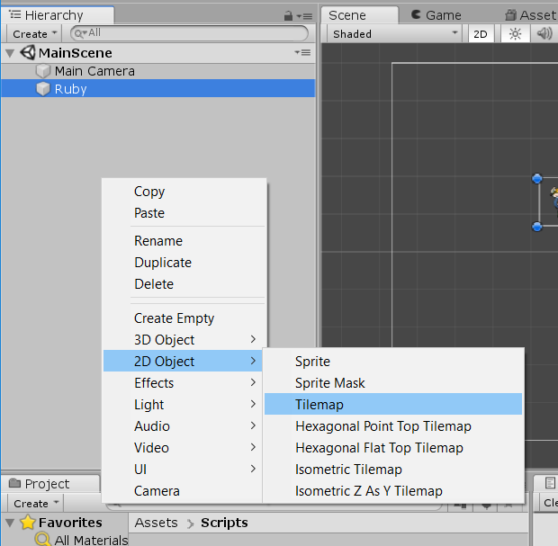
How to use
Step 1: In Hierarchy > create tile-map

Slide 4
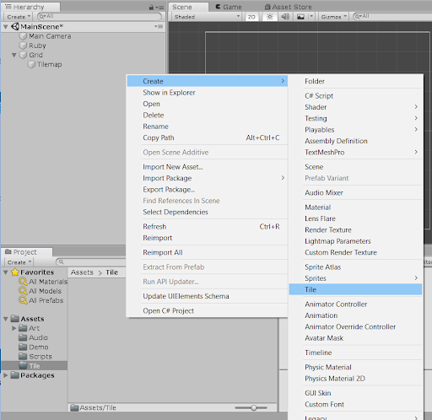
How to use
Step 2:
In Project > create tile
Continue, we drag sprite to sprite slot
So we have a tile

Slide 5
How to use
Step 3: create a palette
Go to Window > 2D > Tile palette. This will open the Tile Palette window
- Create a new palette
- Drag tile (created before) into that palette, save assets
- Now we can paint on the grid view

Slide 6
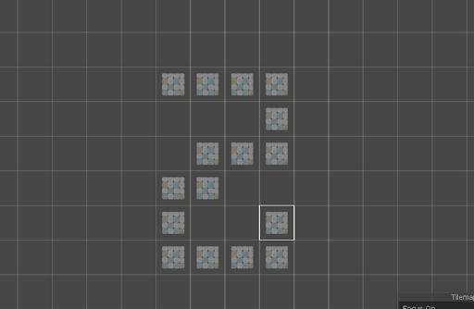
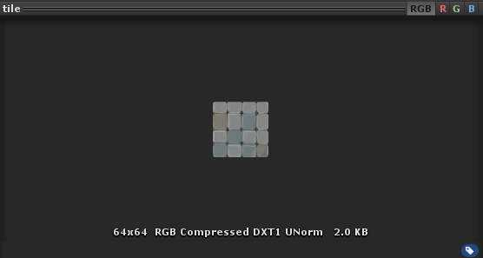
How to use
But tiles aren’t connected,
There are huge gaps between them
Because:
Each cell is 1 unit in width and 1 unit in height
The sprite is only 64 pixels in width and height
It’s < 100 pixels, it will be < 1 unit
Solution:
Change the Pixel Per Unit value to 64 > Done

Slide 7
Notes with palette
Know what active tilemap is using (because can have a lot of tilemaps)
Tile palette toolbar:
Picker (I): copy a group and create a new brush
Paintbrush (B): choose tool and choose tile again, and paint with single brush
Fill Box (U): paint with multi tiles
Eraser (D): erase with active brush*
Fill (G): choose tool and choose tile, paint at blank tiles > it will fill those tiles
Edit: press this button, we can edit our palette
Active brush: is single or multiple tile up to your last time you choose

Slide 8
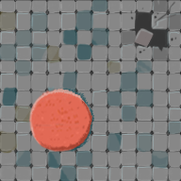
Tile-set
This is a tile set (can split the image into nine Sprites)
Sprite mode: multiple
Pixel per unity: 64
Sprite editor > Slice > Type: Grid by cell size, pixel size: x=y=64
Slice > Apply

Slide 9
Assign your Sprites to Tiles
Drag sprites (from project window) into palette
> save asset. Do not need create tile
You’re ready to paint your world!
TIP: Remember, the Fill Box Tool can help you paint your world quickly

Slide 10
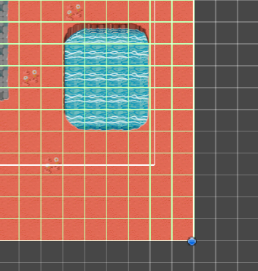
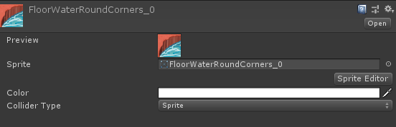
Collide with tilemaps
When we add component ‘Tilemap Collider 2D’ to tilemap object
It looks like the next image
If we just want player collider with water tile,
Choose the tile, and set Collider Type = Sprite (collide with player)
And other tile, Collider Type = None

Slide 11
Optimize the Tilemap Collider
It’s heavier on computation for the physics system; if you have a big world, it can start slowing down game
It can create small problems on the borders between tiles. Since they are two Colliders side-by-side, and there is a tiny gap between them
To address these issues, Unity offers a component called a Composite Collider 2D

Slide 12
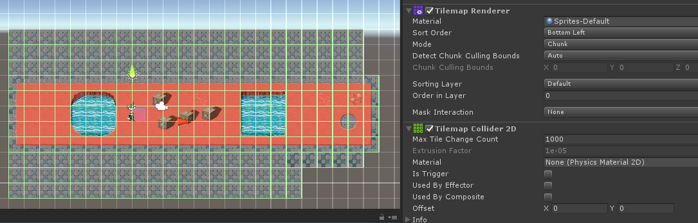
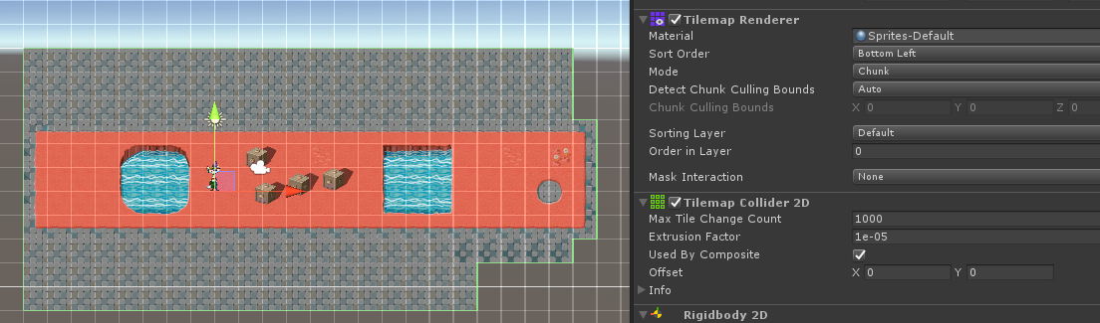
Optimize the Tilemap Collider
Add Composite Collider 2D to tilemap object (rigidbody 2D auto add too)
Enable the Used By Composite checkbox
Set the Rigidbody Body Type property to Static

Slide 13
2D Tilemap Asset Workflow: From Image to Level
https://blogs.unity3d.com/2018/01/25/2d-tilemap-asset-workflow-from-image-to-level/
https://www.raywenderlich.com/23-introduction-to-the-new-unity-2d-tilemap-system

Slide 14
Isometric

Slide 15
Animation with tile
Ex: If we have a waterfall, we can make waterfall down

