Slide 1
PORTALDOT HACKER HOUSE 2026 · TRACK 3: NODE OPERATIONS & TOOLING
PortaPulse
High-performance node operations and real-time telemetry for the Portaldot network.
Live RPC data
Four operator tools
Open source
Read straight from
wss://mainnet.portaldot.io
Telemetry, RPC benchmark,
batch planner, heartbeat alerts
MIT licensed, React 19 +
@polkadot/api, no mocks
naomi197.github.io/portapulse

Slide 2
THE PROBLEM
Node operators fly blind on Portaldot
01
No native telemetry view
Validators and node runners have no single place to watch block height, finality lag, peer count, or head size for a Portaldot node.
02
Slow blocks hide failures
Portaldot produces roughly one block per minute. A stalled chain looks identical to a quiet one until it is far too late to react.
03
RPC endpoints are a black box
There is no quick way to compare latency or health between a public endpoint and a local development node before trusting it.
04
Outages are noticed after the fact
Without an alerting path, desync, peer isolation, and finality stalls surface only when someone happens to look.

Slide 3
THE SOLUTION
One dashboard that reads the chain directly
Real-time telemetry
RPC benchmark
Latest block, median block time, extrinsics in head, active peers, and finalized head, refreshed from live RPC.
Timed health checks across public and local endpoints so operators can pick the fastest path.
Batch load planner
Heartbeat alerts
Sizes a transaction batch against the observed head size and reports estimated blocks to clear.
A standalone worker polls the chain and posts real alerts to Discord or Slack when a node degrades.

Slide 4
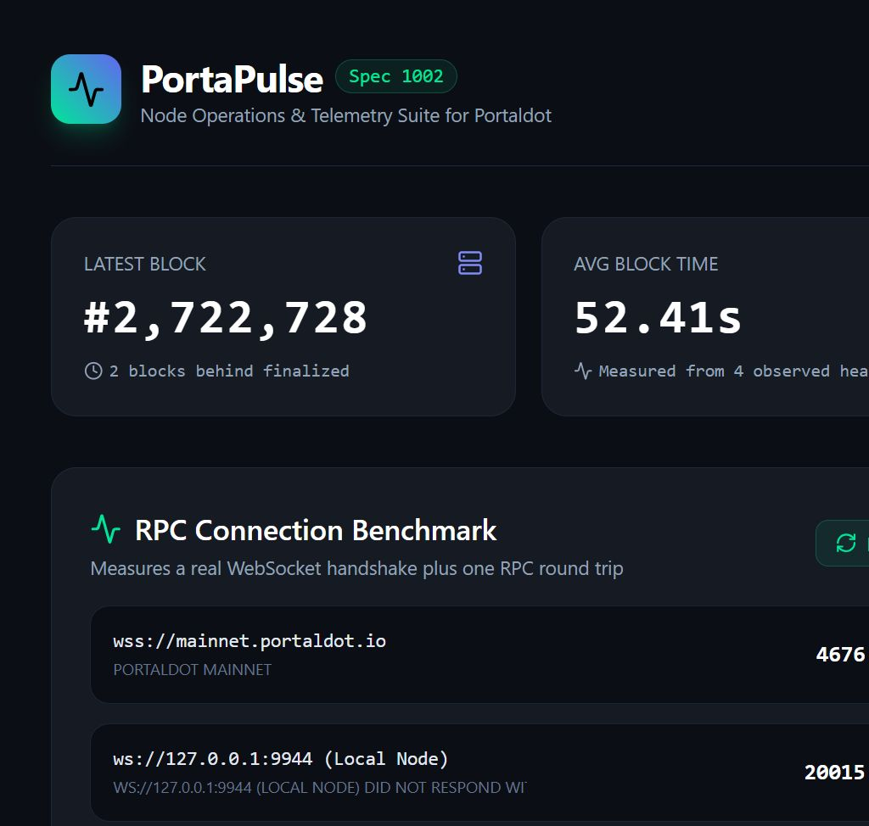
EVIDENCE — LIVE DATA
Every metric is a real RPC value, not a mock
Observed against wss://mainnet.portaldot.io
Chain
Portaldot Mainnet
Client
Portaldot Node 2.0.0
Runtime spec
1002
Token
POT · 14 decimals
SS58 prefix
42
Block production
~1 block / minute
Independent checks ship with the repo: verify-client.mjs and measure-block-time.mjs connect to the live network and print the same numbers.

Slide 5
OPERATIONS — ALERTING
The worker catches failures the browser cannot
A browser tab cannot wake you when your machine is asleep. worker/heartbeat.mjs is a standalone Node process that polls the chain and delivers real alerts.
Condition
Severity
Default threshold
No new block for a while
Critical
180 s
Node reports it is still syncing
Warning
—
Peer count below the minimum
Critical
1 peer
Finality lag grows too large
Warning
10 blocks
Alerts fire once when a condition opens, repeat on a cooldown while it persists, and send a recovery notice when it clears.

Slide 6
WHY PORTALDOT
Node health is the product's whole premise
Portaldot produces blocks slowly
Roughly one block per minute means a stall is easy to miss and expensive to diagnose after the fact. PortaPulse treats finality lag and block silence as first-class signals.
Operator tooling is the gap
Portaldot V3 combines Substrate and EVM execution. Validators and infrastructure teams need monitoring, benchmarking, and alerting that speaks that stack directly.
Built on Portaldot primitives
PortaPulse reads Portaldot RPC through @polkadot/api, targets the Portaldot Mainnet and local development endpoints, and reports Portaldot chain properties — POT, SS58 prefix 42, runtime spec 1002.

Slide 7
STATUS & NEXT STEPS
Working today, with a clear runway
Shipped
Next
— Live dashboard reading Portaldot Mainnet
— Historical charts for block time and extrinsics
— RPC benchmark across public and local nodes
— Prometheus export for existing monitoring stacks
— Batch load planner against observed head data
— Heartbeat worker with Discord / Slack alerts
— Validator staking and slashing status
— Alert-rule test suite and verification scripts
— Portaldot testnet deployment as the network opens
— Public repo, README, and 63-second demo
PortaPulse is open source under MIT and already deployed: naomi197.github.io/portapulse · github.com/naomi197/portapulse

Slide 8
THE ASK
Support PortaPulse as the
operator toolkit for Portaldot
Node health decides whether a network is usable. PortaPulse gives validators and infrastructure teams the telemetry, benchmarking, and alerting to keep Portaldot nodes reliable — and it is ready to extend as the ecosystem grows.
naomi197.github.io/portapulse · github.com/naomi197/portapulse

