Slide 1

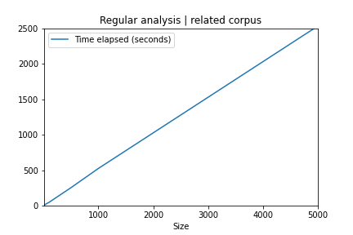
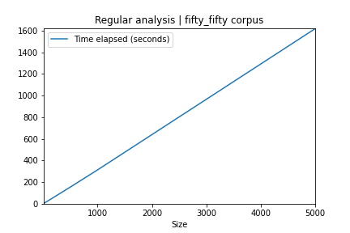
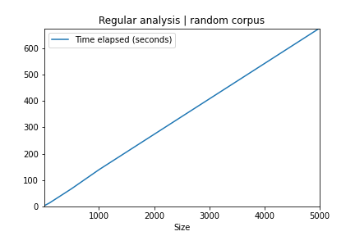
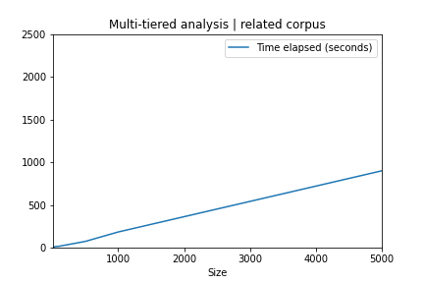
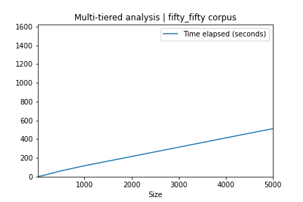
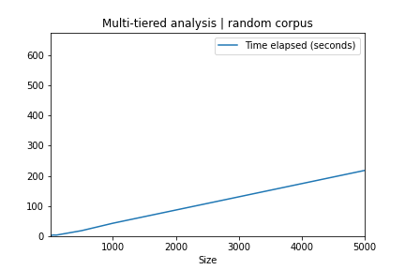
Increasing the Efficiency of Text Analysis Programs Using a Multi-Tiered Approach
By Daniel O’Brien and Advisor Michael Gildein
Abstract
Technologies Used
Corpora
Real World Applications
Natural Language Processing is an increasingly researched field that has a few major barricades holding back its progress. One of these barricades is the intensive computational costs used by its processes. The goal for this project is to explore potential efficiencies that can be gained by implementing a multi-tiered filter based analysis system. A text-analysis script was written and designed in order to prove this hypothesis. The resulting data indicates that a multi-tier approach can be successfully implemented for an increase in efficiency.
Python
Programming Language
Jupyter Notebook
Integrated Development Environment
Github
Source Code Management
Doc2Vec
Natural Language Processing Python
package
Pandas
Data manipulation Python package
Nltk
Natural Language Tokenizer Python
package
Sklearn
Vector Analysis Python package
BeautifulSoup
Web scraper python package
Related
Patent Enforcement
Corpus is filled with articles related to given seed. Worst case scenario
Patents can be compared to product descriptions quickly and efficiently allowing companies to sift through large volumes of potential infringements.
Fifty Fifty
Corpus is half filled with related articles, half filled with random articles. Average case scenario.
Credit Transfers
Random
Enable universities to efficiently compare the course descriptions and make a guided decision as to whether or not the credits should transfer.
Corpus is filled with entirely random articles. Best case scenario.
Results
Conclusion
Related
Fifty Fifty
Random
This data shows that it is possible to boost efficiency in natural language processing applications using a multi-tiered approach. It also shows that this approach works on broad sets of documents that span multiple different topics. The multi-tiered process proves to be effective in the best, average, and worst case scenarios, with an efficiency boost ranging 2.8x to 3.1x faster than the regular analysis process. This means that the approach has a wide range of potential applications in the Data Science Industry. Considerations should be made to implement a similar system in any application involved in natural language processing and text similarity analysis.

