Slide 1
CI/CD
John Businge
john.businge@unlv.edu

Slide 2
Announcements
The two lab marks will be posted by the end of the weekend
Precondition report feedback this weekend
A quick glance at the ideas, they seem solid.
Start working on the CI lab – Due 09/24/2024
Start working on DP I – Due 09/30/2024
Kane Toomer from the Advising center will visit 09/25/2024

Slide 3
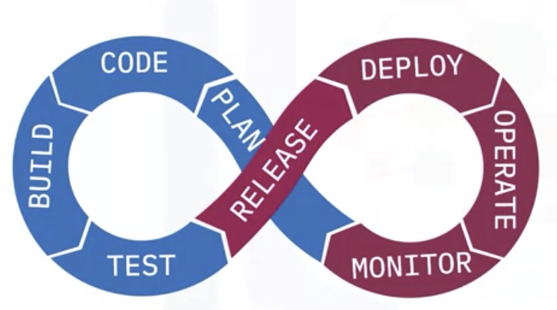
What is CI/CD
CI/CD is not one process. It’s two separate and distinct processes that happen right after each other.
CI is an automation process that allows you to integrate your work into the main branch so your branch stays within a reasonable distance.
CD is then taking the integrated code and deploying it somewhere.

Slide 4
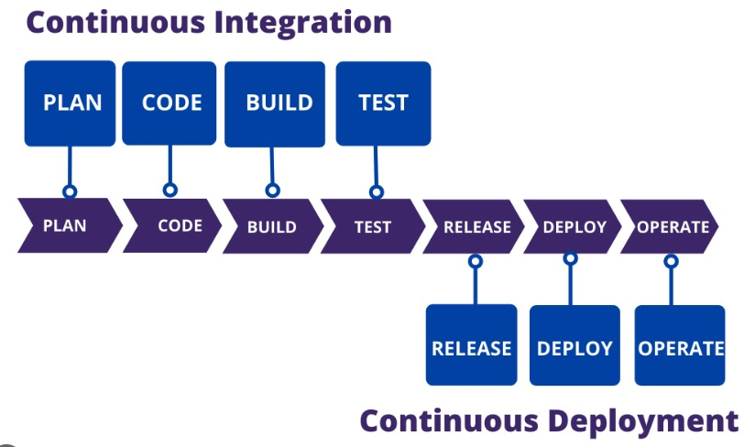
CI/CD pipeline
Project focus
Continuous Intergration
Continuous Delivery
Encompasses the entire software development lifecycle from planning and coding to building and testing
Emphasis on the frequent integration of code changes
automated building of the application
running of automated tests to ensure the quality and correctness
Staging environment for automated deployment
Release – changes are prepared (e.g., triggering automated tests)
Deploy – packaged application is deployed in the staging environment
Operate - the application is actively monitored and maintained in the production environment (manual step)
Notes:
CI is where developers plan and then code the solution, and then build it and test it in several repeating cycles until it’s complete. And then the solution is ready to be delivered.
While Continuous Delivery is made up of Release, Deploy, and Operate phases, where the solution is released, and the binaries are deployed into a given environment in repeating cycles, and the solution is then in live operation from that point on.
In the class and project, we will focus on only CI

Slide 5
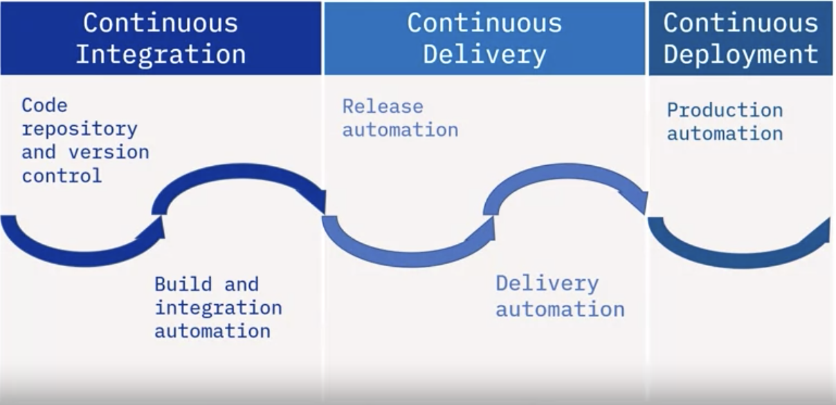

Continuous Deployment
Manual approval of the changes after CI before deployment
Pushing changes to production automatically after passing CI
Continuous Integration
Continuous Deployment
Notes:
Continuous Deployment’ is when you continuously push to production
Release automation – for example releasing your package to a package manager
Production automation – deploying your package to production – e.g., deploying your app/package to app store or google play

Slide 6
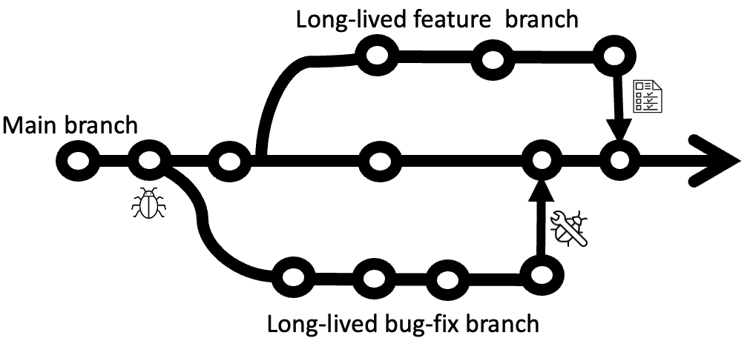
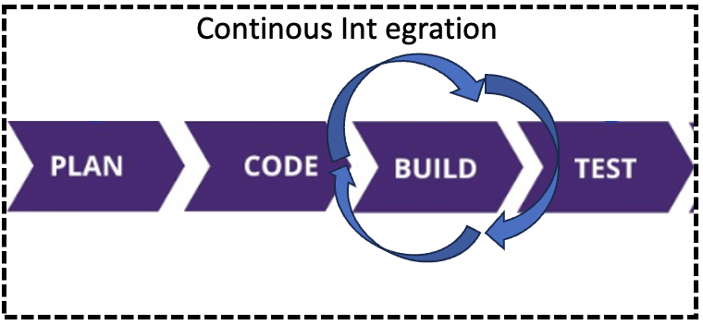
Traditional Development
CI Development
Developers work in long-lived development branches
Merging and building occurs periodically
Continued development on branches causes drift
Short-lived branches
Frequent pull requests
Automated CI tools
Notes:
Traditional development
The developers work on large features or fixes and commit them into their own development branches.
These branches can exist for a long time, have a large scope, and generally require many code changes and edits.
When development is completed on these branches, only then are they tested and merged into the main branch and built for production.
This development method can cause drift between the main branch and the development branch, among other issues.
2. In the next couple of slides, I will discuss each of the features of CI

Slide 7
Short-lived branches
A playground for developers to create and test new features
Meant to be deleted after being merged
Benefits
Reduces drift
Reduces parallel changes

Slide 8
Frequent pull requests
Created for a specific feature or bug-fix
Merged by maintaners/owners
Frequent pull requests serve as small pieces of bigger puzzle, it easy to build upon the most updated code.
Benefits:
Frequent feedback from increased collaboration - PR review
Faster reaction to changes
Reduced management risks
Notes:
Making frequent pull requests back to the master or main branch is a best practice. These pull requests are meant to contain code updates that serve a specific purpose. It makes code changes cleaner and easier to understand.
A pull request requires approval from a repository maintainer or owner to be successfully merged. At a minimum, no one should be able to approve their own pull request. You want to ensure that every change has at least two sets of eyes on it
These frequent pull requests serve as small pieces of a much bigger puzzle, making it easy to build upon the most updated code.
Benefits:
Each pull request needs to be reviewed, which facilitates increased collaboration among developers. It also enables developers to react quickly.
Required changes can be tested and put into production faster, so solutions can get to the customer faster.
And due to the frequency of Continuous Integration, you know exactly how much functionality you have built to date, reducing management risk. It improves your ability to predict when and if you will deliver the necessary functionality on time.

Slide 9
Automated CI
Uses webhooks to monitor events (e.g., pull requests, pushes, releases)
These tools can run tests that ensure your file changes or pull requests don’t break the entire application.
Streamlines the development process so that testing and checking code is never tedious
Tools:
GitHub Actions
CircleCI
Jenkins CI
Travis CI
Notes:
Automated CI tools (like those on the right) subscribe to events, such as pull requests, using webhooks that can then trigger a workflow. That workflow can be anything, such as building an application. Once complete, these tools report back with messages of a successful or failed build.
These tools can run tests that ensure your file changes or pull requests don’t break the entire application.
With these automation tools, you can streamline your development process so that testing and checking your code is never tedious.

Slide 10
Common CI/CD tools
Jenkins
Software installed on a server where the central build takes place
Oldest and most complex
CircleCI
A platform that can be used to implement DevOps practices
Travis CI
Hosted CI service that helps developers build & test projects hosted on GitHub and BitBucket
GitHub Actions
A platform to automate builds and tests and deploy GitHub workflows
Only works with GitHub
CI lab focus

Slide 11
Benefits of CI
Faster code-change reaction time
You make a change to your code
Code gets tested
Even if you forgot to run the tests, the CI tool will test it.
Change gets built
Even if you forgot to check if the build works, the CI tool will check it.
Deliver solutions quickly into customer’s hands
Knowing that all the tests have passed, and the build is not broken.
Notes:
The first benefit of CI/CD is that you get faster reaction times to code changes.
Because every time you make a change to your code and push it to a remote branch, the change gets tested, so even if you forgot to run the tests, the CI tool will test it.
2. Then, the change gets built, so even if you forgot to check if the build works, the CI tool will check it.
3. And then you can deliver the solution into your customers’ hands more quickly, knowing that all of the tests have passed, and the build is not broken.

Slide 12
Benefits of CI - Reduced code integration risk
Integrating smaller and smaller things
Smaller changes mean less risk of something going wrong
No need of integrating 100,000 lines of code into your code base
Only need to integrate 10-50 lines of code
Remember, less change means less risk.

Slide 13
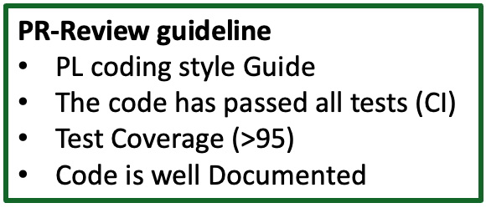

Benefits of CI – Higher code quality
Every Pull request = code review opportunity
When someone makes a pull request, go and look at the code
Extra pair set of eyes
Pull request review:
All is good - “Yeah it looks good to me” or
Code is not doing what it’s supposed to do - “why are you changing this?”
Notes:
Another benefit is that you get higher code quality with CI/CD, because things are constantly being reviewed and constantly being tested.
Every pull request is an opportunity for a code review. Forget about scheduling code reviews as a separate task. One of the things you should be doing as a best practice is, when someone makes a pull request, you should go and look at the code.
Having another set of eyes looking at what was changed while you're waiting for the test to pass is always going to be a good thing.
During your review of the pull request you can either say “yeah it looks good to me”, or maybe you look at the title and it says, the code needs to do this, but then you see some piece of the code and realise that this code has nothing to do with that, so you can ask, “why are you changing this?”.

Slide 14



Benefits of CI – Higher code quality
Test 1
Test 2
Test 2
Do all tests pass?
Code coverage
What happened?
Wrote code but didn’t test?
PR Review - “the code coverage went down and so I’m not going to approve this yet. Please write more test cases”
New update, Coverage >= 95%,
PR Review – “I accept the PR now”.
Standard
After PR
95%
91%
Notes:
Look at the tests. Do all tests pass?
Look at the code coverage. Let’s say the code coverage went down. Your team has a standard of 95% code coverage, but code coverage was only at 91%.
So, what happened?
Maybe somebody wrote code, but they didn't write a test case to run all the lines of code.
In the review of the pull request, you can simply say that you don't accept it, and you can request more changes to the code.
You could say “the code coverage went down and so I’m not going to approve this yet”, and you can request that they write more test cases for the code.
And then they can go and write more test cases, and the pull request will see the code changes and rerun the tests.

Slide 15
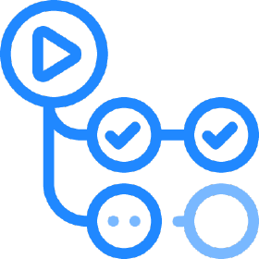
GitHub Actions – Marketplace
GitHub Actoins is a CI/CD tool available on every repository
Integrated into GitHub as a service
It allows you to treat your CI pipeline as code
It uses a .github/workflows/ folder to store workflow definitions as .yaml files

Slide 16
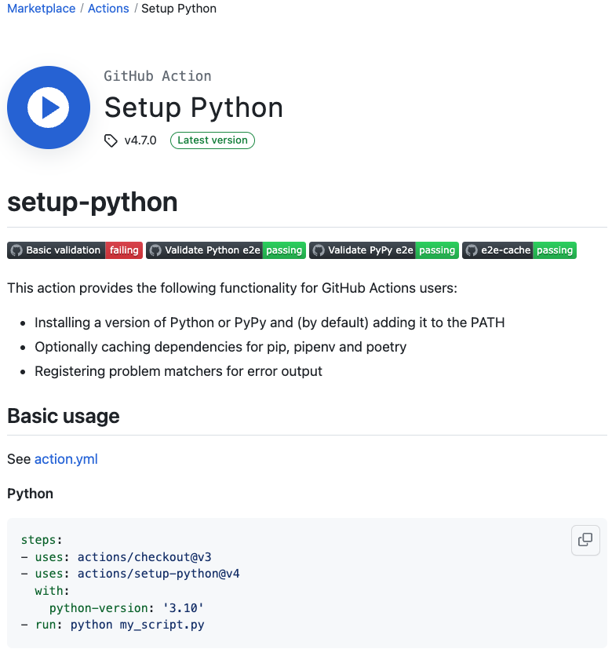
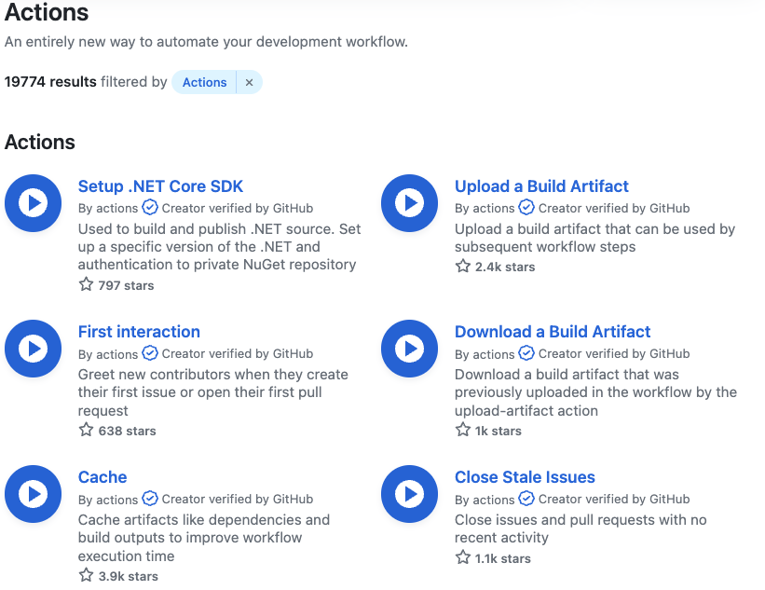
GitHub Actions
GitHub Actoins Marketplace hosts actions for workflows
Large variety of actions available
They help you jumpstart your workflows

Slide 17
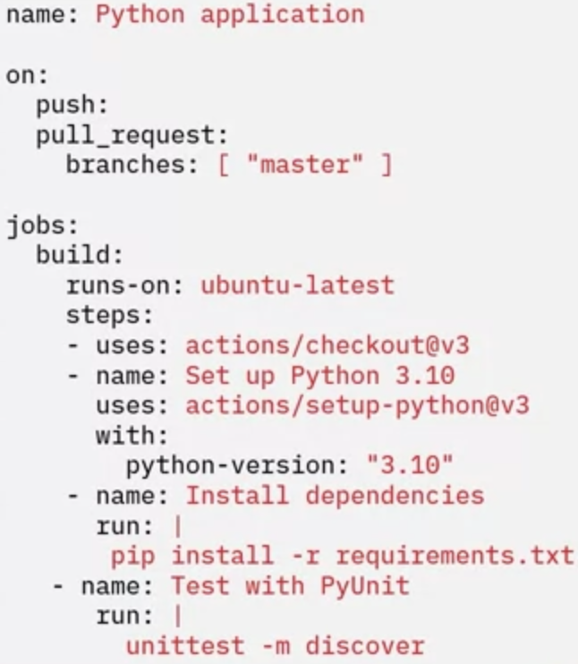
GitHub Actions - setup
All you need is a workflows folder and a .yaml file
No other configurations is needed
Starter code is also available
Notes:
You can edit them for your situation

Slide 18
GitHub Actions setup
Create a ‘.github’ folder
.github
workflows
Create a workflows’ folder
ci.yaml
cd.yaml
Place workflow .yaml files
Publish.yaml
Notes:
1. Workflow has an Event that tells when a workflow should run. Events could be things like when you push to a repo, create a pull request, or create
a release, e.t.c
2. Workflows use runners to execute the jobs. There are built-in runners for different virtual environments, or you can use a self-hosted runner in your environment.
3. A workflow contains one or more jobs. You can have one job that builds your component and another job that publishes it to an artifact repository, and still another job that deploys it to an environment.
4. Each job can contain one or more steps. One step can check out the code, another step might compile the code, yet another step might run a linter on the code, and you'll probably have a step that runs a suite of test cases to make sure that the code works properly
5. And each step can contain one or more actions or shell commands. Actions are the lowest level of a workflow. They perform a single task like check out code, install dependencies, compile code, or run tests. This hierarchy of jobs, steps, and actions allows you to logically group the actions performed by your workflow.

Slide 19
GitHub Actions - setup basic concepts
Workflow is the basic concept in GitHub Actions
Workflows is a series of automated procedures represented as Jobs
E.g., workflow for CI, workflow for CD, and another workflow for publishing
Everyrepository can have any number of workflows
Each workflow has the following components:
Event
Runner
Jobs
Steps
Actions
Events
Push
Pull Request
Release
Issue
Workflow contains a runner that execute jobs
Built-in runners
Hosted runners
Workflow contains Jobs
Builds component
Publishes to artifact repository
Deploys it to an environment
Jobs Contain steps
Checkout code
Compile code
Run linter
Run test suite
Steps contain Actions of shell commands
Checkout code
Compile code
Run tests
Notes:
1. Workflow has an Event that tells when a workflow should run. Events could be things like when you push to a repo, create a pull request, or create
a release, e.t.c
2. Workflows use runners to execute the jobs. There are built-in runners for different virtual environments, or you can use a self-hosted runner in your environment.
3. A workflow contains one or more jobs. You can have one job that builds your component and another job that publishes it to an artifact repository, and still another job that deploys it to an environment.
4. Each job can contain one or more steps. One step can check out the code, another step might compile the code, yet another step might run a linter on the code, and you'll probably have a step that runs a suite of test cases to make sure that the code works properly
5. And each step can contain one or more actions or shell commands. Actions are the lowest level of a workflow. They perform a single task like check out code, install dependencies, compile code, or run tests. This hierarchy of jobs, steps, and actions allows you to logically group the actions performed by your workflow.

Slide 20
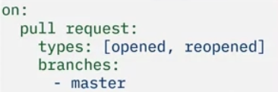


Events
Something that activates the execution of a workflow e.g.,
fork, issues, push, pull request, release
Event examples
Project focus
Runs whenever a pull request is opened or reopened against a master/main branch
Runs whenever a push is made to the main branch including merging a pull request
Lab focus
Runs whenever a release is published
Great for triggering a packaging workflow, e.g., publishing your Java project to Maven
Notes:
Remember, an event is something that activates the execution of a workflow. There are currently very many different events that can trigger a workflow. The bold ones are the most popular.
All events start with the keyword ‘on:’ followed by the keyword of the event. In this case, ‘pull request.’
Then some events have ‘types.’ In this example, this event is listening for types, such as when a pull request is opened
or reopened.
Another input to the pull request event is a list of branches to monitor. This example designates the master branch as the target.

Slide 21
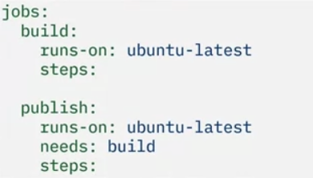
Jobs
Each workflow can have multiple jobs
Jobs are named whatever you want
Jobs run in parallel unless dependencies specified using the ‘needs’ keword
Each job contains:
Runner
Services (optional)
Steps
The publish job will only run after the build job that it depends on has been completed successfully
Notes:
There are two jobs, build and publish

Slide 22
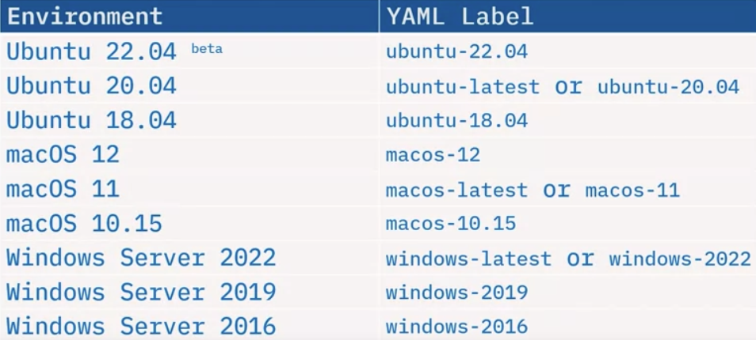
Runners
A runner is a server that performs a job on a specific platform or operating system.
Notes:
A runner is a server that performs a job on a specific platform or operating system.
In this list, you can see all the operating systems that GitHub Actions supports.
There are several flavours of Ubuntu, macOS, and Windows Server.
Once you specify a runner for a job, all of the steps will be executed on that runner.

Slide 23



Runner Examples
This job runs on whatever the latest version of Ubuntu is.
This job runs on Ubuntu 22.04 regardless of the lasted version.
This job runs runs inside a Python 3.9-slim Docker container (Debian 11) on top if the latest Ubuntu distribution
Notes:
Here are some examples of runner definitions.

Slide 24
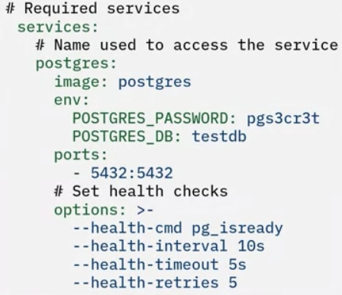
Services
Services are defined as Docker containers
Databases, messages queues, and more
The name you use becomes the DNS name used to access it
The service in this example is named postgres
Notes:
Jobs can also optionally define required services for the workflow. Services are defined as Docker containers. You could use any public Docker image you'd like to create the service, including your own. You can create databases, message queues, or services your workflow needs.
This example creates a Postgres database that is required before running some unit tests. So, in this example, you would look for your Postgres database on a host called postgres.
Using services like this allows you to specify the same Docker containers that you use in development for use in your workflows.

Slide 25
Actions
steps:
- name: Upload code coverage
uses: codecov/codecov-action@v3
with:
version: “v0.1.13”
Actions are procedures that can be executed within a step.
Actions require the (uses:) keyword
Actions can have arguments by specifying (with:) keyword followed by name-value pairs
Read the actions documentation to explore all options
Notes:
Actions are procedures that can be executed within a step.
Defining actions requires the ‘uses:’ keyword followed by the name of the action. There is a large library of actions in the GitHub Actions Marketplace community.
Actions can have arguments to configure them by specifying the ‘with:’ keyword followed by name-value pairs. Some actions use the ‘args:’ keyword.
In this example, the codecov action accepts a version as one of its optional parameters.
Read the actions documentation to explore all possible options that you can configure an action with.

Slide 26
Steps
steps:
- name: Run unit tests with nose
id: testing
run: nosetests
env:
DATABASE_URI: “redis://redis:6379”
FLASK_APP: service:app
Steps are the heart of GitHub Actions. This is where all the work happens.
Steps can have an optional name (name:) that displays in the report
Steps can have an optional (id:) to refer to other steps
Steps have either an action (uses:) or a shell command (run:)
Steps can have an environment variable (env:)
Notes:
Steps are the heart of GitHub Actions. This is where all of the work happens.
A step is a task comprising one or more shell commands or actions.
Steps can have an optional name specified by the ‘name:’ keyword that displays in the report.
It’s best to name your steps something descriptive so that when you look at the report, you know exactly what's going on in each step.

Slide 27
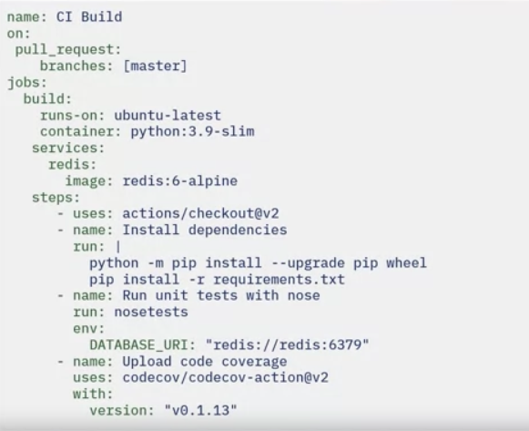
Putting everything together
Every workflow has a name: CI Build
Triggered on a Pull request
Runs in Python 3.9 container on top of the latest Ubuntu server
Notes:
Let's put everything together with an example.
Every workflow has a name. This one is called ‘CI Build’ because it's part of a Continuous Integration workflow.
It’s triggered on a pull request to the master branch.
It has a job called ‘build’ that runs in a Python 3.9 container on top of the latest
Ubuntu runner.
And it creates a database service called ‘redis’ from the Redis 6-Alpine Docker image

Slide 28
Steps
Steps: checkout the code using a GitHub Action
uses shell commands
upgrade pip and wheel to upgrade Python
pip to install all of the packages in the ‘requirements.txt’ file.
Runs unit tests with nosetests command
Establishes an environment variable
Uploads code coverage data on the Codecov website
Notes:
Let's put everything together with an example.
Every workflow has a name. This one is called ‘CI Build’ because it's part of a Continuous Integration workflow.
It’s triggered on a pull request to the master branch.
It has a job called ‘build’ that runs in a Python 3.9 container on top of the latest
Ubuntu runner.
And it creates a database service called ‘redis’ from the Redis 6-Alpine Docker image

Slide 29
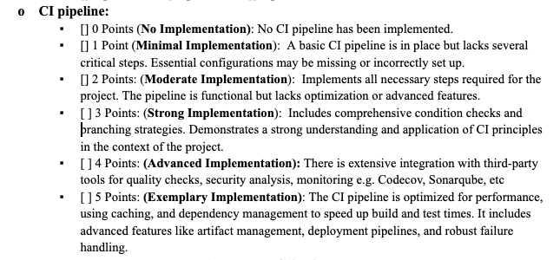
Project
One previous projects: Course Evaluation App

