Slide 1
Using LLMs to Perform Specific Software Development Lifecycle Activities
Prepared by: John Businge
john.businge@unlv.edu

Slide 2






The Hype around LLMs for Software Development
Cooled down
Notes:
The initial hype around using LLMs for software development has already started to cool down
The conversation has shifted from expecting LLMs to replace software developers (i.e., artificial intelligence) to considering LLMs as partners and focusing on where to best apply them (i.e., augmented intelligence).

Slide 3
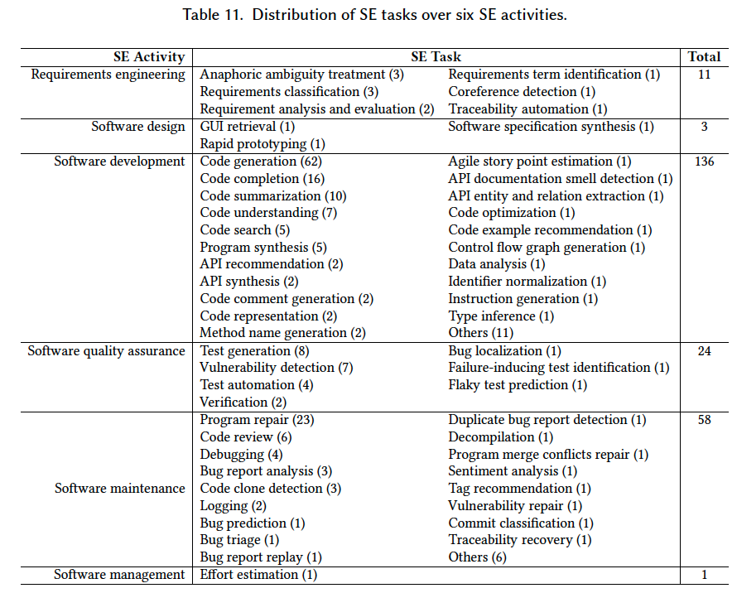
What SE Tasks have been addressed to date using LLM4SE
Hou et al. LLMs for SE: A Systematic Literature Review
https://arxiv.org/pdf/2308.10620.pdf
Analyzed 229 research papers on the subject
Read Section 6 of the paper to find which papers have addressed the SE tasks.
Notes:
Traceability automation. Software and system traceability refers to the ability to establish and maintain relationships between software artifacts, such as requirements, design definitions, code, and test cases, for product querying and development support

Slide 4
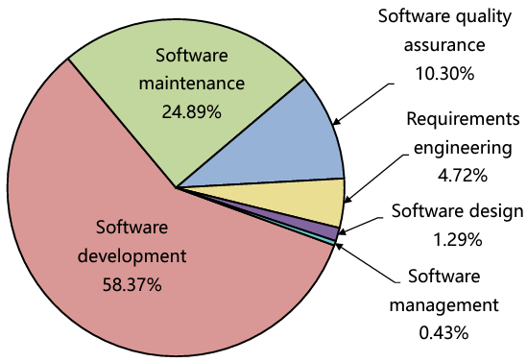
What SE Tasks have been addressed to date using LLM4SE
58.37% in software development showcases the significance of LLMs in producing code or text

Slide 5


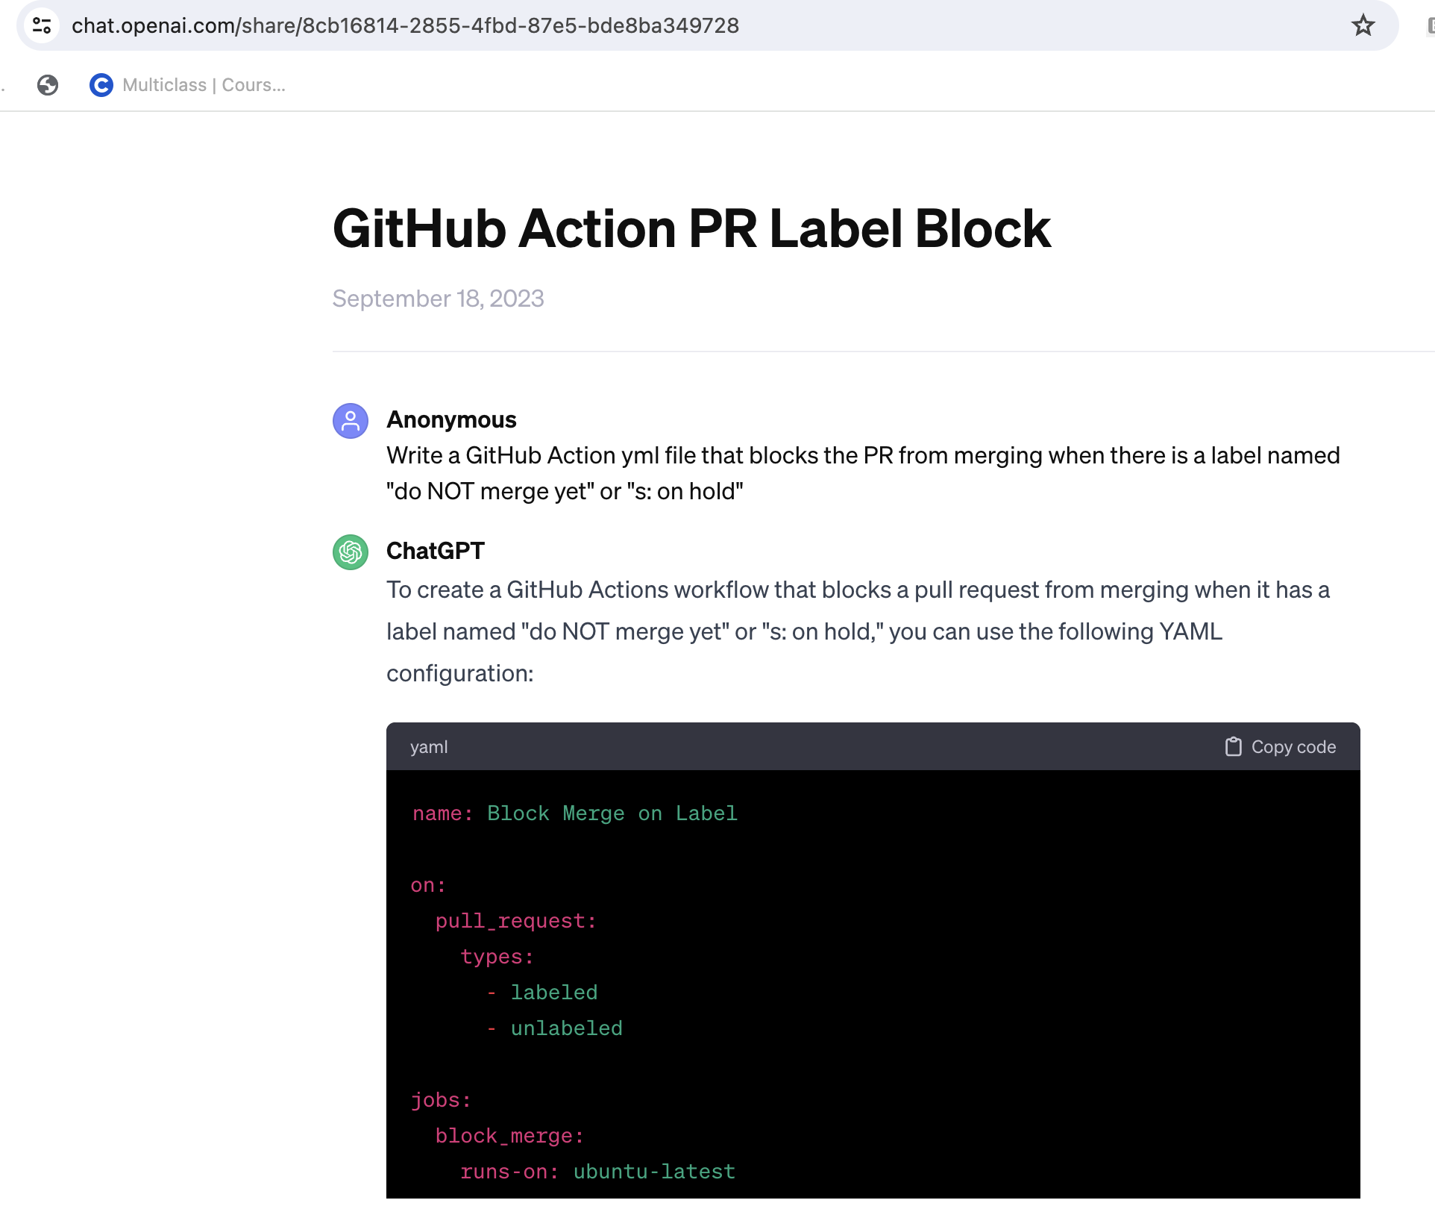
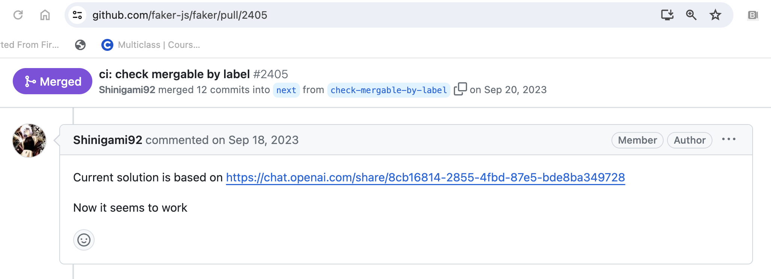
How are developers using ChatGPT to solve SE tasks?

Slide 6
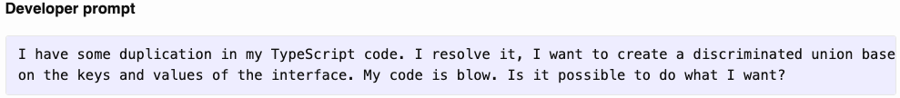
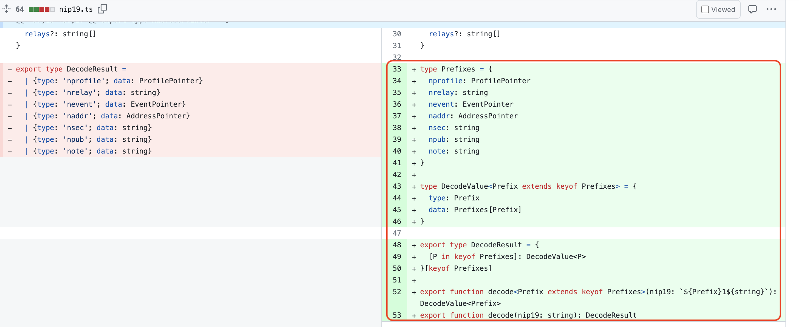
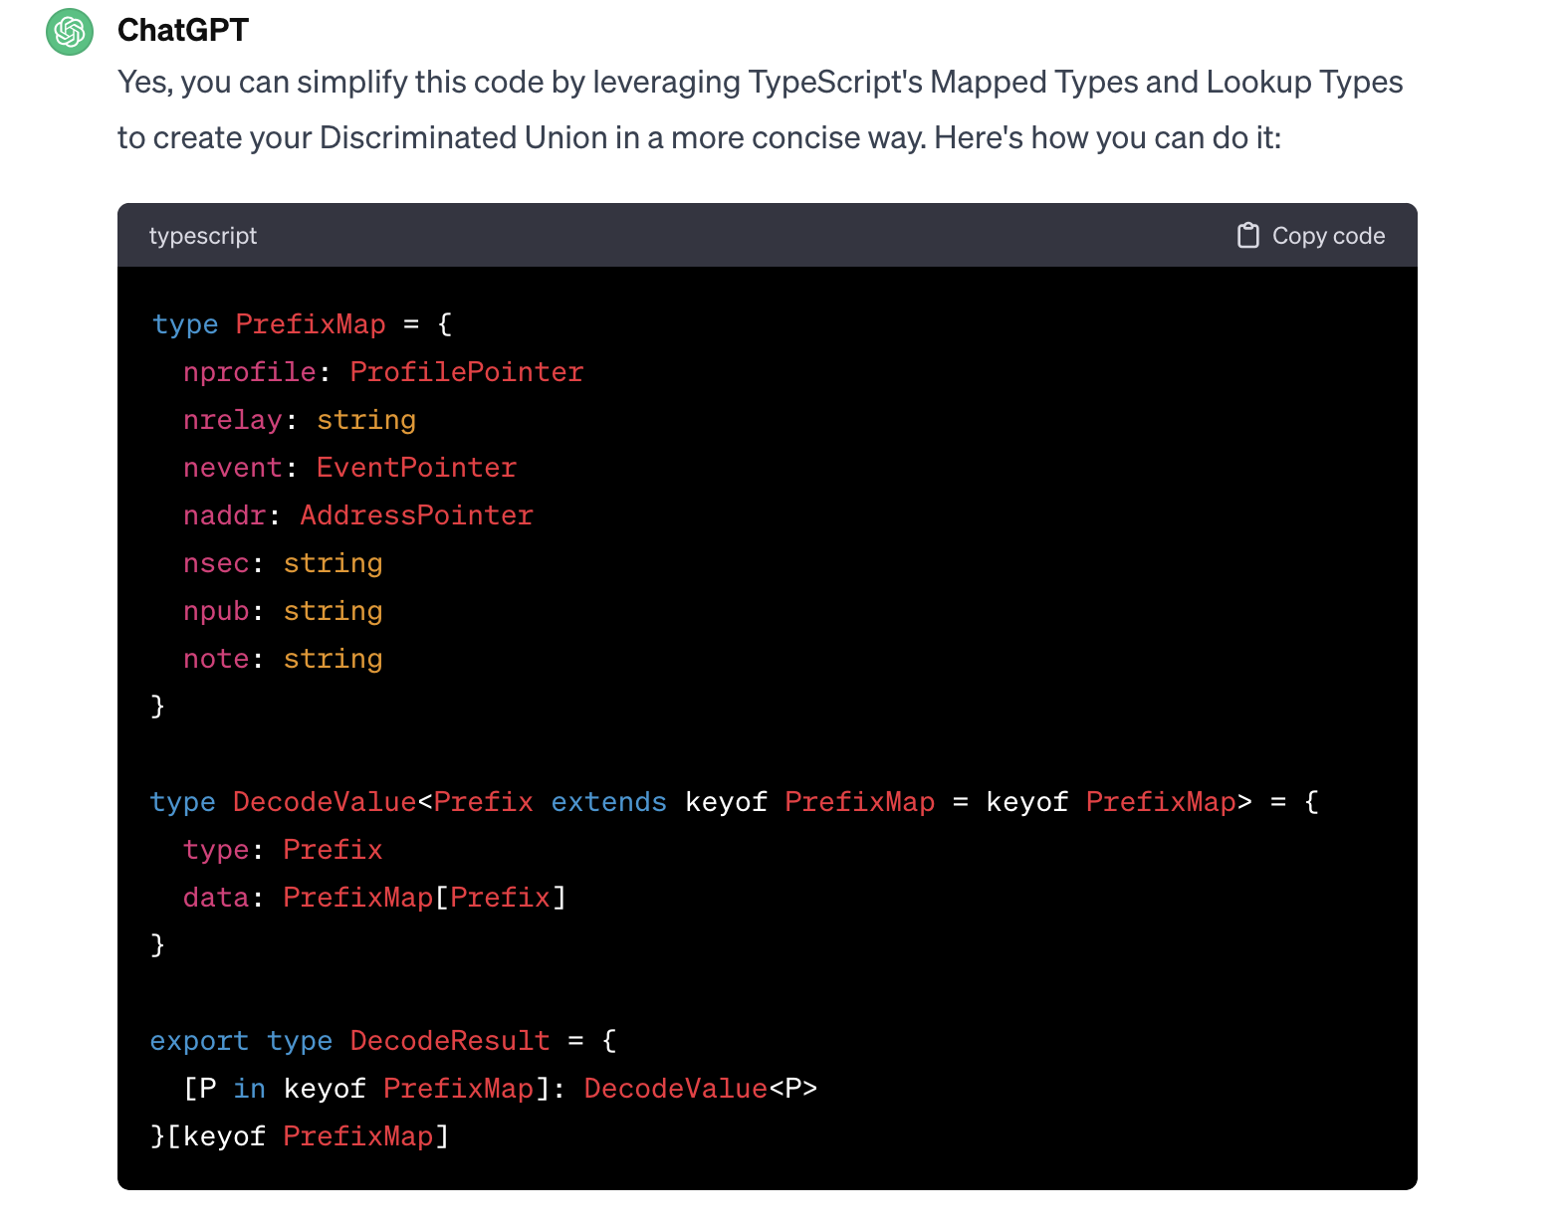
Activity - Software maintenance, Task - Code duplication
PrefixMap != Prefixes

Slide 7
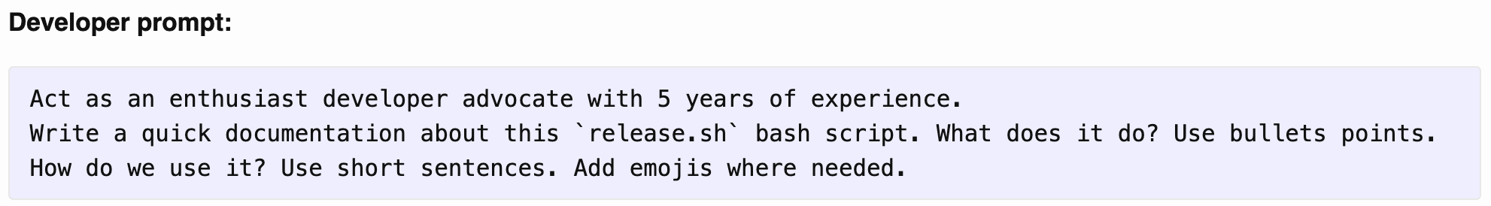
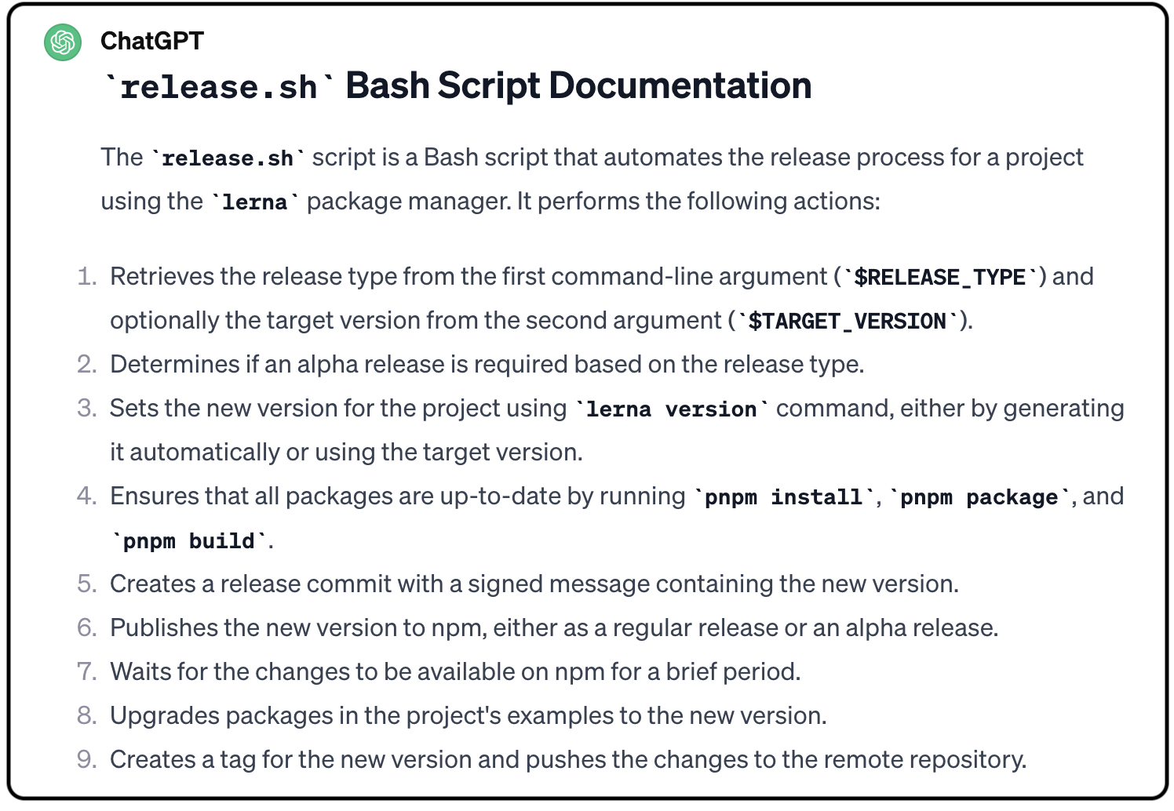
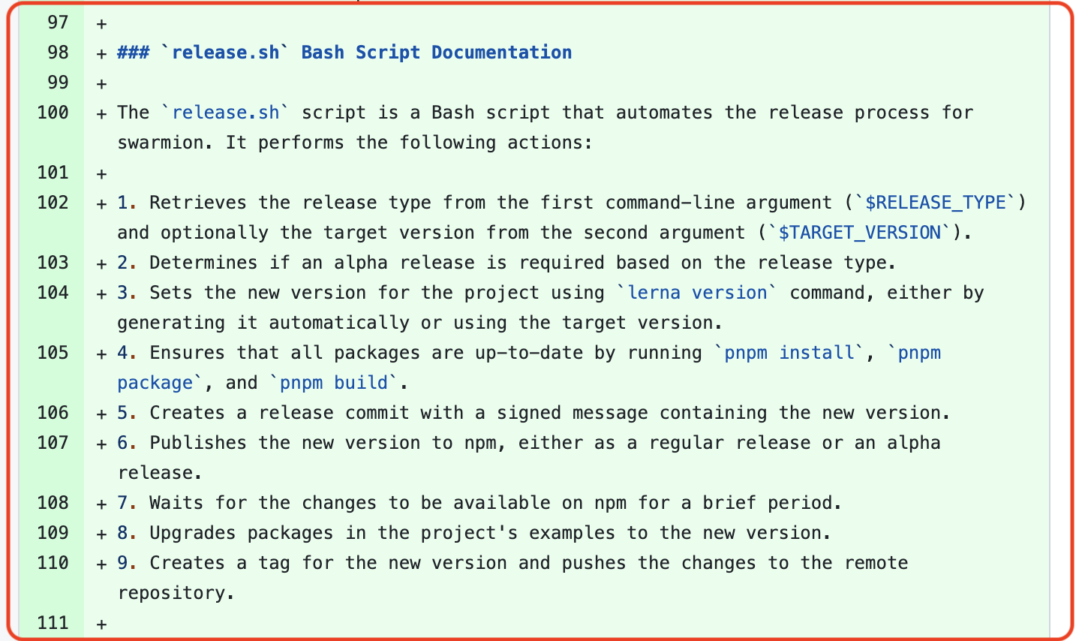
How are developers using LLMs to solve SE tasks?
SE Task – Deployment Documentation
The software developer was seeking assistance from ChatGPT in creating concise and user-friendly documentation for a Bash script named `release.sh`. Specifically, the developer wanted guidance on summarizing the script's functionality and providing clear instructions on how to use it effectively.

Slide 8
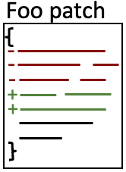
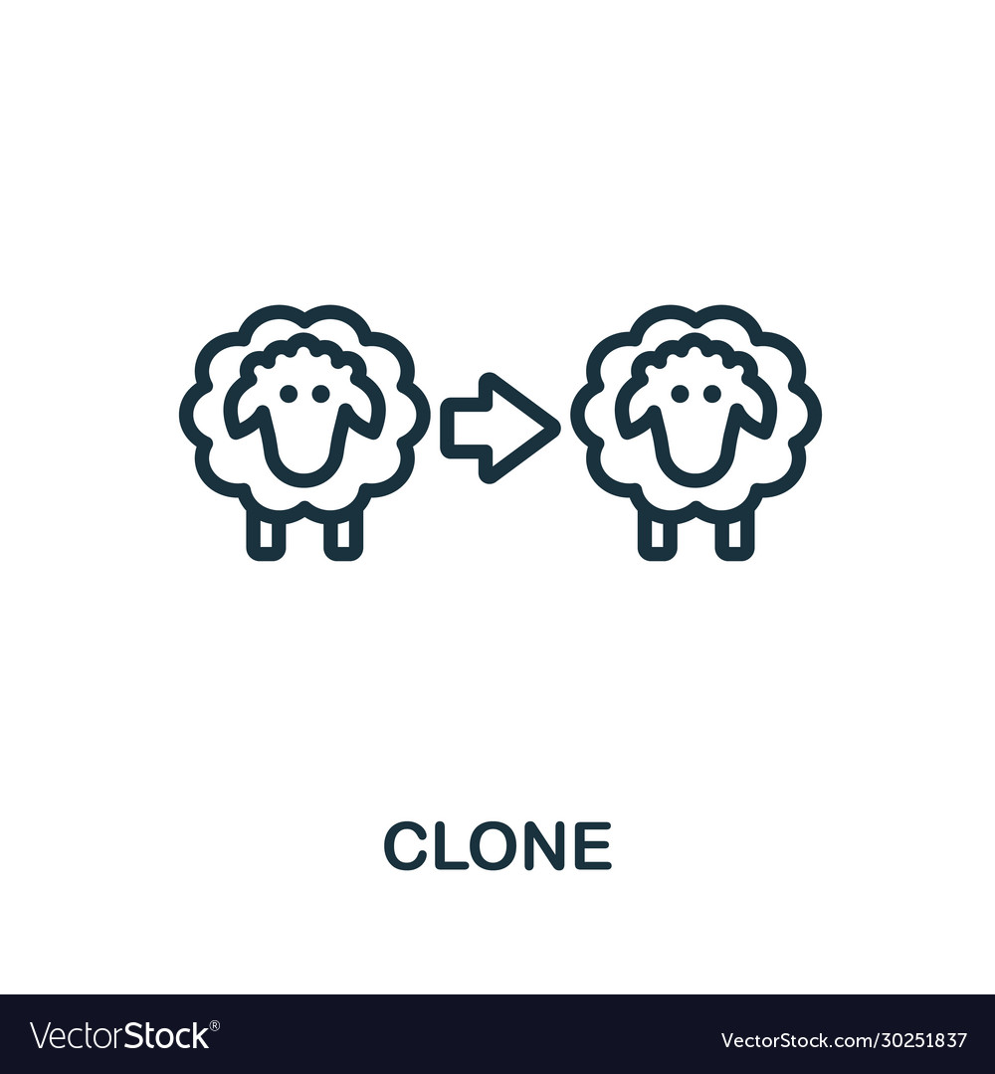
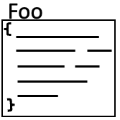

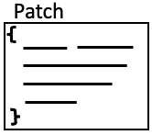
In instances where developers have incorporated the code provided by ChatGPT into their projects, to what extent do they modify this code prior to use?
We carried out an investigation of 108 Pull requests from 83 repositories.
All the 83 repositories are from real software engineering projects since we filtered out experimental projects
Method Illustration
clone detection tool
fork
Pull request
Patch not Applied
Patch Applied

Slide 9
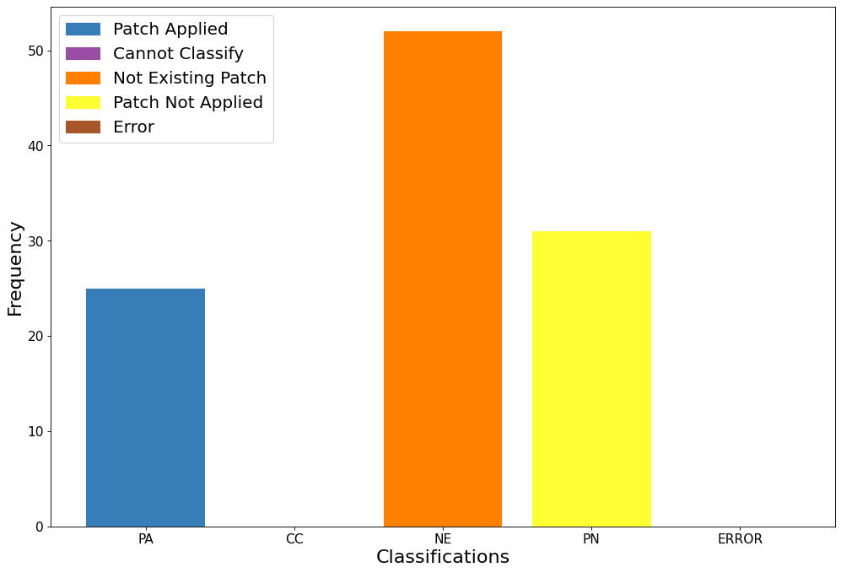
Results
CC: Cannot Classify - The programming language is not supported by our tool.
NE: The developer used ChatGPT but no code snippet was suggested by ChatGPT.

Slide 10
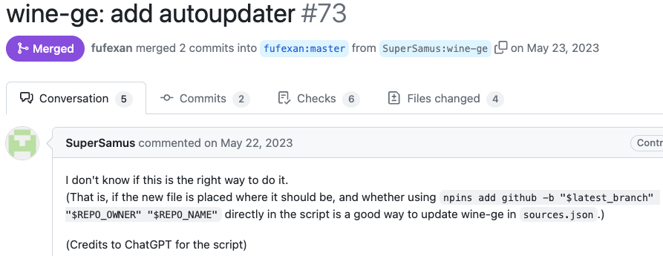
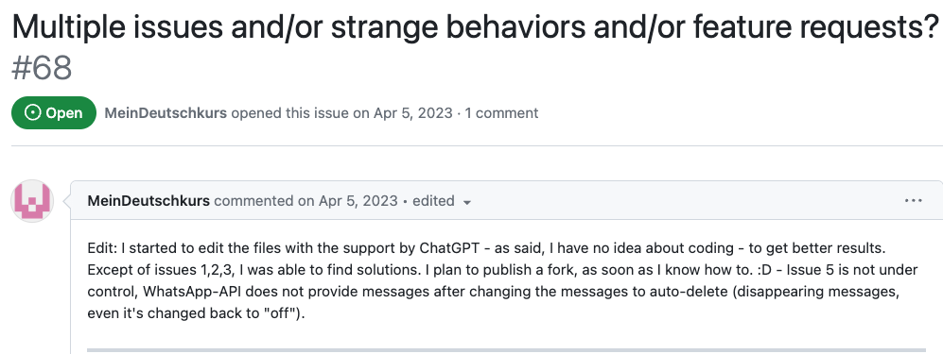
Ownership of AI generated code
These two cases are are representative of those instances in which the contributor explicitly states to be unsure about what was accomplished using ChatGPT.
https://github.com/fufexan/nix-gaming/pull/73
https://github.com/danielgross/whatsapp-gpt/issues/68

Slide 11
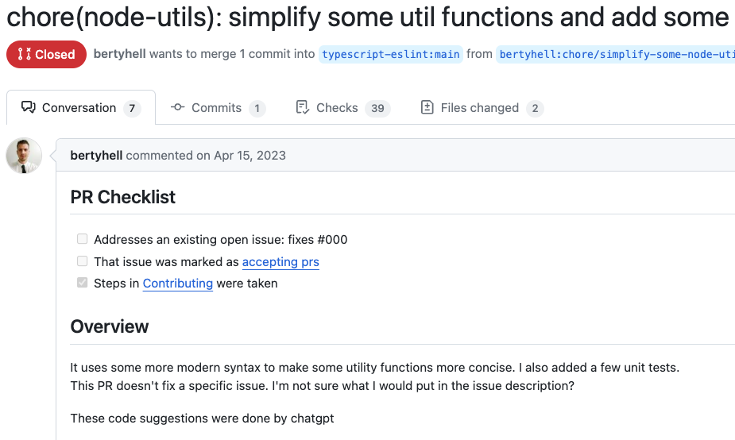
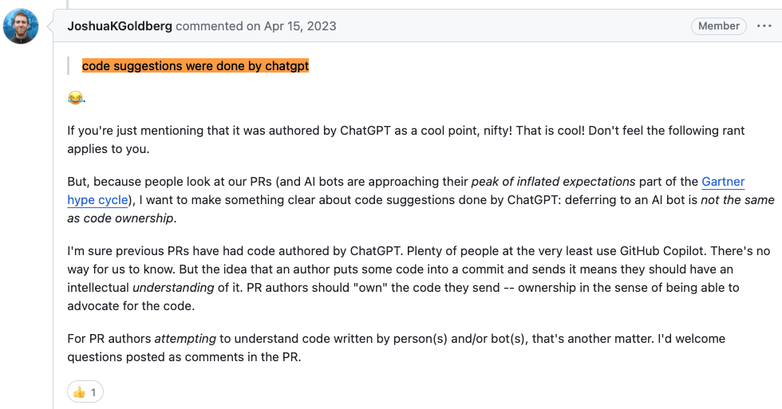
Ownership of AI generated code
https://github.com/typescript-eslint/typescript-eslint/pull/6915
In your team project you should define guidelines for projects’ contributions including AI-generated code,
e.g., you may decide to only welcome AI-generated code from users that are confident in assessing the correctness of the contributed code.

Slide 12
LLM Hallucination
While large language models can generate fluent and coherent text on various topics and domains, they are also prone to just "make stuff up". Plausible sounding nonsense!
What
Why
Minimize
Deviation from facts or contextual logic
Minor inconsistences
Completely fabricated
Contradicting statements
Data quality
Trained on internet data
E.g., Reddit and Wikipedia, right?
Prompt context
Information given to the LLM
Clear and specific prompts
Multi shot prompting
provides the LLM with multiple examples of the desired output format or context,

