Slide 1
Software Analysis, Design and Implementation
Dr. John Businge
John.businge@unlv.edu

Slide 2
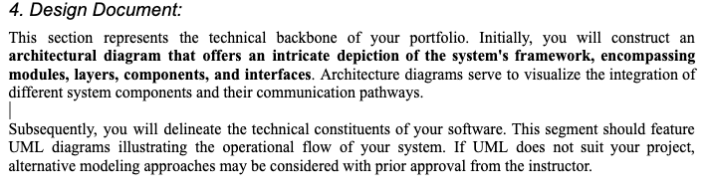
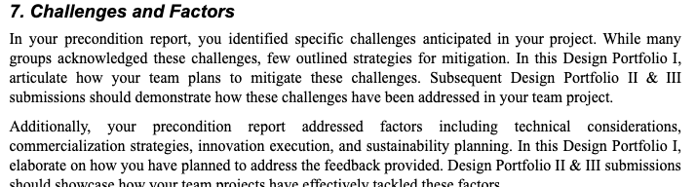
Announcements
Second last week of our face-to-face
Meetings - you should have a balance of online/physical meetings
After next week, aim for at least two meetings per week
In subsequent deliverables, each team member should indicate their contributions to the report sections
Design Portfolio I changes

Slide 3

Chapters 6 - 7
Chapter 6 - Analysing a System
https://link.springer.com/chapter/10.1007/978-3-319-24280-4_6
Chapter 7 - Design and Implementation
https://link.springer.com/chapter/10.1007/978-3-319-24280-4_7
Free PDF version on Springer
https://doi.org/10.1007/978-3-319-24280-4_7

Slide 4
Software design questions
Take a minute and think of the projects that you worked on
Did they have a good design?
Could the design be done better?
Was there even a design at all?
How do you know if the software was well-designed?
Think of how easy it was to make changes to your code.
Did a small code change produce a ripple-effect for changes elsewhere in the code?
Was your code hard to reuse?
Was the software difficult to maintain after a release?
Notes:
You may have worked on small programs, so you may worked on a larger-scale system. Take a minute and think of the projects that you worked on.
If you answered yes to any of these questions, chances are you could benefit from a better design. Good design isn't just about code

Slide 5
The Design Process Questions
On what platform(s) (hardware and software) will the system run?
What languages and programming paradigms will be used for implementation?
What user interfaces will the system provide? These include GUI screens, printouts, and other devices.
What classes and interfaces need to be coded? What are their responsibilities?
How is data stored on a permanent basis? What medium will be used? What model will be used for data storage?
What happens if there is a failure? Ideally, we would like to prevent data loss and corruption. What mechanisms are needed for realising this?
Notes:
During the design process, a number of questions need to be answered

Slide 6
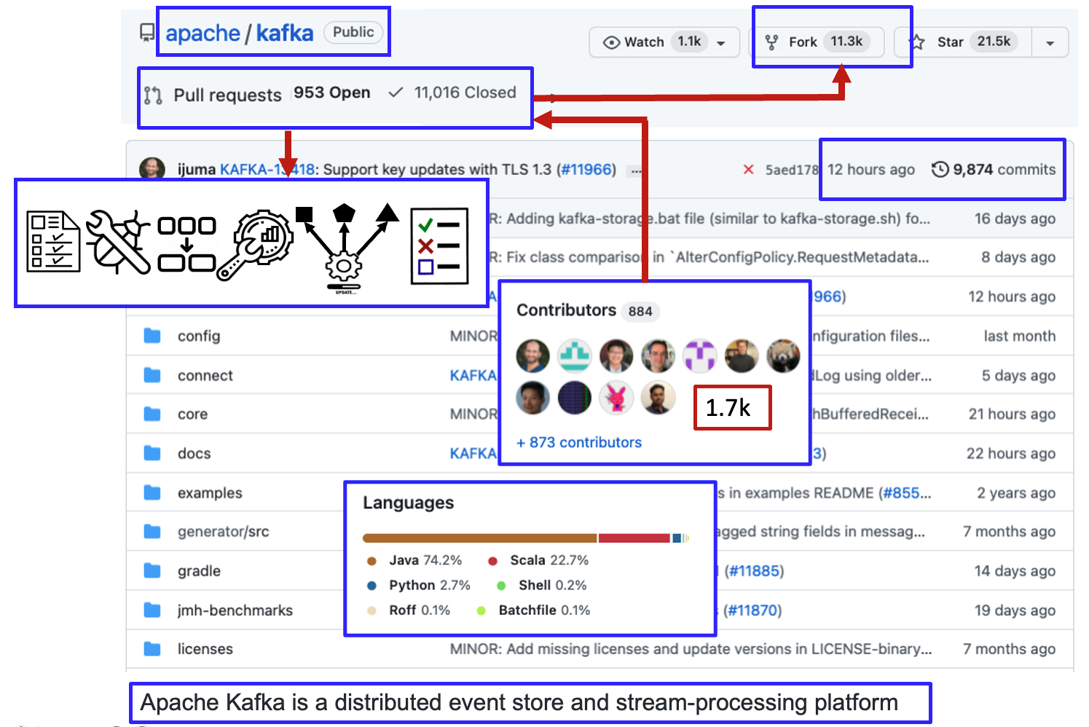
Consider this scenario.
You join a project that's been in development for a while.
You look at the code and become instantly overwhelmed.
If there is no high-level design of the code, your life would be a living hell for you to do anything on this project
6
Notes:
Consider this scenario.
You join a project that's been in development for a while.
You look at the code and become instantly overwhelmed.
If there is no high level design of the code, your life would be a living hell for you to do anything on this project
This picture is an example of a repository and I'' explain what social coding i
This picture pretty much sums up most of the elements of my talk
- >9K Revisions (commits),
- 12K pull requests or change requests (new features, bug fixes, refactorings, optimizations, dependency upgrades, and test cases)
- There are over 1.7k contributors responsible for the PRs
- some of the 11K forks are responsible for these PRs
- The repository is written in a range of programming languages

Slide 7
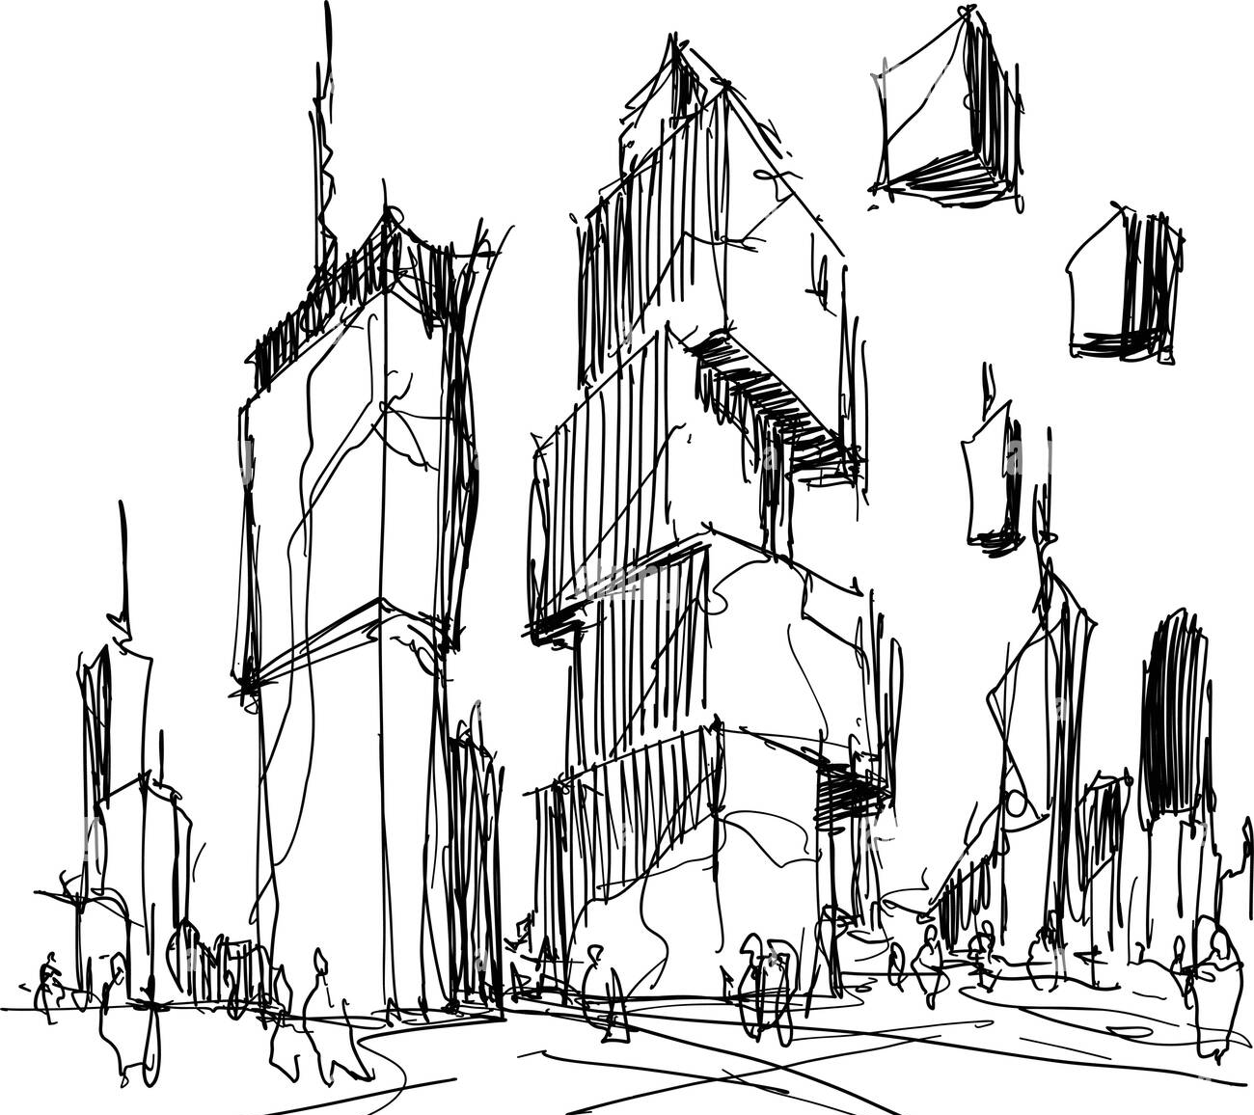
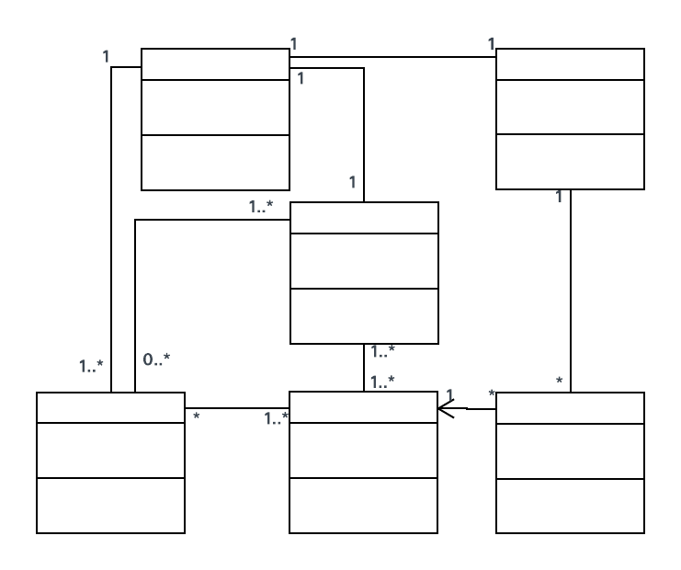

Software Requirements, Conceptual and Technical Designs
Problem Space
Solution Space
Requirements
Conceptual Design
Technical Design
Notes:
The design activity involves taking requirements and outlining a solution. This activity involves producing a conceptual and then a technical design, resulting in two corresponding kinds of artifacts, conceptual mock-ups, and technical diagrams.

Slide 8
Conceptual Design vs Technical Design
Conceptual design – sets out the stage
Defining the system's requirements and functionalities
Overall design approach before diving into detailed technical specifications.
Data Model
User Interfaces design
Technological Considerations
Technical Design – dives deeper into specifics
Component Design: Dividing the system into smaller components with clear roles and interfaces.
Data Design: Planning the data model, encompassing database schema, structures, flow diagrams, and access methods.
Interface Design: Specifying interactions between system components, such as APIs, protocols, and communication methods.
Algorithm Design: Crafting algorithms for data processing, computational logic, and optimization.

Slide 9
Conceptual Design vs Technical Design
Conceptual Design | Technical Design
Focuses on high-level ideas, goals, and requirements | Focuses on detailed specifications and implementation details
Captures the essence and purpose of the system | Specifies how the system will be built and function
Emphasizes the "what" of the system | Emphasizes the "how" of implementing the system
Typically expressed through diagrams and narratives | Typically expressed through diagrams and documentation
Helps stakeholders understand the scope and vision | Guides developers in building the system components
May involve brainstorming sessions and user interviews | Involves architectural decisions and technical trade-offs

Slide 10
Conceptual Design vs Technical Design
Aspect | Conceptual Design | Technical Design
Scope Definition | Define the overall purpose and goals of the system | Define specific features, functionalities, and components
Representation | High-level diagrams (e.g., context diagram) | Detailed diagrams (e.g., UML diagrams)
Requirements | Identifies user needs and business objectives | Translates requirements into technical specifications
Decision Making | Establishes broad design principles and strategies | Determines implementation details and technologies used
User Experience | Focuses on user interactions and overall usability | Specifies interface design and interaction mechanisms
Abstraction Level | Abstract and conceptual | Concrete and detailed

Slide 11

UML is the most popular modeling language and become the de-facto standard to design today's large object-oriented systems

Slide 12
There are may Kinds of UML Diagrams
Structure diagrams: show the static architecture of the system irrespective of time.
University system - Student, Faculty, etc.
Behaviour diagrams: depicts the behaviour of a system or business process.
Interaction diagrams: show the methods, interactions and activities of the objects.
University system: show how a student registers for a course.

Slide 13
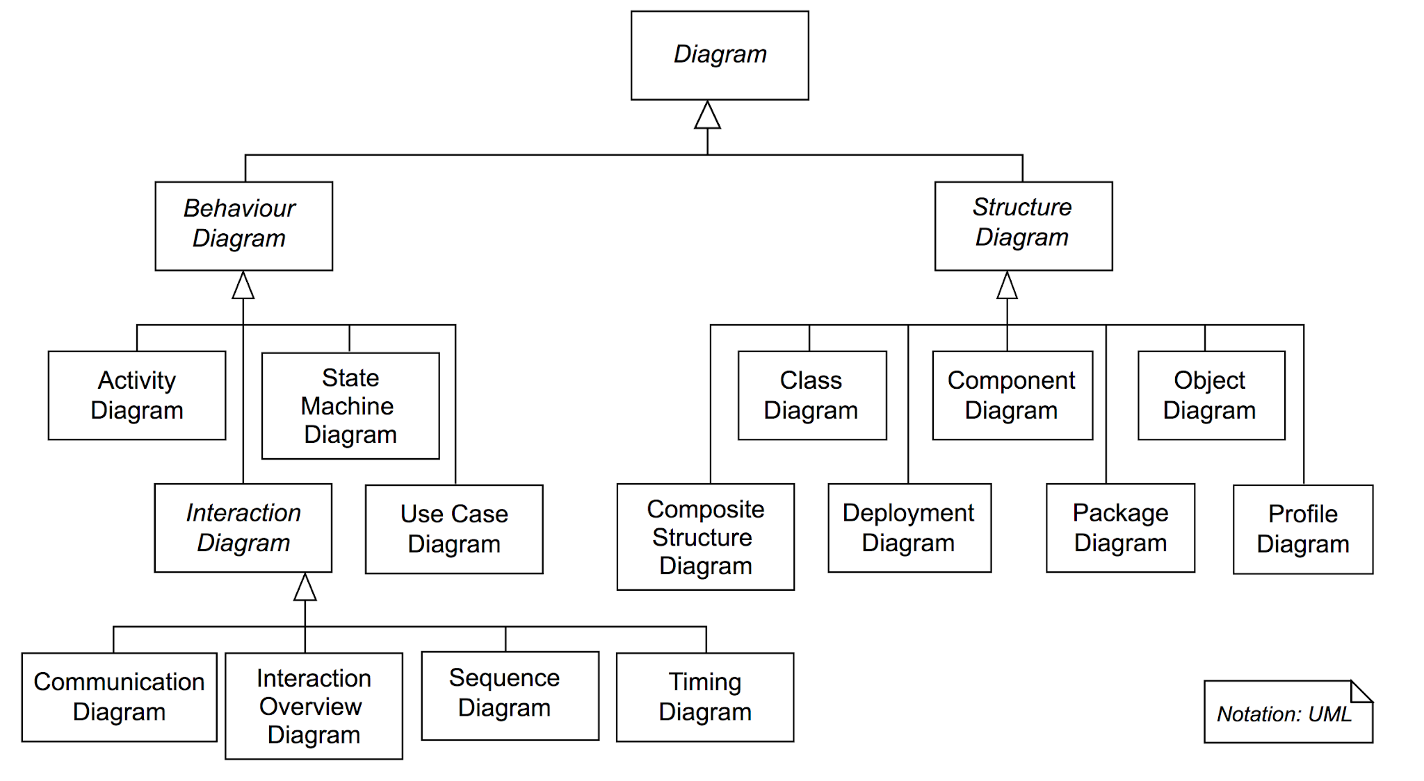
There are may Kinds of UML Diagrams
≈
≈
≈

Slide 14
Component Design Overview
Involves breaking down the system into smaller components or modules and designing their internal structure and interfaces.
Use Case Diagrams: Identify system functionalities or use cases, offering a high-level view of user/system interactions.
Class Diagrams: Crucial for designing internal component structure by representing classes, attributes, methods, and their relationships.
Sequence Diagrams: Detail interactions between components/objects, illustrating message flows and method calls.
Significance: These UML diagrams aid in decomposing the system, defining component structure and interactions, serving as a blueprint for developers during implementation to ensure meeting requirements and design goals.

Slide 15
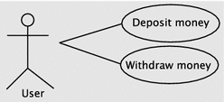
Use Case Diagram
Interaction between an actor and the systems
Actor – human or software
System

Slide 16
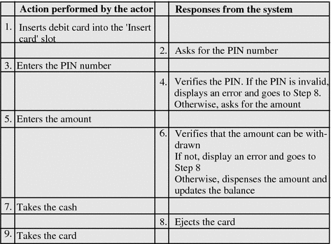
Use Case Diagram
Use case for withdrawing money

Slide 17
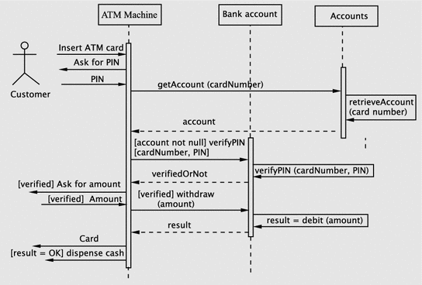
Sequence Diagrams
Sequence Diagrams describes how objects in your system interact to complete a specific task.

Slide 18
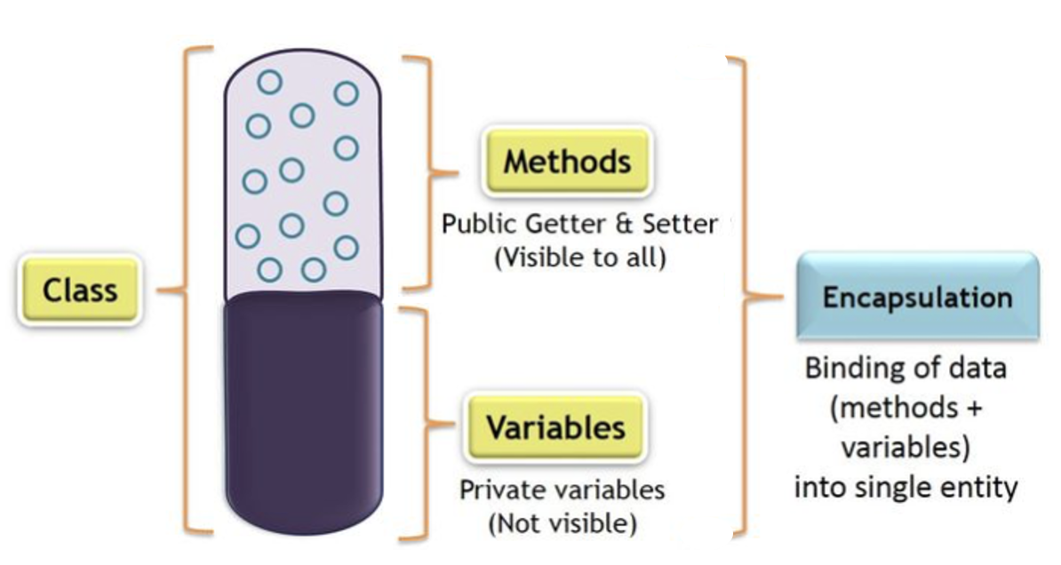
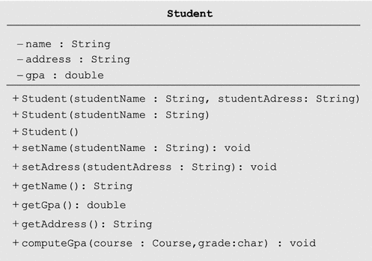
Class Diagram
Name
-ve: private
Variables
+ve: public
Methods and their return types
A well-structured class design typically consists of the following components: a name, private attributes, and public methods. This practice embodies the concept of encapsulation, wherein data (comprising methods and variables) is encapsulated within a singular entity.

Slide 19
Object Oriented Analysis, Design and Implementation
We will examine steps in Object-oriented software development
Analysis
Design
Implementation
To illustrate the process, let us study a relatively simple example
Software to manage a small library
Functions:
Lending books
Receiving back books
Doing operations such as: querrying, registering members, e.t.c, and keeping track of the transactions

Slide 20
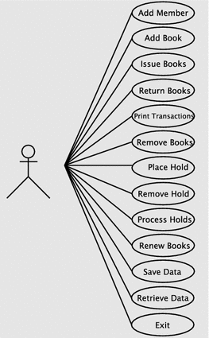
Analysis phase overview
Involves gathering, documenting the requirements, and developing a conceptual model of the system.
Software to manage a small library – functional requirements
Register a members
Add books
Issue books
Return books
Remove books
….
Use case diagram for the library system

Slide 21
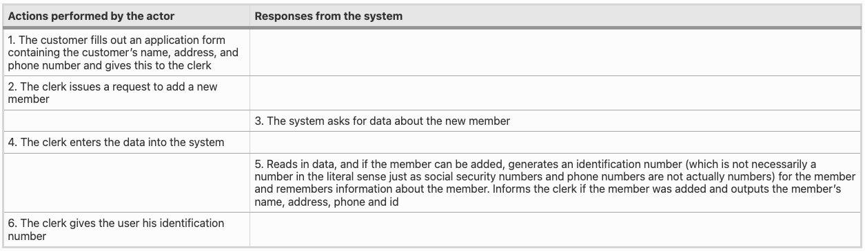
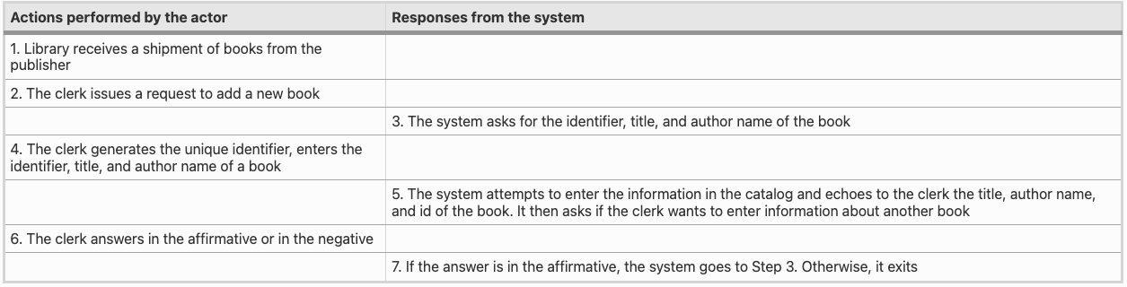
Use case Register New Member
Use case Adding New Books
Use case diagram for the library system

Slide 22
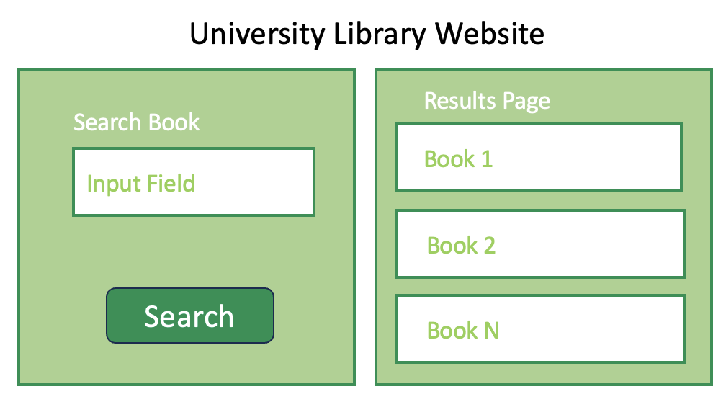
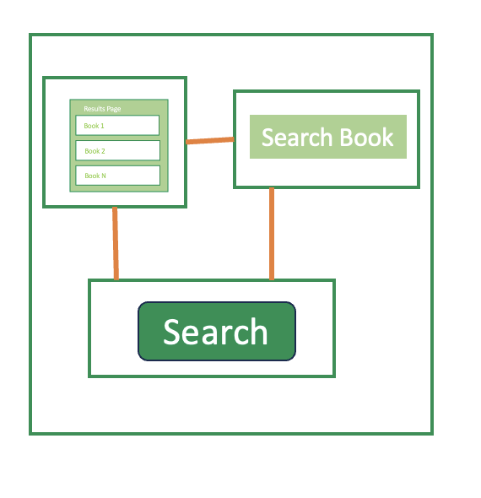
Software Design - Identifying software classes
Design
Goal
Classes
Functions
Components
Components
Conceptual Design
Library Software Classes
Member
Book
Library
Catalog
….
Notes:
Having decided on an adequate set of software classes, our next task is to assign responsibilities to these.

Slide 23
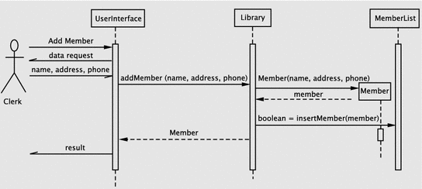
Software Design - Assigning Responsibilities to Classes
Having decided on an adequate set of software classes, our next task is to assign responsibilities. The next step is, therefore, to spell out the details of how the system meets its responsibilities. Sequence Diagrams are a great UML tool for describing responsibilities of classes.
Sequence diagram for registering a new member
Notes:
Having decided on an adequate set of software classes, our next task is to assign responsibilities.
The next step is, therefore, to spell out the details of how the system meets its responsibilities
Sequence Diagrams are a great UML tool for describing responsibilities of classes
Back to our use case of registering users
The clerk issues a request to the system to add a new member. The system responds by asking for the data about the new member. This interaction occurs between the library staff member and the UserInterface instance. The clerk enters the requested data, which the UserInterface accepts.
1. addMember within the Library class, then
2. Create a Member object with the supplied parameters and return a reference to the Member object
3. Insert the member into the member list and return the result of the operation.
Invoke the Member constructor from within the addMember method of Library. The constructor returns a reference to the Member object and an operation, insertMember, is invoked on MemberList to add the new member.

Slide 24
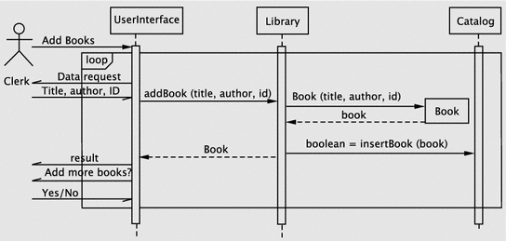
Software Design - Assigning Responsibilities to Classes
Sequence diagram for adding books
In this case, when the request is made by the actor, the system enters a loop. Since the loop involves interacting repeatedly with the actor, the loop control mechanism is in the UI itself.
Notes:
In this case, when the request is made by the actor, the system enters a loop. Since the loop involves interacting repeatedly with the actor, the loop control mechanism is in the UI itself.
The first operation is to get the data about the book to be added. The algorithm here consists of the following steps:
create a Book object,
add the Book object to the catalog and
return the result of the operation.
The first three are is handled in a manner similar to the previous use case.
(iv) The UI returns the result and continues until the actor indicates an exit.

Slide 25
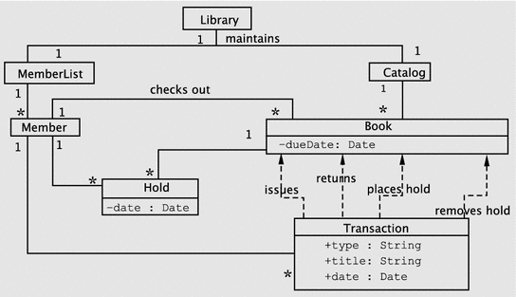
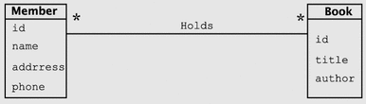
Class Diagrams – Relationships between classes
Library Software Classes
Library
MemberList
Catalog
Member
Book
Holds
Transaction
Note that Hold is not shown as an association class, but an independent class that connects Member and Book.
The new class Transaction is added to record transactions; this has a dependency on Book since it stores the title of the book.

Slide 26
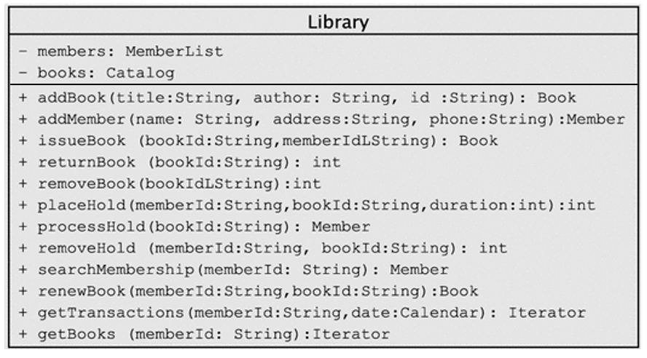
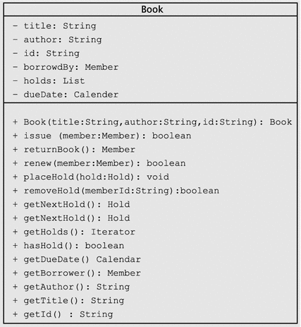
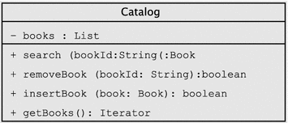
Class Diagrams
Library Software Classes
Library
MemberList
Catalog
Member
Book
Holds
Transaction

Slide 27



Implementing Our Design
Code
Library Software Classes
Library
MemberList
Catalog
Member
Book
Holds
Transaction
UserInterface
Test
Debug
Notes:
In this phase, we code, test, and debug the classes that implement the business logic (Library, Book, etc.) and UserInterface.

Slide 28
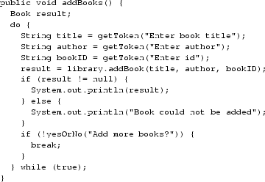


Implementing Our Design
Adding New Books
addBooks method in the UserInterface class
addBook method inside the Library class
insertBook method in the Catalog class
Notes:
In this phase, we code, test, and debug the classes that implement the business logic (Library, Book, etc.) and UserInterface.

Slide 29

Project
I expect use of at least the three UML diagrams
Use case diagrams
Class diagrams
Sequence diagrams
For the Starting Design Portfolio
One or two use cases/functionality comprising of the three of the UML diagrams
For Design Portfolio II and III
Extract from DP II

