Slide 1
Software Analysis, Design and Implementation
Dr. John Businge
John.businge@unlv.edu

Slide 2
Announcements
Last week of face-to-face classes
Weekly survey - best to fill after your weekly meetings
Leaders, kindly remind your colleagues to fill in the survey
I will be discussing the results of the survey with groups in discord where necessary
My colleague Prof. Andy Stefik – informed me of the a talk by one of the founders of the “Agile manifesto”

Slide 3

Chapters 6 - 7
Chapter 6 - Analysing a System
https://link.springer.com/chapter/10.1007/978-3-319-24280-4_6
Chapter 7 - Design and Implementation
https://link.springer.com/chapter/10.1007/978-3-319-24280-4_7
Free PDF version on Springer
https://doi.org/10.1007/978-3-319-24280-4_7

Slide 4
Software design questions
Take a minute and think of the projects that you worked on
Did they have a good design?
Could the design be done better?
Was there even a design at all?
How do you know if the software was well-designed?
Think of how easy it was to make changes to your code.
Did a small code change produce a ripple-effect for changes elsewhere in the code?
Was your code hard to reuse?
Was the software difficult to maintain after a release?
Notes:
You may have worked on small programs, so you may worked on a larger-scale system. Take a minute and think of the projects that you worked on.
If you answered yes to any of these questions, chances are you could benefit from a better design. Good design isn't just about code

Slide 5
The Design Process Questions
On what platform(s) (hardware and software) will the system run?
What languages and programming paradigms will be used for implementation?
What user interfaces will the system provide? These include GUI screens, printouts, and other devices.
What classes and interfaces need to be coded? What are their responsibilities?
How is data stored on a permanent basis? What medium will be used? What model will be used for data storage?
What happens if there is a failure? Ideally, we would like to prevent data loss and corruption. What mechanisms are needed for realising this?
Notes:
During the design process, a number of questions need to be answered

Slide 6


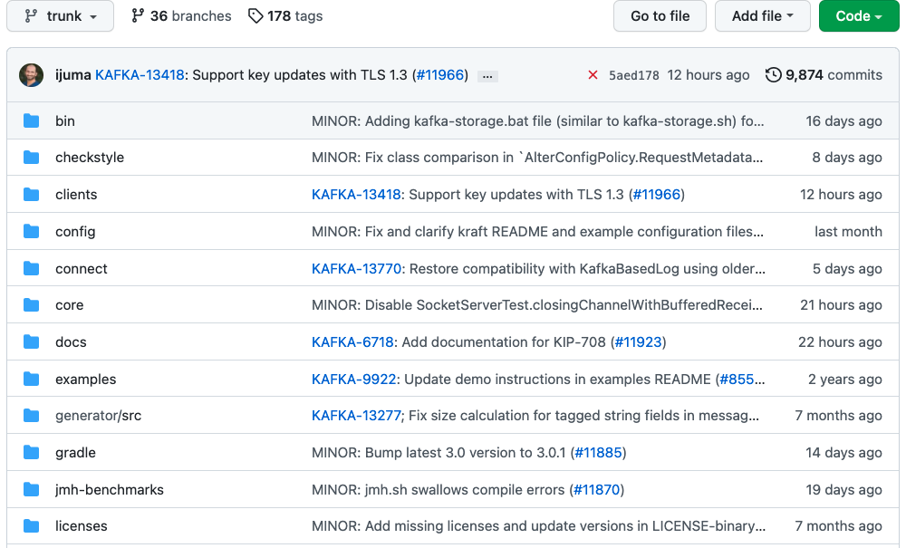


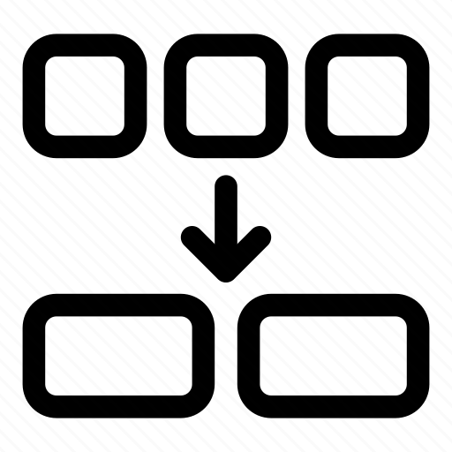



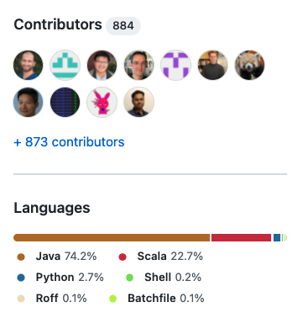
1.7k
Apache Kafka is a distributed event store and stream-processing platform
6
Notes:
Consider this scenario.
You join a project that's been in development for a while.
You look at the code and become instantly overwhelmed.
If there is no high level design of the code, your life would be a living hell for you to do anything on this project
This picture is an example of a repository and I'' explain what social coding i
This picture pretty much sums up most of the elements of my talk
- >9K Revisions (commits),
- 12K pull requests or change requests (new features, bug fixes, refactorings, optimizations, dependency upgrades, and test cases)
- There are over 1.7k contributors responsible for the PRs
- some of the 11K forks are responsible for these PRs
- The repository is written in a range of programming languages

Slide 7

UML is the most popular modeling language and become the de-facto standard to design today's large object-oriented systems

Slide 8
There are may Kinds of UML Diagrams
Structure diagrams: show the static architecture of the system irrespective of time.
University system - Student, Faculty, etc.
Behaviour diagrams: depicts the behaviour of a system or business process.
Interaction diagrams: show the methods, interactions and activities of the objects.
University system: show how a student registers for a course.

Slide 9
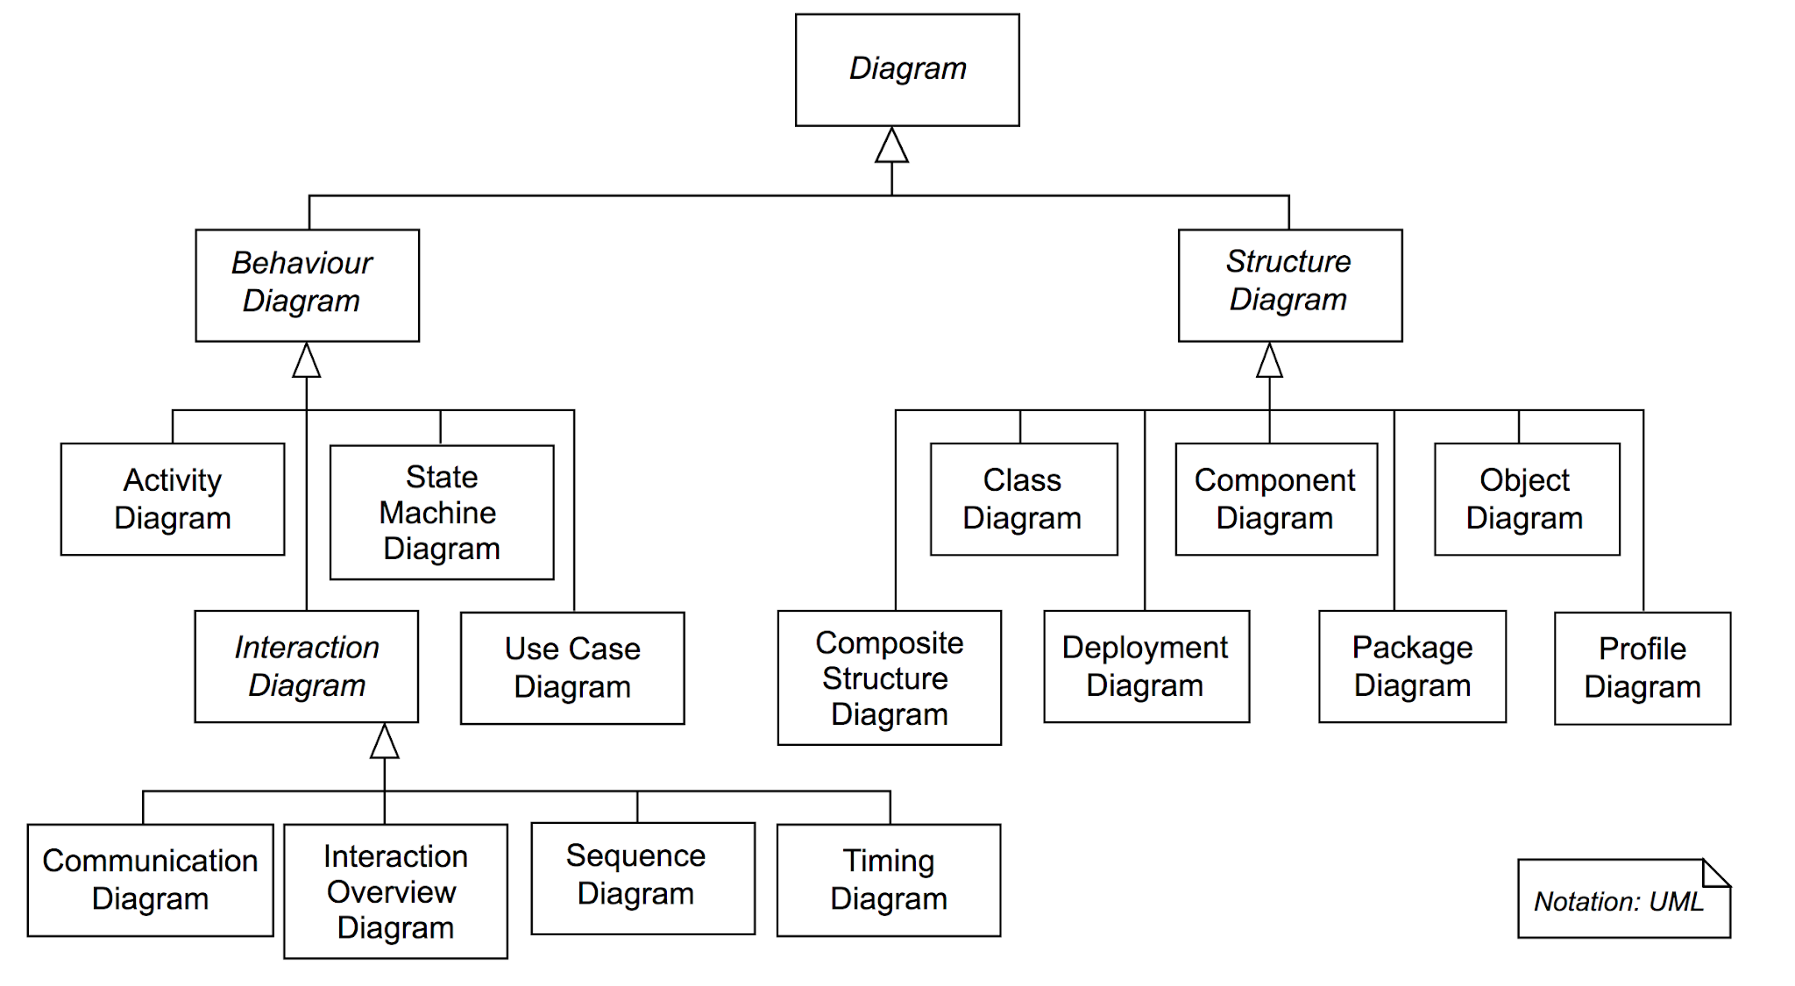
There are may Kinds of UML Diagrams
≈
≈
≈

Slide 10
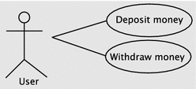
Use Case Diagram
Interaction between an actor and the systems
Actor – human or software
System

Slide 11
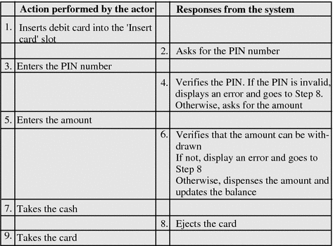
Use Case Diagram
Use case for withdrawing money

Slide 12
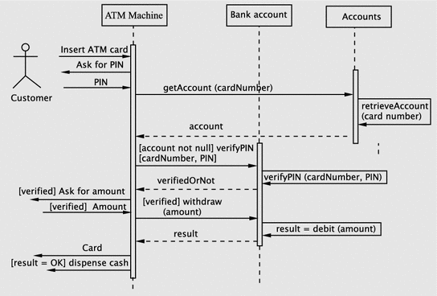
Sequence Diagrams
Sequence Diagrams describes how objects in your system interact to complete a specific task.

Slide 13
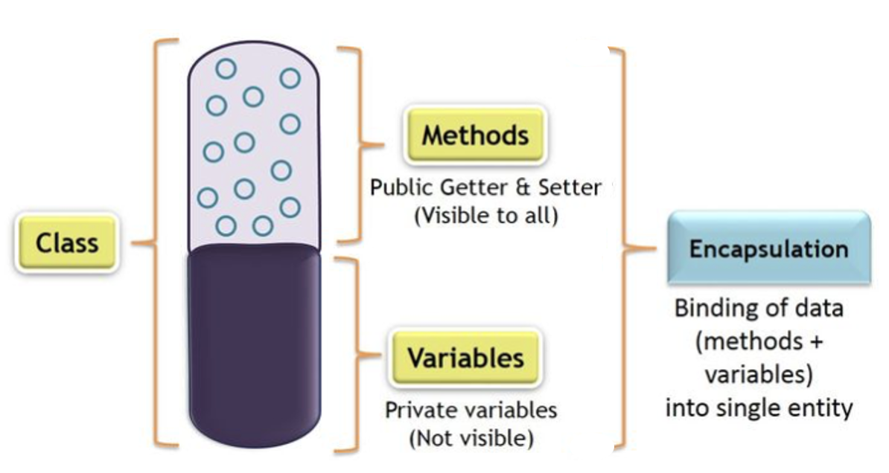
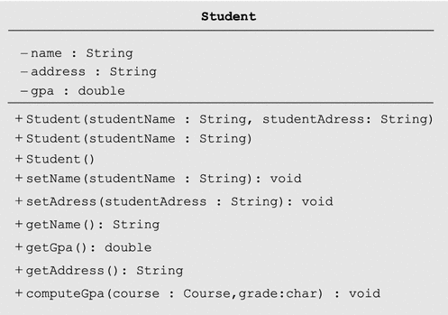
Class Diagram
Name
-ve: private
Attributes
+ve: public
Methods and their return types

Slide 14
Object Oriented Analysis, Design and Implementation
We will examine steps in Object-oriented software development
Analysis
Design
Implementation
To illustrate the process, let us study a relatively simple example
Software to manage a small library
Functions:
Lending books
Receiving back books
Doing operations such as: querrying, registering members, e.t.c, and keeping track of the transactions

Slide 15
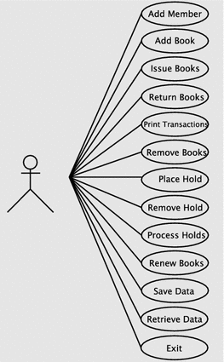
Analysis phase overview
Involves gathering, documenting the requirements, and developing a conceptual model of the system.
Software to manage a small library – functional requirements
Register a members
Add books
Issue books
Return books
Remove books
….
Use case diagram for the library system

Slide 16
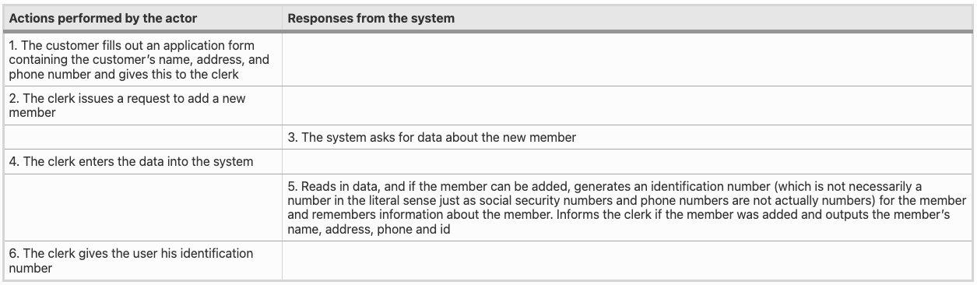
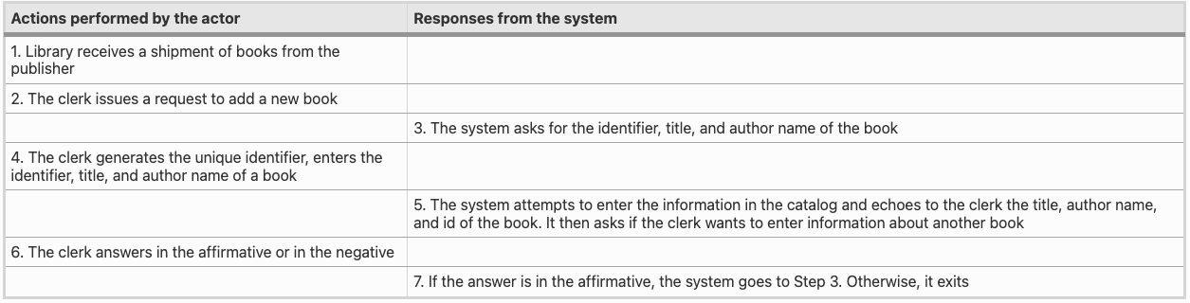
Use case Register New Member
Use case Adding New Books
Use case diagram for the library system

Slide 17
Software Design
Design process questions
On what platform(s) (hardware and software) will the system run?
What languages and programming paradigms will be used for implementation?
What user interfaces will the system provide?
What classes and interfaces need to be coded? What are their responsibilities?
….

Slide 18
Software Design - Major Subsystems
Business logic: This subsystem deals with input data processing, data creation, queries, and data updates.
User interface: This subsystem interacts with the user, accepting and outputting information.

Slide 19
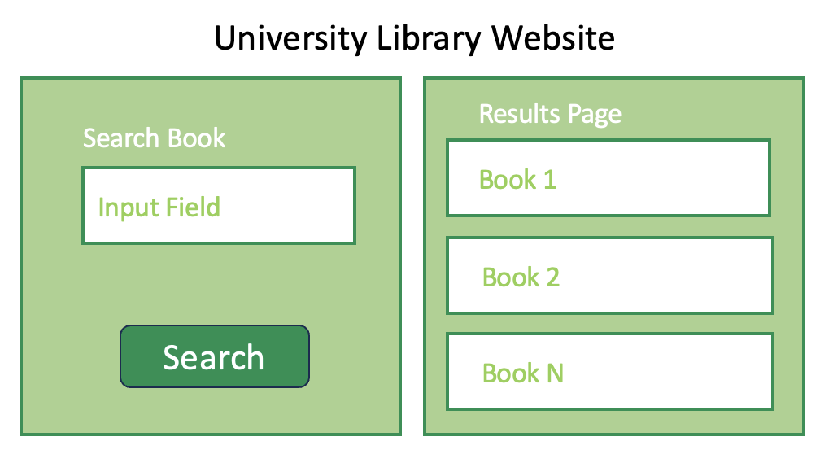
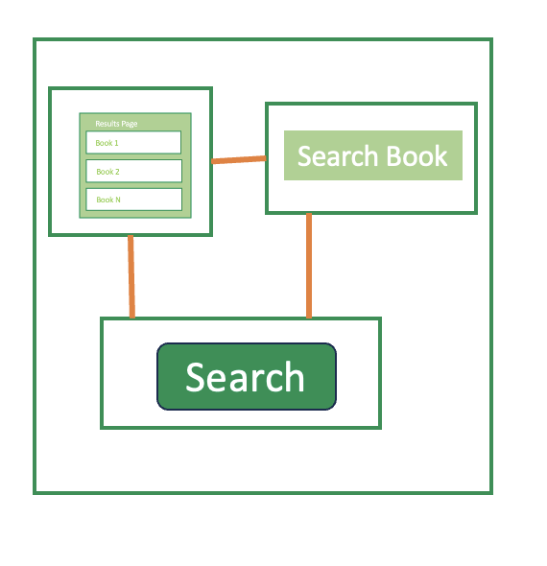
Software Design - Identifying software classes
Design
Goal
Classes
Functions
Components
Components
Conceptual Design
Library Software Classes
Member
Book
Library
Catalog
….
Notes:
Having decided on an adequate set of software classes, our next task is to assign responsibilities to these.

Slide 20
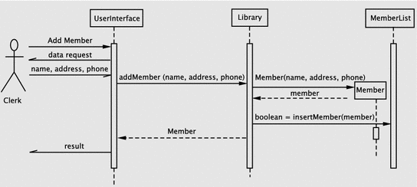
Software Design - Assigning Responsibilities to Classes
Sequence diagram for registering a new member
Notes:
Having decided on an adequate set of software classes, our next task is to assign responsibilities.
The next step is, therefore, to spell out the details of how the system meets its responsibilities
Sequence Diagrams are a great UML tool for describing responsibilities of classes
Back to our use case of registering users
The clerk issues a request to the system to add a new member. The system responds by asking for the data about the new member. This interaction occurs between the library staff member and the UserInterface instance. The clerk enters the requested data, which the UserInterface accepts.
1. addMember within the Library class, then
2. Create a Member object with the supplied parameters and return a reference to the Member object
3. Insert the member into the member list and return the result of the operation.
Invoke the Member constructor from within the addMember method of Library. The constructor returns a reference to the Member object and an operation, insertMember, is invoked on MemberList to add the new member.

Slide 21
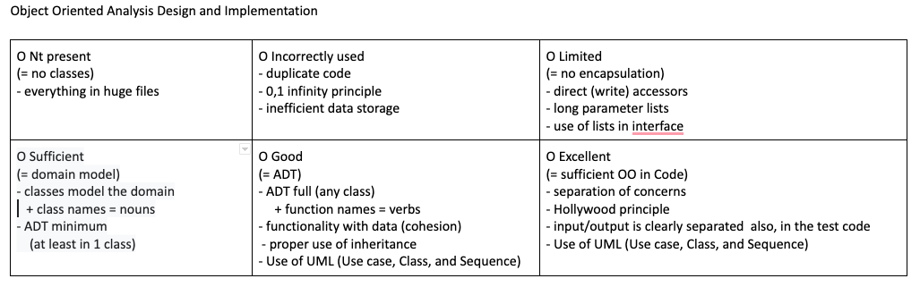
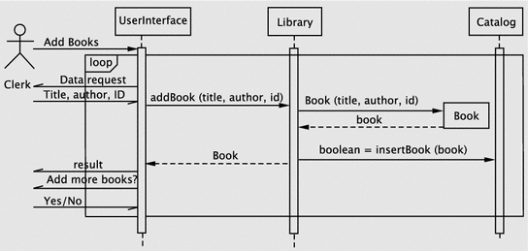
Software Design - Assigning Responsibilities to Classes
Sequence diagram for adding a books
Notes:
In this case, when the request is made by the actor, the system enters a loop. Since the loop involves interacting repeatedly with the actor, the loop control mechanism is in the UI itself.
The first operation is to get the data about the book to be added. The algorithm here consists of the following steps:
create a Book object,
add the Book object to the catalog and
return the result of the operation.
This is handled in a manner similar to the previous use case.
(iv) The UI returns the result and continues until the actor indicates an exit.

Slide 22
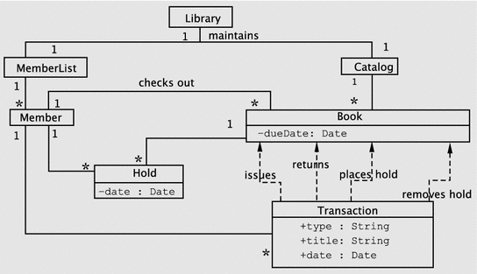

Class Diagrams
Library Software Classes
Library
MemberList
Catalog
Member
Book
Holds
Transaction

Slide 23
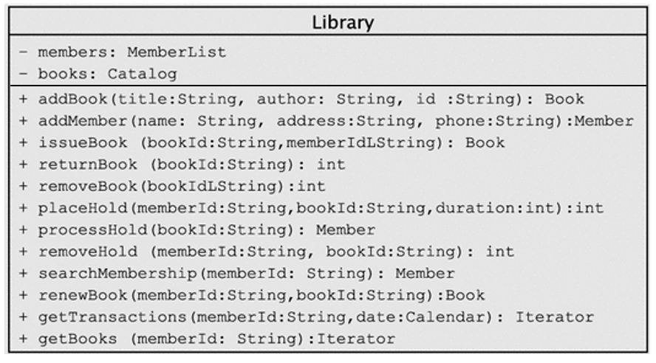
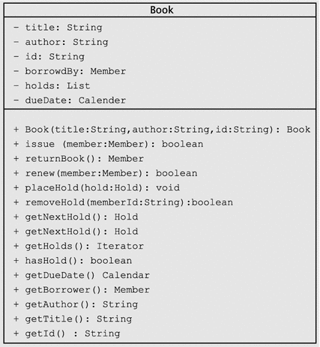
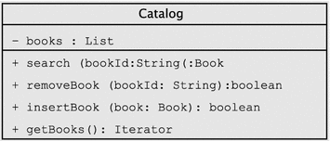
Class Diagrams
Library Software Classes
Library
MemberList
Catalog
Member
Book
Holds
Transaction

Slide 24



Implementing Our Design
Code
Library Software Classes
Library
MemberList
Catalog
Member
Book
Holds
Transaction
UserInterface
Test
Debug
Notes:
In this phase, we code, test, and debug the classes that implement the business logic (Library, Book, etc.) and UserInterface.

Slide 25
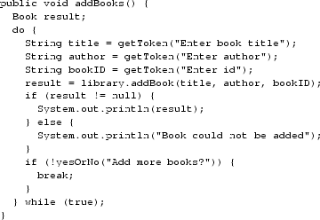


Implementing Our Design
Adding New Books
addBooks method in the UserInterface class
addBook method inside the Library class
insertBook method in the Catalog class
Notes:
In this phase, we code, test, and debug the classes that implement the business logic (Library, Book, etc.) and UserInterface.

Slide 26
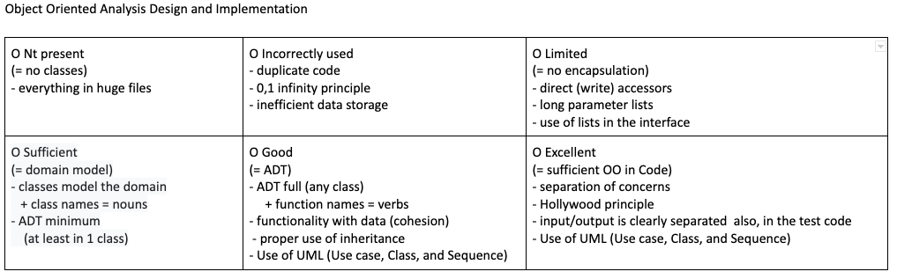
Project
I expect use of at least the three UML diagrams
Use case diagrams
Class diagrams
Sequence diagrams

Slide 27
“People-related factors tend to be the greatest challenges—not technology.”
George Spafford,
Senior Director Analyst
at Gartner
Team success depends on many factors:
Good-faith participation
Effective communication
Equitable contributions

