Slide 1
Dynamic Analysis: Testing
John Businge
john.businge@unlv.edu

Slide 2
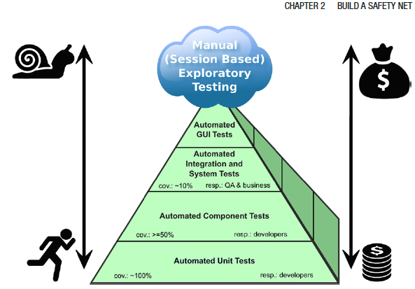
Introduction
Dynamic Analysis verifies properties of a system during execution/runtime.
Testing Analysis is one example of Dynamic Analysis
Unit tests, integration tests, system tests, and acceptance tests use dynamic testing
Notes:
Another example is using a debugger.
The different testing techniques like Unit tests, Integration tests, system tests, and acceptance tests use dynamic testing.
Experience has shown that the total costs regarding implementation and maintenance of tests increase toward the top of the pyramid.

Slide 3
Testing in the Book
Tests are your life insurance!
Tests are essential to assuring the quality of code activities.
Write Tests to Enable Evolution
Good tests can find bugs in your artifact
Tests can also detect unwanted behavior
You can also write tests to understand a part of a system
Test the Interface, Not the implementation. This is essentially Black-box testing.
Notes:
There are many parts in the book related to testing. The first one I like very much is “Tests are your life assurance!”
Black-box testing is a method of software testing that examines the functionality of an application without peering into its internal structures or workings.
This test method can be applied virtually to every level of software testing: unit, integration, system and acceptance.

Slide 4
Unit Testing
In this session, we focus on Unit Testing.
Unit testing focuses on the smallest testable parts of an application called units (e.g., a class method or function)
There are other types of testing (Integration, Performance, Security, etc.)
It does not mean that Unit Testing is more important, but those are the tests we can more easily automatize and benefit from tool support.
Notes:
In this lab, we are going to focus on unit testing
In unit testing, the focus is on the smallest testable parts of an application, called units (an example is a method)

Slide 5
Quality of a Test Suite
How do you know if your unit test cases are good enough?
Are they really testing the application?
When do we stop testing?
Solution: Test Coverage!

Slide 6
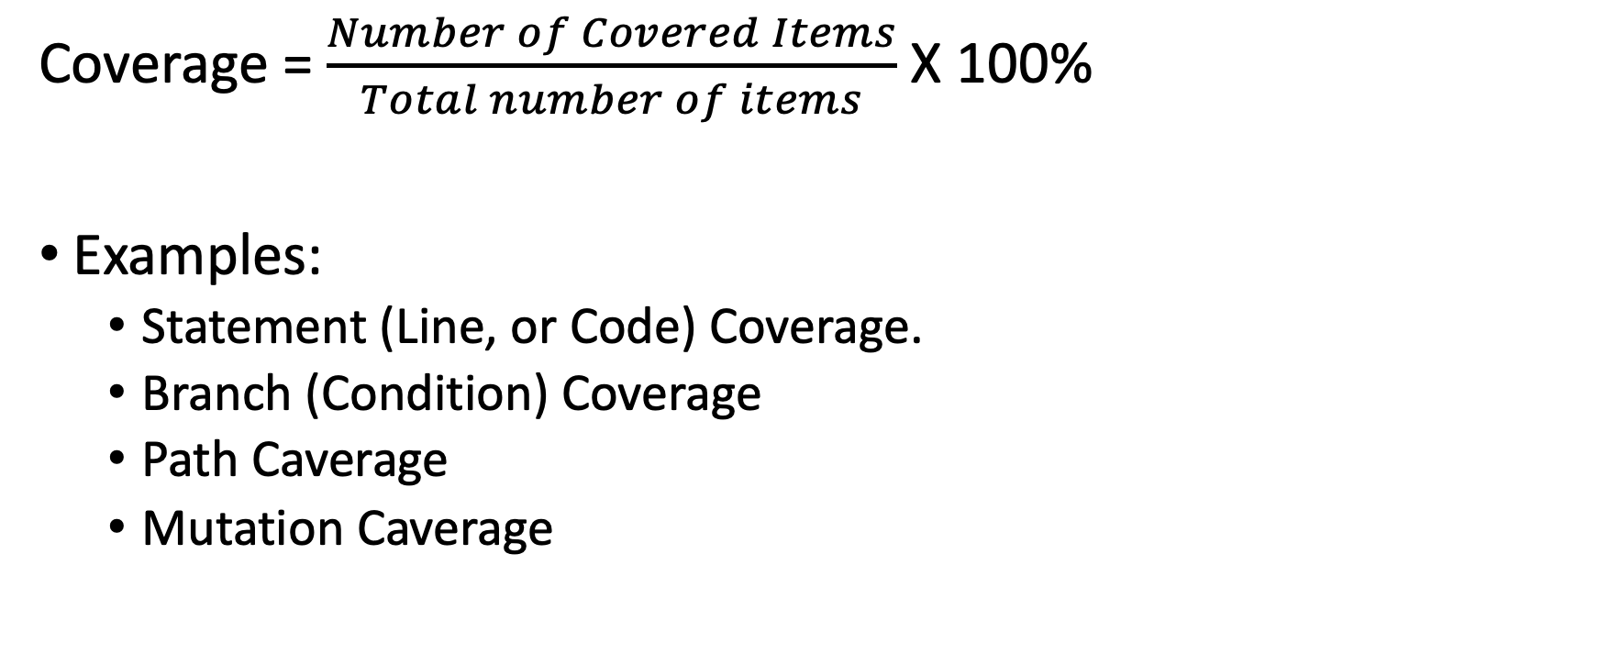
Test Coverage
Coverage = $\frac{Number of Covered Items}{Total number of items}$ X 100%
Examples:
Statement (Line, or Code) Coverage.
Branch (Condition) Coverage
Path Caverage
Mutation Caverage

Slide 7
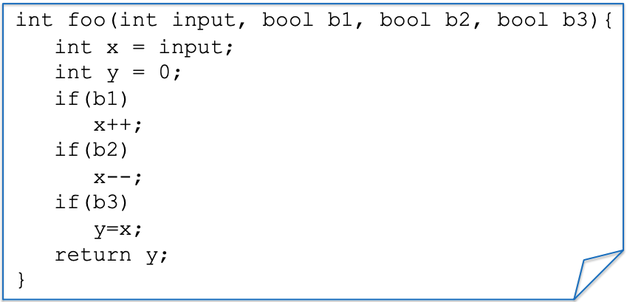
Example: a function to test
Notes:
We have a simple function foo with inputs - > input, 3 booleans b1, b2, b3
We also have three if statements that manipulate the input

Slide 8
Statement/Line/Code Coverage
Test Case(s)
ASSERT foo(0, true, true, true) == 0;
Notes:
Suppose we have a test case trying to assert if I call this function foo with

Slide 9
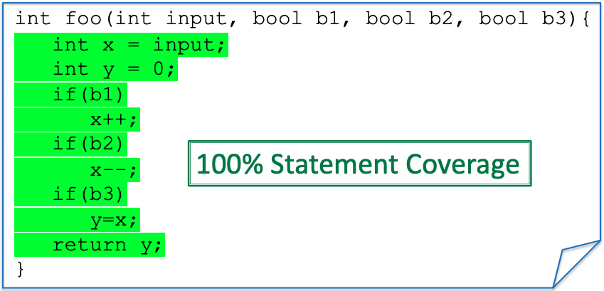
Statement/Line/Code Coverage
Test Case(s)
ASSERT foo(0, true, true, true) == 0;
Notes:
All the lines of this code will be executed, and hence we have 100% coverage
If I change one of the

Slide 10
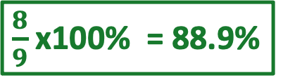
Statement/Line/Code Coverage
Test Case(s)
ASSERT foo(0, true,, true, true) == -1;
false
$\frac{8}{9}$ x100% = 88.9%
x++;
Notes:
All the lines of this code will be executed, and hence we have 100% coverage
If I change one of the

Slide 11
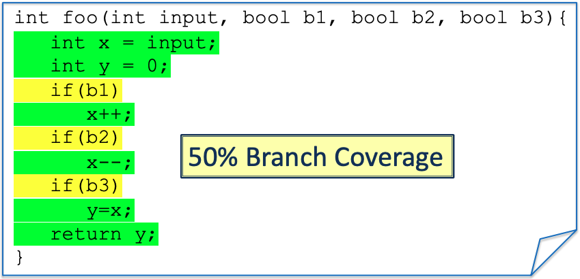
Branch/Condition Coverage
Test Case(s)
ASSERT foo(0, true, true, true) == 0;
Notes:
Branch every condition. Needs to cover all the conditions coverage
The TC needs to it goes inside the if or inside the else.
In this case, we only have the only if and no else. All the different states of the condition (true or false) need to be tested.

Slide 12
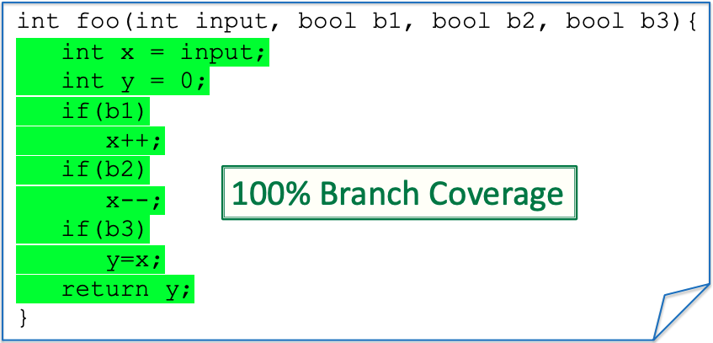
Branch/Condition Coverage
New Test
Test Case(s)
ASSERT foo(0, true, true, true) == 0;
Assert foo(0,false, false, false) == 0;

Slide 13
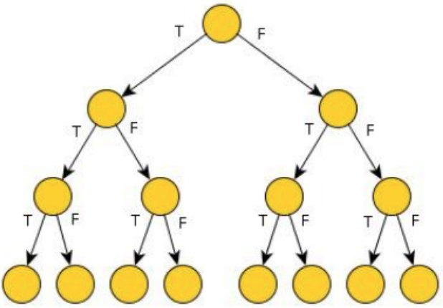
Path Coverage
Paths for three “if” each can be either true (T) or false (F)
8-Paths

Slide 14

Path Coverage
Test Case(s)
ASSERT foo(0, true, true, true) == 0;
ASSERT foo(0,false, false, false) == 0;
25% Path Coverage
Notes:
As you can see, conditionals (and loops) make path coverage hard. We need to write a lot of tests
We get an exponential number of paths on the number of conditionals tests.
This is going to be very costly to test, but on the other hand, it could be that a bug is hidden in one of the paths
We need path coverage to find certain bugs

Slide 15
Testing Coverage for the Project
It is required to show coverage for your Project (in both the Intermediate and the Final Report)
At least Statement Coverage, but Branch Coverage is better.
There is no set coverage limit to reach for the project.
But if your project has very low coverage, you better have a good explanation for that.
Focus on increasing the coverage for the system parts that will be affected by your change.

