Slide 1
Software Testing
John Businge
john.businge@unlv.edu

Slide 2

Free PDF version on Springer
https://link.springer.com/book/10.1007/978-1-4842-5949-8

Slide 3

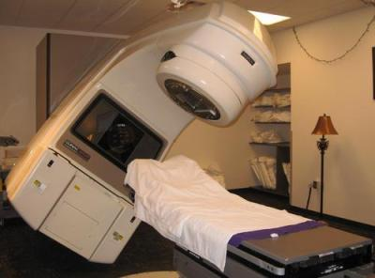





The Need for Testing
1986: THERAC-25 MEDICAL ACCELERATOR DISASTER
One developer
Insufficient testing
https://hackaday.com/2015/10/26/killed-by-a-machine-the-therac-25/
Notes:
This case is probably the most consequential failure in the history of software development. The Therac-25 was a radiation therapy device. Due to
bugs in the control software,
an insufficient quality assurance process, and
other deficiencies,
three patients lost their lives caused due to radiation overdoses.
An analysis of this case determined that, among other things, the software was written by only one person who was also responsible for the tests.

Slide 4
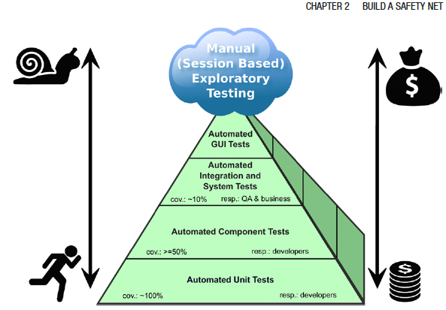
The Test Pyramid
Notes:
The different testing techniques like Unit tests, Integration tests, system tests, and acceptance tests use dynamic testing.
The pyramid shape, of course, is no coincidence. The message behind it is that you should have many more low-level unit tests (approximately 100% code coverage) than any other kind of tests. But why is that?
Experience has shown that the total costs regarding implementation and maintenance of tests increase toward the top of the pyramid.
Large system tests and manual user acceptance tests are usually complex, often require extensive organization, and cannot be automated easily. For instance, an automated UI test is hard to write, often fragile, and relatively slow.

Slide 5
Unit Tests
A unit test is a piece of code that executes a small part of your production code base in a particular context. The test will show you, in a split second, that your code works as you expect it to work. If unit test coverage is pretty high, and you can check in less than a minute that all parts of your system under development are working correctly
Notes:
The different testing techniques like Unit tests, Integration tests, system tests, and acceptance tests use dynamic testing.
The pyramid shape, of course, is no coincidence. The message behind it is that you should have many more low-level unit tests (approximately 100% code coverage) than any other kind of tests. But why is that?
Experience has shown that the total costs regarding implementation and maintenance of tests increase toward the top of the pyramid.
Large system tests and manual user acceptance tests are usually complex, often require extensive organization, and cannot be automated easily. For instance, an automated UI test is hard to write, often fragile, and relatively slow.

Slide 6
Why are unit tests useful?
Unit tests give you immediate feedback about your entire code base. Provided that test coverage is sufficiently high
A high coverage with unit tests can prevent time-consuming and frustrating debugging sessions.
Unit tests are a kind of executable documentation because they show exactly how the code is designed to be used.

Slide 7





Unit Tests Frameworks
Notes:
There are several different unit test frameworks available for C++ development, for example, CppUnit, Boost.Test, CUTE, Google Test, Catch respectively Catch2, and a couple more.

Slide 8
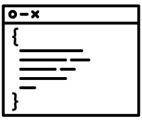


Rules for Good Unit Tests
Production Code
Test Code
Notes:
Unit tests should add value to your project. To achieve this goal, you need to follow some essential rules, which I describe in
this section.
The same high-quality requirements for the production code have to be valid for the unit test code. I’ll go even further. Ideally, there should be no distinction between production and test code—they are equal.

Slide 9
Rules for Good Unit Tests - Unit Test Naming
If a unit test fails, the developer wants to know immediately:
What is the name of the unit; whose test failed?
What was tested, and what was the environment of the test
What was the expected test result, and what was the actual test result of the failed test?

Slide 10
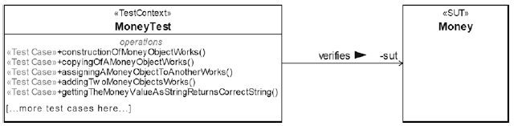
Rules for Good Unit Tests - Unit Test Naming
Test Name: <Unit_Under_Test>Test
<Unit_Under_Test>
The system under test, (SUT) Money and its test fixture, MoneyTest
Notes:
The system under test, (SUT) Money and its test fixture, MoneyTest

Slide 11
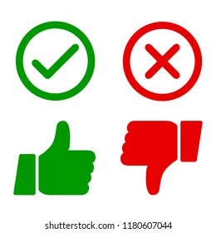
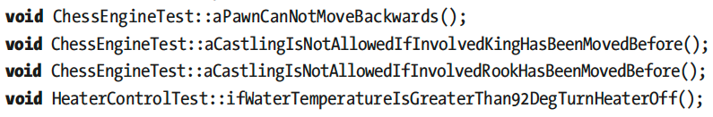
Rules for Good Unit Tests - Unit Test Naming
Expressive and descriptive unit tests
Undescriptive unit tests
<PreconditionAndStateOfUnitUnderTest>_<TestedPartOfAPI>_<ExpectedBehavior>
testConstructor()
test4391()
sumTest()
cacheIsEmpty_addElement_sizeIsOne()
cacheContainsOneElement_removeElement_sizeIsZero();
givenTwoComplexNumbers_add_Works()
givenTwoMoneyObjectsWithDifferentBalance_InequalityComparison_Works()
invoiceIsReadyForAccounting_getInvoiceDate_returnsToday()
Examples of Unit Test Names that Verify Domain-Specific Requirements

Slide 12
Rules for Good Unit Tests – One Assession per Test
void MoneyTest::givenTwoMoneyObjectsWithDifferentBalance_
InequalityComparison_Works() {
const Money m1(-4000.0);
const Money m2(2000.0);
ASSERT_TRUE(m1 != m2);
}
void MoneyTest::givenTwoMoneyObjectsWithDifferentBalance_
testAllComparisonOperators() {
const Money m1(-4000.0);
const Money m2(2000.0);
ASSERT_TRUE(m1 != m2);
ASSERT_FALSE(m1 == m2);
ASSERT_TRUE(m1 < m2);
ASSERT_FALSE(m1 > m2);
// ...more assertions here...
}
void MoneyTest::givenTwoMoneyObjectsWithSameBalance_
EqualityComparison_Works() {
const Money m1(-4000.0);
const Money m2(2000.0);
ASSERT_TRUE(m1 == m2);
}
Difficult to find cause of error
Early failing assertions obsures additional errors
“...testAllComparisonOperators()” not a good name.

Slide 13
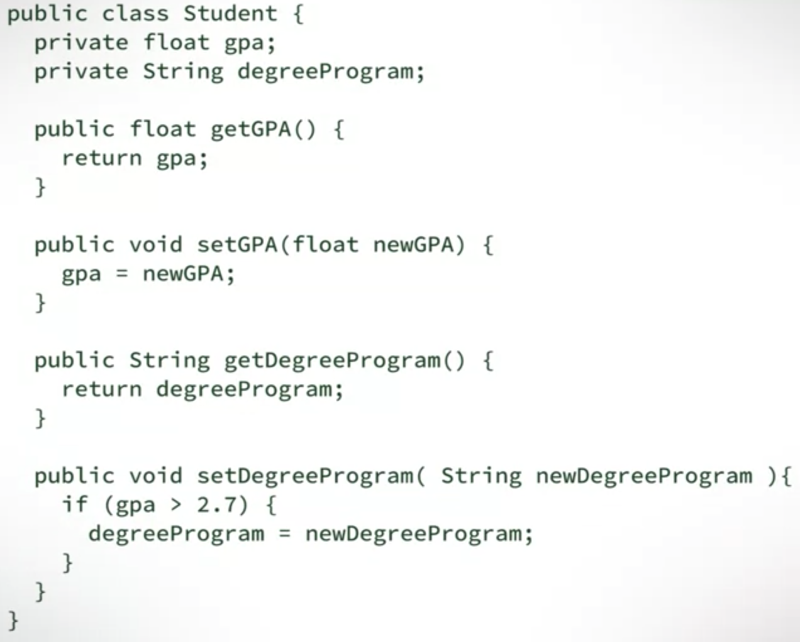
Rules for Good Unit Tests – Exclude Getters and Setters
Don’t write unit tests for usual/simple getters and setters of a class
Sometimes, getters and setters are not that simple, especially those that implement information hiding

Slide 14
Rules for Good Unit Tests – Exclude Third-Party Code
We don’t have to verify that libraries or frameworks do work as expected

Slide 15
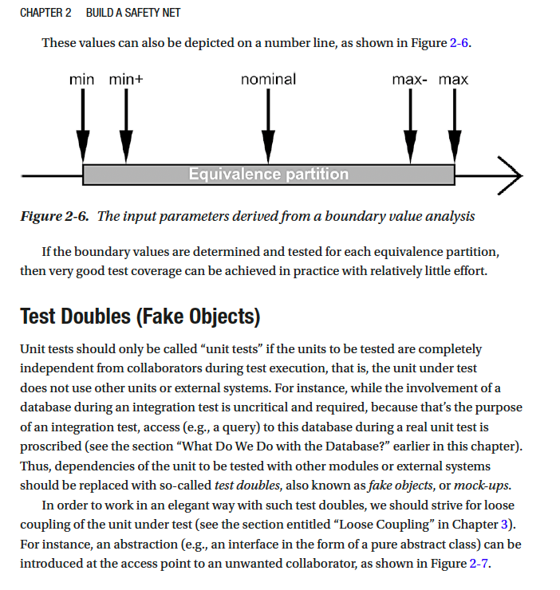
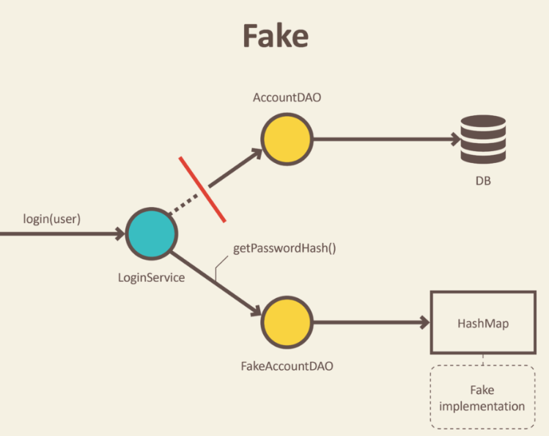
Rules for Good Unit Tests – Exclude External Systems
Mock things out and test your code, not theirs
Read – Test Doubles (Fake Objects)
https://blog.pragmatists.com/test-doubles-fakes-mocks-and-stubs-1a7491dfa3da

Slide 16
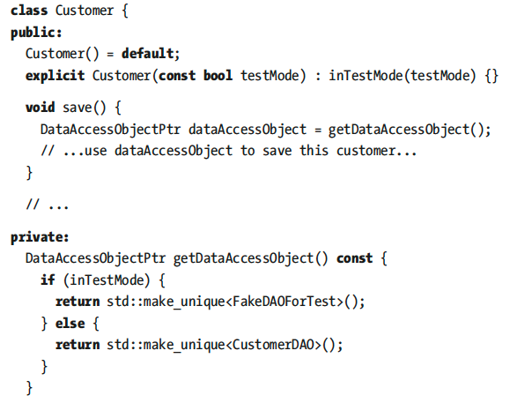
Rules for Good Unit Tests – Don’t Mix Test Code with Production Code
Avoid Dependencies to Test Code

Slide 17


Rules for Good Unit Tests – Tests Must Run Fast
Large Software Project
>1000 unit tests
contains
If running all unit tests takes 15 minutes, ½ hour, or more, developers are impeded in doing their work
If 1-test tales 0.5 secs -> 1,000-tests will take 8 minutes
Executing the whole test suit 10 times will cost 1.5 hours of waiting time.
This might result developers running tests less times.
A good test suit should run under 3-minutes

Slide 18




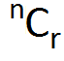
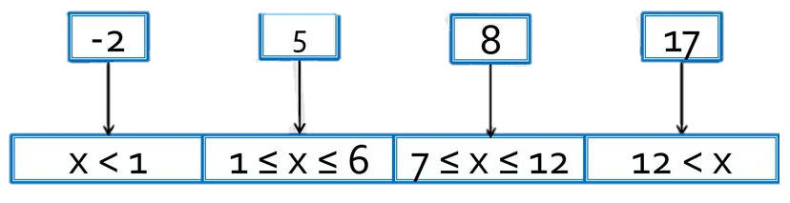


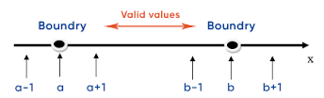

Rules for Good Unit Tests – Tests Input Data
How do I find all test cases that are necessary to ensure good fault detection?
Test cases
High Test Coverage
Select
Equivalence Partitioning/Class
Boundary Value Analysis
Test cases
Notes:
A large set of input combinations and you will end up with an almost infinite number of test cases.

Slide 19


Rules for Good Unit Tests – Tests Input Data
Equivalence Partitioning
Test input data/test cases:
{-2, 5, 8, 17}
Partitions:
1
2
3
4
Bank Interest Calculator API
The bank charges 4 percent penalty interest on overdrafts.
The bank offers 0.5 percent interest for the first 5,000 USD savings.
The bank offers 1 percent interest for the next 5,000 USD savings.
The bank offers 2 percent interest for the rest.
Interest is calculated on a daily basis.
Two Classes
Amount of money and, as interest is calculated on a daily basis
number of days for which this amount is valid
The equivalence partitioning for the amount of money
The equivalence partitioning for number of days
Notes:
Let us use and example of the The bank interest calculator API with the following requirements
The idea behind equivalence partitioning is that it is enough to pick only one value from each partition for testing. The hypothesis behind this technique is that if one condition/value in a partition passes a test, all others in the same partition will also pass.
Likewise, if one condition/value in a partition fails, all other conditions/values in that partition will also fail. If there is more than one parameter, as in our case, appropriate combinations should be formed.

Slide 20


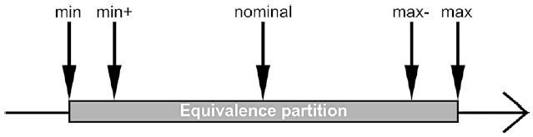

Rules for Good Unit Tests – Tests Input Data
Boundary Value Analysis
Extreme value
High Test Coverage
The input parameters derived from a boundary value analysis
Notes:
Now let us look at boundary value analysis
Many software bugs can be traced back to difficulties in the border areas of the equivalence classes, for example at the transition between two valid equivalence classes, between a valid and an invalid equivalence class, or due to an extreme value that was not taken into account.
The result of such an analysis is useful to select the input values of a numerical parameter for the tests: min, min+1, nominal, max-1, max
If the boundary values are determined and tested for each equivalence partition, then very good test coverage can be achieved in practice with relatively little effort.

Slide 21
Quality of a Test Suite
How do you know if your unit test cases are good enough?
Are they really testing the application?
When do we stop testing?
Solution: Test Coverage!

Slide 22
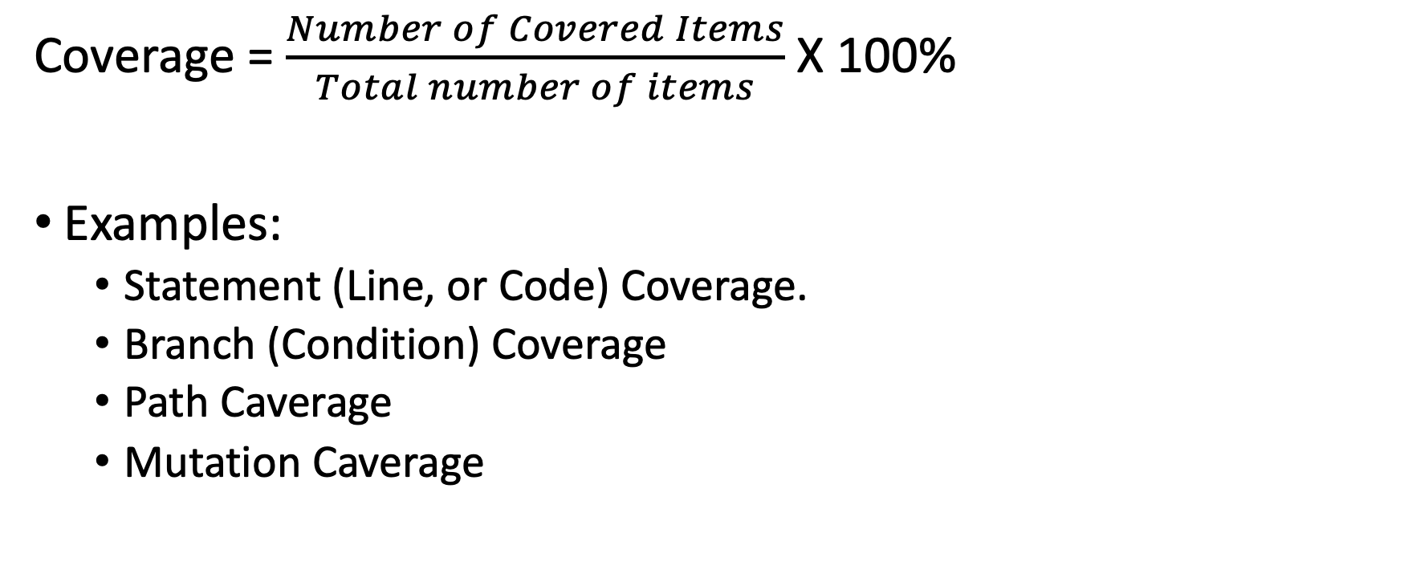
Test Coverage
Coverage = $\frac{Number of Covered Items}{Total number of items}$ X 100%
Examples:
Statement (Line, or Code) Coverage.
Branch (Condition) Coverage
Path Caverage
Mutation Caverage

Slide 23
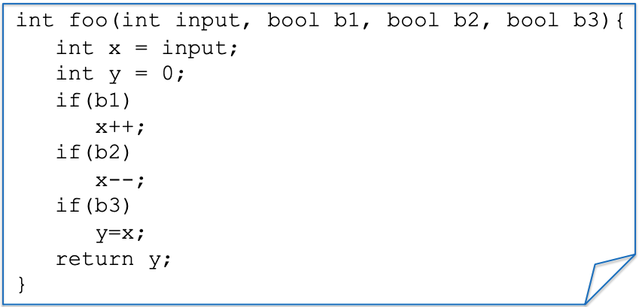
Example: a function to test
Notes:
We have a simple function foo with inputs - > input, 3 booleans b1, b2, b3
We also have three if statements that manipulate the input

Slide 24
Statement/Line/Code Coverage
Test Case(s)
ASSERT foo(0, true, true, true) == 0;
Notes:
Suppose we have a test case trying to assert if I call this function foo with

Slide 25
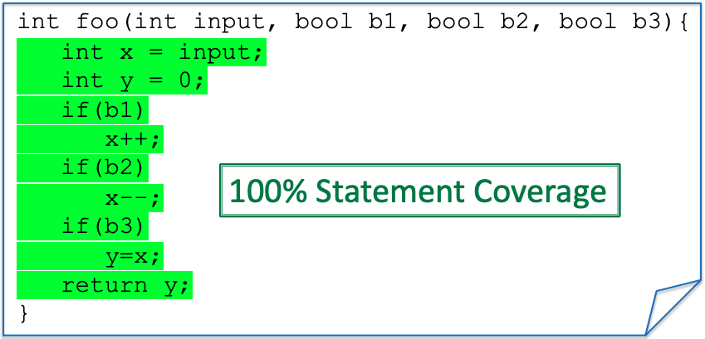
Statement/Line/Code Coverage
Test Case(s)
ASSERT foo(0, true, true, true) == 0;
Notes:
All the lines of this code will be executed, and hence we have 100% coverage
If I change one of the

Slide 26
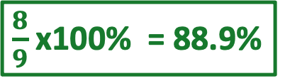
Statement/Line/Code Coverage
Test Case(s)
ASSERT foo(0, true,, true, true) == -1;
false
$\frac{8}{9}$ x100% = 88.9%
x++;
Notes:
All the lines of this code will be executed, and hence we have 100% coverage
If I change one of the

Slide 27
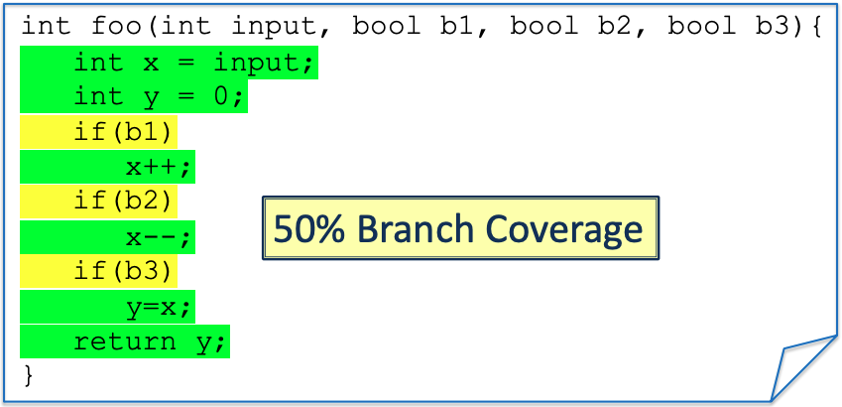
Branch/Condition Coverage
Test Case(s)
ASSERT foo(0, true, true, true) == 0;
Notes:
Branch every condition. Needs to cover all the conditions coverage
The TC needs to it goes inside the if or inside the else.
In this case, we only have the only if and no else. All the different states of the condition (true or false) need to be tested.

Slide 28
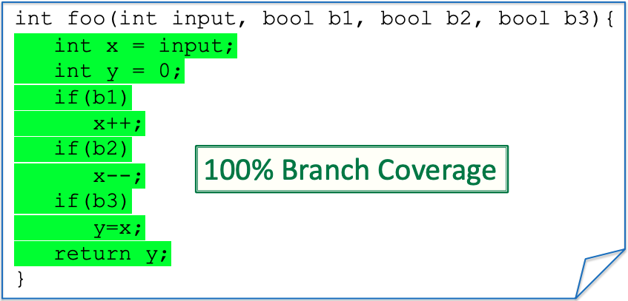
Branch/Condition Coverage
New Test
Test Case(s)
ASSERT foo(0, true, true, true) == 0;
Assert foo(0,false, false, false) == 0;

Slide 29
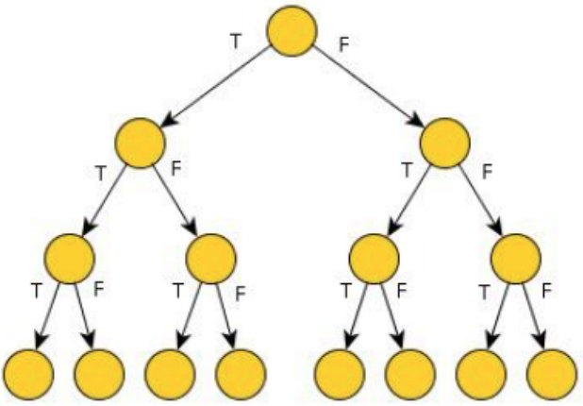
Path Coverage
Paths for three “if” each can be either true (T) or false (F)
8-Paths

Slide 30

Path Coverage
Test Case(s)
ASSERT foo(0, true, true, true) == 0;
ASSERT foo(0,false, false, false) == 0;
25% Path Coverage
Notes:
As you can see, conditionals (and loops) make path coverage hard. We need to write a lot of tests
We get an exponential number of paths on the number of conditionals tests.
This is going to be very costly to test, but on the other hand, it could be that a bug is hidden in one of the paths
We need path coverage to find certain bugs

Slide 31
Testing Coverage for the Project
It is required to show coverage for your Project (in both the Intermediate and the Final Report)
At least Statement Coverage, but Branch Coverage is better.
If your project has very low coverage, you better have a good explanation for that.
Focus on increasing the coverage for the system parts that will be affected by your change.

Slide 32
