Slide 1
Dynamic Analysis: Testing
John Businge
john.businge@unlv.edu

Slide 2
The value of testing
“If it is worth building, it is worth testing.
If it is not worth testing, why are you wasting your time working on it?”
- Scott Ambler, agiledata.org

Slide 3
Software testing levels
Testing for acceptability
Evaluate the compliance with business requirements
Done by the end user
Usually performed in the same environment as the systems environment
Acceptance Tests
Entire software process is tested
Evaluate the compliance with specific requirements
Putting the whole system together
Testing the behaviour of the different modules that make up the system
System Tests
Testing individual units as a group
Expose flaws between integrated units.
Are the units calling the API correctly?
Testing the behaviour of the different modules that make up the system
Integration Tests
Testing individual units
Happy paths and sad paths, e.g., if and else paths
Is my module working?
Tests run in the CI server
Unit Test

Slide 4
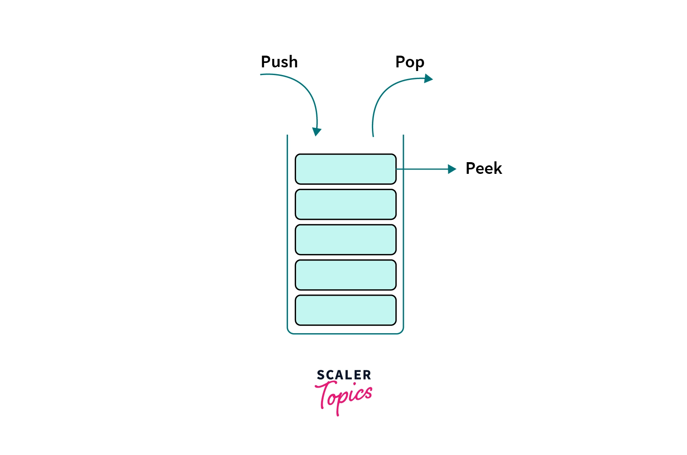
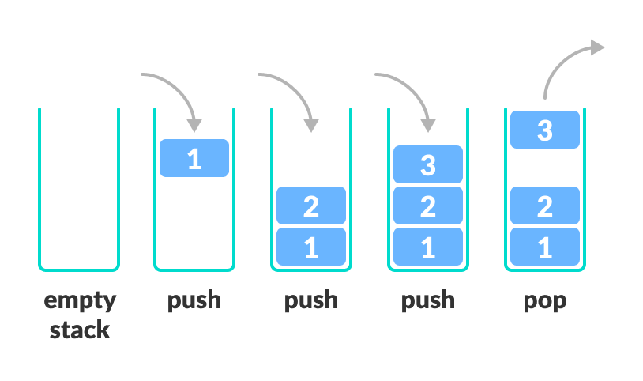
Anatomy of a Test Case
Peek
Notes:
Let's take a look at an example test case.
In this example, we’re going to use a common programming construct know as a stack

Slide 5
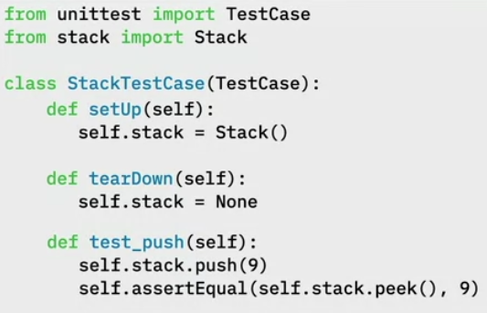

Test Case for push() and pop() function
Test Fixtures
Push
Pop
Peek
9
Notes:
Let's take a look at an example test case.
In this example, we’re going to use a common programming construct know as a stack
1. First, we will import the TestCase and the Stack classes
2. Write out class StackTestCase
3. Write the text Fixtures that allows you to specify the initial state of the of the system before a test case is run
setUp() is declaring an instance variable called self.stack and assigning it to a new Stack.
tearDown() is setting self.stack to None to make sure that it doesn’t get reused
4. Now we write our first Test Case test_push(self)
When the program executes, self.stack = Stack() will be called
Next,

Slide 6
Testing in the Book
Tests are your life insurance!
Tests are essential to assuring the quality of code activities.
Write Tests to Enable Evolution
Good tests can find bugs in your artifact
Tests can also detect unwanted behavior
You can also write tests to understand a part of a system
Test the Interface, Not the implementation. This is essentially Black-box testing.
Notes:
There are many parts in the book related to testing. The first one I like very much is “Tests are your life assurance!”
Black-box testing is a method of software testing that examines the functionality of an application without peering into its internal structures or workings.
This test method can be applied virtually to every level of software testing: unit, integration, system and acceptance.

Slide 7
Unit Testing
In this session, we focus on Unit Testing.
Unit testing focuses on the smallest testable parts of an application called units (e.g., a class method or function)
There are other types of testing (Integration, Performance, Security, etc.)
It does not mean that Unit Testing is more important, but those are the tests we can more easily automatize and benefit from tool support.
Notes:
In this lab, we are going to focus on unit testing
In unit testing, the focus is on the smallest testable parts of an application, called units (an example is a method)

Slide 8
Quality of a Test Suite
How do you know if your unit test cases are good enough?
Are they really testing the application?
When do we stop testing?
Solution: Test Coverage!

Slide 9
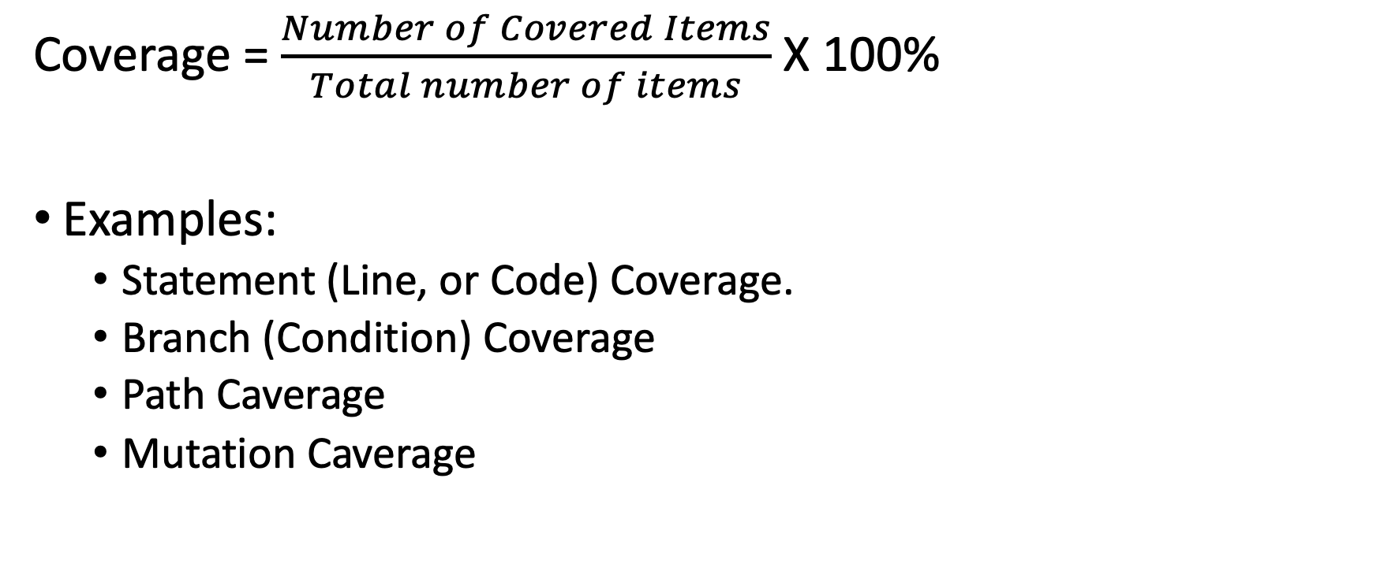
Test Coverage
Coverage = $\frac{Number of Covered Items}{Total number of items}$ X 100%
Examples:
Statement (Line, or Code) Coverage.
Branch (Condition) Coverage
Path Caverage
Mutation Caverage

Slide 10
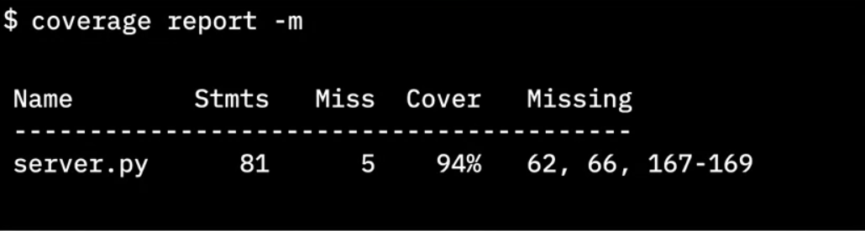
Importance of test coverage
High test coverage gives you confidence that your code works as expected
Test coverage reports can reveal which lines of code were not tested
Python cmd tool
Total lines of code
# lines without test cases
Percent of coverage
Lines without test cases
Notes:
Finally it gives us the line numbers that did not have test cases.
This info is critical because now we know where to concentrate our tests.
We need to go write more test cases to cause those lines of code to be executed.

Slide 11
Full test coverage
You must include “happy” paths and “Sad” paths to get full test coverage
Even with 100% test coverage, your code can still have bugs
Don’t stop testing when your code reaches 100%
Notes:
100% test coverage only means that every line of code has been tested with some known good data.
You can still pass bad data into your code and find bugs.
So don't stop testing when your code cover reaches 100%.
Keep challenging the integrity of your code with bad data and corner cases to make sure
your code behaves as expected under both favorable and adverse conditions.

Slide 12
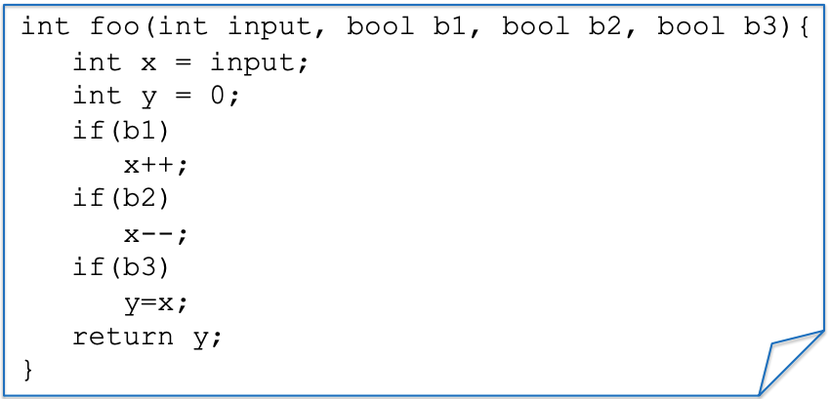
Example: a function to test
Notes:
We have a simple function foo with inputs - > input, 3 booleans b1, b2, b3
We also have three if statements that manipulate the input

Slide 13
Statement/Line/Code Coverage
Test Case(s)
ASSERT foo(0, true, true, true) == 0;
Notes:
Suppose we have a test case trying to assert if I call this function foo with

Slide 14
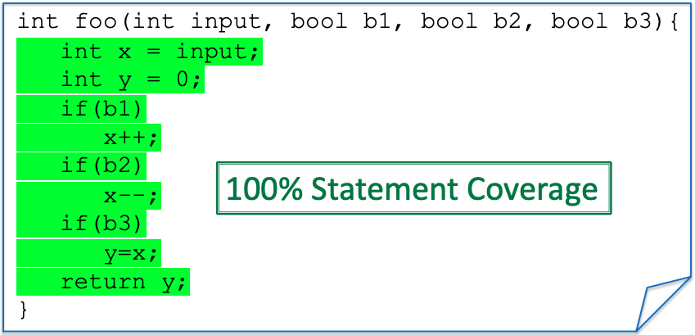
Statement/Line/Code Coverage
Test Case(s)
ASSERT foo(0, true, true, true) == 0;
Notes:
All the lines of this code will be executed, and hence we have 100% coverage
If I change one of the

Slide 15
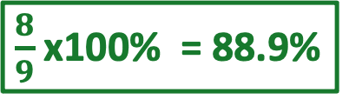
Statement/Line/Code Coverage
Test Case(s)
ASSERT foo(0, true,, true, true) == -1;
false
$\frac{8}{9}$ x100% = 88.9%
x++;
Notes:
All the lines of this code will be executed, and hence we have 100% coverage
If I change one of the

Slide 16
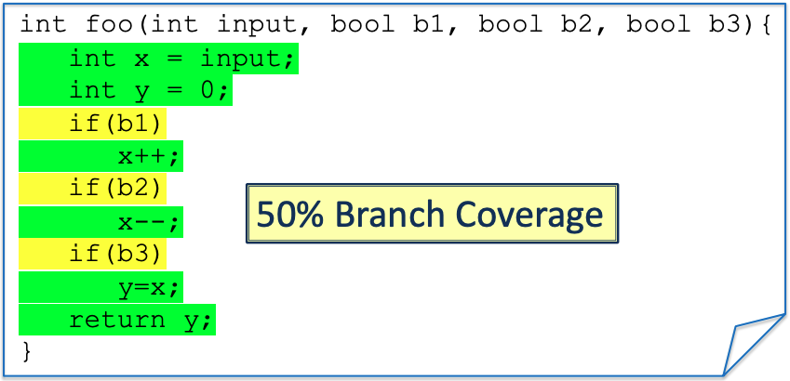
Branch/Condition Coverage
Test Case(s)
ASSERT foo(0, true, true, true) == 0;
Notes:
Branch every condition. Needs to cover all the conditions coverage
The TC needs to it goes inside the if or inside the else.
In this case, we only have the only if and no else. All the different states of the condition (true or false) need to be tested.

Slide 17
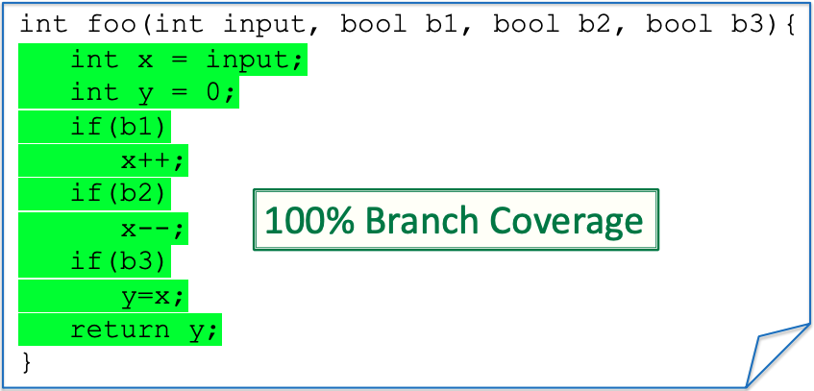
Branch/Condition Coverage
New Test
Test Case(s)
ASSERT foo(0, true, true, true) == 0;
Assert foo(0,false, false, false) == 0;

Slide 18
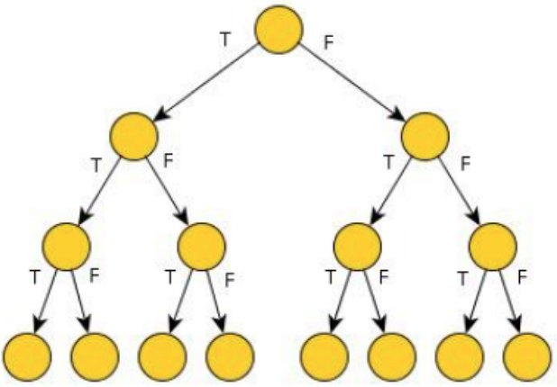
Path Coverage
Paths for three “if” each can be either true (T) or false (F)
8-Paths

Slide 19

Path Coverage
Test Case(s)
ASSERT foo(0, true, true, true) == 0;
ASSERT foo(0,false, false, false) == 0;
25% Path Coverage
Notes:
As you can see, conditionals (and loops) make path coverage hard. We need to write a lot of tests
We get an exponential number of paths on the number of conditionals tests.
This is going to be very costly to test, but on the other hand, it could be that a bug is hidden in one of the paths
We need path coverage to find certain bugs

Slide 20
Test driven development
TDD means that your tests drive the design and development of your code. You don't write code and then write tests. You write the tests first.
You write the tests for the code you wish you had, then you write the code to make the tests pass.
How can I write code for tests that I haven't written the code yet?
Think about how you write a design for code you haven't written yet: you describe how the code should behave and then you write code that behaves that way
TDD is no different. The test case describes the behavior that you want the code to have.
For TDD, you care about the call.
Did the right call get called? Did the right return come back?
Did it bring back the right data in the right format? And so on.
TDD is used for this unit testing.

Slide 21
Tools for TDD
xUnit series:
JUnit for Java,
PyUnit for Python,
NUnit for .Net platform, and
Embunit for C and C++
Jasmine for JavaScript
Mocha for Node.js
Simplest for PHP
Notes:
The message is that you should look for a testing framework
for the language that you are using and learn it.
It will save you a lot of time because each one gives you the tools that you need to properly test your code.

Slide 22
Tools for TDD
Pyunit
Nose – is a test runner
allows you to add color and formatting and other test output
Nose has the ability to call the Coverage tool
Notes:
The message is that you should look for a testing framework
for the language that you are using and learn it.
It will save you a lot of time because each one gives you the tools that you need to properly test your code.

Slide 23
Basic TDD workflow
RED
(Fail)
Write test case that fails
Red,
Green,
Refactor
REFACTOR
GREEN
(Pass)
Write test case that fails
Improve the code quality
Notes:
In TDD, you first write a test case for the code you wish you had. You don’t start by writing the code.
You write the test cases first. Second, you write the code to make that test case pass.
And then third, you refactor the code to make it more robust,
knowing that the test cases will let you know if you change the code’s behavior.
And finally, refactor that code to make it more robust knowing that
the test case will let you know if you change the behavior of the code.

Slide 24
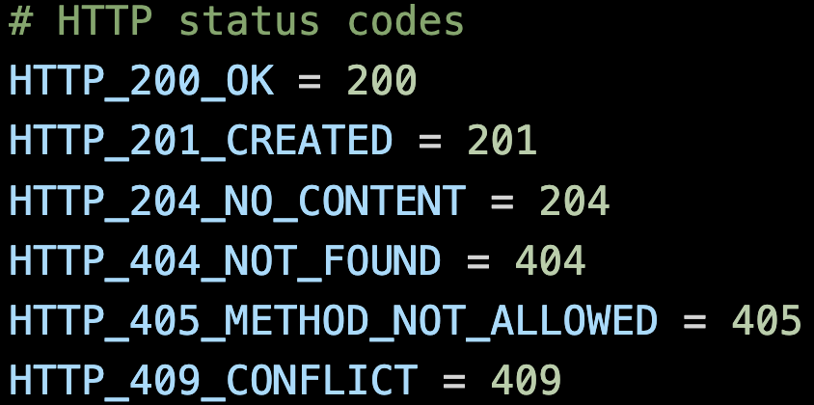
Scenario Requirements
Create a web service that can keep track of multiple counters, like hit counters on a web page
API must be RESTFul
Endpoint should be called /counters
When creating a counter, you specify the name of the path
E.g., /counters/shoes
Duplicate names should return a conflict error code
The error codes for HTTP conflict in a RESTful service is 429 Conflict.
Notes:
Imagine this scenario. You’ve been asked to build a web service that can keep track of multiple counters.
These counters are like hit counters on a webpage.
So you’ve been told the API must be restful. That tells you a bit about the behavior and the HTTP verbs that you’ll use to create the service.
It must follow RESTful guidelines.
The endpoint should be called /counters. Knowing this and the fact that it should be RESTful gives you a lot of information about how you should call the endpoint.
You’ve also been told that when creating a counter, you must specify the name in the path of the call.
So the call will be /counters/ and then the name of the counter.
The final requirements specify that duplicate names must return an error code.
The error codes for HTTP conflict in a RESTful service is 429 Conflict.
Given those requirements, we can start writing a test
that creates a counter by calling POST on /counters with a name appended, like “shoes.”

Slide 25
It should create a counter
Given the requirements, write a test case
By calling POST /counters/shoes
Since the API is RESTFul, Return code equals: 201_CREATED
Data equals: {“shoes”: 0 }
Calling POST /counters/toys
Return code equals: 201_CREATED
Data equals: {“toys”: 1 }
Notes:
Given those requirements, we can start writing a test
that creates a counter by calling POST on /counters with a name appended, like “shoes.”

Slide 26
It should error on duplicates
Given the requirements, write a test case to test duplicates
Calling POST /counters/shoes
Return code equals: 201_CREATED
Calling POST /counters/shoes
Return code equals: 429_CONFLICT
Notes:
Given those requirements, we can start writing a test
that creates a counter by calling POST on /counters with a name appended, like “shoes.”

Slide 27
Test cases drive the development
Write test cases based on the requirements
Write the code to make the test cases pass
You know that if you wrote the code first, you’d still probably write a little program to test it
Why not make that program into a formal test case from the start?
TDD workflow is a back-and-forth process. You write a test case, and then you write the code. You write more test cases to check different inputs or affected behaviors, and then you write more code.
TDD yields higher code quality

Slide 28
Testing Coverage for the Project
It is required to show coverage for your Project (in both the Intermediate and the Final Report)
At least Statement Coverage, but Branch Coverage is better.
There is no set coverage limit to reach for the project.
But if your project has very low coverage, you better have a good explanation for that.
Focus on increasing the coverage for the system parts that will be affected by your change.

