Slide 1
Using LLMs to Perform Specific Software Development Lifecycle Activities
Prepared by: John Businge
john.businge@unlv.edu

Slide 2






The Hype around LLMs for Software Development
Cooled down
Notes:
The initial hype around using LLMs for software development has already started to cool down
The conversation has shifted from expecting LLMs to replace software developers (i.e., artificial intelligence) to considering LLMs as partners and focusing on where to best apply them (i.e., augmented intelligence).

Slide 3
Utilization of LLM for in SE Tasks
Requirements Engineering
Requirements classification
Traceability automation
Software Design
GUI retrieval
Rapid prototyping
Software Development
Code generation
Code understanding
Code search
Software Quality Assurance
Test generation
Test automation
Failure-inducing test identification
Software Maintenance
Code review
Debugging
Program repair
Software management
Effort estimation
Notes:
Traceability automation. Software and system traceability refers to the ability to establish and maintain relationships between software artifacts, such as requirements, design definitions, code, and test cases, for product querying and development support

Slide 4
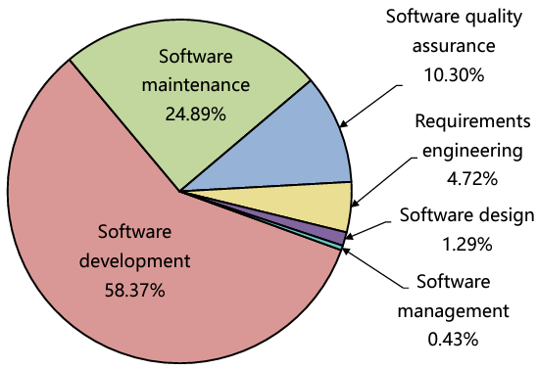
Utilization of LLM for in SE Tasks
Hou et al. LLMs for SE: A Systematic Literature Review - https://arxiv.org/pdf/2308.10620.pdf
- Analyzed 229 research papers on the subject
58.37% in software development showcases the significance of LLMs in producing code or text
Read Chapter 6 of paper by Hou et al. to find papers that have used LLMs to solve the SE tasks.

