Slide 1
Dynamic Analysis: Testing
John Businge
john.businge@unlv.edu

Slide 2
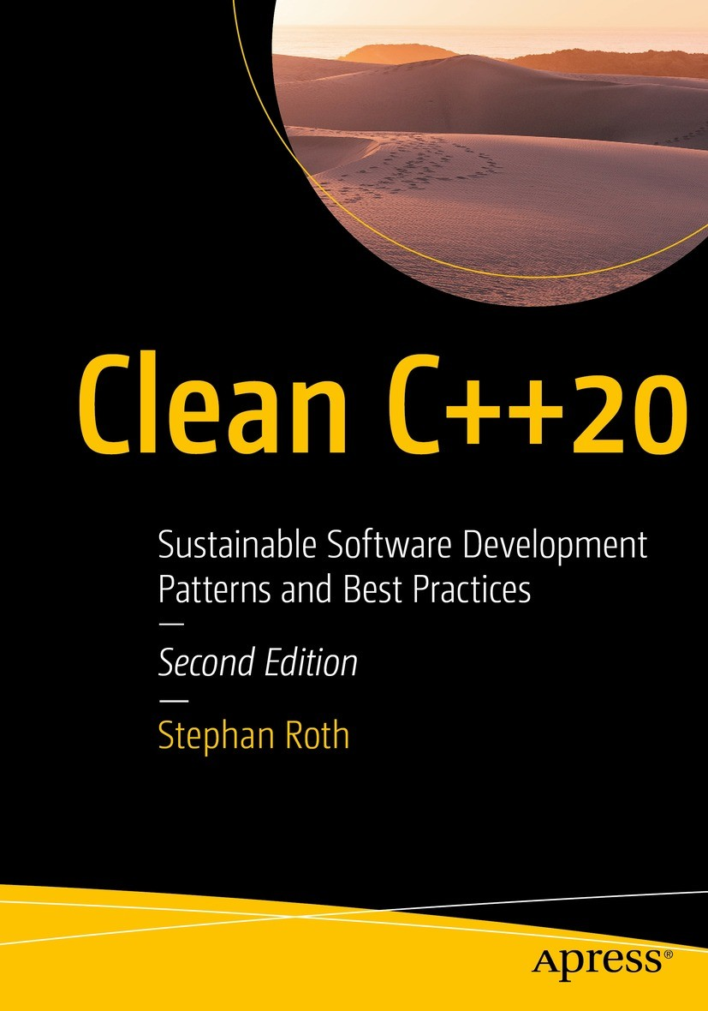
Free PDF version on Springer
https://link.springer.com/book/10.1007/978-1-4842-5949-8
Chapter 2 and Chapter 8

Slide 3
Testing
“If it is worth building, it is worth testing.
If it is not worth testing, why are you wasting your time working on it?”
Scott Ambler, agiledata.org

Slide 4

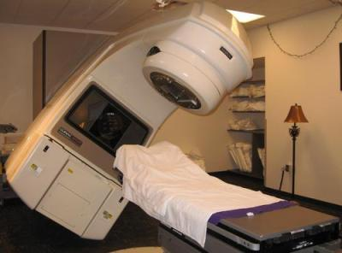





The Need for Testing
KILLED BY A MACHINE: THE THERAC-251986: MEDICAL ACCELERATOR DISASTER
One developer
Control Software
Insufficient testing
https://hackaday.com/2015/10/26/killed-by-a-machine-the-therac-25/
Notes:
This case is probably the most consequential failure in the history of software development. The medical accelerator disaster. Due to
bugs in the control software,
an insufficient quality assurance process, and
other deficiencies,
three patients lost their lives caused due to radiation overdoses.
An analysis of this case determined that, among other things, the software was written by only one person who was also responsible for the tests.

Slide 5
Software testing levels
Acceptance Tests
Testing for acceptability
Evaluate the compliance with business requirements
Done by the end user
System Tests
Entire software process is tested
Evaluate the compliance with specific requirements
Putting the whole system together
Testing individual units as a group
Expose flaws between integrated units.
Are the units calling the API correctly?
Testing the behaviour of the different modules that make up the system
Integration Tests
Testing individual units, e.g., functions or methods
Happy paths and sad paths, e.g., if and else paths
Is my module working?
Tests run in the CI server
Unit Test
Notes:
Each level has a different scope, so different tests are run.
At the lowest level is unit testing.
At this level of the software testing process, you test individual units or components of a software system.
The purpose of these tests is to validate that each unit performs as designed.
these are the tests that run in the CI server when you integrate your code to let you know if you broke something
At the next level up is integration testing
At this level of the software testing process, you’re combining individual units and testing them as a group.
The purpose of this test is to expose flaws in the interaction between integrated units.
At this level, you are testing several modules to make sure that they work together and see how they behave with various inputs.

Slide 6
Unit Testing
We focus on Unit Testing.
Unit testing focuses on the smallest testable parts of an application called units (e.g., a class method or function)
It does not mean that Unit Testing is more important, but those are the tests we can more easily automatize and benefit from tool support.
Notes:
In this lab, we are going to focus on unit testing
In unit testing, the focus is on the smallest testable parts of an application, called units (an example is a method)

Slide 7
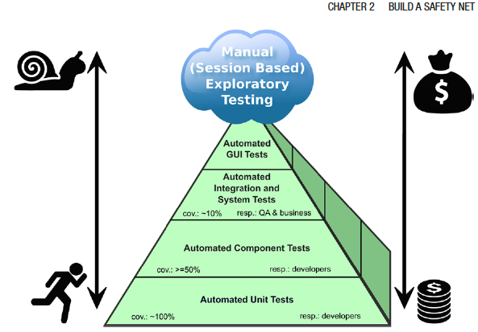

The Test Pyramid
Hard
Test Automation complexity
Cost of test implementation / maintainance
Easy
Aim to have more unit tests (100%)
Notes:
The different testing techniques like Unit tests, Integration tests, system tests, and acceptance tests use dynamic testing.
The pyramid shape, of course, is no coincidence. The message behind it is that you should have many more low-level unit tests (approximately 100% code coverage) than any other kind of tests. But why is that?
Experience has shown that the total costs regarding implementation and maintenance of tests increase toward the top of the pyramid.
Large system tests and manual user acceptance tests are usually complex, often require extensive organization, and cannot be automated easily. For instance, an automated UI test is hard to write, often fragile, and relatively slow.

Slide 8
Why are unit tests useful?
Unit tests give you immediate feedback about your entire code base. Provided that test coverage is sufficiently high.
A high coverage with unit tests can prevent time-consuming and frustrating debugging sessions.
Unit tests are a kind of executable documentation because they show exactly how the code is designed to be used.
Unit testing makes development go faster.

Slide 9
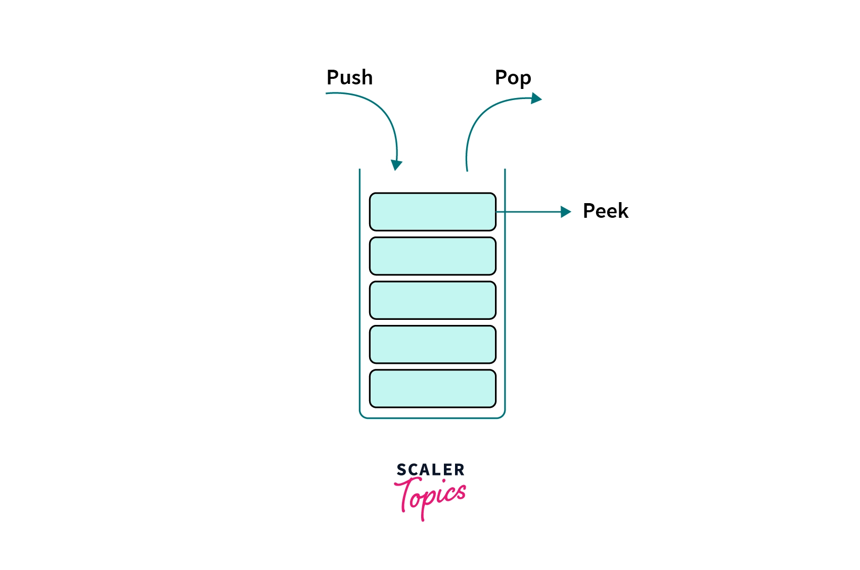
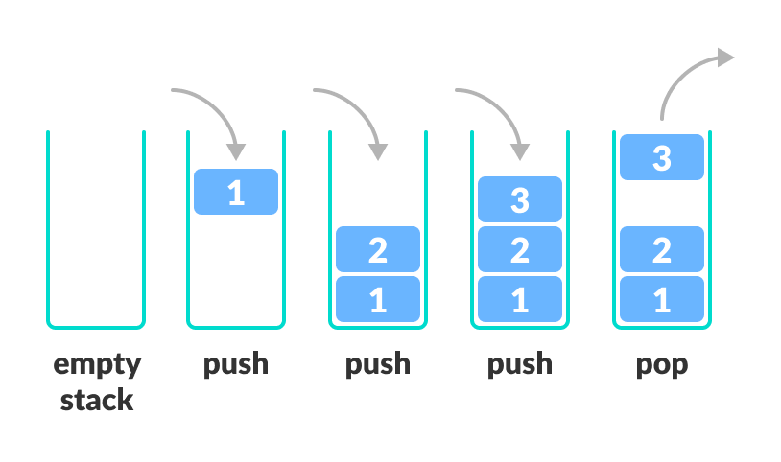
Anatomy of a Test Case
Peek
Notes:
Let's take a look at an example test case.
In this example, we’re going to use a common programming construct know as a stack

Slide 10
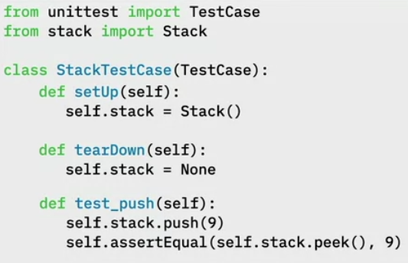

Test Case for push() and pop() function
Test Fixtures: Specify initial state of the of the testcase.
setUp() is declaring an instance variable called self.stack and assigning it to a new Stack.
tearDown() is setting self.stack to None to make sure that it doesn’t get reused
Test Fixtures
Push
Pop
Peek
9
Notes:
Let's take a look at an example test case.
In this example, we’re going to use a common programming construct know as a stack
1. First, we will import the TestCase and the Stack classes
2. Write out class StackTestCase
3. Write the text Fixtures that allows you to specify the initial state of the of the system before a test case is run
setUp() is declaring an instance variable called self.stack and assigning it to a new Stack.
tearDown() is setting self.stack to None to make sure that it doesn’t get reused
4. Now we write our first Test Case test_push(self)
When the program executes, self.stack = Stack() will be called
Next, self.stack.push(9) is called

Slide 11
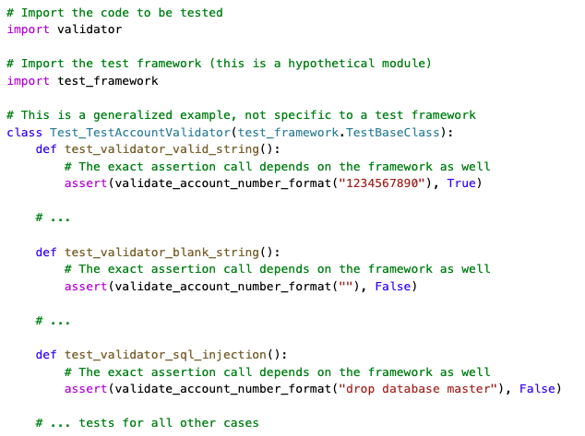

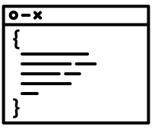


Rules for Good Unit Tests
Production Code
Unit tests should add value to your project.
The same high-quality requirements for the production code should be valid for the unit test code.
Ideally, there should be no distinction between production and test code—they are equal.
Test Code
Notes:
Unit tests should add value to your project. To achieve this goal, you need to follow some essential rules, which I describe in
this section.
The same high-quality requirements for the production code have to be valid for the unit test code. I’ll go even further. Ideally, there should be no distinction between production and test code—they are equal.

Slide 12
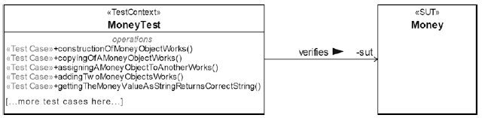
Rules for Good Unit Tests - Unit Test Naming
If a unit test fails, the developer wants to know immediately:
What is the name of the unit; whose test failed?
What was the expected test result, and what was the actual test result of the failed test?
Test Name: <Unit_Under_Test>Test
<Unit_Under_Test>

Slide 13
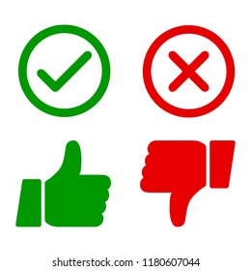
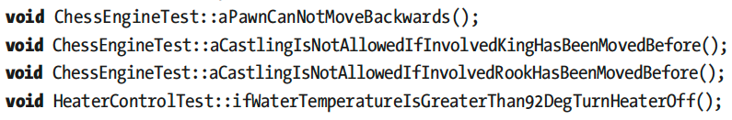
Rules for Good Unit Tests - Unit Test Naming
Expressive and descriptive unit tests
Undescriptive unit tests
<PreconditionAndStateOfUnitUnderTest>_<TestedPartOfAPI>_<ExpectedBehavior>
testConstructor()
test4391()
sumTest()
cacheIsEmpty_addElement_sizeIsOne()
cacheContainsOneElement_removeElement_sizeIsZero();
givenTwoComplexNumbers_add_Works()
givenTwoMoneyObjectsWithDifferentBalance_InequalityComparison_Works()
invoiceIsReadyForAccounting_getInvoiceDate_returnsToday()
Examples of Unit Test Names that Verify Domain-Specific Requirements

Slide 14
Rules for Good Unit Tests – One Assession per Test
void MoneyTest::givenTwoMoneyObjectsWithDifferentBalance_
InequalityComparison_Works() {
const Money m1(-4000.0);
const Money m2(2000.0);
ASSERT_TRUE(m1 != m2);
}
void MoneyTest::givenTwoMoneyObjectsWithDifferentBalance_
testAllComparisonOperators() {
const Money m1(-4000.0);
const Money m2(2000.0);
ASSERT_TRUE(m1 != m2);
ASSERT_FALSE(m1 == m2);
ASSERT_TRUE(m1 < m2);
ASSERT_FALSE(m1 > m2);
// ...more assertions here...
}
void MoneyTest::givenTwoMoneyObjectsWithSameBalance_
EqualityComparison_Works() {
const Money m1(-4000.0);
const Money m2(2000.0);
ASSERT_TRUE(m1 == m2);
}
Difficult to find cause of error
Early failing assertions obsures additional errors
“...testAllComparisonOperators()” not a good name.

Slide 15
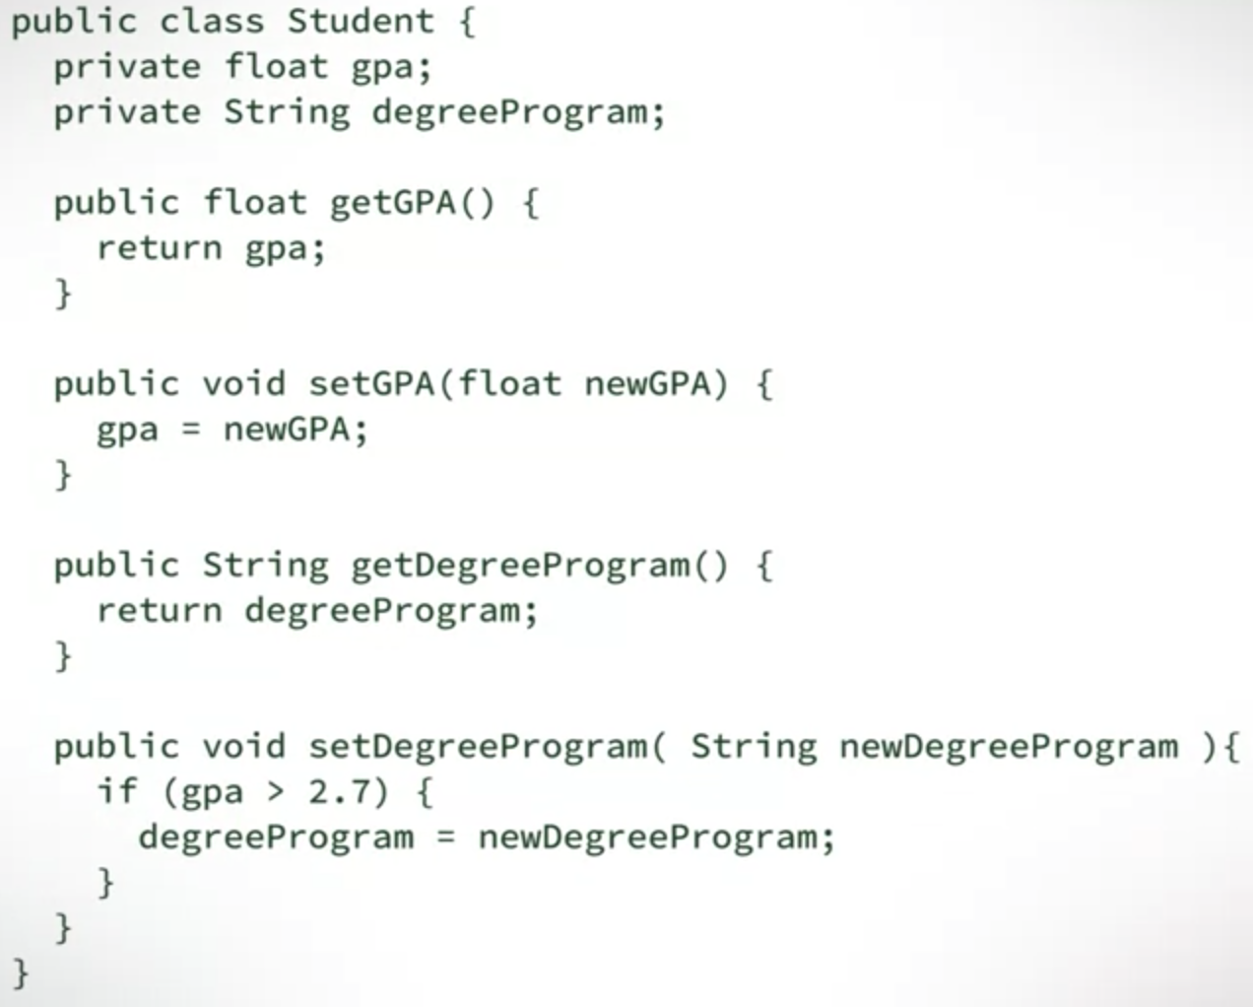
Rules for Good Unit Tests – Exclude Getters and Setters
Don’t write unit tests for usual/simple getters and setters of a class
Sometimes, getters and setters are not that simple, especially those that implement information hiding
Notes:
Do you really expect that something could go wrong with such straightforward methods? These member functions are typically so simple that it would be foolish to write unit tests for them. Furthermore, usual getters and setters are implicitly tested by other and more important unit tests.

Slide 16
Rules for Good Unit Tests – Exclude Third-Party Code
We don’t have to verify that libraries or frameworks do work as expected

Slide 17
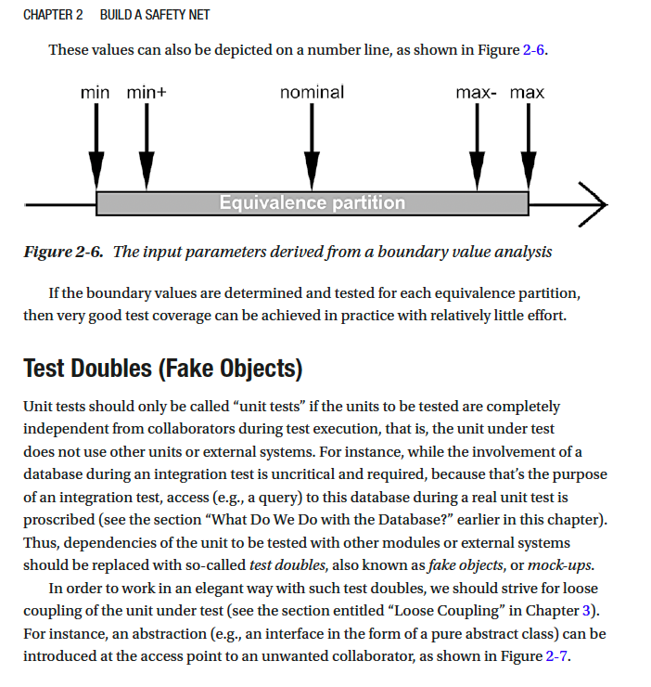
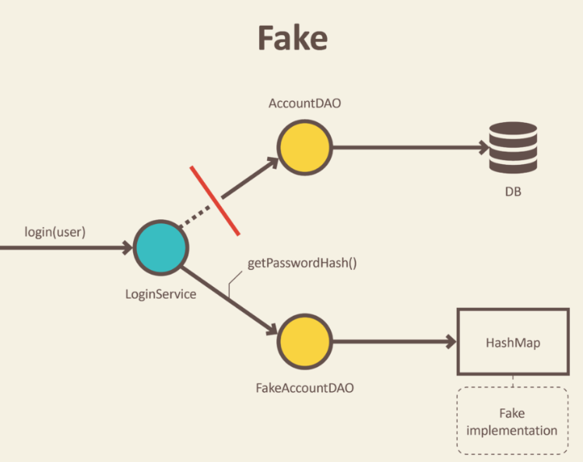
Rules for Good Unit Tests – Exclude External Systems
Mock things out and test your code, not theirs
Read – Test Doubles (Fake Objects)
https://blog.pragmatists.com/test-doubles-fakes-mocks-and-stubs-1a7491dfa3da
Book: Clean C++20: Chapter 2

Slide 18
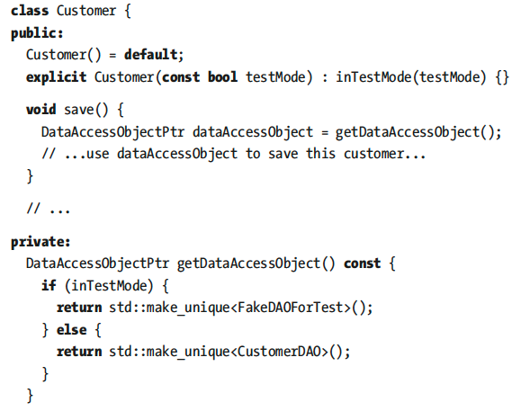
Rules for Good Unit Tests – Don’t Mix Test Code with Production Code
Avoid Dependencies to Test Code

Slide 19



Rules for Good Unit Tests – Tests Must Run Fast
>1000 unit tests
Large Software Project
contains
If running all unit tests takes 15 minutes, ½ hour, or more, developers are impeded in doing their work
If 1-test tales 0.5 secs -> 1,000-tests will take 8 minutes
Executing the whole test suit 10 times will cost 1.5 hours of waiting time.
This might result developers running tests less times.
A good test suit should run under 3-minutes

Slide 20



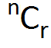
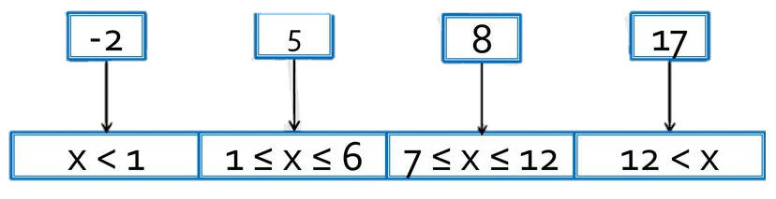


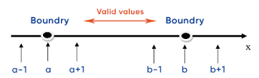

Rules for Good Unit Tests – Tests Input Data
How do I find all test cases that are necessary to ensure good fault detection?
Test cases
High Test Coverage
Select
Equivalence Partitioning/Class
Boundary Value Analysis
Test cases
Notes:
A large set of input combinations and you will end up with an almost infinite number of test cases.

Slide 21



Rules for Good Unit Tests – Tests Input Data
Equivalence Partitioning
Test input data/test cases:
{-2, 5, 8, 17}
Partitions:
1
2
3
4
Bank Interest Calculator API
The bank charges 4 percent penalty interest on overdrafts.
The bank offers 0.5 percent interest for the first 5,000 USD savings.
The bank offers 1 percent interest for the next 5,000 USD savings.
The bank offers 2 percent interest for the rest.
Interest is calculated on a daily basis.
Two Classes
Amount of money as interest is calculated on a daily basis
number of days for which this amount is valid
The equivalence partitioning for the amount of money
The equivalence partitioning for number of days
Notes:
Let us use and example of the The bank interest calculator API with the following requirements
The idea behind equivalence partitioning is that it is enough to pick only one value from each partition for testing. The hypothesis behind this technique is that if one condition/value in a partition passes a test, all others in the same partition will also pass.
Likewise, if one condition/value in a partition fails, all other conditions/values in that partition will also fail. If there is more than one parameter, as in our case, appropriate combinations should be formed.

Slide 22


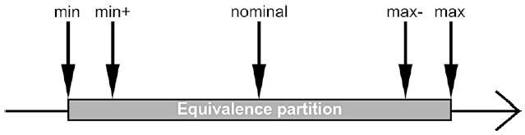

Rules for Good Unit Tests – Tests Input Data
Boundary Value Analysis
Extreme value
High Test Coverage
The input parameters derived from a boundary value analysis
The boundary values are determined and tested for each equivalence partition
Notes:
Now let us look at boundary value analysis
Many software bugs can be traced back to difficulties in the border areas of the equivalence classes, for example at the transition between two valid equivalence classes, between a valid and an invalid equivalence class, or due to an extreme value that was not taken into account.
The result of such an analysis is useful to select the input values of a numerical parameter for the tests: min, min+1, nominal, max-1, max
If the boundary values are determined and tested for each equivalence partition, then very good test coverage can be achieved in practice with relatively little effort.

Slide 23
Quality of a Test Suite
How do you know if your unit test cases are good enough?
Are they really testing the application?
When do we stop testing?
Solution: Test Coverage!

Slide 24
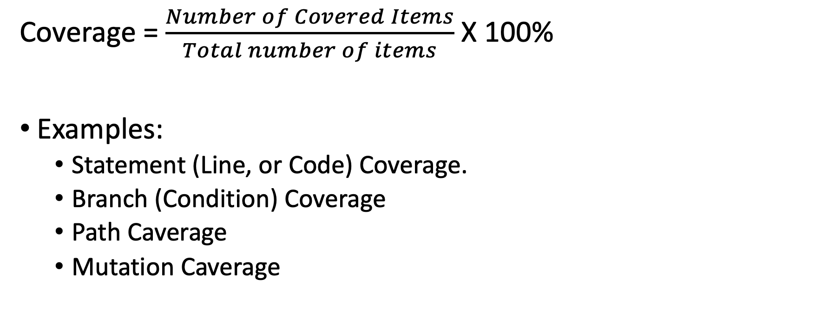
Test Coverage
Coverage = $\frac{Number of Covered Items}{Total number of items}$ X 100%
Examples:
Statement (Line, or Code) Coverage.
Branch (Condition) Coverage
Path Caverage
Mutation Caverage

Slide 25
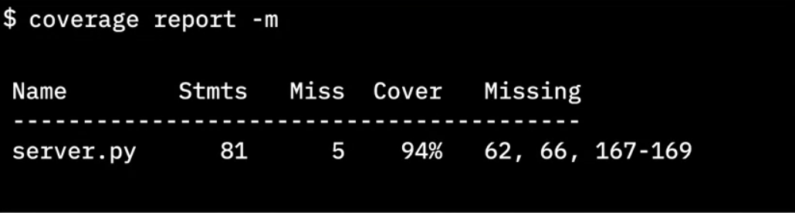
Importance of test coverage
High test coverage gives you confidence that your code works as expected
Test coverage reports can reveal which lines of code were not tested
Python cmd tool
Total lines of code
# lines without test cases
Percent of coverage
Lines without test cases
Notes:
Finally it gives us the line numbers that did not have test cases.
This info is critical because now we know where to concentrate our tests.
We need to go write more test cases to cause those lines of code to be executed.

Slide 26
Full test coverage
You must include “happy” paths and “Sad” paths to get full test coverage
100% test coverage only means that every line of code has been tested with some known good data.
You can still pass bad data into your code and find bugs.
Even with 100% test coverage, your code can still have bugs
Don’t stop testing when your code reaches 100%
Notes:
100% test coverage only means that every line of code has been tested with some known good data.
You can still pass bad data into your code and find bugs.
So don't stop testing when your code cover reaches 100%.
Keep challenging the integrity of your code with bad data and corner cases to make sure
your code behaves as expected under both favourable and adverse conditions.

Slide 27
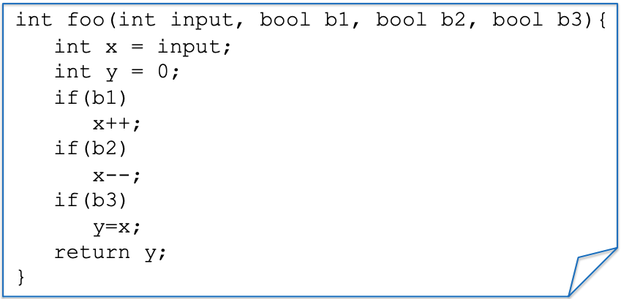
Example: a function to test
Notes:
We have a simple function foo with inputs - > three booleans b1, b2, b3
We also have three if statements that manipulate the input

Slide 28
Statement/Line/Code Coverage
Test Case(s)
ASSERT foo(0, true, true, true) == 0;
Notes:
Suppose we have a test case trying to assert if I call this function foo with ASSERT foo(0, true, true, true)

Slide 29
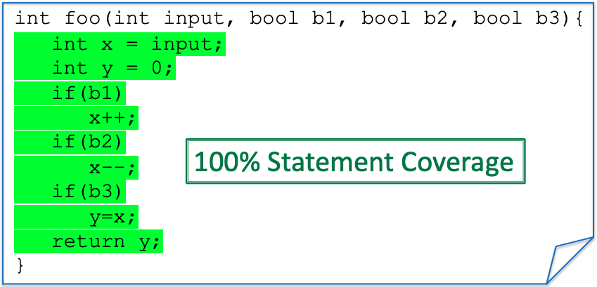
Statement/Line/Code Coverage
Test Case(s)
ASSERT foo(0, true, true, true) == 0;
Notes:
All the lines of this code will be executed, and hence we have 100% coverage
If I change one of the

Slide 30
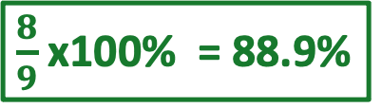
Statement/Line/Code Coverage
Test Case(s)
ASSERT foo(0, true,, true, true) == -1;
false
$\frac{8}{9}$ x100% = 88.9%
x++;
Notes:
All the lines of this code will be executed, and hence we have 100% coverage
If I change one of the

Slide 31
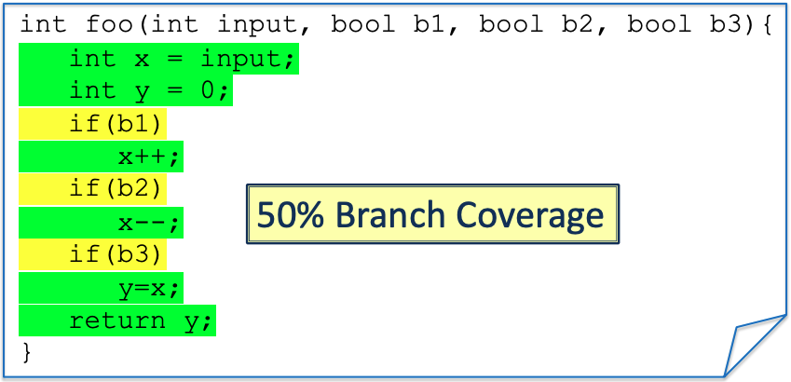
Branch/Condition Coverage
Test Case(s)
ASSERT foo(0, true, true, true) == 0;
Notes:
Branch every condition.
All the different states of the condition (true or false) need to be tested.
The TC needs to go inside the if and inside the else.
In this case, we only have the only if and no else.

Slide 32
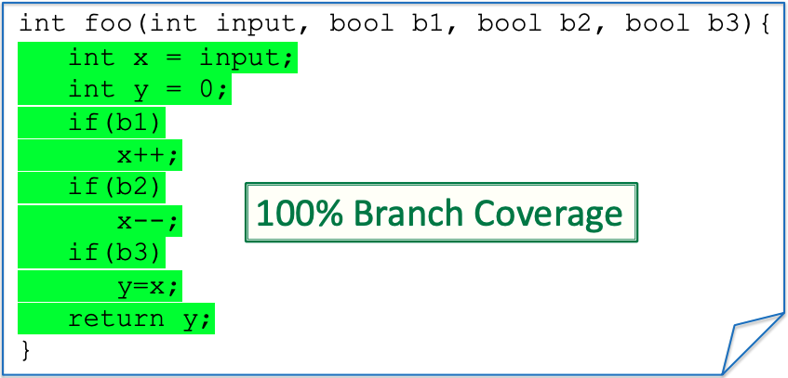
Branch/Condition Coverage
New Test
Test Case(s)
ASSERT foo(0, true, true, true) == 0;
Assert foo(0,false, false, false) == 0;

Slide 33
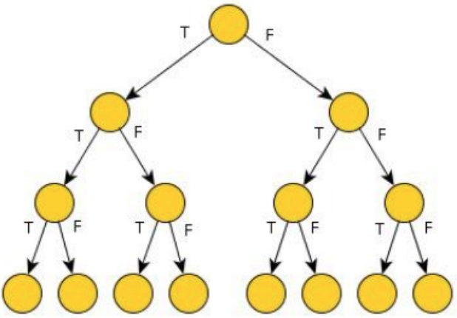
Path Coverage
Paths for three “if” each can be either true (T) or false (F)
8-Paths

Slide 34

Path Coverage
Test Case(s)
ASSERT foo(0, true, true, true) == 0;
ASSERT foo(0,false, false, false) == 0;
25% Path Coverage
Notes:
As you can see, conditionals (and loops) make path coverage hard. We need to write a lot of tests
We get an exponential number of paths on the number of conditionals tests.
This is going to be very costly to test, but on the other hand, it could be that a bug is hidden in one of the paths
We need path coverage to find certain bugs

Slide 35
Test drive the development
TDD means that your tests drive the design and development of your code. You don't write code and then write tests. You write the tests first.
Write test cases based on the requirements.
Write the code to make the test cases pass.
You know that if you wrote the code first, you’d still probably write a little program to test it.
Why not make that program into a formal test case from the start?
TDD workflow is a back-and-forth process. You write a test case, and then you write the code. You write more test cases to check different inputs or affected behaviours, and then you write more code.
TDD yields higher code quality.

Slide 36
Basic TDD workflow
RED
(Fail)
Write test case that fails
Red,
Green,
Refactor
REFACTOR
GREEN
(Pass)
Write test case that fails
Improve the code quality
I have prepared the lab which will guide you in practicing with TDD
Notes:
In TDD, you first write a test case for the code you wish you had. You don’t start by writing the code. You write the test cases first.
Second, you write the code to make that test case pass.
And then third, you refactor the code to make it more robust, knowing that the test cases will let you know if you change the code’s behaviour.
And finally, refactor that code to make it more robust knowing that the test case will let you know if you change the behaviour of the code.

Slide 37
Tools for Testing
xUnit series:
JUnit for Java,
PyUnit for Python,
NUnit for .Net platform, and
Embunit for C and C++
Jasmine for JavaScript
Mocha for Node.js
Simplest for PHP
Notes:
The message is that you should look for a testing framework
for the language that you are using and learn it.
It will save you a lot of time because each one gives you the tools that you need to properly test your code.

Slide 38
Testing Coverage for the Project
It is required to show coverage for your Project (DP II and DP III)
At least Statement Coverage, but Branch Coverage is better.
If your project has very low coverage, you better have a good explanation for that.
Focus on increasing the coverage for the system parts that will be affected by your change.

Slide 39
