Slide 1
Leveraging ChatGPT in Software Engineering
Prepared by: John Businge
john.businge@unlv.edu

Slide 2
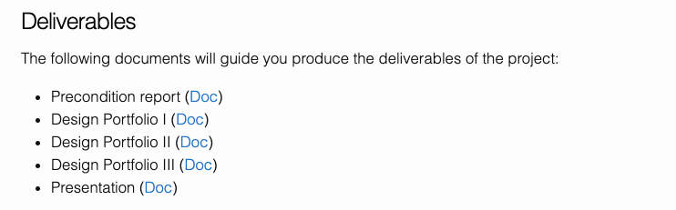
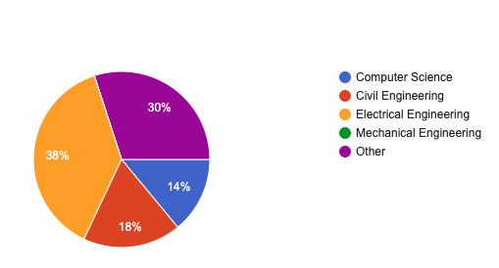
Announcements
Lab on ChatGPT is published
New team Repos are meant for the project
Career Preparation with Mr. James Benaventa

Slide 3






The Hype around LLMs for Software Development
Cooled down
Notes:
The initial hype around using LLMs for software development has already started to cool down
The conversation has shifted from expecting LLMs to replace software developers (i.e., artificial intelligence) to considering LLMs as partners and focusing on where to best apply them (i.e., augmented intelligence).

Slide 4
Introduction to ChatGPT
A powerful language model developed by OpenAI
GPT - Generative Pre-trained Transformer models
GPT-2, GPT-3, GPT-3.5, GPT-4
BERT
T5
RoBERTa
Has capabilities in understanding and generating human-like text based on input prompts.

Slide 5
Objectives of Leveraging ChatGPT in Team projects
Enhancing Problem-Solving Skills: Utilize ChatGPT for complex problem-solving tasks.
Improving Code Quality: Enhance code readability and efficiency with ChatGPT insights.
Promoting Creativity: Inspire innovative solutions and approaches in project development.
Preparing for Industry Tools: Familiarize students with AI-powered tools for future careers.
Encouraging Collaboration: Foster teamwork through shared problem-solving with ChatGPT.
Providing Real-World Experience: Simulate industry scenarios for practical learning.
Gather insights: Continuously refine curriculum based on student experiences and repository data for better learning outcomes in future classes.

Slide 6
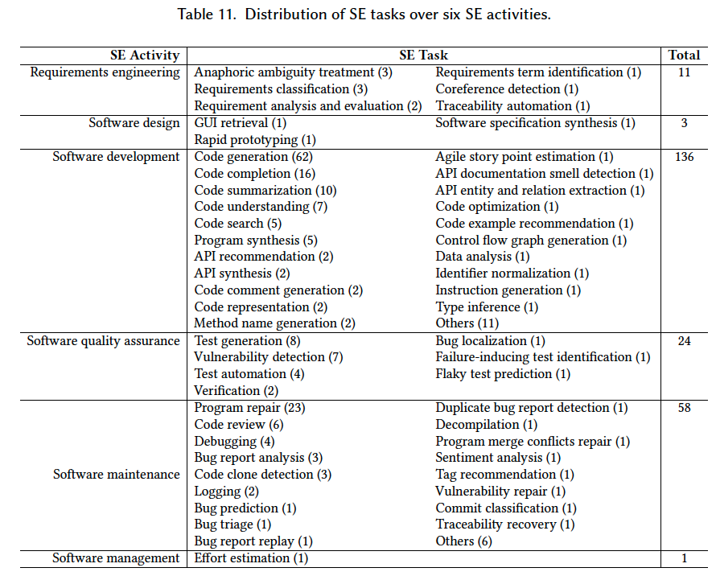
What SE Tasks have been addressed to date using LLM4SE
Hou et al. LLMs for SE: A Systematic Literature Review
https://arxiv.org/pdf/2308.10620.pdf
Analyzed 229 research papers on the subject
Read Section 6 of the paper to find which papers have addressed the SE tasks.
Notes:
Traceability automation. Software and system traceability refers to the ability to establish and maintain relationships between software artifacts, such as requirements, design definitions, code, and test cases, for product querying and development support

Slide 7
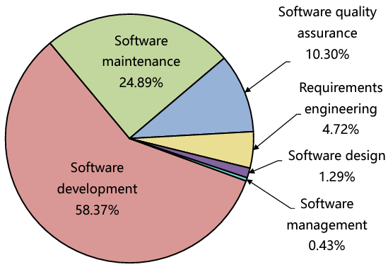
What SE Tasks have been addressed to date using LLM4SE
58.37% in software development showcases the significance of LLMs in producing code or text

Slide 8


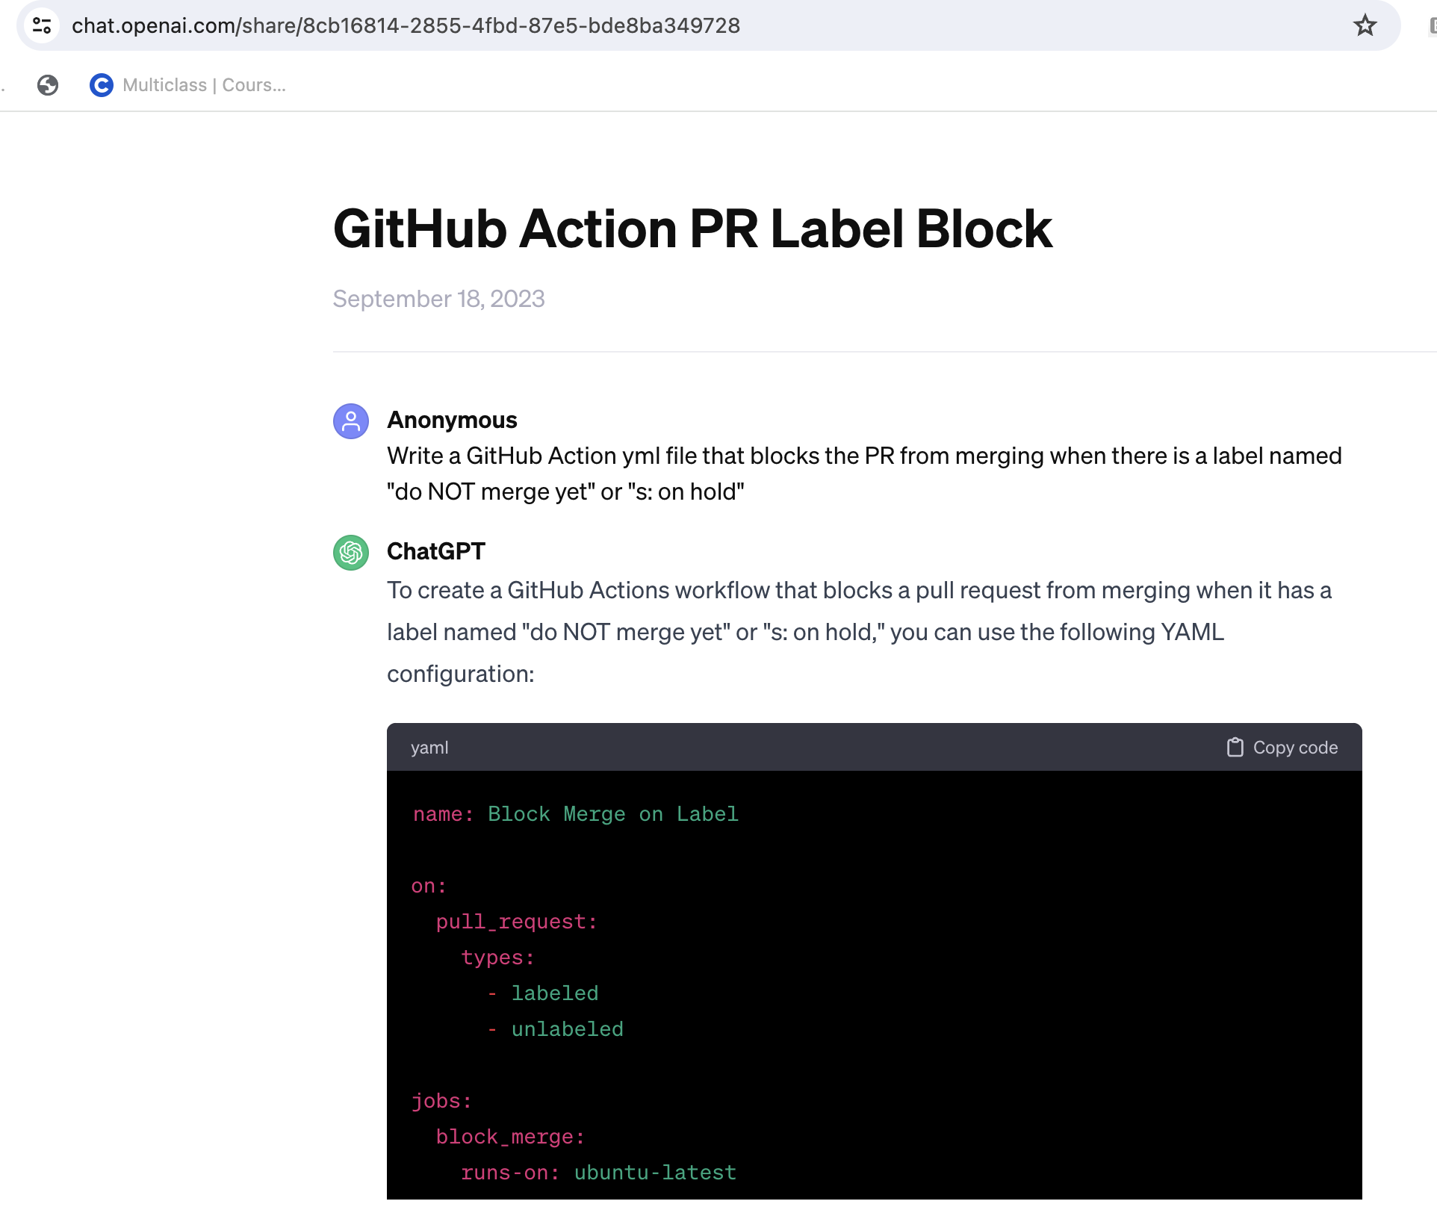
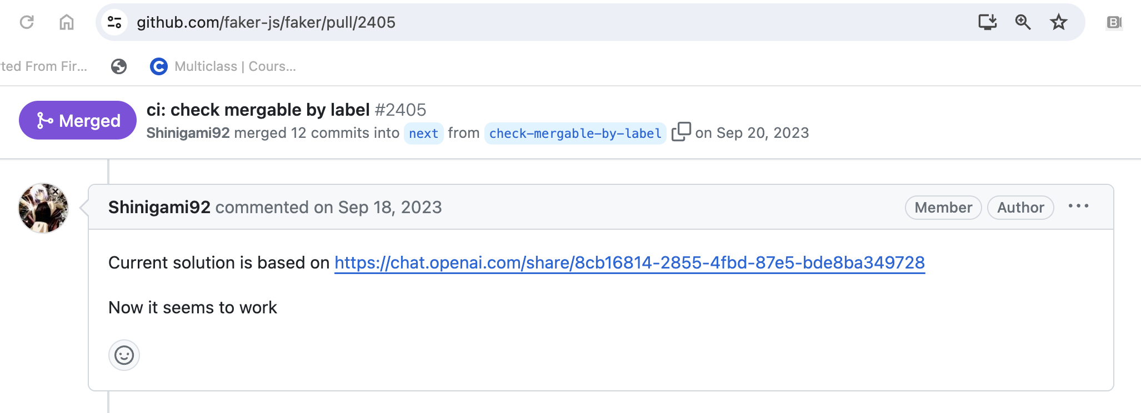
How are developers using ChatGPT to solve SE tasks?

Slide 9
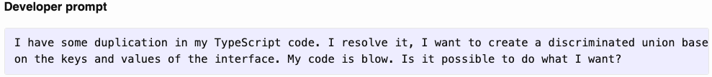
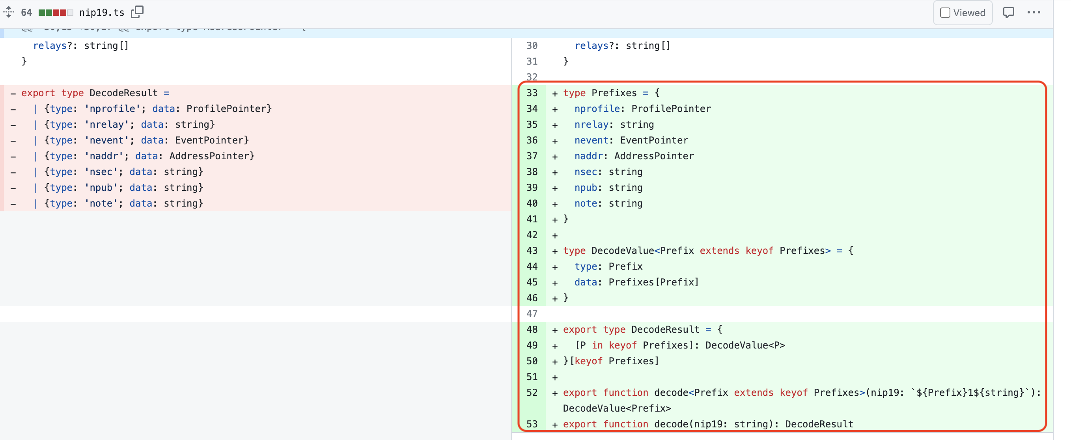
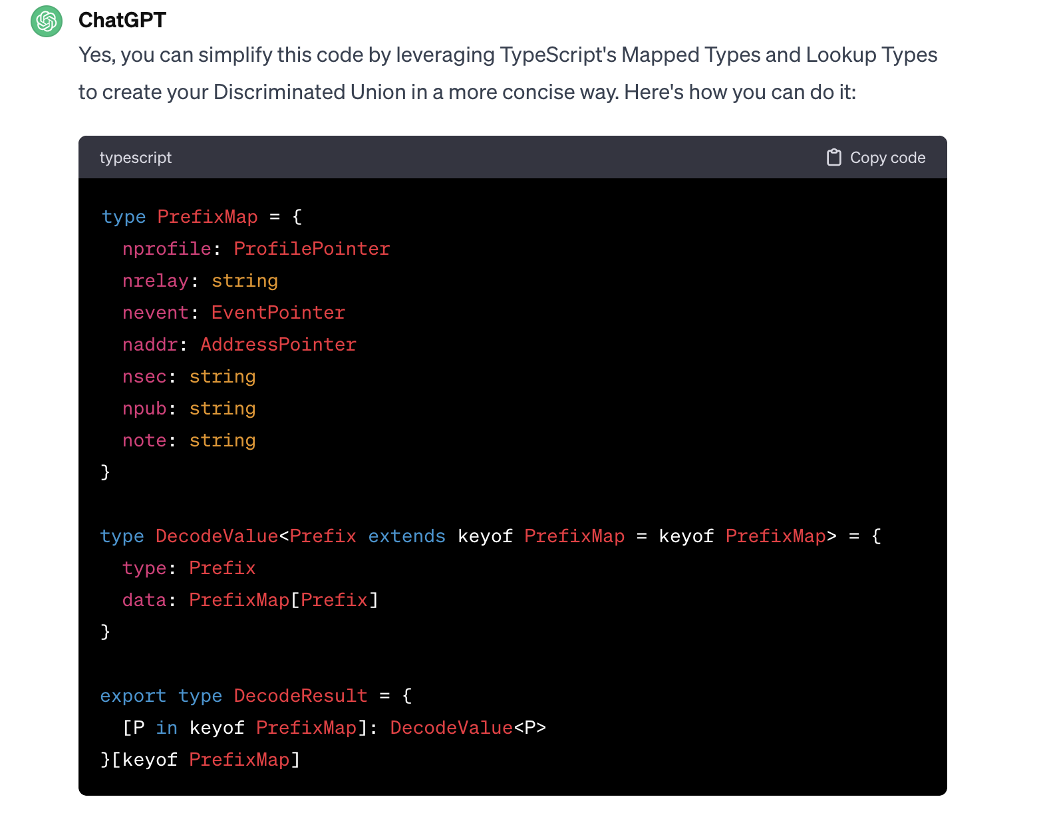
Activity - Software maintenance, Task - Code duplication & refactoring
PrefixMap != Prefixes

Slide 10
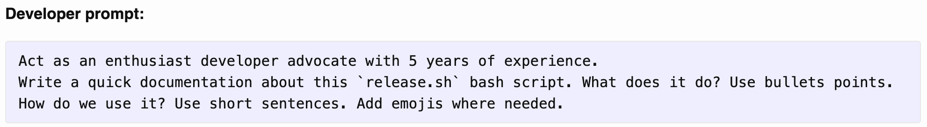
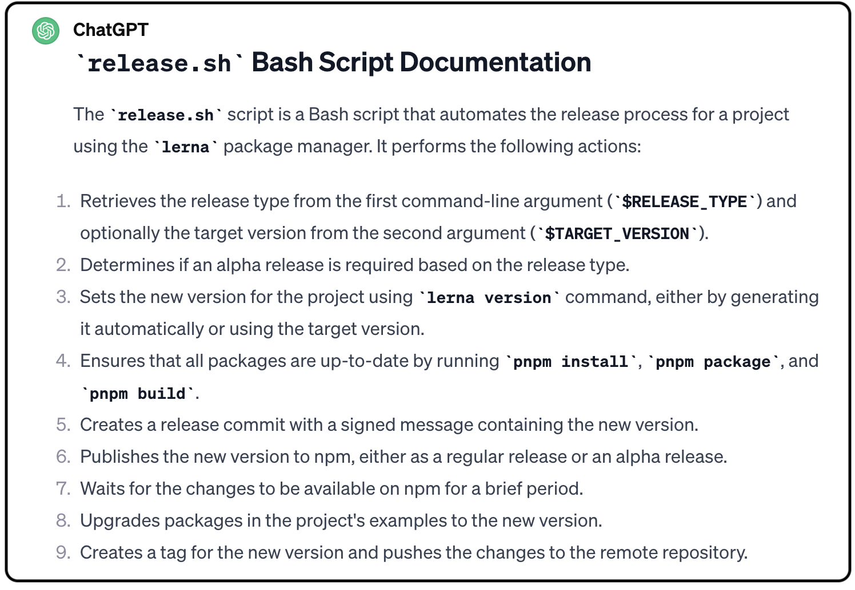
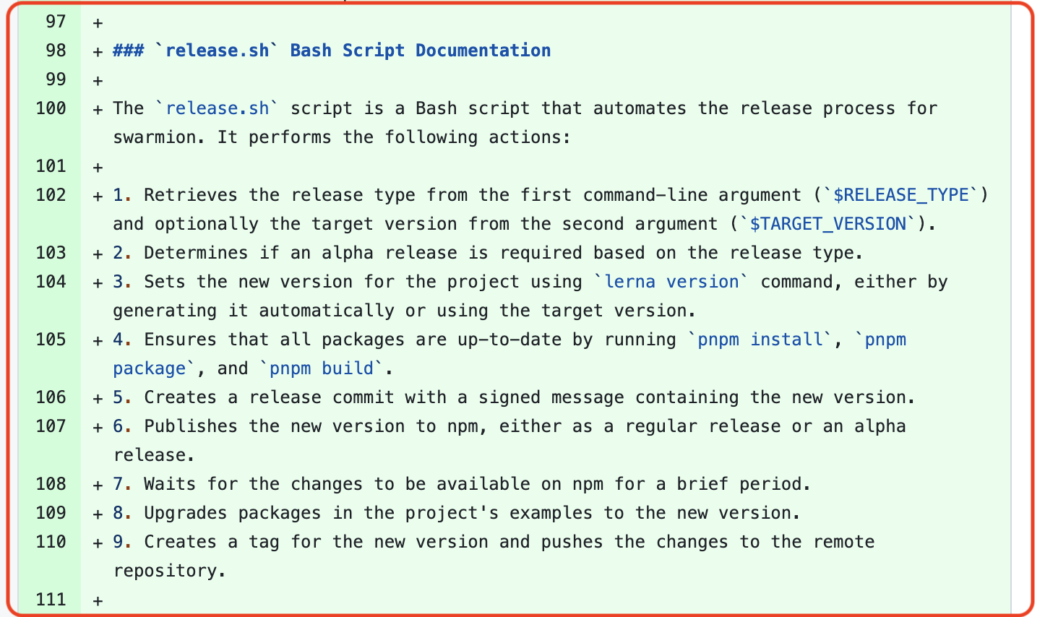
How are developers using LLMs to solve SE tasks?
SE Task – Deployment Documentation
The software developer was seeking assistance from ChatGPT in creating concise and user-friendly documentation for a Bash script named `release.sh`. Specifically, the developer wanted guidance on summarizing the script's functionality and providing clear instructions on how to use it effectively.

Slide 11
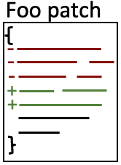
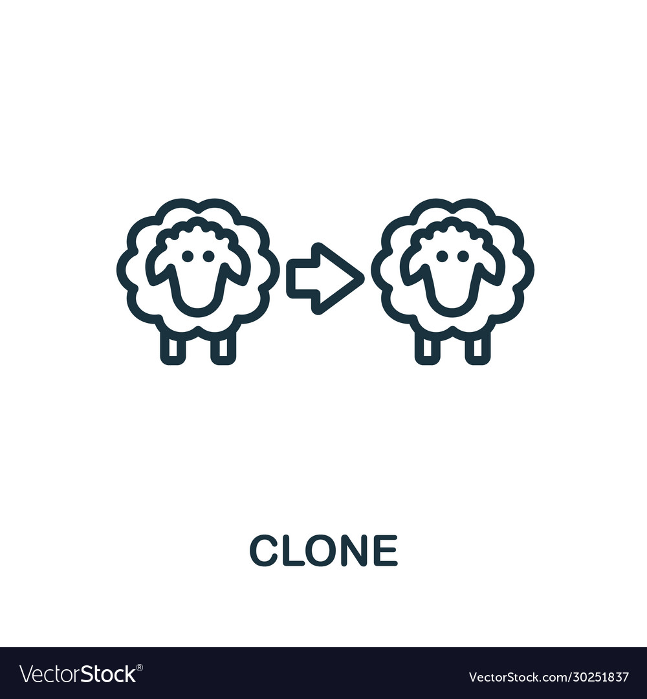


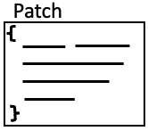
In instances where developers have incorporated the code provided by ChatGPT into their projects, to what extent do they modify this code prior to use?
We carried out an investigation of 108 Pull requests from 83 repositories.
All the 83 repositories are from real software engineering projects since we filtered out experimental projects
Method Illustration
clone detection tool
fork
Pull request
Patch not Applied
Patch Applied

Slide 12
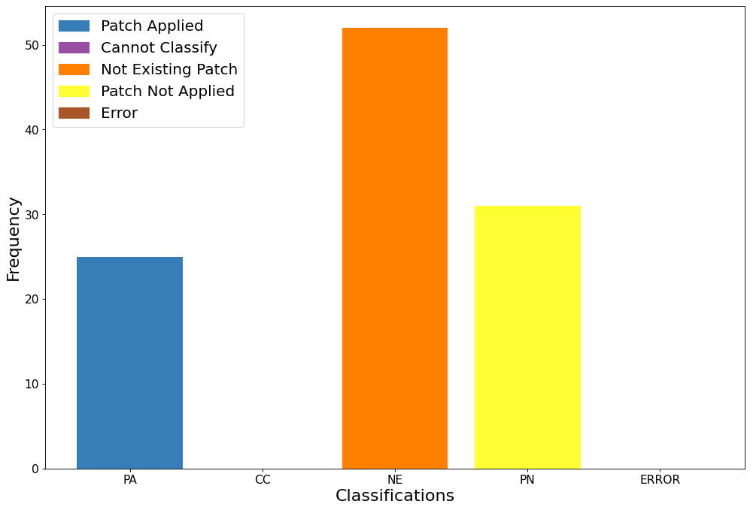
Results
CC: Cannot Classify - The programming language is not supported by our tool.
NE: The developer used ChatGPT but no code snippet was suggested by ChatGPT.

Slide 13
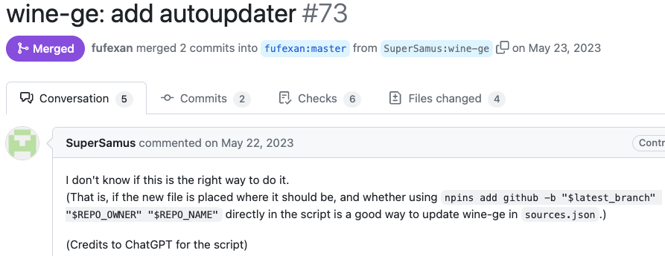
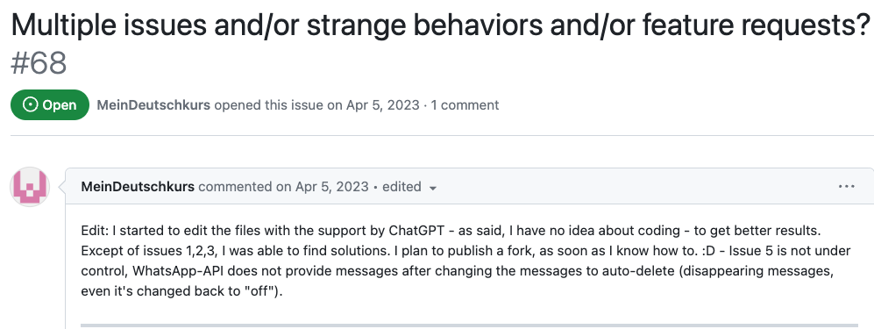
Ownership of AI generated code
These two cases are are representative of those instances in which the contributor explicitly states to be unsure about what was accomplished using ChatGPT.
https://github.com/fufexan/nix-gaming/pull/73
https://github.com/danielgross/whatsapp-gpt/issues/68

Slide 14
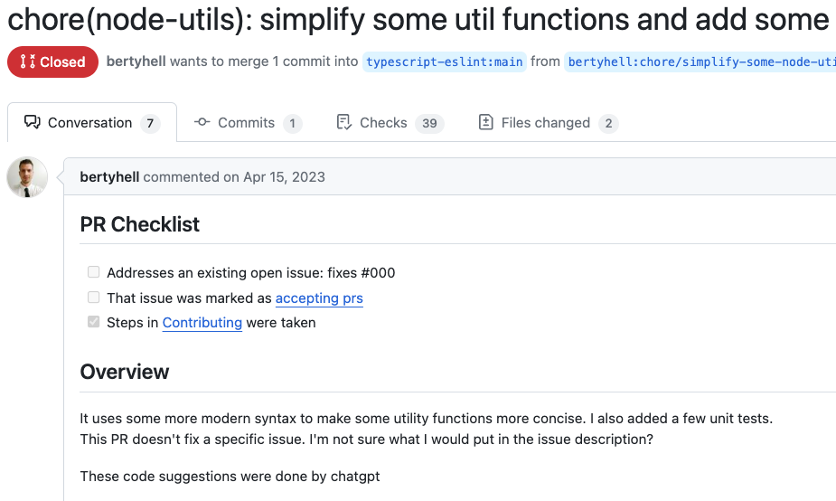
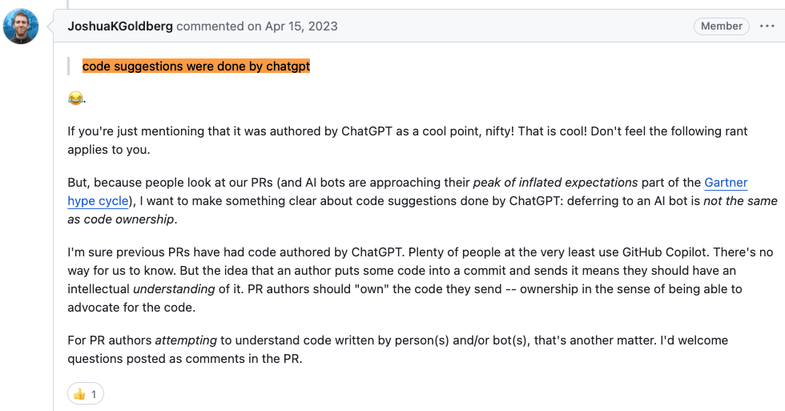
Ownership of AI generated code
https://github.com/typescript-eslint/typescript-eslint/pull/6915
In your team project you should define guidelines for projects’ contributions including AI-generated code,
e.g., you may decide to only welcome AI-generated code from users that are confident in assessing the correctness of the contributed code.
Conduct a thorough peer reviews on code suggested by LLMs

Slide 15
LLM Hallucination
While large language models can generate fluent and coherent text on various topics and domains, they are also prone to just "make stuff up". Plausible sounding nonsense!
What
Why
Minimize
Deviation from facts or contextual logic
Minor inconsistences
Completely fabricated
Contradicting statements
Data quality
Trained on internet data
E.g., Reddit and Wikipedia, right?
Semantically, LLMs have no idea what its saying.
They are just doing Math.
Factually, it can occasionally make errors.
Clear and specific prompts
Structured prompting
Role-based prompting

Slide 16
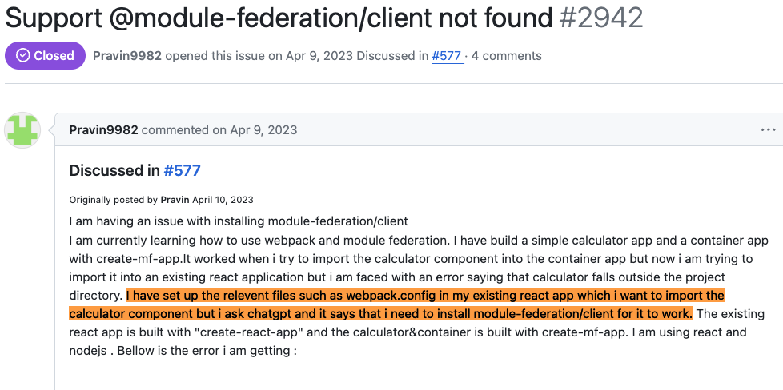
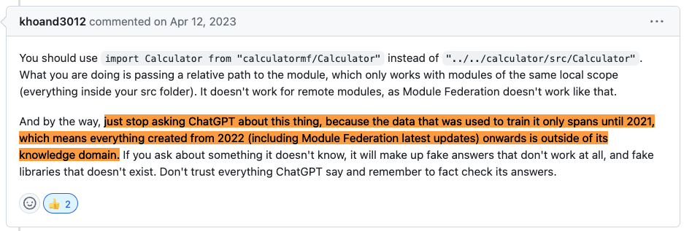
LLM Hallucination – What and Why
In modern development, ChatGPT's pre-2021 training restricts its understanding, resulting in speculative or inaccurate responses ("hallucinations") regarding newer technologies like Module Federation.
https://github.com/module-federation/module-federation-examples/issues/2942

Slide 17
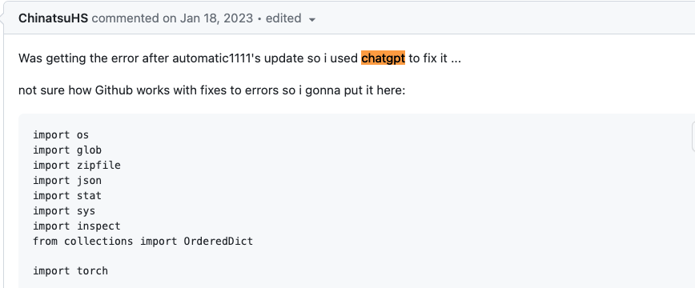
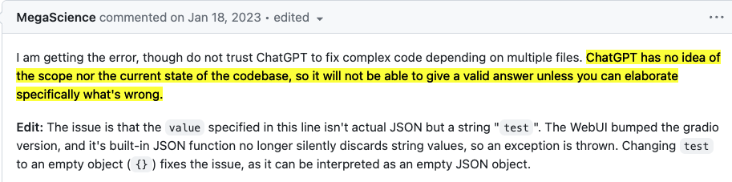
LLM Hallucination – What and Why
ChatGPT hallucinated in this context because it lacks real-time awareness and understanding of the specific problem being discussed. The suggestions were based on general patterns or associations it learned from its training data, rather than a precise understanding of the developers' current task or the relevance of the library to the issue at hand.
Developers should avoid relying solely on ChatGPT for guidance on cutting-edge or domain-specific topics beyond its training data, especially in rapidly evolving fields like software development. Instead, they should verify ChatGPT's suggestions with up-to-date sources or with domain experts to ensure accuracy and relevance.
https://github.com/kohya-ss/sd-webui-additional-networks/issues/43
These are the kind of collaborations your teams should be involved in to address ChatGPT’s hallucinations

Slide 18
LLM Hallucination – Minimize
Structured or Role-based Prompting
You are a senior software engineer tasked with {specific task}. You will be provided with {relevant details}, including the source code of {related files}. Your objective is to {describe the task in detail}.
Project Description: {Provide a brief overview of the project and its context}
Issue Description: {Describe the specific problem or task you need to address}
{Source Code: Include any relevant code snippets or files}
Please address the task based on your expertise and understanding, ensuring that the solution is robust and well-documented. Provide the updated source code along with detailed comments explaining your approach and any modifications made.

Slide 19
LLM Hallucination – Minimize
Structured or Role-based Prompting - Example
You are a senior software engineer tasked with optimizing the performance of a web application. You will be provided with the relevant codebase, including the source files for the frontend and backend components. Your objective is to identify and implement optimizations to enhance the application's speed and efficiency.
Project Description: The web application is an e-commerce platform built with React for the frontend and Node.js for the backend. It allows users to browse products, add them to cart, and proceed to checkout. The application is experiencing slow load times and occasional server timeouts during peak traffic hours.
Issue Description: The main performance bottlenecks are observed during database queries and rendering of large product catalogs. Additionally, some API endpoints are experiencing latency issues, impacting the overall responsiveness of the application.
Source Code:
Frontend: [link to frontend repository or relevant files]
Backend: [link to backend repository or relevant files]
Please address the task based on your expertise and understanding, ensuring that the solution is robust and well-documented. Provide the updated source code along with detailed comments explaining your approach and any modifications made.

Slide 20
Challenges of Using ChatGPT
Understanding ChatGPT's capabilities and limitations – hallucinations
You may struggle to discern when to rely on ChatGPT versus traditional problem-solving methods.
Interpreting and implementing ChatGPT suggestions effectively
This requires not only comprehending the suggestions but also ensuring they align with the project requirements and best practices.
Overreliance on ChatGPT: You may become overly reliant on ChatGPT as a solution-finding tool.
leading reduced critical thinking skills.
Limited Understanding of Software Engineering Concepts:
You may lack the foundational knowledge and understanding of key concepts, making it challenging to formulate precise queries or evaluate ChatGPT's responses effectively.

Slide 21
Fostering Collaboration to Mitigate Challenges with ChatGPT
Understanding and Interpreting Responses: Collaborating with peers allows students to discuss and compare interpretations of ChatGPT-generated responses, facilitating clearer understanding.
Dependency on Training Data: Diverse peer backgrounds supplement ChatGPT's responses with additional insights, compensating for training data gaps.
Quality and Accuracy of Responses: Peer collaboration enables validation of response quality and accuracy, identifying errors or inaccuracies collectively.
Limited Understanding of Software Engineering Concepts: Peer support fills knowledge gaps collaboratively, clarifying concepts and refining queries.
Read Section 6 of the paper, Hou at al. LLMs for SE: A SLR
Overreliance on ChatGPT: Collaboration encourages a balanced problem-solving approach, avoiding overreliance and developing critical thinking skills.
Integration with Existing Workflows: Peer sharing of best practices and technical expertise aids in effectively integrating ChatGPT into existing workflows.

Slide 22
Conclusion
Integrating ChatGPT into your team projects offers exciting opportunities but also comes with challenges. By fostering collaboration, we can harness the potential of ChatGPT while developing critical thinking skills and ensuring the quality of our solutions.
Exploration in Team Projects: While the lab and class introduced limited software engineering tasks, the team projects will offer a broader range of tasks. For further insights, refer to Section 6 of the paper, Hou at al. LLMs for SE: A SLR

