Slide 1
CS 472 Survey Responses from Students

Slide 2
Announcements
DP I marks released
Comments of features are suggestions
DP II & III
Individual 60%
Team 40%
Last face-to-face class – Does not mean that you should stop coming to campus.
A physical meeting at least every 2 weeks is requred

Slide 3
“People-related factors tend to be the greatest challenges—not technology.”
George Spafford,
Senior Director Analyst
at Gartner
Notes:
I introduced this quote at the beginning of this class

Slide 4
Teaming in a Software Project
Teaming is a core component in practically all professional software engineering careers
It’s best to be taught this skill before you get into the field.
Freeriders usually bring stress and more work to the hardworking teammates
Team success depends on many factors:
Good-faith participation
Effective communication
Equitable contributions

Slide 5





Survey motivation
1.Learn from my mistakes
During the semester
After the semester
2. Identify students teamwork challenges
teamwork interaction complaints
SDD prject teams
Notes:
Two key motivations for conducting the survey
First time teaching this class.
I wanted to learn from the students at the end of the semester.
This will help me improve the content as well as class management in subsequent classes I will be teaching.
2. Identify student complaints and how to address them
During the semester, a few of the groups had challenges with teamwork. The student privately reported to me and I tried to solve their problems.

Slide 6


Survey preparation
Survey
Software Development Project groups
A total of 15 open and closed ended optional questions
Survey was anticipated to last between 20 – 30 minutes
Respondents were asked to keep annonymous
Survey was open for one month
Notes:
I asked individuals to volunteree and participate in the survey

Slide 7
Survey responses
Three survey sections
Background information
What makes teams successful
Learning new technologies
Survey
Spring 2023 | 19 of 70 students 27% response rate | 7/7 project teams represented
Fall 2023 | 10 of 25 students 40 % response rate | 4/4 teams represented
Notes:
I could have gotten more but I sent in the survey very late

Slide 8
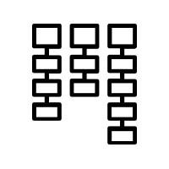
Survey Analysis
4/15 question were multiple choice closed and
11/15 questions were open-ended questions.
card-sorting: from text to themes
open-ended questions

Slide 9
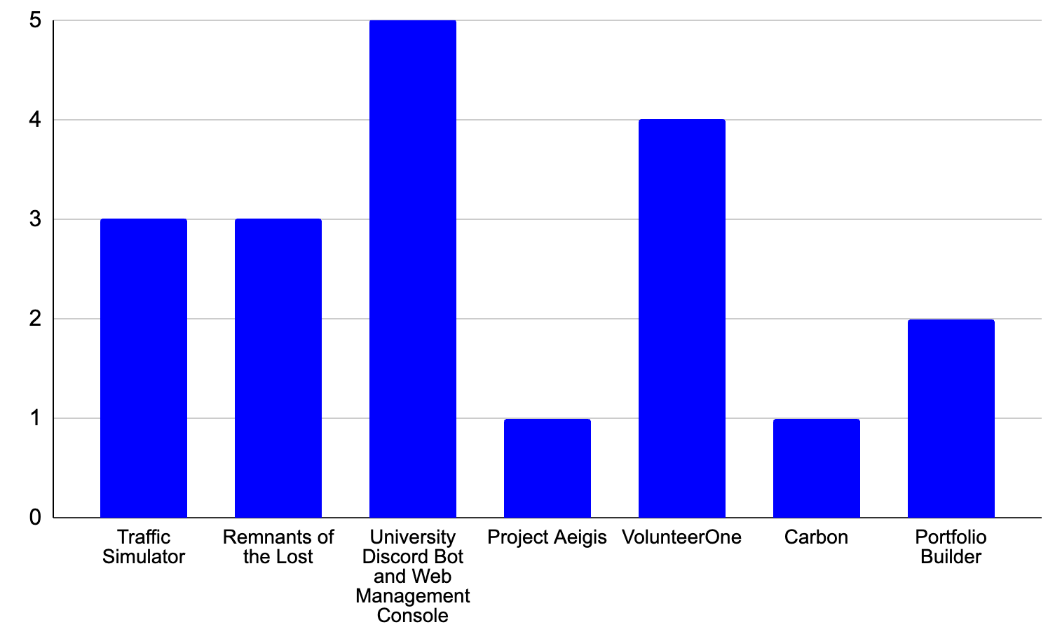
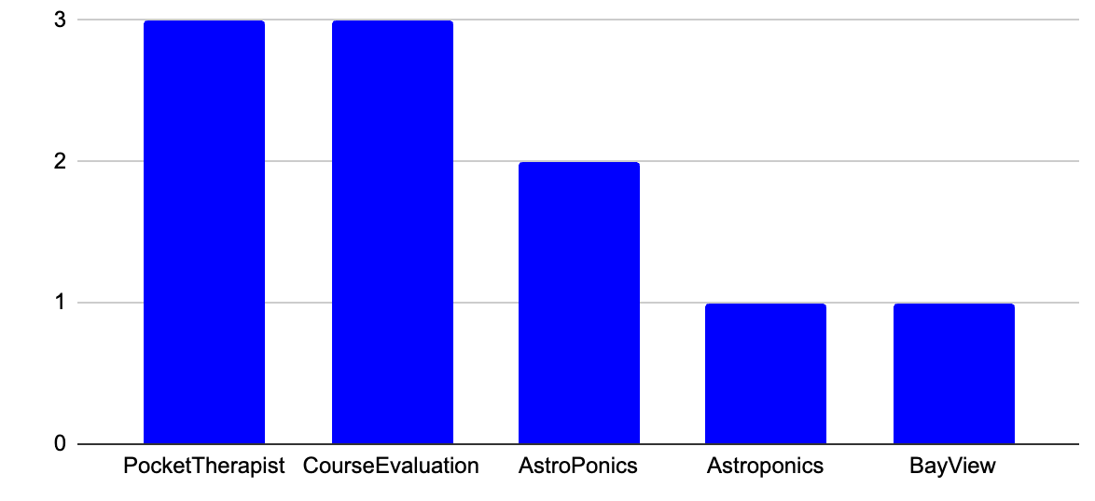
Survey Results - Background
Qn.1: Kindly select the of your team project name.
Spring 2023
Fall 2023
Notes:
We had seven teams

Slide 10
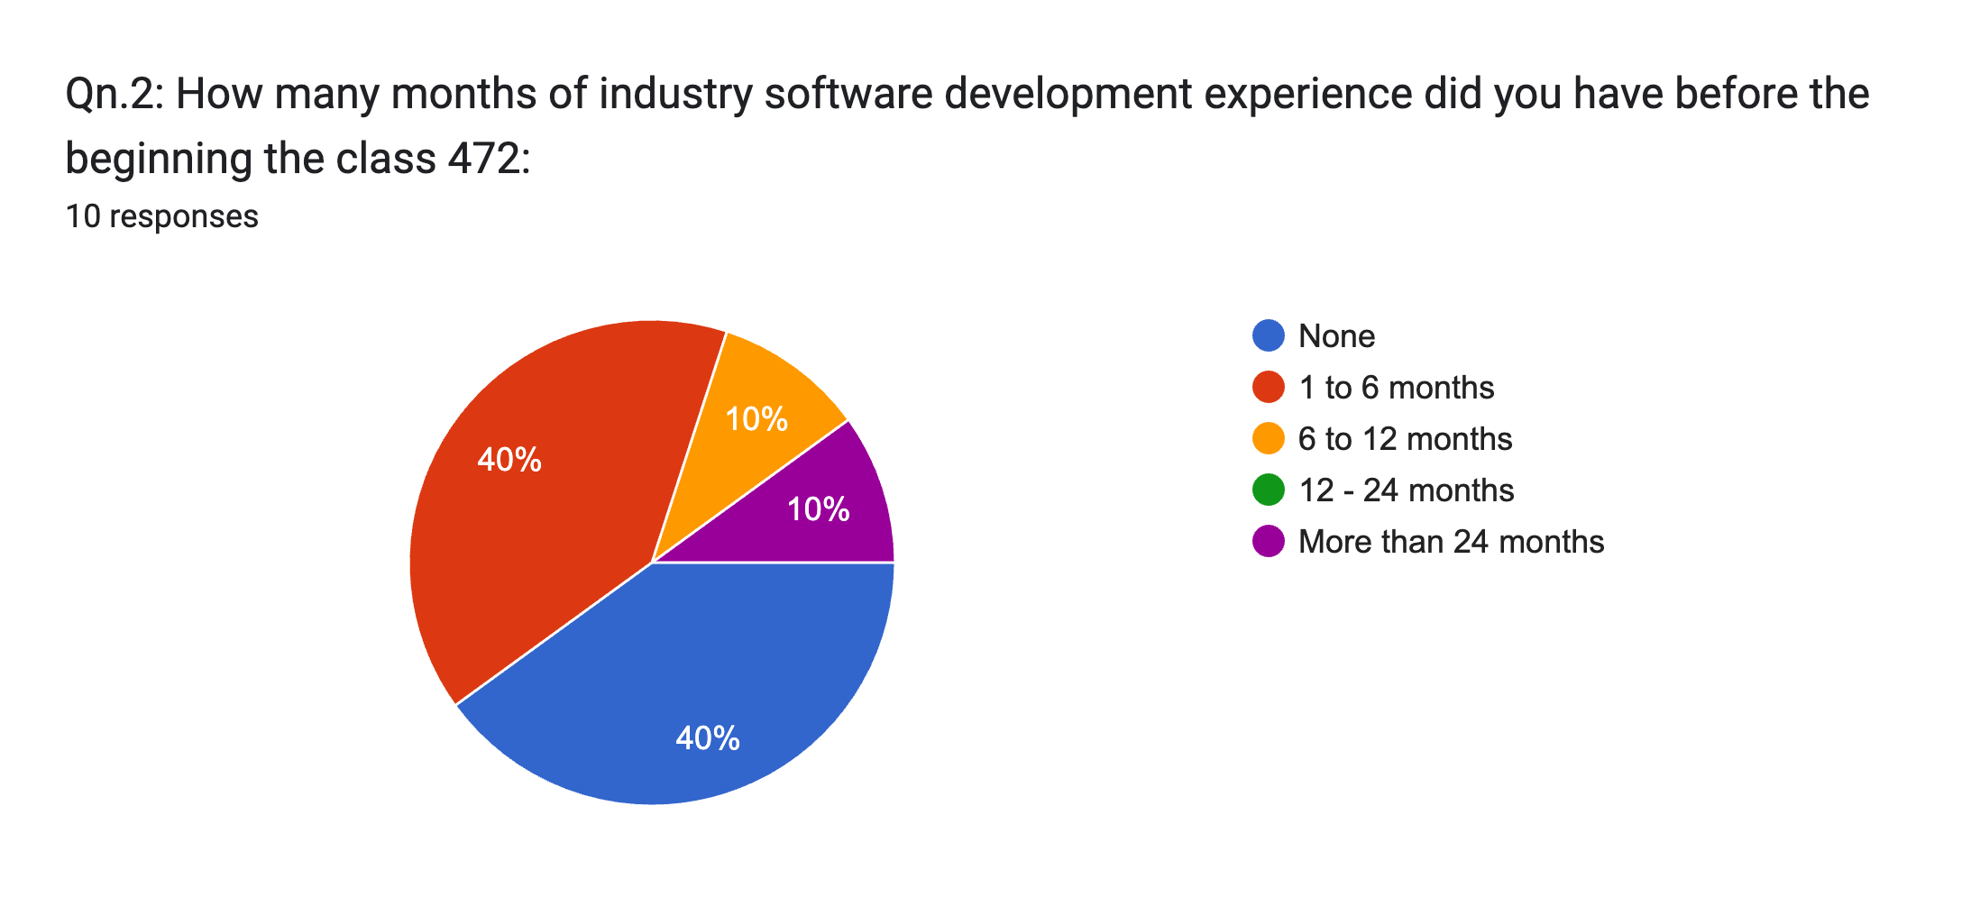
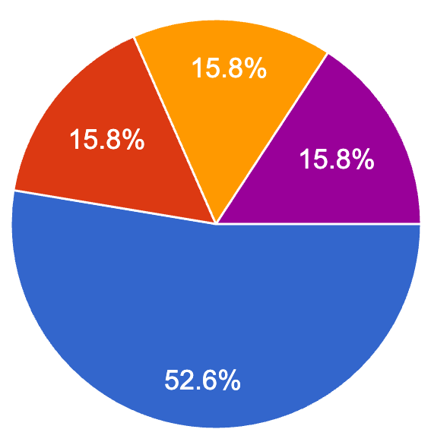
Survey Results - Background
Qn.2: How many months of industry software development experience did you have before the beginning the class 472:
Spring 2023 - 19 responses
Fall 2023 - 10 responses
Notes:
We had seven teams

Slide 11
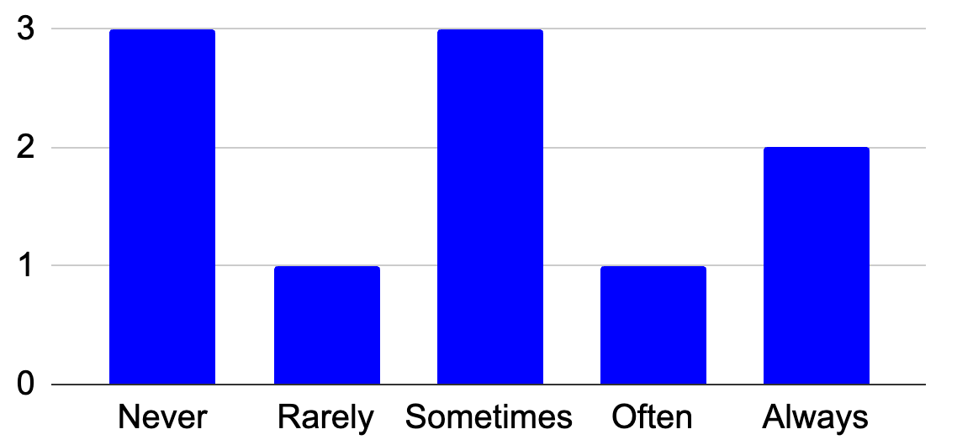
Survey Results – Team management
Qn3. How often were you involved in leadership roles?
Spring 2023
Fall 2023
Notes:
We had seven teams

Slide 12
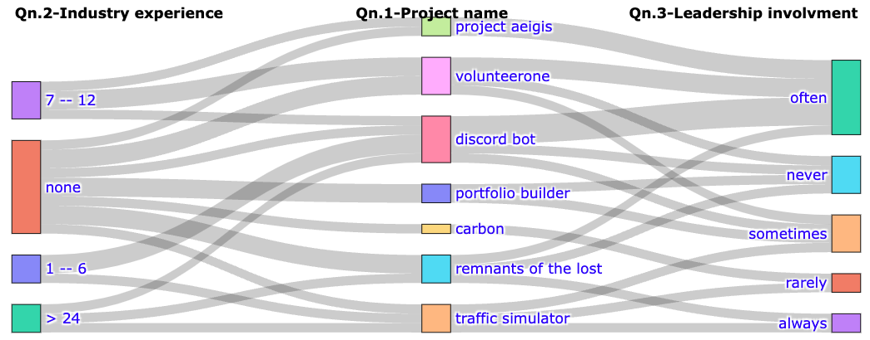
Survey Results – Team management
Multiple choice questions
Qn.1: Kindly select your team project name.
Qn.2: How many months of industry software development experience did you have?
Qn.3. How often were you involved in leadership roles during the project?
Notes:
Here we visualize the results of three questions

Slide 13
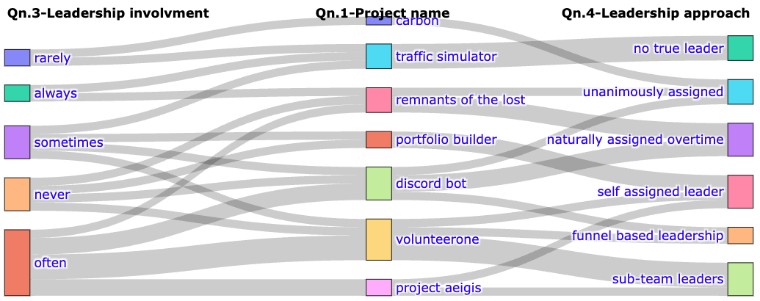
Survey Results – Team management
Qn.1: Kindly select the of your team project name.
Qn.3. How often were you involved in leadership roles during the project?
Qn.4 Could you describe your team’s leadership approach?
Theme | Description
No true leader | everyone did their own portion of work
Naturally assigned overtime | The leader was naturally assigned over time
Unanimously assigned | The person with the most experience was chosen to lead the group
Sub-team leaders
Self assigned leader | The leader was self assigned at the beginning of the project
Funnel based leadership | The members priorities were focused at the level of vision, output goals, and criteria.
Open-ended question
Notes:
Here we visualize the results of four questions

Slide 14


Survey Results – Team management
[R11]. Unanimously assigned. […] was unanimously assigned to […] because he was the only one with the work experience to software industry. With his knowledge, he was able to guide us through the usual process of how software development goes. He was able to help us set up the planning stage and the tech stack. Decisions were usually made through unanimous voting but sometimes, we try to choose whatever's the best interest for the group.
[R16]. Sub-team leaders. Our team split into two groups, a backend and frontend. each with a group leader who managed that portion of the project.
Open-ended question
[R1]. No true leader. Equality - everyone does their own portion of work. There would be times of leadership, but after people would collaborate without a true leader.
[R2]. Naturally assigned overtime. We attempted to allow anyone to step up and take on any task. We had no centralized leadership, but some people didn't step up to any tasks so a centralized leadership formed naturally from a lack of participation by few.
Notes:
Here we visualize the results of four questions

Slide 15
Survey Results – Team management
[R11]. Naturally assigned overtime. We attempted to allow anyone to step up and take on any task. We had no centralized leadership, but some people didn't step up to any tasks so a centralized leadership formed naturally from a lack of participation by few.
I found this model worked the best for meeting frequency and maximized understanding and involvement probability.
One weekly meeting to ensure we are caught up on deliverables + demos, led Bi-weekly by Director, other weeks are led in a random Round Robin style with remaining members.
Questions about project parts, next steps, help requests, issues.
Each member demo'd their parts, complete or not.
Teammates provide feedback, and ensured alignment with current code base.
Second weekly meeting a few days after, longer, open-ended and led by Director
Covers PR's , issues, problems, (designated collaboration time)
Virtual.
A note about #1: This was not implemented untill week 12 (10 weeks into the project) I would suggest that a Director lead every meeting until week 3. Any sooner than this and you are not effectively solidified as the group's lead. I believe that this method only works if you are believed by all members to be the team's lead.
Notes:
Here we visualize the results of four questions

Slide 16
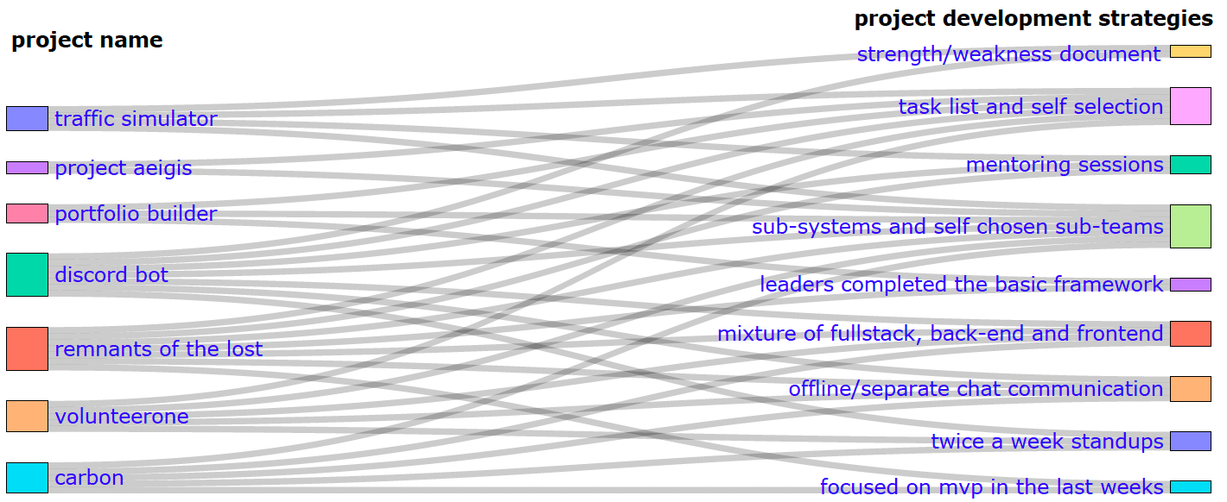
Survey Results – Team management
Qn.1: Kindly select the of your team project name.
Qn.5: Briefly describe the strategies your group employed to manage the contributions to the project.
Theme | Description
Sub-systems and self chosen sub-teams | We divided the project into sections and allowed each memberto self select the sub-project
Task list and self selection | We created tasks and team members self selected what the wanted to work on
Strength/weakness document | We had a document that stated our interests and our strengths/weaknesses regarding our experience with development.
Twice a week stand-ups | Sub-system meeting one day and all members meeting another day to claim tasks
Mixture of full stack, back-end and frontend | Majority of the group members contributed both in the backend and front end to learn more.
Mentoring sessions | Expirience team members mentored other mates on new technologies
Leaders completed the basic framework | Our team is led by the leader to complete the basic framework, and then the members complete each component.
Offline/separate chat communication | Members working on related tasks had a lot of offline communication.
Focused on MVP in the last weeks | In the last weeks we created a spreadsheet with our remaining tasks to get to a Minimum Viable Product and assigned ourselves those.

Slide 17
Survey Results – Team management
Qn.1: Kindly select the of your team project name.
Qn.5: Briefly describe the strategies your group employed to manage the contributions to the project.
[R1]. Sub-systems and self chosen sub-teams. We divided our group into self-chosen sub groups. We divided the project into sections and allowed each member to choose where they wanted to go. Thankfully, experienced members knew that they should target the most complex sections while also incorporating less experienced members […]
[R5]. Strengths/weaknesses. We had a document that stated our interests and our strengths/weaknesses regarding our experience with development. Many of us wanted to have experience with certain things we had never used before. We then spent time creating tasks on a Notion page and people claimed what tasks they were interested in. […]
[R5]. Twice a week stand-ups. We would have weekly stand ups twice a week to get an idea of peoples blockers and what tasks are still needed to be done. This time we would claim tasks or allocate tasks. […] It seemed that our interests were split in half and we all worked together to allocate tasks according to need based status. […]
[R16]. Offline/separate chat communication.[…] Aside from this, we also had a lot of offline communication regarding the tasks we were working on. During the sub-team meetings, we discussed how to split up tasks and figure out what to work on, then we spent the full meetings discussing larger project deadlines, frontend/backend integration, and current progress of the project. […]
[R9]. Task list and self selection. For the backend, i created a list of tasks to complete on github issues. Then delegated tasks based on what my members wanted to do. During each meeting we check the progress and delegate more tasks.
.

Slide 18
Survey Results – Team management
Qn.1: Kindly select the of your team project name.
Qn.5: Briefly describe the strategies your group employed to manage the contributions to the project.
[R11]. ]. Task list and self selection
After the preliminary month of planning, I gathered the teams availability, and first allowed a preference by interest. Certain people had first pick because they completed their section of the first report.
However, sections of the project were initially divided by availability. This quickly proved inadequate, as people were not initially willing to commit to the project. So we switched to dividing the work between pages of the application. Each person was responsible for maintaining that page. […], the person making the changes was responsible for ensuring original functionality.
After about week 5, the team broke down some, and the majority of the project was transferred to the productive members with the most free time.

Slide 19
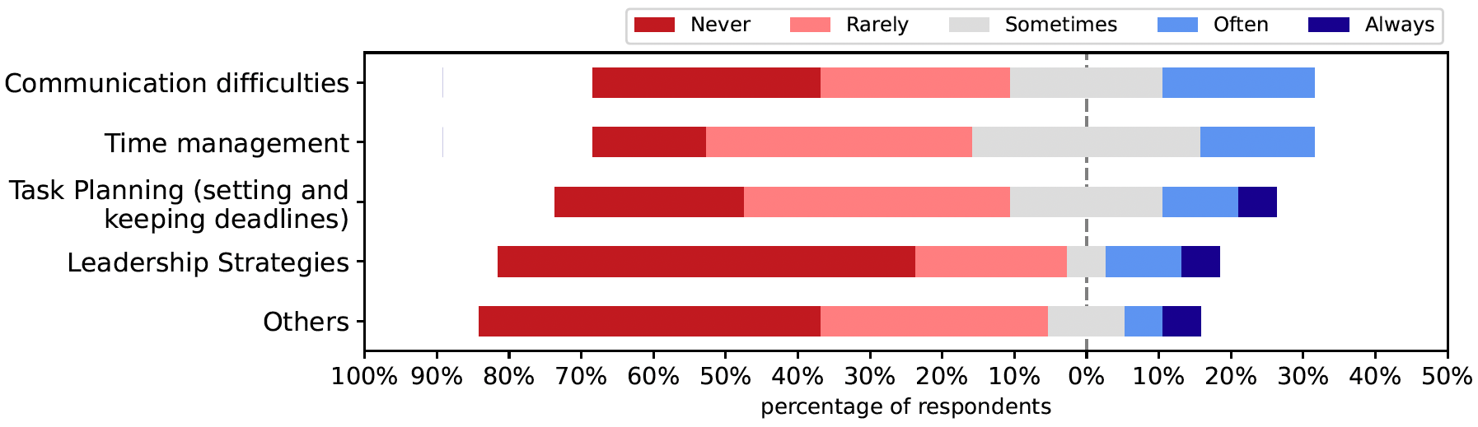
Survey Results – Team management
Qn.6: Please rank the following challenges that could have impeded effective teamwork.
Qn.7: If your ranking for "Others" in Qn.7 above was 4 or 5, kindly provide us what it represents.
Learning Curve of using the Software
[R2]. Others -- People simply not doing work. We only had about half of our group contribute anything meaningful to the project. The half of the group that were participating had not authority to make the students participate and continue to remain difficult to work with for the even when they were mentioned by the professor in our group chat.
[R14]. Others -- frontend and backend teams should have collaborated more. Maybe instead of separating the frontend and backend completely, some members should have been in both to better understand the needs of each group that the other group could provide.

Slide 20
Survey Results – Team management
Qn.8: Kindly provide details for your choices in Qn.6 above
[R2] Time Management. Regarding time management, even if you started working on the project immediately (start of October). You'd be surprised how short of an amount of time 2 to 2.5 months is. We barely deployed a minimum viable product.
[R2] Communication Difficulties. Most of the team were hard to communicate with at the beginning. […], we had a meeting discussing the best platform to reach out on. After this meeting, most of the team was easy to get a hold of, but few were still hard to communicate with.
[R2] Task Planning. Task planning was difficult due to the difference in experience plus some tasks taking more time than expected. The latter parts of the project had many missed deadlines that resulted in a rushed final 2 weeks of development.
[R2] Leadership Strategy. I couldn't have asked more of the 2 leaders we had. They were students with no experience that was on front end, but they both put in a lot of work beyond coding. Creating tasks and identifying requirements was a lot more work that they did to the best of their ability.
[R16]. Time management -- Sometimes some team members cannot join the meeting because they do not have time, So I think time management will be a challenge than other reasons.

Slide 21
Survey Results – Team management
Qn.8: Kindly provide details for your choices in Qn.6 above
[R10] Task Planning. […] setting and keeping deadlines is simply a matter of self-accoutability. […] My only advice regarding planning is "get to know your people". If you know your people, you will know who will work and who will slack. Failing to know the team kills the team. This applies to both leadership and membership, people might look up to a strong leader but if you are paired with someone useless, you will not be very happy to find that out the day of the deliverable.
[R10] Time Management. This is the most important part of this category, yet it is the second responsibility of a leader. If you cannot manage your time as a leader, you wont be able to handle the regular randomness of a team, and the team will either replace you or fall apart. Both are not ideal. Similarly, if the members do not manage their time well, they will not meet deadlines, producing an unhappy client and possibly failing as a whole.
[R10] Communication Difficulties. A team that cannot communicate is not a team. […], any break down of communication during the project is problematic. […], if members cannot communicate effectively between each other, productivity and efficiency are dampened.
[R10] Leadership Strategy. This is a large part of every team, but it isnt so much about following a plan as it is to "Get to know your people", understand them. Be balanced. That is being both able to empathize, but teach, scold, but don't burn them, and if it really takes it, get into whatever their doing, and help them.
[R10] Leadership Strategy. The most important thing about leadership, is proving your capable to your team to lead them. You need their utmost trust, because there will come a time when they let go. And if you’re not ready, everything will fall apart.

Slide 22
Survey Results – Team management
Qn.8: Briefly describe how your would plan to avoid the challenges if you were to do the project again. This information will help the teams doing the project in future classes.
[R2]. We would have established a much, much better way of holding people accountable for work from the first week we began the group. We tried to be lenient with people at the start because learning a new development platform […] can be difficult; however, the level that the lack of participation reached in the last months was insurmountable. For DP1, we should have kept a much stricter log of the work that people were and weren't doing.
[R6]. One suggestion would be to all be on top of things and start as soon as you can to get to know your group members and their strengths and weaknesses so that we can all help each other. My team and I made very sure that we did that.
[R16]. […] to avoid challenges faced, it is important to just plan out everything you need from the beginning and work on a minimum viable product (the bare bones to make what you want work). Our team tried to do this in our separate teams, but we waited very long to do the integration. It would have gone much smoother if we had deployed our server from the beginning and set up the actions pipeline to publish our code from the repo. […]
[R19]. We would have worked on unit testing much earlier as we didn't realize how time consuming it would've been
[R3]. I would recommend in person meetings/ hybrid more than 100% online meetings.
Notes:
We would have worked on unit testing much earlier as we didn't realize how time consuming it would've been

Slide 23
Survey Results – Team management
Qn.8: Briefly describe how your would plan to avoid the challenges if you were to do the project again. This information will help the teams doing the project in future classes.
[R20]. To the leaders: The most important thing about leadership, is proving you're capable to your team to lead them. You need their utmost trust, because there will come a time when they let go. And if you're not ready, everything will fall apart.
It isn’t so much about following a plan as it is to "Get to know your people", understand them. Be balanced. That is being both able to empathize, but teach, scold, but don't burn them, and if it really takes it, get into whatever their doing, and help them.
[R19] Realistically, I think all groups will have friction between the inexperienced and experienced members, and even a group with all experienced members would have this to a lesser degree. In my opinion, there are 2 ways to help this issue.
[…]
Resisting project scope creep is key to having members contribute fairly and consistently. If a certain feature requires advanced knowledge of the framework, then inexperienced members will take much longer to complete that feature, experienced members will have to do all the work, or the feature will be incomplete. The MVP should be emphasized as the goal in feature planning and task creation/assignment.
[R6]. To the members: The most important thing about being just "a part" of a team, is to realize that you're not just "a part", you are the team.
A clock is the usual cliché comparison, but its absolutely correct, if any one person starts to falter, the leader can only do so much before they try to replace the broken cog. Which in this project is not possible.
Notes:
We would have worked on unit testing much earlier as we didn't realize how time consuming it would've been

Slide 24
Survey Results – Team management
Qn.8: Briefly describe how your would plan to avoid the challenges if you were to do the project again. This information will help the teams doing the project in future classes.
[R20]. To the non-believers:
I know you're out there, you may not know it yet, but you're out there.
Please do your best, and communicate if you need help. If you don’t communicate, your team cannot help you.
[R21]. Unfortunately there's no true way to avoid these challenges. […] There's a difference between people who take pride in their work and people who don't. As somebody who does, I couldn't turn in a project that was half completed, missing components, or was otherwise unfunctional. My group members were willing to turn in something that barely worked because "it was more about the presentation and group work then the project".
Notes:
We would have worked on unit testing much earlier as we didn't realize how time consuming it would've been

Slide 25
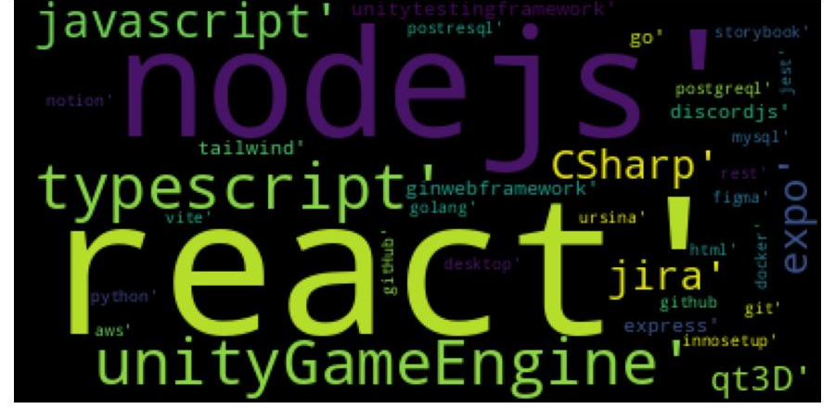
Survey Results – Learning New Technology
Qn.9: Please list the new technologies your team used to implement the project.
Qn.10: Please pick one or more technologies and briefly describe how the technology was used in your team project.
[R12]. React was our main language in the frontend and we used it to make the webapp and it was super simple to set up and do; especially since we have had some people on our team with previous experience who could guide people stuck.
[R16]. Docker as a container made it quite easy to set up the project for multiple machines. Everything was put together, so whichever person was running it on their own machine would have the exact same results as someone else running it on theirs.
[R12]. Go was used for programming the backend API. It was the interface that digested http requests from the frontend mobile client and made necessary calls to the database.
[R13]. Typescript was used for the entirety of the project. […]. This technology was used to create both the front end portion and back end portion of the project. This language enabled everything we needed, including the usage of a database and discord.js, to complete the project to where we did.
[R5]. Unity packages used to ensure a reduction in repeated work. For example, I had initially found a Unity package which virtually created a Main Menu for us. This would allow us to focus on more core/backend components of game development. (In this instance, possibly due to a lack of communication, the UI team went and spent time creating their own modified Main Menu).

Slide 26
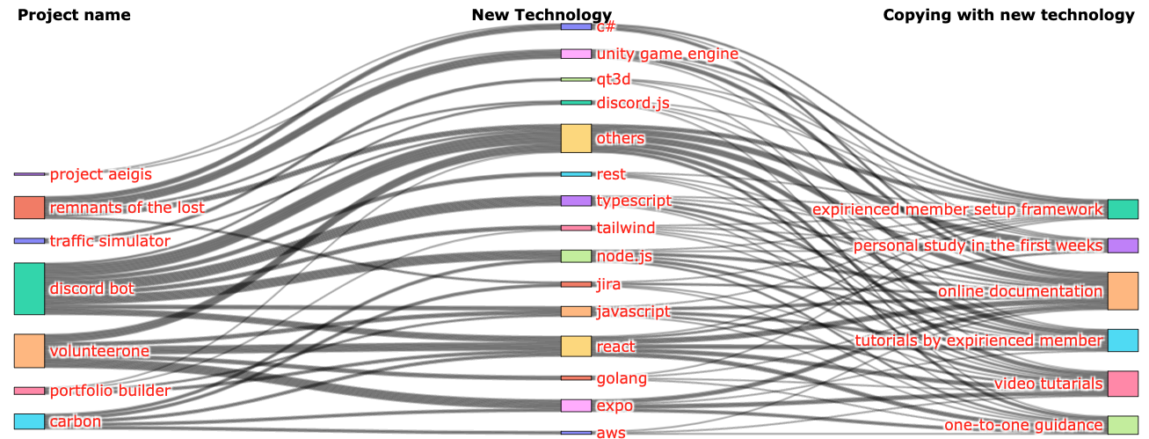
Survey Results – Learning New Technology
Qn.11: As a follow-up of Qn.9, describe how your team and you individually planned and learned to use the technologies.

Slide 27
Survey Results – Learning New Technology
Qn.11: As a follow-up of Qn.9, describe how your team and you individually planned and learned to use the technologies.
[R5]. Experienced member setup the framework. I looked up and implemented most if not all of these plugins and packages. Once setup, the team was able to select a button to determine if they wanted to generate code coverage during their testing or not. Certain team members did display some initiative and found useful tools and shortcuts when creating Unity tests however.
[R7]. Tutorials by experienced member. An experienced member of our team recorded tutorials for team members to use to get started with unity. Additional tutorials online were shared to help everyone get up to speed. Individually, I followed the tutorials provided to learn the basics of unity to get used to using the engine before we started work on the group project.

Slide 28



Survey Results – Learning New Technology
Qn.12: Kindly discuss any other suggestions on how we can improve the management of the team project.
[R7]. Have everyone review prs. We ended up only having three or so people review everything. Having a review deadline at the end of the week helped us as well.
I would suggest that pull request reviews share more of the project weight. Because most of the weight was the pull request itself, many students would forget or ignore pull request reviews.
[R7]. I think some students probably felt unqualified to provide a review for certain PR's and so they end up not doing reviews. […]. I don’t really have a solution, a lot of reviews kinda just end up getting submitted by about two people in a group.

Slide 29
Closing remarks
The survey results helped me better plan for my class this semester
Do not put the weight on the team leader. Be a team player!
I hope you have managed to learn an idea or two from the talk
Kindly participate in the survey at the end of the semester
Each of you has a unique out look on how to manage a group
“People-related factors tend to be the greatest challenges—not technology.”
George Spafford,
Senior Director Analyst
at Gartner
Team success depends on many factors, for example:
Good-faith participation
Effective communication
Equitable contributions

