Slide 1
CS 472 Survey Responses from Students

Slide 2
Announcements
Lab assignments
A few of you had challenges in the testing lab (python)
Last semester I had 70 students and all managed to do the labs
If you have failed to find time to do the labs, the project is likely going to be worse and this will be problem for your teammates.
CI lab is due 10/03/2023
Design Portfolio I is due 10/10/2023
Weekly group meetings
https://docs.google.com/document/d/1bq32N9LfLpy4ogQ7UOonJxeK8di6-GyuSPCGBUecLoE/edit

Slide 3
“People-related factors tend to be the greatest challenges—not technology.”
George Spafford,
Senior Director Analyst
at Gartner
Notes:
I introduced this quote at the beginning of this class

Slide 4
Teaming is a core component in practically all professional software engineering careers
It’s best to be taught this skill before you get into the field.
Freeriders usually bring stress and more work to the hardworking teammates
Team success depends on many factors:
Good-faith participation
Effective communication
Equitable contributions

Slide 5





Survey motivation
1.Learn from my mistakes
During the semester
After the semester
2. Identify students teamwork challenges
teamwork interaction complaints
SDD prject teams
Notes:
Two key motivations for conducting the survey
First time teaching this class.
I wanted to learn from the students at the end of the semester.
This will help me improve the content as well as class management in subsequent classes I will be teaching.
2. Identify student complaints and how to address them
During the semester, a few of the groups had challenges with teamwork. The student privately reported to me and I tried to solve their problems.

Slide 6


Survey preparation
Survey
Software Development Project groups
A total of 15 open and closed ended optional questions
Survey was anticipated to last between 20 – 30 minutes
Respondents were asked to keep annonymous
Survey was open for one month
Notes:
I asked individuals to volunteree and participate in the survey

Slide 7
Survey responses
19 of 70 students
27% response rate
7/7 project teams
represented
Survey
Three survey sections
Background information
What makes teams successful
Learning new technologies
Notes:
I could have gotten more but I sent in the survey very late

Slide 8
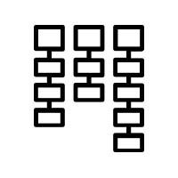
Survey Analysis
4/15 question were multiple choice closed and
11/15 questions were open-ended questions.
card-sorting: from text to themes
open-ended questions

Slide 9
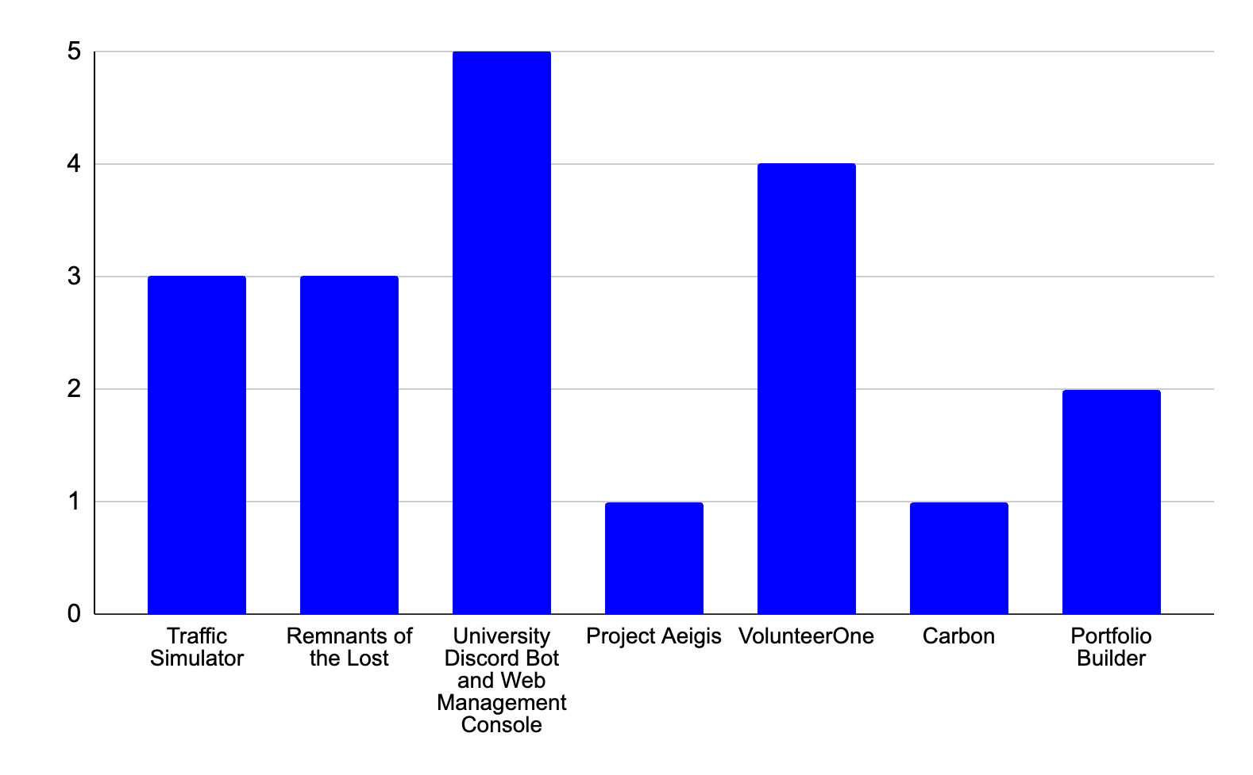
Survey Results - Background
Qn.1: Kindly select the of your team project name.
Notes:
We had seven teams

Slide 10
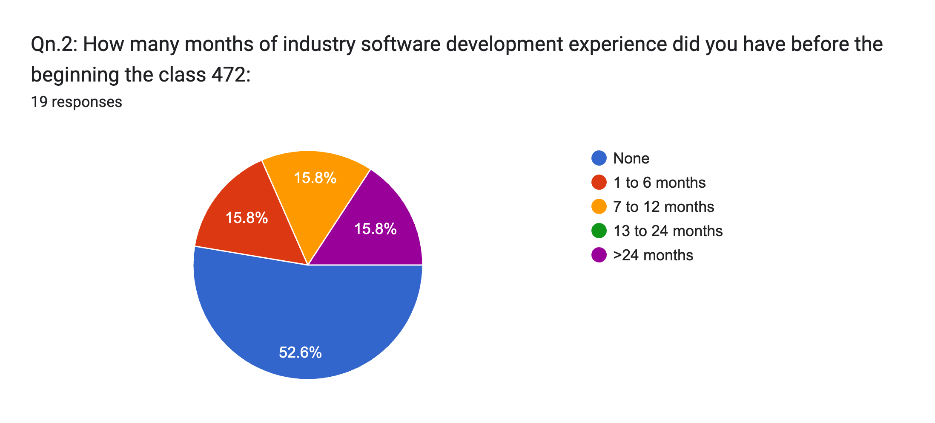
Survey Results - Background
Notes:
We had seven teams

Slide 11
Survey Results – Team management
Qn3. How often were you involved in leadership roles?
Notes:
We had seven teams

Slide 12
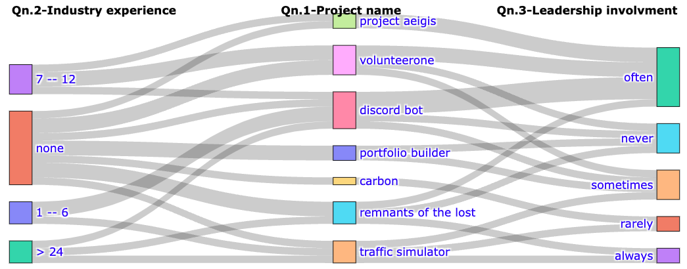
Survey Results – Team management
Multiple choice questions
Qn.1: Kindly select your team project name.
Qn.2: How many months of industry software development experience did you have?
Qn.3. How often were you involved in leadership roles during the project?
Notes:
Here we visualize the results of three questions

Slide 13
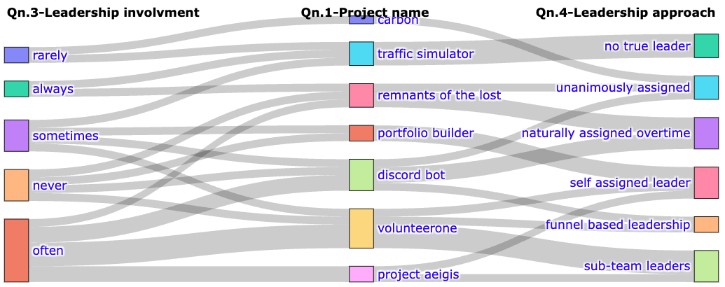
Survey Results – Team management
Qn.1: Kindly select the of your team project name.
Qn.3. How often were you involved in leadership roles during the project?
Qn.4 Could you describe your team’s leadership approach?
Theme | Description
No true leader | everyone did their own portion of work
Naturally assigned overtime | The leader was naturally assigned over time
Unanimously assigned | The person with the most experience was chosen to lead the group
Sub-team leaders
Self assigned leader | The leader was self assigned at the beginning of the project
Funnel based leadership | The members priorities were focused at the level of vision, output goals, and criteria.
Open-ended question
Notes:
Here we visualize the results of four questions

Slide 14


Survey Results – Team management
[R11]. Unanimously assigned. […] was unanimously assigned to […] because he was the only one with the work experience to software industry. With his knowledge, he was able to guide us through the usual process of how software development goes. He was able to help us set up the planning stage and the tech stack. Decisions were usually made through unanimous voting but sometimes, we try to choose whatever's the best interest for the group.
[R2]. Naturally assigned overtime. We attempted to allow anyone to step up and take on any task. We had no centralized leadership, but some people didn't step up to any tasks so a centralized leadership formed naturally from a lack of participation by few.
[R16]. Sub-team leaders. Our team split into two groups, a backend and frontend. each with a group leader who managed that portion of the project.
Open-ended question
[R1]. No true leader. Equality - everyone does their own portion of work. There would be times of leadership, but after people would collaborate without a true leader.
Notes:
Here we visualize the results of four questions

Slide 15
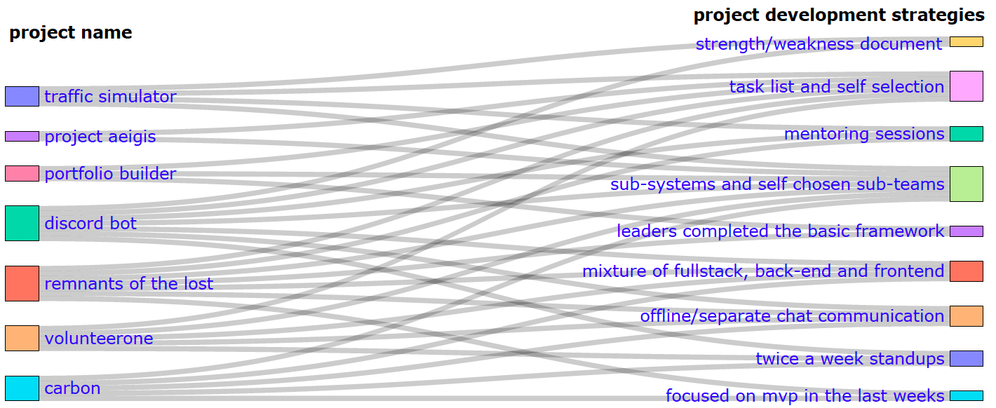
Survey Results – Team management
Qn.1: Kindly select the of your team project name.
Qn.5: Briefly describe the strategies your group employed to manage the contributions to the project.
Theme | Description
Sub-systems and self chosen sub-teams | We divided the project into sections and allowed each memberto self select the sub-project
Task list and self selection | We created tasks and team members self selected what the wanted to work on
Strength/weakness document | We had a document that stated our interests and our strengths/weaknesses regarding our experience with development.
Twice a week stand-ups | Sub-system meeting one day and all members meeting another day to claim tasks
Mixture of full stack, back-end and frontend | Majority of the group members contributed both in the backend and front end to learn more.
Mentoring sessions | Expirience team members mentored other mates on new technologies
Leaders completed the basic framework | Our team is led by the leader to complete the basic framework, and then the members complete each component.
Offline/separate chat communication | Members working on related tasks had a lot of offline communication.
Focused on MVP in the last weeks | In the last weeks we created a spreadsheet with our remaining tasks to get to a Minimum Viable Product and assigned ourselves those.

Slide 16
Survey Results – Team management
[R5]. Strengths/weaknesses. We had a document that stated our interests and our strengths/weaknesses regarding our experience with development. Many of us wanted to have experience with certain things we had never used before. We then spent time creating tasks on a Notion page and people claimed what tasks they were interested in. […]
[R1]. Sub-systems and self chosen sub-teams. We divided our group into self-chosen sub groups. We divided the project into sections and allowed each member to choose where they wanted to go. Thankfully, experienced members knew that they should target the most complex sections while also incorporating less experienced members […]
[R9]. Task list and self selection. For the backend, i created a list of tasks to complete on github issues. Then delegated tasks based on what my members wanted to do. During each meeting we check the progress and delegate more tasks.
.
[R16]. Offline/separate chat communication.[…] Aside from this, we also had a lot of offline communication regarding the tasks we were working on. During the sub-team meetings, we discussed how to split up tasks and figure out what to work on, then we spent the full meetings discussing larger project deadlines, frontend/backend integration, and current progress of the project. […]
[R5]. Twice a week stand-ups. We would have weekly stand ups twice a week to get an idea of peoples blockers and what tasks are still needed to be done. This time we would claim tasks or allocate tasks. […] It seemed that our interests were split in half and we all worked together to allocate tasks according to need based status. […]

Slide 17
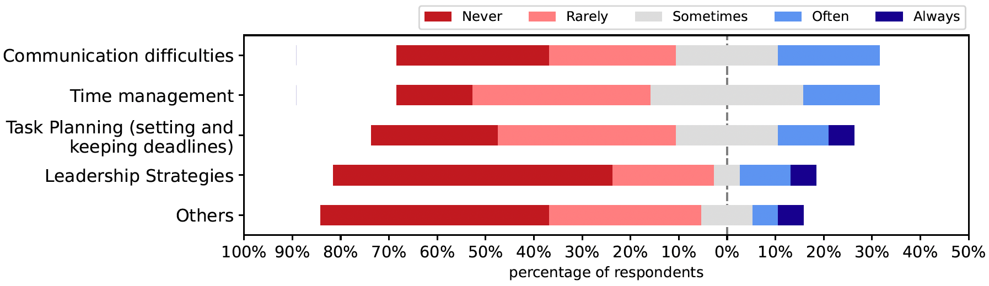
Survey Results – Team management
Qn.6: Please rank the following challenges that could have impeded effective teamwork.
Qn.7: If your ranking for "Others" in Qn.7 above was 4 or 5, kindly provide us what it represents.
[R2]. Others -- People simply not doing work. We only had about half of our group contribute anything meaningful to the project. The half of the group that were participating had not authority to make the students participate and continue to remain difficult to work with for the even when they were mentioned by the professor in our group chat.
[R14]. Others -- frontend and backend teams should have collaborated more. Maybe instead of separating the frontend and backend completely, some members should have been in both to better understand the needs of each group that the other group could provide.
[R16]. Time management -- Sometimes some team members cannot join the meeting because they do not have time, So I think time management will be a challenge than other reasons.

Slide 18
Survey Results – Team management
Qn.8: Briefly describe how your would plan to avoid the challenges if you were to do the project again. This information will help the teams doing the project in future classes.
[R2]. We would have established a much, much better way of holding people accountable for work from the first week we began the group. We tried to be lenient with people at the start because learning a new development platform […] can be difficult; however, the level that the lack of participation reached in the last months was insurmountable. For DP1, we should have kept a much stricter log of the work that people were and weren't doing.
[R6]. One suggestion would be to all be on top of things and start as soon as you can to get to know your group members and their strengths and weaknesses so that we can all help each other. My team and I made very sure that we did that.
[R16]. […] to avoid challenges faced, it is important to just plan out everything you need from the beginning and work on a minimum viable product (the bare bones to make what you want work). Our team tried to do this in our separate teams, but we waited very long to do the integration. It would have gone much smoother if we had deployed our server from the beginning and set up the actions pipeline to publish our code from the repo. […]
[R3]. I would recommend in person meetings/ hybrid more than 100% online meetings.
[R19]. We would have worked on unit testing much earlier as we didn't realize how time consuming it would've been
Notes:
We would have worked on unit testing much earlier as we didn't realize how time consuming it would've been

Slide 19
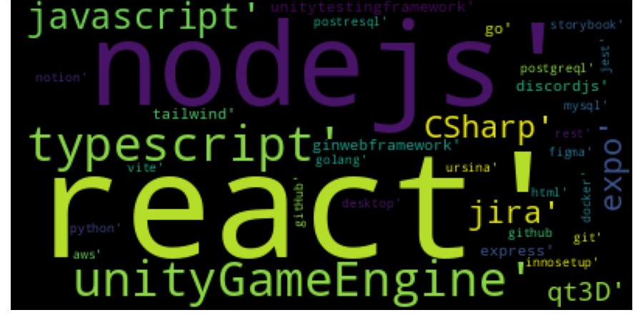
Survey Results – Learning New Technology
Qn.9: Please list the new technologies your team used to implement the project.
Qn.10: Please pick one or more technologies and briefly describe how the technology was used in your team project.
[R12]. React was our main language in the frontend and we used it to make the webapp and it was super simple to set up and do; especially since we have had some people on our team with previous experience who could guide people stuck.
[R16]. Docker as a container made it quite easy to set up the project for multiple machines. Everything was put together, so whichever person was running it on their own machine would have the exact same results as someone else running it on theirs.
[R12]. Go was used for programming the backend API. It was the interface that digested http requests from the frontend mobile client and made necessary calls to the database.
[R13]. Typescript was used for the entirety of the project. […]. This technology was used to create both the front end portion and back end portion of the project. This language enabled everything we needed, including the usage of a database and discord.js, to complete the project to where we did.
[R5]. Unity packages used to ensure a reduction in repeated work. For example, I had initially found a Unity package which virtually created a Main Menu for us. This would allow us to focus on more core/backend components of game development. (In this instance, possibly due to a lack of communication, the UI team went and spent time creating their own modified Main Menu).

Slide 20
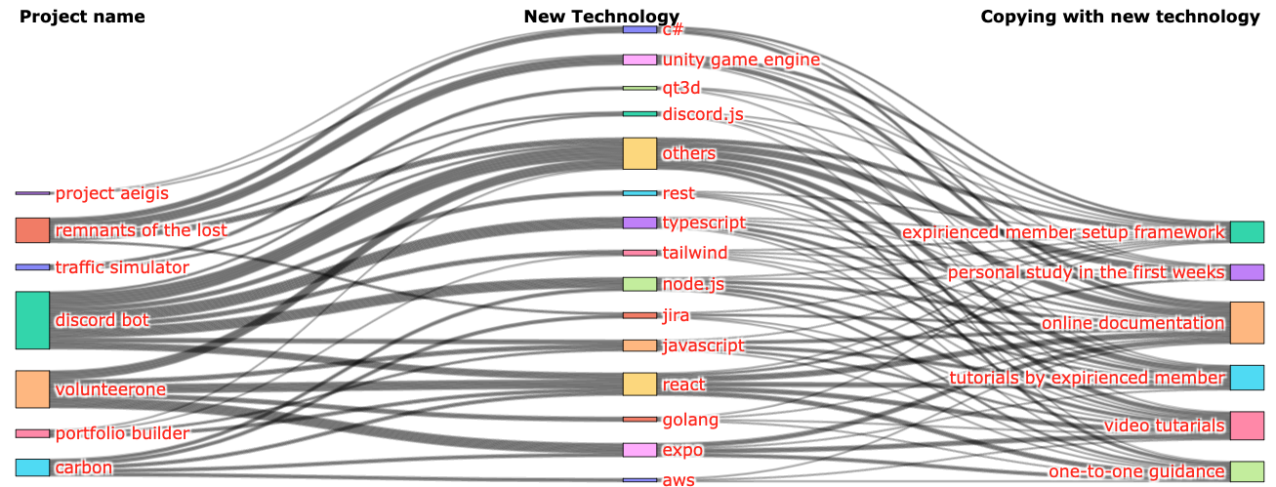
Survey Results – Learning New Technology
Qn.11: As a follow-up of Qn.9, describe how your team and you individually planned and learned to use the technologies.
[R5]. Experienced member setup the framework. I looked up and implemented most if not all of these plugins and packages. Once setup, the team was able to select a button to determine if they wanted to generate code coverage during their testing or not. Certain team members did display some initiative and found useful tools and shortcuts when creating Unity tests however.
[R7]. Tutorials by experienced member. An experienced member of our team recorded tutorials for team members to use to get started with unity. Additional tutorials online were shared to help everyone get up to speed. Individually, I followed the tutorials provided to learn the basics of unity to get used to using the engine before we started work on the group project.

Slide 21
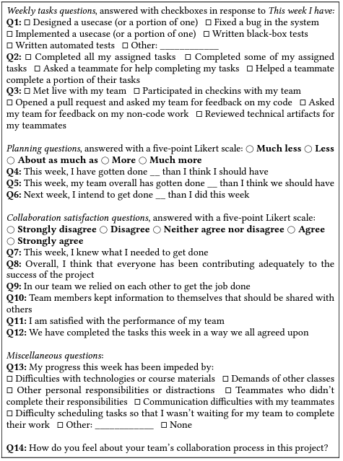
Weekly Servey
https://docs.google.com/forms/d/e/1FAIpQLSfk0ryEJRhLCjgKXX7k6VhC_ThHWXKc5rZjCzYKAcECuS6G-g/viewform

