Slide 1
Software Testing & Continuous Integration
John Businge
john.businge@unlv.edu

Slide 2
Announcements
9/9/26 we will have a class – We have visitors in the class
First lab deadline tonight
Precondition report – deadline 9/4/26

Slide 3
Testing
“If it is worth building, it is worth testing.
If it is not worth testing, why are you wasting your time working on it?”
Scott Ambler, agiledata.org

Slide 4

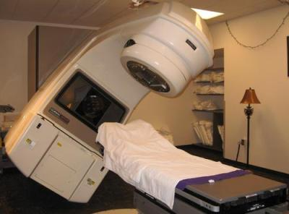

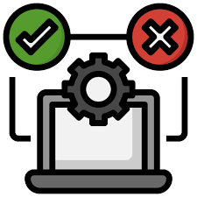



The Need for Testing
KILLED BY A MACHINE: THE THERAC-251986: MEDICAL ACCELERATOR DISASTER
One developer
Control Software
Insufficient testing
https://hackaday.com/2015/10/26/killed-by-a-machine-the-therac-25/
Notes:
This case is probably the most consequential failure in the history of software development. The medical accelerator disaster. Due to
bugs in the control software,
an insufficient quality assurance process, and
other deficiencies,
three patients lost their lives caused due to radiation overdoses.
An analysis of this case determined that, among other things, the software was written by only one person who was also responsible for the tests.

Slide 5
Learning Objectives
By the end of the lecture and lab, you should understand how to:
Design meaningful unit tests and interpret coverage results.
Apply the Red-Green-Refactor cycle.
Use CI to validate pull requests automatically.
Combine tests, reviews, and status checks to control merges.

Slide 6
Unit Testing
We focus on Unit Testing.
Unit testing focuses on the smallest testable parts of an application called units (e.g., a class method or function)
It does not mean that Unit Testing is more important, but those are the tests we can more easily automatize and benefit from tool support.
Notes:
In this lab, we are going to focus on unit testing
In unit testing, the focus is on the smallest testable parts of an application, called units (an example is a method)

Slide 7
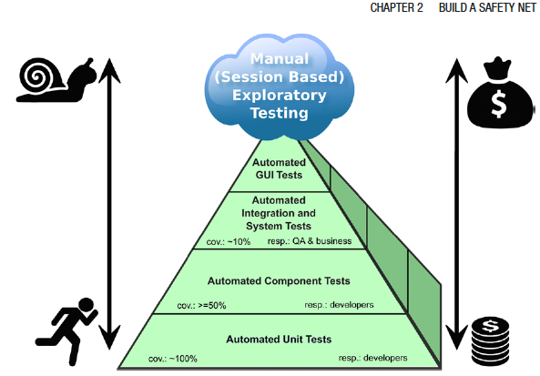

The Test Pyramid
Hard
Test Automation complexity
Experience shows that the cost of test implementation / maintainance
Easy
Build a broad base of fast, focused unit tests.
Use fewer integration and end-to-end tests because they are generally slower, more complex, and more expensive to maintain.
Notes:
The test pyramid illustrates the relative balance among different levels of testing. A project should generally contain many fast, focused unit tests, fewer integration tests, and a smaller number of end-to-end or acceptance tests.
This does not mean that unit tests should constitute exactly 100% of the tests or that every project must achieve 100% unit-test coverage. The appropriate balance depends on the system’s architecture, risks, and important user workflows.
Unit tests form the broad base because they are usually fast, easier to automate, and good at identifying failures in small pieces of code. Integration tests verify that components work together, while end-to-end and acceptance tests evaluate complete workflows.
As we move upward in the pyramid, tests usually become slower, more expensive to create and maintain, and more difficult to diagnose when they fail. However, the higher-level tests remain necessary because unit tests alone cannot reveal every integration or workflow problem.
For your Senior Design projects, the practical message is to create enough fast unit tests to support frequent local testing and CI, while also adding appropriate integration or end-to-end tests for critical system interactions.

Slide 8
Unit tests provide fast, focused feedback
◎
Focused diagnosis
ONE SMALL UNIT
Test one unit in isolation.
def calculate_total(items):
return sum(items)
×
Early defect detection
Find failures near their source.
def test_calculate_total():
assert calculate_total([4, 5]) == 9
↻
Safer changes
×
Refactor with greater confidence.
✓
Expected behavior
Automated feedback
✓
Run tests locally and through CI.
Fast unit tests create the foundation for TDD and continuous integration.
Notes:
Before Click 1
Unit tests provide fast, focused feedback about small parts of a system. Let us consider a simple example.
Click 1
Here, calculate_total() is the unit being tested. The test checks that inputs 4 and 5 produce 9.
Because the test is focused, a failure is easier to locate and diagnose.
Click 2
Unit tests help us detect defects early, make code changes more safely, and receive automated feedback locally and through CI.
Click 3
Fast unit tests therefore provide the foundation for test-driven development and continuous integration.
Next, let us examine the structure of a unit test.

Slide 9
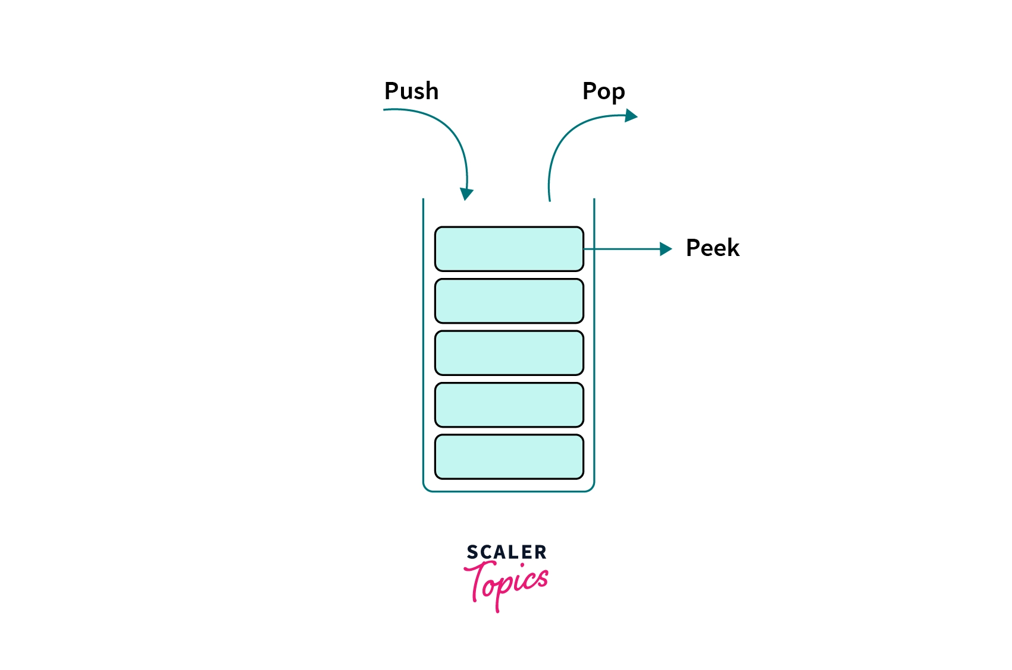
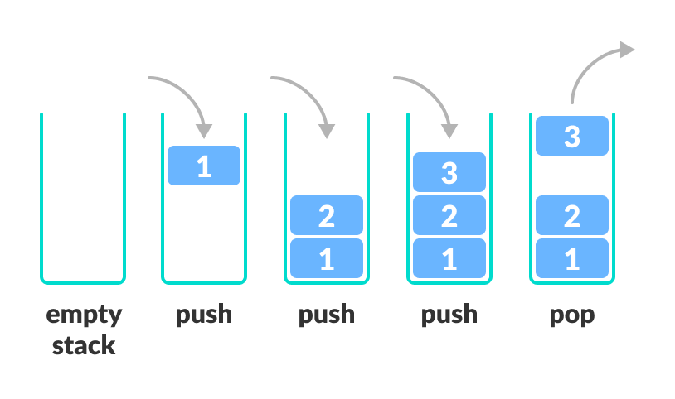
Anatomy of a Test Case - Stack
Peek
Notes:
Let's take a look at an example test case.
In this example, we’re going to use a common programming construct know as a stack

Slide 10
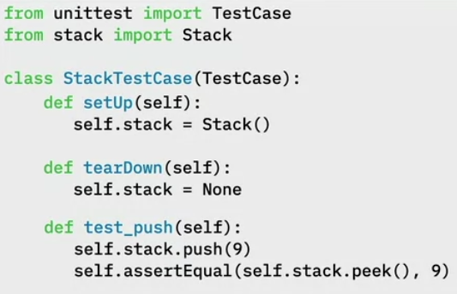

Test Case for push() and pop() function
Test Fixtures: Specify initial state of the of the testcase.
setUp() is declaring an instance variable called self.stack and assigning it to a new Stack.
tearDown() is setting self.stack to None to make sure that it doesn’t get reused
Test Fixtures
Push
Pop
Peek
9
Notes:
Let's take a look at an example test case.
In this example, we’re going to use a common programming construct know as a stack
1. First, we will import the TestCase and the Stack classes
2. Write out class StackTestCase
3. Write the text Fixtures that allows you to specify the initial state of the of the system before a test case is run
setUp() is declaring an instance variable called self.stack and assigning it to a new Stack.
tearDown() is setting self.stack to None to make sure that it doesn’t get reused
4. Now we write our first Test Case test_push(self)
When the program executes, self.stack = Stack() will be called
Next, self.stack.push(9) is called

Slide 11
A good test name explains the behavior being verified
DESCRIPTIVE NAME
✓
UNCLEAR NAME
Make the behavior
explicit
?
test1()
test_pop_after_push_returns_last_item()
BEHAVIOR
SCENARIO
EXPECTED OUTCOME
What behavior failed?
What is tested
Under what condition
What should happen
When a test fails, its name should help the team understand what behavior broke.
Notes:
A name such as test1 tells us only that a test failed; it does not identify the behavior.
A descriptive name communicates the behavior, the scenario, and the expected outcome.
Here, the name tells us that pop, after a push, should return the last item.
The exact naming convention may vary, but a failing test name should help the team understand what broke.

Slide 12
Unit tests stay focused by replacing external dependencies
Interaction belongs to Integration
UNIT UNDER TEST
DB
Real database
{ }
LoginService
Network, data, and availability can fail
Verify our authentication logic
NOT CONTROLLED BY THE TEST
✓
Test double
Fast, predictable response controlled by the test
Use a test double to isolate the unit; test the real dependency separately.
Clean C++20, Chapter 2, section on Test Doubles (Fake Objects).
https://blog.pragmatists.com/test-doubles-fakes-mocks-and-stubs-1a7491dfa3da
Notes:
Unit tests should focus on the behavior of one unit, not on whether a database, API, file system, or network happens to be available.
Here the real database is replaced by a test double that returns a controlled response.
This does not mean the real database is never tested. Its interaction belongs in integration testing.
Isolation also makes unit tests faster and more predictable, which leads to the next slide.
[Sources]
Clean C++20, Chapter 2, section on Test Doubles (Fake Objects).
https://blog.pragmatists.com/test-doubles-fakes-mocks-and-stubs-1a7491dfa3da

Slide 13
Fast unit tests keep the feedback loop short
A short feedback loop supports frequent, confident changes.
1
2
3
SLOW
Long wait
Change code
Run unit tests
Act on feedback
Small edit or refactoring
Locally or through CI
Fix quickly or continue
Tests get
postponed
Keep the unit-test suite fast enough to run repeatedly during development.
Notes:
Developers continually make small changes to the code—adding functionality, fixing defects, or refactoring existing code.
After making a change, developers should be able to run the unit tests immediately. Because these tests are focused and isolated, they should provide feedback quickly.
Quick feedback allows developers to fix a failure while the change is still fresh in their minds. If the tests pass, they can confidently continue working.
Feedback interrupts development and Tests may be postponed

Slide 14
We cannot test every possible input value
Example: a bank-interest function may accept any account balance.
REPRESENTATIVE TEST CASES
POSSIBLE INPUT VALUES
Select systematically
−$2,000
overdraft behavior
$2,500
first interest tier
negative
many valid balances
very large
$7,500
second interest tier
$15,000
highest interest tier
Testing every value is impossible.
A manageable starting set—not random samples
Equivalence partitioning
Boundary-value analysis
Choose values from behaviors that should differ.
Then test values near each rule change.
Notes:
The circles represent possible account-balance values accepted by the function. Because the range is extremely large, we cannot test every possible balance.
We therefore select inputs systematically rather than randomly. These four values form a manageable starting set because each represents a different interest-rule behavior.
Equivalence partitioning helps us identify the different behavior classes and choose a representative from each one. Boundary-value analysis then adds tests around the points where the behavior changes. The next two slides examine these techniques using the same example.

Slide 15
Equivalence partitioning samples each behavior class
Example: a bank applies different interest rules to different account balances.
Balance < $0
$0–$5,000
$5,000–$10,000
Balance > $10,000
4% overdraft penalty
0.5% interest
1% interest
2% interest
✓
✓
✓
✓
−$2,000
$2,500
$7,500
$15,000
Start with one representative value from every class that should behave differently.
Notes:
On the previous slide, we selected four representative test cases. This slide explains how we identified them.
Equivalence partitioning divides the possible inputs into classes that should produce meaningfully different behavior. In this example, the applicable interest rule changes across these four balance ranges.
Instead of testing every balance, we begin with one representative value from each class. Negative two thousand dollars represents the overdraft class; the other three values represent the three interest classes.
The assumption is that values within the same class should be processed similarly. This does not prove that every value in the class is correct, but it gives us a systematic and manageable starting set.
Equivalence partitioning helps us cover the different categories of behavior without testing every possible input. However, the representative values are located safely inside their classes. Defects often occur near the points where one class changes into another. We therefore examine those boundaries next.

Slide 16
Boundary-value analysis tests where behavior changes
Defects often hide immediately below, at, or above a boundary.
$0
$5,000
$10,000
just below
at
just above
○
●
○
○
●
○
○
●
○
−1
0
1
4,999
5,000
5,001
9,999
10,000
10,001
Partitions cover the categories; boundary tests probe the transitions between them.
Notes:
The previous slide tested one value from inside each equivalence class. Boundary-value analysis focuses instead on the transitions between those classes.
In this example, the behavior changes at zero dollars, five thousand dollars, and ten thousand dollars. These are therefore the boundaries we need to examine carefully.
For each boundary, we test a value immediately below it, the boundary itself, and a value immediately above it.
At five thousand dollars, for example, we test 4,999, 5,000, and 5,001. These cases verify that the implementation changes behavior at exactly the correct point—not one value too early or too late.
These examples assume balances are represented in whole dollars. If the system accepts cents, we should use the smallest meaningful increment, such as 4,999 dollars and 99 cents, 5,000 dollars, and 5,000 dollars and 1 cent.
The two techniques are complementary. Equivalence partitioning covers the different categories of behavior, while boundary-value analysis tests the risky transitions between them. Together, they produce a small but systematic set of high-value test cases.

Slide 17
Quality of a Test Suite
How do you know if your unit test cases are good enough?
Are they really testing the application?
When do we stop testing?
Solution: Test Coverage!

Slide 18
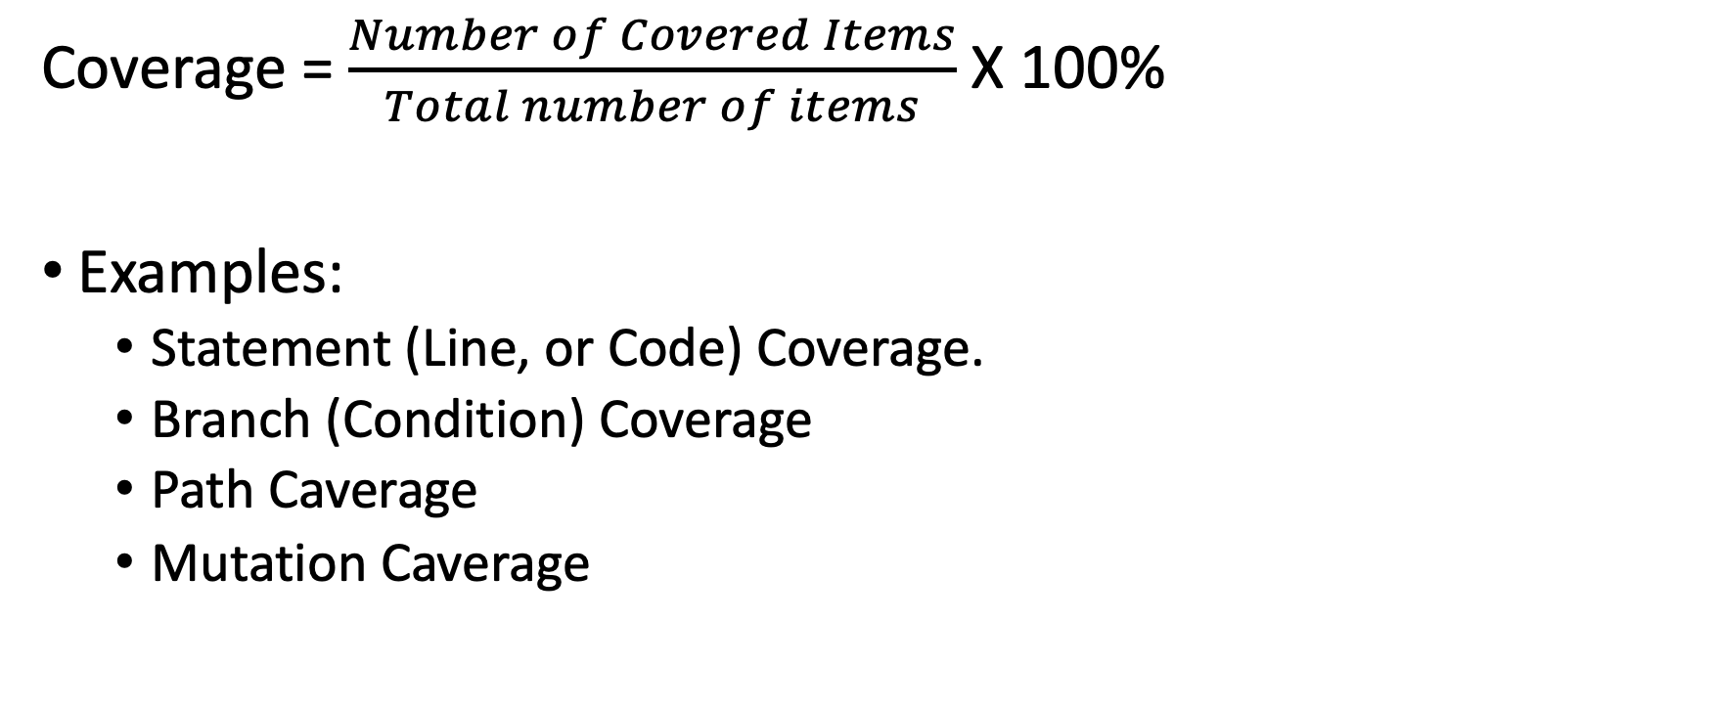
Test Coverage
Coverage = $\frac{Number of Covered Items}{Total number of items}$ X 100%
Examples:
Statement (Line, or Code) Coverage.
Branch (Condition) Coverage
Path Caverage
Mutation Caverage

Slide 19
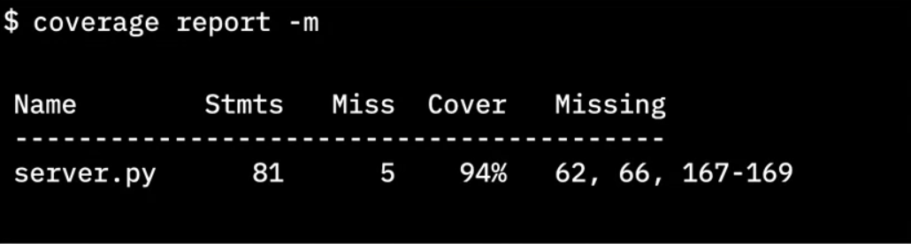
Importance of test coverage
High test coverage gives you confidence that your code works as expected
Test coverage reports can reveal which lines of code were not tested
Python cmd tool
Total lines of code
# lines without test cases
Percent of coverage
Lines without test cases
Notes:
Finally it gives us the line numbers that did not have test cases.
This info is critical because now we know where to concentrate our tests.
We need to go write more test cases to cause those lines of code to be executed.

Slide 20
Full test coverage
You must include “happy” paths and “Sad” paths to get full test coverage
100% test coverage only means that every line of code has been tested with some known good data.
You can still pass bad data into your code and find bugs.
Even with 100% test coverage, your code can still have bugs
Don’t stop testing when your code reaches 100%
Notes:
100% test coverage only means that every line of code has been tested with some known good data.
You can still pass bad data into your code and find bugs.
So don't stop testing when your code cover reaches 100%.
Keep challenging the integrity of your code with bad data and corner cases to make sure
your code behaves as expected under both favourable and adverse conditions.

Slide 21
One function contains three independent decisions
THREE BOOLEAN DECISIONS
int foo(int input, bool b1, bool b2, bool b3) {
int x = input;
int y = 0;
if (b1) x++;
if (b2) x--;
if (b3) y = x;
return y;
}
b1
true: increment x
false: leave x unchanged
b2
true: decrement x
false: leave x unchanged
b3
true: copy x into y
false: leave y as 0
Each decision can be true or false, creating different execution paths.
Notes:
This function accepts an integer and three Boolean inputs.
Each Boolean controls a separate decision. When true, its associated statement executes; when false, that statement is skipped.
Because each decision can be true or false, different combinations create different execution paths.”

Slide 22
Line coverage shows which executable lines ran
Test: foo(0, false, true, true) == −1
1
int x = input;
✓
COVERAGE RESULT
2
int y = 0;
✓
3
if (b1)
✓
8 of 9
4
x++;
×
5
if (b2)
✓
88.9% line coverage
6
x--;
✓
7
if (b3)
✓
8
y = x;
✓
Missed: x++;
9
return y;
✓
because b1 is false
Line coverage reveals unexecuted code—not whether every decision was tested both ways
Notes:
We begin with one test in which b1 is false while b2 and b3 are true.
The test executes these eight lines. Because b1 is false, the statement x++ is skipped.
Using this executable-line count, eight of nine lines run, giving 88.9% line coverage. Line coverage identifies unexecuted code, but it does not show whether every decision was tested both ways.

Slide 23
Two tests can achieve 100% branch coverage
Branch coverage asks whether every decision has been true and false at least once.
TEST CASES
OUTCOMES EXERCISED
Test 1
foo(0, true, true, true) == 0
b1
b2
b3
TRUE
✓
✓
✓
Test 2
foo(0, false, false, false) == 0
FALSE
✓
✓
✓
Together, the tests exercise both outcomes of every decision.
100% branch coverage confirms both outcomes—not every combination.
Notes:
The first test makes all three decisions true.
The second test makes all three decisions false.
Across these two tests, every decision has evaluated to both true and false. Therefore, branch coverage is 100%.

Slide 24
Three binary decisions create eight execution paths
Each of the three decisions has two outcomes: 2 × 2 × 2 = 2³ = 8 paths.
T = true F = false
T T T
T T F
T F T
T F F
F T T
F T F
F F T
F F F
Path coverage considers combinations of decisions, not only individual outcomes.
Notes:
Each of the three decisions has two possible outcomes.
Combining those outcomes produces eight execution paths. Each label shows the outcomes of b1, b2, and b3, in that order.”
Unlike branch coverage, path coverage considers complete combinations of decisions.

Slide 25
100% branch coverage can still cover only 2 of 8 paths
Test 1: foo(0, true, true, true) == 0
→ T T T
Test 2: foo(0, false, false, false) == 0
→ F F F
!
T T T
✓
T T F
not tested
T F T
not tested
T F F
not tested
25%
F T T
not tested
F T F
not tested
F F T
not tested
F F F
✓
PATH
COVERAGE
2 of 8 paths
A defect in an untested combination can remain hidden—even with 100% branch coverage.
Notes:
Although every decision has been true and false, these tests exercise only two of the eight possible combinations.
Two divided by eight gives 25% path coverage.
A defect in one of the six untested combinations could remain hidden. This is why a coverage percentage must always be interpreted together with the coverage criterion being measured.

Slide 26
Test drive the development
TDD is a software development approach where tests are written before the actual code. The cycle can be summarized as Red-Green-Refactor.
Red: Write a failing test (indicating that the functionality doesn't exist or work yet).
Green: Write the minimal amount of code to make the test pass.
Refactor: Clean up the code while ensuring the test still passes.

Slide 27
Basic TDD workflow
RED
(Fail)
Write test case that fails
Red,
Green,
Refactor
REFACTOR
GREEN
(Pass)
Write code for test case – tests pass
Improve the code quality
I have prepared the lab which will guide you in practicing with TDD
Notes:
The TDD Cycle
Step 1: Write a test that defines a function or improvements of a function.
Step 2: Run the test and see it fail (this ensures the test is working and the feature isn't implemented yet).
Step 3: Write the simplest possible code to pass the test.
Step 4: Refactor the code while keeping the tests green.
Step 5: Repeat for each new feature or function.

Slide 28
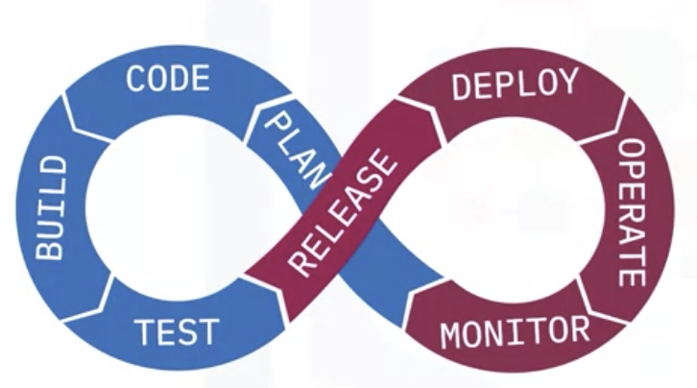
What is CI/CD
CI/CD are two related but distinct stages in a modern development workflow.
Continuous Integration (CI) provides automated feedback on code changes before they are merged, typically via pull requests.
CI answers the question: “Is this change safe to integrate?”
Continuous Delivery / Deployment (CD) takes validated code and releases it to an environment, either automatically or with manual approval.
CI/CD help teams maintain velocity and trust — especially when working with AI-generated or AI-assisted code.

Slide 29
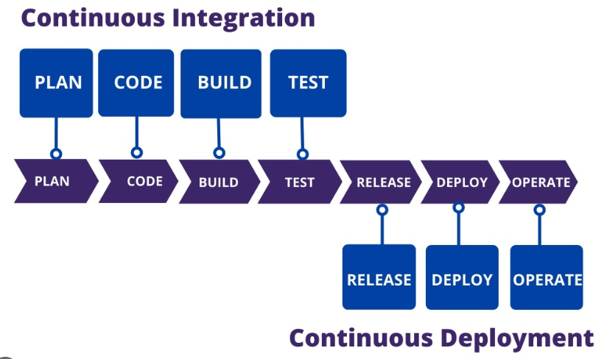
CI/CD pipeline
Project focus
Continuous Intergration
Continuous Delivery
CI is a repeating feedback loop that evaluates proposed changes as they are proposed.
Developers write code, and CI automatically builds and tests those changes to answer one key question: “Is this change safe to integrate?”
CI runs many times throughout development — not to finish the system, but to keep changes small, compatible, and reviewable.
Continuous Delivery (CD) focuses on what happens after code has been integrated.
It includes the Release, Deploy, and Operate phases, where validated binaries are packaged, deployed to an environment, and monitored in operation — sometimes automatically, sometimes with manual approval.
Notes:
In this class and in your project, we focus exclusively on CI — the part of the pipeline that supports pull requests, code reviews, and safe collaboration.

Slide 30
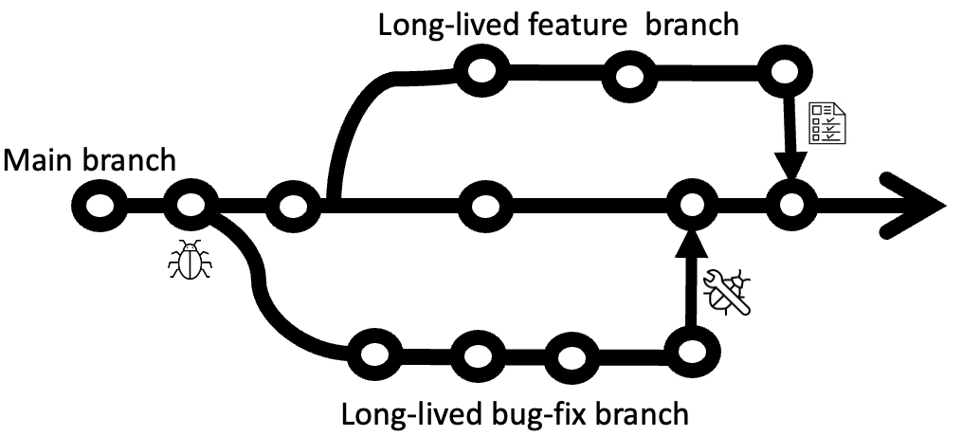
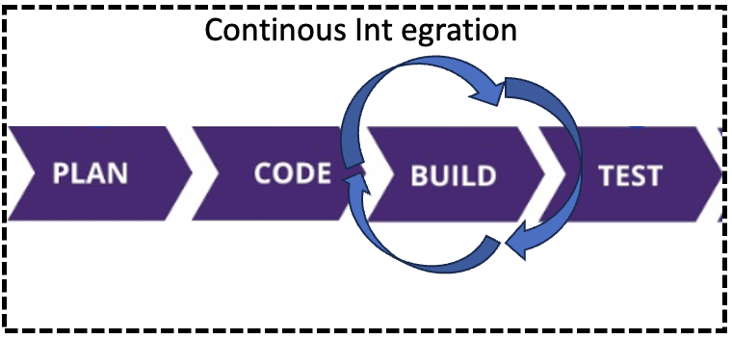
Traditional Development
CI Development
Developers often work on large features
Develop for extended periods of time
Teasting, integration, and building happen late after wor is done
Continued development on branches causes drift
Short-lived branches
Frequent pull requests
Automated CI tools help with feedback befoere integration
The goal is not speed for its own sake, but early feedback, smaller changes, and reduced integration risk.
CI doesn’t prevent bugs — it prevents surprises.”
Notes:
Traditional development
The developers work on large features or fixes and commit them into their own development branches.
These branches can exist for a long time, have a large scope, and generally require many code changes and edits.
When development is completed on these branches, only then are they tested and merged into the main branch and built for production.
This development method can cause drift between the main branch and the development branch, among other issues.
2. In the next couple of slides, I will discuss each of the features of CI

Slide 31
Short-lived branches
A playground for developers to create and test new features
Meant to be deleted after being merged
Benefits
Reduces drift
Reduces parallel changes
Limits the blast radius of mistakes (human or AI-generated)
AI makes it easy to generate a lot of code quickly. Short-lived branches make it safe to do that.

Slide 32
Frequent pull requests
Created for a specific feature or bug-fix
Merged by maintaners/owners
Each pull request represents a small, reviewable decision
Smaller PRs are easier to review, reason about, and reject
Benefits:
Frequent feedback from increased collaboration - PR review
Faster reaction to changes
Reduced management risks
Notes:
Making frequent pull requests back to the master or main branch is a best practice. These pull requests are meant to contain code updates that serve a specific purpose. It makes code changes cleaner and easier to understand.
A pull request requires approval from a repository maintainer or owner to be successfully merged. At a minimum, no one should be able to approve their own pull request. You want to ensure that every change has at least two sets of eyes on it
These frequent pull requests serve as small pieces of a much bigger puzzle, making it easy to build upon the most updated code.
Benefits:
Each pull request needs to be reviewed, which facilitates increased collaboration among developers. It also enables developers to react quickly.
Required changes can be tested and put into production faster, so solutions can get to the customer faster.
And due to the frequency of Continuous Integration, you know exactly how much functionality you have built to date, reducing management risk. It improves your ability to predict when and if you will deliver the necessary functionality on time.

Slide 33
Benefits of CI
Faster code-change reaction time
You make a change to your code
Code gets tested
Even if you forgot to run the tests, the CI tool will test it.
Fast feedback before mistakes become expensive
Change gets built
Even if you forgot to check if the build works, the CI tool will check it.
Deliver solutions quickly into customer’s hands
Knowing that all the tests have passed, and the build is not broken.
CI isn’t about saving time — it’s about failing fast while the change is still small.”
Notes:
The first benefit of CI/CD is that you get faster reaction times to code changes.
Because every time you make a change to your code and push it to a remote branch, the change gets tested, so even if you forgot to run the tests, the CI tool will test it.
2. Then, the change gets built, so even if you forgot to check if the build works, the CI tool will check it.
3. And then you can deliver the solution into your customers’ hands more quickly, knowing that all of the tests have passed, and the build is not broken.

Slide 34
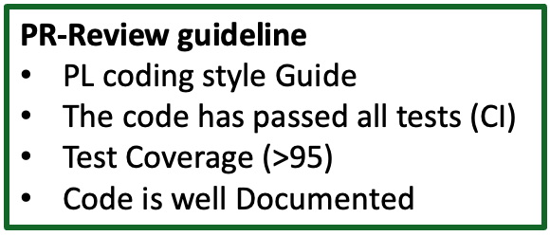

Benefits of CI – Higher code quality
Every Pull request = code review opportunity
When someone makes a pull request, go and look at the code
Extra pair set of eyes
Pull request review:
All is good - “Yeah it looks good to me” or
Code is not doing what it’s supposed to do - “why are you changing this?”
PR reviews verify intent, not just correctness
Notes:
Another benefit is that you get higher code quality with CI/CD, because things are constantly being reviewed and constantly being tested.
Every pull request is an opportunity for a code review. Forget about scheduling code reviews as a separate task. One of the things you should be doing as a best practice is, when someone makes a pull request, you should go and look at the code.
Having another set of eyes looking at what was changed while you're waiting for the test to pass is always going to be a good thing.
During your review of the pull request you can either say “yeah it looks good to me”, or maybe you look at the title and it says, the code needs to do this, but then you see some piece of the code and realise that this code has nothing to do with that, so you can ask, “why are you changing this?”.

Slide 35


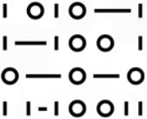
Benefits of CI – Higher code quality
Test 1
Test 2
Test 2
Do all tests pass?
Code coverage
What happened?
Wrote code but didn’t test?
PR Review - “the code coverage went down and so I’m not going to approve this yet. Please write more test cases”
New update, Coverage >= 95%,
PR Review – “I accept the PR now”.
Standard
After PR
95%
91%
Notes:
Look at the tests. Do all tests pass?
Look at the code coverage. Let’s say the code coverage went down. Your team has a standard of 95% code coverage, but code coverage was only at 91%.
So, what happened?
Maybe somebody wrote code, but they didn't write a test case to run all the lines of code.
In the review of the pull request, you can simply say that you don't accept it, and you can request more changes to the code.
You could say “the code coverage went down and so I’m not going to approve this yet”, and you can request that they write more test cases for the code.
And then they can go and write more test cases, and the pull request will see the code changes and rerun the tests.

Slide 36
Continuous Integration is not about speed — it’s about controlling risk.
Each CI practice exists to reduce a specific failure mode:
Short-lived branches reduce integration drift
Frequent pull requests reduce review and merge complexity
Automated CI reduces human error and missed checks
Together, these practices make collaboration safe; even when changes are frequent, large, or AI-generated.

Slide 37
How CI becomes real on GitHub
Short-lived branches → workflows run on pull_request
Frequent PRs → CI status checks on every PR
Automated CI → required workflows before merge
Risk reduction → failing CI blocks integration

Slide 38
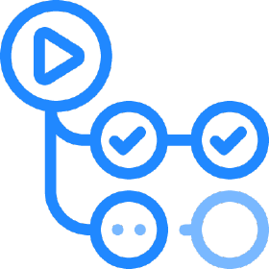
GitHub Actions – Marketplace
GitHub Actions is GitHub’s native CI system
It enforces CI rules directly on pull requests and branches
It allows you to treat your CI pipeline as code
It uses a .github/workflows/ folder to store workflow definitions as .yaml files
GitHub Actions isn’t just automation — it’s how GitHub enforces CI discipline.

Slide 39
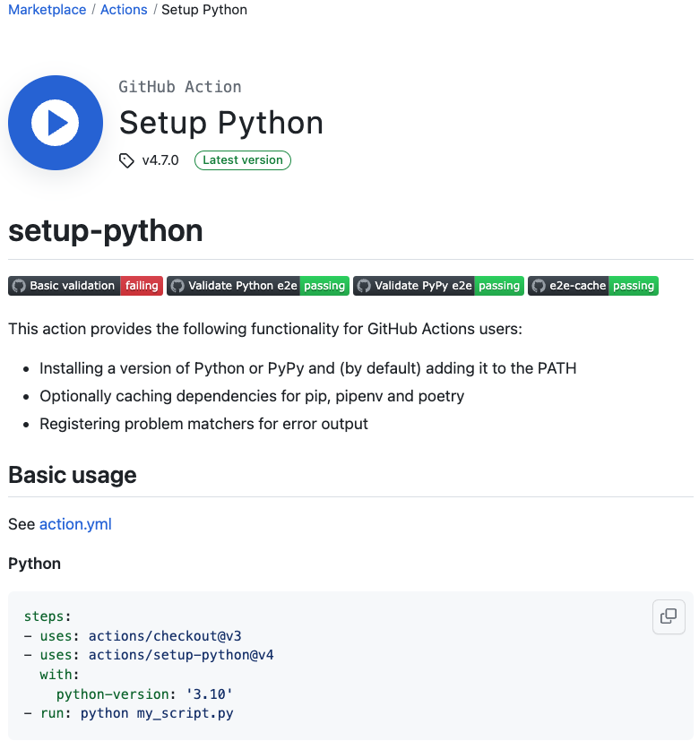
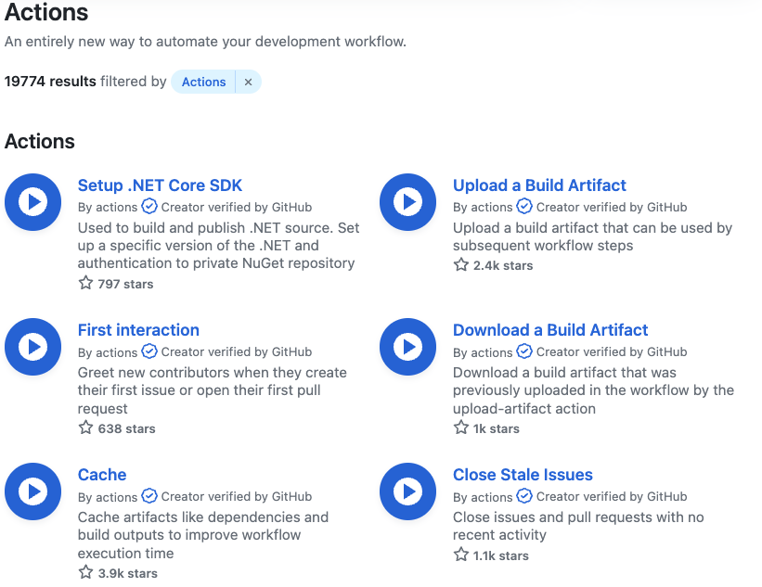
GitHub Actions
GitHub Actoins Marketplace hosts actions for workflows
Large variety of actions available
They help you jumpstart your workflows
Actions help you standardize and enforce checks across all contributors (human or AI)

Slide 40
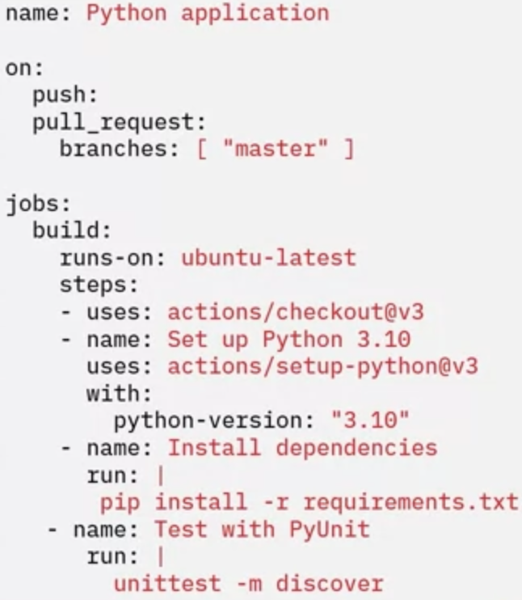
GitHub Actions - setup
All you need is a workflows folder and a .yaml file
Minimal configuration is needed to get started
Starter code is also available
Advanced rules (secrets, protections) can
be added incrementally
Notes:
You can edit them for your situation

Slide 41
GitHub Actions setup
Create a ‘.github’ folder
.github
workflows
Create a workflows’ folder
ci.yaml
cd.yaml
Place workflow .yaml files
Publish.yaml
When code is written by humans or AI, this workflow is what decides whether it’s allowed in.
Notes:
1. Workflow has an Event that tells when a workflow should run. Events could be things like when you push to a repo, create a pull request, or create
a release, e.t.c
2. Workflows use runners to execute the jobs. There are built-in runners for different virtual environments, or you can use a self-hosted runner in your environment.
3. A workflow contains one or more jobs. You can have one job that builds your component and another job that publishes it to an artifact repository, and still another job that deploys it to an environment.
4. Each job can contain one or more steps. One step can check out the code, another step might compile the code, yet another step might run a linter on the code, and you'll probably have a step that runs a suite of test cases to make sure that the code works properly
5. And each step can contain one or more actions or shell commands. Actions are the lowest level of a workflow. They perform a single task like check out code, install dependencies, compile code, or run tests. This hierarchy of jobs, steps, and actions allows you to logically group the actions performed by your workflow.

Slide 42
GitHub Actions - setup basic concepts
Workflow is the basic concept in GitHub Actions
Workflows is a series of automated procedures represented as Jobs
E.g., workflow for CI, workflow for CD, and another workflow for publishing
Every repository can have any number of workflows
Each workflow has the following components:
Event
Runner
Jobs
Steps
Actions
Events
Push
Pull Request
Release
Issue
Workflow contains a runner that execute jobs
Built-in runners
Hosted runners
Workflow contains Jobs
Builds component
Publishes to artifact repository
Deploys it to an environment
Jobs Contain steps
Run linter
Run test suite
Steps contain Actions of shell commands
Checkout code
Compile code
Run tests
Notes:
1. Workflow has an Event that tells when a workflow should run. Events could be things like when you push to a repo, create a pull request, or create
a release, e.t.c
2. Workflows use runners to execute the jobs. There are built-in runners for different virtual environments, or you can use a self-hosted runner in your environment.
3. A workflow contains one or more jobs. You can have one job that builds your component and another job that publishes it to an artifact repository, and still another job that deploys it to an environment.
4. Each job can contain one or more steps. One step can check out the code, another step might compile the code, yet another step might run a linter on the code, and you'll probably have a step that runs a suite of test cases to make sure that the code works properly
5. And each step can contain one or more actions or shell commands. Actions are the lowest level of a workflow. They perform a single task like check out code, install dependencies, compile code, or run tests. This hierarchy of jobs, steps, and actions allows you to logically group the actions performed by your workflow.

Slide 43
GitHub Actions - setup basic concepts
Workflow is the basic concept in GitHub Actions
Workflows is a series of automated procedures represented as Jobs
E.g., workflow for CI, workflow for CD, and another workflow for publishing
Every repository can have any number of workflows
Each workflow has the following components:
Event
Runner
Jobs
Steps
Actions
Events
Push
Pull Request
Release
Issue
Workflow contains a runner that execute jobs
Built-in runners
Hosted runners
Workflow contains Jobs
Builds component
Publishes to artifact repository
Deploys it to an environment
Jobs Contain steps
Run linter
Run test suite
Steps contain Actions of shell commands
Checkout code
Compile code
Run tests
Notes:
1. Workflow has an Event that tells when a workflow should run. Events could be things like when you push to a repo, create a pull request, or create
a release, e.t.c
2. Workflows use runners to execute the jobs. There are built-in runners for different virtual environments, or you can use a self-hosted runner in your environment.
3. A workflow contains one or more jobs. You can have one job that builds your component and another job that publishes it to an artifact repository, and still another job that deploys it to an environment.
4. Each job can contain one or more steps. One step can check out the code, another step might compile the code, yet another step might run a linter on the code, and you'll probably have a step that runs a suite of test cases to make sure that the code works properly
5. And each step can contain one or more actions or shell commands. Actions are the lowest level of a workflow. They perform a single task like check out code, install dependencies, compile code, or run tests. This hierarchy of jobs, steps, and actions allows you to logically group the actions performed by your workflow.

Slide 44
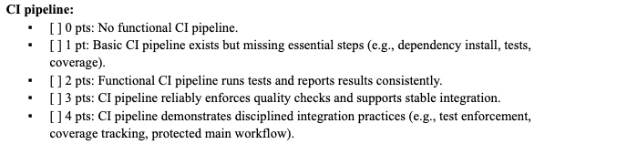
Project
One previous projects: Course Evaluation App

