Slide 1
Practice with Unified Modeling Language
Dr. John Businge
John.businge@unlv.edu

Slide 2

Chapters 6 - 7
Chapter 6 - Analysing a System
https://link.springer.com/chapter/10.1007/978-3-319-24280-4_6
Chapter 7 - Design and Implementation
https://link.springer.com/chapter/10.1007/978-3-319-24280-4_7
Free PDF version on Springer
https://doi.org/10.1007/978-3-319-24280-4_7

Slide 3
There are may Kinds of UML Diagrams
Structure diagrams: show the static architecture of the system irrespective of time.
University system - Student, Faculty, etc.
Behaviour diagrams: depicts the behaviour of a system or business process.
Interaction diagrams: show the methods, interactions and activities of the objects.
University system: show how a student registers for a course.

Slide 4
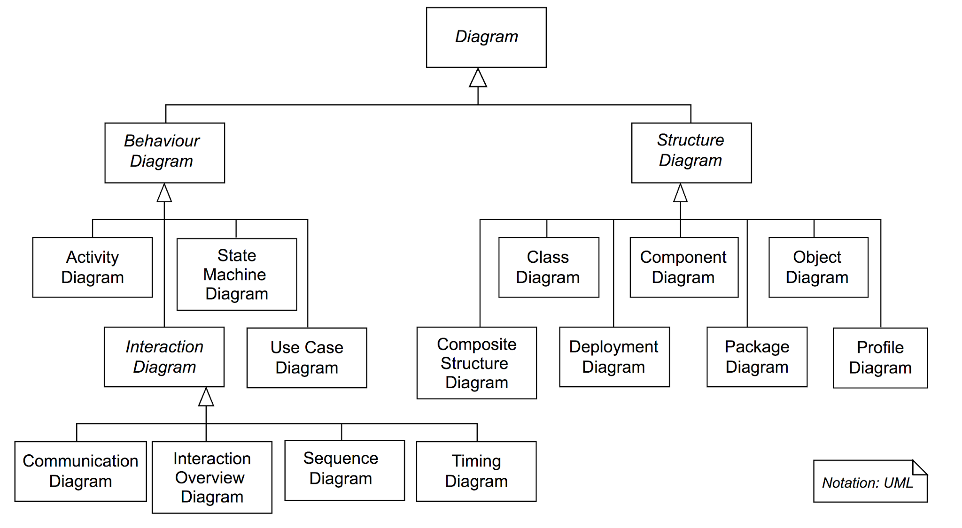
There are may Kinds of UML Diagrams
≈
≈
≈

Slide 5
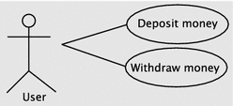
Use Case Diagram
Interaction between an actor and the systems
Actor – human or software
System

Slide 6
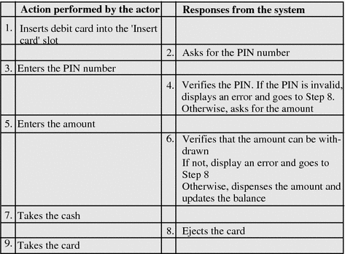
Use Case Diagram
Use case for withdrawing money

Slide 7
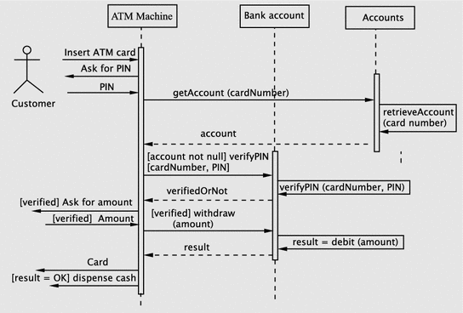
Sequence Diagrams
Sequence Diagrams describes how objects in your system interact to complete a specific task.

Slide 8
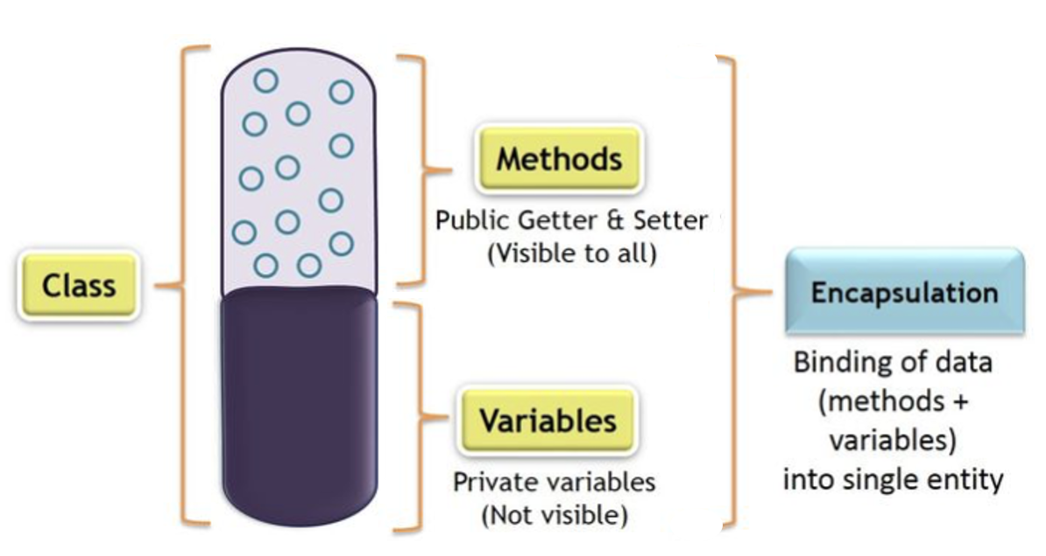
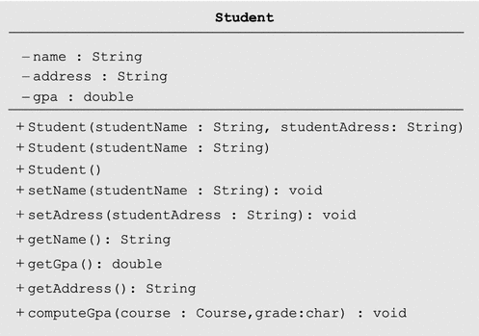
Class Diagram
Name
-ve: private
Attributes
+ve: public
Methods and their return types

Slide 9
Object Oriented Analysis, Design and Implementation
We will examine steps in Object-oriented software development
Analysis
Design
Implementation
To illustrate the process, let us study a relatively simple example
Software to manage a small library
Functions:
Lending books
Receiving back books
Doing operations such as: querrying, registering members, e.t.c, and keeping track of the transactions

Slide 10
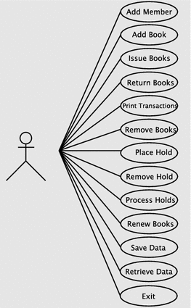
Analysis phase overview
Involves gathering, documenting the requirements, and developing a conceptual model of the system.
Software to manage a small library – functional requirements
Register a members
Add books
Issue books
Return books
Remove books
….
Use case diagram for the library system

Slide 11
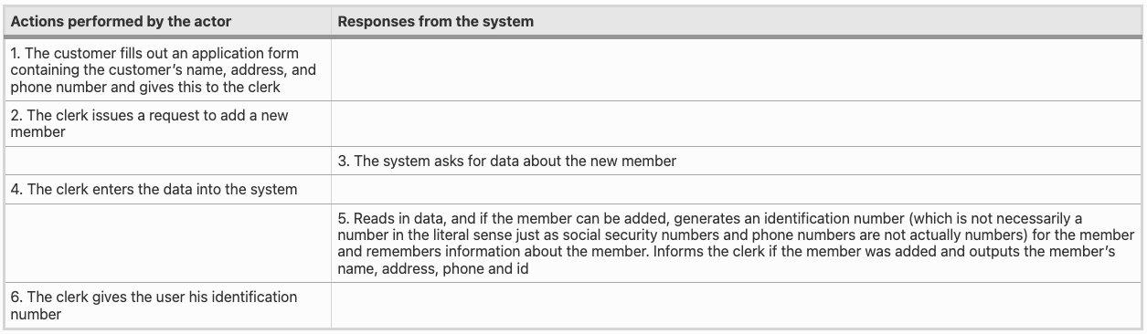
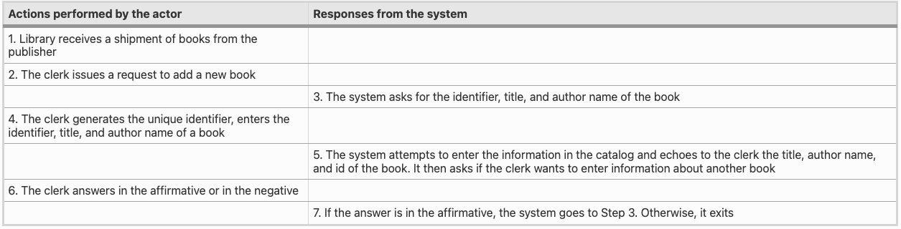
Use case Register New Member
Use case Adding New Books
Use case diagram for the library system

Slide 12
Software Design
Design process questions
On what platform(s) (hardware and software) will the system run?
What languages and programming paradigms will be used for implementation?
What user interfaces will the system provide?
What classes and interfaces need to be coded? What are their responsibilities?
….

Slide 13
Software Design - Major Subsystems
Business logic: This subsystem deals with input data processing, data creation, queries, and data updates.
User interface: This subsystem interacts with the user, accepting and outputting information.

Slide 14
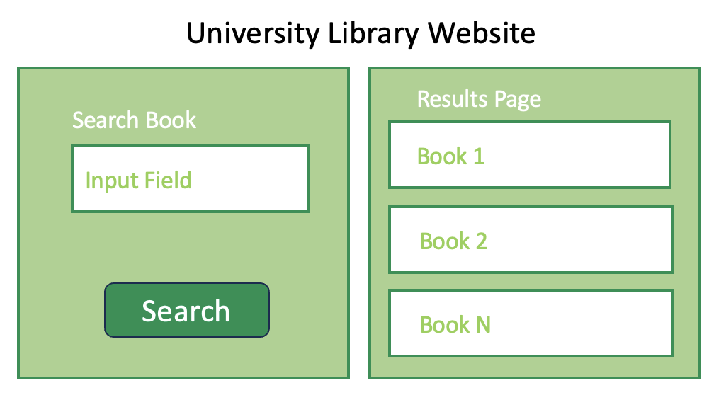
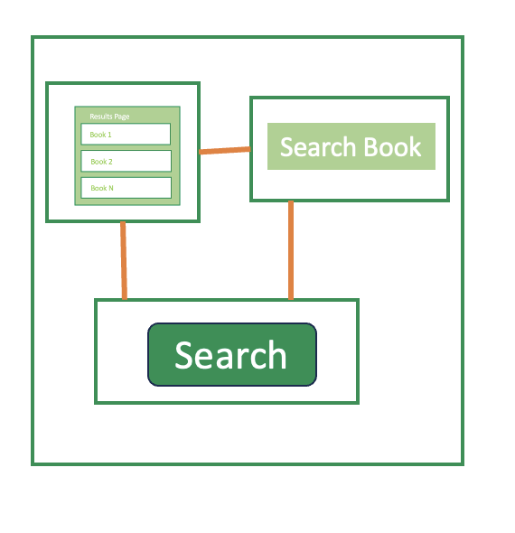
Software Design - Identifying software classes
Design
Goal
Classes
Functions
Components
Components
Conceptual Design
Library Software Classes
Member
Book
Library
Catlog
….
Notes:
Having decided on an adequate set of software classes, our next task is to assign responsibilities to these.

Slide 15
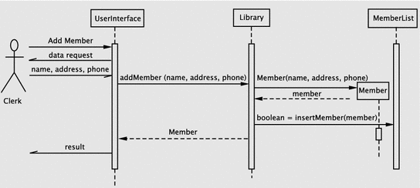
Software Design - Assigning Responsibilities to Classes
Sequence diagram for registering a new member
Notes:
Having decided on an adequate set of software classes, our next task is to assign responsibilities.
The next step is, therefore, to spell out the details of how the system meets its responsibilities
Sequence Diagrams are a great UML tool for describing responsibilities of classes
Back to our use case of registering users
The clerk issues a request to the system to add a new member. The system responds by asking for the data about the new member. This interaction occurs between the library staff member and the UserInterface instance. The clerk enters the requested data, which the UserInterface accepts.
1. addMember within the Library class, then
2. Create a Member object with the supplied parameters and return a reference to the Member object
3. Insert the member into the member list and return the result of the operation.
Invoke the Member constructor from within the addMember method of Library. The constructor returns a reference to the Member object and an operation, insertMember, is invoked on MemberList to add the new member.

Slide 16
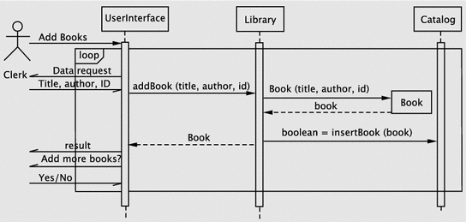
Software Design - Assigning Responsibilities to Classes
Sequence diagram for adding a books
Notes:
This use case allows the insertion of an arbitrary number of books into the system. In this case, when the request is made by the actor, the system enters a loop. Since the loop involves interacting repeatedly with the actor, the loop control mechanism is in the UI itself.
The first operation is to get the data about the book to be added. The algorithm here consists of the following steps:
create a Book object,
add the Book object to the catalog and
return the result of the operation.
This is handled in a manner similar to the previous use case.
(iv) The UI returns the result and continues until the actor indicates an exit.

Slide 17
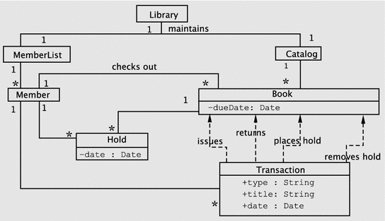

Class Diagrams
Library Software Classes
Library
MemberList
Catalog
Member
Book
Holds
Transaction
….

Slide 18
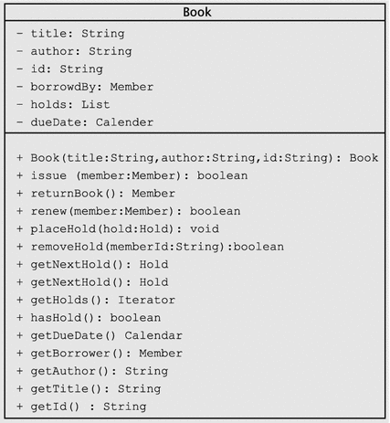
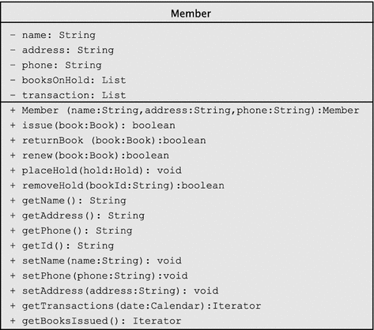
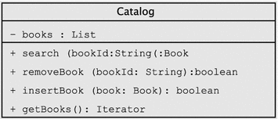
Class Diagrams

Slide 19
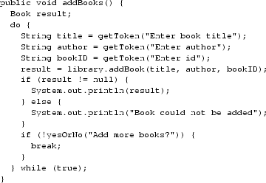
Implementing Our Design
Notes:
In this phase, we code, test, and debug the classes that implement the business logic (Library, Book, etc.) and UserInterface.

