Slide 1

GCS 3205 – Mobile Web Application
Department of Computer Science Gulu University
Daniel Ogenrwot
d.ogenrwot@gu.ac.ug https://www.gu.ac.ug
October 20, 2020

Slide 2

Lecture-5 Application Cache
Web application caching is the process of storing dynamically generated data for reuse and leaving data closer to the end user.
HTML5 introduces application cache, which means that a web application is cached, and accessible without an internet connection.

Slide 3
Advantages
Offline browsing - users can use the application when they're offline
Speed - cached resources load faster
Reduced server load - the browser will only download updated/changed resources from the server

Slide 4
Disadvantages
Stale Data
Overhead
Complexity

Slide 5
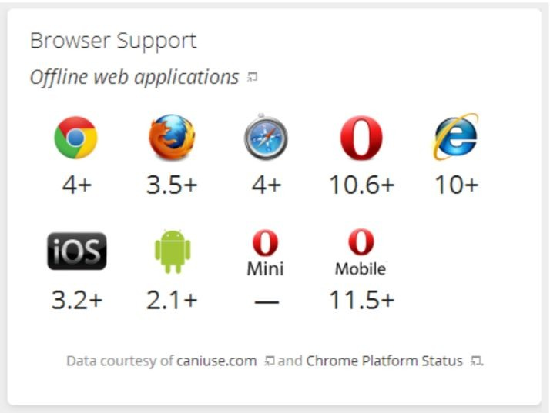
Browser Support

Slide 6
Type of Caching
Client Caching
browser caches URLs for future uses
Mozilla Firefox, Google Chrome
Proxy Caching
proxy server caches most requested URLs
Varnish ( reverse proxy ) - CDN ( forward proxy )
Server-side Caching
server side cache reduces load on server
File System Cache
In-Memory Cache (MemCached, Redis)

Slide 7
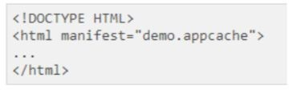
Cache Manifest Basics
To enable application cache, include the manifest attribute in the document's <html>
Tag:
Every page with the manifest attribute specified will be cached when the user visits it. If the manifest attribute is not specified, the page will not be cached (unless the page is specified directly in the manifest file).
The recommended file extension for manifest files is: ".appcache"
A manifest file needs to be served with the correct media type, which is "text/cache-manifest". Must be configured on the web server.

Slide 8
The Manifest file
The manifest file is a simple text file, which tells the browser what to cache (and what to never cache).
The manifest file has three sections:
CACHE MANIFEST - Files listed under this header will be cached after they are downloaded for the first time
NETWORK - Files listed under this header require a connection to the server, and will never be cached
FALLBACK - Files listed under this header specifies fallback pages if a page is inaccessible

Slide 9
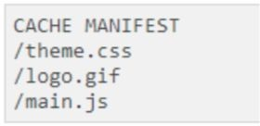
CACHE MANIFEST
The first line, CACHE MANIFEST, is required:
The manifest file above lists three resources: a CSS file, a GIF image, and a JavaScript file. When the manifest file is loaded, the browser will download the three files from the root directory of the web site. Then, whenever the user is not connected to the internet, the resources will still be available.

Slide 10


NETWORK
The NETWORK section below specifies that the file "login.asp" should never be cached, and will not be available offline:
An asterisk can be used to indicate that all other resources/files require an internet connection:

Slide 11

FALLBACK
The FALLBACK section below specifies that "offline.html" will be served in place of all files in the /html/ catalog, in case an internet connection cannot be established:
Note: The first URI is the resource, the second is the fallback.

Slide 12
UPDATING THE CACHE
Once an application is cached, it remains cached until one of the following happens:
❏ The user clears the browser's cache
❏ The manifest file is modified (see tip below)
❏ The application cache is programmatically updated
Be careful with what you cache.
Once a file is cached, the browser will continue to show the cached version, even if you change the file on the server. To ensure the browser updates the cache, you need to change the manifest file.
Note: Browsers may have different size limits for cached data (some browsers have a 5MB limit per site).

Slide 13
Full example of .appcache file
CACHE MANIFEST
# This is a comment CACHE:
/css/screen.css
/css/offline.css
/js/screen.js
/img/logo.png http://example.com/css/styles.css FALLBACK:
/ /offline.html NETWORK:
*

Slide 14
THANK YOU

