Slide 1
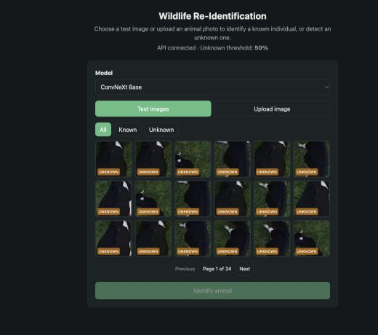
INTRODUCTION & BACKGROUND
WildlifeReID-10k
Open-set animal re-identification
Wildlife monitoring often captures the same individual across different cameras, dates and conditions. The task is to recognize the animal, not only its species.
This project compares ConvNeXt Base and MiewID on the same 100 known identities and the same open-set test queries.
606 test queries
Notes:
Wildlife re-identification links photographs of the same individual animal across different observations.
The project compares a classification model and an embedding model under the same open-set protocol.
The screenshot shows the React application connected to the Flask API.

Slide 2
Problem statement
A useful system must identify known animals and reject unseen ones
01
Individual animals can look different
02
Some queries belong to unseen animals
Camera angle, lighting, distance and body pose change between photographs. A model must match identity despite these differences.
A closed-set model always chooses one of the known labels. An open-set system must return UNKNOWN when the evidence is weak.
Core question
Can the system name a known animal without forcing every query into one of the 100 trained identities?
Success requires accurate identity retrieval and reliable known-versus-unknown separation.
Notes:
Species classification does not solve this problem because the goal is to identify the individual animal.
The open-set setting matters because the test data includes identities that never appeared in training.
The system must balance correct known-identity matches with unknown rejection.

Slide 3
Proposed solution
One web interface compares two trained re-identification approaches
1
2
3
4
Query image
Flask API
Prediction
Response
Choose a held-out test image or upload a photograph.
Validate the file and send it to the selected model.
Use ConvNeXt classification or MiewID embedding search.
Return identity, confidence, unknown decision and Top-5.
React frontend
Shared endpoint
Two model paths
Friendly result
ConvNeXt Base
MiewID
Fair comparison
100-class softmax baseline
Embedding and cosine gallery search
Same 100 identities and 606 queries
Notes:
The React frontend uses one Flask response format for both models.
ConvNeXt predicts an identity class, while MiewID compares a query embedding with a gallery built from training images.
Both models use the same 100 identities selected with random_state 42 and the same 606 test queries.

Slide 4
Evaluation approach
Top-1, Top-5 and AUROC answer different questions
Top-1
Top-5
AUROC
First choice
Shortlist
Known vs unknown
Counts a known query as correct only when the first predicted identity matches the true animal.
Counts a known query as correct when the true animal appears anywhere among the first five identities.
Measures how well the score separates unseen animals from known ones across all possible thresholds.
Best for the final identity shown to the user
Useful when a person reviews candidates
50% is random and 100% is perfect
The 50% unknown rule is a demo threshold
ConvNeXt uses softmax probability. MiewID uses cosine similarity. Their raw percentages are not directly comparable, which is why AUROC is the fair open-set metric.
Notes:
Top-1 and Top-5 use the 238 known queries only.
AUROC uses all 606 queries and checks the ranking across every threshold.
A threshold is an operating decision. It is not the same thing as model accuracy.
mAP is available in the MiewID test script but is not part of the final two-model result table.

Slide 5
Results and conclusion
Same 100 identities, same 606 queries and no retraining
Recommended primary model
MiewID
88.24% Top-1
95.86% open-set AUROC
MiewID gives the better first identity and separates unseen animals more reliably.
ConvNeXt stays as the faster baseline
34.1 ms average per image
ConvNeXt also leads Top-5 by 2.10 percentage points.
Notes:
MiewID leads Top-1 by 5.47 percentage points and AUROC by 5.05 points.
ConvNeXt leads Top-5 and was faster on the Apple MPS evaluation machine.
Keep ConvNeXt in the interface as the faster baseline, but present MiewID as the main re-identification model.
Source: src/models/comparison_results.json and src/models/comparison_predictions.csv.

