Slide 1
J0028
Exploring OpenShift – Hands-on Lab:
OpenShift 101
Budi Darmawan
Garage Solution Engineering
Dave Thiessen
Garage Solution Engineering

Slide 2
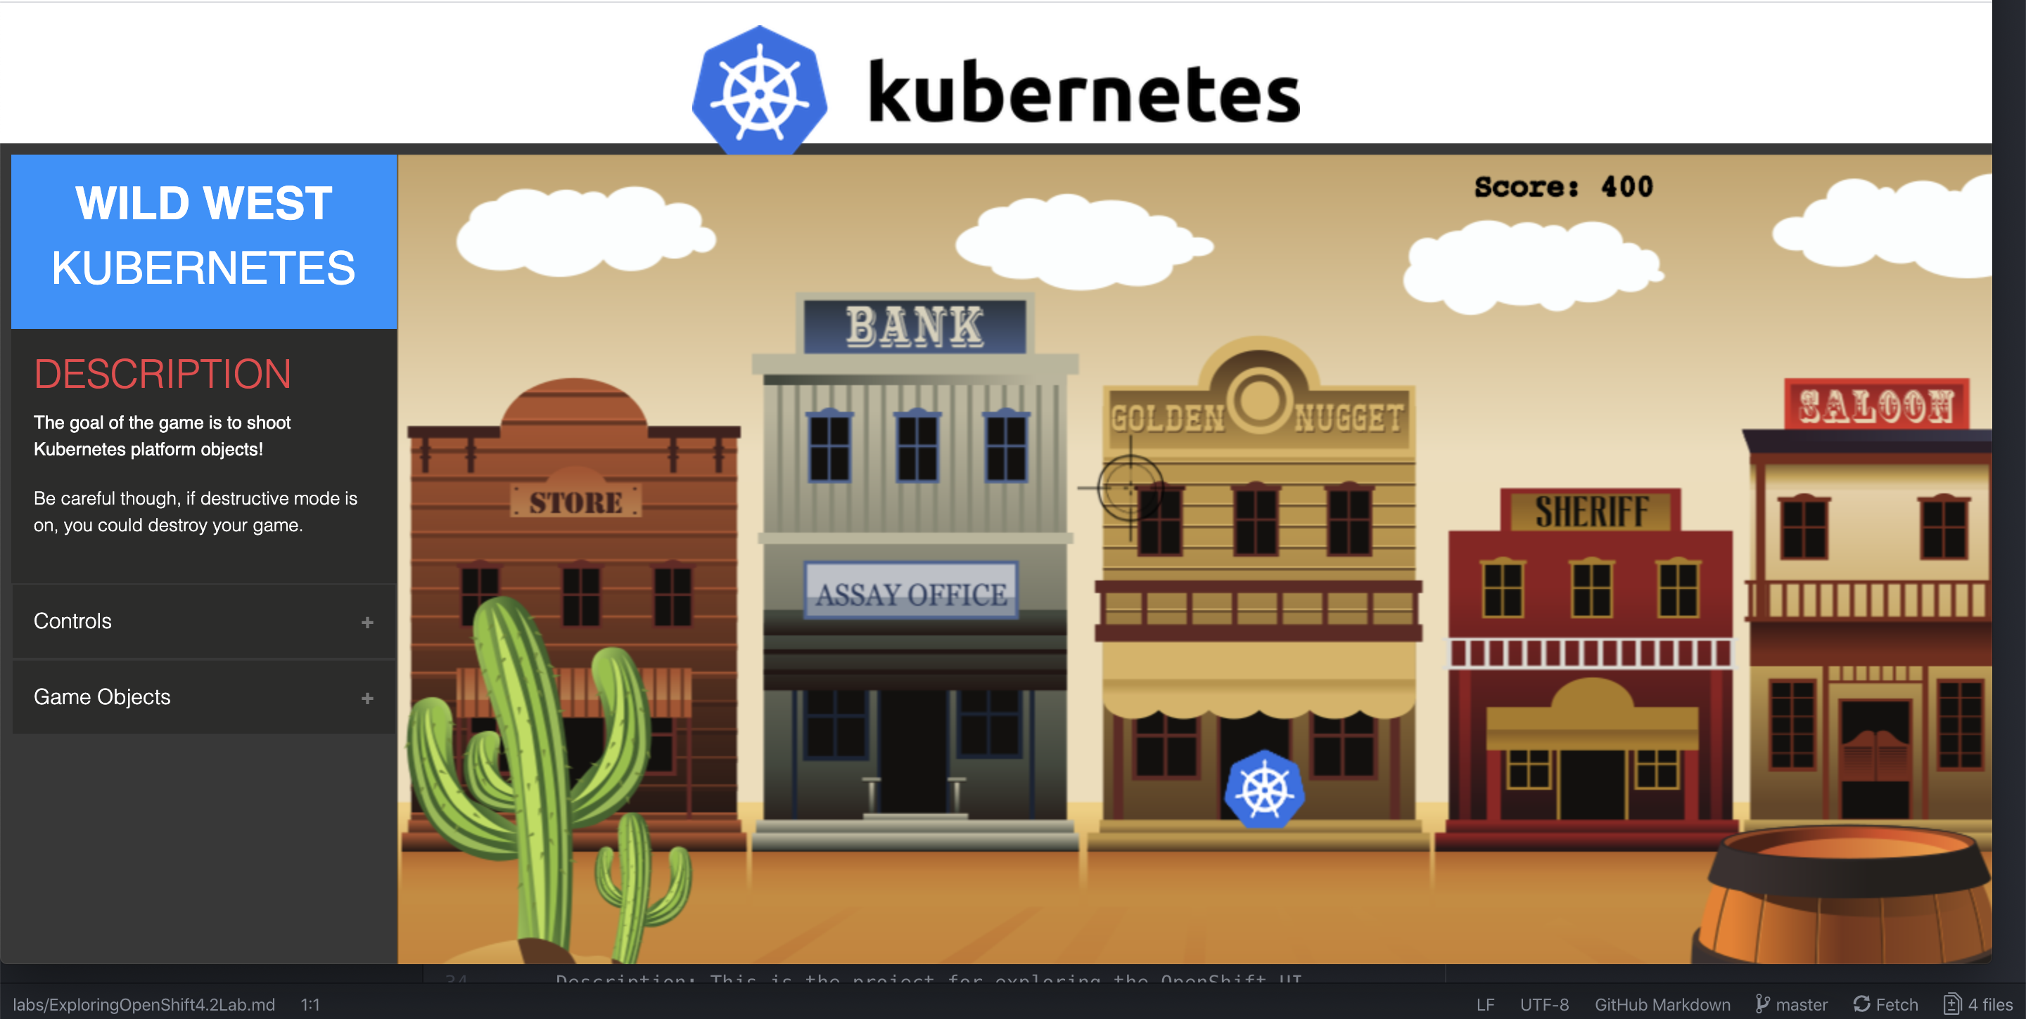
Our Game: Wild West

Slide 3
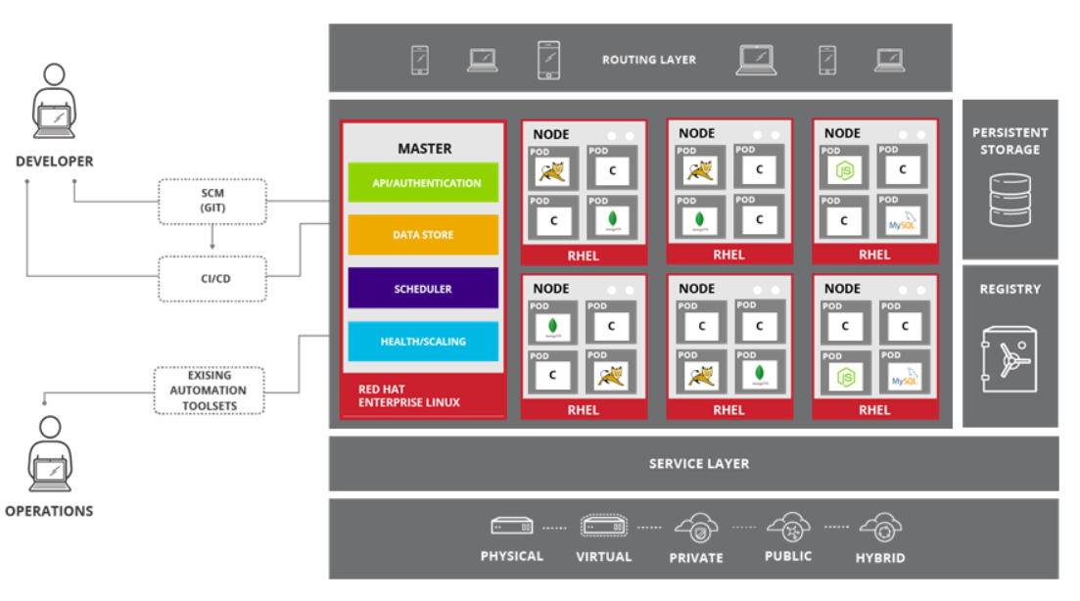

An OpenShift Cluster
RHCOS / RHEL
RHCOS / RHEL
RHCOS / RHEL
RED HAT
COREOS
RHCOS / RHEL
RHCOS / RHEL
RHCOS / RHEL
Notes:
This is a high-level architecture diagram of the OpenShift 3 platform. Subsequent slides investigate how these components interact within an OpenShift infrastructure.
OpenShift has a complex multicomponent architecture. The slides in this course can be used to help prospects understand how the components work together.

Slide 4

What’s going on inside?

Slide 5
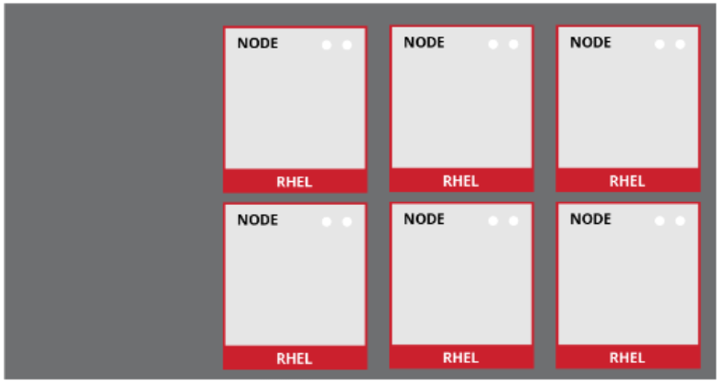

Worker Nodes
Node host
An OpenShift cluster has 2 types of nodes: Workers and Masters
Worker Nodes are instances of RHEL or Red Hat CoreOS with OpenShift installed
Worker Nodes are where applications run
Worker Nodes are orchestrated by Master Nodes
kubelet and other software run on node
RHCOS / RHEL
RHCOS / RHEL
RHCOS / RHEL
RHCOS / RHEL
RHCOS / RHEL
RHCOS / RHEL
Notes:
OpenShift can run on either Red Hat Enterprise Linux or Red Hat Enterprise Atomic Host.
OpenShift has two types of hosts: nodes and masters.
Nodes are instances of Red Hat Enterprise Linux or Red Hat Atomic Host that will ultimately host application instances in containers. Nodes are where end-user applications run.
Nodes are orchestrated by the masters, which you learn more about shortly.
The OpenShift node daemon and other software runs on a node.

Slide 6
What is going on inside Worker Nodes?
a container is the smallest compute unit
CONTAINER

Slide 7
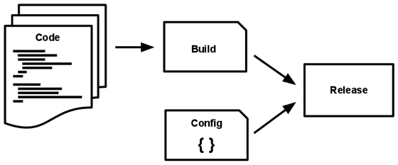
Containers & Container Images
containers are created from container images
IMAGE
CONTAINER
BINARY
RUNTIME

Slide 8
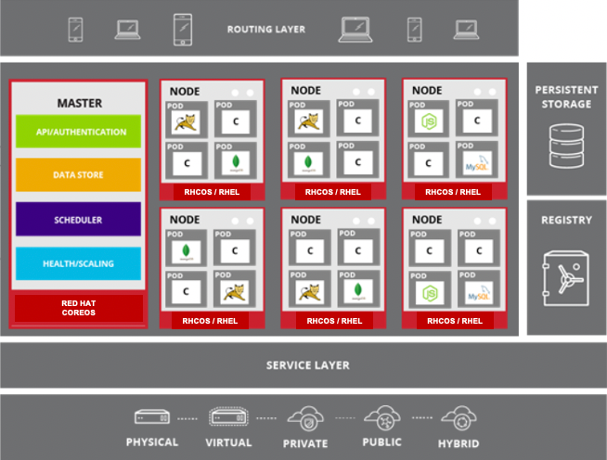
Image Registry
container images are stored in an image registry
IMAGE REGISTRY
IMAGE
IMAGE
IMAGE
CONTAINER
IMAGE
IMAGE
IMAGE

Slide 9
Pods
containers are wrapped in pods which are units of deployment and management
POD
POD
CONTAINER
CONTAINER
CONTAINER
10.140.4.44
10.15.6.55

Slide 10
Pod Replication
ReplicationControllers & ReplicaSets ensure a specified number of pods are running at any given time
1
2
N
image name
replicas
labels cpu memory
storage
POD
POD
POD
...
CONTAINER
CONTAINER
CONTAINER
ReplicaSet ReplicationController

Slide 11
Services
apps can talk to each other via services
SERVICE
“backend”
services provide internal load-balancing and service discovery across pods
role: backend
POD
POD
POD
POD
role: frontend
CONTAINER
role: backend
CONTAINER
role: backend
CONTAINER
role: backend
CONTAINER
10.140.4.44
10.110.1.11
10.120.2.22
10.130.3.33

Slide 12
Routes
routes make services accessible via real-world URLs
app-prod.mycompany.com
ROUTE
SERVICE
“frontend”
> curl http://app-prod.mycompany.com
role: frontend
POD
POD
POD
role: frontend
CONTAINER
role: frontend
CONTAINER
role: frontend
CONTAINER
Notes:
A route exposes a service at a host name, like www.example.com, so that external clients can reach it by name.
DNS resolution for a host name is handled separately from routing. Admin may have configured a DNS wildcard entry that will resolve to the node that is running the OpenShift Container Platform router
Pods running on OpenShift, don’t need to go through the routing layer and can interact with each other directly through the services.
After the router discovers the Pod endpoints via the service, it sends the Pod traffic directly to those endpoints and bypasses the service layer

Slide 13

Projects
projects isolate apps across environments, teams, groups and departments
PAYMENT DEV
CATALOG
POD
POD
POD
❌
POD
POD
POD
C
C
C
C
C
C
PAYMENT PROD
INVENTORY
POD
POD
POD
❌
❌
POD
POD
POD
C
C
C
C
C
C

Slide 14
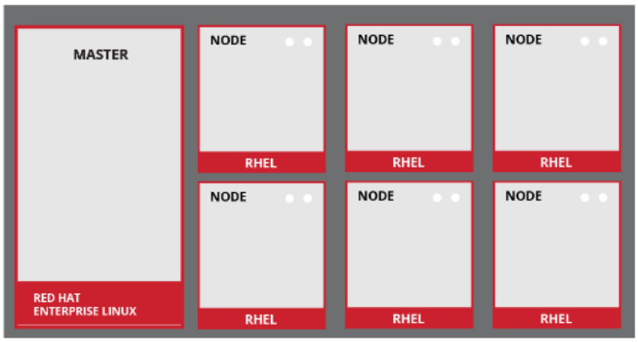
Master Nodes
Master Nodes run Red Hat CoreOS
Primary functions:
Orchestrate all activities on worker nodes
Maintain state within OpenShift environment
Use multiple masters for high availability
RHCOS / RHEL
RHCOS / RHEL
RHCOS / RHEL
RED HAT
COREOS
RHCOS / RHEL
RHCOS / RHEL
RHCOS / RHEL
Notes:
Like OpenShift node hosts, a master host is installed on Red Hat Enterprise Linux or Red Hat Atomic Host. The master is the orchestration and scheduling engine for OpenShift, and it is responsible for knowing and maintaining the state of the OpenShift environment.
Multiple masters can be used in an environment for high availability.

Slide 15
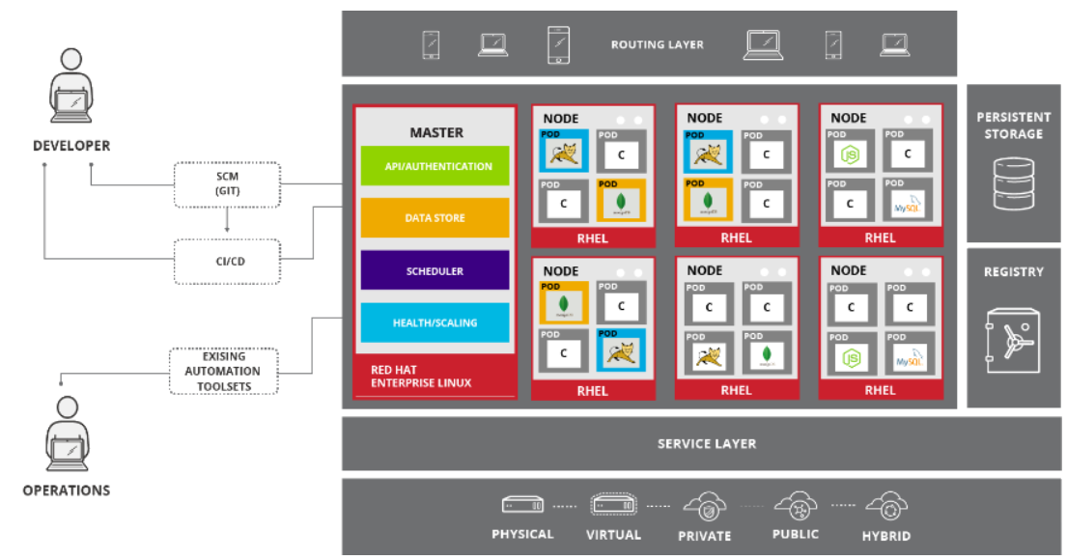
Master Node Functions
API / Authentication
All users access OpenShift through same standard interfaces
Web UI, CLI, and IDEs all go through a single authenticated and RBAC-controlled API
CI/CD tools access OpenShift through this API
Users do not need system-level access to OpenShift hosts, even for complicated debugging and troubleshooting
RHCOS / RHEL
RHCOS / RHEL
RHCOS / RHEL
RED HAT
COREOS
RHCOS / RHEL
RHCOS / RHEL
RHCOS / RHEL
Notes:
Interacting with OpenShift boils down to interacting with the API, no matter what tools are used.
All users—operators, developers, and application administrators—access OpenShift through the same standard interfaces. The web UI, CLI, and IDEs all go through the authenticated and RBAC-controlled API.
Users do not need system-level access to any of the OpenShift hosts, even for complicated debugging and troubleshooting.
Continuous integration and continuous deployment systems can be easily integrated with OpenShift through these interfaces.
And because OpenShift is built on top of Red Hat Enterprise Linux, existing systems management and systems monitoring tools can be used.

Slide 16
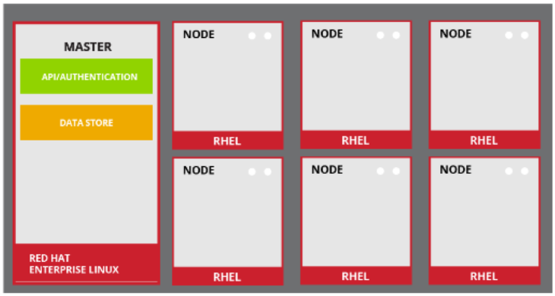
Master Node Functions
Desired and Current State Source of Knowledge
Held in data store that uses etcd as distributed key-value store
Also holds things like RBAC rules, application environment information, and non-application user data
RHCOS / RHEL
RHCOS / RHEL
RHCOS / RHEL
RED HAT
COREOS
RHCOS / RHEL
RHCOS / RHEL
RHCOS / RHEL
Notes:
etcd is another critical component of the OpenShift architecture. It is the distributed key-value data store for state and other information within the OpenShift environment.
etcd also holds things like RBAC rules, application environment information, and non-application user data.

Slide 17
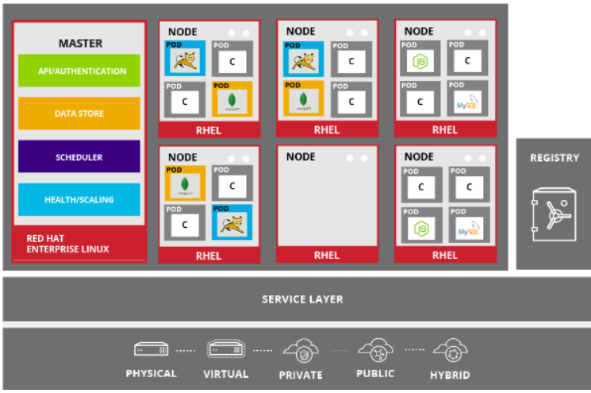
Master Node Functions
Scheduler
Responsible for determining pod placement
Takes current memory, CPU, and other environment utilization into account when placing pods on nodes
For application high availability, spreads pod replicas between nodes
RHCOS / RHEL
RHCOS / RHEL
RHCOS / RHEL
RED HAT
COREOS
RHCOS / RHEL
RHCOS / RHEL
RHCOS / RHEL
Notes:
The OpenShift scheduler uses a combination of configuration and environment state to determine the best fit for running pods across the nodes in the environment.
The scheduler is the specific component, on the master, responsible for determining pod placement. It takes the current memory, CPU, and other environment utilization into account when placing pods on nodes.
The scheduler also spreads pod replicas between nodes for application high availability.

Slide 18
Master Node Functions
Health and Scaling
Master monitors health of pods
Users configure pod probes for liveness and readiness
Automatically replaces failed pods
Pods can be automatically scaled based on CPU utilization
Scale up and down
RHCOS / RHEL
RHCOS / RHEL
RHCOS / RHEL
RED HAT
COREOS
RHCOS / RHEL
RHCOS / RHEL
RHCOS / RHEL
Notes:
The OpenShift master is capable of monitoring application health via user-defined pod probes. Users can onfigure pod probes for liveness and readiness. The master scales out pods based on CPU utilization metrics

Slide 19
Now……Getting Back to Our Game

Slide 20

OpenShift Cluster – access & application yaml
OpenShift Cluster
yaml
oc
API: 6443
HTTPS: 443

Slide 21
OpenShift Cluster - deployment and pods
OpenShift Cluster
deployment
pod
pod
pod
yaml
oc
API: 6443
HTTPS: 6443

Slide 22
OpenShift Cluster - service
OpenShift Cluster
service
deployment
pod
pod
pod
yaml
oc
API: 6443
HTTPS: 6443

Slide 23
OpenShift Cluster - route
OpenShift Cluster
service
deployment
pod
pod
pod
oc
API: 6443
route
HTTPS: 6443

Slide 24
OpenShift Cluster - role and rolebinding
OpenShift Cluster
service
deployment
pod
pod
pod
oc
API: 6443
HTTPS: 6443
view

Slide 25
OpenShift Cluster - Storage
OpenShift Cluster
service
deployment
pod
pod
pod
oc
API: 6443
HTTPS: 6443
pvc
storageclass
pv

Slide 26






If you get to the last part … Source2Image (S2I)
Code (Git)
Developer
Repository
CODE APPLICATION
Image Registry
Builder
Image
S2I
BUILD IMAGE
Container Image
DEPLOY

Slide 27
Now……Let’s Play…….Yee Ha!

