Slide 1




The industry leader of mobile device

Slide 2















Slide 3


Slide 4




Customized Reporting
Customer DATA Analysis
Asset Recovery
Warranty Service

Slide 5
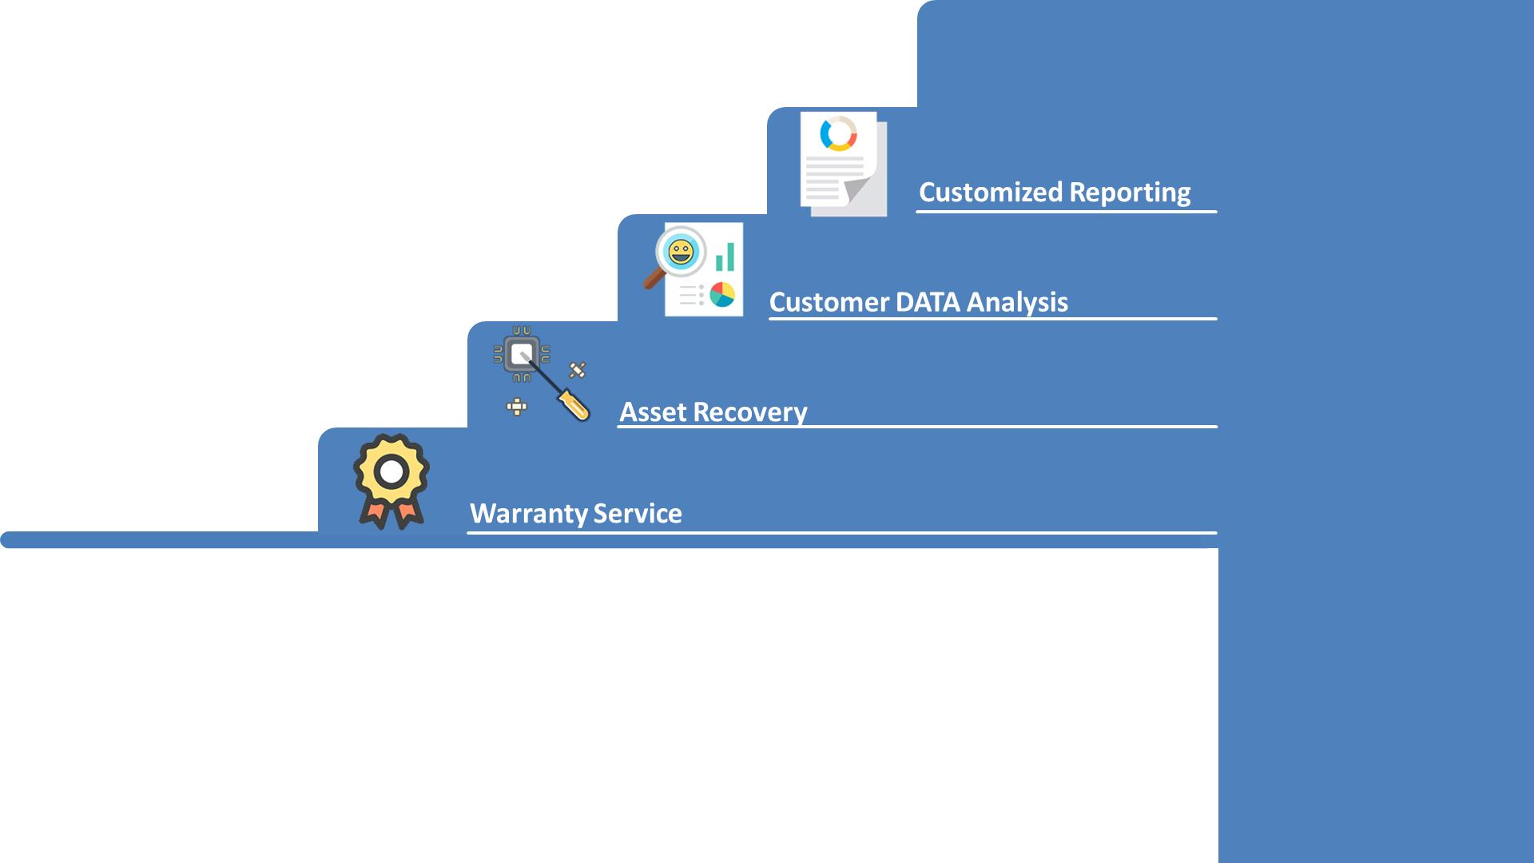

Slide 6










ESTABLISHED
1999
1999

Slide 7


Slide 8









