Slide 1
Aviation Risk Analysis & Recommendations
Phase 1 Project
DANIEL OWUOR

Slide 2
Project overview
Context: The company is diversifying into commercial and private aviation and requires a deep understanding of operational risks to inform fleet acquisition.
Project Scope: Evaluation of aviation accident data from 1962 to 2023 to determine safety records of various manufacturers and models.
Outcome: Actionable recommendations for stakeholders to acquire a safe and reliable fleet.
Data Source: NTSB Aviation Accident Dataset (1962-2023)

Slide 3
Business Understanding
The Problem: The new aviation division has capital for investment but lacks historical data on operational risks. Purchasing without this insight poses significant safety and financial liability.
Key Objectives:
  Identify the top 3 low-risk aircraft categories and manufacturers.
  Determine factors that increase accident severity (e.g., weather, phase of flight).
  Provide evidence-based investment recommendations.
Stakeholders: Head of Aviation Division (Purchasing), Investment Committee (Financial Risk), Operations Team (Reliability).

Slide 4
Data Understanding
Dataset Overview
88,889 aviation accident records (1962-2023)
31 original features describing aircraft, events, and outcomes
Focused on 1990-2023 for modern aviation relevance
Key Data Points Analyzed
Aircraft make, model, and category
Injury severity and counts (fatal, serious, minor)
Weather conditions and flight phase
Purpose of flight and damage extent
Data Quality: Addressed missing values, standardized categories, filtered for commercial relevance.

Slide 5
Data Analysis - Risk Factors
Data Preparation
Standardized manufacturer and model names
Focused on post-1990 data for modern relevance
Created severity categories (Fatal, Non-Fatal Injury, etc.)
Filtered to manufacturers with ≥50 accidents for statistical significance
Analytical Approach
Frequency Analysis: Accident volume by manufacturer/model
Severity Analysis: Fatality rates and injury outcomes
Contextual Analysis: Weather, flight phase, and purpose impacts
Trend Analysis: Safety improvements over time

Slide 6
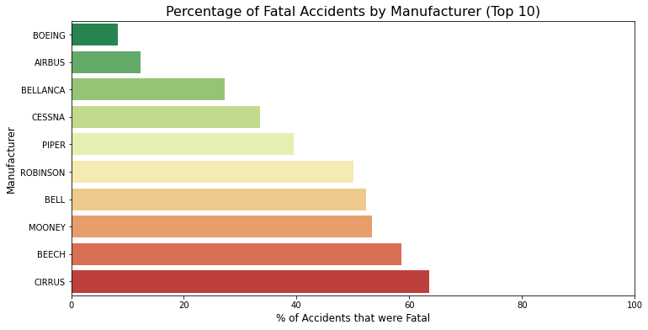
Visualization 1 - Manufacturer Risk Profile
Key Findings:
Boeing, Cessna, Piper, Airbus, Bellanca show moderate fatality rates despite high accident volumes
Robinson & Bell helicopters exhibit highest fatality rates (50-70%)
Industry average fatality rate: ~40%
Business Insight: Some manufacturers combine high operational volume with manageable risk profiles.

Slide 7
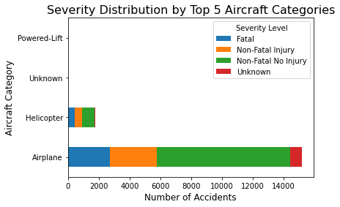
Aircraft Category Safety
Key Findings:
Airplanes dominate accident volume but show varied severity
Helicopters show disproportionate fatal outcomes
Gliders/Balloons have lower fatal rates but limited commercial application
Fixed-wing aircraft offer better risk profiles for commercial operations than rotary-wing alternatives.

Slide 8
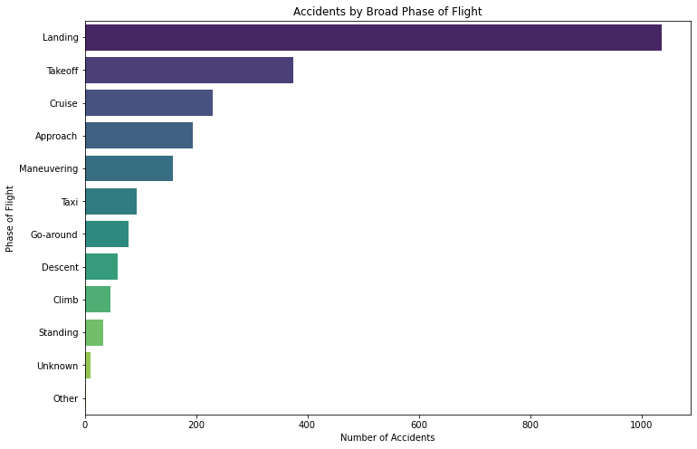
Accident severity by phase of flight
Key Findings:
High risk phases: most accidents occur during landing and takeoff.
Low risk phases: during cruising and taxi

Slide 9
Recommendations
Prioritize Boeing, CESSNA, PIPER, & Airbus
Lower fatality rates (30-40%) compared to industry average
High operational volume provides extensive safety data
Established maintenance networks and training programs
Limit Robinson & bell helicopter acquisition.
Highest fatality rates among top manufacturers (50-70%)
Primarily used in higher-risk Personal/Instructional contexts
Weather sensitivity and operational complexity increase risk
Implement phased operational strategy
Personal/Instructional flights dominate accident data but build experience
Commercial operations show better safety records per flight hour
Gradual expansion allows safety culture development

Slide 10
Thank You
Questions?

