Slide 1
Aviation Risk Analysis & Recommendations
Phase 1 Project
DANIEL OWUOR

Slide 2
Beginning
Context: The company is diversifying into commercial and private aviation and requires a deep understanding of operational risks to inform fleet acquisition.
Project Scope: Evaluation of aviation accident data from 1962 to 2023 to determine safety records of various manufacturers and models.
Outcome: Actionable recommendations for stakeholders to acquire a safe and reliable fleet.

Slide 3
Business Understanding
The Problem: The new aviation division has capital for investment but lacks historical data on operational risks. Purchasing without this insight poses significant safety and financial liability.
Key Objectives:
  Identify the top 3 low-risk aircraft categories and manufacturers.
  Determine factors that increase accident severity (e.g., weather, phase of flight).
  Provide evidence-based investment recommendations.
Stakeholders: Head of Aviation Division (Purchasing), Investment Committee (Financial Risk), Operations Team (Reliability).

Slide 4
Data Understanding
Data Source: National Transportation Safety Board (NTSB) Aviation Accident Database (1962–2023).
Dataset Scope: Tens of thousands of records covering:
Aircraft: Make, Model, Category, Engine Type.
Event: Date, Location, Phase of Flight.
Outcome: Fatalities, Serious Injuries, Aircraft Damage (Hull Loss).
Data Quality Actions:
Filtered for modern relevance (1990–Present).
Standardized manufacturer names (e.g., Cessna, Piper).
Imputed missing injury data with zero to ensure accurate severity calculations.

Slide 5
Data Analysis - Risk Factors
Key Risk Indicators:
Phase of Flight: Analysis focuses on "Broad Phase of Flight" to identify high-risk moments such as Takeoff, Landing, and Cruise. Weather: Evaluation of Visual Meteorological Conditions (VMC) vs. Instrument Meteorological Conditions (IMC) to understand environmental impact.
Severity Metrics: Classification of accidents into "Fatal" vs. "Non-Fatal" and "Hull Loss" (Destroyed) vs. "Repairable

Slide 6
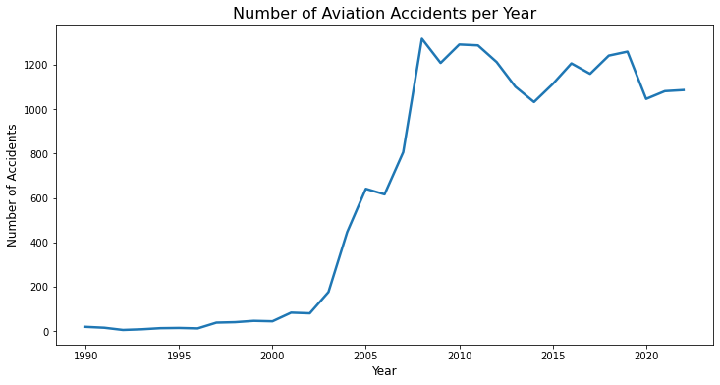
Manufacturer & Modernization Trends
Safety Over Time: Analysis reveals a steady decrease in accidents year-over-year, correlating with improvements in manufacturing standards and technology.
Manufacturer Volume: High-volume manufacturers (e.g., Cessna, Piper) appear frequently in accident data due to market ubiquity, requiring normalized risk assessment.
Engine Technology: Comparison of Piston vs. Turbine engines shows distinct differences in safety reliability for corporate vs. personal usage.

Slide 7
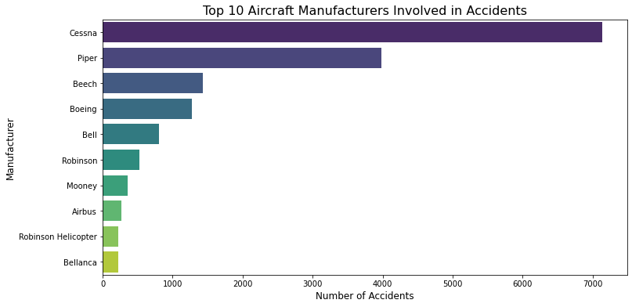
Recommendations
Prioritize Modern Fleets: Focus acquisition on aircraft manufactured post-2000. Data shows significantly improved safety engineering and reduced liability in newer models.
Commercial-Grade for Corporate Travel: Bypass light piston aircraft for executive transport. Invest in Turbine-class aircraft (Jet/Turboprop) which demonstrate superior safety protocols and lower accident rates (7.4%). Boeing (Commercial/Turbine) has the lowest fatality rate (~7.4%), reflecting the safety of transport-category certification standards.
Beechcraft and Mooney, while having fewer total accidents, have significantly higher Fatality Rates (~29.5% and ~28.2% respectively).

Slide 8
Next Steps
Phase 2 Analysis: Integrate financial cost-benefit analysis for the recommended aircraft models (Acquisition Cost vs. Insurance/Maintenance).
Operational Implementation: Develop a "Safety Management System" (SMS) framework based on the identified risk factors (e.g., strict weather minimums).
Pilot Training: Tailor training programs to address the specific high-risk flight phases identified in the data.

Slide 9
Thank You
Questions?
Name – Daniel Owuor

