Slide 1

Systèmes Embarqués Microprogrammés
HayBall
Daniel Panero (EL-342800)

Slide 2
NDS features: checklist (1/3)
ARM Processors
  ARM9 to control the two screens, the arrows and START keys, load the music stream from the SD-Card and send IPC messages to the ARM7 to control the sound. ARM7 to control the touchscreen and the audio
Timers / Interrupts
  Timer 0 with 64 divider to animate the sprites and background shifts
  Timer 2 to manage the sound stream
Graphics
  Main screen: Mode 5 2D with Background 2 (Ext. Rotoscale) and VRAM A
  Sub screen: Mode 0 2D with Background 0,1 (Tiled) and VRAM C
Keypad
  Interrupt waiting for START for starting the game
  Polling to play the game either with the touch screen or with the arrow keys
  The tractor’s sprite moves accordingly to the arrow key you are pressing

Slide 3
NDS features: checklist (2/3)
Touchscreen
  Polling to play the game either with the touch screen or with the arrow keys.
  The tractor’s sprite follows you where you touched (and smoothly turns around)
Sound
  Custom music stream handler to manage the music/sound effects
  Streaming of music/sound effects from the SD-Card, allowing for long and accurate music in wav file (3 minutes, approx. 21 mb)
Secondary Storage (optional)
  Used to store music/sound effect in the sound folder and stream from it
Sprites (optional)
  Several sprites in the oamSub were used with complex rotations and animations

Slide 4
NDS features: checklist (3/3)
WiFi (optional)
  Not used

Slide 5
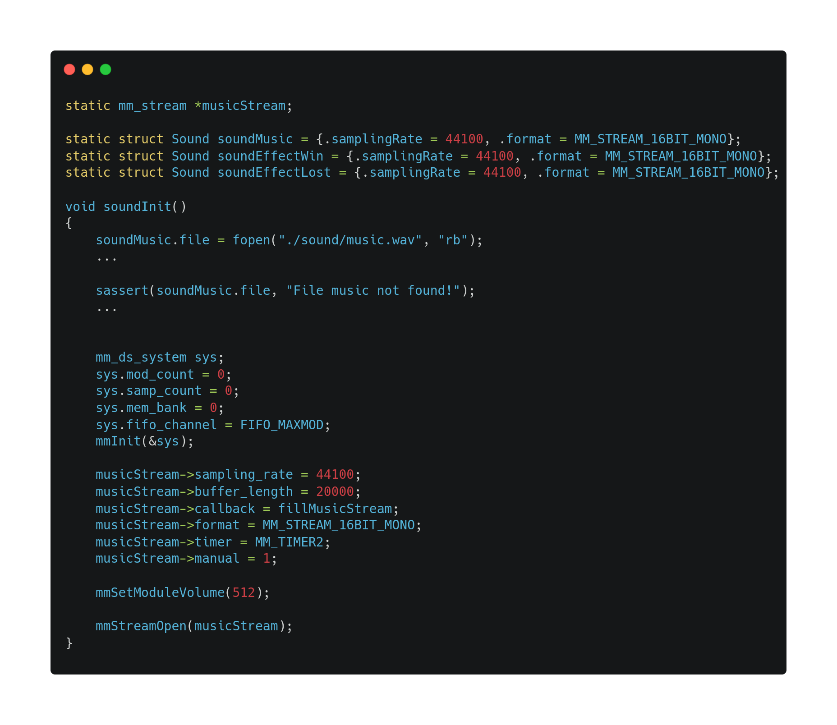

Music stream (1/2)

Slide 6
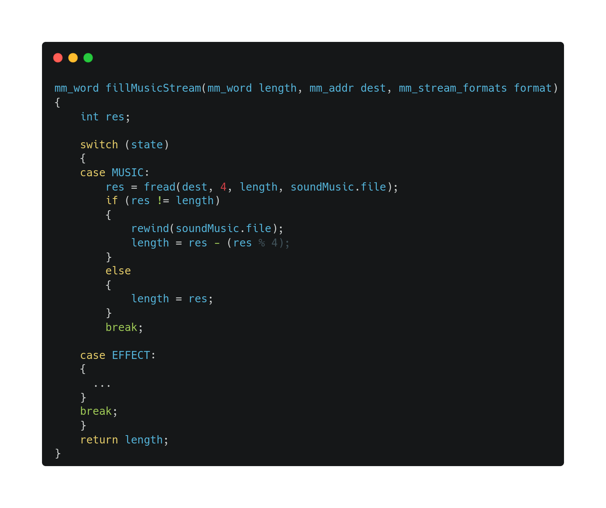
Music stream (2/2)

Slide 7
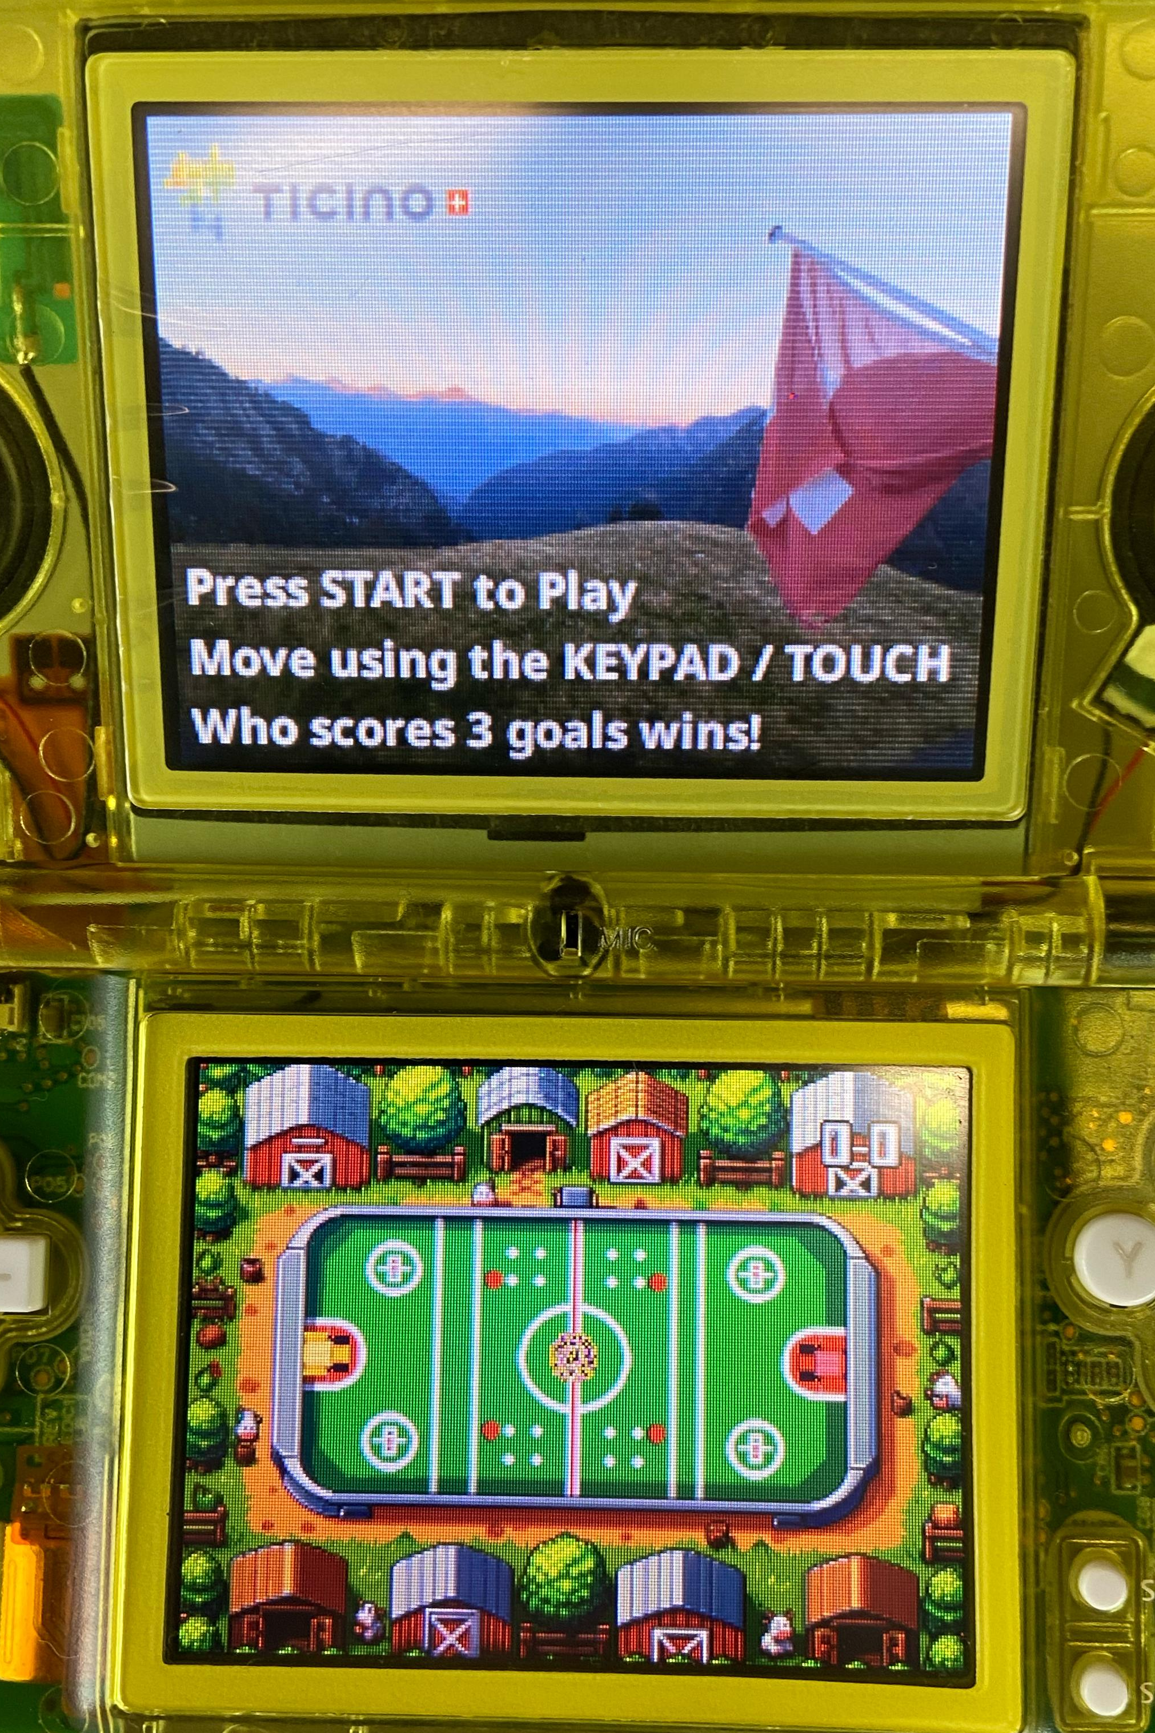
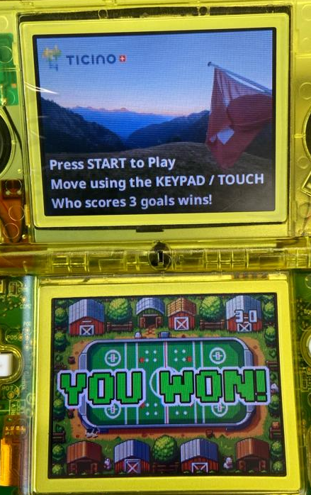
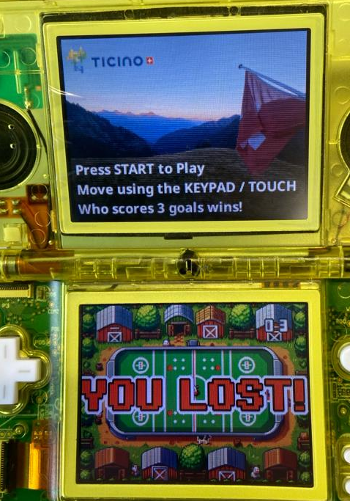
NDS project screenshots

Slide 8
Notable features and future ideas
Notable features
  The collision boxes are circular (therefore a more nuanced physics)
  Friction, different masses and collision are based on physics
  Sprites, Sound are managed using structs so they can be easily added
Future ideas
  Extending sound.c in its own independent library: automatic discovery of music and sound effect, replicate Maxmod sound distortion (panning…), multichannel playing...

Slide 9
Let’s play!

