Slide 1
Building Data Dashboards
with Kiro
From Screenshot to Production — Powered by AI
Amazon Redshift Serverless • Chart.js • Kiro CLI

Slide 2




What is Kiro?
Kiro is an AI-powered development assistant that operates directly in your terminal. It reads files, executes commands, interacts with AWS services, analyzes images, and writes production-ready code.
Image Analysis
Understands dashboard layouts, chart types, and KPIs from screenshots
Database Design
Creates normalized star-schema datamarts optimized for analytics
Data Generation
Produces realistic synthetic data with business-accurate patterns
AWS Integration
Provisions infrastructure, manages IAM, loads data via Data API

Slide 3
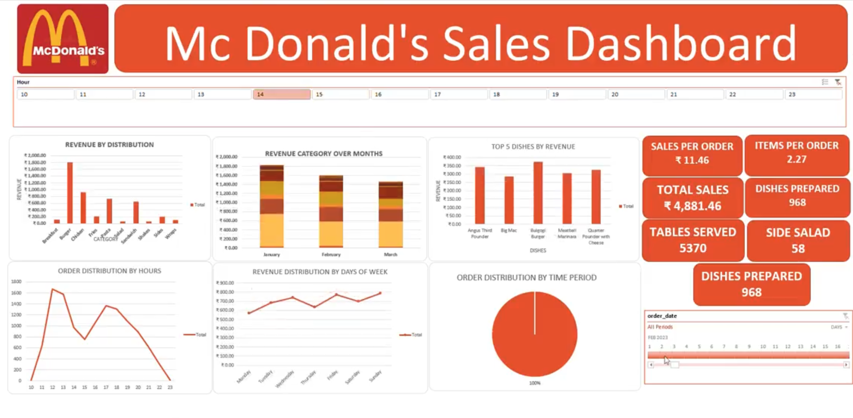
The Challenge
Build an interactive sales dashboard from just a screenshot — including database schema, synthetic data, and a fully working frontend.
Original reference screenshot provided to Kiro

Slide 4


End-to-End Workflow
1. Analyze
Kiro reads the screenshot, identifies 6 chart types, extracts KPI values, maps data relationships
2. Design Schema
Creates star-schema with categories, menu_items (dimensions) and orders, order_items (facts)
3. Generate Data
Produces 6,569 orders with realistic patterns — lunch peaks, weekend spikes, seasonal trends
4. Load to Redshift
Uses AWS Data API with IAM auth and Secrets Manager — no credentials in code
5. Build Dashboard
Creates Chart.js dashboard with 6 interactive charts, KPI cards, and hour-based filtering
6. Add Interactivity
Hour filter dynamically updates all charts and KPIs simultaneously

Slide 5
Database Schema Design
Kiro designed a star schema optimized for analytical queries
DIMENSIONS
FACTS
categories
category_id | category_name
menu_items
item_id | item_name | category_id | unit_price
orders
order_id | order_date | order_hour | day_of_week
order_items
order_item_id | order_id | item_id | qty | line_total
6,569
14,646
HK$ 67,303
2.23
Orders
Line Items
Total Revenue
Items/Order

Slide 6

Security Best Practices
Secrets Manager
Admin credentials stored in AWS Secrets Manager — never exposed in code or logs
IAM Authentication
Redshift Data API uses IAM roles — no database passwords needed for operations
Least Privilege
IAM user granted only CREATE on the specific database, not superuser access
Schema Isolation
Dedicated mcdhk schema isolates dashboard data from other workloads
VPC Isolation
Redshift Serverless runs inside a private VPC — not publicly accessible

Slide 7

Best Practices with Kiro
Provide Visual References
Screenshots help Kiro extract layout, chart types, colors, and data patterns accurately
Describe Business Context
Explain KPIs and audience — e.g., 'optimize staffing around peak hours' guides data generation
Iterate in Phases
Break into schema → data → dashboard → interactivity to validate each step
Let Kiro Handle AWS
Kiro creates schemas, manages permissions, and loads data — no console switching
Review Security
Ask Kiro about security at each step — it uses Secrets Manager, IAM auth, and schema isolation

Slide 8
Frontend Library Options
Library | Stars | Best For
Chart.js | 64K+ | Simple, zero-dependency, great for demos
Apache ECharts | 62K+ | Enterprise-grade, GPU-accelerated, rich themes
D3.js | 109K+ | Maximum flexibility for custom visualizations
Recharts | 24K+ | Declarative React components
Tremor | 16K+ | Full dashboard component library with Tailwind
Plotly.js | 17K+ | 40+ chart types including 3D and scientific
Recommendation: Apache ECharts for enterprise deployments, Tremor for React-based dashboard systems

Slide 9
Ready to Build?
Kiro transforms visual requirements into production-ready
dashboards — from database to frontend — in a single conversation.
kiro-cli • Amazon Redshift Serverless • Chart.js

