Slide 1
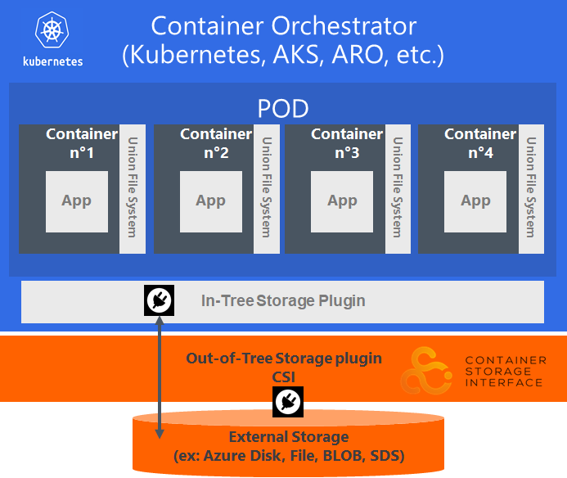
Persistent storage integration with a Container orchestrator
ARO did not ship with any CSI drivers, it used Kubernetes PV framework aka in-tree plugin. These volume plugins were “in-tree” meaning their code was part of the core k8s code and shipped with the core Kubernetes binaries.
Term | Definition
Container Storage Interface (CSI) | A specification attempting to establish an industry standard interface that Container Orchestration Systems (COs) can use to expose arbitrary storage systems to their containerized workloads.
in-tree | Code that exists in the core Kubernetes repository.
out-of-tree | Code that exists somewhere outside the core Kubernetes repository.
CSI Volume Plugin | A new, in-tree volume plugin that acts as an adapter and enables out-of-tree, third-party CSI volume drivers to be used in Kubernetes.
CSI Volume Driver | An out-of-tree CSI compatible implementation of a volume plugin that can be used in Kubernetes through the Kubernetes CSI Volume Plugin.

Slide 2
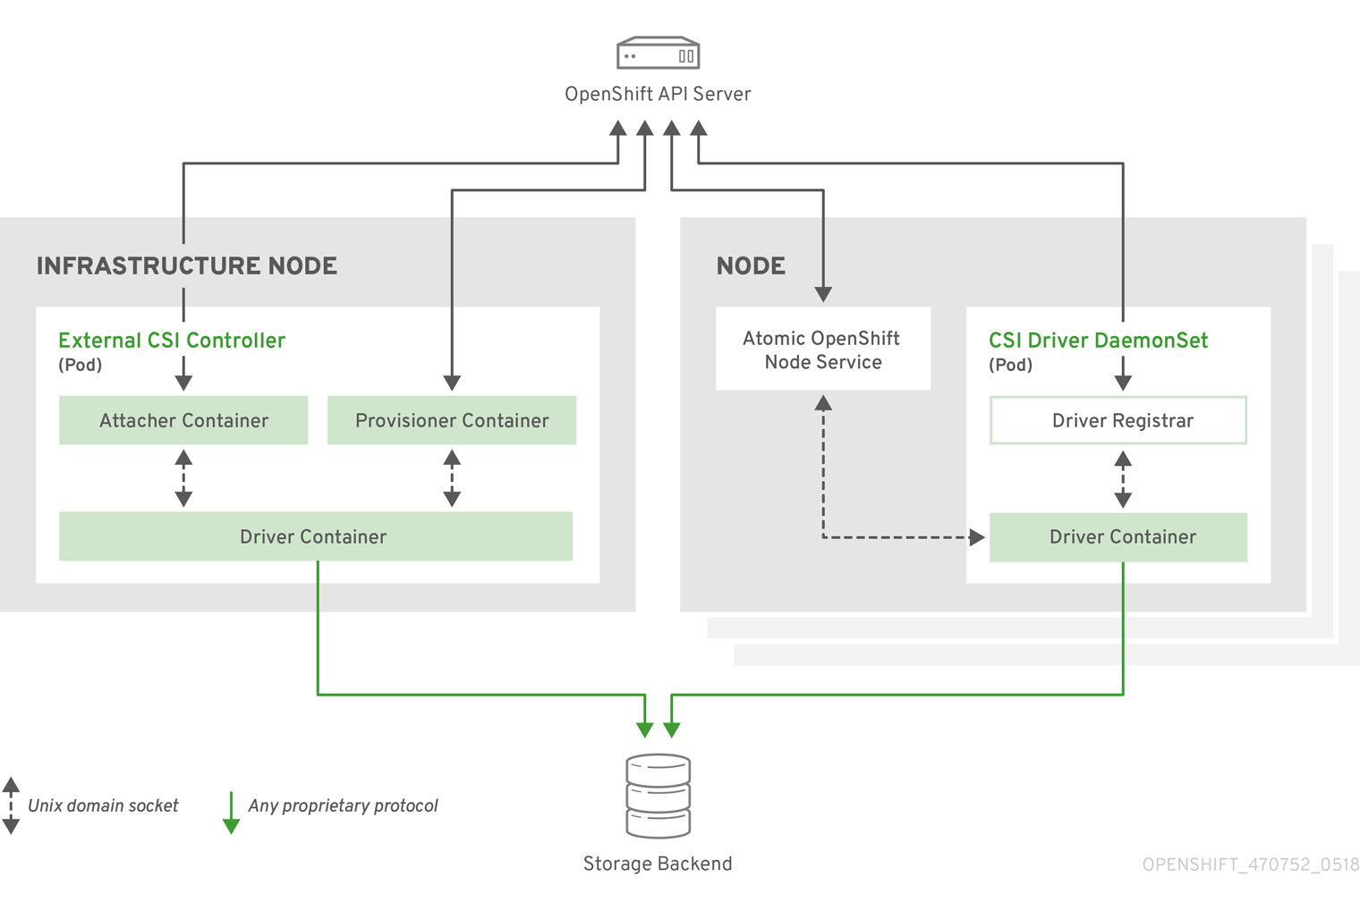
PV with CSI in ARO
https://docs.openshift.com/aro/4/storage/persistent_storage/persistent-storage-csi.html
Notes:
External CSI Controllers is a deployment that manages the storage lifecycle . The CSI driver DS runs a pod on every node that allows ARO to mount storage provided by the CSI driver to the node and use it in pods as PV.

Slide 3
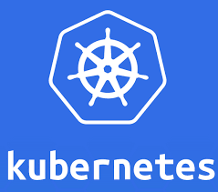





Persistent storage integration with a Container orchestrator
Container Orchestrator
(Kubernetes, AKS, ARO, etc.)
Performance
High throughput, low latency, auto-scaling
POD
Union File System
Union File System
Union File System
Union File System
Container
n°1
Container
n°2
Container
n°3
Container
n°4
Resiliency & availability
Disaster recovery, replication, data durability
App
App
App
App
Security
Encryption, BYOK, RBAC, Policy
In-Tree Storage Plugin
Out-of-Tree Storage plugin
CSI
Management
Monitoring
External Storage
(ex: Azure Disk, File, BLOB, SDS)

Slide 4
Union File System
UnionFS is a FS service for Linux, FreeBSD and NetBSD which implements a union mount for other FS. It allows files and directories of separate FS, known as branches, to be transparently overlaid, forming a single coherent FS. Contents of directories which have the same path within the merged branches will be seen together in a single merged directory, within the new, virtual FS.
Docker uses UnionFS to layer Docker images. As actions are done to a base image, layers are created and documented, such that each layer fully describes how to recreate an action. This strategy enables Docker's lightweight images, as only layer updates need to be propagated.
All layers except the topmost
are Read Only
R/W Container Layer
4. Add NPM
3. Add Node
2. Add Nginx
1. Base OS: Alpine
Host Kernel
https://en.wikipedia.org/wiki/UnionFS

Slide 5
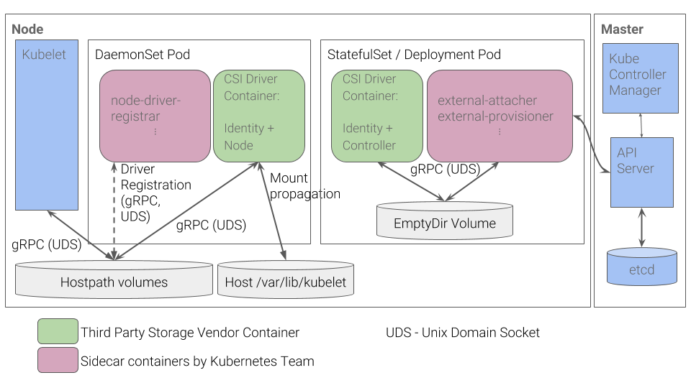
CSI Design
https://github.com/kubernetes/community/blob/master/contributors/design-proposals/storage/container-storage-interface.md

