Slide 1
Program Name goes here
Link to github Repository:
Links to trello board / project management tools:
You MUST provide evidence showing how the problem has been decomposed, how the components have been developed and trialled, and of how they have been assembled and tested to create a final, working outcome.

Slide 2
Relevant Implications
Explain the relevant implications here. Please watch this video to learn how to do this.
Notes:
Explain the relevant implications here. Then as you work, develop your code, discuss how the implications are being met.

Slide 3
Decomposition
Paste screenshots of your initial Trello board / task decomposition on this slide. If you have a long list, you might need to break it up into several columns. Delete this instruction when you are done.
Notes:
Paste screenshots of your initial Trello board / task decomposition on this slide. If you have a long list, you might need to break it up into several columns. Delete this instruction when you are done.

Slide 4
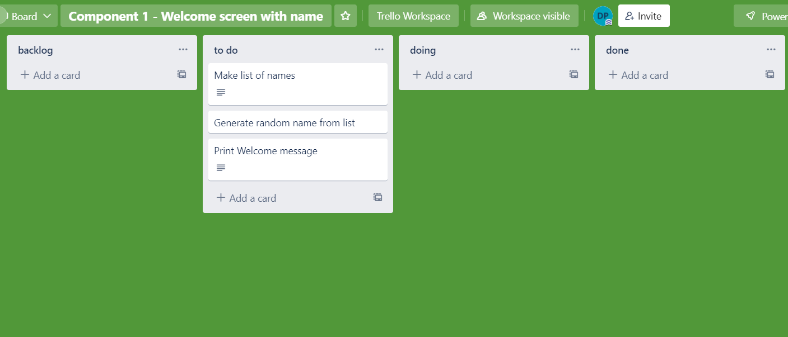
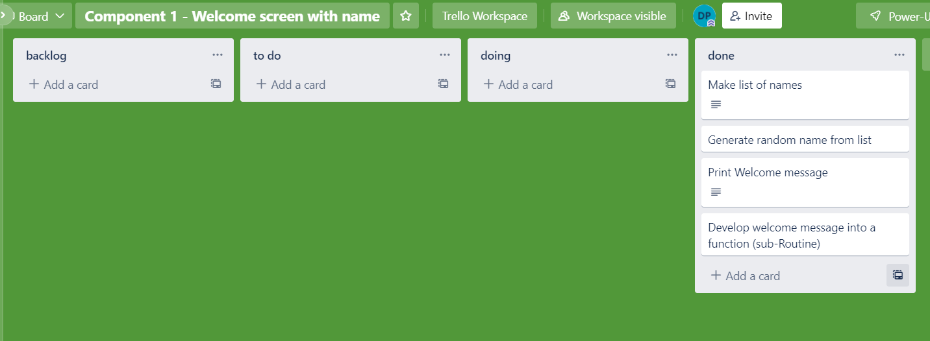
Component 1 (Trello screenshot) Version 1 Version 2

Slide 5
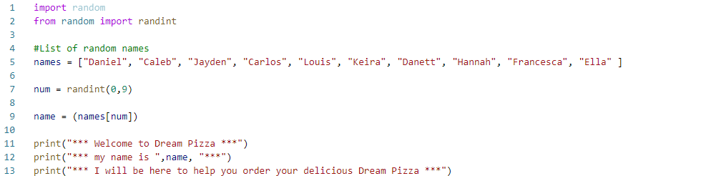

Component 1 - Test Plan (and screenshot)
Test Case | Expected Values
Run Program | Print Welcome message with random names from list of names – Runs correctly

Slide 6
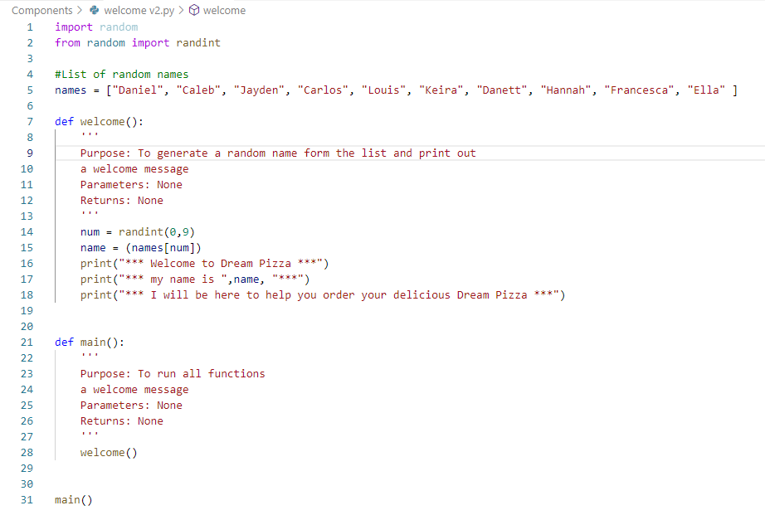

Component 1 version 2 - Test Plan (and screenshot)
Test Case | Expected Values
Run Program | Main and welcome run correctly. Welcome message prints with random name

Slide 7
Version Control Evidence
Your version control evidence should go here. This could be in the form of annotated screenshots which show you you managed this process or you could make a brief screencast explaining how you implemented version control.
Notes:
Your version control evidence should go here. This could be in the form of annotated screenshots which show you you managed this process or you could make a brief screencast explaining how you implemented version control.

Slide 8
Discusses how the information from planning, testing and trialling of components assisted in the development of a high-quality outcome
Notes:
Discusses how the information from planning, testing and trialling of components assisted in the development of a high-quality outcome

