Slide 1
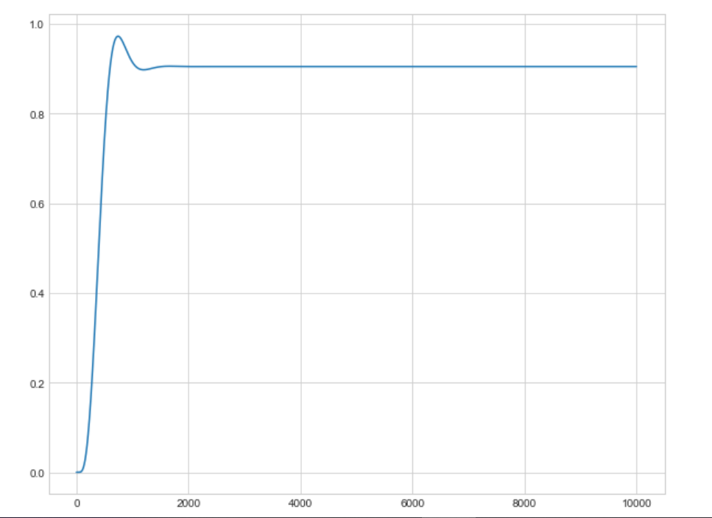
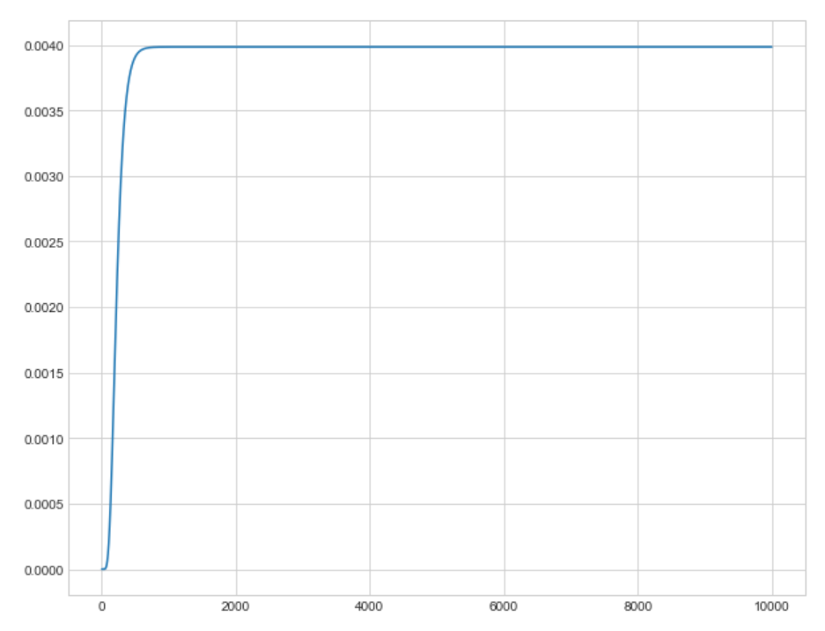


$v_{1,max}=$0.2nm/s
$v_{1,max}=$0.1nm/s
[MAPK-PP]
Time (s)
Time (s)

