Slide 1
Project 1 World Development Indicators
Daniel Pimentel
Marie-Jeanne Beda
Ufoma iduh

Slide 2
SUMMARY OF SOURCE DATA https://datacatalog.worldbank.org/dataset/world-development-indicators
Data was retrieved from World_Bank.org.
The summary of the raw data was sourced as a world development indicator.
The columns contained in the source data are; Country Name, Country Code, Indicator Name, Indicator Code, and columns containing years ranging from 1960 to 2018.
Data was imported as a CSV file with over 400k line items.
Data was cleaned and structured using Python codes, with varied libraries, such as pandas as pd, matplotlib as plt and as ticker, numpy as np, csv, etc.

Slide 3
Data Clean-up steps/procedure
In cleaning up the data, we asked certain questions that enabled our cleanup process, some of which are as follows:
The length and count of countries as well as the country codes-The number of countries in our data set came up to 247.
The indicator Name from which our parameters were drawn-this totaled 1344.
The range of years that are present in the data set-1960 to 2018.
The number of years present in the dataset-58

Slide 4
Summary of Project-WDI.
WDI Project was done using the following parameters:
The number of refugees living in the United States going back 25 years ago; 1990 to 2015.
Arms export from the United States for a period of ten years from 2008 to 2018.
Global arms exports for the same ten-year period.
Analysis of comparison between global exports and exports from the US.
The Top four countries that are exporters of Arms.
These parameters are illustrated using Line graphs, multi line graphs, bar charts, pie charts, and histogram.

Slide 5
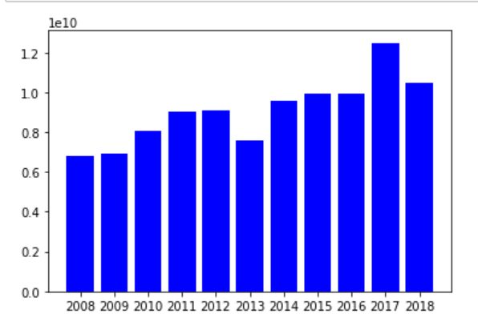
Bar chart representing USA Arms from 2008 to 2018-A ten-year period depiction.
The highest sales ever recorded was in 2017 based on WDI source data.
Record of sales of ammunition is measured in billions.
Currency used is in the United States Dollars.

Slide 6
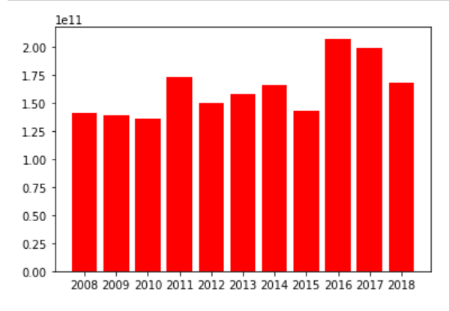
Bar chart representing Global sales of Arms from 2008 to 2018-A ten-year period depiction.
The highest sales was in 2016 based on WDI source data.
Record of sales of ammunition is measured in billions.
Currency used is in the United States Dollars.

Slide 7
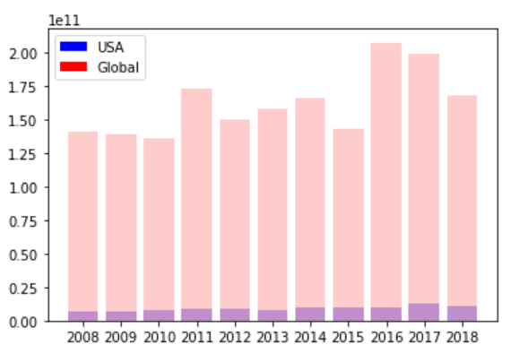
Analysis of comparison between exports of Arms Globally vs. USA-for a ten-year period
The percentage rate of sales of Arms in in the USA range from 4.25 percent to 6.25 percent.
From the graph, the higher the sales of Arms globally, the higher the sales of Arms exported from the US.

Slide 8

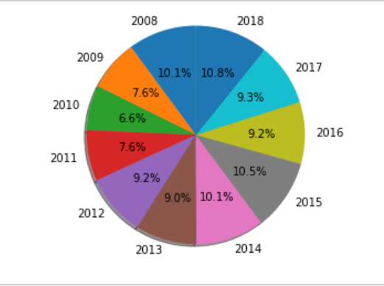



Percentage representation of USA Arms Export-Using a Pie Chart.

Slide 9
Findings
Between these two bar charts we can see that in 2002 and 2013 there were greater arms exports Globally than in the USA. So in 2002 and in 2013 the USA was not the leading contributor to arms exported but from 1960-2001 and 2003-2012 and 2014 the USA arms exports per capita almost identically match up with the arms exported per capita globally.

Slide 10
Findings
With the first histogram we can see the arms exported per capita by the USA from 1960-2014. This chart shows that for most of those years the USA exported between 11 and 13 million arms. Using this information the second histogram displays the arms exported per capita globally from 1960-2014, with the USA annotated above the 12 million marker. Most countries lie between 0 and 1 million arms exported, while the USA and several other countries contribute on a larger scale.

Slide 11
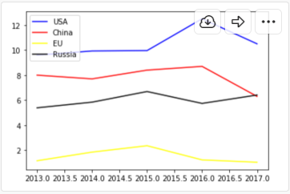
Arms exports between the Top Four Countries
This line chart compares Arms export between the four top exporters. Based on our graph drawn from our data-set, we can see that the US is the top exporter, followed by China, and then Russia.
AT the end of 2017, Russia and China are tied in equal sales.

Slide 12
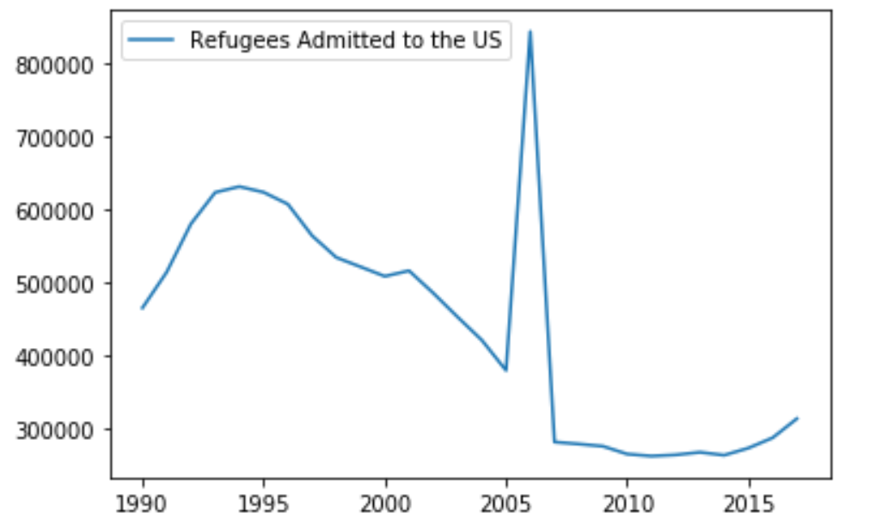
Graphical representation of Refugees admitted to the USA from 1990 t0 2015
We can tell from the graph that there was a sharp increase between 2005 to 2006 in refugees admitted to the US.
There was also a sharp decline from 2006, most likely would have been caused by the period of economical recession.

Slide 13
Conclusion
From this data it seems that the USA is a top contributor to arms exports globally from 1960-2018, except in 2002 and 2013.
Also, the United States accepted hundreds of thousand of refugees on a yearly basis and recorded its highest intake of refugees in 2006.

Slide 14
References
https://datacatalog.worldbank.org/dataset/world-development-indicators
https://matplotlib.org/3.1.1/api/_as_gen/matplotlib.pyplot.grid.html
https://www.google.com

