Slide 1
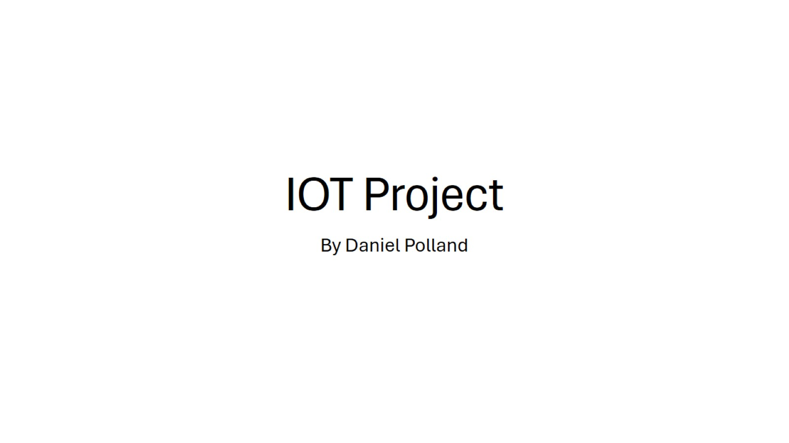
IOT Project

Slide 2
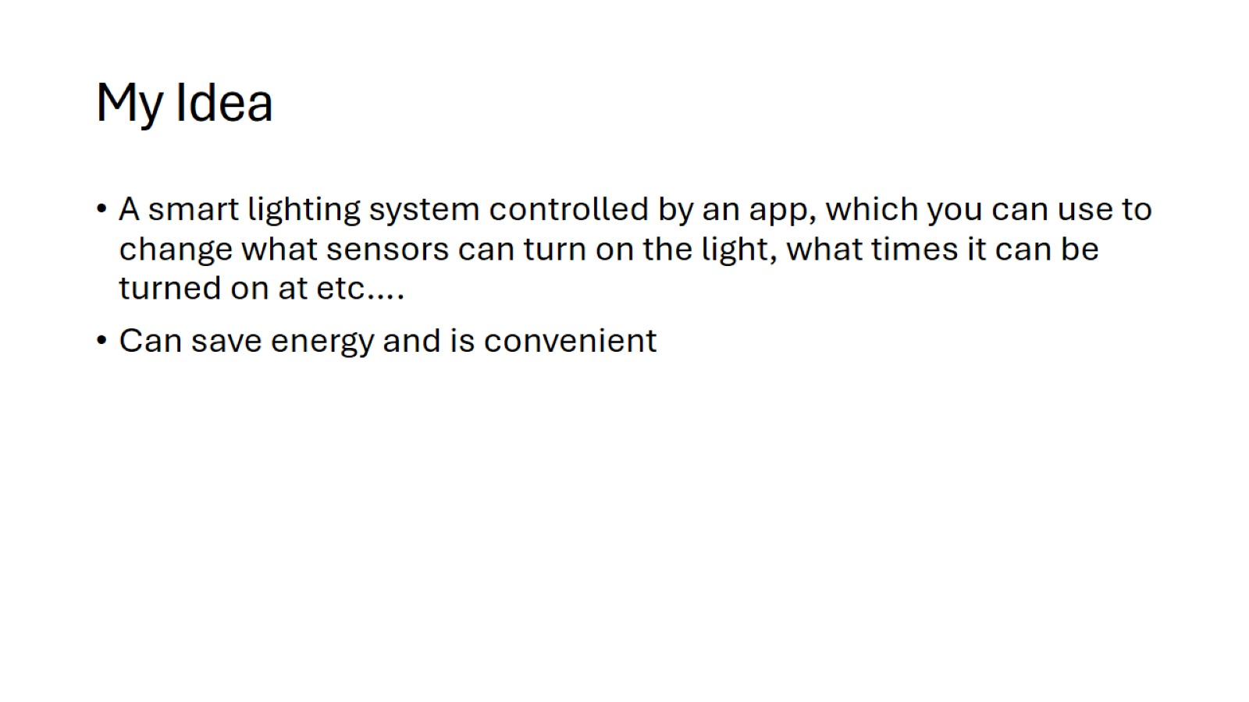
My Idea

Slide 3

Research

Slide 4
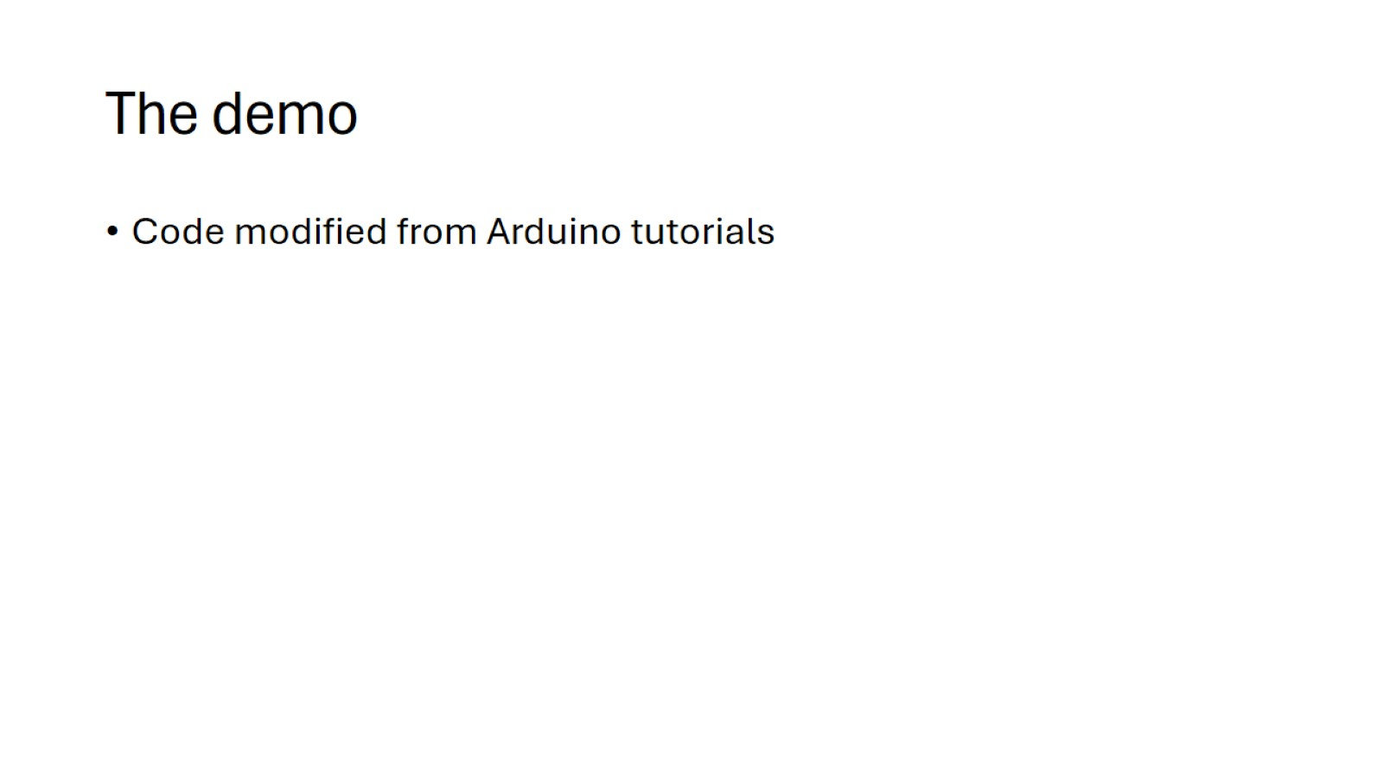
The demo

Slide 5

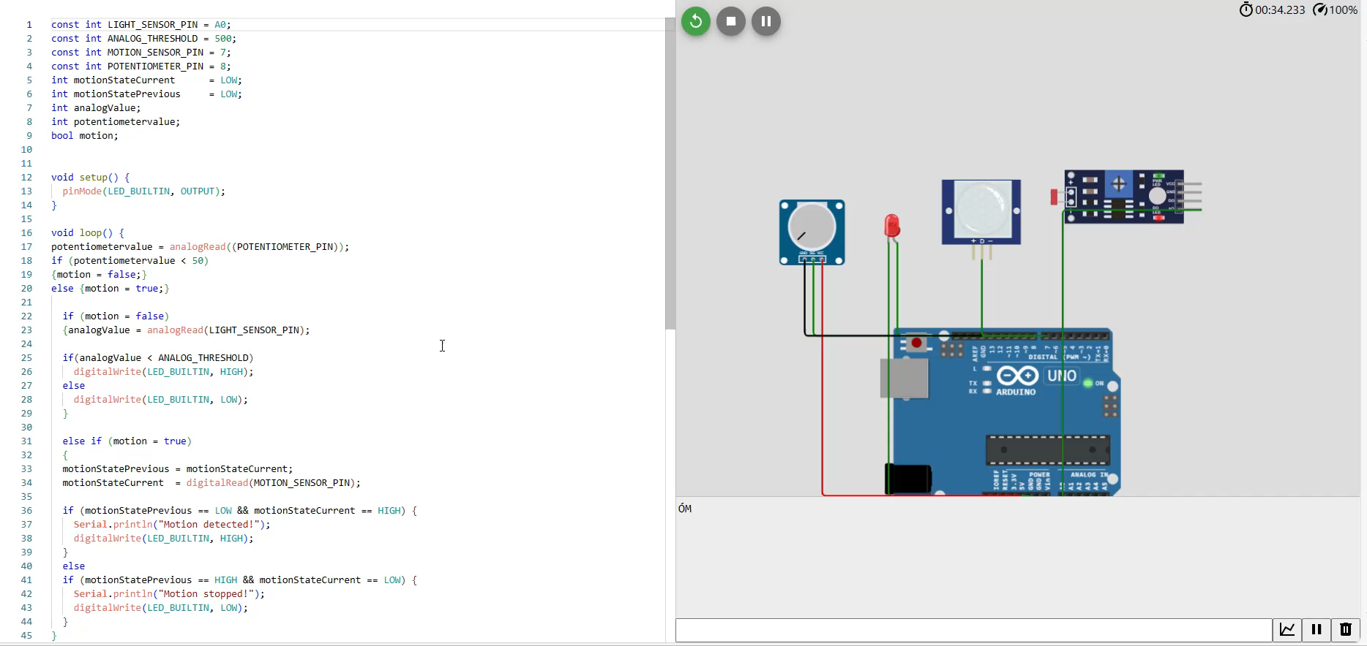

Slide 6
Future Plans
App to control lighting system.
Added security functionality.

