Slide 1
Final Project Hardware Implementation of Pipelined MIPS and RISC-V
Digital System Design
Speaker: Kane
Instructor: 吳安宇教授
Date: 2020/05/28

Slide 2
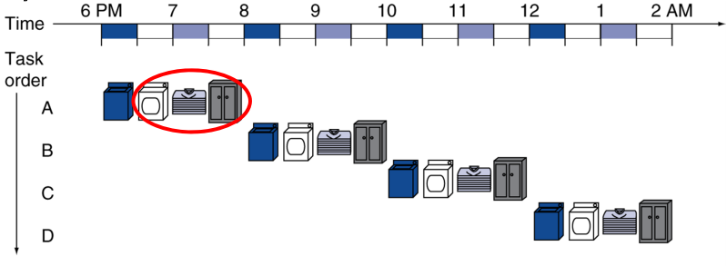
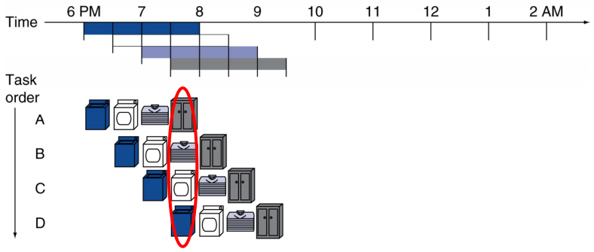
MIPS/RISC-V Processors
Single-Cycle
Simple design with low throughput
Pipelined
Higher throughput
Complex design
For handle hazard

Slide 3
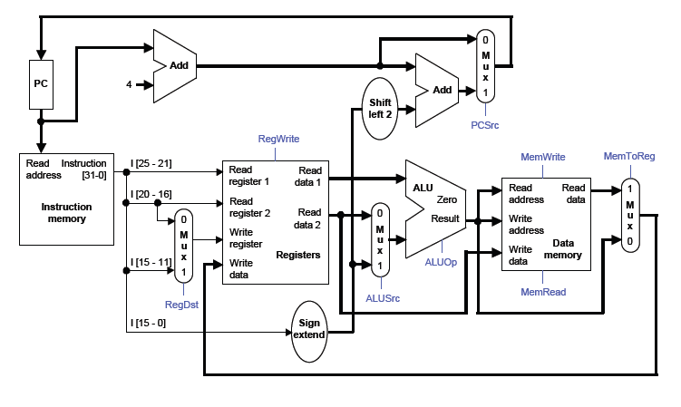
Final Project
HW3: Single Cycle MIPS/RISC-V
Final Project: Pipelined MIPS/RISC-V Processor
With Instruction cache and data cache

Slide 4
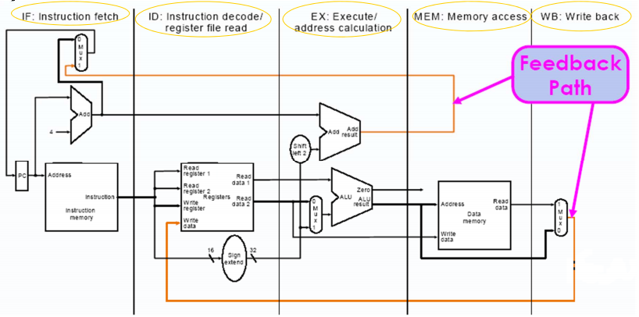
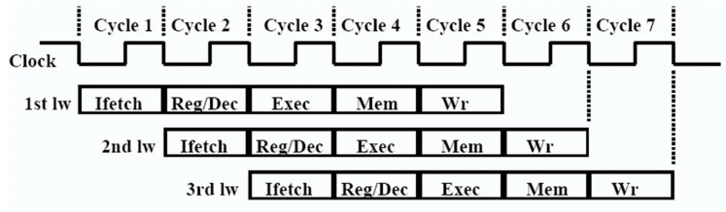
Pipeline
Splits into several functional unit and perform instruction in parallel way
Your design should follow this 5-stage pipelined structure

Slide 5
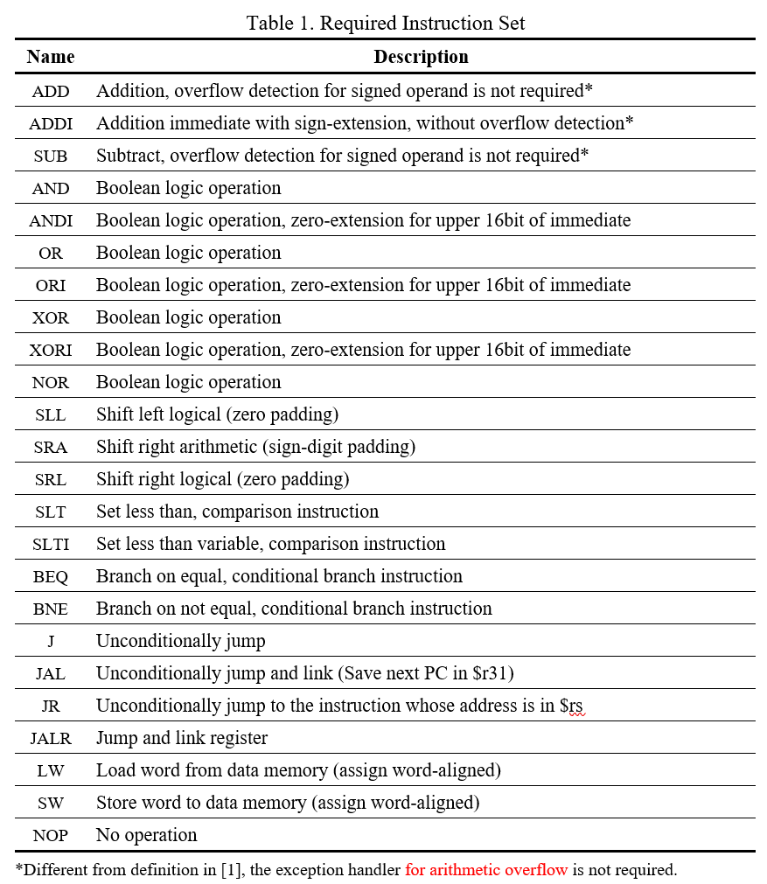
Required Instruction Set
You need to modify several pars to fit our specifications.
For example, you need to add the path for J-type instructions

Slide 6


Hazards
In order to implement pipelined-MIPS, you need to resolving hazard in hardware
Structural Hazard
the hardware cannot support the combination of instructions
Data Hazard
data that is needed to execute the instruction is not yet available (dynamic).
Load-use Data Hazard
load instruction (lw) (read data from main memory) has not yet become available when it is requested

Slide 7
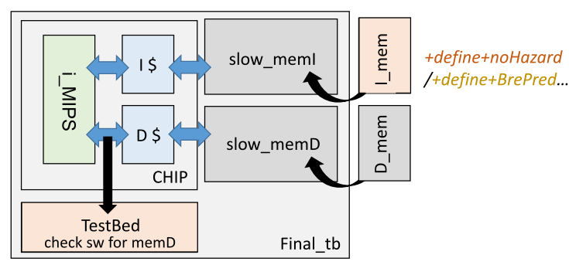
How’s the test works?
Your design
I_mem: Instruction Memory
D_mem: Data memory

Slide 8
Extensions (MIPS)
Branch Prediction(+define+BrPred)
Always not branch
Branch / Not branch / Branch
Always branch
L2 Cache(+define+L2Cache)
Long version of Fibonacci
Multiplication/Division (+define+MultDiv)
Factorial

Slide 9
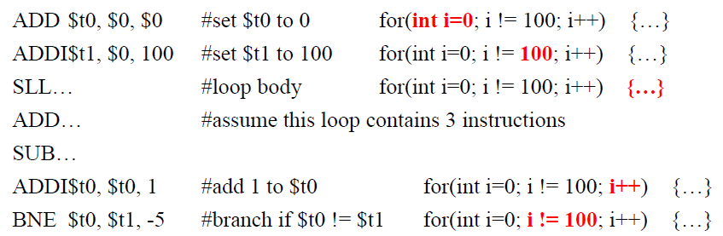
Branch Prediction
For loop is commonly see in programming
for(i=0;i<k;i++) → they did BEQ in every loop
To increase overall efficiency of system, branch prediction is always used
With branch prediction → waste 3 cycles
Waste 99 cycles

Slide 10
Comparison Metrics
Score 1 (BP_S1): Total execution cycles of ‘I_mem_BrPred’
BP_S1 = total cycle counts of the I_mem_BrPred
Score 2 (BP_S2): Total execution cycles of ‘I_mem_hasHazard’
BP_S2 = total cycle counts of the I_mem
Score 3 (BP_S3): Synthesis area of BPU (um2)

Slide 11
L2 Cache
Main goal
Add 2 separate L2 caches for I-cache and D-cache
Unified L2 cache (1 L2 cache for both L1 I-cache & L1 D-cache) will be considered as better design (not required)
Total size of respective L1 cache is suggested to be 32 words
8 blocks & each 4 words
Total size of respective L2 caches(I+D) are suggested to be 256 words
Block size and number of blocks are up to your considerations

Slide 12
Comparison Metrics
Base on the test program: “I_mem_L2Cache”
Score 1 (L2C_S1): Avg. memory access time (ns)
L2C_S1 = HT1 + MR1*(HT2+MR2*MP2)
HT: hit time
MR: miss rate
MP: miss penalty
~1: of level 1 cache
~2: of level 2 cache
Score 2 (L2C_S2): Total execution time (ns)
L2C_S2 = total execution time of the test program
Don’t worry about the performance evaluation. It is just one of the criteria. Focus more on what you design to solve problems you face.

Slide 13
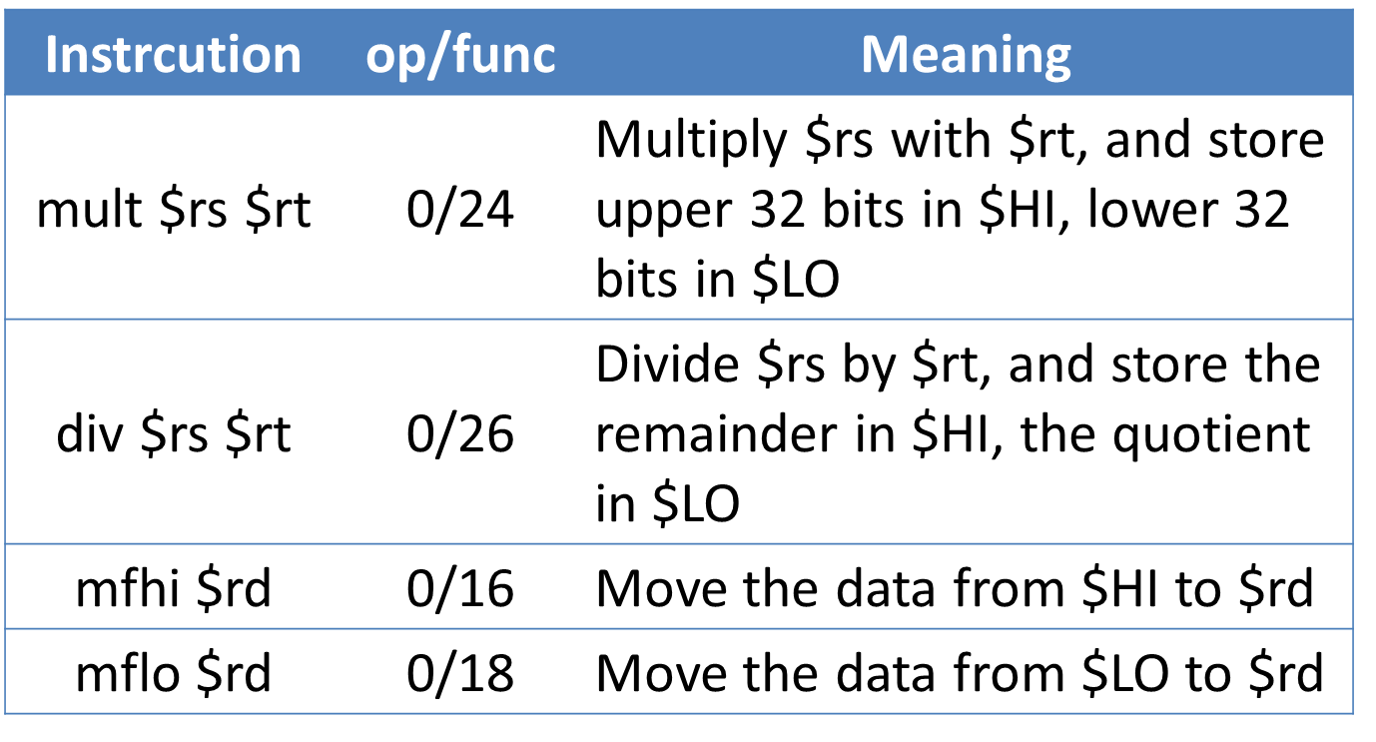
Multiplication/Division
Main goal
Add a computation unit and control unit to support multiplication and division instructions

Slide 14
Comparison Metrics
Base on the test program “I_mem_MultDiv”
Score 1 (MD_S1): Area of MultDiv (um²)
MD_S1 = area of MultDiv - area of baseline chip
Score 2 (MD_S2): Total execution time (ns)
MD_S2 = total execution time of test program
Score 3 (MD_S3): Minimum clock period (ns)
MD_S3 = clock period of MIPS core
Don’t worry about the performance evaluation. It is just one of the criteria. Focus more on what you design to solve problems you face.

Slide 15
Extensions (RISC-V)
Branch Prediction(+define+BrPred)
Always not branch
Branch / Not branch / Branch
Always branch
L2 Cache(+define+L2Cache)
Long version of Fibonacci
Supporting compressed instructions (+define+(de)compression)
Extract C-Instructions
PC increment
Address alignment issues

Slide 16
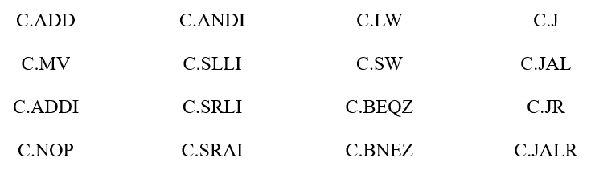
Compressed Instruction
Implement the following 16 C-instructions as the extension to your base RISC-V core
Extract information encoded in C-instructions
PC increment
Address alignment issued (32/16 混合)

Slide 17
Comparison Metrics
delta A(compressed design – baseline design) *T(given compressed testbench)
Some comparison of different method can be discuss in presentation or in report

Slide 18
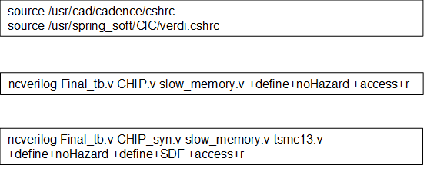
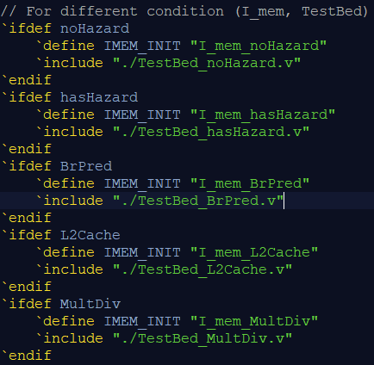
Simulation Example
Change +noHazard for testing different cases
+hasHazard
+BrPred
+L2Cache
+MultDiv

Slide 19
Grading Policy
All grades of this project consist of three equal aspects:
1) Proposal: Project check point (5%)
2) Presentation (45%)
3) Final Report: technical features (50%)
The technical features are grading by two parts:
Baseline (50%)
Extension (50%)

Slide 20
Baseline (50%)
The solid requirements include:
Supporting all instructions above
With caches
Pass all test assembly programs
Complete the circuit synthesis. Note that the slack cannot be negative.
Then the performance is evaluated by:
Area (um²) * Total simulation time (ns);
And baseline points will be based on your AT ranking among other MIPS teams.

Slide 21
Extension(50%)
There are three topics of extension.
Branch prediction mechanism.
Two-level caches, i.e. with L2 caches.
Supporting multiplication and division.
Implement as much and deep as you can of the topics of extension.
Deeper exploration → higher score
The content also affect quality of presentation

Slide 22
Presentation Hint
More performance from deeper pipelines, parallelism (Chap. 4.10, page 332) may explore in your final project reports!
Branch prediction
Multiple issues
VLIW (Very long length Instruction Word)
Superscalar
Dynamic scheduling
Out-of-order execution
Speculation
Reorder buffer
Register renaming

Slide 23
※Notice
Latches are not allowed in gate level code after synthesis, use Flip-flop instead.
Negative Slack and Timing Violations are not allowed after synthesis.
The tsmc13.v file is not allowed to be downloaded! Or you may offend the copyright protected by NTU & CIC!

Slide 24
Find your partner and topic
Choose the topic you want to do, due 2020/05/30 24:00 (only team leader)
https://forms.gle/DP4hVreFQEr5oGJr9

Slide 25
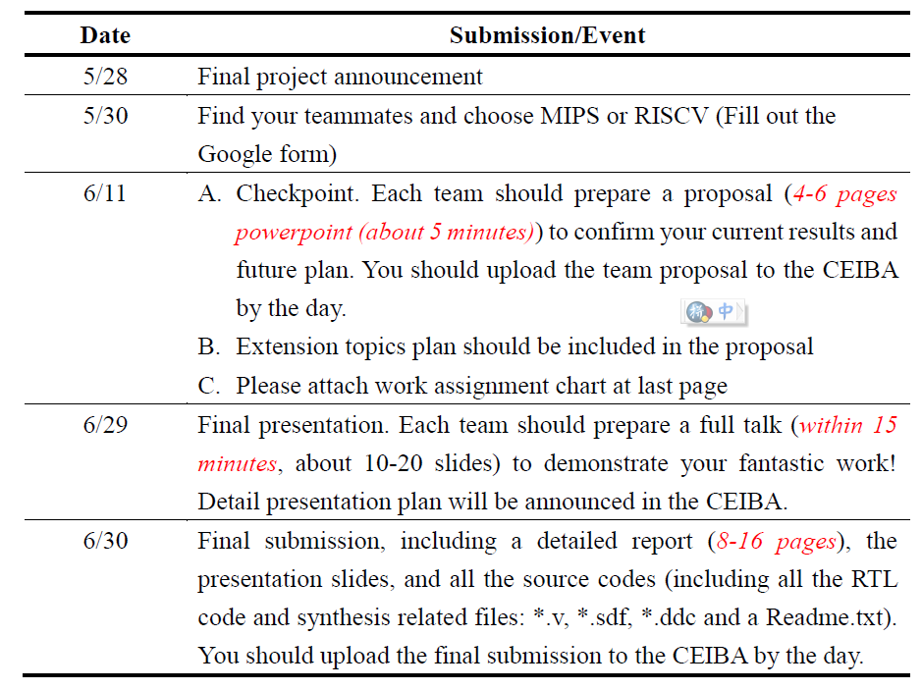
Timeline

Slide 26
Fill out the form
Choose the topic you want to do, due 2020/04/20 24:00
https://forms.gle/qTdBs66pvL1LXvEw7
After you submitted your work, please fill out the following form to illustrate what you have done, due 2020/05/06 24:00
https://forms.gle/rgTx3CfPQMjQVKvw8
※You must fill out the form to finish HW3

