Slide 1
Veteran Affairs Office
University of Florida

Slide 2
office of Veterans services
Veterans Services is under the domain of the Office of the University Registrar. The office serves as the liaison between the University, its students, and the various federal, state, and local agencies concerned with veterans’ benefits which includes the VA Regional Processing Office and the State Approving Agency . Two full time professionals and several work-study students provide services to veterans and their dependents that include outreach, certification, general counseling and overall advocacy for veterans.

Slide 3
SERVICES provided:
Advising and certification of educational benefits
Veterans Out -of- State Fee Waiver
Licensing and Certification
Tuition Deferments
Military training to college credit
Any GI Bill debt issues

Slide 4
Post 9/11 gi bill OR chapter 33
If you have at least 90 days of aggregate active duty service after Sept. 10, 2001, and are still on active duty, or if you are an honorably discharged veteran or were discharged with a service-connected disability after 30 days, you may be eligible for this VA-administered program. http://www.benefits.va.gov/gibill/post911_gibill.asp
The transferability option under the Post-9/11 GI Bill allows Service members to transfer all or some unused benefits to their spouse or dependent children. The Department of Defense (DoD) determines whether or not you can transfer benefits to your family. Once the DoD approves benefits for transfer, the new beneficiaries may apply for them. http://www.benefits.va.gov/gibill/post911_transfer.asp

Slide 5
Post 9/11 and online programs
Post 9/11 will pay to the school, all in-state tuition and fees.
Students receive a book stipend of $41.67 per credit hour up to $1000 per year.
Students also receive a monthly housing allowance (MHA). Resident students receive a rate based on the zip code of our school. Students who are exclusively online receive a rate one half of the national average, which is currently $754.50 per month. In order for the student to receive the full MHA they must be enrolled in at least one credit hour in an on campus course. Veterans who are currently on active duty do not receive this stipend.
Full payment of all benefits is based on a student’s eligibility rating. This percentage is determined by their active duty time served after September 10, 2001. Students with less than 100% eligibility will receive a proportional amount.
http://benefits.va.gov/GIBILL/resources/benefits_resources/rates/ch33/ch33rates080114.asp

Slide 6
Other va educational benefits
Chapter 30 (Montgomery GI Bill)
Includes a monthly stipend of $1,717.00, if student is going to school full time.
Chapter 35 (Dependents Education Assistance Program)
Student must be the dependent of a veteran who has a 100% service connected disability or was killed while serving in the military. Monthly stipend is $1,018.00.
Chapter 1606 & 1607 (Reserve or Guard Education Assistance Program)
Members who are actively participating in the selective Reserve. This includes the Army, Naval, Air Force, Marine Corps, Coast Guard, Army National, and Air National Guard. Students only receive a monthly stipend and it varies according to length of service and contract.
http://www.benefits.va.gov/gibill/handouts_forms.asp

Slide 7
How do students get started?
1. Students will initially apply for their benefit through VONAPP
The VONAPP (Veterans On Line Application) website is an official U.S. Department of Veterans Affairs (VA) website that enables service members, veterans and their beneficiaries, and other designated individuals to apply for benefits: http://vabenefits.vba.va.gov/vonapp/default.asp
2. Once students are admitted into the university and have applied for their benefit, they can fill out the online UF Enrollment Certification Request found at http://veterans.ufl.edu/
This form must be filled out every term a student wants to utilize their benefits.
3. Students are required to submit a copy of their Certificate of Eligibility . This document provides us with their eligibility rating and the length of time they will have to use their benefit. Students can obtain this letter by creating a premium account through Ebenefits. https://www.ebenefits.va.gov/ebenefits/homepage
Ebenefits also provides veterans with access to DD-214’s or other documentation from their military service and additional VA benefits.

Slide 8
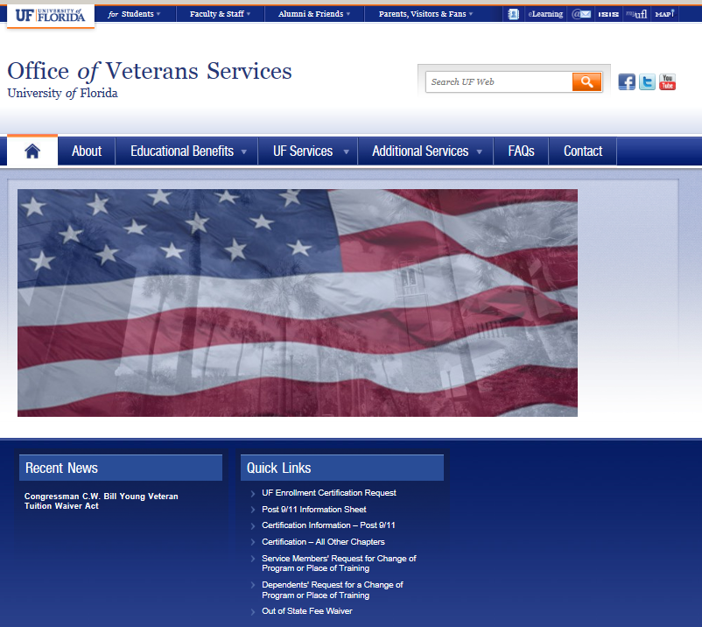

http://veterans.ufl.edu/

Slide 9
OUT- OF- STATE FEE Waiver
In accordance to Florida Statute 1009.26(13)(a), honorably discharged veterans of the United States Armed Forces, the United States Reserve Forces, or the National Guard who physically reside in the state of Florida may request an out-of-state fee waiver.
Waiver is applicable for 110 percent of the required credit hours of the degree or certificate program.
Proof of honorable discharge and residence in Florida is required.
Application for waiver is here: http://registrar.ufl.edu/pdf/vaoutofstatefeewaiver.pdf
***For terms beginning after July 1, 2015, a new Federal Law offering out-of-state fee waivers for veterans and dependents will take effect.

Slide 10
office of Veterans services
222 Criser Hall
P.O. Box 114000
Gainesville, FL 32611-4000
Phone: (352)294-2948
Fax: (352)846-2872
E-mail: vacounselor@ufl.edu
Website: http://veterans.ufl.edu/

