Slide 1
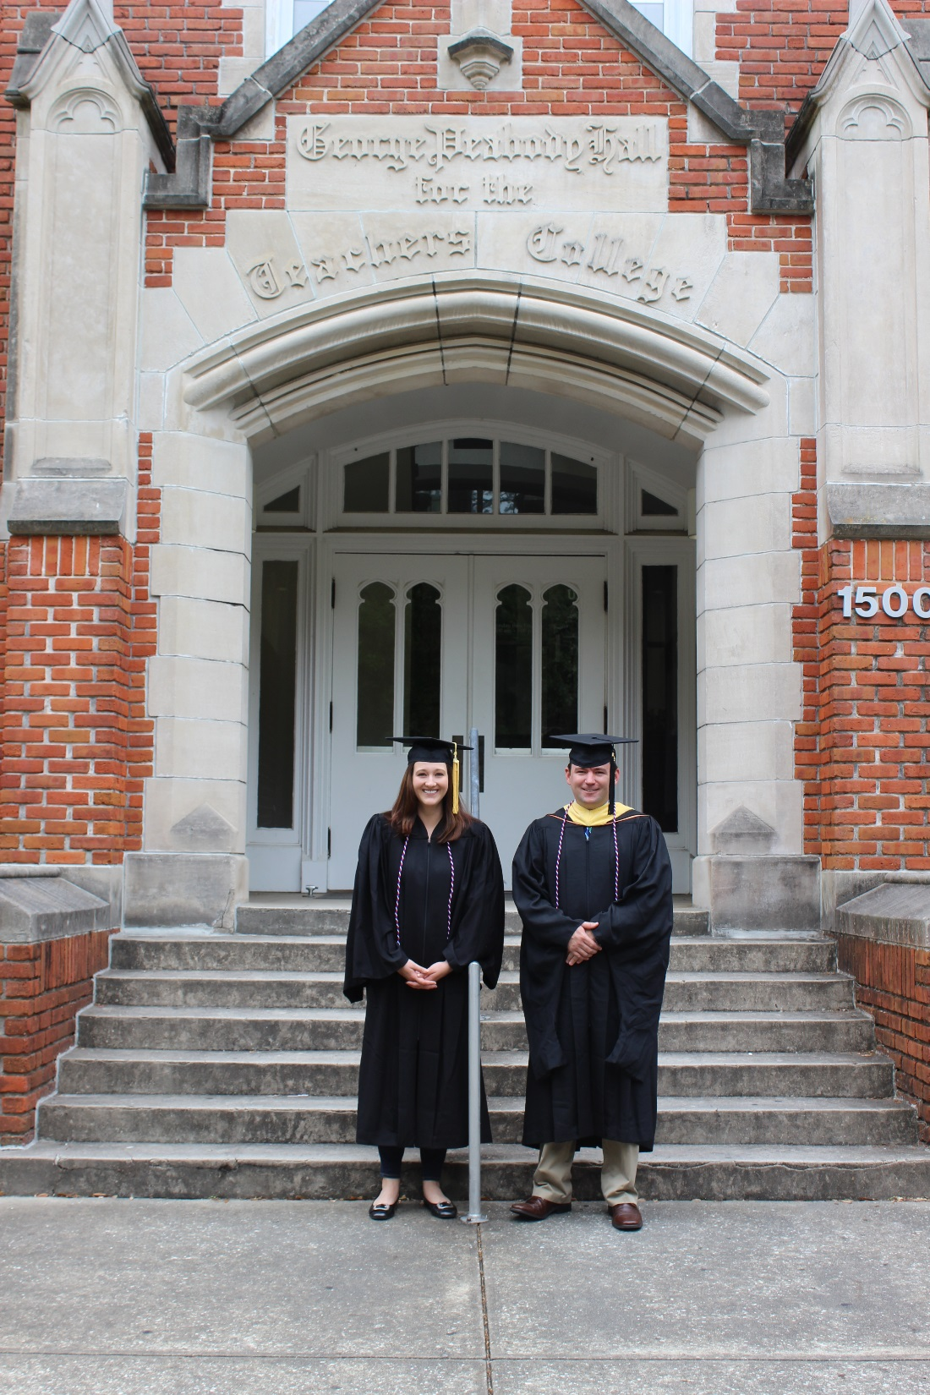
Services for Veterans, Active Duty Service Members, & Dependents at the University of Florida

Slide 2
UF Student Veteran Demographics

Slide 3
UF Student Veteran Demographics

Slide 4
UF Student Veteran Demographics

Slide 5
UF Student Veteran Demographics
Spring 2015 Registered Veteran and Active Duty
College | Total
WARRINGTON COLLEGE OF BUSINESS ADMINISTRATION | 175
COLLEGE OF ENGINEERING | 126
COLLEGE OF AGRICULTURAL AND LIFE SCIENCES | 82
COLLEGE OF LIBERAL ARTS AND SCIENCES | 78
COLLEGE OF PHARMACY | 41
COLLEGE OF PHARMACY (PHARM D.) | 36
COLLEGE OF PUBLIC HEALTH AND HEALTH PROFESSIONS | 25
COLLEGE OF JOURNALISM AND COMMUNICATIONS | 21
COLLEGE OF EDUCATION | 19
COLLEGE OF HEALTH AND HUMAN PERFORMANCE | 18
LEVIN COLLEGE OF LAW | 15
COLLEGE OF DESIGN, CONSTRUCTION, AND PLANNING | 11
COLLEGE OF MEDICINE | 11
COLLEGE OF NURSING (DOCTOR NURSING PRACTICE ) | 10
COLLEGE OF VETERINARY MEDICINE | 10
M.E. RINKER, SR. SCHOOL OF CONSTRUCTION MANAGEMENT | 10
COLLEGE OF FINE ARTS | 8
COLLEGE OF NURSING | 6
SCHOOL OF PHYSICIAN ASSISTANT STUDIES | 6
COLLEGE OF DENTISTRY | 5
FISHER SCHOOL OF ACCOUNTING | 3
DEPARTMENT OF PHYSICAL THERAPY | 2
INTERDISCIPLINARY STUDIES | 2
DIVISION OF CORRESPONDENCE STUDY | 1
Grand Total | 721

Slide 6





Slide 7

Vet Success On-Campus Counselor Charlotte Kemper
VA educational benefits
GI Bill; Vocational Rehabilitation; Disability Compensation; VA Medical Care; Home Loan; and Life Insurance
Understanding and applying for Vocational Rehabilitation & Employment (Chapter 31)
Vocational exploration and career counseling services (Chapter 36)
Information on college credit for military experience and training
Information on applying for other VA benefits to include disability compensation, life insurance and home loan guaranty
Assistance with electing healthcare benefits through the Veterans Health Administration
Information and referrals to VA medical and mental health services
Referrals to the local Vet Center for readjustment counseling services
Referrals to on-campus, community, and VA resources to ensure academic success
Guidance and support while using VA educational benefits
Employment information and assistance
Student Veteran peer mentoring and tutoring services

Slide 8
Services for UF Online Students
The Collegiate Veterans Success Center (CVSC) is a host site for the U.S. Department of Veterans Affairs' VetSuccess on Campus (VSOC) Program.
Charlotte Kemper, MHS, CRC VetSuccess on Campus Counselor 352-294-7215 phone 352-294-7216 fax Charlotte.Kemper@va.gov
One-on-one appointments are available via phone or Skype with Collegiate Veterans Success Center staff
UF Online students in or around Gainesville can utilize the CVSC in Yon Hall 418
Numerous resources are available online at www.dso.ufl.edu/veteran

Slide 9
Central Points of Contact for Veterans & Dependents
UF Collegiate Veterans Success Center
Dr. Anthony DeSantis anthonyd@dso.ufl.edu
UF Office of Veterans Services
Damaris Najera dnajera@registrar.ufl.edu
Michael Kreeger mkreeger@ufl.edu
UF/Santa Fe Vet Success On-Campus Counselor
Charlotte Kemper charlotte.kemper@va.gov
UF Collegiate Veterans Society
ufl.cvs@gmail.com
UF Admissions
Mike Miller wmmiller@admissions.ufl.edu
UF Office of Student Financial Affairs
Donna Kolb dkolb@ufl.edu
VA Health
Terri Turner Teresa.Turner2@va.gov
UF Disability Resource Center
accessUF@dso.ufl.edu
UF Counseling and Wellness Center
Rosa West dansar@ufl.edu
UF Career Resource Center
Alexandra Ricker AlexandraR@crc.ufl.edu

Slide 10




Selected Resources
The teaching center offers proctoring services for distance education students.
George Smathers Libraries offers off-campus access to their online library, and also hosts online workshops.
The Disabled American Veterans has over 300 offices nationwide that offer services that include Ride Share programs, outreach for veterans, and employment resources.
The Counseling and Wellness Center offers a therapist assisted online program for distance learners. The CWC also offers “thedesk”, an online resource that supports students in making better study habits.

Slide 11



Selected Resources
The Career Resource Center offers Career link, an interactive online service where students can schedule appointments, internship, and communicate with potential employers.
The Disability Resource Center allows students to schedule intake appointments over skype, and offers accommodations to students with disabilities both in person and online.
Gator Well offers students online resources on healthy living, time management, and many other health topics.

Slide 12

Selected Resources
VA Health Care offers veterans prescription refills, appointment scheduling, and secure messages with their healthcare provider all through their eBenefits website.
The Office of Veteran Services offers students to certify online through their website.

Slide 13
Contact Information
Kirsten Berling
kirstenb@dso.ufl.edu
352-392-1261

