Slide 1

Codestarters Project 2 – Extract, Transform & Load Project “Correlation between a loan portfolio and the GDP”
Graciela Herrera
Daniel Peña
Jose Rojas
Abraham Espinosa
Bayardo Aguilar
May 25th, 2019

Slide 2

Content
Summary
Extract, Transform & Load (Data Clean up & Exploration)
Annex – Jupyter Notebook

Slide 3

Summary A brief summary of the activities performed to gather the data and start the clean up & exploration process: - The intention was to match PIB data by geographic state and loan data from the biggest bank in Mexico - Data was collected from multiple sources (CNBV & INEGI websites), and downloaded as csv - Transform the data - clean and structure the data (more details will be explained with the Data Analysis walkthrough) - Load the data into a database

Slide 4
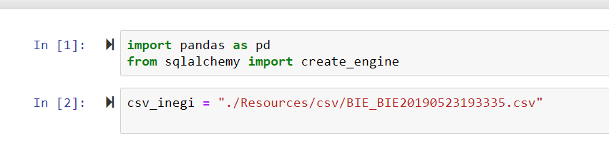
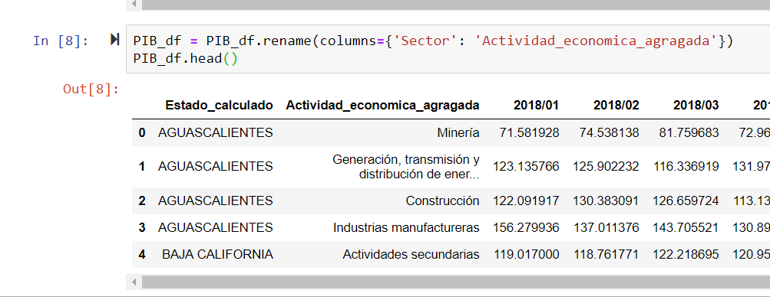
Data Analysis
1. Upload the data from INEGI
2. INEGI data cleaning process and homogenization with the CNBV classifications

Slide 5
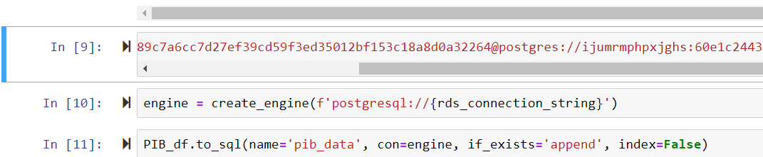
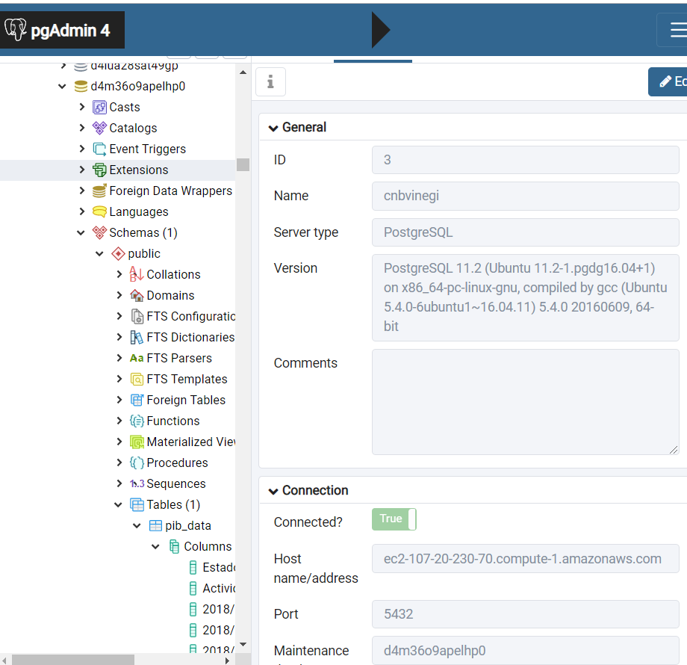
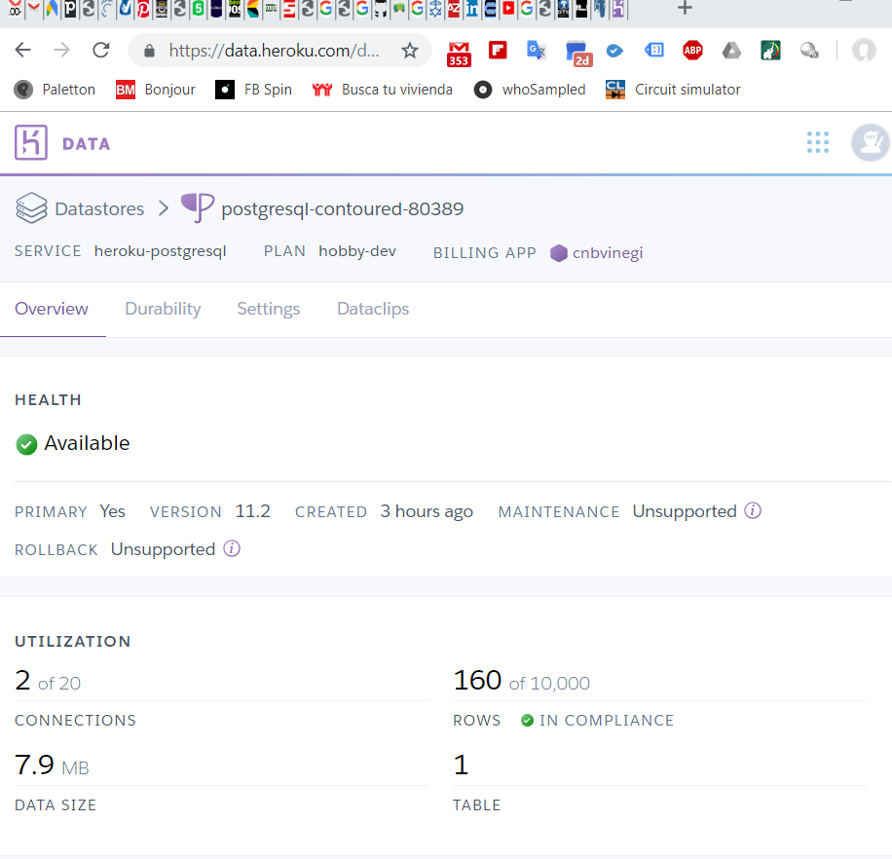
Data Analysis
3. Uploading the data to a postgre database in Heroku

Slide 6
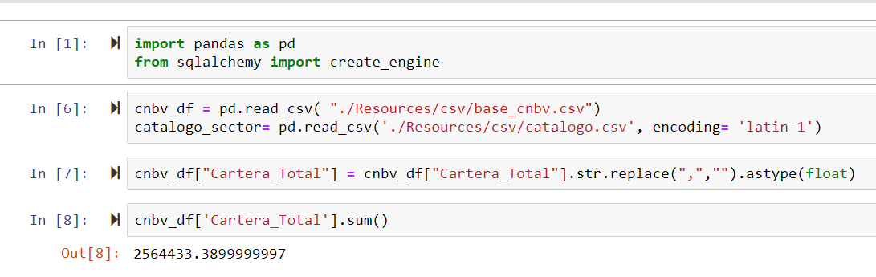
Data Analysis
4. Uploading data from the CNBV in a different notebook

Slide 7
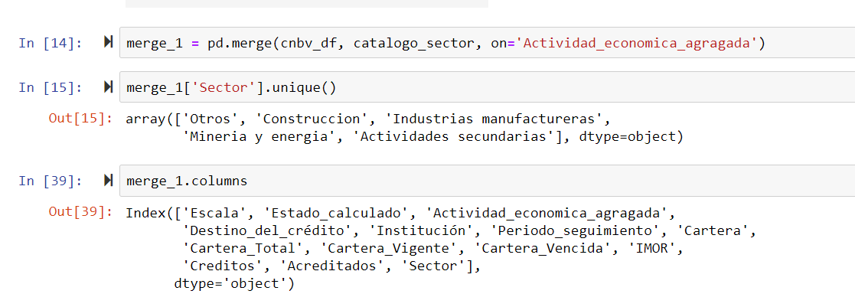
Data Analysis
5. Homogenization process between CNBV and INEGI data through a catalog generated by the team

Slide 8
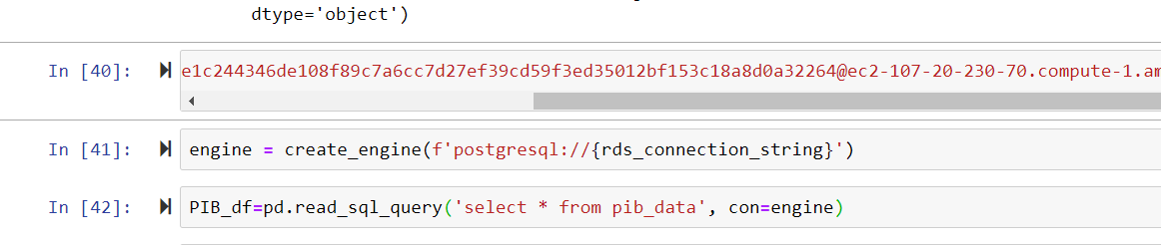
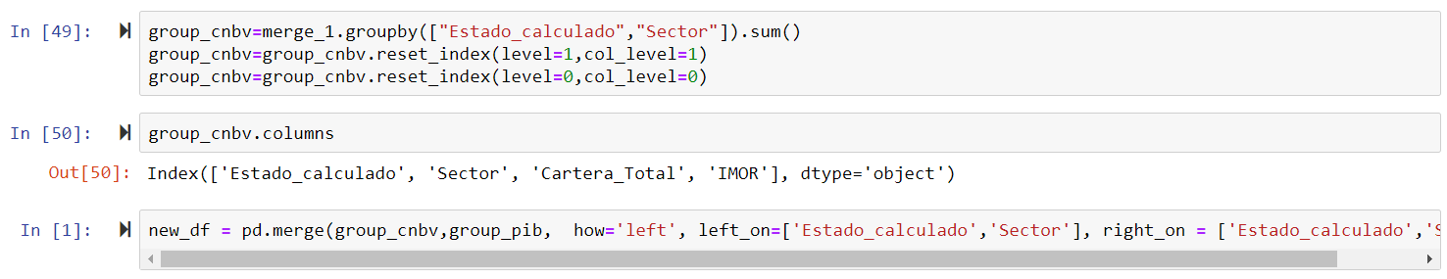
Data Analysis
6. Download the INEGI data from Heroku to the CNBV Jupyter notebook
7. Merging both databases and identifying important data

Slide 9
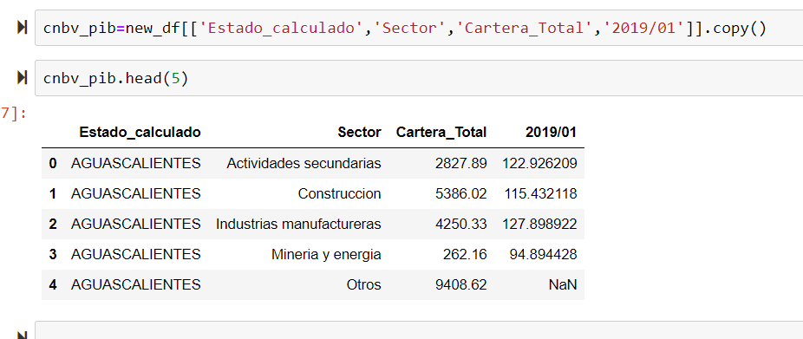
Data Analysis
8. Final data clean up to observe the correlation between the loan portfolio and the GDP (PIB) in January 2019

Slide 10
Questions?

Slide 11
Thank You!
Codestarters – Project 2
Graciela Herrera
Daniel Peña
Jose Rojas
Abraham Espinosa
Bayardo Aguilar
May 25th, 2019

