Slide 1
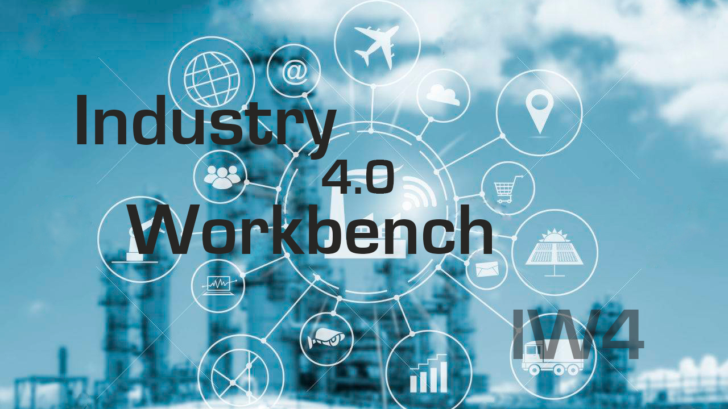

Slide 2

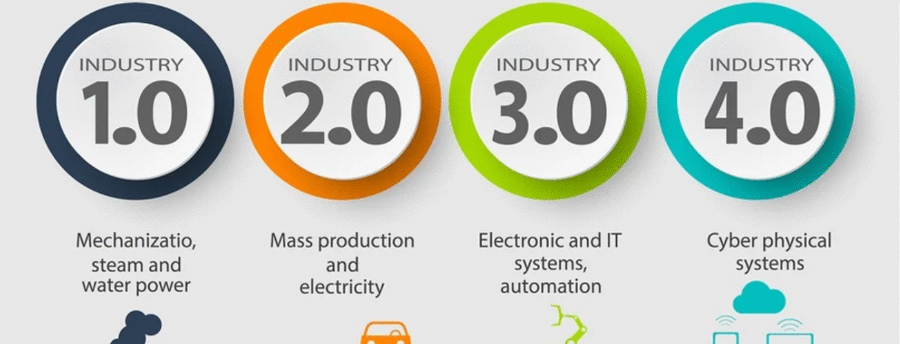
What’s Industry 4.0
Industry 4.0 is a current trend of automation and data exchange in manufacturing technologies.
Cyber-physical systems
Internet of things
Cloud computing
Artificial Intelligence

Slide 3
Motivation
Industry 4.0 can increase your productivity
Industry 4.0 generate saving in energy and maintenance

Slide 4
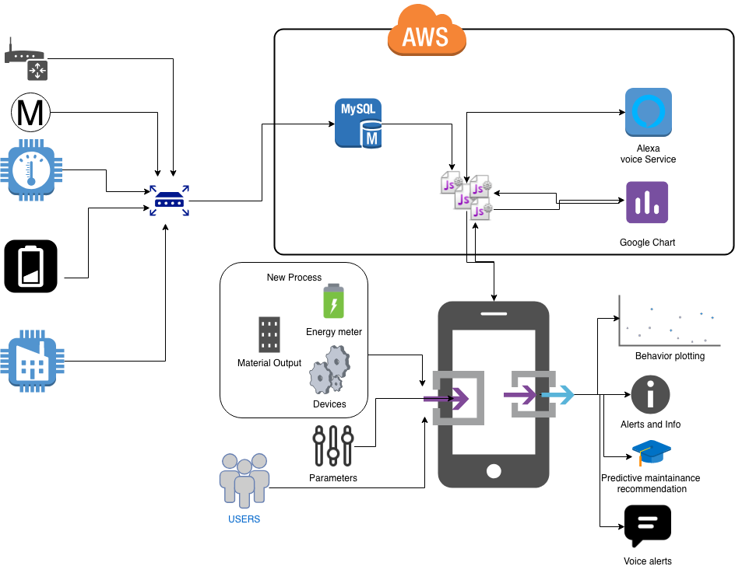
Results

Slide 5
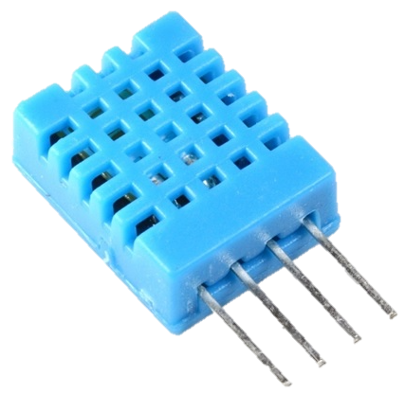
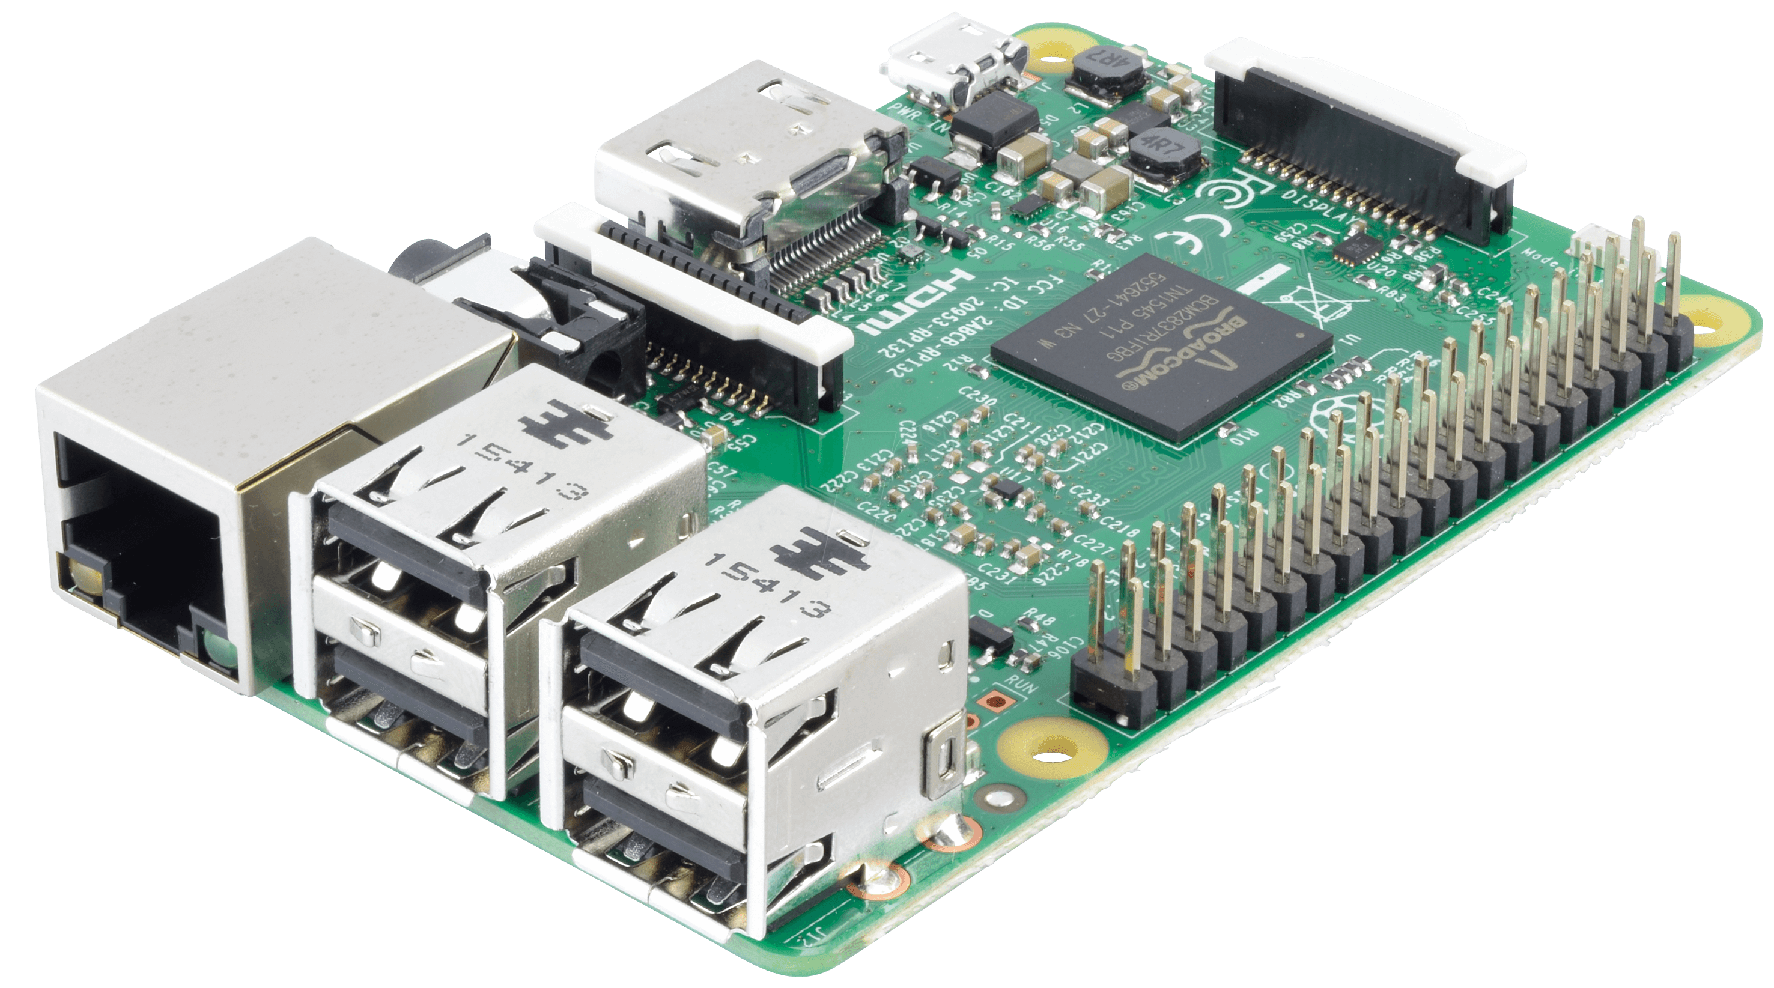
Results
Post JSON
{NumSerie: '1234’,LectureP1: '16.0’,LectureP2: '23.0’}
Temperature
&
Humidity
sensor
Internet
Amazon
AWS
EC2
DTH11
Raspberry Pi
Running nodejs

Slide 6

Team Effort
The first team is focused on the development of the graphical interface.
The second team is focused on developing the main program, routes and charts.
The Third team is focused on the sensor and Alexa development.

Slide 7

Individual Responsibilities
Sergio:
Daniel Peña:
Developing the main program.
Juan Ortega:
Setting the environment on AWS
Developing the frontend for handlebars
Routes
Google API Charts
Developing the sensor
Integrate Alexa

Slide 8
Challenges
To develop a more powerful graphic interface.
To develop a system capable of manage different types of devices from different vendors.
Implement security to meet the Amazon requirements

Slide 9
Improvements
Add a user system with different privileges
Push Alert Events
Create more handsfree voice commands
Add big data capabilities, to perform predictive analysis.

Slide 10
DEMO

